Slide 1


A Heart to Serve,
A Life to Live
The Art of Aligning Passion and Purpose
Epiphany Masaganda
Entreprenuer | Motivational Speaker
Founder of Epiphany Life Coach

Slide 2


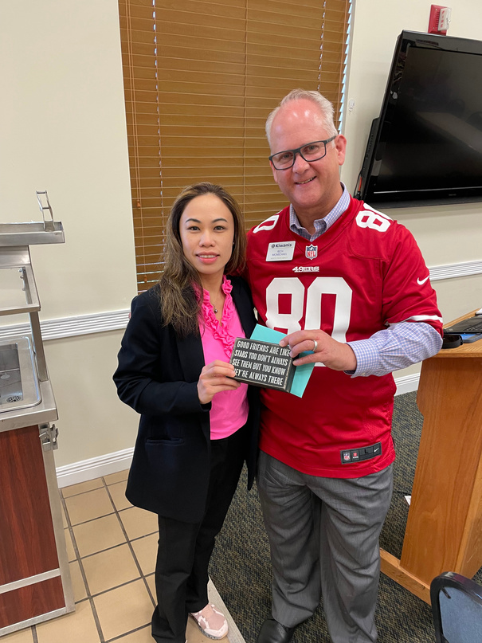


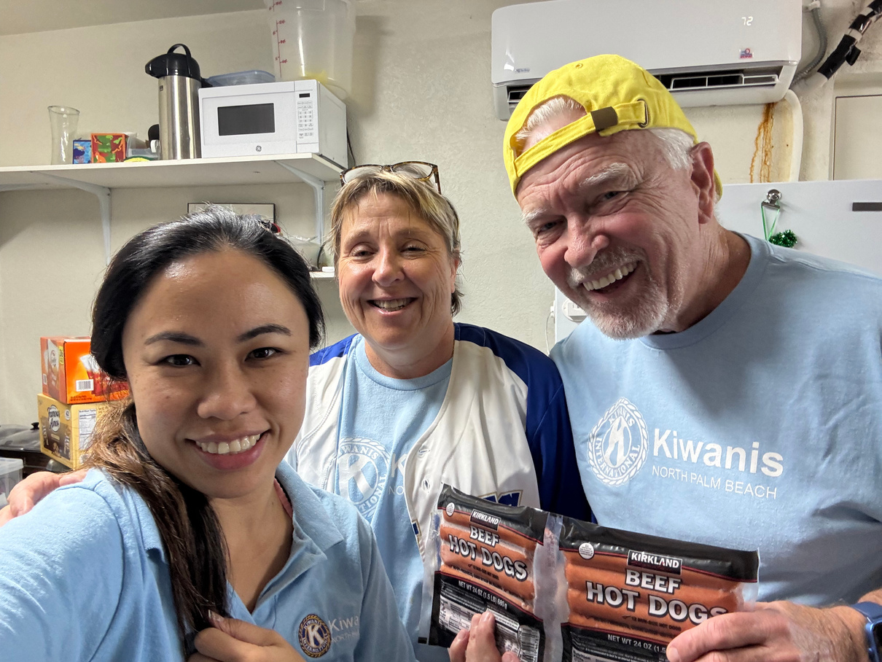
To Serve from the Heart
Why I joined Kiwanis

Slide 3
M – MOMENT OF TRUTH: The Volunteer/Leader’s Dilemma
🎯 Common struggles mention:
  Overcommitting from guilt
  Feeling depleted
  Struggling to say no
  Losing touch with personal goals
“What are your signs that you’re stretched too thin — even while doing something good?”
“Just because it’s a good thing doesn’t mean it’s the right thing for you right now.”

Slide 4

Wheel of Life
Kiwanis Edition
Health
“What’s thriving? What’s being neglected?”
Finances
Family
10
5
Kiwanis
1
Work/Career
Spirituality
Personal Growth
“Balance isn’t about doing everything equally.
It’s about doing the right things intentionally.”
Fun & Recreation

Slide 5
E.N.E.R.G.Y. is how we stay in the game — long-term.
E– Energy First: Instead of planning around time, prioritize activities based on energy. Focus your full presence on what matters most. Ten focused minutes beats an hour of distraction.
N – Negativity Audit: Notice what drains you. Let go of commitments that weigh you down just because they’re expected. Protect your peace.
E – Essential Focus: One thing at a time. Multitasking scatters energy. Give your full attention to what deserves it.
R – Recognize Your Race: Life isn’t a sprint — it’s a marathon. Learn to pace your energy for the long run. Be urgent with tasks, but patient with purpose.
G – Go All In: Don’t waste energy trying to be what you’re not. Show up fully as YOU. That’s where power lives.
Y – Your Pace: Know how YOU recharge. Know your ideal rhythm. Manage your focus like it’s gold.

Slide 6
E.A.R.L.Y. Wind-Down Routine
E – Evening Routine: Make time for a peaceful wind-down. Reduce screen time, wear something cozy for sleep, and create a dark, calm space with minimal distractions.
A – Affirmations: Say something kind to yourself before bed. Write or speak phrases like “I will wake up refreshed” or “I’m ready for tomorrow.” You’re programming your mind.
R – Reminders: Jot down a to-do list or priority list for the next day. This reduces anxiety and builds positive anticipation.
L – Let Go: Write down your frustrations or disappointments from the day. Then, write what you’re grateful for. Release and renew.
Y – Your Why: Remind yourself why you want to wake up with energy and purpose. What pulls you out of bed with passion?
This routine, E.A.R.L.Y., is your evening reset — so you can rise with focus and strength.

Slide 7
Eisenhower Matrix
URGENT & IMPORTANT
NOT URGENT & IMPORTANT
DO FIRST
SCHEDULE IT
URGENT & NOT IMPORTANT
NOT URGENT & NOT IMPORTANT
DELEGATE IT
ELIMINATE IT

Slide 8
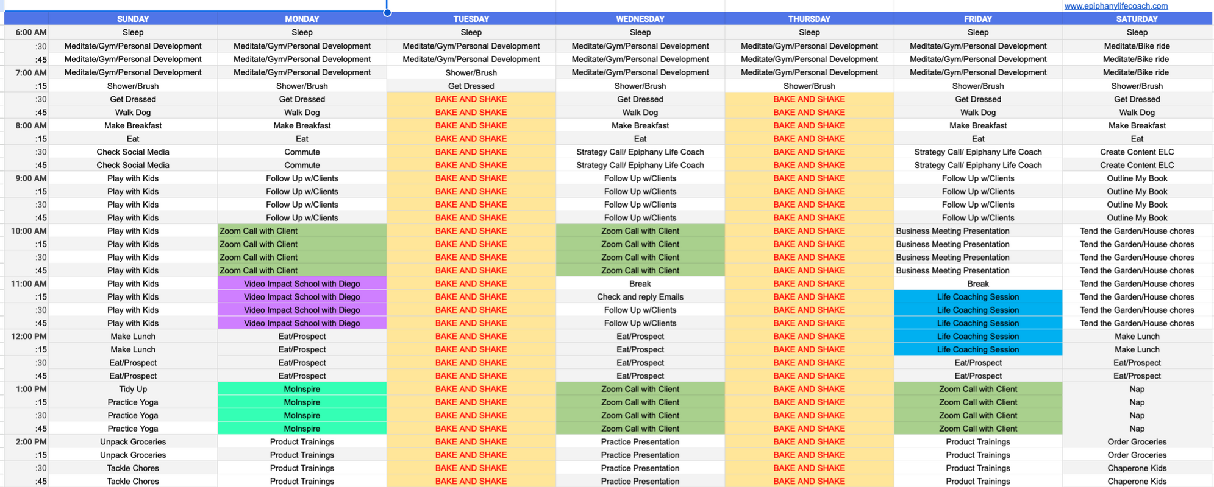
Time Blocking

Slide 9
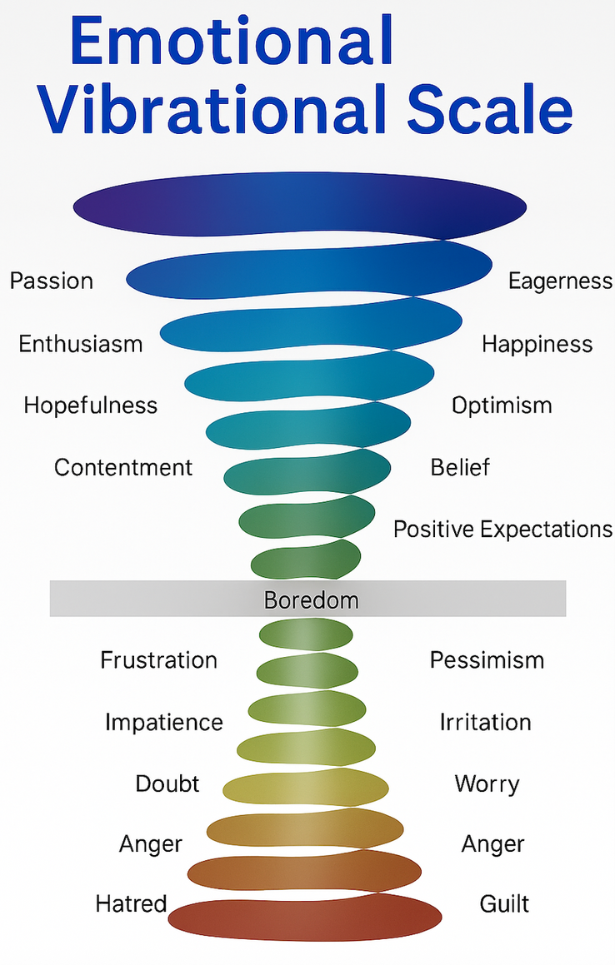


Joy
Freedom
Love
Empowered
Jealousy
Insecurity

Slide 10


epiphany@epiphanylifecoach.com
+1-941-539-1268
Thank You

