Slide 1

Aktion Club
Empowering adults with disabilities to make a difference in their communities.
Notes:
Welcome to the presentation. My name is _____________________________, and I’m here today to share helpful information about Aktion Club.

Slide 2
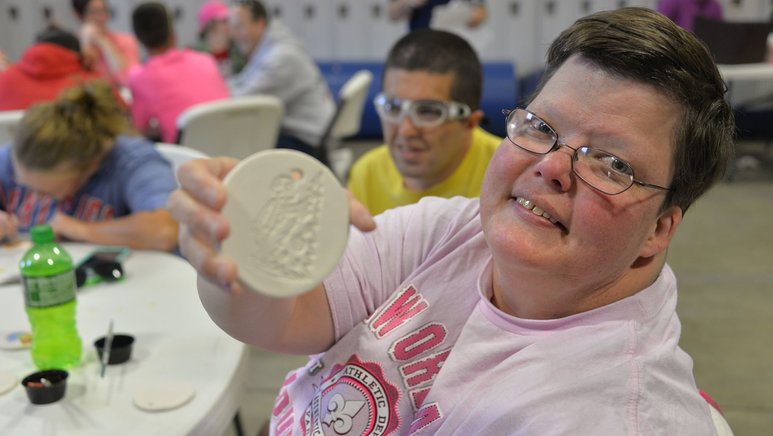
Aktion Club
    Community service group composed of adults with disabilities.
    A program of Kiwanis International.
    One of (5) Kiwanis Service Leadership Programs.
Notes:
Akton Club - where development has no disability
Aktion Club is the one and only service club for adults with disabilities. Clubs are formed at or with various organizations that support individuals with disabilities, as well as other community programs. These caring adults develop confidence and character as they take on leadership roles in their clubs and direct service projects. Members gain a sense of purpose and personal satisfaction as they serve their communities, help others and discover their own talents.

Slide 3

Kiwanis Service Leadership Programs
K-Kids
Elementary school students ages 6 – 12
Builders Club
Middle school students ages 11-14
Key Club
High school students ages 14 – 18
Circle K
College and University students
Aktion Club
Adults with disabilities
Notes:
Kiwanis International is:
A program of Kiwanis International dedicated to serving the children of the world.
660,000 members in 80 countries.
Raise US $100 million each year.

Slide 4
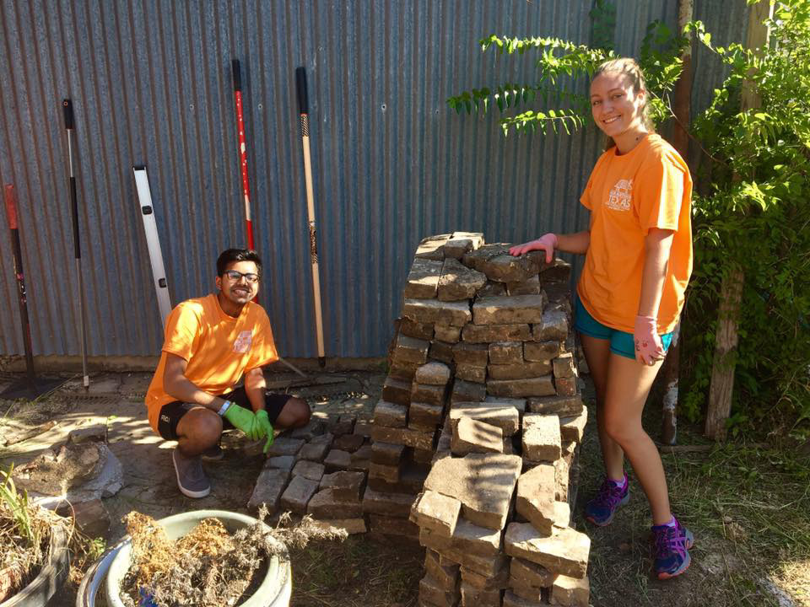

College/University students
circlek.org
Largest student-led collegiate community service, leadership development and fellowship organization in the world.
Located on 540 + campuses in 14 nations.
Notes:
The next generation of community leaders
Members of Circle K International (CKI) develop as leaders, make life-long friends and improve their world through service. The decision-making , problem-solving and team-building sklls they learn while serving others are directly transferable to the jobs they will seek upon graduation. Dedication to community service is hallmark of CKI. Their CKI annual convention is centered around a large scale service project that makes a positive impact on the host city.

Slide 5
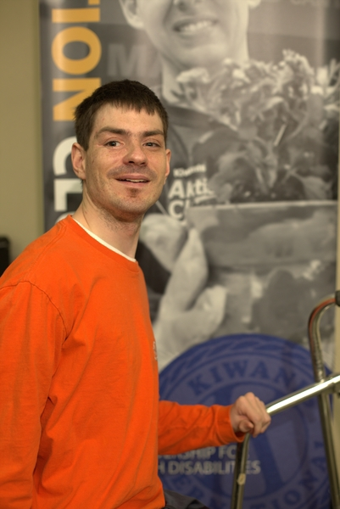
Mission
  Develop initiative and leadership.
  Serve the community.
  Be an integral part of society.
  Demonstrate the dignity and value of citizens living with disabilities.
Notes:
Aktion Club’s mission is to:
Develop initiative and leadership.
Serve the community.
Be an integral part of society.
Demonstrate the dignity and value of citizens living with disabilities.

Slide 6
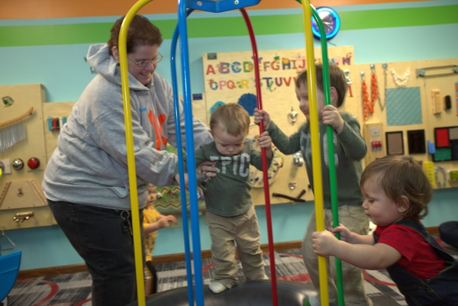
Vision
To develop competent, capable, caring leaders through the vehicle of service.
Notes:
Aktion Club’s Vision:
To develop competent, capable, caring leaders through the vehicle of service.

Slide 7
Core Values
    Character Building
      The ability to do the right think even when it might be the unpopular choice.
    Leadership
      The ability to listen, communicate, serve and guide others.
    Inclusiveness
      Accepting and welcoming differences in other people.
    Caring
      The act of being concerned about or interested in other people or situations.
Notes:
The Core Values of Aktion Club:
Character Building
The ability to do the right think even when it might be the unpopular choice.
Leadership
The ability to listen, communicate, serve and guide others.
Inclusiveness
Accepting and welcoming differences in other people.
Caring
The act of being concerned about or interested in other people or situations.

Slide 8
History
    Organized in 1987 in Florida.
    Became an official program of Kiwanis International on October 1, 2000.
Notes:
The history of Aktion Club:
Organized in 1987 in Florida
Official program of Kiwanis International on October 1, 2000 – (Clubs chartered, pay club fees, receive liability ins)

Slide 9
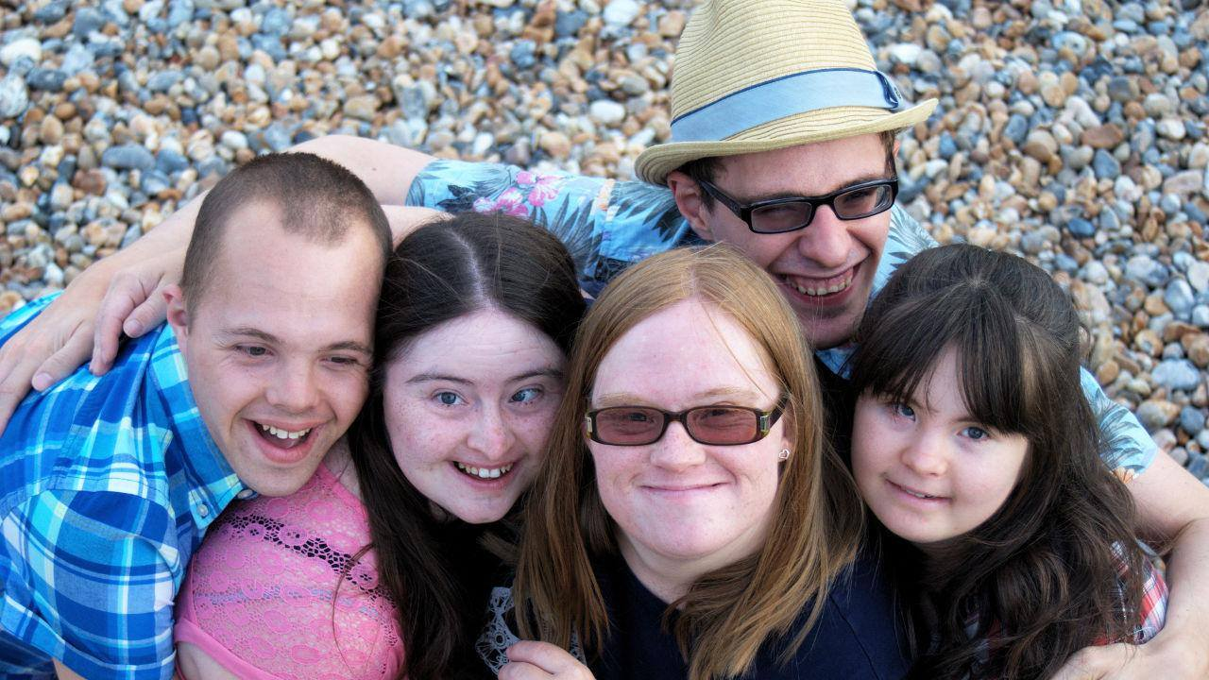
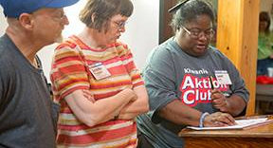

Aktion Club Statistics
  USA
  Canada
  Austria
  Australia
  Aruba
  Bahamas
  Barbados
  Columbia
Jamaica
Malaysia
Korea
Italy
Philippines
New Zealand
  12,500 members
  500+ clubs
  14 countries
Notes:
Read slide to not Aktion Club stats.

Slide 10


Slide 11

Aktion Club
Back to service!
2021-2022

Slide 12

Aktion Club
Kiwanis needs your assistance in welcoming back COVID-A and inactive clubs.

Slide 13

Homecoming 2021-22
  2020-2021 Club data
 | 4/14/2021 Members | 4/14/2021 Active Clubs | 2019-20 EOY Members | 2019-20 EOY Active Clubs | COVID | % of Mbrs | % Clubs | Projections from Summer 2020 Advisor Survey
Aktion Club | 3,765 | 188 | 10,066 | 453 | 136 | 37.40% | 41.50% | 46%
CKI | 7,119 | 364 | 9,876 | 555 | 40 | 72.08% | 65.59% | 85%
Key Club | 128,688 | 4,755 | 230,512 | 5,331 | 470 | 55.83% | 89.20% | 83%
Builders Club |  | 844 |  | 1,385 | 564 |  | 60.94% | 62%
K-Kids |  | 760 |  | 1,218 | 606 |  | 62.40% | 49%

Slide 14
Homecoming 2021-22
  Resources to invite clubs back to service:
    Branded templates (Letters, flyers, etc.)
    Scripts to encourage clubs to return.
    District Administrators - Resources to conduct webinars.
    District Administrators - Inactive club contact information(emails/addresses)

Slide 15

Aktion Club
Visit the Homecoming page on AktionClub.org for helpful resources.

Slide 16
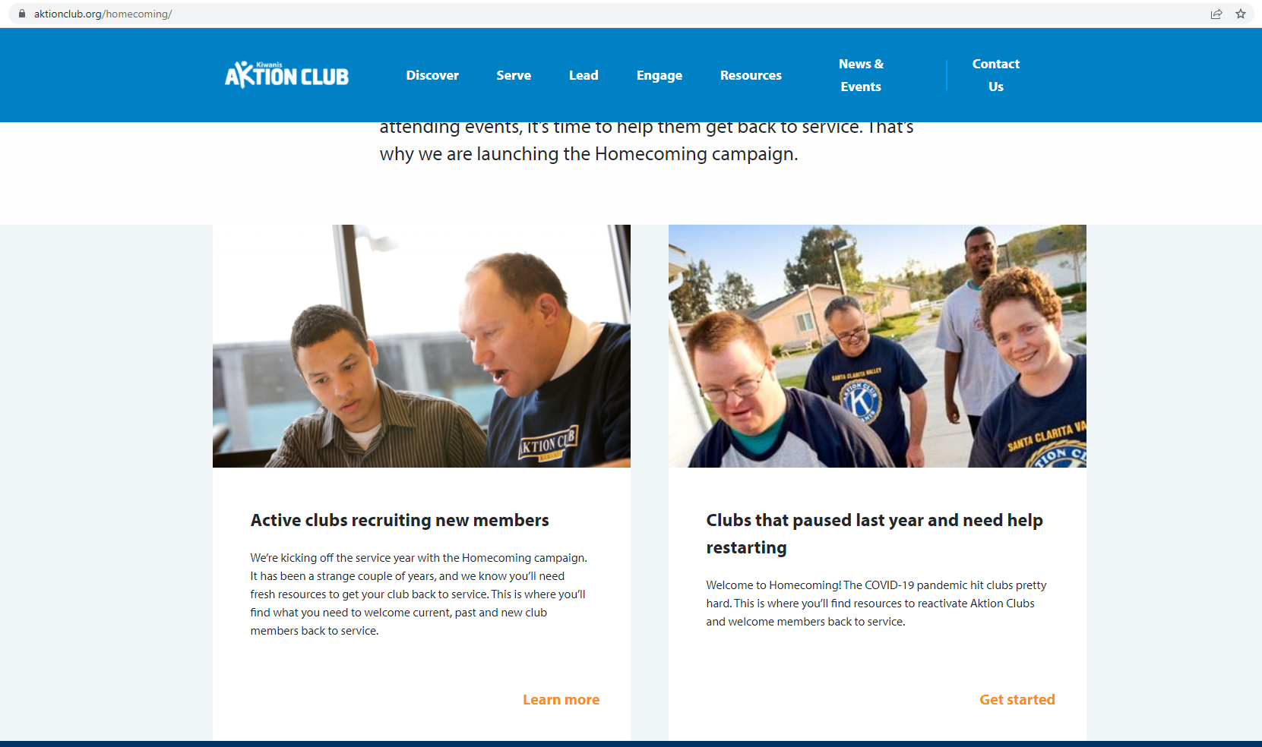
AktionClub.org/Homecoming

Slide 17

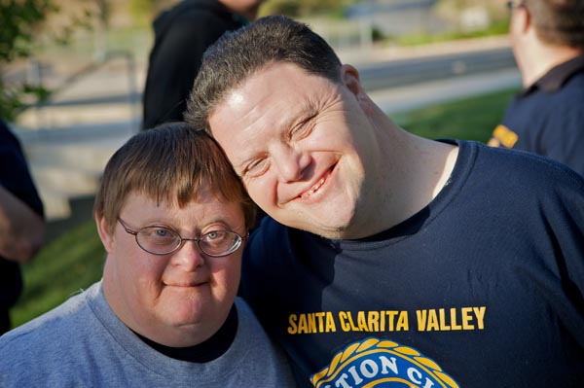
A service club for adults living with disabilities.
aktionclub.org
The only service club for adults living with disabilities – mental, emotional, developmental, physical.
Notes:
Where development has no disability
Aktion Club is the one and only service club for adults with disabilities. Clubs are formed at or with various organizations that support individuals with disabilities, as well as other community programs. These caring adults develop confidence and character as they take on leadership roles in their clubs and direct service projects. Members gain a sense of purpose and personal satisfaction as they serve their communities, help others and discover their own talents.

Slide 18

Aktion Club Activities
Club meetings
Service projects
Fundraising projects
Social activities
District conferences
Notes:
Aktion Club activities include:
CLUB MEETINGS
SERVICE PROJECTS
FUNDRAISING Projects
SOCIAL ACTIVITIES
District conferences

Slide 19
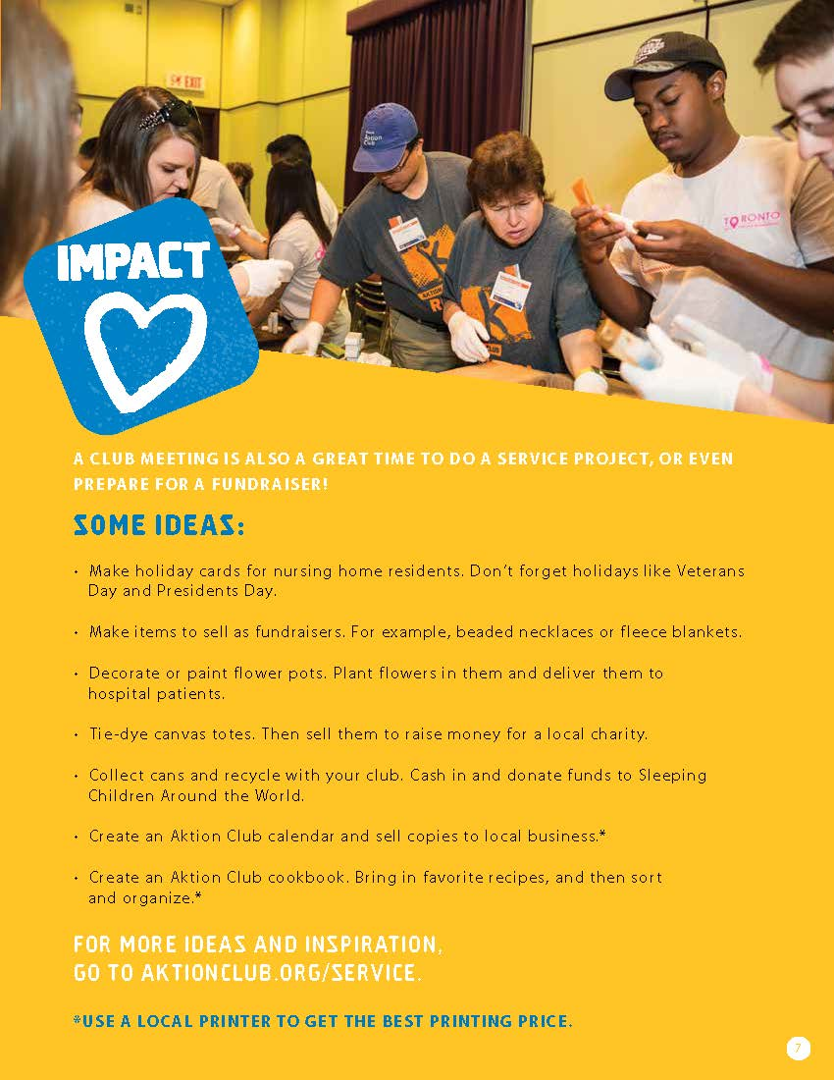
Club Meetings
Meet 1 or 2 times per month
Business (Planning events)
Speaker (Educational session)
Activity (Service project)
Notes:
Aktion Club meetings happen 1 to 2 times per month. Download a sample meeting agenda online. Meetings are conducted like a Kiwanis club meeting where new business, old business, committee reports are all shared.

Slide 20
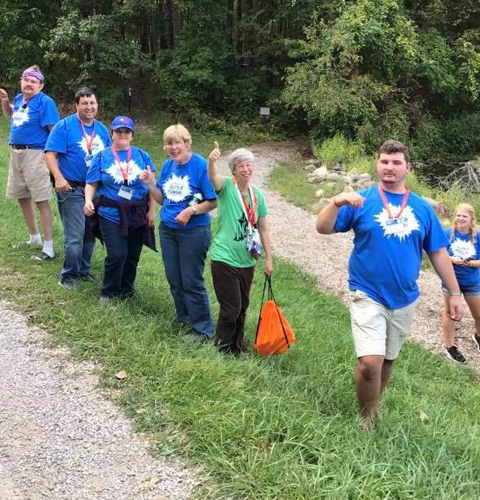
Service Projects
Cards for military personnel
Nursing home visits
Park clean-up
Create & donate Kiwanis dolls
Make fleece blankets for children’s hospitals
Notes:
Sample Aktion Club service projects include:
Cards for military personnel
Nursing home visits
Park clean-up
Salvation Army bell-ringing
Create and donate Kiwanis dolls
Make fleece blankets for children’s hospitals
For more ideas about what Aktion Clubs are doing search online for Kiwanis Aktion Club and visit one or several of the many Aktion Club websites to see how clubs are making a difference.

Slide 21
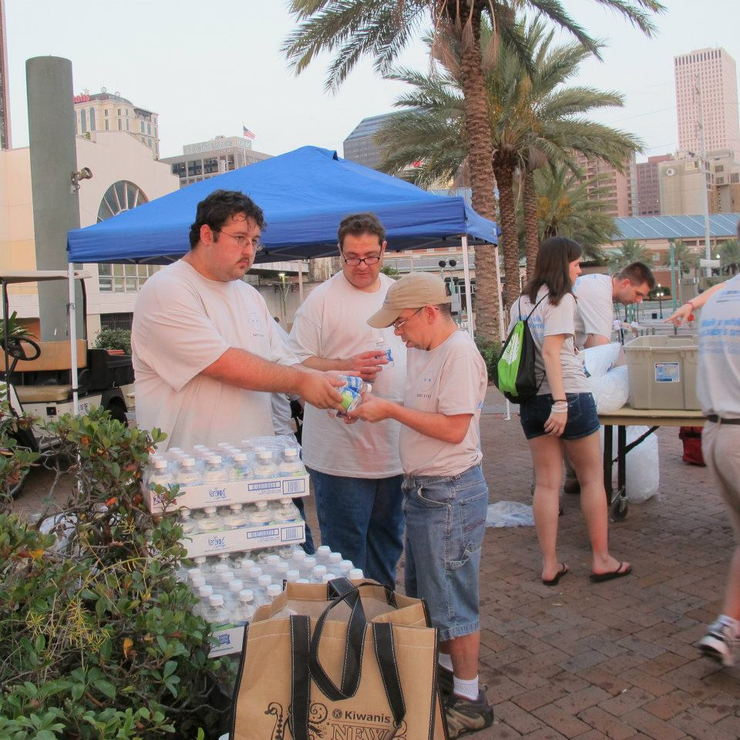
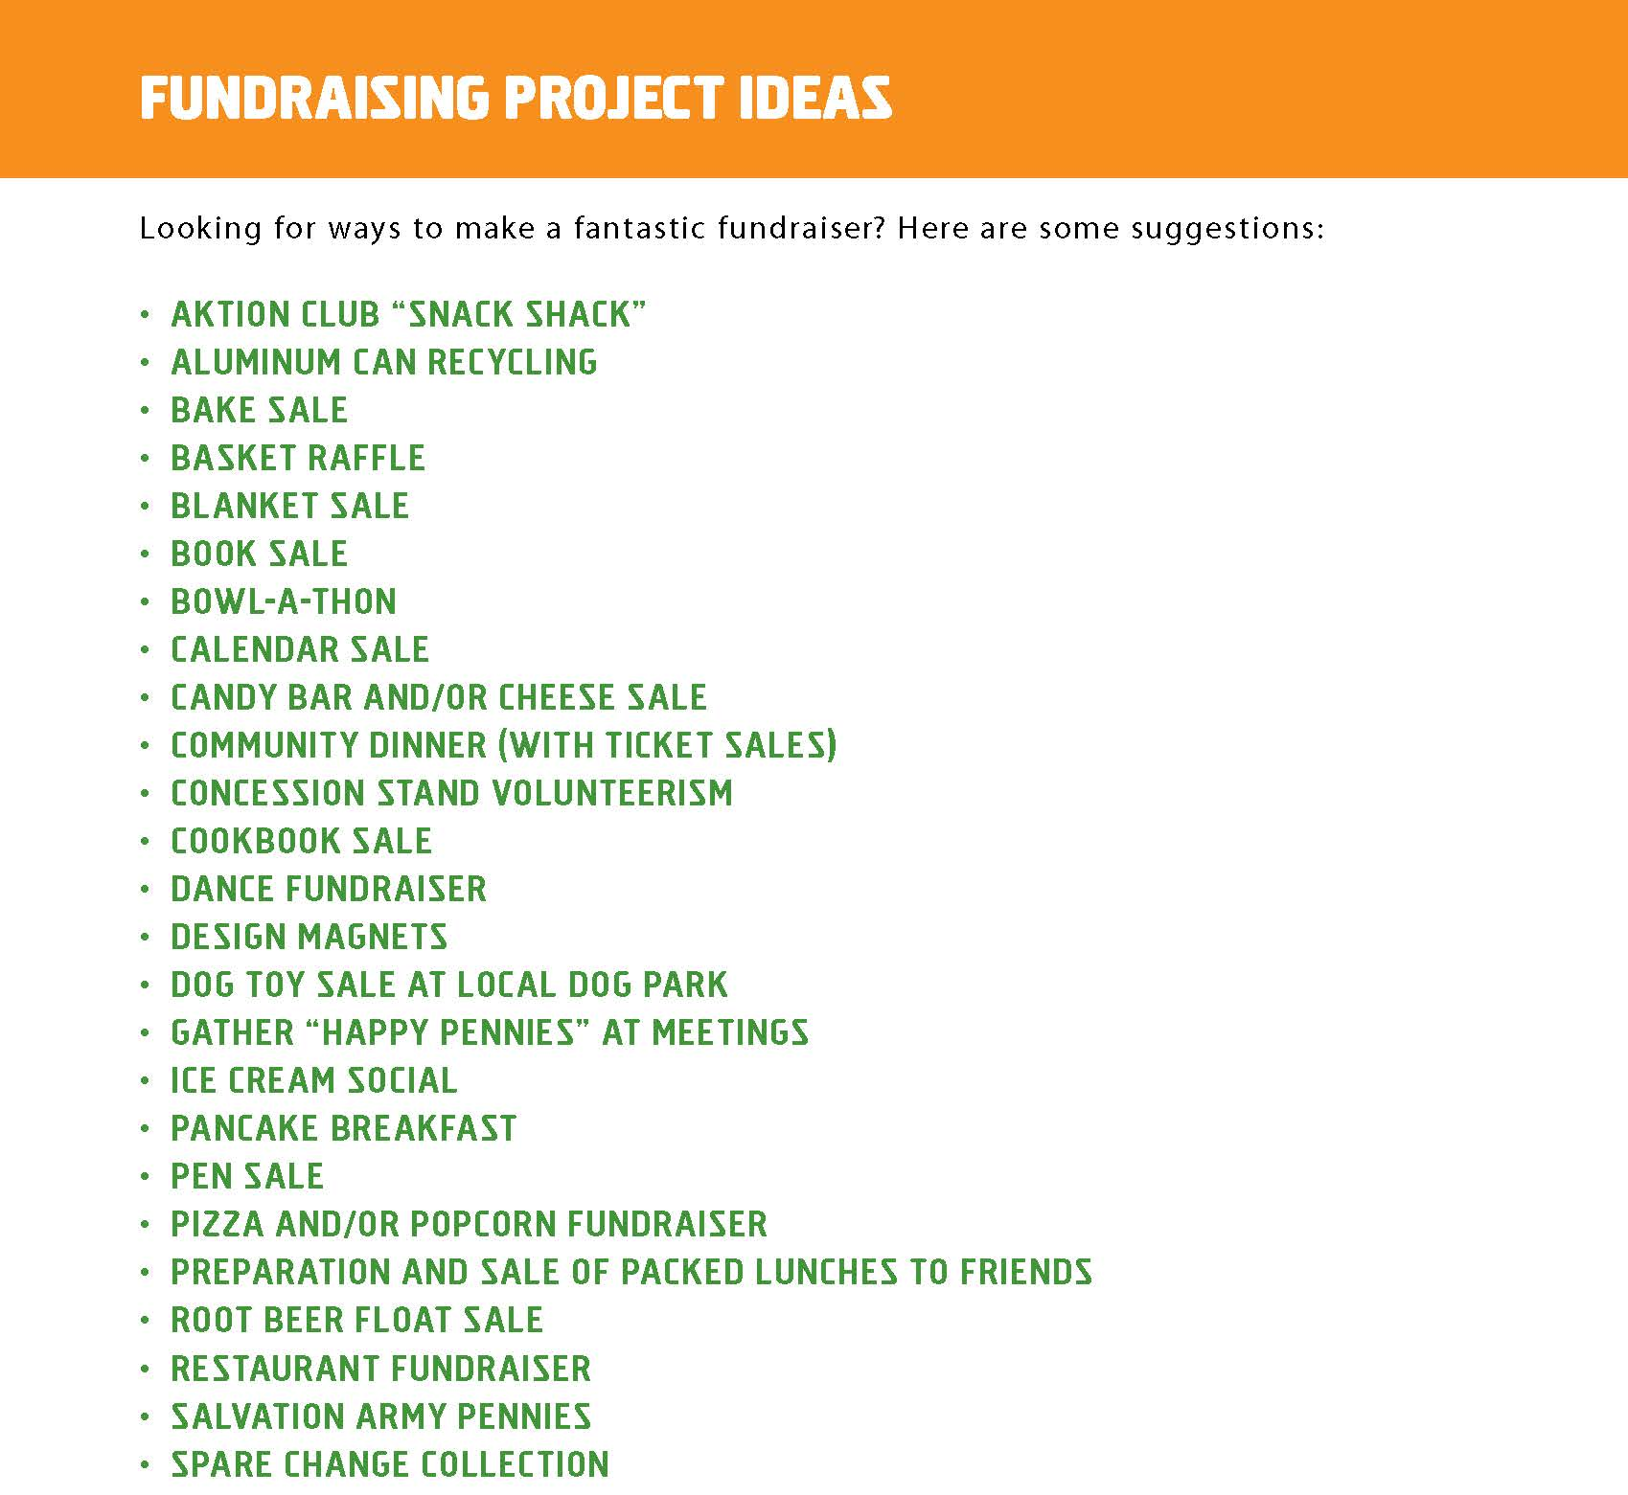
Fundraising Projects
Notes:
Aktion Club’s often hold fundraising events to help fund service projects. Here are examples of how Aktion Clubs raise money.
Car washes
Fashion show
Creating and selling Christmas ornaments, calendars, cookbooks
Salvation Army bell ringing

Slide 22
Social activities
Dances
Dinners
Sporting events
Concerts
Picnics
Camp
Notes:
Aktion Clubs also conduct social activities. These might include:
Dances
Dinners
Sporting events
Concerts
Picnics
Camping retreats

Slide 23
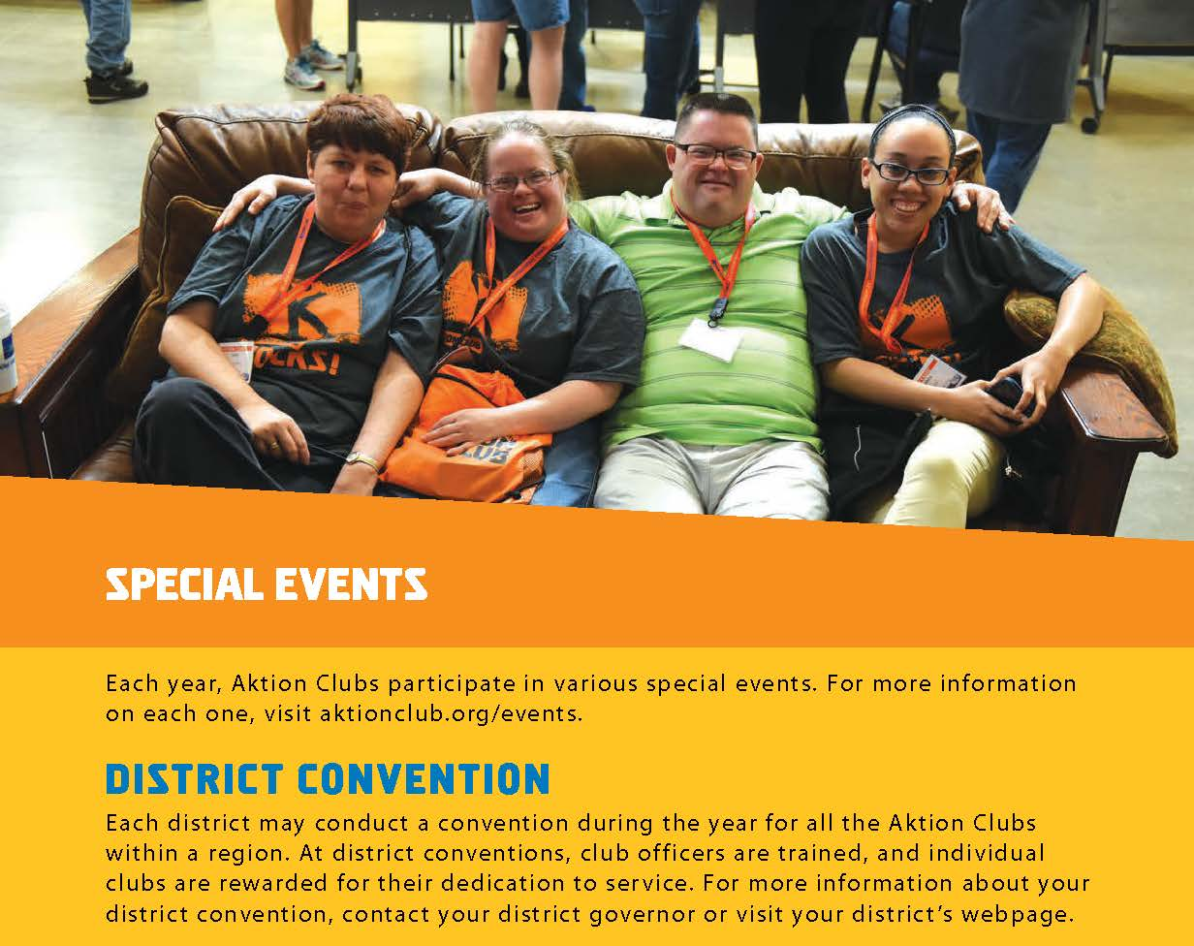

District conferences
Notes:
Consider working with Kiwanis and Circle K clubs within the district to organize a district conference for Aktion Club members. If it’s not possible to meet in person organize a virtual event through Zoom.

Slide 24
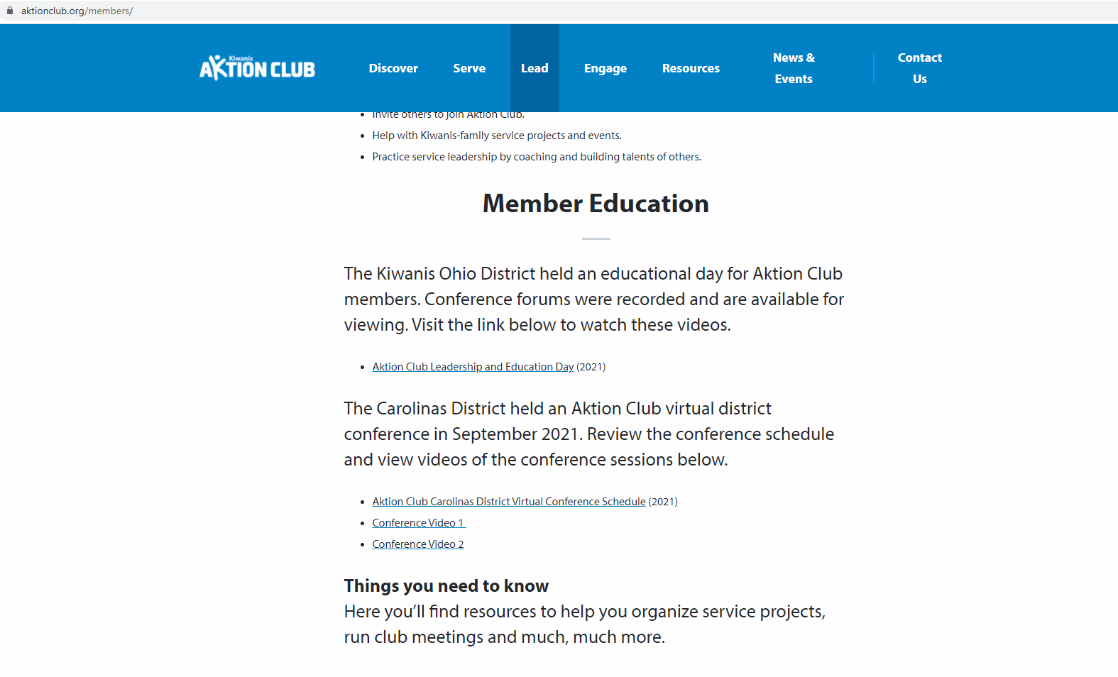
AktionClub.org / Lead / Members

Slide 25

Aktion Club Resources
Notes:
Let’s review resources available to Aktion Club advisors and club members.

Slide 26
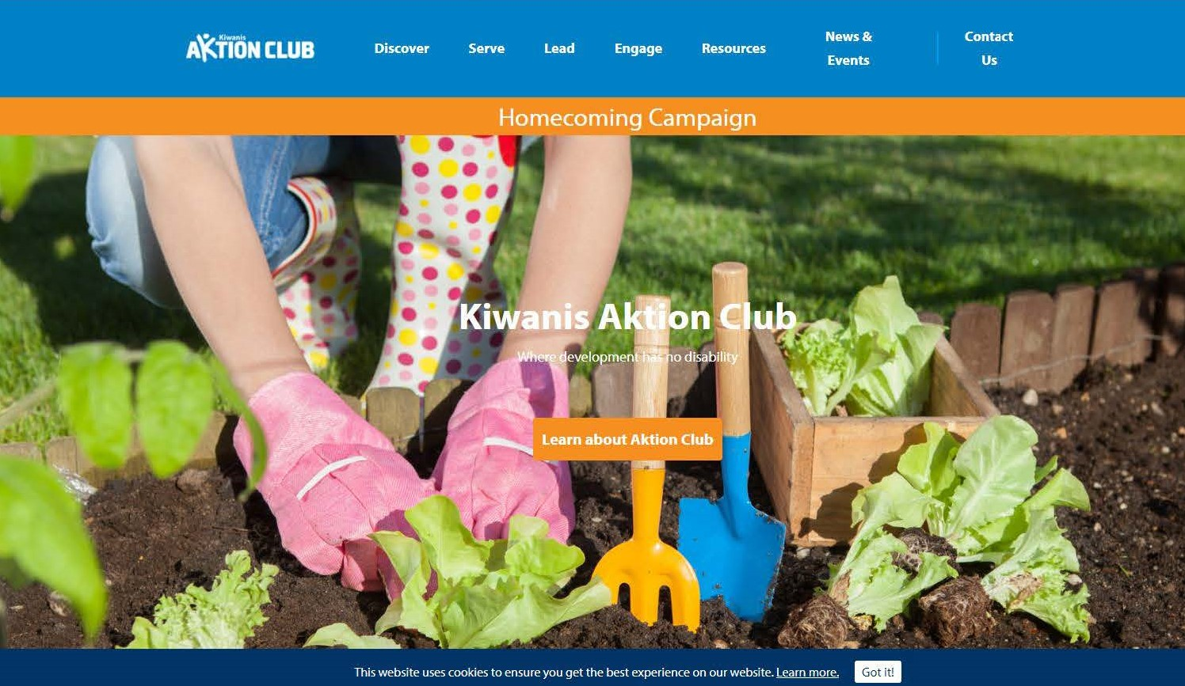
AktionClub.org
Notes:
The Aktion Club website, AktionClub.org is a great place to start when looking for resources. There’s a specific page for club advisors. The advisor can download guides, calendars, handbooks, contest information and more.

Slide 27
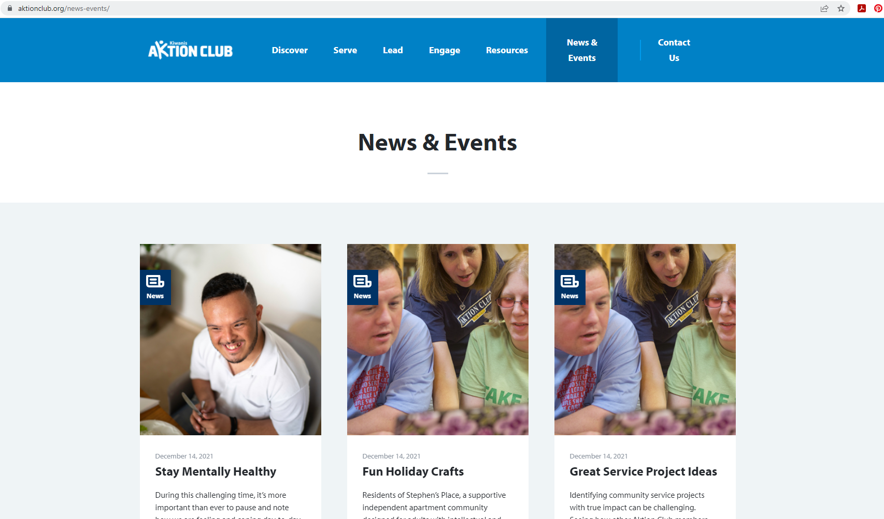
News & Events

Slide 28

Advisor e-newsletters
Notes:
Aktion Club advisors also receive a monthly e-newsletter with helpful information about upcoming events and suggested service projects. E-newsletters are archived online under the Resources tab.

Slide 29

Advisor guide
About Aktion Club
Advisor Tools
Working with members
Serve
Lead
Engage
Growing the Club
Special Events
Kiwanis Family
Notes:
When an Aktion Club is chartered a club program kit is mailed to the club. This includes an advisor guide. The advisor guide can also be downloaded from the website. The guide highlights every aspect of leading a club.

Slide 30

Member handbook
History
Service
Meeting Agendas
Calendar
Club achievements
Leadership Training
Special events
Aktion Club Week
The Kiwanis Family
Notes:
When an Aktion Club is chartered a charter kit is sent to the new club and includes member handbooks. Member handbooks are also mailed to new club members if new members join the club in the future.

Slide 31
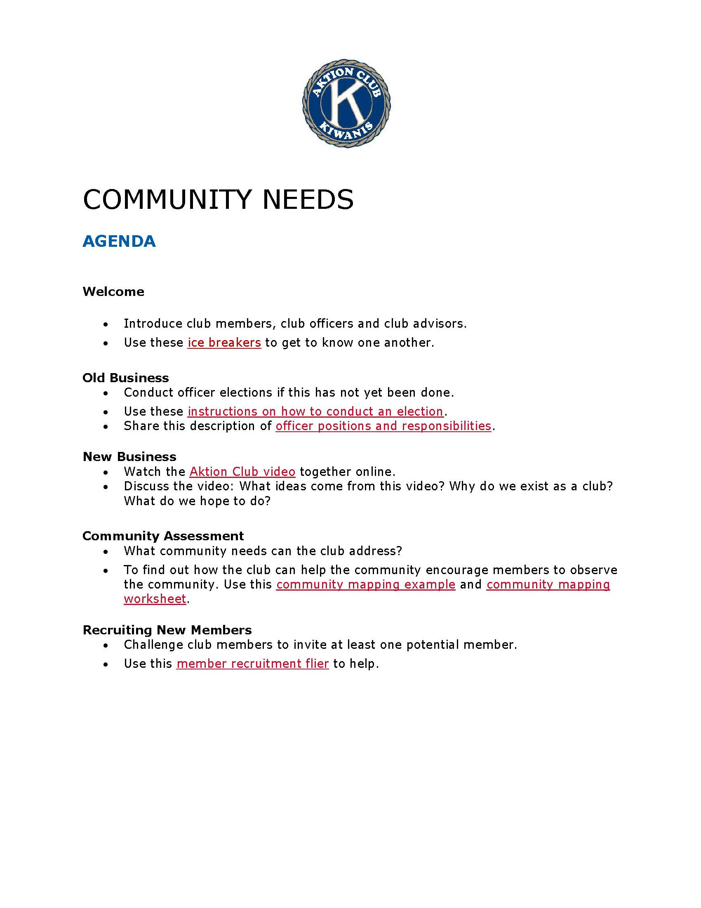
Virtual Meeting Kits
Digital or In-Person meetings
New resources and worksheets
Topics include goal-setting, project planning, elections, and specific causes like bullying, hunger, and civic engagement.
Notes:
Virtual Meetings started in early September with a Back to School agenda kit. We’ve shared four so far with another arriving in November focused on hunger needs and activities.
Specialized agendas for the three “youth” programs. They are designed to be used with digital meetings, but the worksheets and resources can be printed for in-person meetings as well.
In addition to a focus topic like Back-to-School and bullying, they offer practical instructions and resources for things like officer elections, action-planning, and goal-setting.
Available on Keyclub.org for Key Club and Kiwanis.org for BC and KK. (Links on next slide)

Slide 32

Virtual meeting resources
Kiwanis.org/VirtualKeyLeader
Notes:
There are also wonderful virtual resources available to help lead Aktion Club meetings online or in person. One of these resources is Kiwanis leadership training, Key Leader. It’s available online at www.Kiwanis.org/VirtualKeyLeader.

Slide 33
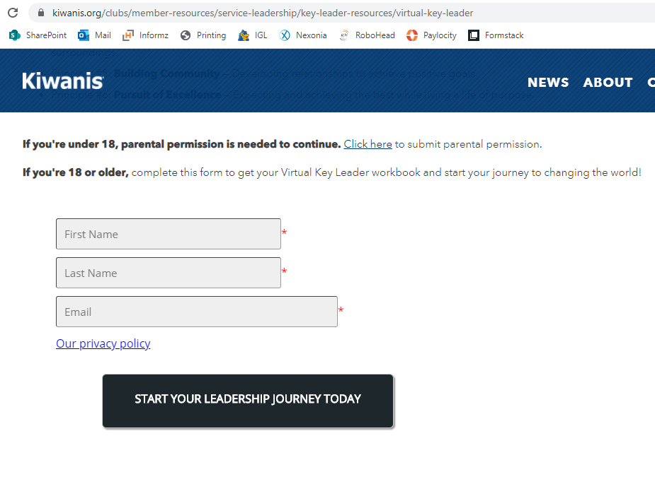
https://kiwanis.org/virtualkeyleader
Form for anyone under 18. This requires permission from a parent.
An email with the digital workbook will arrive within 30 minutes of registering.

Slide 34
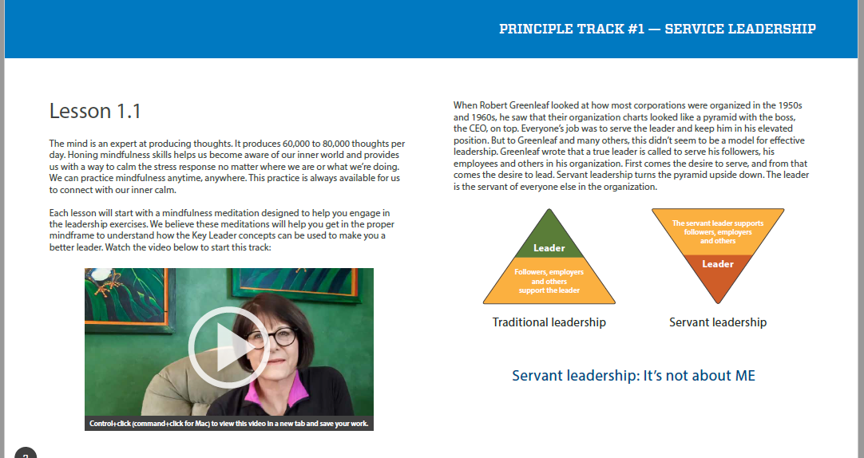
Videos in each exercise. Each of the 6 tracks starts with a Mindfulness exercise.

Slide 35
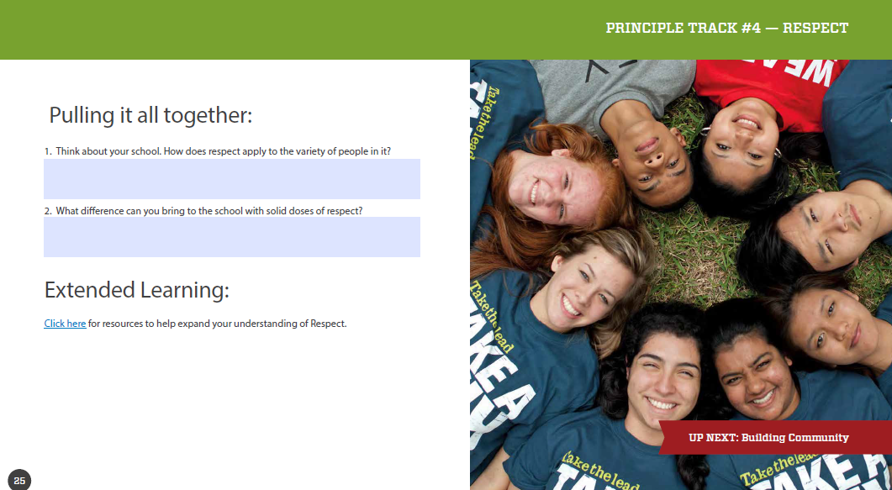
Type answer in the PDF.
Includes links to web resources.

Slide 36




Many Uses
Class/
Meeting
Independent
Study
Family/Community
Activity
Promotional/
Marketing

Slide 37

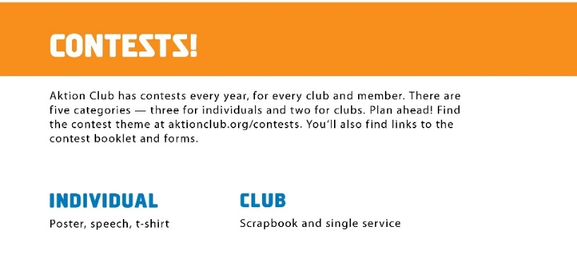
Awards & recognition
Entries are submitted electronically through the website.
Notes:
Award and recognition opportunities are available for Aktion Club members. All entries are submitted online and virtual recognition is presented so clubs can promote accomplishments online.

Slide 38

Aktion Club partners
Notes:
Aktion Club has partnered with two amazing organizations, Sleeping Children Around the World or (SCAW) and UNICEFs Trick-or-Treat for UNICEF.
Sleeping Children Around the World
The mission of SCAW is to provide bed kits to children in need throughout the developing world. This is carried out through free-will donations and partnerships with volunteers around the globe. A bed kit donation of $35 provides a mat or mattress, pillow, sheet, blanket, mosquito net (if applicable), clothes outfit, towel and school supplies. Aktion Club raises funds to provide bed kits.
Trick-or-Treat for UNICEF
All money collected by Key Club, Aktion Club, K-Kids or Builders Club members will support The Eliminate Project to help save and protect moms and babies from maternal and neonatal tetanus. Learn more about The Eliminate Project.
About the Eliminate Project
Every 17 minutes, a newborn baby dies from tetanus. That short lifetime is marked by pain — babies suffer an extreme sensitivity to light, sound or contact that prevents even a mother’s touch.
But it doesn’t have to be this way. In 2010, the Kiwanis family partnered with UNICEF to eliminate maternal and neonatal tetanus (MNT) through a joint effort called The Eliminate Project. As of July 30, 2019, The Eliminate Project has raised more than US$86 million.
Trick-or-Treat for UNICEF is an easy — and fun — way for the Kiwanis family to raise money to protect moms and babies from this deadly disease.
Since 2010, we’ve helped eliminate MNT in 26 countries. Every year, 24,000 more babies are born unaffected by tetanus. And millions of mothers have been vaccinated.
But the fight is not over. MNT still affects moms and babies in the 13 countries that are hardest to reach.
Now, it’s more important than ever. This Halloween, Trick-or-Treat for UNICEF to save and protect lives.

Slide 39

Aktion Club merchandise
Notes:
Another great resource available to clubs is the Kiwanis Aktion Club store. Free literature is available here as well as wonderful Aktion Club merchandise which can be purchased to honor club advisors and members.

Slide 40
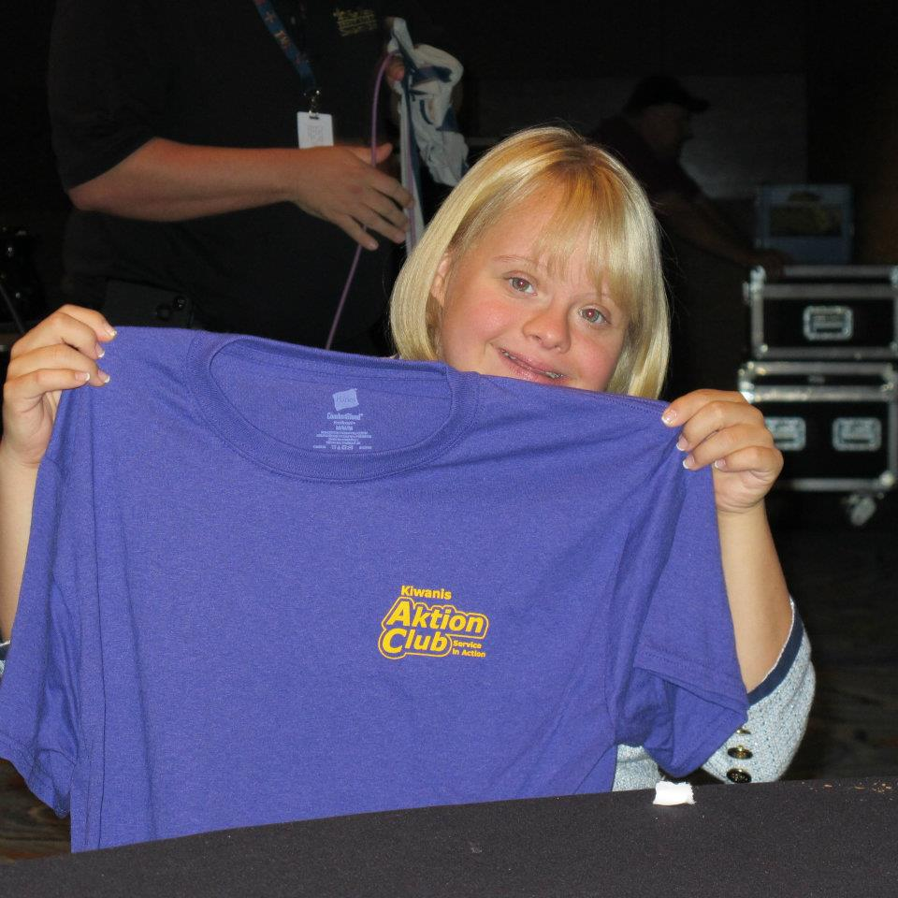
Who can sponsor an Aktion Club?
One or more Kiwanis clubs
Organizations working with adults with disabilities
Notes:
One or more Kiwanis clubs can sponsor an Aktion Club. Often times Aktion Clubs are sponsored in partner with an organization that serves adults with disabilities.

Slide 41
Akion Club member benefits
Building positive self-esteem.
Development of initiative and leadership skills.
Inclusion as active member of the community.
Opportunity to develop meaningful friendships.
Opportunity to better the community and world.
Notes:
Share information on the slide.

Slide 42
Benefits of sponsorship
Personal growth and development.
Create a more inclusive community.
Provide opportunity to share talents.
Provide opportunity to mentor member while engaging with their communities through service.
Develop relationships that may last a lifetime.
Notes:
Share information from the slide.

Slide 43
Benefits to the community
Involved citizens helps a community grow.
Creates an inclusive climate.
Promotes acceptance.
Breaks down barriers.
Notes:
Share information from the slide.

Slide 44
How do I start a club?
FIND: Advisors, members and a place to meet.
LEAD: Get organized, complete paperwork, train club leaders, and build enthusiasm.
SERVE: Reach out to the community and make a difference through meaningful service projects.
Notes:
Share information from the slide.

Slide 45
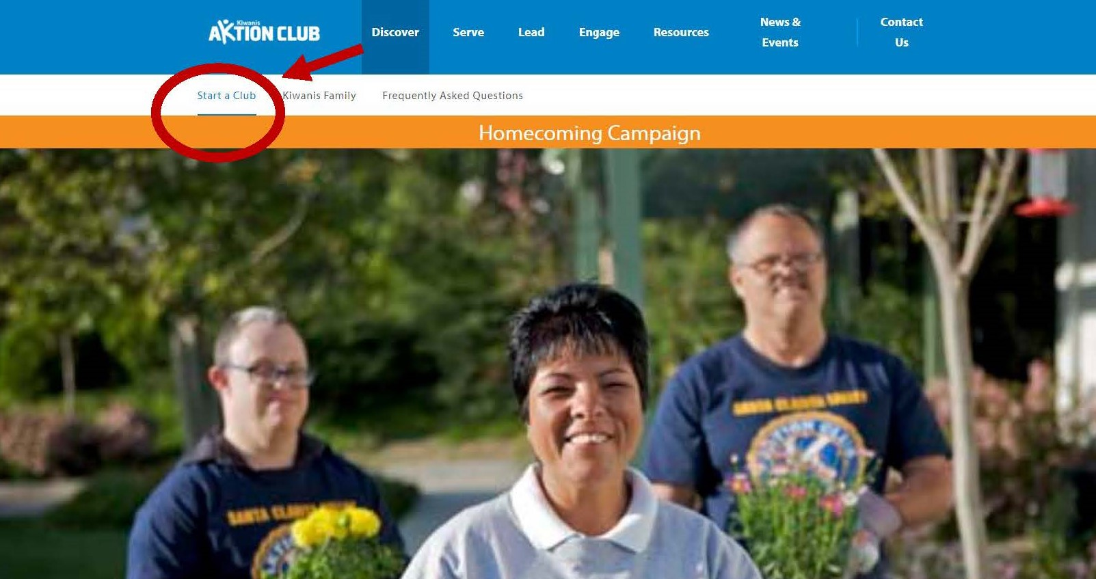
Online resources to start a club
Notes:
Information about how to charter an Aktion Club is available on the Aktion Club website. Aktion Club’s can be chartered online.

Slide 46
Thank you!
Visit AktionClub.org for more information.
Notes:
Thank you. If you have questions please email aktionclub@kiwanis.org.

