Slide 1
Club Leadership Education Florida District Training
July 2025

Slide 2

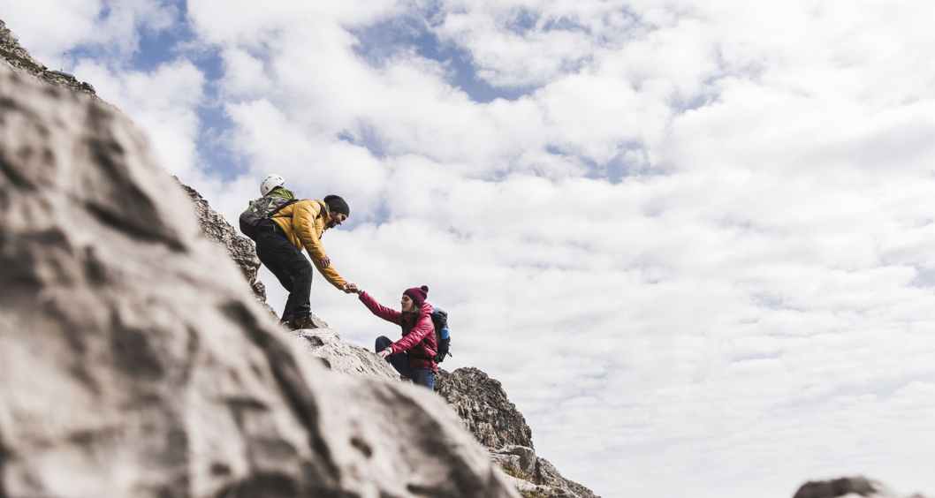

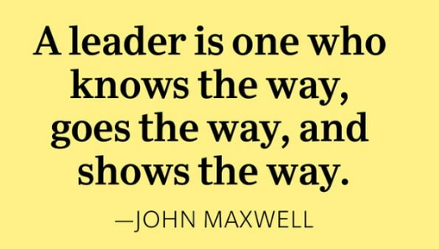
Get their attention
2
Notes:
A good leadership quote to get things started!

Slide 3

Get their attention
Believe you can and you’re halfway there.
3
Notes:
Quote by Theodore Roosevelt
How can we achieve the confidence we need to jump into a new (or continuing) leadership role for the NEXT 12 months?

Slide 4


Get their attention
4
Notes:
???

Slide 5

Your Expectations
What are your expectations for today’s training?
5

Slide 6

The Plan for Today
Today’s main topics:
Membership
Florida District Specifics
Fundraising
Florida Foundation
Service Projects

Slide 7


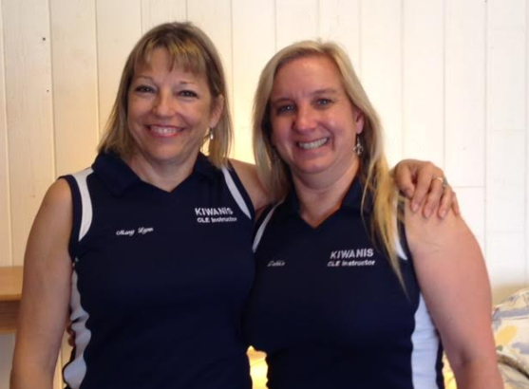


Introductions & Housekeeping
Add photo of Instructor(s)
Notes:
Welcome the participants, Introduce ourselves, Housekeeping (bathrooms, snacks, length of presentation), Fidgets

Slide 8

Parking Lot
Questions during the presentation?
Insights or examples to share?
Use a Post-it
and
Place it in the parking lot!

Slide 9
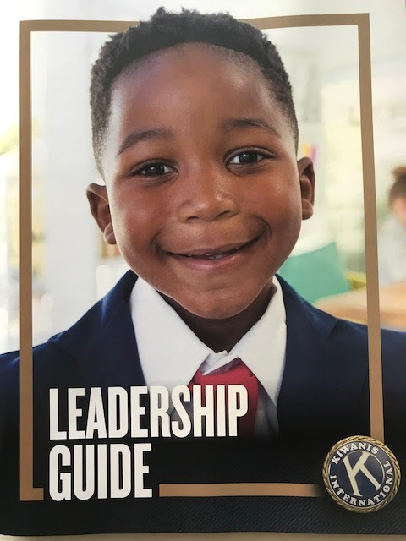
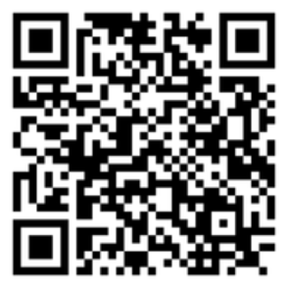
The Leadership Guide
Key Topics:
Kiwanis 101
President
Secretary
Treasurer
Membership Chair
Resources
Updated in January 2024!
Notes:
https://www.kiwanis.org/members/for-leaders/officer-guide/

Slide 10

Getting to know you
Building Focus & Fun
Starting off with something Social!
Notes:
First off – who is attending Club Leadership Education for the FIRST TIME?
Ask incoming presidents to stand… ask them to introduce themselves
Ask incoming secretaries to stand…ask them to introduce themselves
Ask incoming treasurers to stand…ask them to introduce themselves
Who is left? - ask them to introduce themselves

Slide 11

Officer Duties
Responsibilities of Leadership
Notes:
Added this section in case you need it- OPTIONAL

Slide 12

President
Primary Responsibilities
Organizes an effective leadership team
Leads club and board meetings
Promotes member participation in all club activities
Sets Annual Goals
12

Slide 13

Secretary
Primary Responsibilities
Manages & Maintains club and membership records online
Keeps minutes of club and board meetings
Acts as official club contact for all club mail/email correspondence
Tracks projects and project participation
13

Slide 14

Treasurer
Primary Responsibilities
Coordinates the collection and disbursement of money
Receives and deposits all funds paid to the club
Maintains the club’s financial accounts and records
Prepares and disburses bills to members
Guides the board in preparing an annual budget
14

Slide 15
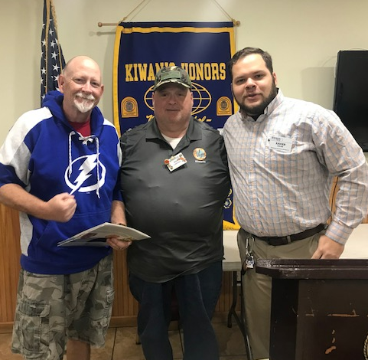
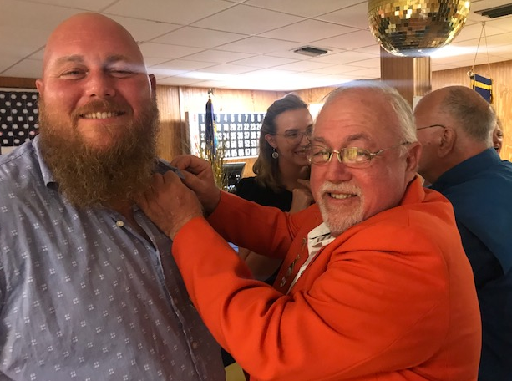
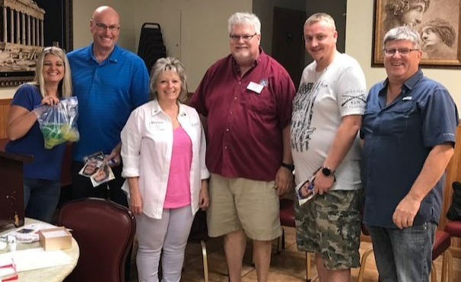
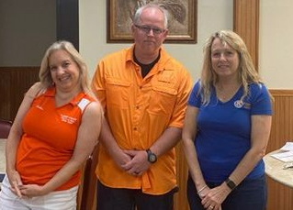
Membership
Expanding our Kiwanis Family

Slide 16



Goals: Two-Fold
Best Practices
Establish a Membership Team
Follow through to meet your membership goals
Tools
Add FUN to meeting new prospective members
Manage club growth
Establish recruitment as a continuous club operation
16
Notes:
“Committee” can be just the Chair plus an assistant Membership Chair.

Slide 17


Club Membership Chair
Find new members
Retain current ones
Dedicated to membership –
Key Roles
Engages Current Members
Establishes Membership Goals
Promotes the Club
17
Notes:
Works with the president to set realistic membership goals.
Takes responsibility for promoting the club to the public.
Engages current members to keep them active in club activities.

Slide 18

Membership Team
Actions & Purpose
Sets membership goals.
Develops an action plan for meeting goals.
Teaches others how to invite people to the club.
Plans membership drives and special member events.
Communicates the importance of membership to club members.
Manages new-member orientation.
18
Notes:
Membership Team can be just the Chair plus one or two other people. You don’t need a lot of people, just effective ones.
Make this a handout?

Slide 19

Lead & Inspire
The Membership Chair leads the Charge …
But Inspiration comes from YOU.
ENCOURAGE your members to get involved!
19
Notes:
The Club Membership Chair LEADS the charge, but YOU, as club leaders, are responsible for INSPIRING all club members to get involved!

Slide 20


“Two for Two”
Growing your club month by month,
person to person
TWO FOR TWO
Provides a way to organize your efforts
20
Notes:
TWO FOR TWO
RESOURCE: TWO FOR TWO WORKBOOK (PDF)
Two For Two Video - https://youtu.be/mUgPwcePo4s
FACILITATE
Kiwanis has a new way to recruit members – it's called Two for Two.
Basically this approach calls for two members of your club to bring two members every month.
Use the roster analysis worksheet to look at potential members by their occupations. Who could help your club? An accountant? A banker? Someone in communications or IT?
Someone in your club likely knows people who meet this criteria. Select your prospects on the basis of what your club needs.

Slide 21
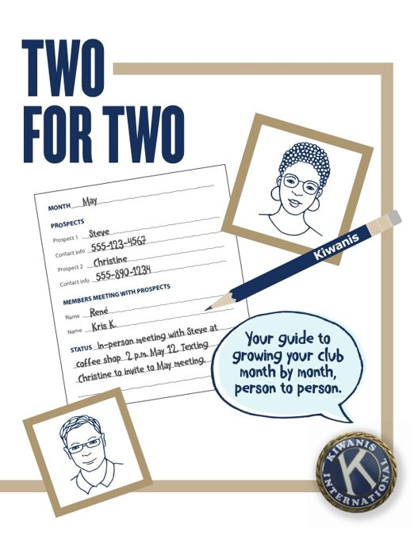
“Two for Two”
Identify two members to reach out to two prospects for each month.
Members invite prospects to a meeting or service project.
21
Notes:
TWO FOR TWO
RESOURCE: TWO FOR TWO WORKBOOK (PDF)
Two For Two Video - https://youtu.be/mUgPwcePo4s
FACILITATE
Kiwanis has a new way to recruit members – it's called Two for Two.
Basically this approach calls for two members of your club to bring two members every month.
Use the roster analysis worksheet to look at potential members by their occupations. Who could help your club? An accountant? A banker? Someone in communications or IT?
Someone in your club likely knows people who meet this criteria. Select your prospects on the basis of what your club needs.

Slide 22
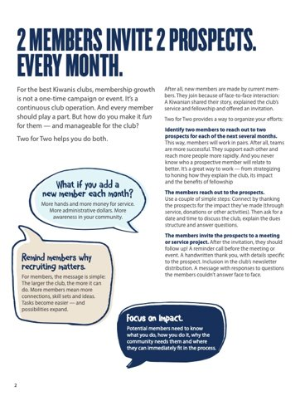
“Two for Two”
24 prospects in one year
Convert 12 to new members
Continue to host other great
membership events
22
Notes:
TWO FOR TWO
FACILITATE
Think about how easy it would be to grow your club using this tactic. Two prospects a month – so 24 for the year. Strive to convert 12 to become new members. You can do this activity every month while you host other membership events such as open houses or inviting people to service projects. This approach is more effective than inviting a prospective member to attend a meeting. Start with a service project – people who want to help kids are much more likely to attend a service project than a meeting. Once they are hooked on the service aspect, they can attend the meetings.

Slide 23

Make Invitations Personal
When you introduce Kiwanis
Tell stories
Connect on a personal level
Show your passion
Have fun!

Slide 24
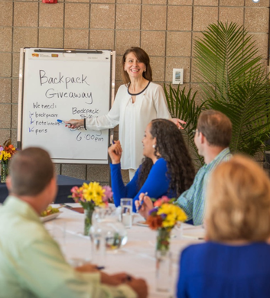
Inviting New Members
To Find & Recruit New Members
Membership Drives
Flexible Memberships
Club Projects
Special Events
24

Slide 25
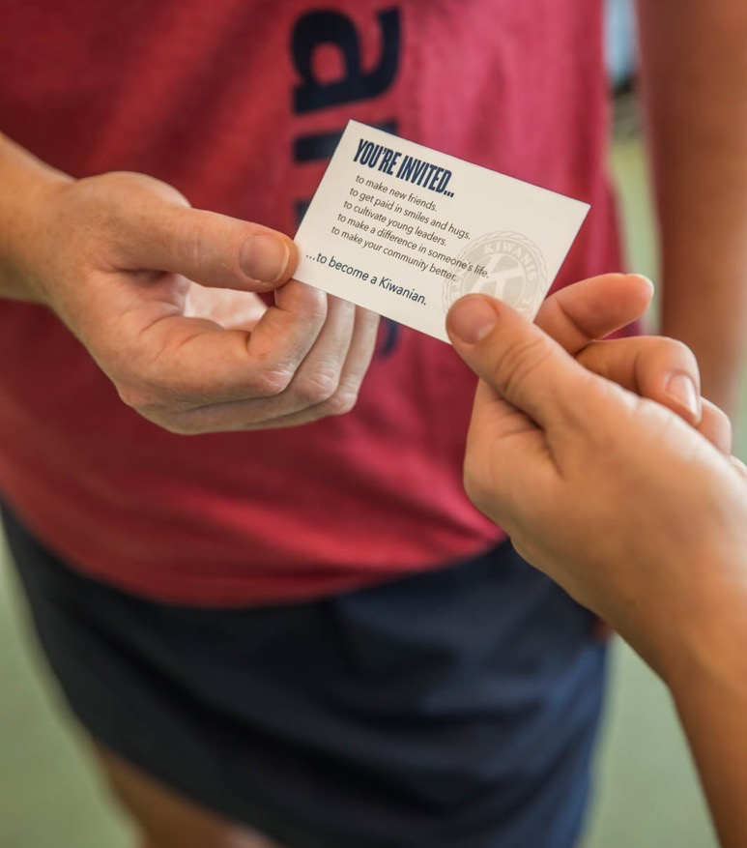
Flexible Memberships
Available “Special” Memberships
Goal is drect, detailed & Meaningful
Corporate Memberships
Holds one position
Designed for transient positions
Avoids additional fees
Club Satellites
Host Club Membership
Can petition for own Charter with 15 members
Notes:
One club doubled their membership by making all Corporate members a 2 for 1. The Corporate member would pay double the dues to become a member and also sponsor a teacher or first responder into the club.

Slide 26

“Membership Event”
Get Potential Members “in the door”!
Make it INTERESTING and FUN…
Unique keynote speaker
Engaging community project
Special Kiwanis-sponsored event
Notes:
Something that a potential member would like to attend -
There are so many ways to make recruitment fun: contests, special guest events and themed meetings just to name a few.
In addition, as potential members look for a club in their area, they fill out an electronic form at kiwanis.org. This form is sent to your district and then to clubs in the immediate area. These potential members have expressed an interest in Kiwanis. Follow up with them.
Sometimes, leads can be representatives from other organizations looking for speaking opportunities or donations, but many are people looking for a place to serve. The only way to know is to follow up.
Looking at your club roster, identify what part of the community is not reflected in your membership. Is it a certain job industry, a missed skill set that your club could benefit from? Is it a demographic?
Roster analysis - p. 20 in participant workbook
Prospect list – p. 21 in participant workbook

Slide 27

Embracing Variety
Welcome those who share a –
Different culture, social structure or belief system
27
Notes:
Humans are social creatures; we tend to “hang out” with others “like us”. Give your club a chance to “look beyond your front door” to add to the Kiwanis Family.
Kiwanis is about helping children – anyone with the heart to do that would make a welcome member to any club

Slide 28
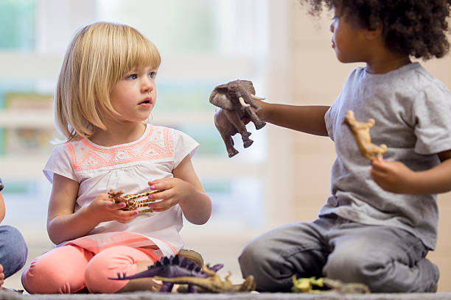
Time to SHARE – Brainstorming!
What member-recruitment ideas do YOU have?
What Events spark your interest?
What has worked for you in the past?
28
Notes:
Discuss what has worked for the clubs in the past.
PRINT COPIES-one per club: Membership Plan Form
https://www.kiwanis.org/wp-content/uploads/2024/03/Membership-Planning-Worksheet.pdf

Slide 29

Coffee/Tea Break Time!

Slide 30

Prepare for New Members
Before a membership drive
Schedule service projects after the drive
Plan for a new member orientation
Plan to have new member folder, pins, and certificates ready as needed
30
Notes:
Membership Team can handle this.

Slide 31
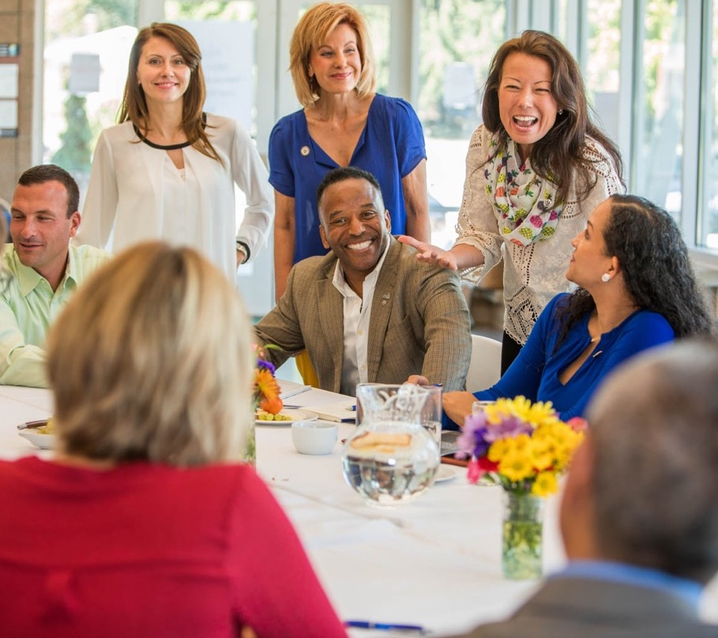
Managing NEW Members
Orientation
Induction ceremony
Mentoring
Involvement
31
Notes:
Keeping a new member takes special care and attention. Take these four steps after each new member completes his or her application.
Step 1: Orientation: Providing new-member orientation is an important part of helping new members understand what a great organization and club they’re joining. A fillable new member orientation presentation available for download at kiwanis.org/orientation
Step 2: Mentoring: Find a member — maybe it’s the sponsoring member — who will take a special interest in helping him or her stay connected, especially in those initial months.
Step 3: Induction ceremony: Make induction into membership a special event. It’s a once-in-a lifetime experience; so, treat it that way. Publicly let the new members tell their reasons for joining the club. Invite the new members’ family and friends. Recognize the sponsoring members. (p. 25-26 in participant workbook)
Step 4: Involvement: Getting new members involved in an area that’s meaningful for them is key to getting them emotionally connected to the club and the work your club does for the community. Find the right committee, discover each member’s talents and figure out where you need those talents.

Slide 32

Engaging EXISTING Members
Actively keep members engaged in club activities.
Celebrate club and member accomplishments.
Reach out & Re-engage members who have gone inactive.
Use the member satisfaction survey at kiwanis.org/ACEtools.
32
Notes:
Once again- this is a primary task of the Membership Team.
What can you do to keep members engaged?

Slide 33
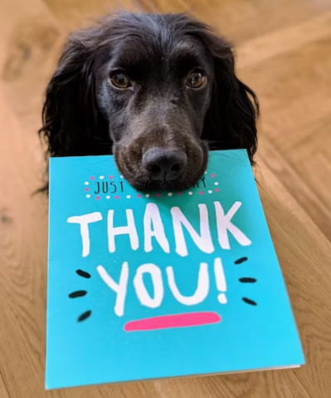

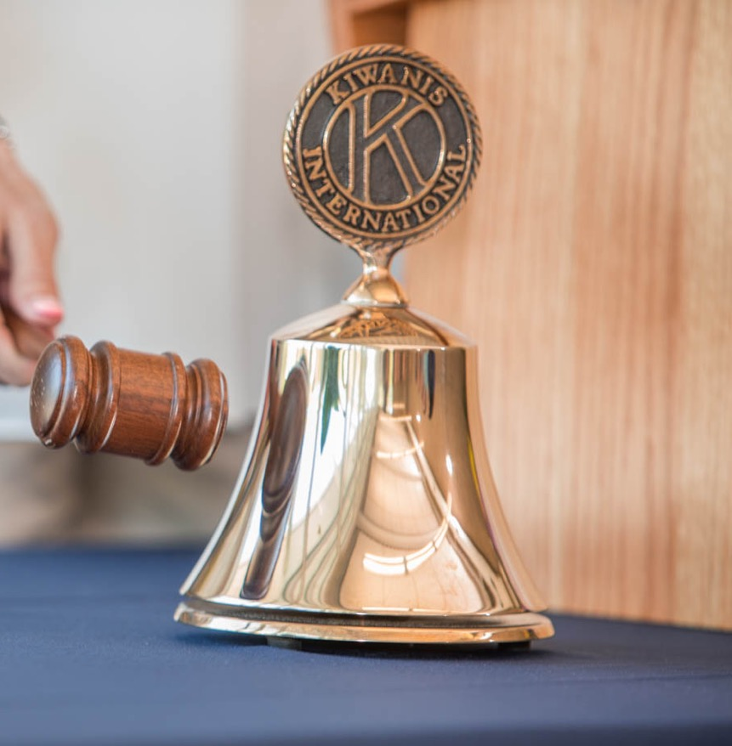
Retaining Members
Tips & Best Practices
New members – Mentoring & Involvement
SMILE and
say Thank You often!
Existing members – Re-engage & Celebrate accomplishments
Club meetings – Member-focused with fun & service
Assessments – Identify unmet community needs
33
Notes:
Most of a member's Kiwanis experience centers around a club’s meeting, which is why every time we meet, we have to think about how our agendas can keep members connected and committed.
Everyone wants to feel good about themselves. One way we can help everyone feel good is to provide recognition whenever it’s appropriate. It’s important to prioritize recognition in your clubs.

Slide 34
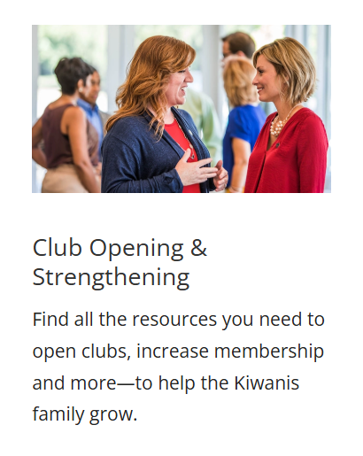



Build-Nurture-Retain
Kiwanis.org: Members
34
Notes:
Kiwanis provides SO MANY resources for clubs – make sure the officers are aware of these.

Slide 35
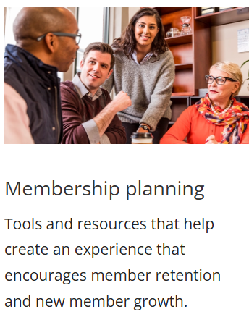
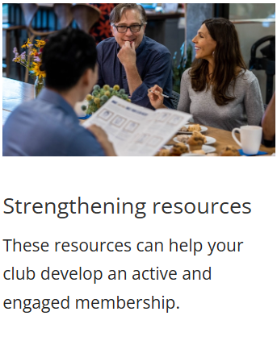
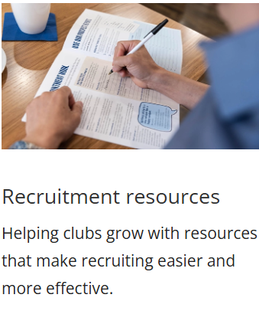
Membership and Growth Tools
Kiwanis.org: members/build-nurture-retain/club-toolbox/
35
Notes:
Kiwanis provides SO MANY resources for clubs – make sure the officers are aware of these.
https://www.kiwanis.org/members/build-nurture-retain/

Slide 36

Asking for Help
Strengthening an existing club
Florida District’s Membership Team:
Past Gov Jeremy Reihl– FL District Membership Chair
Melissa Ajmi– Opening Coordinator
Ingrid Goulbourne – Strengthening Coordinator
Tina Pegler –Retention Coordinator
Submit a Club Boost Application if your Officers and Members are on board
Club Boost Application -https://kiwanis.formstack.com/forms/ordering_a_boost_box2
36
Notes:
Club Boost URL? https://kiwanis.formstack.com/forms/ordering_a_boost_box2
See Handout!

Slide 37

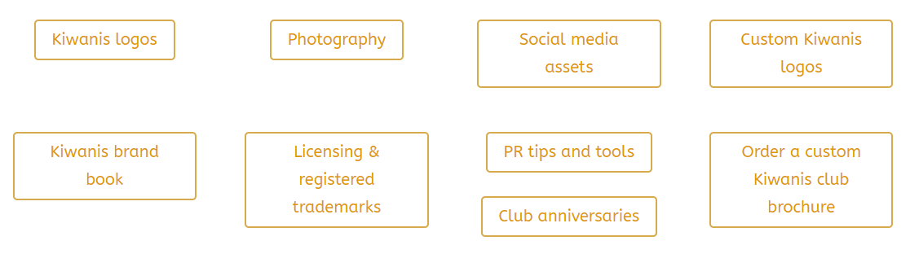
Public Relations
Kiwanis has a public awareness toolkit :
PR and membership committee leaders should work TOGETHER.
37
Notes:
Because public relations is directly connected to membership, it makes sense for PR and membership committee leaders to work hand-in-hand.
Kiwanis has produced a public awareness toolkit that includes information and resources on:
Branding
Print ads
Billboards
Logos
Public service announcements
Merchandise
Digital communications
Media

Slide 38
Member-Recruitment Planning by CLUB
You have 15 minutes!
Set Annual Goal
Identify Membership Team members
Select Recruitment Strategies
Start High-level planning
Notes:
NOTE: where can people take notes? Provide paper?
Include “workshop note-taker” page with Leadership Guides?
SET Annual membership Goal
When to do drives?
Going to do 2 4 2?
High level planning for drive
What service activities does your club do to use as part of a membership drive?
What holes do you have in membership? (Who are you missing?) See 2-for-2 info on KI website

Slide 39

District Specifics

Slide 40
And NOW a Word from your LTG…
<Name>
Division <##>
40

Slide 41

Achieving Distinguished Club
Recognizing Excellence & Effort!
Earn a total of 100 out to 150 points:
Membership & Engagement (up to 55 pts)
Leadership & Education (up to 35 pts)
Community Impact (up to 30 pts)
Financial Viability (up to 15 pts)
Branding & Image (up to 15 pts)
41
Notes:
HANDOUT!
Total of 150 pts possible
Be in good standing with KI & District (by 9/30)
Be at charter strength in membership (by 10/10)

Slide 42

Distinguished Club Recognition
Presidential Letter of Recognition
Distinguished Club President Pin & Certificate
Distinguished Club Secretary Pin & Certificate
Distinguished Club Banner Patch
42
Notes:
HANDOUT!
Total of 150 pts possible
Be in good standing with KI & District (by 9/30)
Be at charter strength in membership (by 10/10)

Slide 43

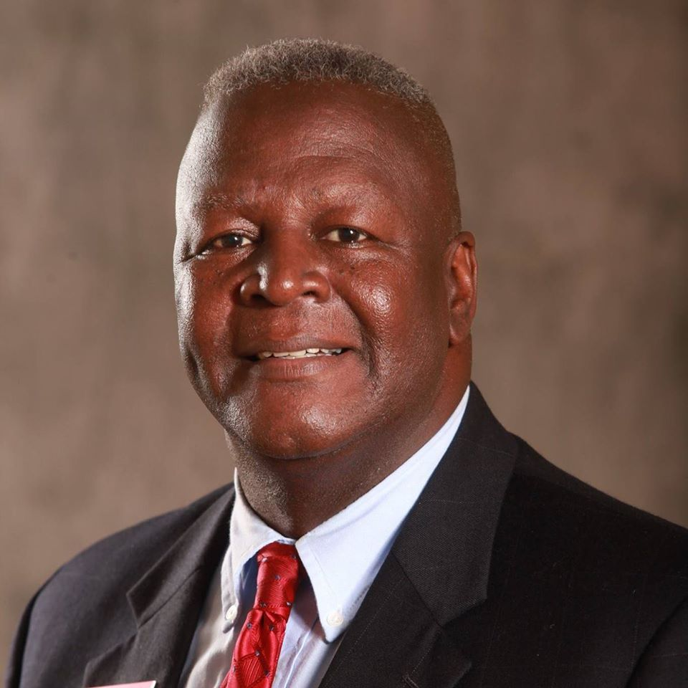
Florida District Governor
All in, Kids win!
Tommy Mills
2025-26 FL District Governor
sda11055@aol.com
(850) 320-5582
43
Notes:
Phone# 813-453-7134

Slide 44
Florida District Governor
Goals and Focus…
Build 9 new clubs
Nurture & Retain Clubs – 100%.
Enhance SLP Programs
Build Community Relationships.
Promote literacy (YCPO)
A Complete TEAM Effort!
44
Notes:
All in, Kids win! – a complete TEAM Effort!

Slide 45

Florida District Governor
A Complete TEAM Effort!
Goals and Focus…
Open 9 new clubs to help more kids and communities
Strengthen clubs by reducing the percentage of clubs under charter strength. Increase the membership of 15 smaller clubs to above 15.
Establish 30 new Service Leadership Programs – Aktion Club, CKI, Key Club, Builders Club, and K-Kids
Enhance our relationship within the community through an increase in community partnership, signature projects, Kiwanis branding, and public relations.
Promote literacy among children ages 0 to 5, with at least 100 projects performed throughout the District.
45
Notes:
All in, Kids win! – a complete TEAM Effort!

Slide 46

Florida District CHAIRS
A Unique RESOURCE for YOU and your CLUB
Need Ideas? Need Advice?
Starting a K-kids
Fundraiser Ideas
Project Ideas
Working in Social Media
Promoting a BUGs Program
Promoting your club
Writing a Grant
Finding Secretary resources
What counts as an Interclub?
Go to Florida Kiwanis website: Leadership
46
Notes:
The District Chairs are available to assist your Division and your club. You can ask them to speak at your Division meetings, or club meetings, or just one on one. They are your resources when starting new initiatives, or looking for fresh ideas, of policies and procedures.
The Division Chair contact information is available on the Florida Kiwanis website

Slide 47



Florida District CHAIRS
Fundraising/Foundations
Community Service
Fundraising
Florida Foundation
Kiwanis Children’s Fund
Grant Writing
Partnerships
Finance
Children’s Wk/Gov’t Liaison
Young Children Priority One
Human & Spiritual Values
Drowning Prevention
Governor’s Project
Risk Manager
SLPs
CKI / CKI Mentorship
Key Club
Builders Club
K-Kids
Youth Protection
47
Notes:
Florida Kiwanis has many ways to expand a person’s leadership ability beyond the club. In addition to Lieutenant Governor we offer District Chair positions. Each District Chair is responsible to provide support to the clubs in their described area. Most are self explanatory. K-Kids includes Terrific Kids and Bring Up Grades. The District Chairs positions are broken down into 6 major areas. They Community Service, Service Leadership Programs, Fundraising/Foundations, Membership, Education & Training, and Administration/Operations. Throughout the year, you will see communication from them, and they may be asking for club input. Please respond to them as they work to make Florida Kiwanis the best District ever.
You can also grow your own leadership by becoming involved. Our District Chairs are looking for committee members. If you would like to become more involved in any of the areas that we serve, please contact suzi.Bredbenner@gmail.com 813-597-5063 for more information and she will put you in contact with the Division Chair.

Slide 48



Florida District CHAIRS
Education & Training
Admin & Operations
Leadership Development
International Convention
District Convention
Communications
Club Reporting
Education
Interclubs
Achievements / Awards
Bylaws & Policies
District Chair Liaison
Lt. Governor Liaison
Parliamentarian
Elections
Membership
Membership Coordinator
New Club Opening
Club Strengthening
Membership Retention
Membership Expansion
Public Relations
Social Media
48
Notes:
Include a slide on District Chair Liaison

Slide 49
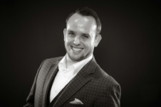
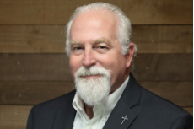
Florida District Office
ADDRESS/Phone:
  Florida District of Kiwanis
  P.O. Box 290489
  Port Orange FL 32129
  407-324-9800
WEBSITE:
FLkiwanis.org
James Lewis: District Secretary
Keith Hatch: District Treasurer
Home Club: Capital City (Tallahassee)
Background: Operations Mgr. FL Dept of Health
Email: FLKiwanis.DistrictSecy@gmail.com
Home Club: Keystone Heights
Background: 28 yrs in accounting, tax, auditing
Email: Keith@dkhpa.com
49
Notes:
Hand out?

Slide 50

Kiwanis Online Resources
  Call 1-800-KIWANIS with any questions during business hours
  https://www.kiwanis.org/
        Florida District Board (LTGs) and District Chairs –
        https://k05.site.kiwanis.org/leadership-2/
        Officer Resources and MORE! –
        https://k05.site.kiwanis.org/resources/
  Kiwanis Member Resources -
    https://www.kiwanis.org/members/
50
Notes:
Handout?
The number of resources on the Kiwanis International website is huge. They have created numerous free resources for every club to use. The Kiwanis Partners are organizations that have made an agreement with Kiwanis International to give all members certain benefits. Some of these partners have even promised to have their members join your Kiwanis Clubs. The Florida District Chairs are often underutilized. It is their volunteer position to support Kiwanis members around the state understand how their chair position can help you.

Slide 51

KI Webinar Officer Training
Officer-Specific Kiwanis International Training Sessions
President training
Treasurer training
    Monday, Aug 4 – 8-10pm EST
    Monday, Aug 6- 8-10pm EST
Secretary training
Membership Chair training
    Tuesday, Aug 5- 8-10pm EST
    Tuesday., Aug 7- 8-10pm EST
Registration Link: TBD
51
Notes:
Handout?
Here is the link where people can register: TBD
According to Lyndsy at KI- the trainings will all be in the first week of August, but I don’t have definitive dates yet.

Slide 52
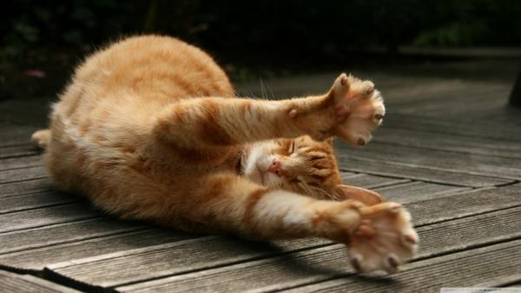
Time for a STRETCH!
52

Slide 53






Supporting your SLPs!
53

Slide 54

Supporting your Service Clubs…
Sponsoring an SLP is a PARTNERSHIP -
  Funding
  Leadership
  Training
  Joint Participation
Don’t be a “silent partner”!
54

Slide 55

SLP Support
Sponsoring Obligations
Club ←→ SLP Interaction
Maintain Expense Line Item in Service Account
Appoint a Kiwanian/Committee to serve as SLP Advisor(s)
Attend SLP meetings and events
Host / Participate in JOINT activities
Invite SLP Club Members to attend Kiwanis club meetings
Notes:
Hand out?
Ask your clubs – how many of you feel that you do a great job supporting your SLPs, after reading these obligations?
These guidelines will help you powerfully influence the SLP clubs you lead.

Slide 56
SLP Support
Sponsoring Obligations
SLP School/Faculty Advisor Follow-up
Meet with School Principal (or rep) every year
Find sponsorship resources, including an online sponsorship toolkit at Kiwanis.org/advisor
Schedule an annual meeting with Kiwanis & SLP Leadership
Ensure all Dues/Fees are PAID
SLP Officer Training
Ensure SLP Officers receive proper training
Ensure SLP members provided with training opportunities BEYOND club level
56
Notes:
Hand out?
Ask your clubs – how many of you feel that you do a great job supporting your SLPs, after reading these obligations?

Slide 57
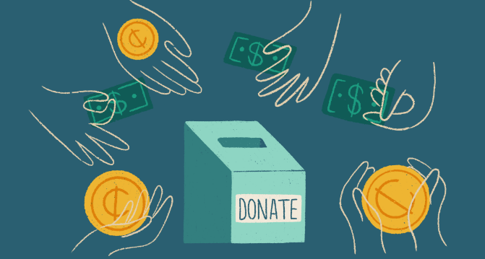

Fundraising
Growing our Resources to HELP the Kids!

Slide 58

Why Organize a Fundraiser?
Carefully consider these questions before you start…
EXISTING Fundraiser
NEW Fundraiser
Do you need more money to fund projects for your club?
Do members look forward to organizing the fundraiser?
What social role will your event play beyond fundraising?
Are your members enthusiastic about your current fundraiser?
Is the event growing?
Is the money made worth the effort put out?
58

Slide 59


Where to START…
Create a committee
Determine a goal
Review current fundraising activities
Brainstorm NEW fundraiser ideas
59
Notes:
Begin with the END in mind…
What other social roles should the fundraiser play
Member recruitment
Media opportunities
Social gathering

Slide 60

Questions to ASK
When considering a Fundraiser, clubs should ask…
What interests our Club Members?
What does our club enjoy?
What are our club’s strengths?
What are popular fundraisers in your area?
Why are they successful?
What do other Kiwanis clubs do?

Slide 61
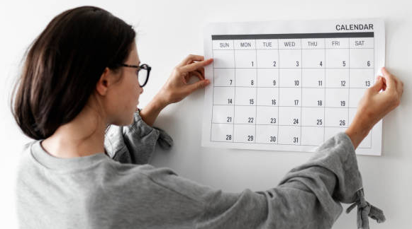
Details Matter!
Things to Consider
Scheduling
Time of Year
Planning timeline
Your club’s current calendar
Competing Local Events
61

Slide 62

Details Matter!
Things to Consider
Resources
Rough Budget
Member/Volunteer Availability
Projected Income
62

Slide 63
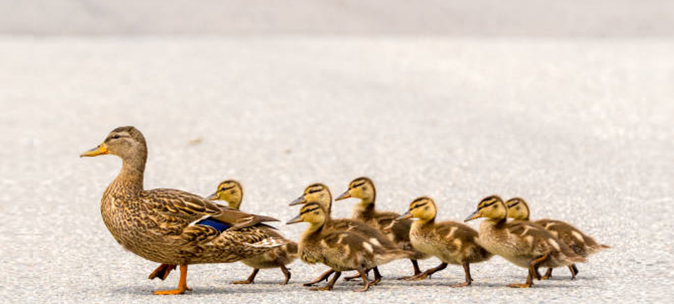
Get your DUCKs in a ROW!
Identify a Leader
Logistics
Marketing
Volunteers
Sales
Sponsors
Identify a Leader
Logistics
Marketing
Volunteers
Sales
Sponsors
Recruit your team
Recruit your team
Divide the responsibilities
Divide the responsibilities
63

Slide 64



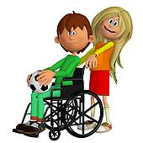
Promote the IDEA
With so many good charities to choose from,
how do we get people support our cause?
  Be SPECIFIC
  Make it REAL
  Bring it HOME
  Make it PERSONAL
64
Notes:
SPECIFIC/REAL: Tell exactly how someone will benefit from their donations. Use statistics and facts from your research.
Not Ummm its for our Foundation. It is much easier to obtain money for a capital improvement or a named need. Give examples 1 blood bank 2 playground 3 art supplies for the handicapped, etc
PERSONAL: People relate to children. If yours is a child-related cause—and it usually is with Kiwanis— involve children in your outreach or promotions.
HOME: How does this need— and your funded solution—affect your community? Name the neighborhoods, schools or buildings involved

Slide 65


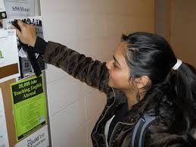


Promote the EVENT
How do we “Get the Word out”?
  EDUCATE your members
  PICTURE it
  Share NEWs and UPDATEs
65
Notes:
EDUCATE: How often do you find that members of the club have NO idea why we are raising funds? Or the nature of your club projects? Prizes to answers at the club meeting. Bullet point lists of information to the club members.
PICTURE: On posters, presentations and fliers, appeal to your audience by using photos of people your project helps or display architectural renderings
of the proposed improvements.
UPDATES: Offer donors updates on the progress of your fundraiser and your project. Post details on your website, or keep in touch via social networks

Slide 66
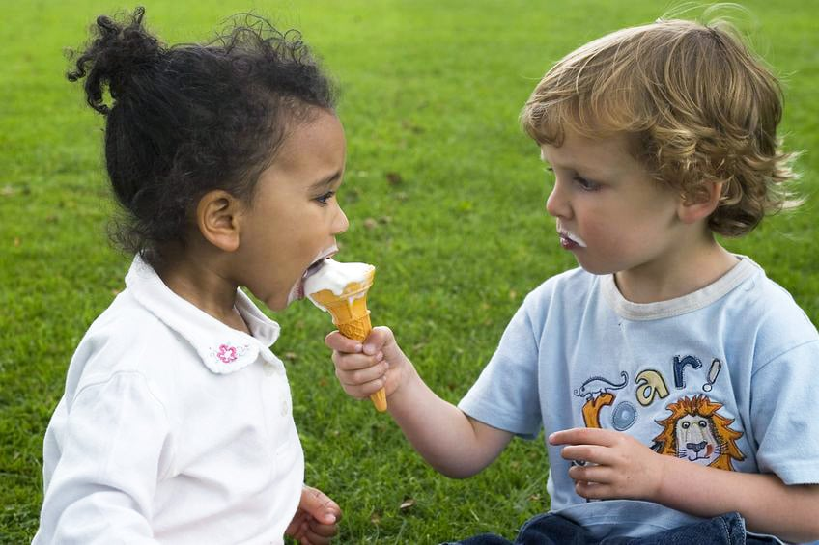
Time to SHARE - Best Practices
What Fundraising Strategies have worked for you in the past?
What Fundraising ideas would you like to pursue?
Any words of wisdom on “Lessons Learned”?
66
Notes:
Discuss what has worked for the clubs in the past.

Slide 67

YOU Can Write Grants Too!
Funding your Fundraiser - Consider Grant Writing
Grants are FREE money for your club
Local Foundations = Better Odds
Not an English Major? …. Download Grammarly for FREE
Treasurer should review budgets

Slide 68
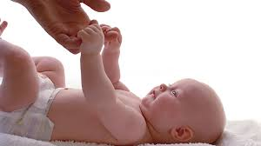

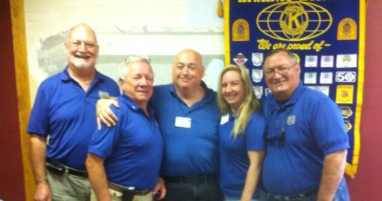
Words of Advice
  Find CONNECTIONS between your project and the community
  Don’t be afraid to spend $$ to MAKE $$
  LOOK the Part!
68
Notes:
CONNECTIONS: Look for logical connections between your cause and your community. If you’re raising money to cover a young cancer patient’s
medical bills, approach the child’s favorite dining spot about hosting a fundraising dinner.
SPEND $$/MAKE $$: This is especially applicable at an organized fundraiser where there are live, silent or Chinese auctions.
LOOK the Part: Dressing up in certain colors or wearing your Kiwanis gear will get you noticed.

Slide 69


Fundraiser Brainstorming by Groups
You have 15 minutes!
Notes:
NOTE: where can people take notes? Provide paper?
Include “workshop note-taker” page with Leadership Guides?
Pick 2 Fundraising ideas and create basic plan
Worksheet

Slide 70

Time to RECHARGE!
Breaktime – 10 minutes

Slide 71

Florida Kiwanis Foundation
Notes:
Florida District Goals
District Foundation
Awards
District Office & Events
Beyond District

Slide 72
And Now… a Word from your Foundation Trustee
<name>, Division <##>
72

Slide 73

Who Are Trustees?
Who and Why Trustees are so important!
Elected to represent YOUR division on the FKF board
Review and assist with grant writing
Assistance with Division and/or Club project collaborations
Updates on grant extensions and new programs
https://floridakiwanisfoundation.org/
Learn more during Meet and Greets on FKF Facebook!
73

Slide 74

Foundation Mini-Grants
Designed for smaller clubs
Not matching funds
$750 maximum per request
Quick response
Apply throughout the year (no set deadline)
Learn more on the website
https://floridakiwanisfoundation.org/
74

Slide 75

Club/Division Grants
Application on website
Matching Grants
Apply every 5 years
Procedures upon Award of Grant
Dec 15/June 15 deadline
Disaster Relief Grants
Designated for emergency disaster somewhere in the Florida District of Kiwanis
Letter of request as application
$2,000 max.
75

Slide 76

Private Fund Grants
Application on website
David and Donna Batelaan Grant Opportunities (3)
Kiwanis Club & Division Grant
Support youth with physical disabilities
Up to $10,000 maximum
SLP Grant (Aktion Club)
Support Aktion Club projects
Up to $2,000 per cycle (2 cycles/yr.)
Apply ONCE/Cycle
SLP Grant (Builders, Key Club, CKI)
Support Builders Clubs, Key Clubs, and CKI Club projects
up to $1,000 maximum
Grant Application June 15th and December 15th
76
Notes:
Grant Application June 15th and December 15th
Two cycles per year - Apply twice a year but only once per cycle

Slide 77

Private Fund Grants
Application on website
Will and Rachel Blechman Grant Opportunity
Young Children Priority One (YCPO)
Support children 0-5 years old
Healthy Child Development Programs
(Physical, Social, Emotional, Cognitive; Language- including early literacy)
Up to $2500 maximum
Grant Application June 15th and December 15th
77
Notes:
healthy child development for ages 0-5 years (Physical; Social, Emotional; Cognitive; Language, including early literacy.

Slide 78

Foundation Scholarships
Providing Education Opportunities…
J. Walker Field – Key Club Students
George & Ann Langguth Scholarship– Kiwanis Family
Charles & Emilia Gugliuzza– CKI Student
Maria Mychaniuk Scholarship- Flagler County Community
Wilton Manors Scholarship- Broward County
Wilton Manors Friends & Family Kiwanis Scholarship
78
Notes:
Updated 12/9/24

Slide 79

FKF can HELP!
In the past year, has your club applied for a Mini-Grant?
In the past 5 years, has your club applied for a Matching or Private Fund Grant?
Has your club made their donation to the Florida Kiwanis Foundation yet?
A Few Quick Questions!
FKF exists to support YOU!
79

Slide 80
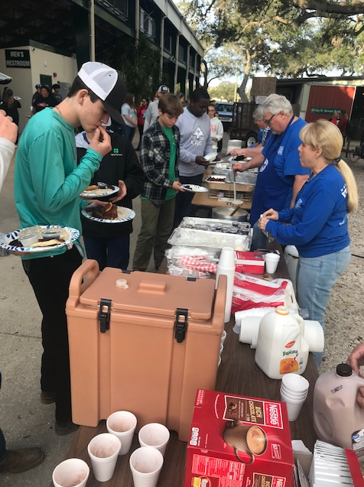
Service Projects
Work to your Strengths
Identify your Community Needs

Slide 81
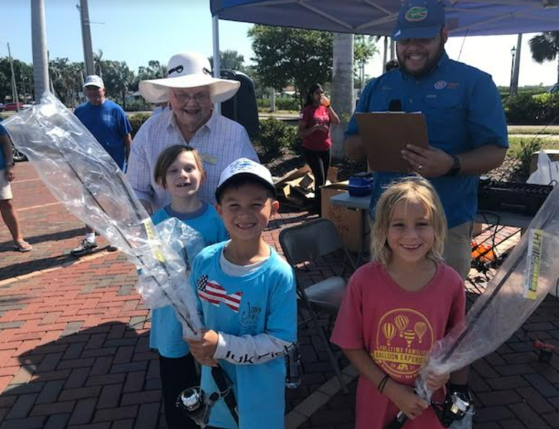
Signature Projects
Recurring
Brand enhancing
High Impact
Membership focused
What community event is your club known for?
Notes:
What are they? How do you pick one? Maybe you have one?
https://www.kiwanis.org/clubs/member-resources/service-projects/signature-projects
Recurring: At a minimum, the project should take place annually.
Brand enhancing: The project should be designed to elevate the Kiwanis brand in the local community with opportunities for public relations activities, such as using the Kiwanis name on the project, media mentions, etc.
High impact: The project should have a demonstrable positive impact on the community; this impact should be measurable in monies raised or children served.
Membership focused: The project should support opportunities to strengthen membership and develop new partnerships.
What community activity or event is my club known for?

Slide 82

Governor’s Project
Promoting Literacy (YCPO)
Reaching children 0-5 years olds
Introduce them to the joys of BOOKs early!
2025-26
82

Slide 83


How to find Ideas
Reach out to…
Schools
Churches
Local Service Organizations
Police/Sheriff/Emergency Services
Search the WEB for “ Service Ideas”
https://www.classy.org/blog/community-service-ideas/
83

Slide 84

What to Consider
Who needs help in your area?
Schools
Churches
Daycares
Police/Emergency Services projects
Other Service Organizations
Club Enthusiasm
Is project well-received by members?
Project Logistics
Materials
Funds
Volunteers
Venue
Effort
Time
84
Notes:
Club enthusiasm – is the project well-received by members?

Slide 85

Service Ideas
Packaging Meals
Landscaping projects
Cooking/Grilling for school events
Cleaning Roads/Beaches
Sponsoring Free Kids Events
Sponsoring elementary/middle school events
Literacy Programs – Providing books, Reading to Kids
Food/Clothing/Diaper Drives – ask your local schools and shelters what THEY need
85
Notes:
Like Fundraising section
Service project at meetings
https://www.classy.org/blog/community-service-ideas/

Slide 86

Time to SHARE – What worked for you?
Successful Service Projects?
Considerations?
Any words of wisdom on “Lessons Learned”?
86
Notes:
Discuss past success – what have clubs done in the past. Get ideas going

Slide 87



Service Project Planning by CLUB
You have 15 minutes!
Pick at least one new Service Idea
Discuss its impact on your community
Start High-level planning
Notes:
Pick 2 service ideas and plan it out
Worksheet

Slide 88


Wrap Up!

Slide 89

A Final Word of Advice
A good leader LEADS by DOING!
Be involved with SLPs, fundraisers, service projects, charitable targets, and division activities.
89

Slide 90

Closing Activities
A few FINAL items:
Participant expectations
“Parking lot”
Attendance credit
Contact information
Survey
90

Slide 91

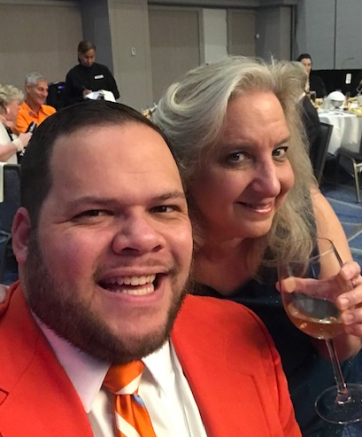
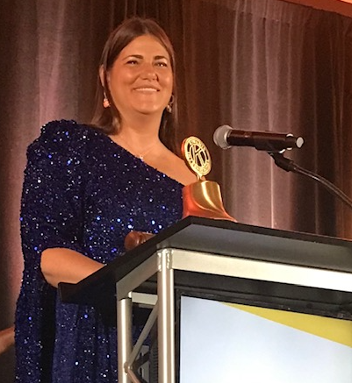
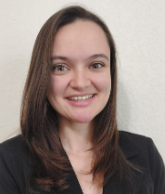
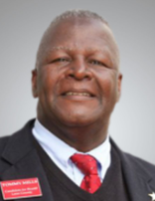
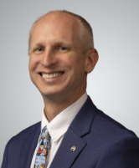
DCON 2025…
Join us at District Convention
Date: August 7-10th (Thurs.-Sunday)
Location: PGA National Resort, Palm Beach Gardens
Cost: $325 Reg, $169/night Hotel
91

Slide 92
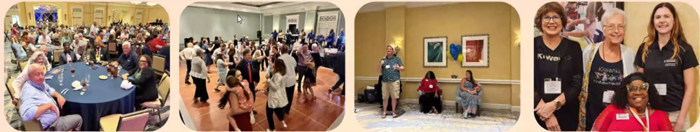
DCON 2025…
Let’s HAVE FUN!
Thursday: Florida Kiwanis Foundation Golf Tournament
Friday: CKI Alumni Assoc. Family Feud Event + Late Night Happy Hour!
Saturday: Kiwanis Got Talent & After Party
92

Slide 93

THANK YOU for being here!
Instructor#1 Name
Instructor#2 Name
CLE Instructor, FL District
CLE Instructor, FL District
Instructor#1 email
Instructor#2 email
Instructor#1 Picture
Phone #
Phone #
Instructor#2 Picture
93

Slide 94
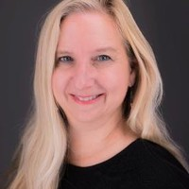
THANK YOU for being here!
NAME
Club Leadership Education Instructor
Instructor’s email
Instructor Picture
Phone #
Wishing you the best in a successful year of service and leadership.
94

