Slide 1
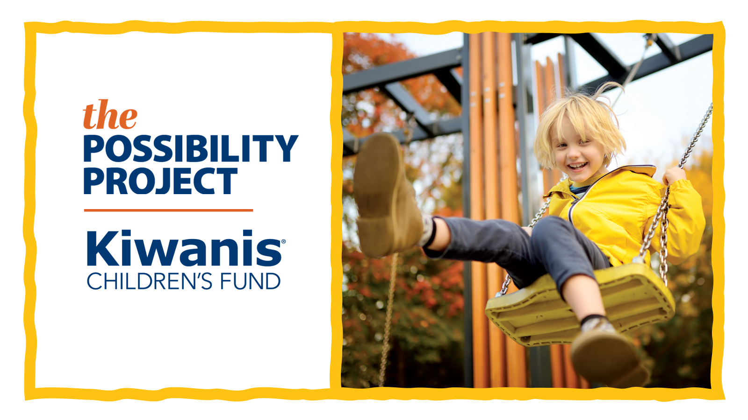
Notes:
Good afternoon. My name is [YOUR NAME], and I’m a volunteer with the Kiwanis Children’s Fund.
Today, I’m excited to introduce The Possibility Project—a bold campaign to impact 10 million children through Kiwanis service projects.
I will also share how your club can support The Possibility Project as an Impact Club—this campaign’s only club recognition level—and how you can use a multiyear fundraising plan to reach your Impact Club goals.

Slide 2
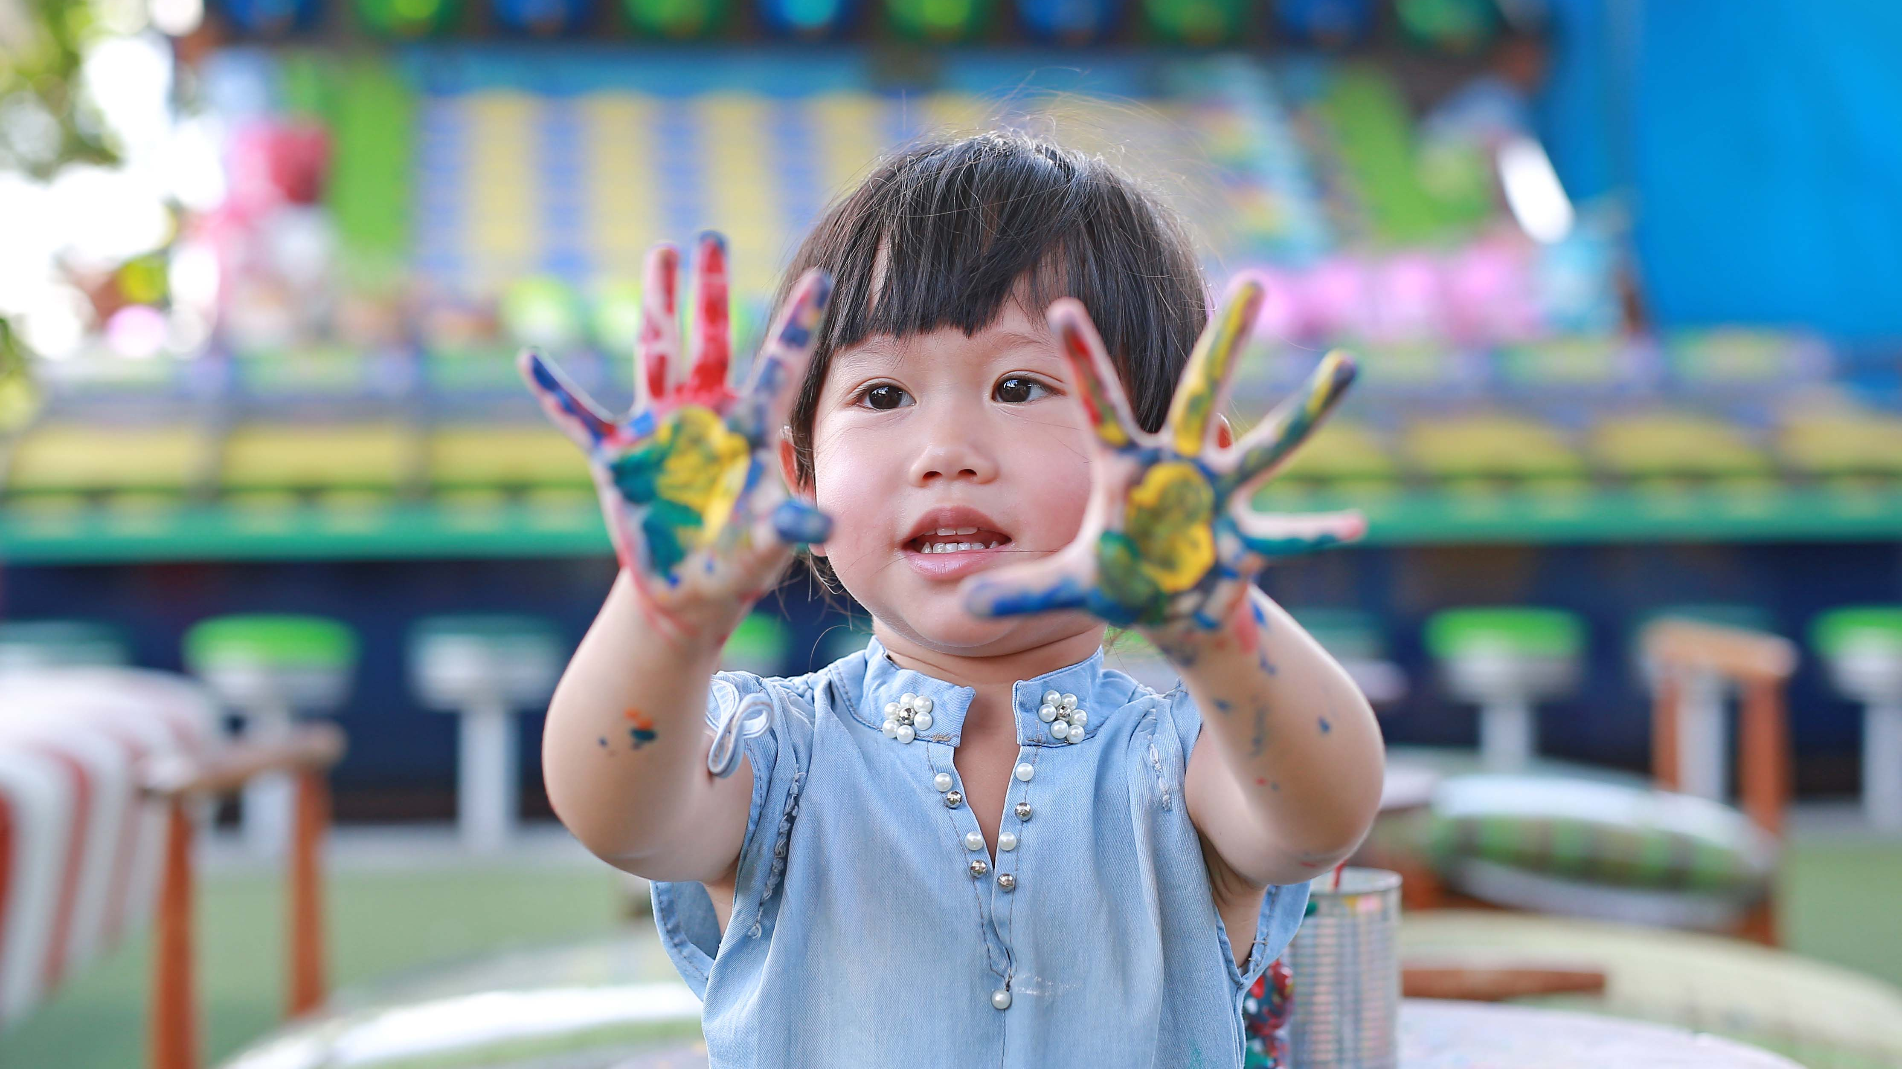
WHAT IS POSSIBLE?
Notes:
“Kids need Kiwanis” isn’t just a slogan—it’s our reality.
Every Kiwanis club sees the challenges kids face within their community:
-Hunger
-Struggles in school
-A lack of accessible play or enrichment opportunities
Imagine what we could do with more resources in more clubs. That’s the power of The Possibility Project.

Slide 3
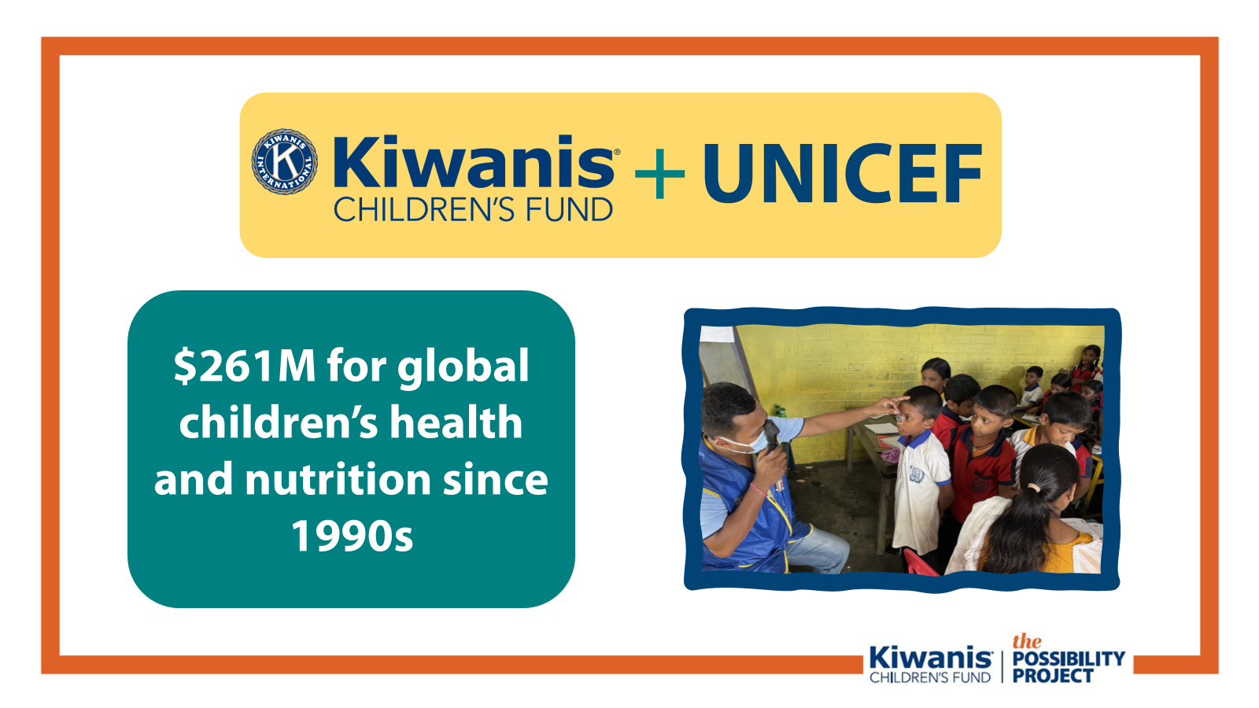
Notes:
For 85 years, the Kiwanis Children’s Fund has helped Kiwanians turn generosity into global impact.
From eliminating maternal and neonatal tetanus in 49 countries, to improving childhood brain development through iodine access, we’ve raised and leveraged over $250 million for children worldwide.

Slide 4
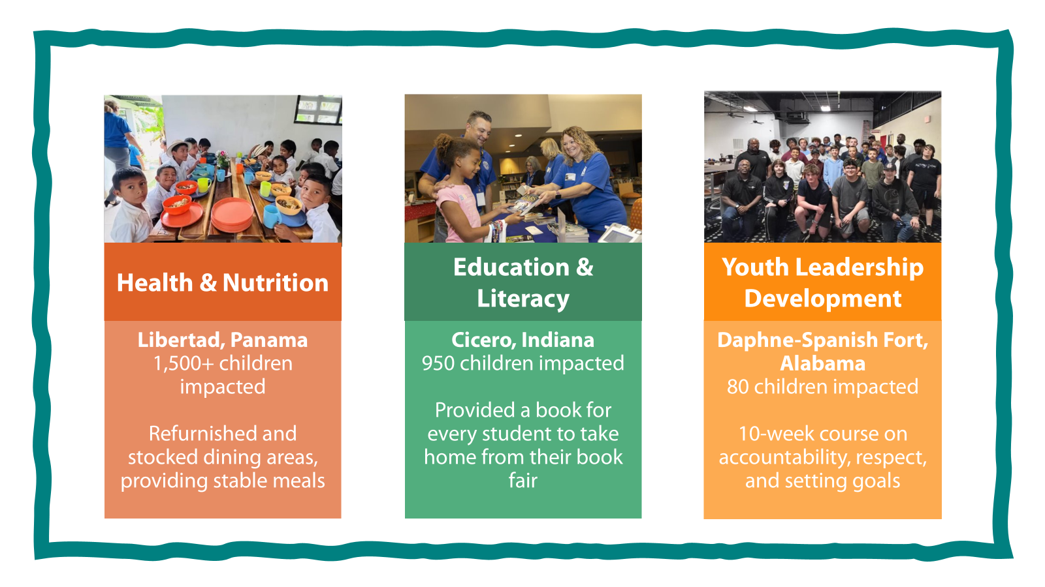
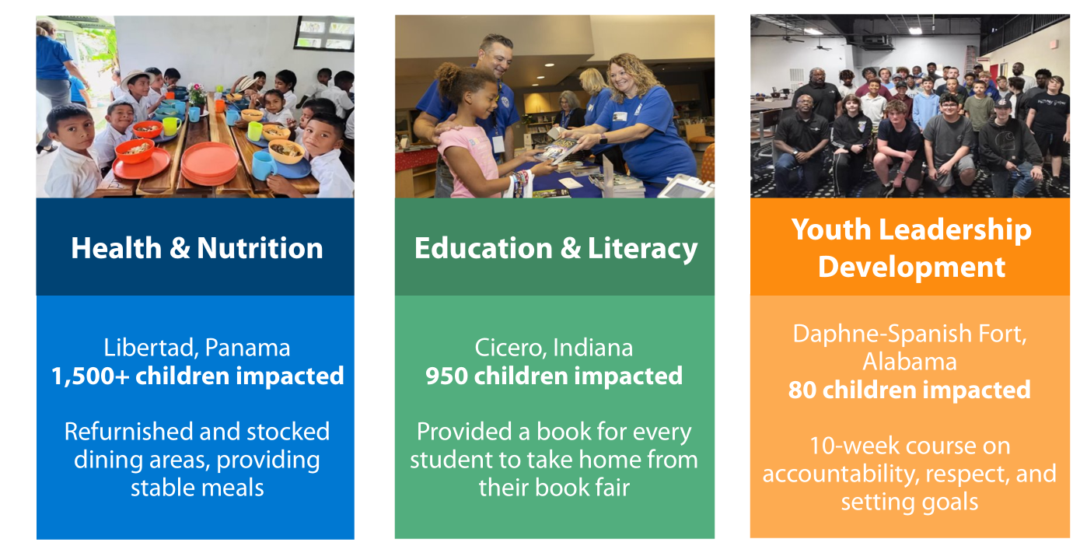
Notes:
We asked: “What do clubs need most?”
Kiwanians showed us that community needs and club service projects fall into three main areas:
Health and Nutrition
Education and Literacy
Youth Leadership Development
These areas are the building blocks for a child's success, creating a lifelong positive impact.
These needs are urgent, and we’re not waiting to help clubs make a difference. The Children's Fund has provided grants recently for Kiwanis service projects by clubs like:
Libertad, Panama, which rebuilt and restocked their local school's dining area, providing stable meals for 1,500 students.
Cicero, Indiana, which provided a book for all 950 children to take home,
Daphne-Spanish Fort, Alabama, which hosted a 10-week program teaching 80 middle schoolers respect, conflict resolution, and goal setting.
By supporting the Children's Fund, you expand your impact beyond your local area to other communities wherever a Kiwanis club exists.

Slide 5

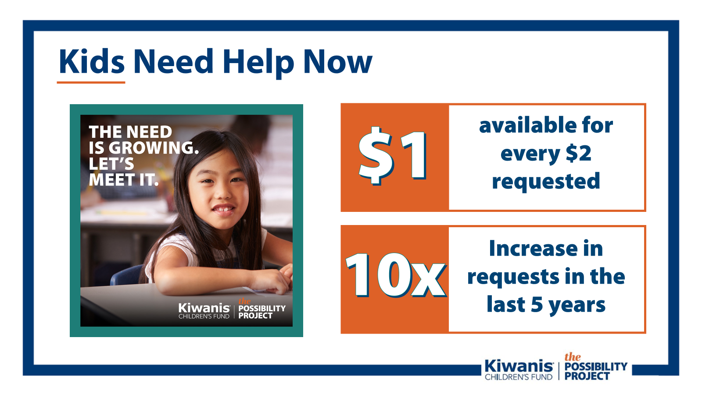
Notes:
The Kiwanis Children's Fund proudly supports service projects that meet urgent needs. But the reality is, millions of children still need our help.
Consider this:
Over 14 million children in the U.S. alone live in households without enough food.
Two out of five 4th graders can't read at a basic level.
Two out of five high school students report feeling lonely, sad, or hopeless.
Grant requests to the Children's Fund have increased tenfold in recent years, but as needs continue to grow, we've only been able to fund $1 for every $2 requested.

Slide 6
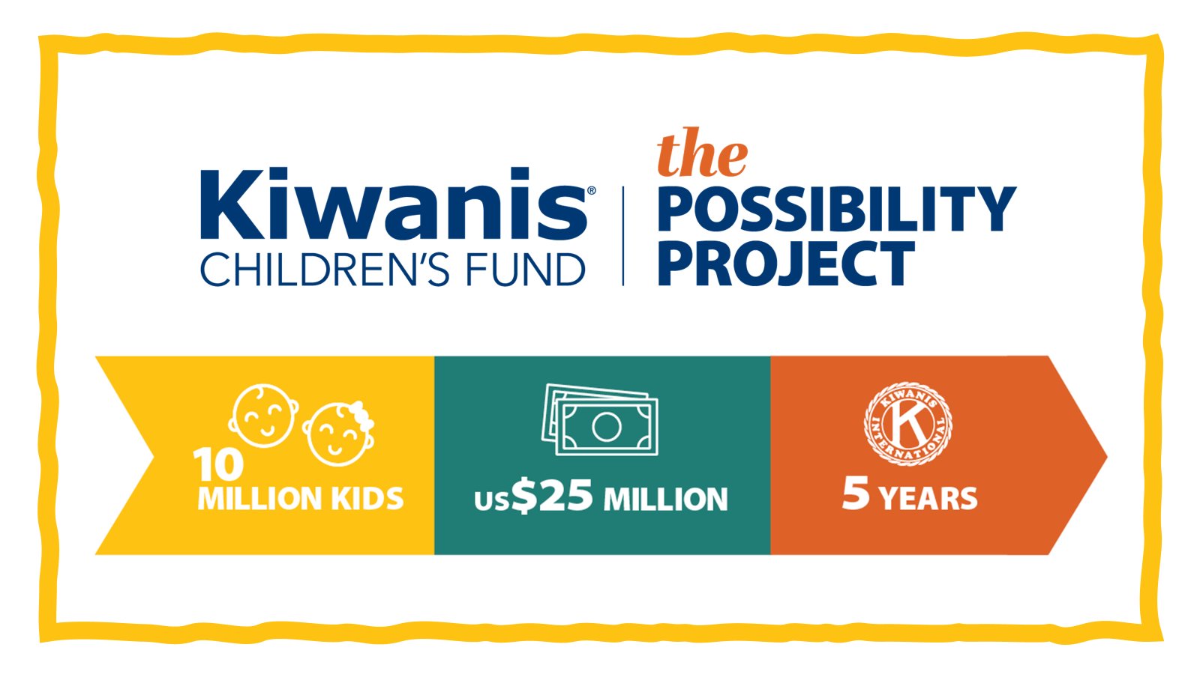
Notes:
The Possibility Project is designed to meet these urgent needs.
We aim to raise $25 million over five years to help over 10 million children—and support more grants for more clubs.
With a grant from the Kiwanis Children’s Fund, it costs just $2.25 to change a child’s life.

Slide 7
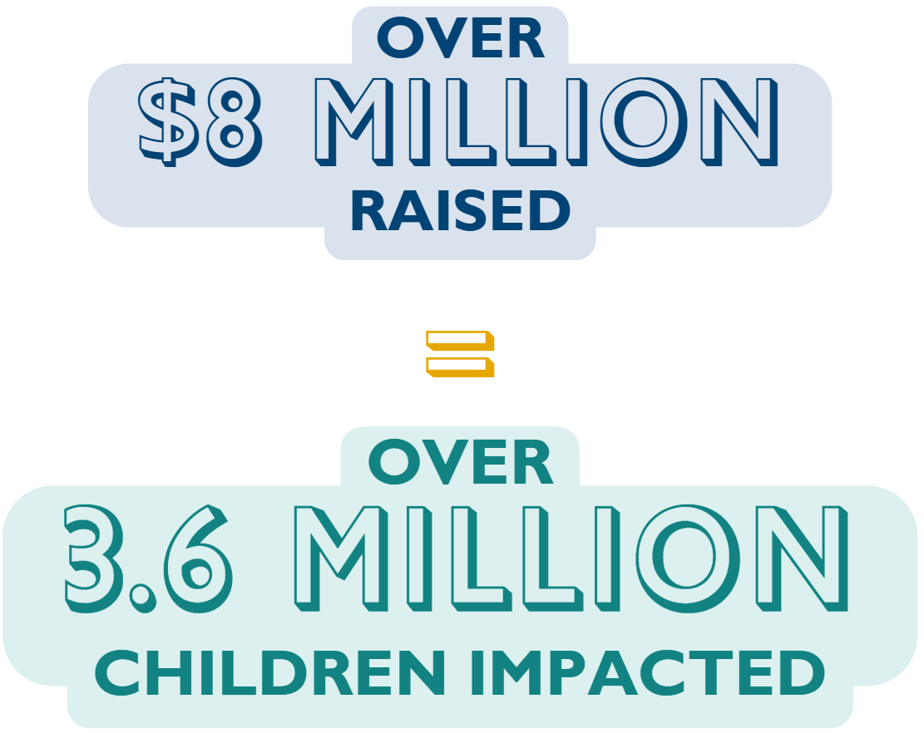
Notes:
The good news is that we started fundraising for The Possibility Project on October 1st, 2022—which means we are well on our way to our goal.
We have already raised more than $8 million. That means Kiwanians have already come together to support club service projects that could reach more than 3.5 million children.

Slide 8
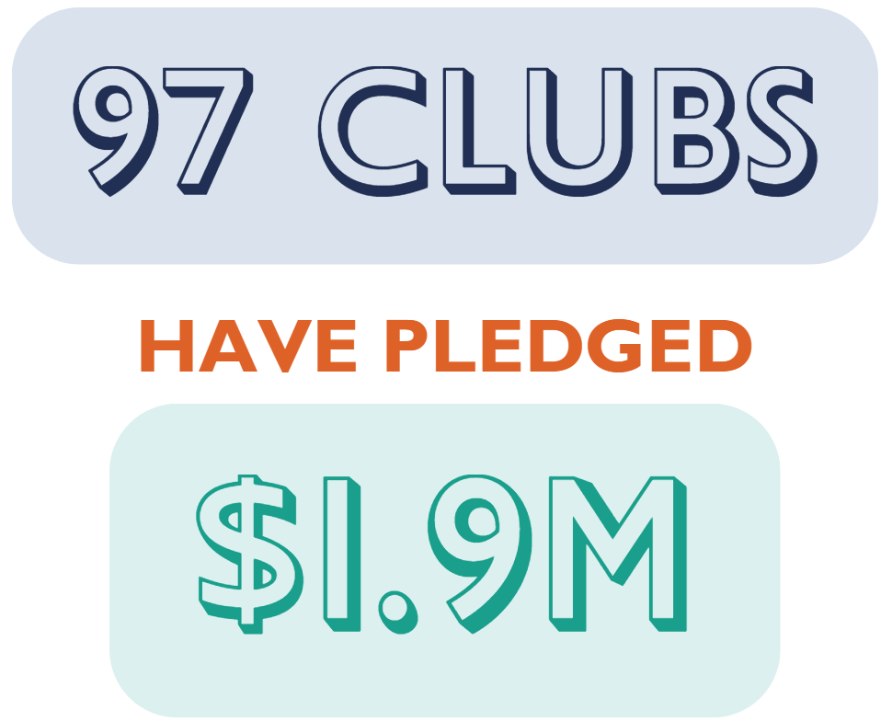
Momentum is Building
Notes:
Momentum is building, including here in [DISTRICT].
Nearly 100 clubs have pledged over $1.9 million as Impact Clubs.
Thank you to the clubs in [DISTRICT] already leading the way: [LIST IC CLUBS].

Slide 9
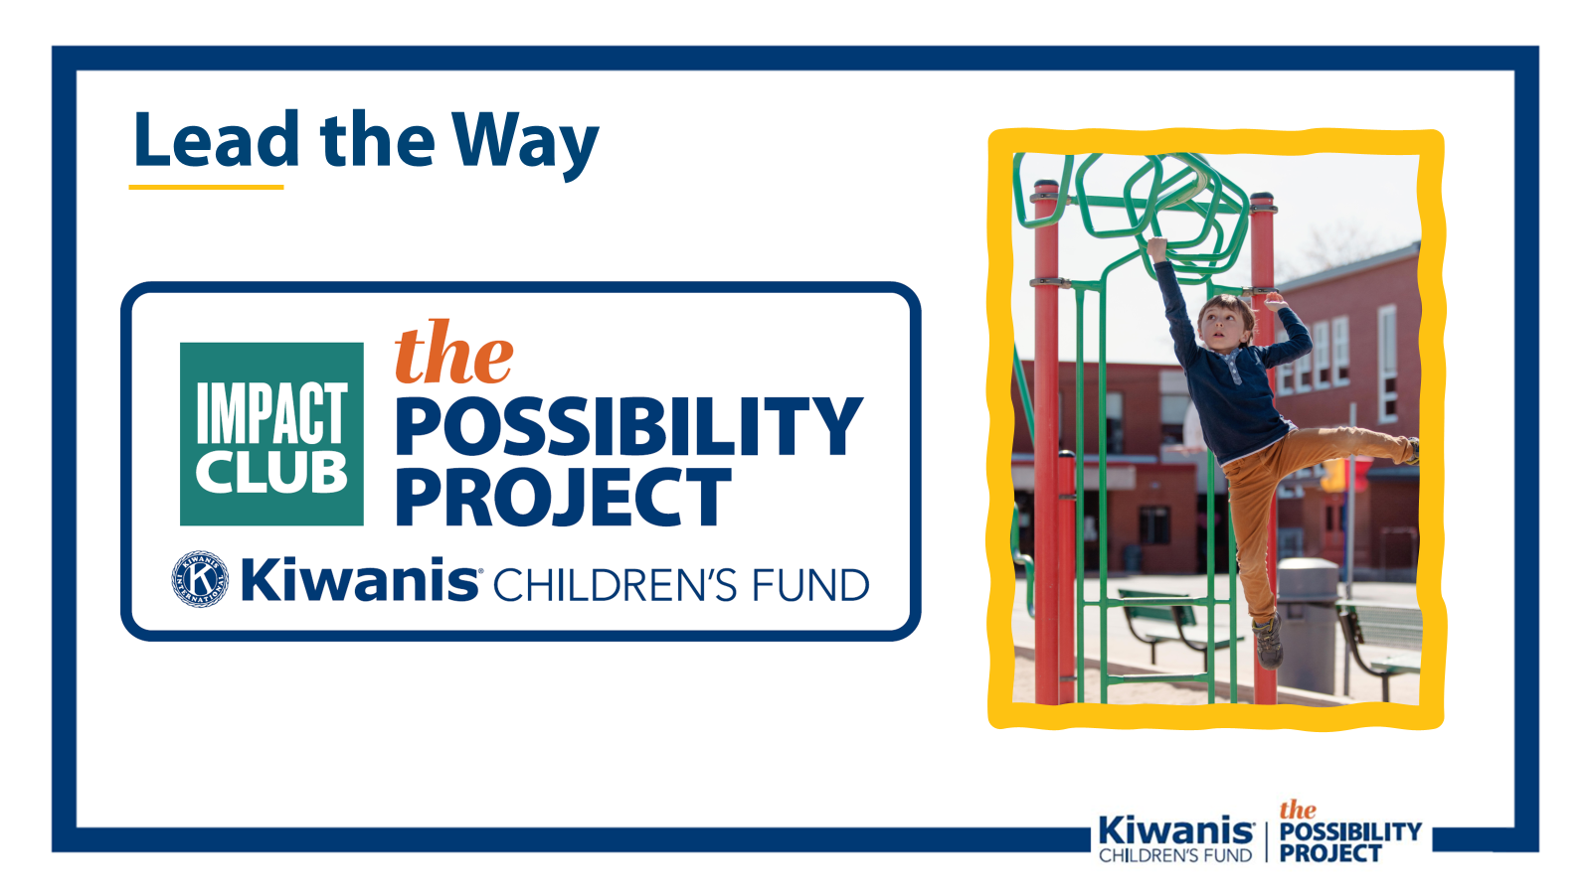
Notes:
The clubs I mentioned a moment ago imagined their possible impact—and took action by becoming Impact Clubs, making a 5-year pledge to support The Possibility Project.
By signing an Impact Club pledge, your club sets a goal to raise $100 per member each year for five years.
That may feel like a big number—but a multiyear fundraising plan helps you break it down by time and source, turning a big goal into manageable steps.
By creating a multiyear fundraising plan, you clearly communicate how you intend to achieve your goal—but this is not a document set in stone. This type of plan allows for flexibility and helps you understand where you can best focus your efforts as a club.

Slide 10

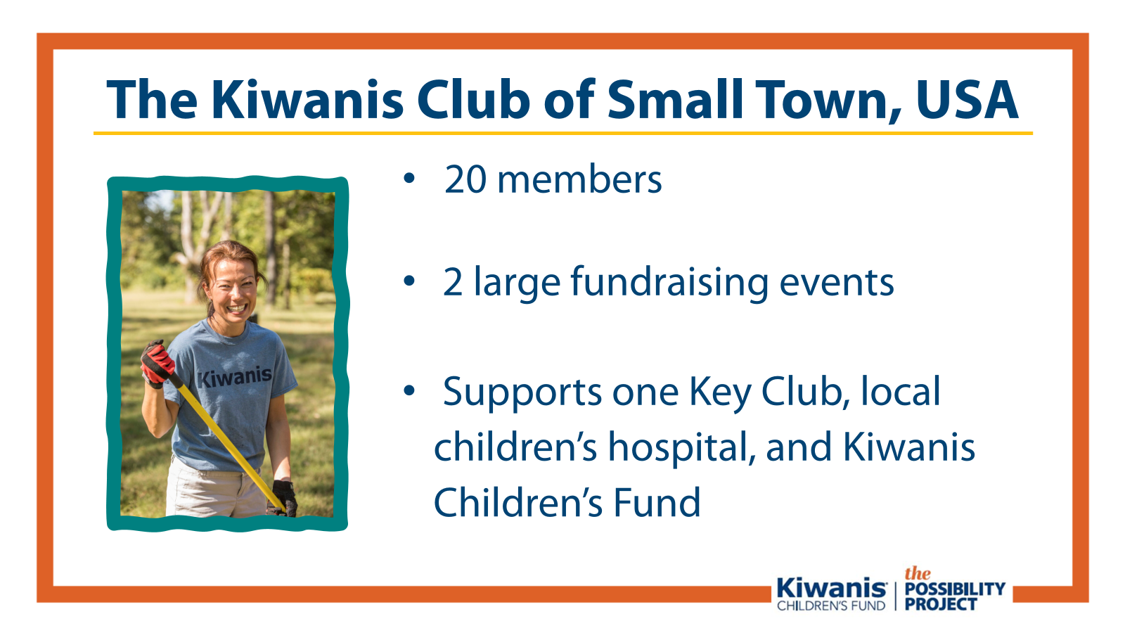
Notes:
I’m going to walk you through an example that you can apply to your own club.
Today, we’ll talk about the Kiwanis Club of Small Town, USA.
As you can see, we have 20 members. We have two big fundraisers, which help us give to our 3 main causes: our Key Club, our local children’s hospital, and the Kiwanis Children’s Fund.
Our club wants to support The Possibility Project, but it is important to us that we are able to continue our support of the Key Club and the local children’s hospital as well.

Slide 11

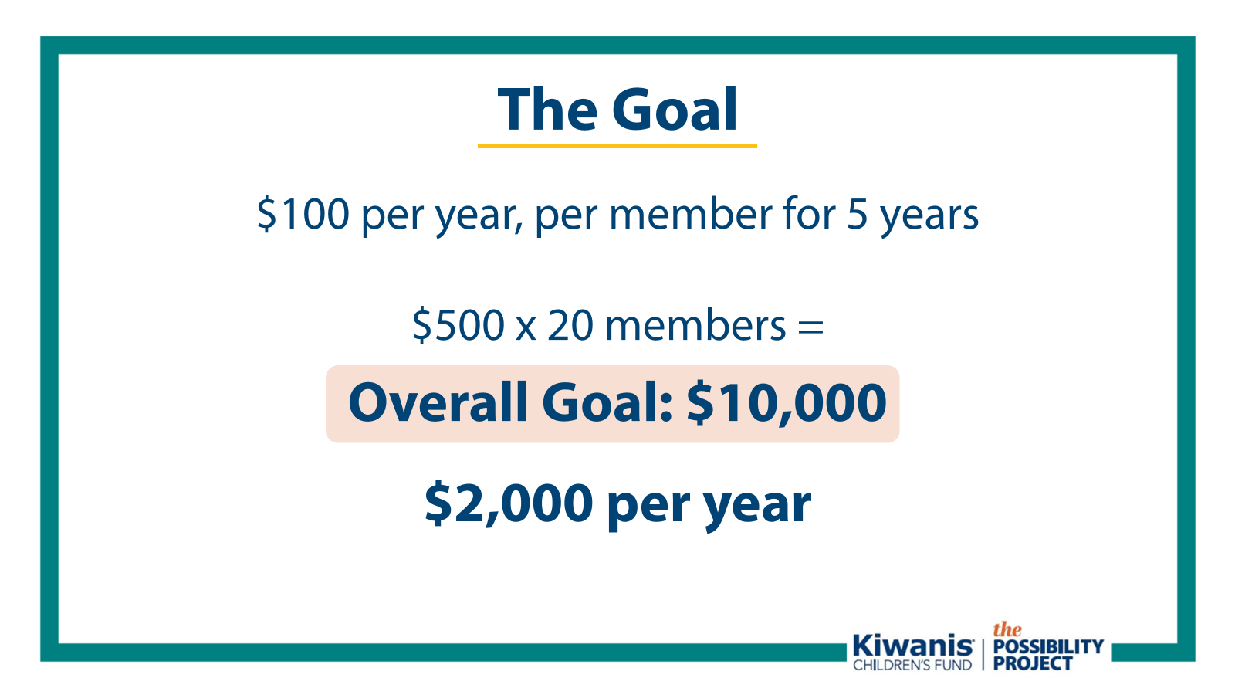
Notes:
The Impact Club goal is based on membership: $100 per year, per member for 5 years.
$500 times 20 members comes out to an overall goal of $10,000. Since it is a 5 year pledge, we will aim to raise about $2,000 per year.
$100/member/year = $8.33/month—just one coffee trip.
But fundraising doesn’t need to fall solely on members. Many clubs use multiple funding sources: events, club funds, and member giving.
Your real goal? Helping kids.
So, divide your pledge by $2.25 it takes to impact a child through the Kiwanis Children’s Fund. Suddenly your goal is no longer in dollars, but in the number of children your club can help. At $2.25 per child, Small Town’s $10,000 pledge means helping 4,000+ kids.
As a club, ask yourselves: how many kids do you want to help?

Slide 12
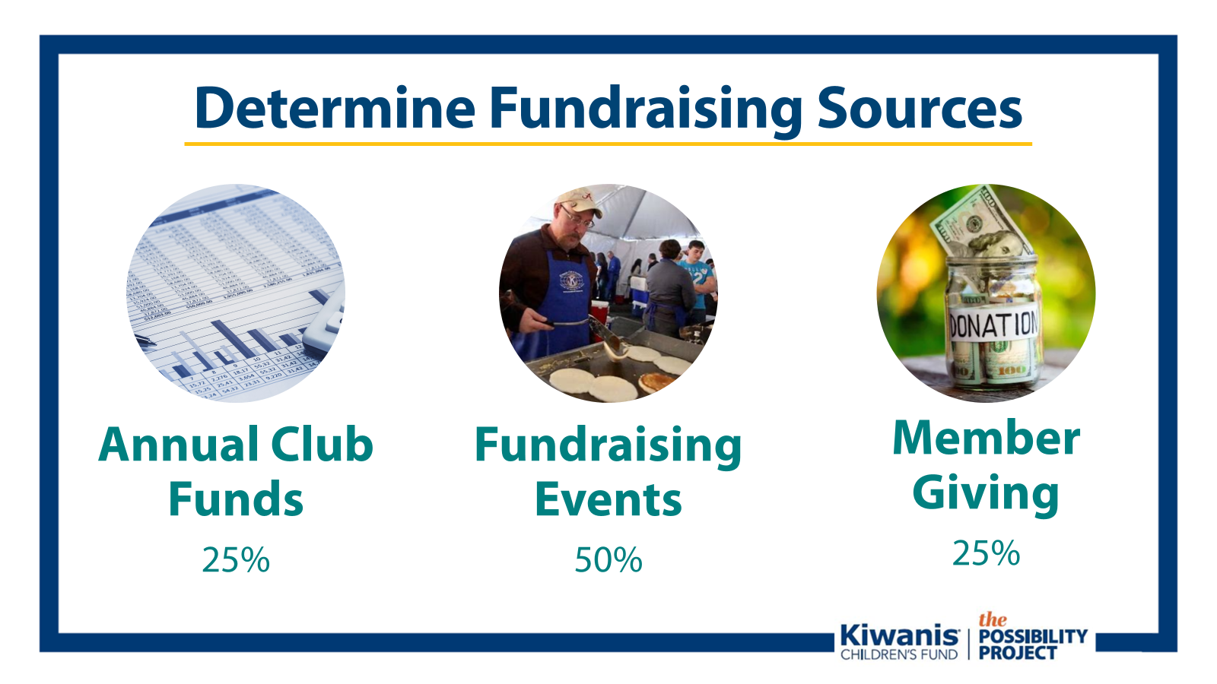
Notes:
Now we have a goal of the dollar amount we hope to raise over 5 years. But where will that money come from? ​
​
Small Town breaks down its pledge like this:
50% from events
25% from member giving
25% from the annual budget
The first step is deciding what percentage of each funding source will make up the total pledge! ​We went ahead and put suggested percentages on each funding source. You may end up doing it differently with your club and can adjust based on what fits your club best.

Slide 13
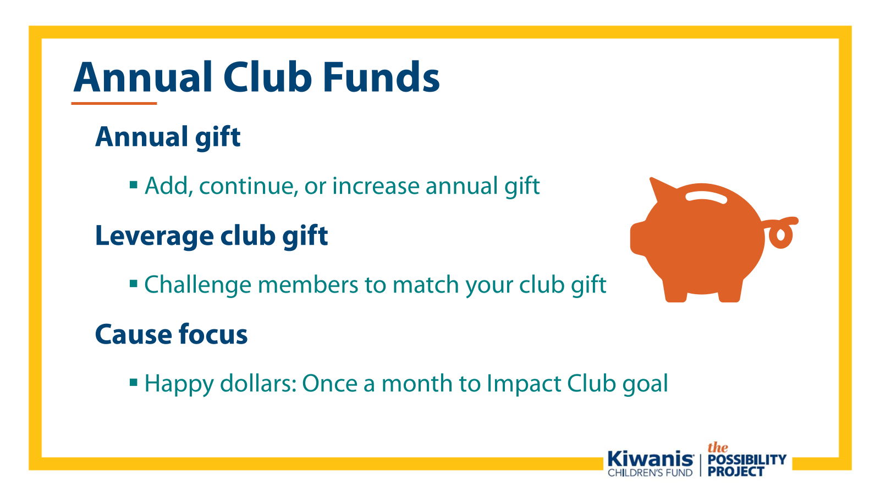
Notes:
If you remember the club is going to break it down to $2,000 annually, annual fund (or your club’s annual budget) is one of the ways that the Impact Club giving level will be met.
Even a modest gift from your club budget each year can make a big difference.
You can also use club funds as matching gifts—inspiring individual club members to give and doubling your impact.
Happy Dollars can be redirected to support your goal, too.

Slide 14
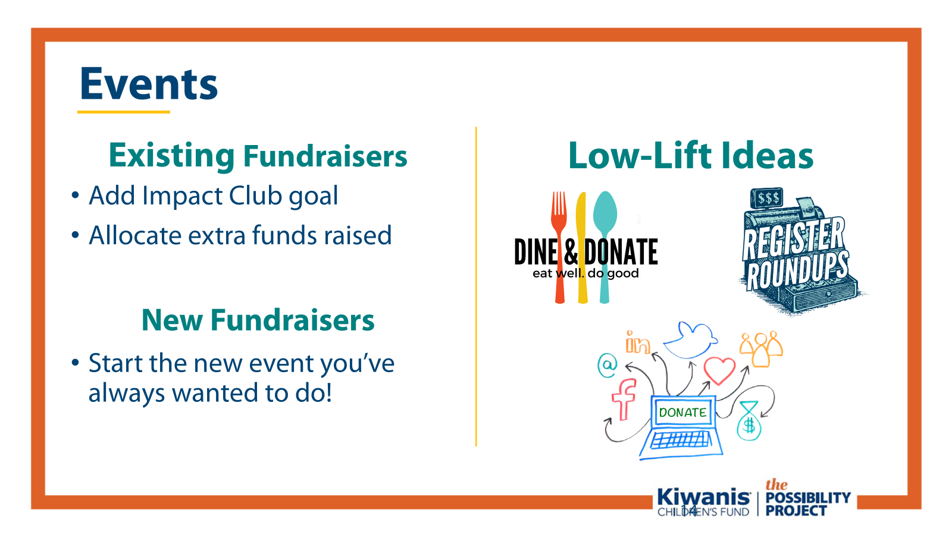
Notes:
Fundraising events are a club’s bread and butter and the ideas are almost endless. They’re a great way to support an Impact Club pledge.
Enhance existing fundraisers or create new ones inspired by your Impact Club pledge.
You can even use low-lift efforts like dine-to-donate nights or social media appeals—every bit adds up.
You can use social media to spread the message to seek donations. Also, you can dine for donations, which is popular and easy. Partner with a local restaurant to receive a portion of every sale on a specific night of a month. The club’s responsibility is simply to spread the word so people eat at the restaurant on that night.

Slide 15
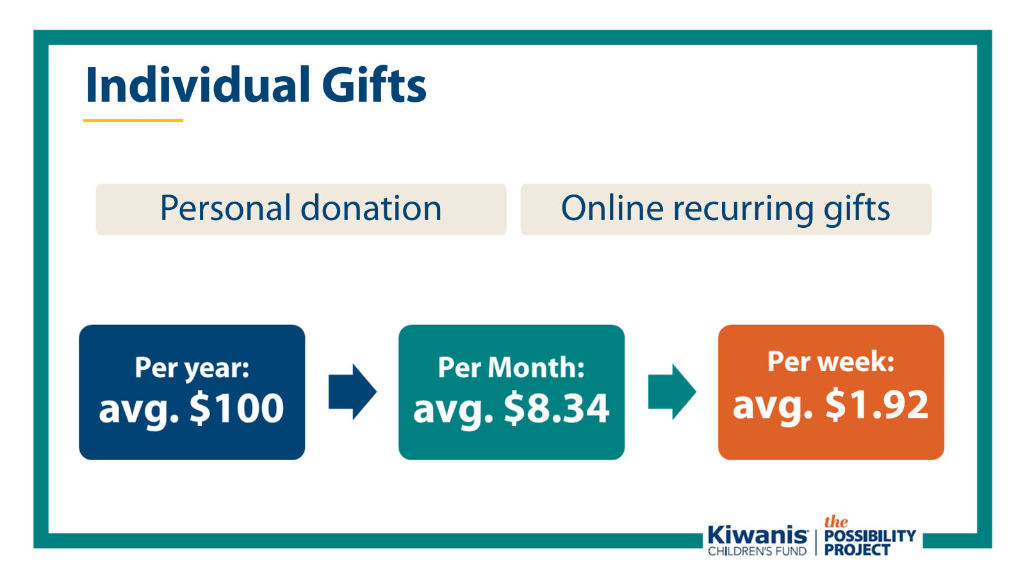
Notes:
When clubs combine efforts, individual giving goes further.
In Small Town’s example, members need to collectively raise just $1,000/year. Some give more, some give less—it’s a team effort.
All personal donations to the Children’s Fund count toward your club’s goal if they list your club as their home club.
There are many ways that individual members can choose to give personally and fundraise on their own:
-Individual fundraising efforts, like reaching out to friends and family
-Personal donations of any size, even if that means setting aside spare change at the end of the week
-Individual pledges, like the Cornerstone pledge, or $15,000 over 3 years—or small pledges made to your club that you will commit to giving a specific amount to the Children’s Fund
-Recurring gifts by setting up an automatic donation on the Kiwanis Children’s Fund’s website
and
-Honoring a club member or outgoing president with a Blechman or Hixson Fellowship

Slide 16
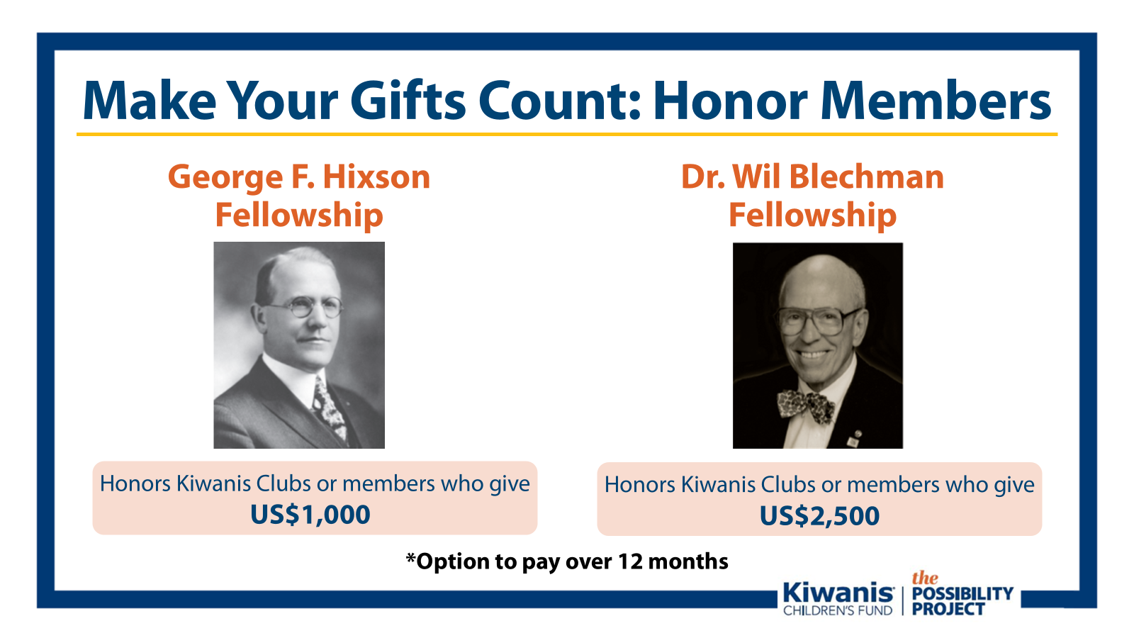
Notes:
Again, you can also honor club members with fellowships while fulfilling your Impact Club commitment so let’s review what those opportunities are:
George F. Hixson Fellowship ($1,000 gift)
Dr. Wil Blechman Fellowship ($2,500 gift)
These can be individual or collective gifts. Challenge your club to give at least one per year as part of your pledge.
Challenging your club members to donate at least one Hixson or Blechman each year is a great way to help meet your member giving goal, while honoring a deserving Kiwanian for all of their great work they do for children.

Slide 17
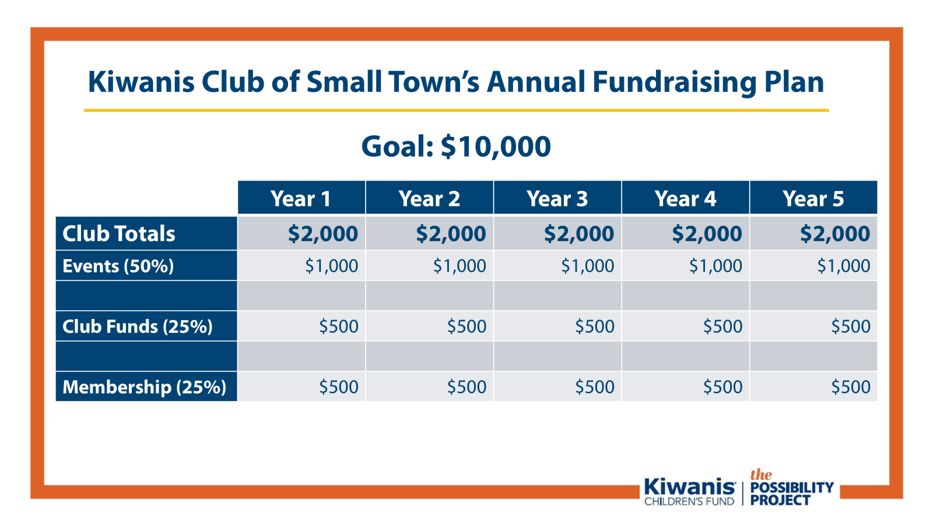
Notes:
Here’s how the Club of Small Town put this all together. Again, breaking it down, they set a clear goal: raise $10,000 over five years, which breaks down to $2,000 each year.
They’re planning to reach that goal by combining three funding sources: about 50% will come from events, 25% will come from member giving, and 25% from the club’s annual fund.
You can see how it is broken down by dollar amount here.
This shows how a mix of fundraising activities can add up to a realistic, achievable plan that everyone in the club can contribute to ensure over 4,000 children are impacted through The Possibility Project.

Slide 18

Notes:
By using multiple fundraising sources and breaking down your goal by year, your club can make an extraordinary difference by becoming an Impact Club.
Kiwanians have come together before, saving millions of lives from preventable diseases, reshaping the world.
Imagine what we can do when we come together to support each other, to help clubs do more to turn possibilities into realities.
Imagine what’s possible if we trust our fellow Kiwanians to live our vision: to be a positive influence in communities worldwide, so that one day, all children will wake up in communities that believe in them, nurture them, and provide the support they need to thrive.

Slide 19
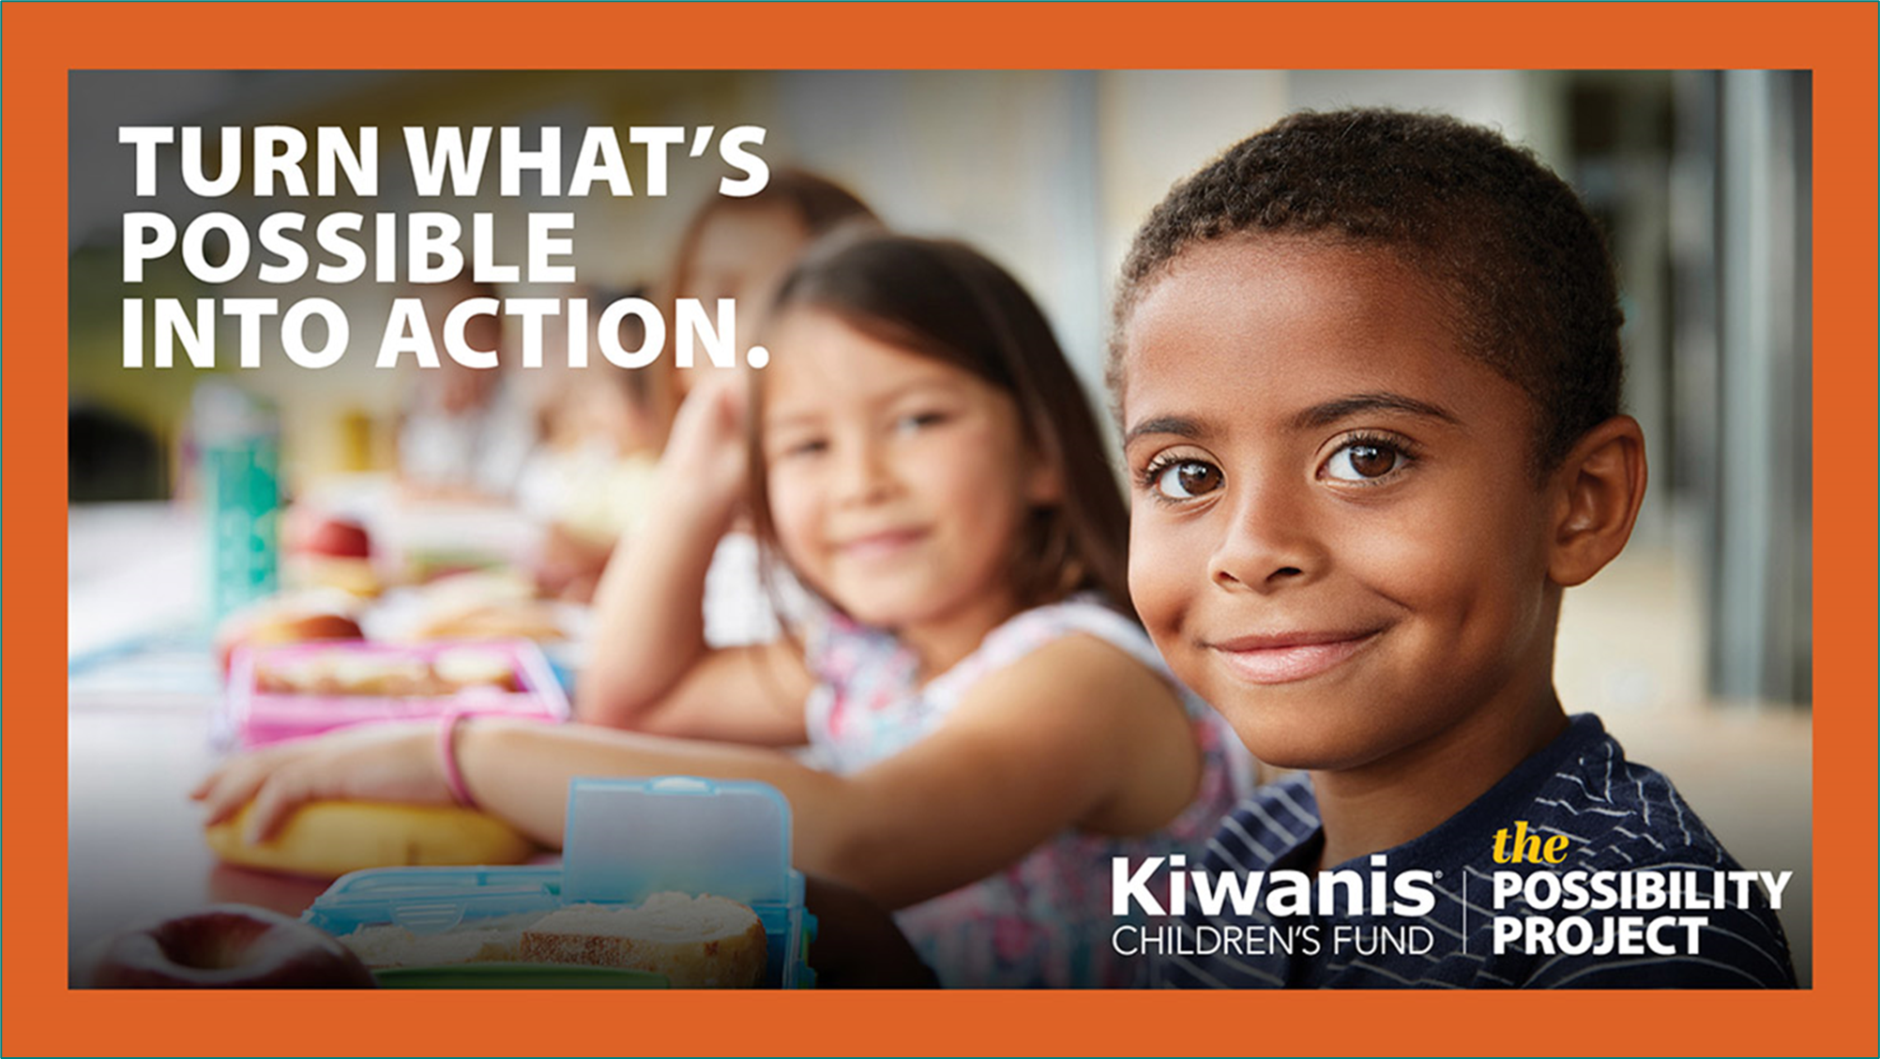
Notes:
Clubs in our district have already received support from The Possibility Project, like the Kiwanis Club of [X]:
[INSERT LOCAL GRANT STORY]
This is what’s possible when we come together.
Think about our mission and who we are: a global organization of volunteers, dedicated to improving the world, one child and one community at a time.
One child, one community at a time.
That is The Possibility Project: One child, one Kiwanis club service project at a time—to show 10 million kids what’s possible.
Make a bold statement that you believe in the power of Kiwanis—in the power of clubs to make a meaningful and positive difference in the lives of children in their communities—and amplify your club’s impact beyond here in [DISTRICT] to Kiwanis communities worldwide.

Slide 20
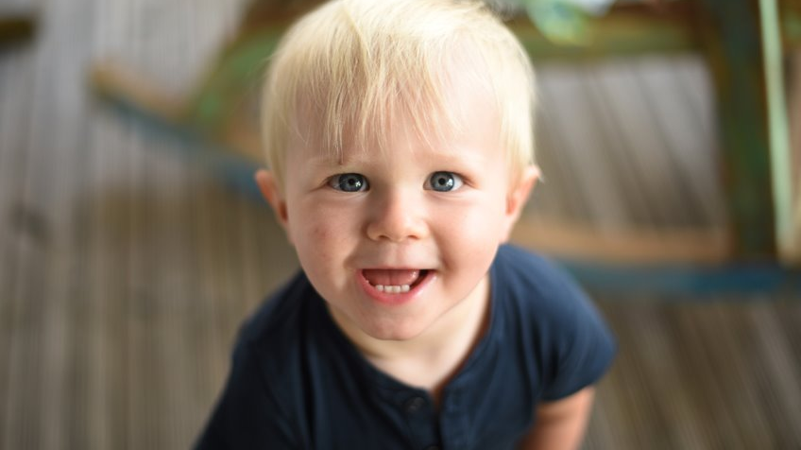
QUESTIONS?
Notes:
Pause for Questions here

Slide 21
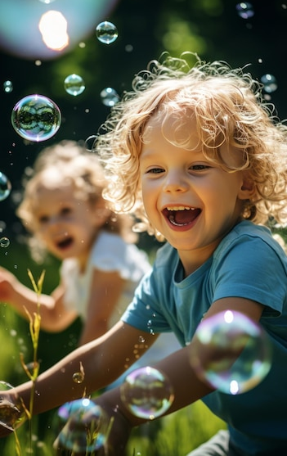

Thank You

