Slide 1

Don’t Let Drama be a
Distraction
Jeremy Riehl
Kiwanis Governor, 2024-25

Slide 2
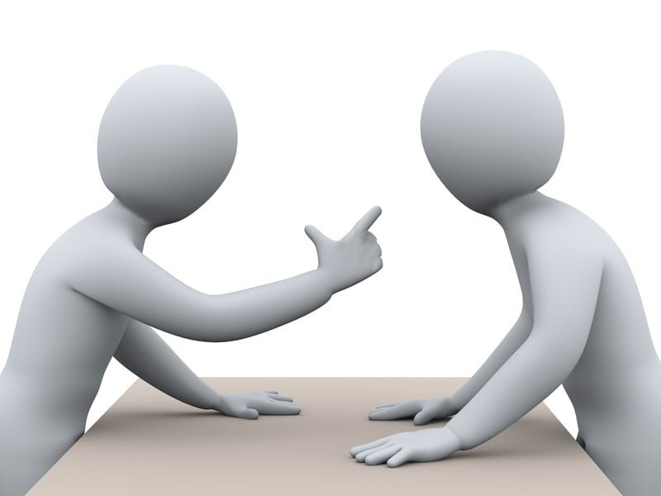
What is Conflict?

Slide 3
What is Conflict?
a serious disagreement or argument, typically a protracted one
a condition in which a person experiences a clash of opposing wishes or needs
an incompatibility between two or more opinions, principles, or interests

Slide 4
Three Conflict Situations
Internal Conflicts
Conflicts you are a part of
Conflicts you are witnessing, either as a leader, subordinate, or peer

Slide 5
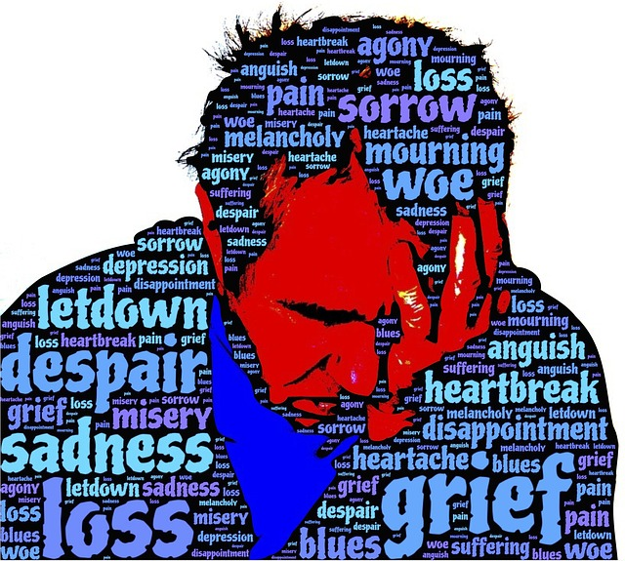
Internal
Conflicts
Self-Awareness
Check Values
Release Guilt/Shame
Pro/Con

Slide 6

Conflicts you are a part of

Slide 7

Steps to Resolution

Slide 8

Assess the level of conflict
* crisis
*tension
*misunderstanding
*incident
*discomfort

Slide 9

Analyze the response
Fight – I win, you lose: Aggressive
Flight – I lose, you win: Passive
Freeze – I lose, you lose: Avoidance
Flow – I win, you win: Assertive

Slide 10

Determine the Desired Outcome
Diffuse
  Should you just apologize and move on?
Win
  Is it important that you remain in this fight?
Reach Consensus
  Do you need to agree to move forward?

Slide 11
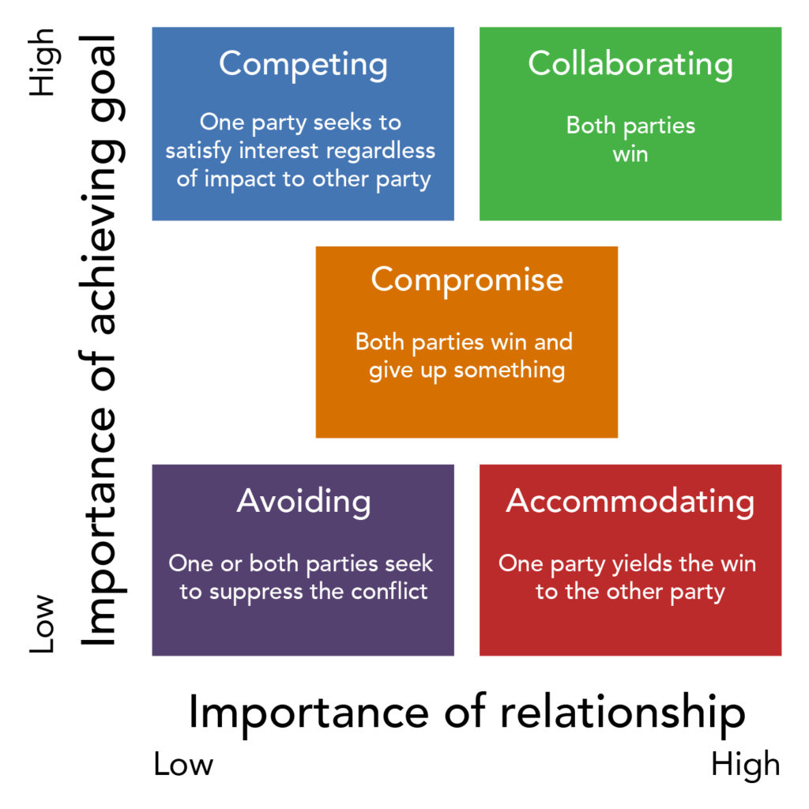
Establish a Plan and Execute

Slide 12

Win/Win (Flow)
  Needs First,
  Solution Later
  Soft on People,
  Hard on Issue

Slide 13

Mind Chatter
  Analyze your internal response
  Express your thoughts

Slide 14

Listening
  Ask open questions
  Listen to support, not to respond
  I hear what you are saying, but we need to take a step back and talk again when we’re not so angry

Slide 15

Reassess
How do I feel?
Is the situation improving?
Do I have new information?

Slide 16
Steps to Resolution
Assess the level of conflict
    Discomfort, Incident, Misunderstanding, Tension, Crisis
Analyze the response
    Fight, Flight, Freeze, Flow
Determine the desired outcome
    Diffuse, Win, Reach consensus
Establish a plan and execute
    Value of Relationship vs Value of Completing a Task
    Should I get involved? If so, how? Take a side or mediate?
    Win/Win, Mind Chatter, Listening
Reassess
    Is the situation improving?
    Do I have new information that might cause me to adjust my plan

Slide 17

Conflicts as a leader

Slide 18
Establish Ground Rules for Communicating
Fight fair
Praise in Public, Criticize in Private
Have Empathy, everyone has their own perspective
Avoid Conflict and Diffuse Situations

Slide 19
Diffuse
  Is it better to be right or to be kind?
  Remove yourself from situation until you are calm
  Empathy, ask questions

Slide 20

Conflict is an Opportunity

Slide 21

Have Questions?

