Slide 1
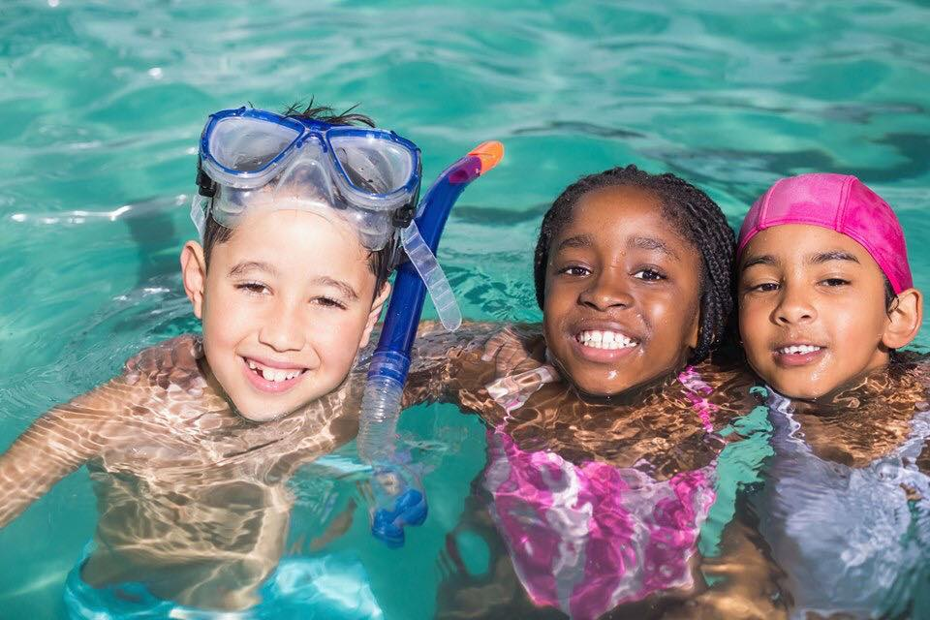

WELCOME TO THE Kiwanis drowning prevention (Swim Safety)
WORK SHOP

Slide 2
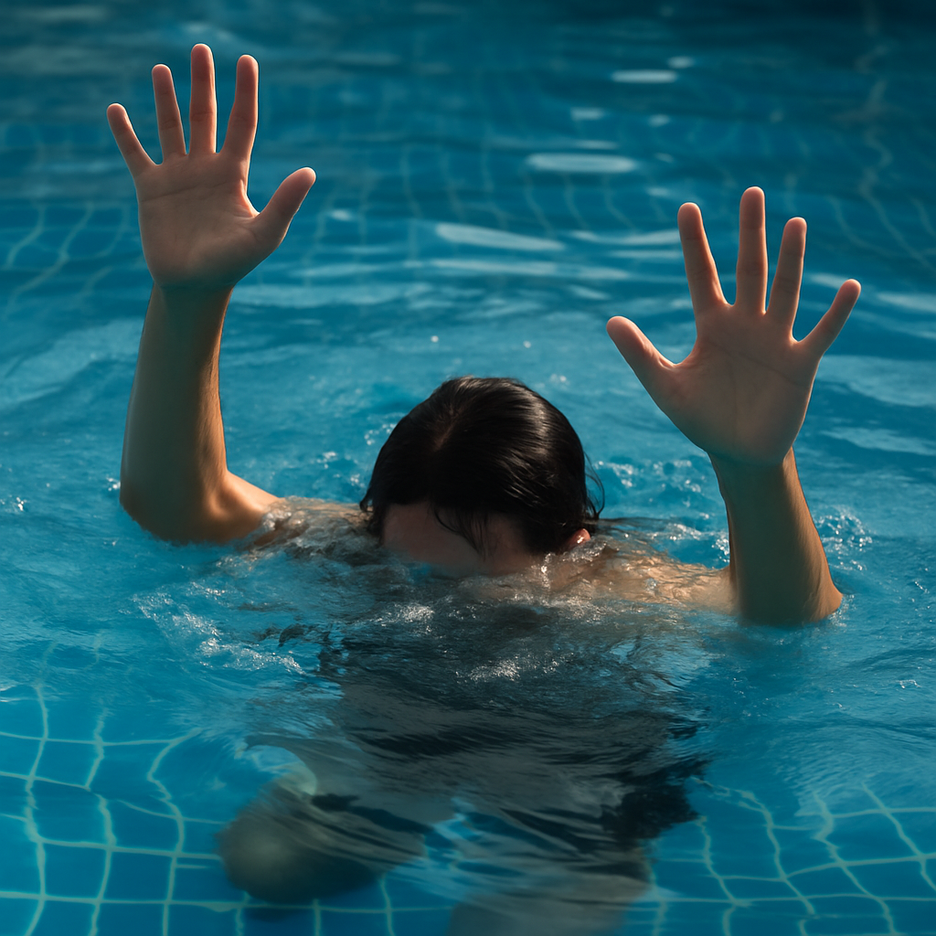

Slide 3
YES
DROWNING IS A SILENT KILLER!

Slide 4
Rick-isim #1
I will not be reading the slides

Slide 5
Drowning is the leading cause of unintentional death in children ages 1 – 4 years old
It’s the second leading cause of death
in children 5 – 14 years old.
(myflfamilies.com)

Slide 6
The best method to protect from drowning is
SUPERVISION

Slide 7
The second best method to protect from drowning is
SWIM LESSONS

Slide 8
YES
SWIM SUIT COLORS REALLY
DO MATTER

Slide 9
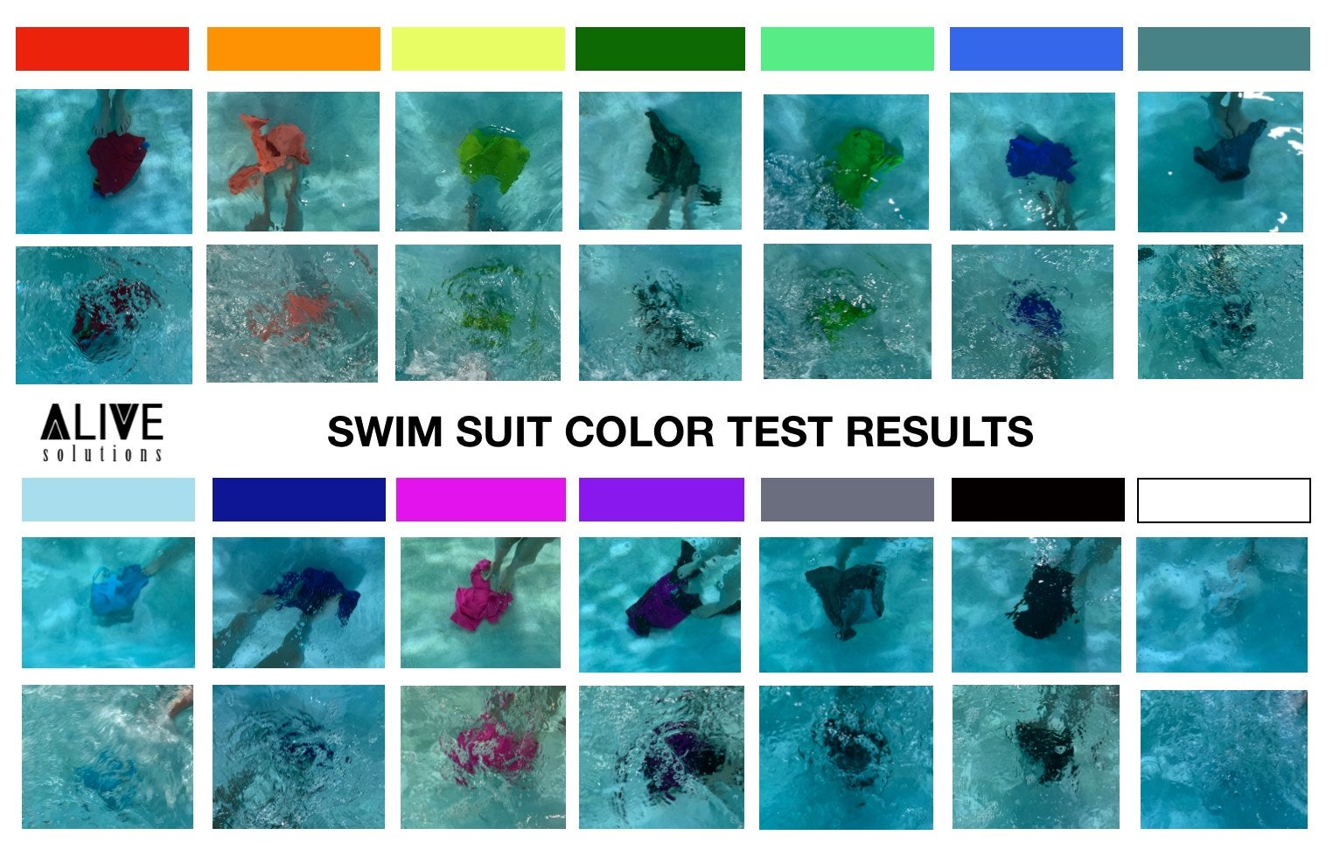
Swimsuit Color Visibility
Brighter colors provide better visibility in water
Dark colors are more visible than lighter colors
White or light colors are difficult to see in water

Slide 10
DID YOU KNOW THAT …
A child’s heart beats, on average, 110 beats per minute
That’s
6,600 beats per hour,
158,400 beats per day,
57,816,000 per year
It all happens without us giving it any thought

Slide 11
LETS DO AN EXPERIMENT
EVERYONE PLEASE STAND

Slide 12
RAISE ONE HAND
OPEN AND CLOSE YOUR HAND 110 TIMES PER MINUTE
DON’T STOP

Slide 13
DID YOU KNOW THAT …
A child’s heart beats, on average, 110 beats per minute
That’s
6,600 beats per hour,
158,400 beats per day,
57,816,000 per year
It all happens without us giving it any thought.

Slide 14
SO HOW DID YOU ALL DO?
DID YOU LOOSE TRACT OF WHERE YOU WERE?
A CHILD’S WORLD IS FILLED WITH AUTOMATIC THINGS AND ADVENTURES.
Just like our hearts beating a child lives in there own world filled with unknown dangers.
WHEN WATER PRESENTS ITSELF TO A CHILD, THEY LOSE ALL AUTOMATIC SENSES AND THOUGHTS OF SAFETY
Ther is one skill that will kick in automatically, yep SWIM LESSONS

Slide 15
    Let’s talk about some good project ideas your club can start to help prevent drownings in your community

Slide 16
Provide information and/or funding for swim lessons
Partner with local swim schools, Red Cross and the YMCA
Institute the State of Florida “WaterSmartFL” program with vouchers for swim lessons to qualifying families

Slide 17
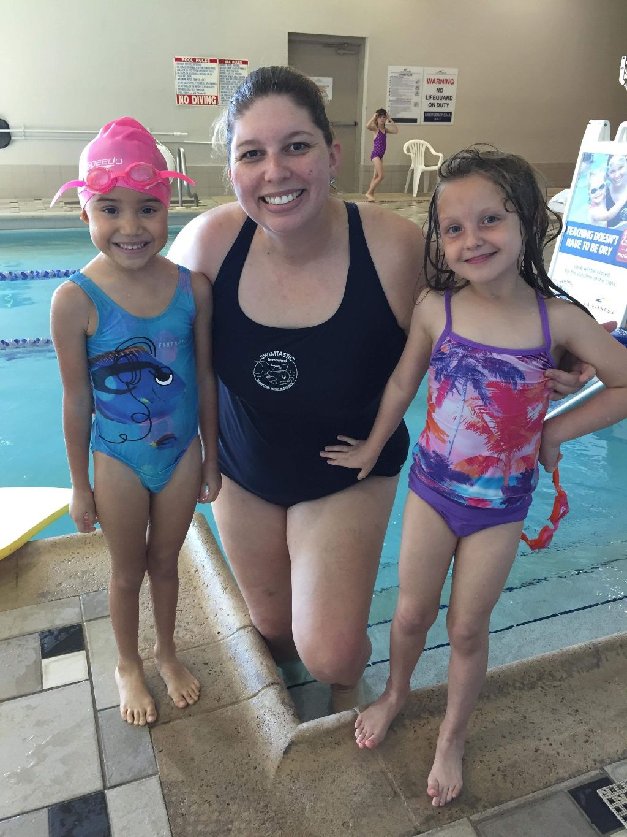
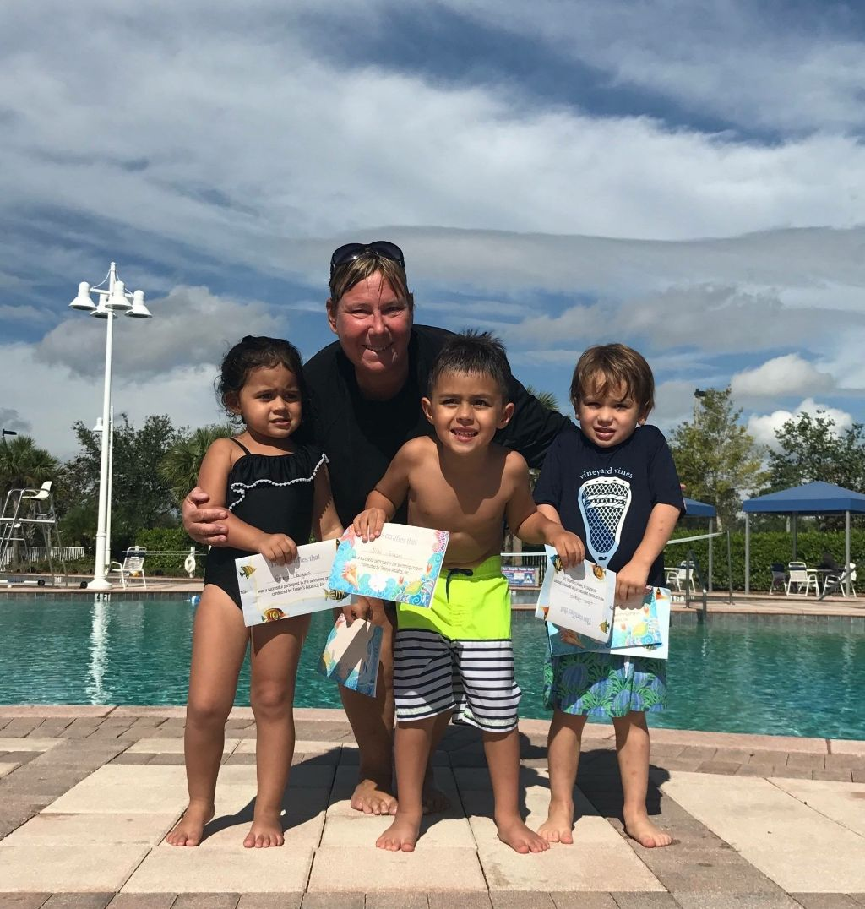

Slide 18
Sponsor and donate Drowning Prevention literature to a little free library in your community
Create your own library book boxes as well

Slide 19
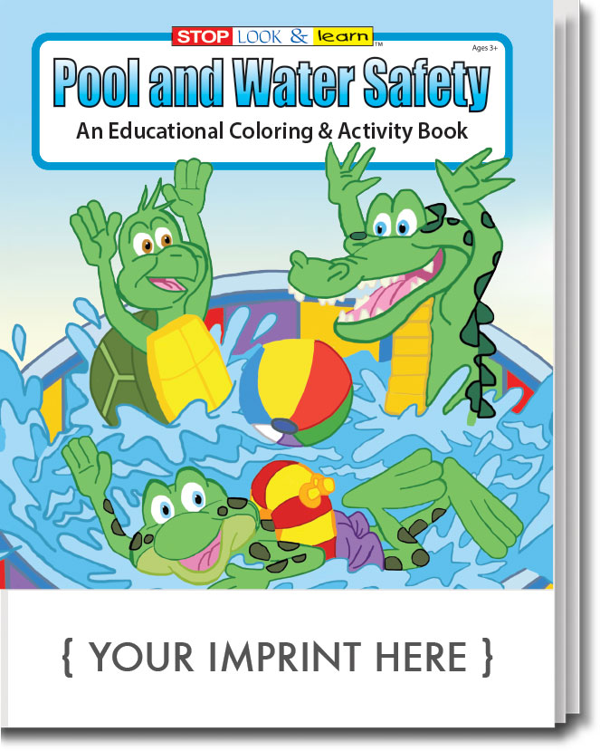

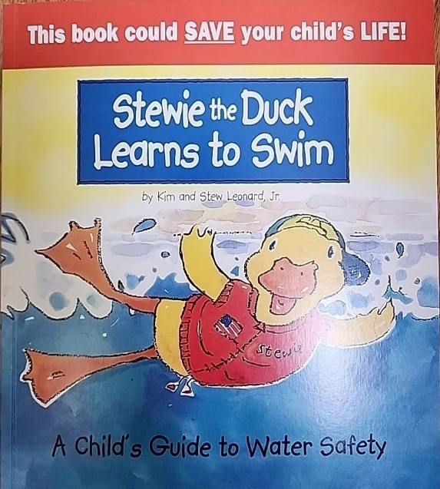

Distribute water safety reading materials to pre- schoolers and elementary school children.

Slide 20
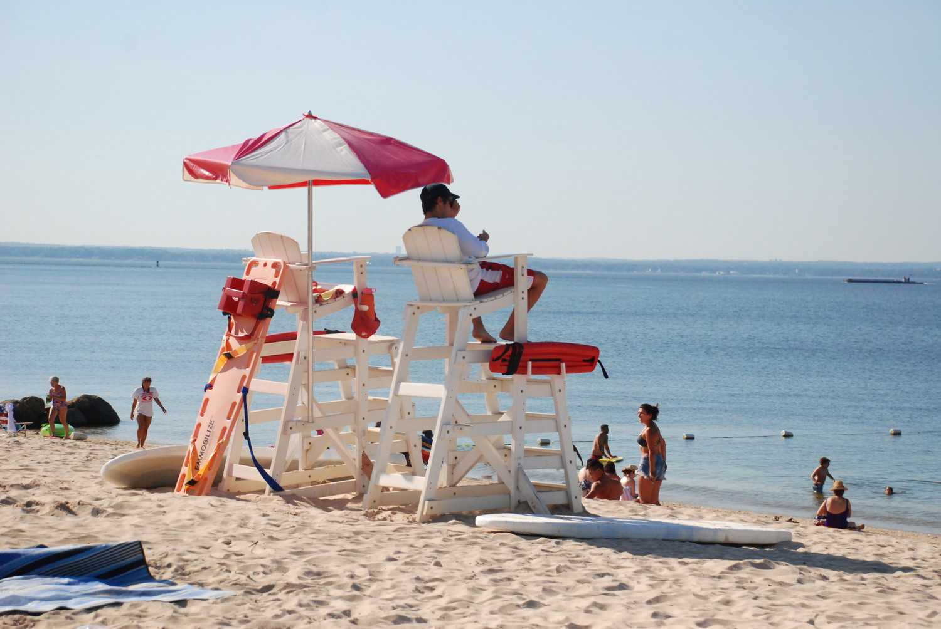
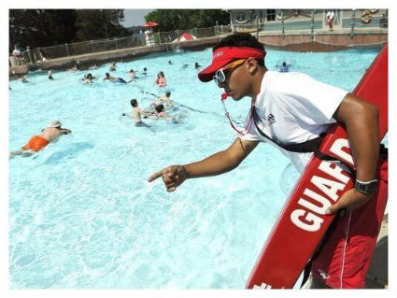
Encourage your key club & cki members to become lifeguards and/or provide scholarships

Slide 21
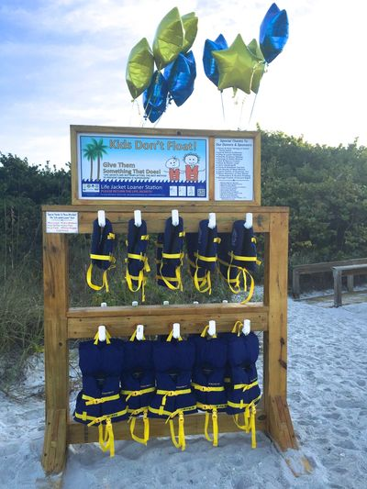
Install and maintain Life jacket loaner stations at a local beach, lake or boat ramps
Coast Guard Approved Required

Slide 22
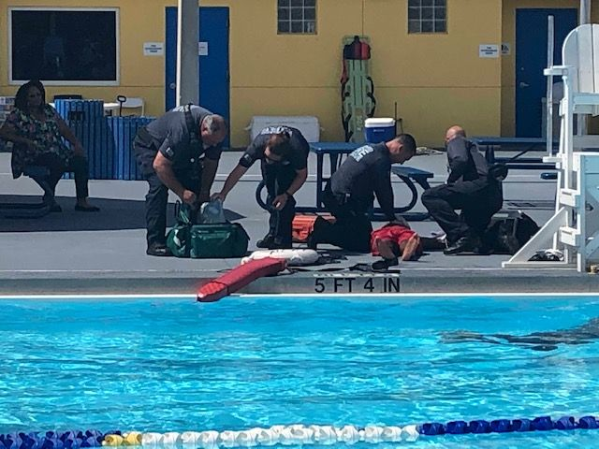
Organize CPR and AED training classes through your local fire department or parks and recreation department and encourage the public to attend
Provide a flyer to the school administration to inform parents of CPR class opportunities

Slide 23
Purchase door alarms and/or water watcher tags
Distribute to your community at locations such as schools, festivals, farmers markets, county fairs and pool decks

Slide 24
Contact local radio, television stations as well as newspapers to provide a
PSA (Public Service Announcement)
on Drowning Prevention with your project details.

Slide 25
Distribute Drowning Prevention Education Flyers to elementary school families
Ask the school administration to distribute the flyer to parents via email.

Slide 26
All Drownings are PREVENTABLE
Supervision is the first and most important of the many safety measures to prevent drownings
Swim lessons are the next most important layer of protection for our young ones.
Life Guards and Swimming in designated areas, Swim suit colors, water watcher tags for party supervision, door alarms, fences, pool covers all add additional layers of safety.

Slide 27
THANK YOU!
Rick Scherer
Rickscherer.kiwanisclermont@gmail.com
Committee Members:
Ava Adams
Rich McMichael

