Slide 1
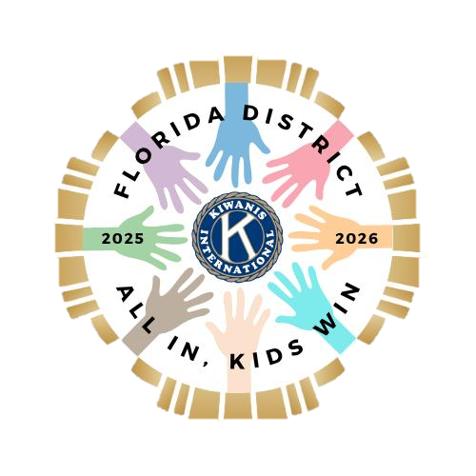
All in for Early Literacy
Governor’s Project
Tommy Mills
FL District Governor
2025-2026

Slide 2
Objectives
At the end of this presentation, audience members will be able to:
Recognize the benefits of early literacy
Recite 1 goal of the 2025-2026 Governor’s Project
Describe one project that can be implemented at the club level to improve early literacy

Slide 3
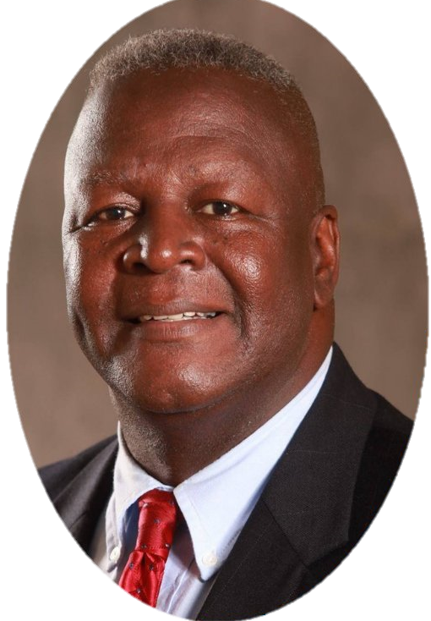
Governor-Elect Tommy Mills
Inspired by a lifelong passion for youth success
Driven by Florida’s literacy gaps in underserved communities
Aligned with Kiwanis mission to serve the children of the world
Designed to allow every club to make a measurable, lasting impact by going “All in”

Slide 4
Why Early Literacy Matters
90% of brain development happens before age 5
Early literacy builds vocabulary, comprehension, and social skills
Children who are read to regularly are more likely to succeed academically
Reading with children strengthens caregiver-child bonds
National Scientific Council on the Developing Child. https://pediatrics.developingchild.harvard.edu/wp-content/uploads/2021/12/Timing_Quality_Early_Experiences-1.pdf
Reach Out & Read. https://reachoutandread.org/

Slide 5
Factors Affecting Literacy
Starting kindergarten without the necessary skills for learning (37%)
Socioeconomic disparaties – 50% starting 1st grade up to 2 years behind peers
Parenteral involvement – children who are read to have stronger literacy skills
Access to resources – poor access to technology
Ferst Readers. https://ferstreaders.org/resources/top-literacy-statistics

Slide 6
Longterm Impact of
Early Literacy
Children who read proficiently by third grade are more likely to graduate high school
Higher literacy rates are linked to higher lifetime earnings
Reduces risk of future unemployment, poverty, incarceration and poor health outcomes
Annie E. Casey Foundation. https://www.aecf.org
National Bureau of Economic Research. https://www.nber.org

Slide 7
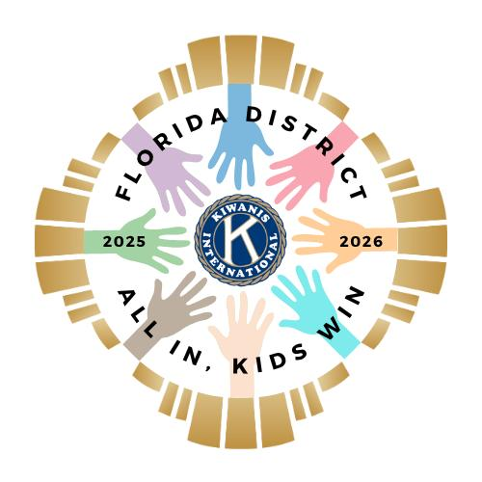
Governor’s Project
2025-2026
All In for Early Literacy
Empowering Florida’s children ages 0 to 5 through reading

Slide 8
Goals 2025-2026
Expand Access to Early Literacy Resources – Increase availability of age-appropriate books and literacy materials, especially in underserved communities.
Empower Parents and caregivers as first teachers – Equip families with tools and knowledge to support language development at home.
Elevate public awareness of the importance of early literacy – Highlight the critical role early reading plays in long-term academic success.

Slide 9
Objectives 2025-2026
Objective 1: Put 10,000 Books in Little Hands
Distribute at least 10,000 books to children ages 0 to 5 in the district during the club year
  Organize new and gently used book collection drives.
  Partner with local businesses and authors to sponsor book donations.
  Partner with local preschools, Head Start programs, WIC centers, food banks, clinics, and shelters and pediatric offices for book distributions.
  Host monthly reading and book giveaway events in parks, libraries, or churches.
  Partner with Key Clubs and Circle K members to participate as reading volunteers.

Slide 10
Objectives 2025-2026
Objective 2: Install 50 Little Libraries in 50 Weeks
Establish 50 “Kiwanis Little Libraries” across the district
Build, install, and maintain free-standing book boxes in underserved neighborhoods.
Clubs “adopt” a little library to refill monthly with children’s books.
Partner with builders, scouts, or students to design and decorate.
https://littlefreelibrary.org/

Slide 11
Who is already doing this?
Last year, several Clubs submitted Signature Project contributing to Early Literacy
  Big Lagoon-Pensacola
  Siesta Key
  Titusville
  Winter Haven

Slide 12

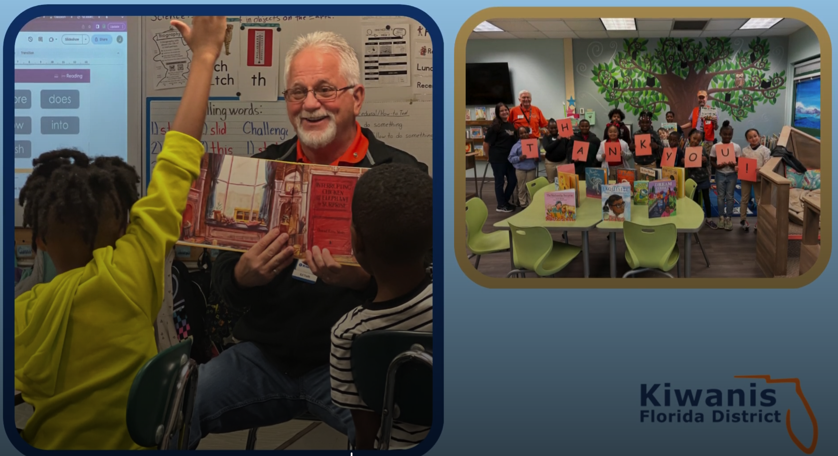

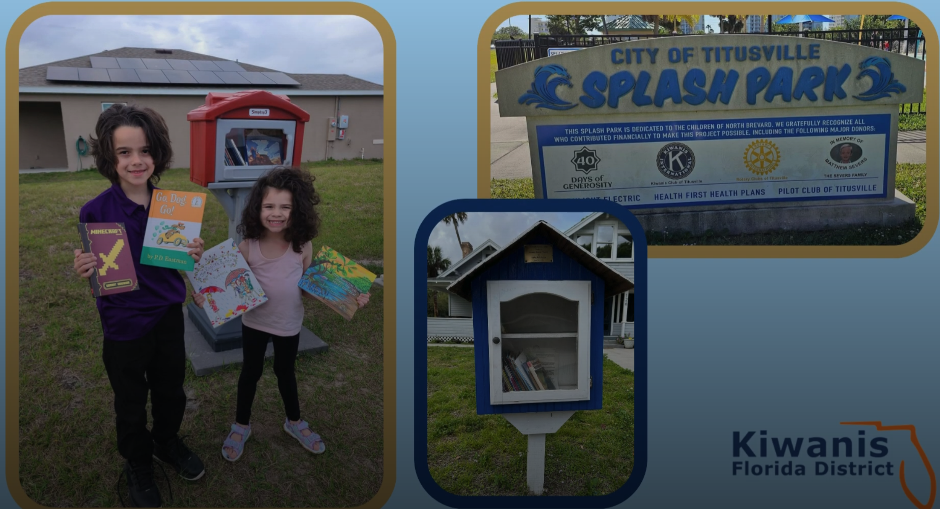
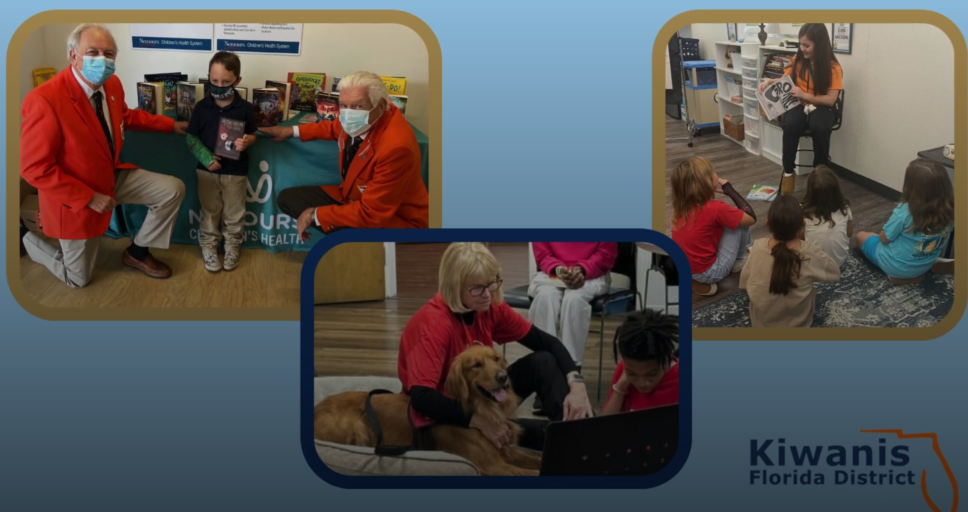

Slide 13


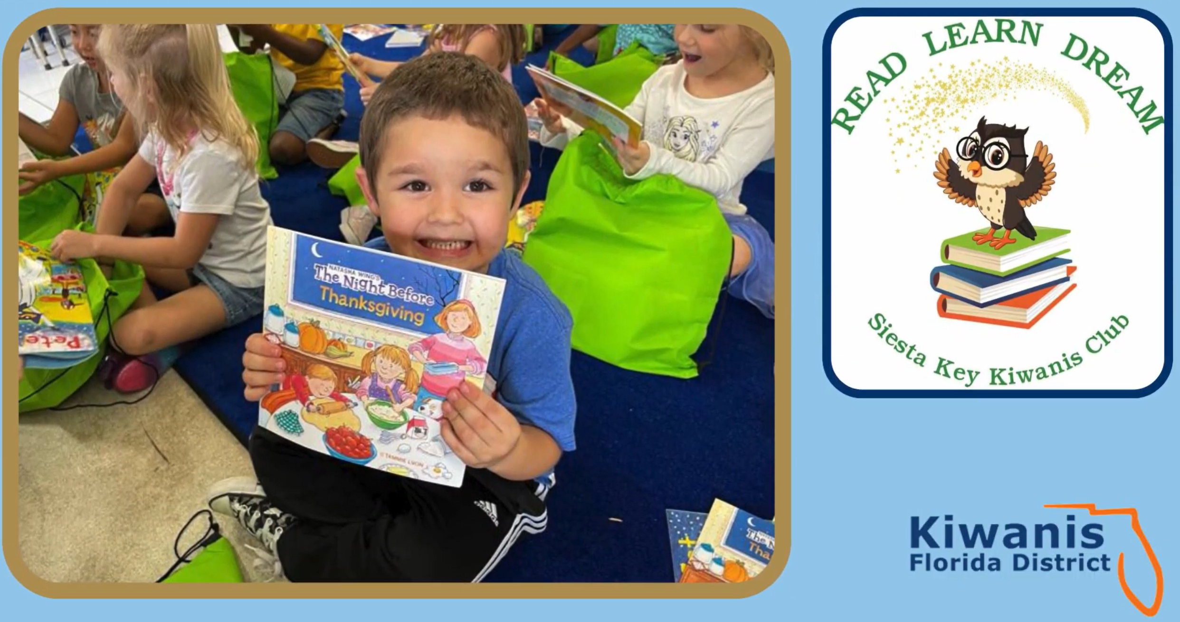
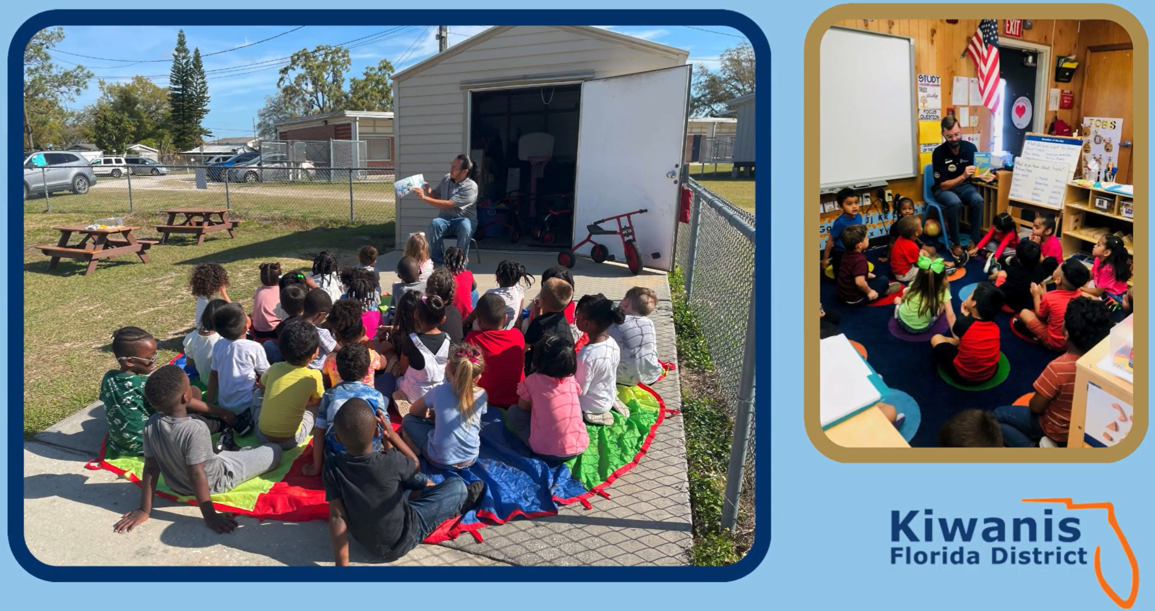


Slide 14
Reporting:
How will they know?
To be released at Kiwanis New Year

Slide 15
Next Steps - Today
Follow Florida Kiwanis Sites for Updates
  Facebook: https://www.facebook.com/floridakiwanis
  Instagram: https://www.instagram.com/florida_kiwanis/

Slide 16
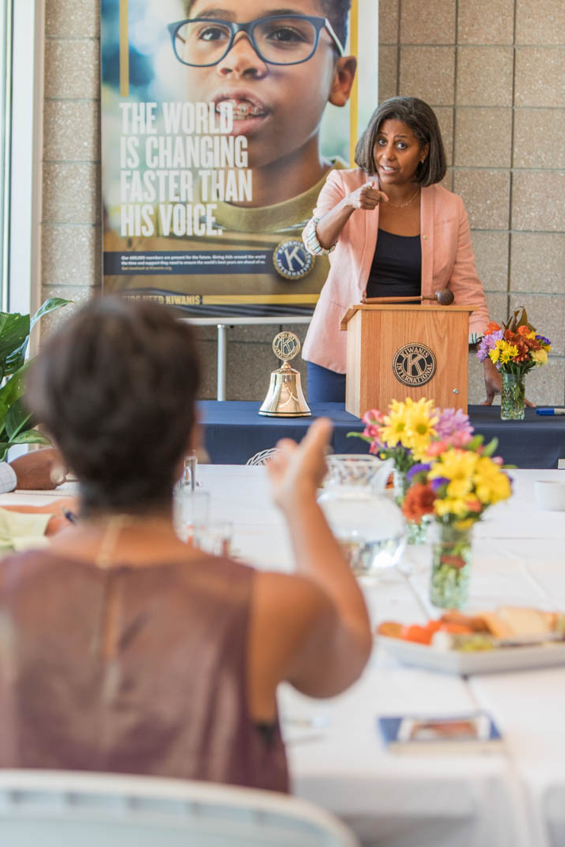
Next Steps
Take the Governor’s Project and Goals to your club.
Contact local literacy coalitions to research local needs.
Invite literacy coalitions and organizations to your club to talk.
Set a goal: Pick at least one project to execute this year.
Consider Mini-Grants for funds
Complete project report to help us measure the success

Slide 17
All in for Early Literacy
Governor’s Project
Questions
Tommy Mills
FL District Governor
2025-2026
Project Chairs: Delvin and Day Scott
Email: KiwanisGovProject.FL@gmail.com
Committee Interest? Send an email.

