Slide 1



D. Keith Hatch
Florida District of Kiwanis
Treasurer (2025-26)

Slide 2

Agenda
About d. Keith hatch
His Story
Key Achievements
2025-26 treasurer focus
Mission & philosophy
New Initiatives
Goals
Closing
Summary
Questions and Answers

Slide 3
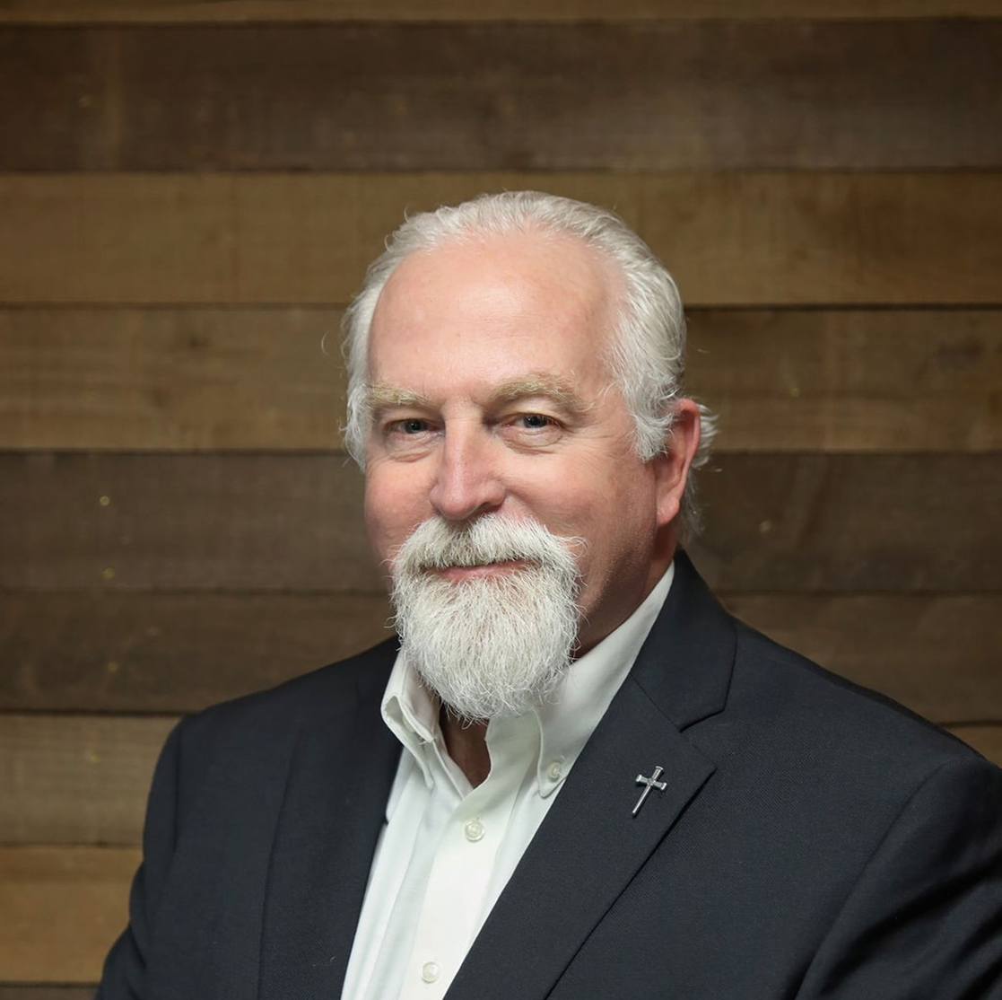
His story
Origins
From Virginia (Lived in Richmond, Chester, and VA Beach/Chesapeake)
Moved to Florida in 2008 due to a career change
FAMILY
Married to Patricia Hatch (Past Lt. Governor for Division 4)
Three children Jessica, William and Samantha
Education & career
Graduated from Virginia Commonwealth University (Richmond, VA) – Accounting and Finance Major
Attended Southeastern Baptist Theological Seminary (Wake Forest, NC)
Worked in Public Accounting, and Health Care (Retired from corporate in January 2025) held positions of Partner of Compliance and Tax, and Director of Risk Management
BUSINESS OWNER OR SHAREHOLDER
D. Keith Hatch PA (Hatch Accounting Tax and Business Broker Services) – Retirement Career
Hatch Realty Service (Shareholder)
Pangborn Ice Cream (Shareholder)

Slide 4
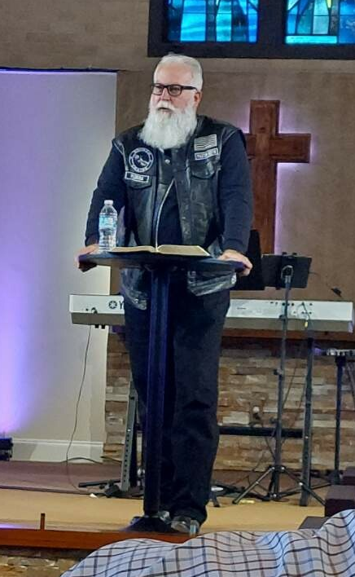


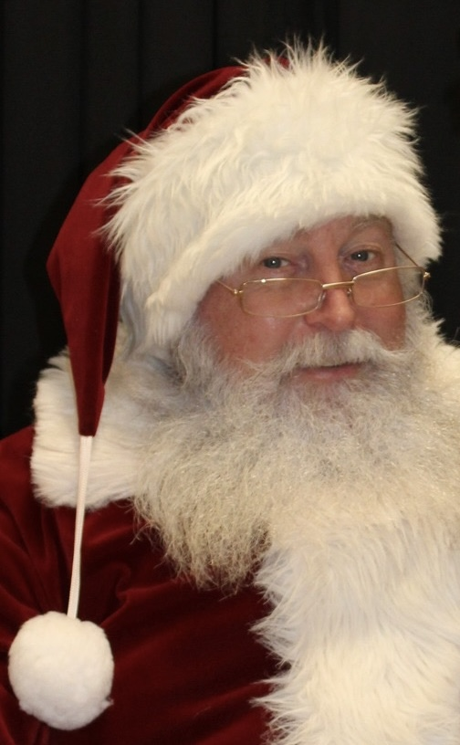

achievements & activities
Professional (Certifications or Licenses) -
  Passed the Certified Public Accountant (CPA) exam 1991 retained license until 2017 (voluntary)
  Florida Real Estate or Transaction Broker – 2021 (Active)
Civic Achievements
  CLAUS Mission - established in 2019 and adopted by the Lake Region Kiwanis Club in 2022.
  Junior Chamber of Commerce (Jaycees) – Awarded the Sidney D. Peck Award for being a Top Ten Outstanding Chapter President in 1990-91
ministry activities
  Ordained to preach the Gospel
  Ride with Broken Chains JC
  Personal Achievement
  Bowled a PERFECT game (300) July 5, 2025

Slide 5
2025-26 Treasurer focus
Mission & philosophy
Mission
To establish financial stability through an efficient and effective accounting and bookkeeping process and reporting platform that supports the Florida District Kiwanis Mission of “changing communities one child at a time”.
Philosophy
Financial stability is more than just having money; it's about establishing a framework that provides peace of mind, promotes growth, and enables the organization to execute the Kiwanis mission with confidence.

Slide 6
2025-26 Treasurer focus
Accounting & bookkeeping
Transition from QuickBooks Desktop to QuickBooks Online
Standardized Chart of Accounts across Service Level Programs (SLP)
Automated Accounts Payable (Voucher) Approval and Payment Process
Establish a dynamic and flexible reporting system and methodology
Financial position
Finish 2025-26 year with a positive District budget variance of 1 to 2 percent ($3,000 to $7,000)
New Initiatives & Goals

Slide 7
Closing
summary
We are positioning our accounting and bookkeeping process to reduce administrative and reporting concerns, allowing the District to focus on the who will make a difference to our future, our CHILDREN.
The question that will need to be answered for every voucher submitted, “How does this expenditure further the Kiwanis mission and benefit the children or our community?”

Slide 8
Questions and maybe Answers
What do you want to know about me or the treasurer’s 2025-26 focus, that I did not answer?

Slide 9
Thank you for allowing me to serve with you!
d. Keith Hatch
Florida District of Kiwanis
Treasurer (2025-26)

