Slide 1
How to Build a Kiwanis Club Website?
By: Jose Mendez and Lindsey Lenhart

Slide 2
How to get a Website?
Go to this website: https://www.kiwanis.org/members/branding-marketing/kiwanis-club-website/
Fill out this interest form:
https://forms.microsoft.com/Pages/ResponsePage.aspx?id=lVEeTcE5J0imcaJuTXADDzsgqfHPEzNNuULdLfsH2aVUNks1OVYySUJTTEFLSzYzOTIzSjA0QVdFTCQlQCN0PWcu
They will then email you the information for your website.
Kiwanis has training modules if you have any questions: https://wiki.site.kiwanis.org/
Kiwanis will also inform you of people in the District who are certified to assist in website building if you need extra assistance

Slide 3
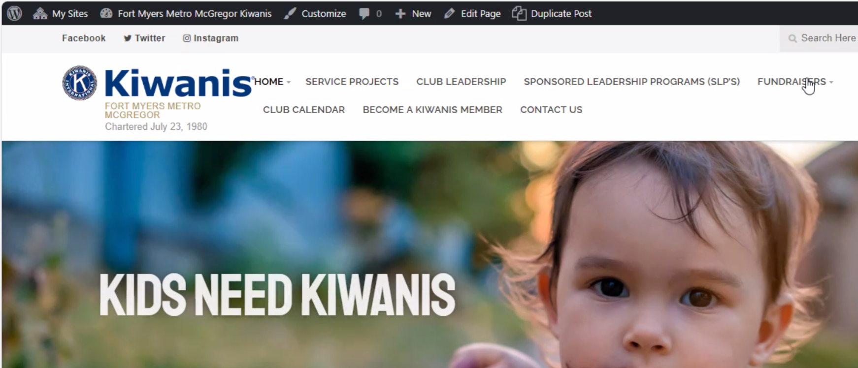
What an Editors Home page looks like?

Slide 4
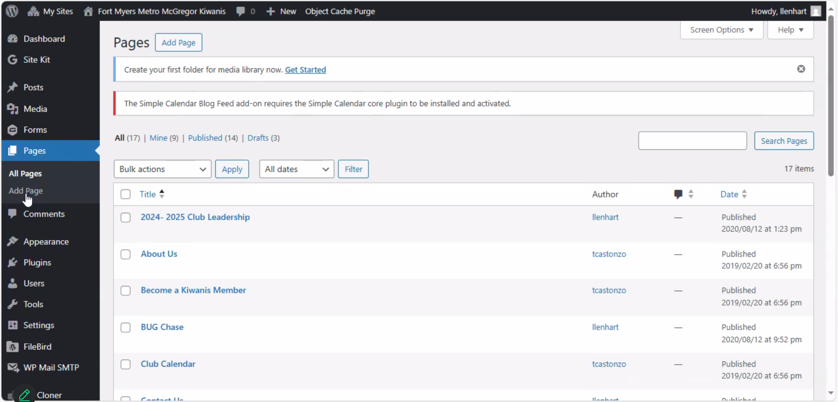
How to create Pages?

Slide 5
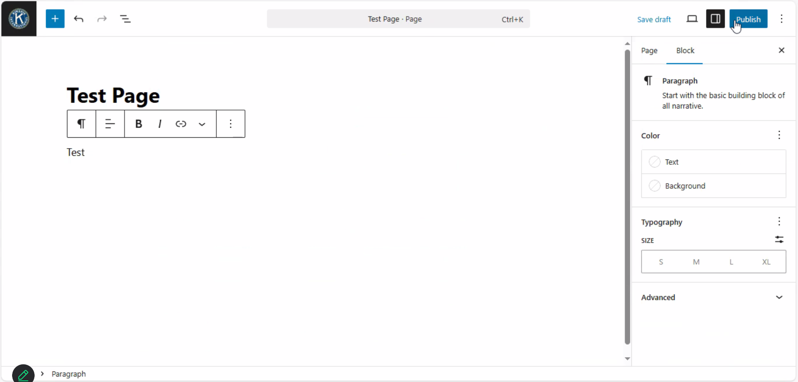
Once you create a Page you can add whatever you want!

Slide 6
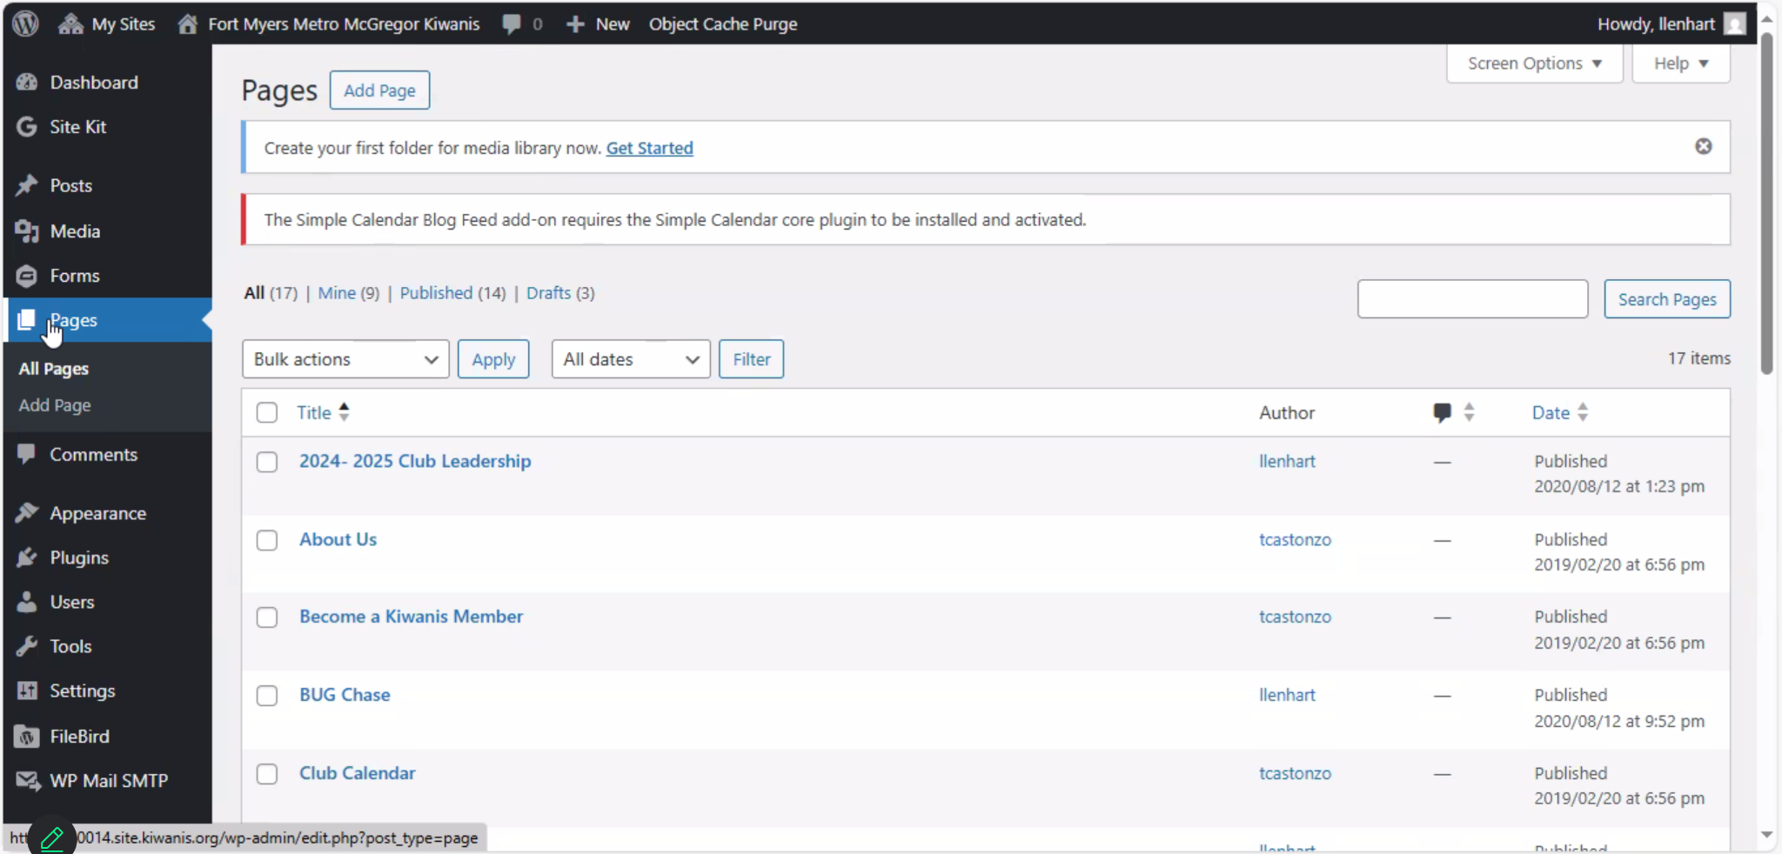
How to Edit Pages?
Click the small WordPress symbol at the top left corner

Slide 7
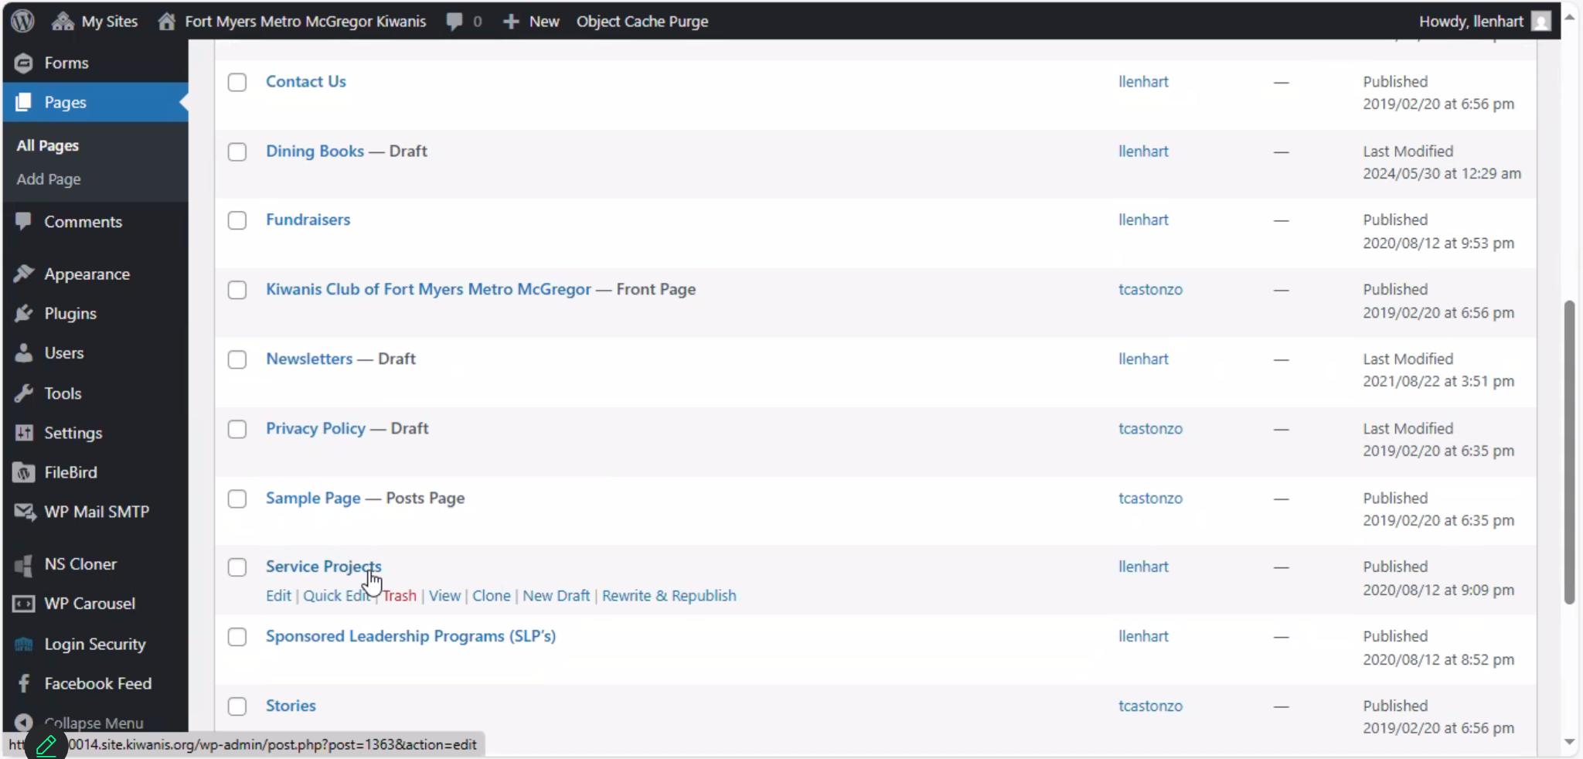
How to work on a Specific Page?
Hover over a page that already exists and click edit

Slide 8
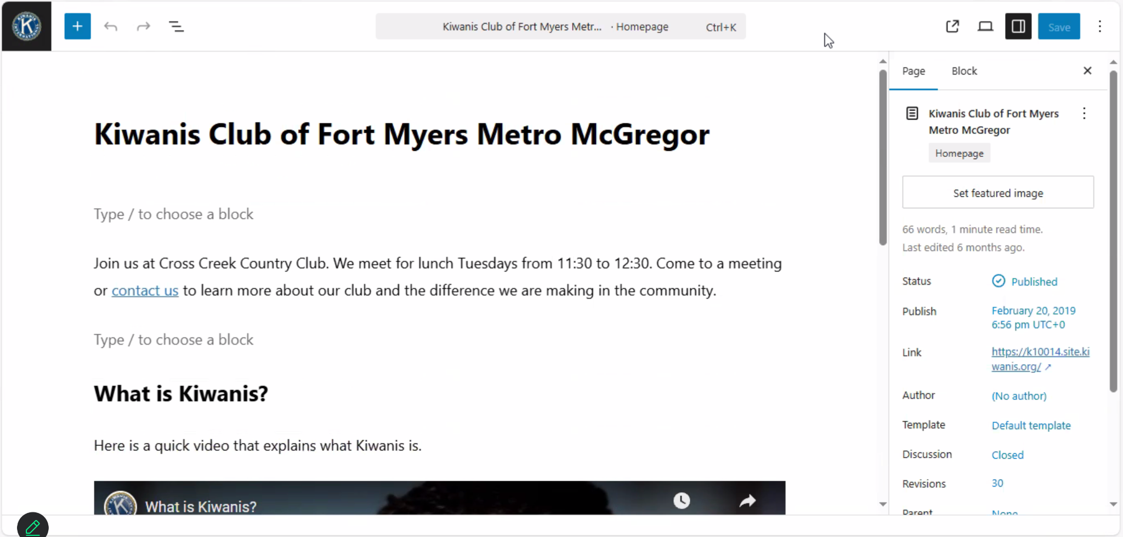
How to edit a Page?
Once you click on editing you can add text blocks, edit them, or add pictures

Slide 9
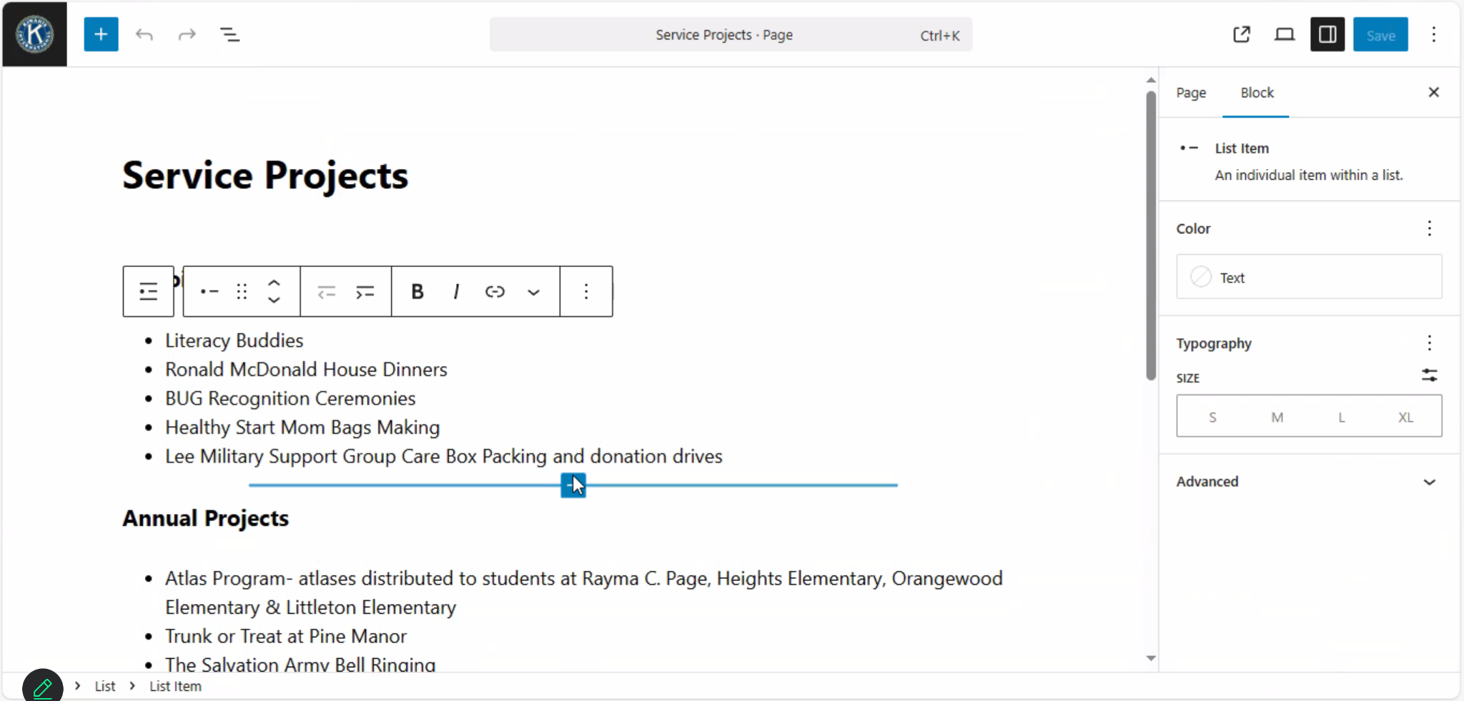
Editing Word Blocks

Slide 10
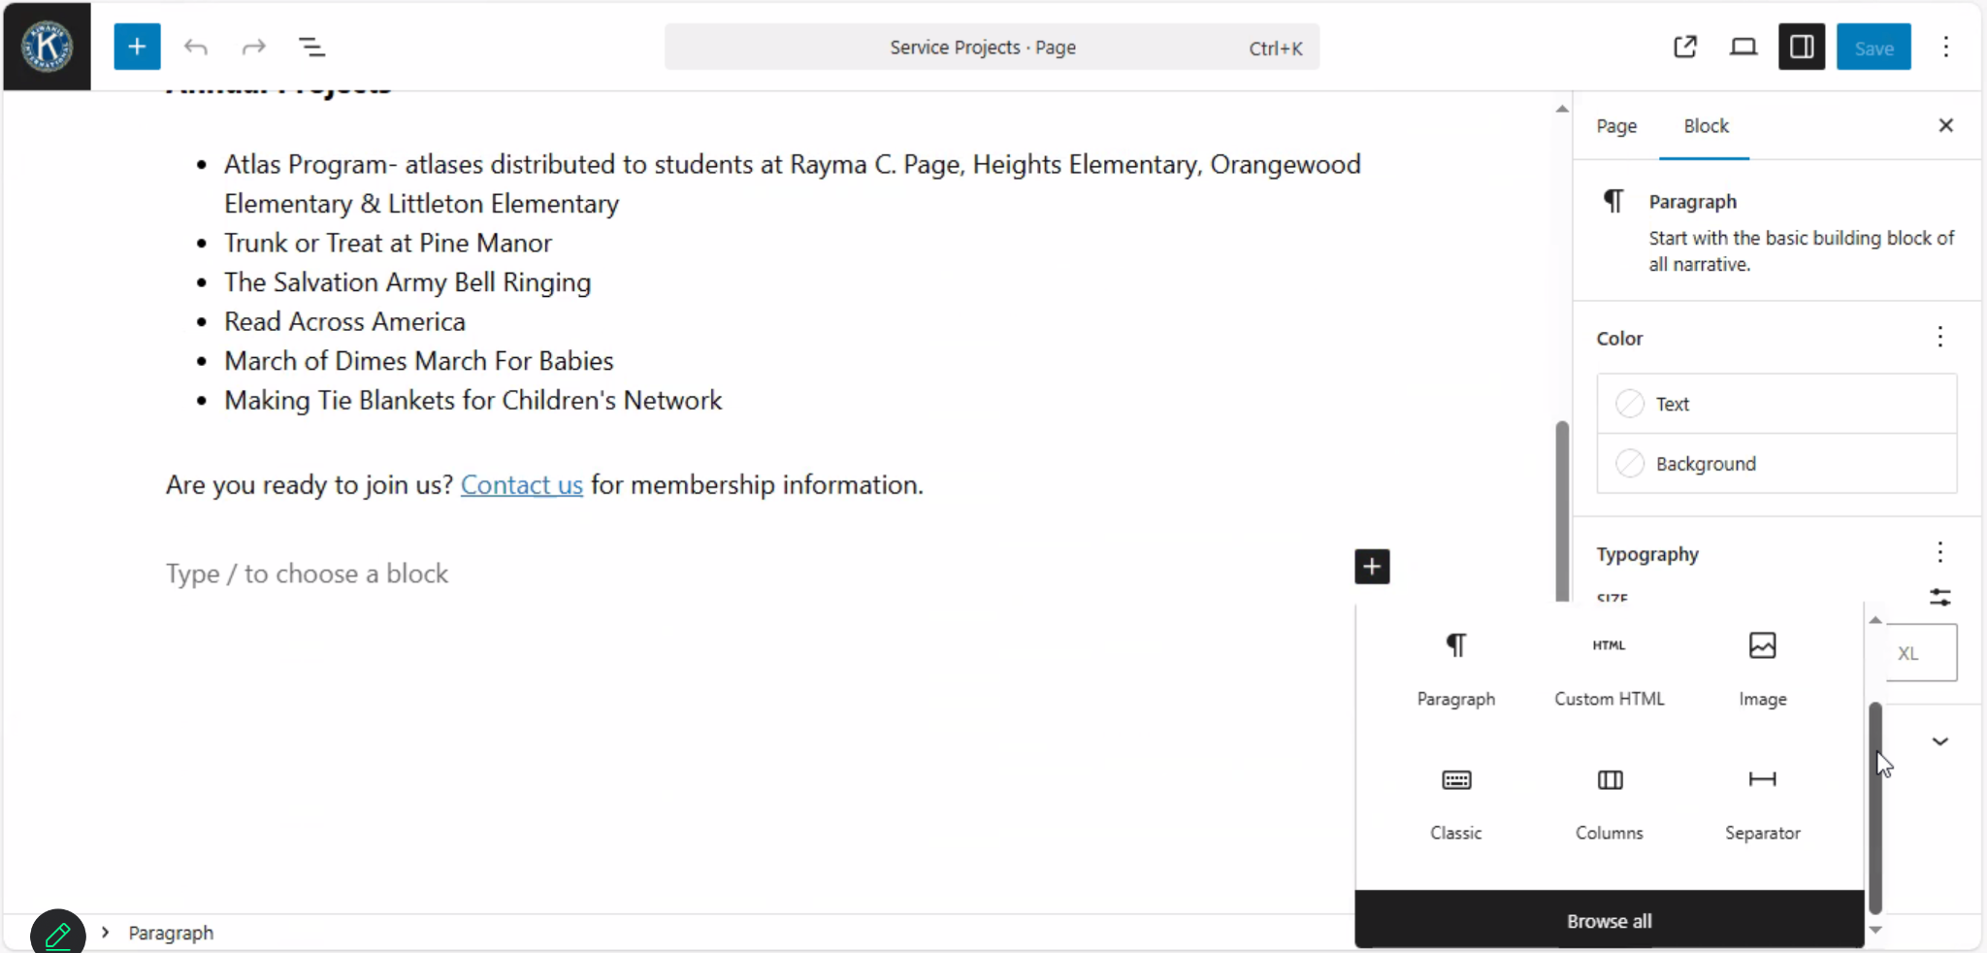
You can even add Images!

Slide 11
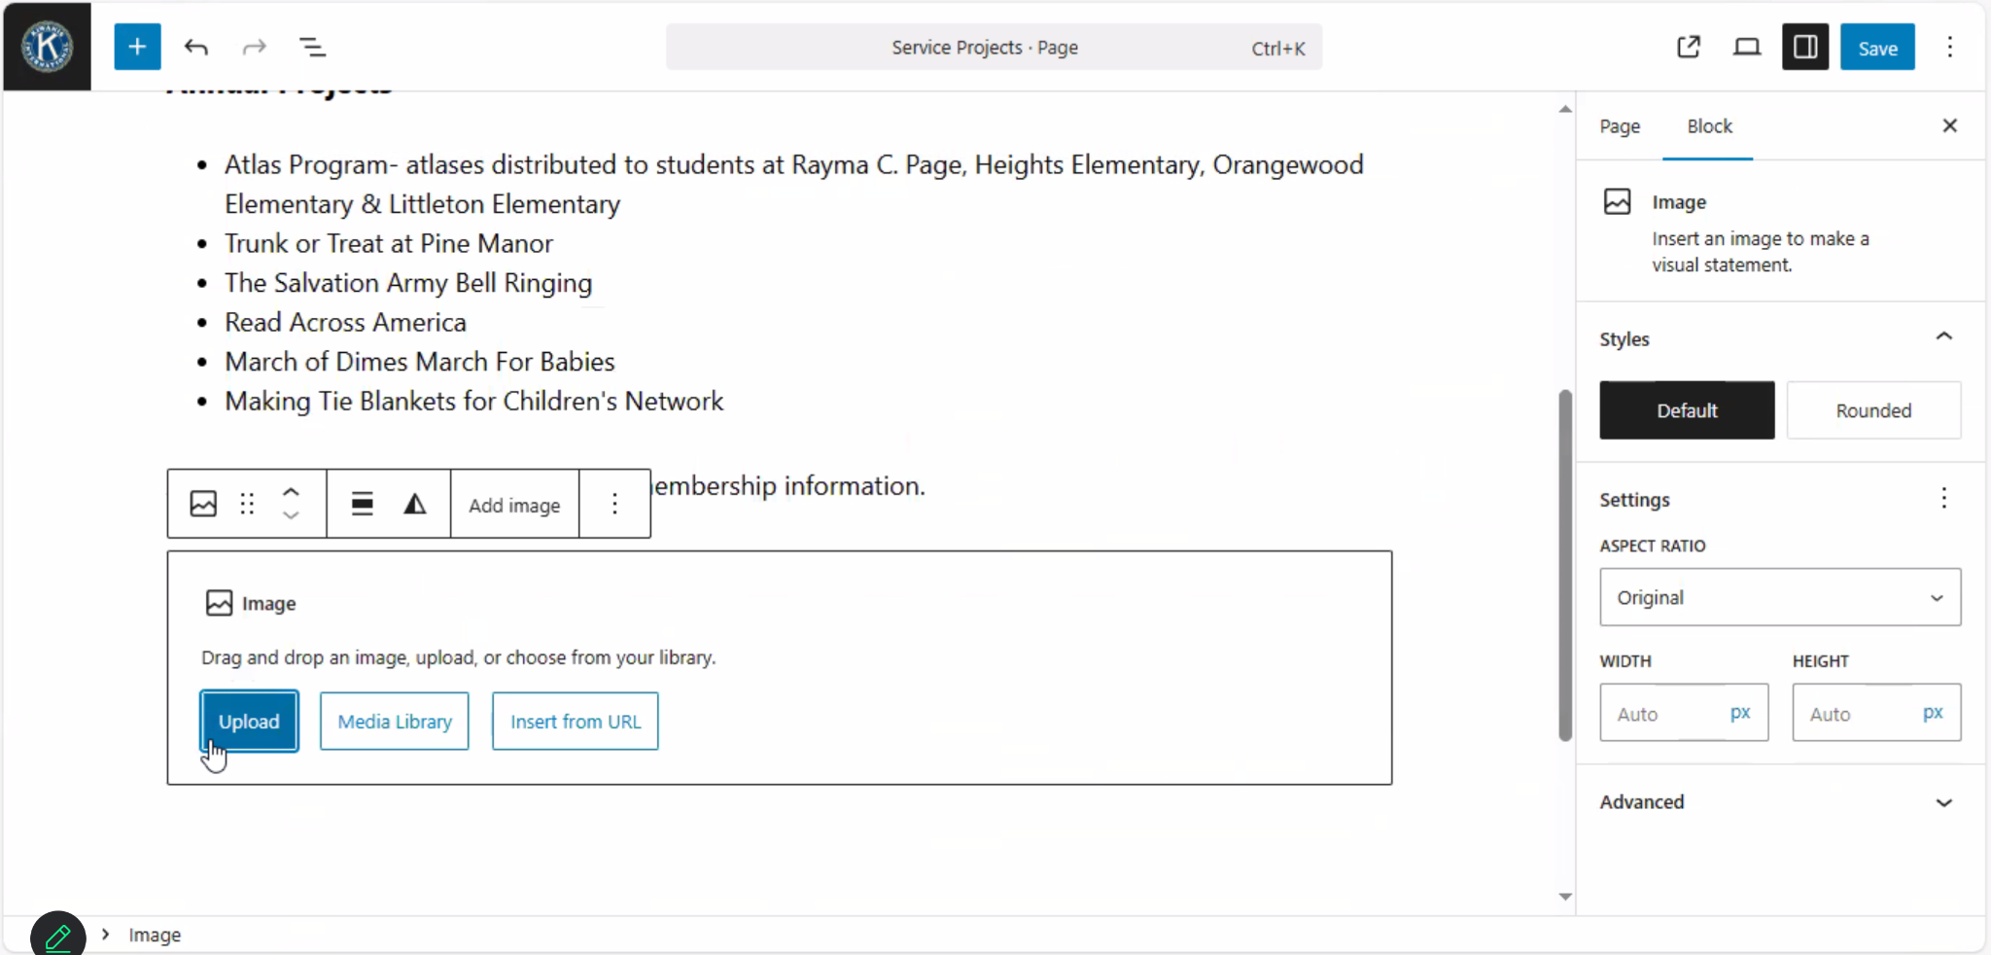
Add Images!

Slide 12
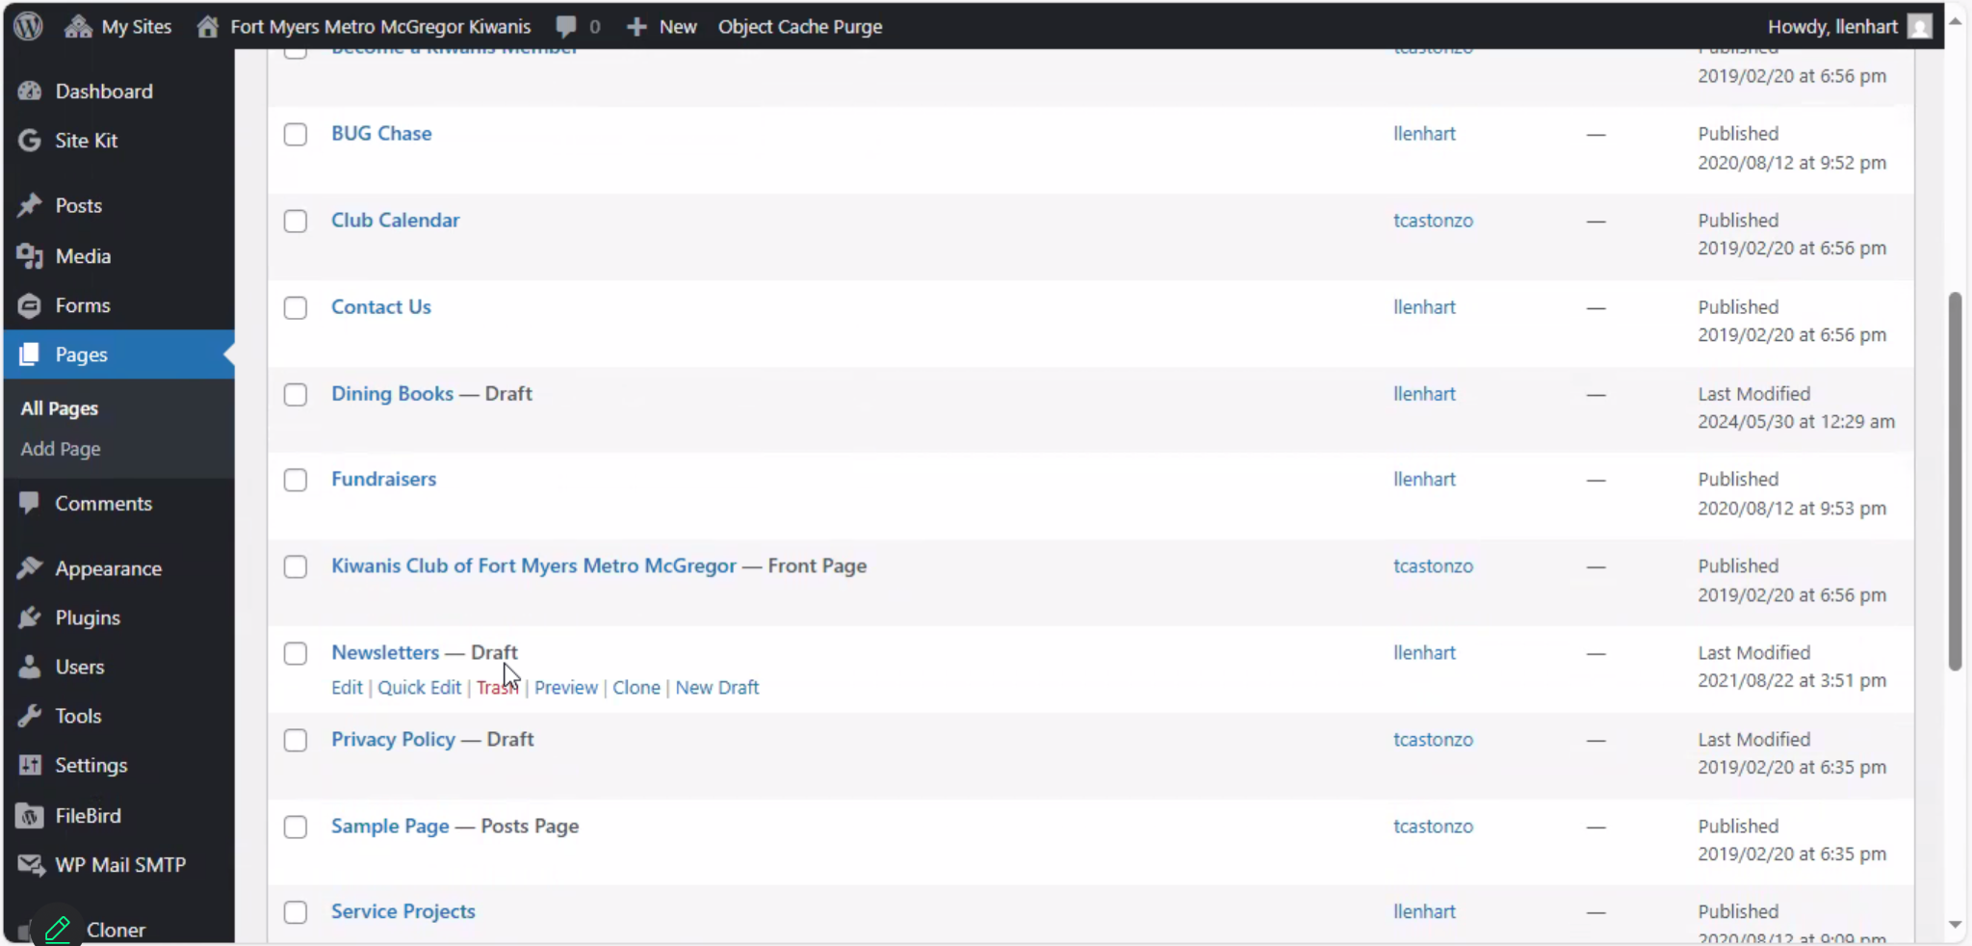
Once you create a page you can save it as a draft!
Until you publish it, it cannot be seen by the public

Slide 13
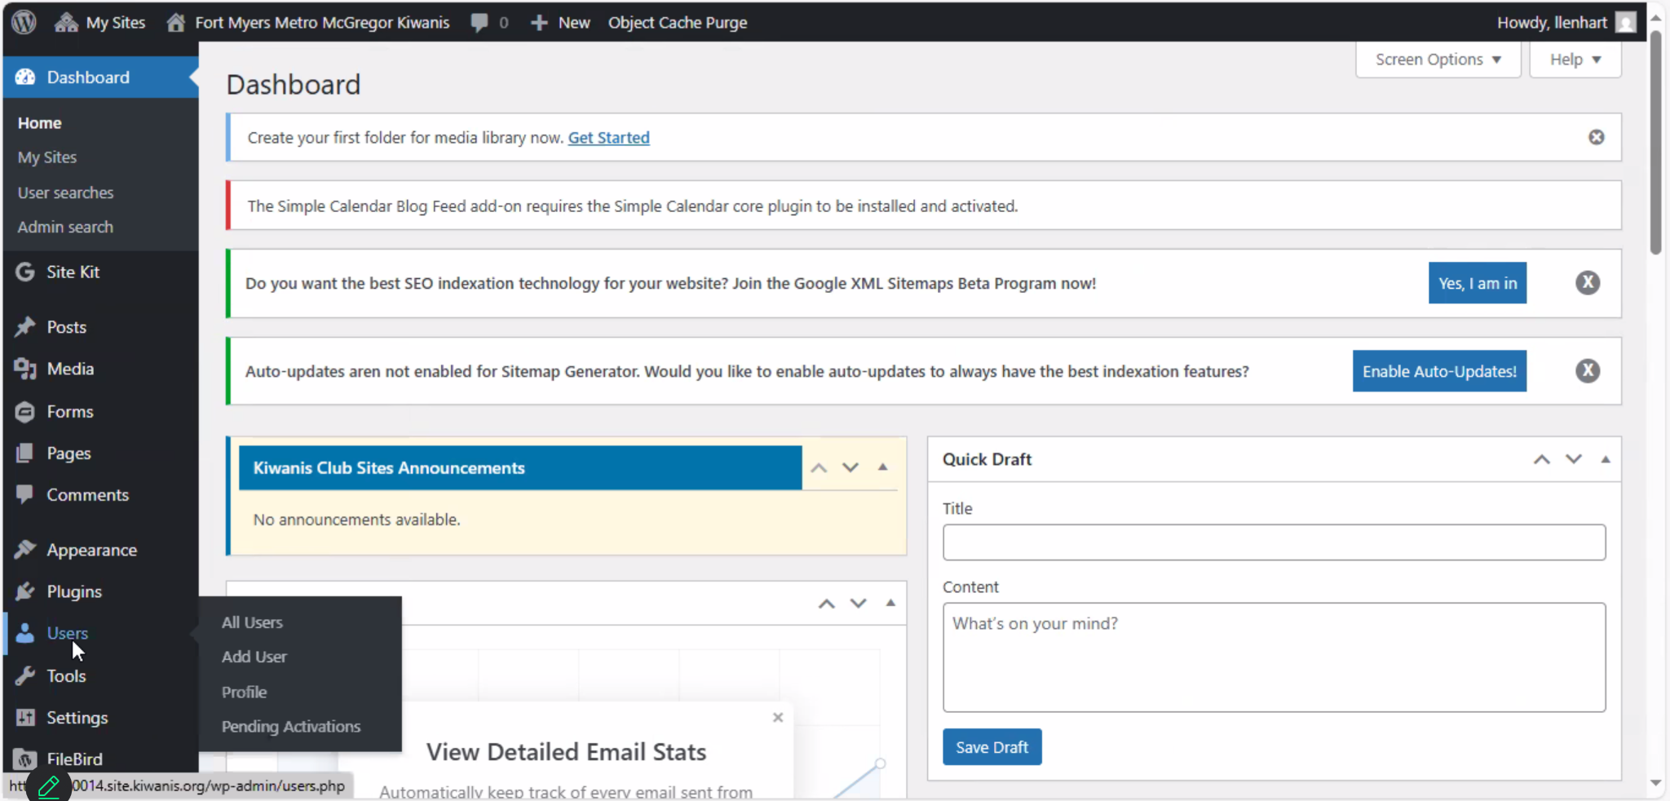
You can have other people edit as well!
Simply add them as a user!

Slide 14
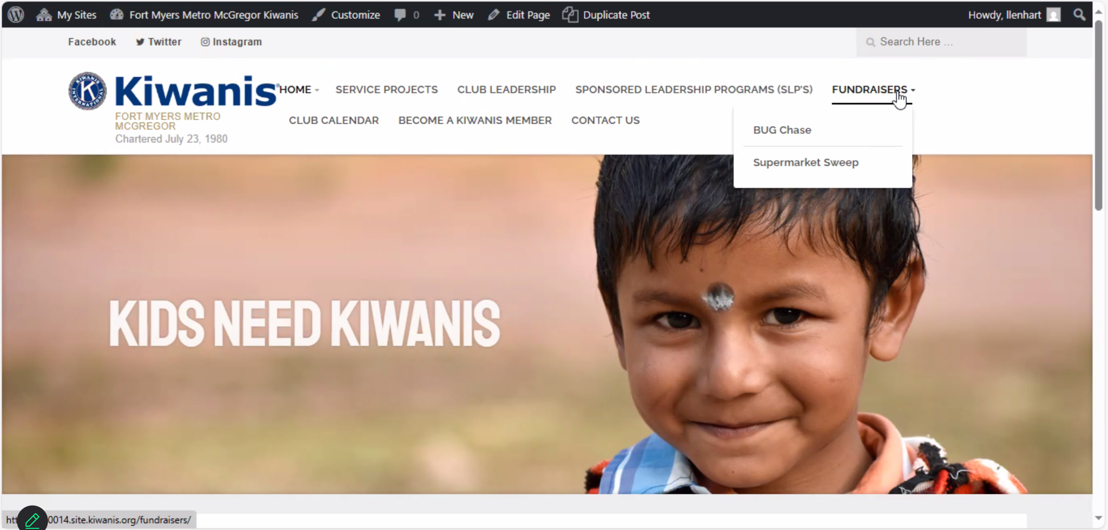
How to edit the home page?

Slide 15
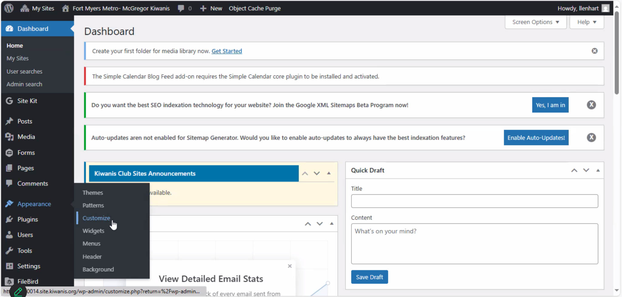
Go back to the main edit page
Click on appearances and customize

Slide 16
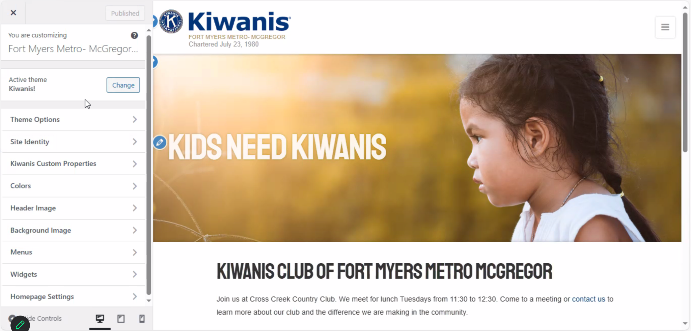
Once there you have different options

Slide 17
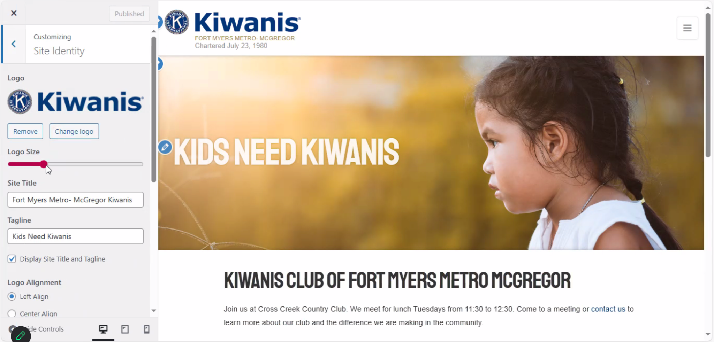
You can change the logo size and club name

Slide 18
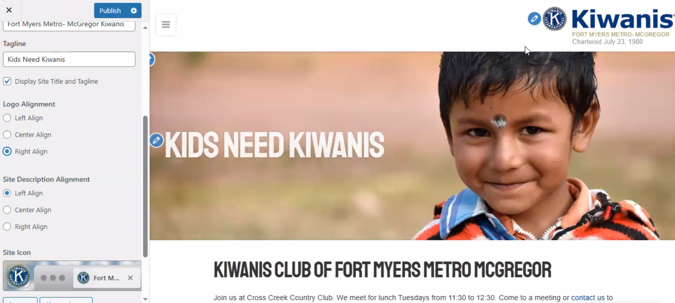
You can change the alignment of things

Slide 19
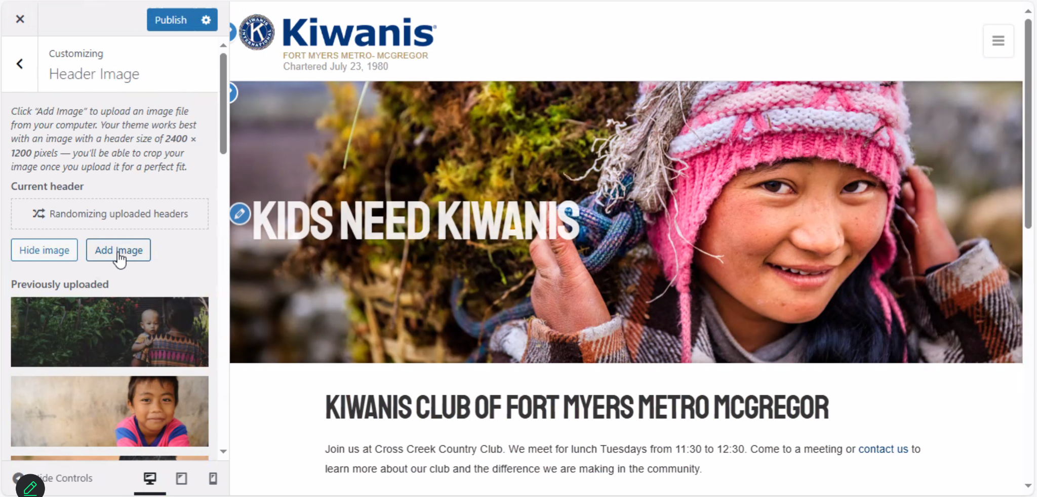
You can change the images!

Slide 20
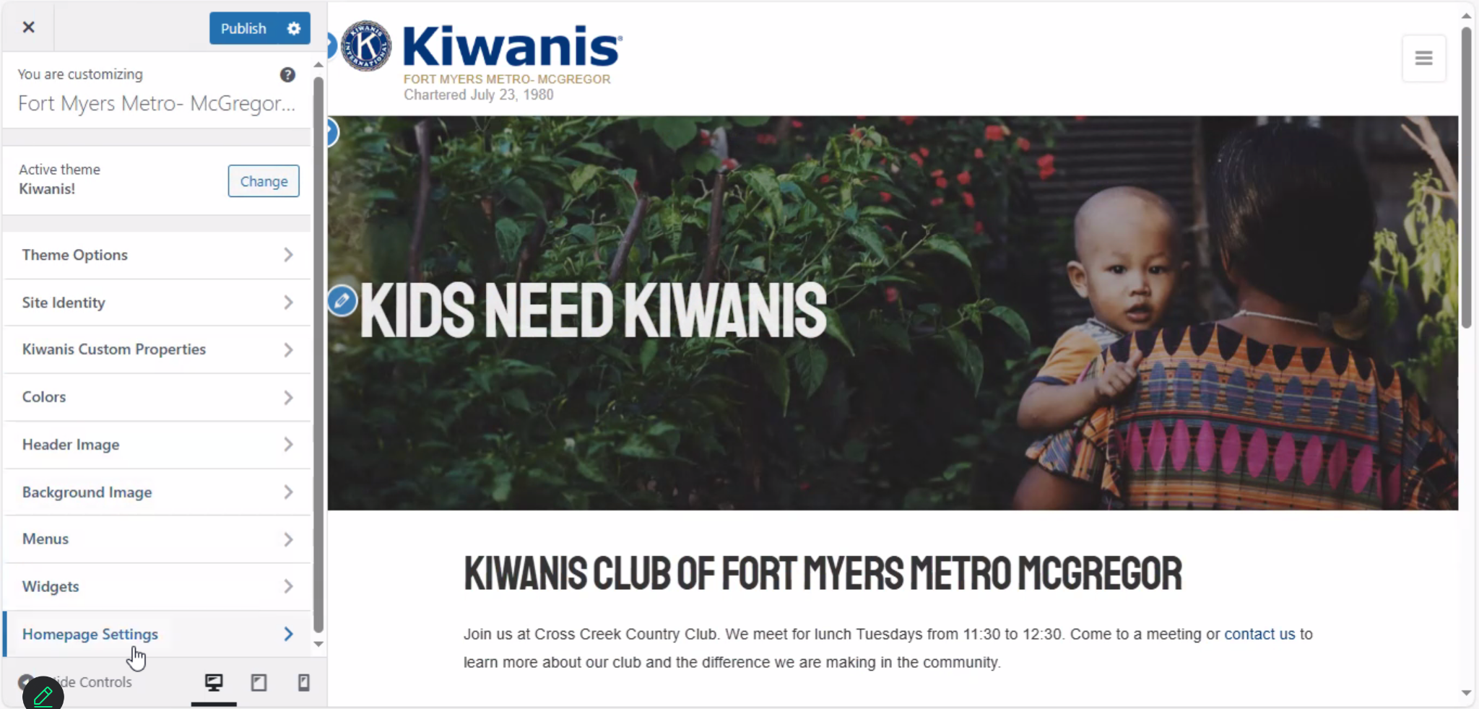
You can also change what is your home page

Slide 21
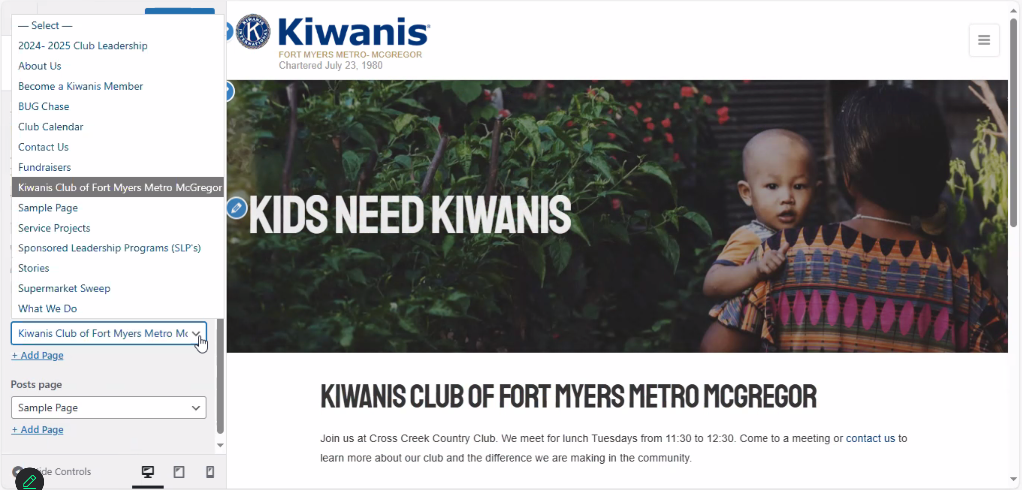
You would choose which page from the list

Slide 22
You can also edit what pages are shown on your main page

Slide 23
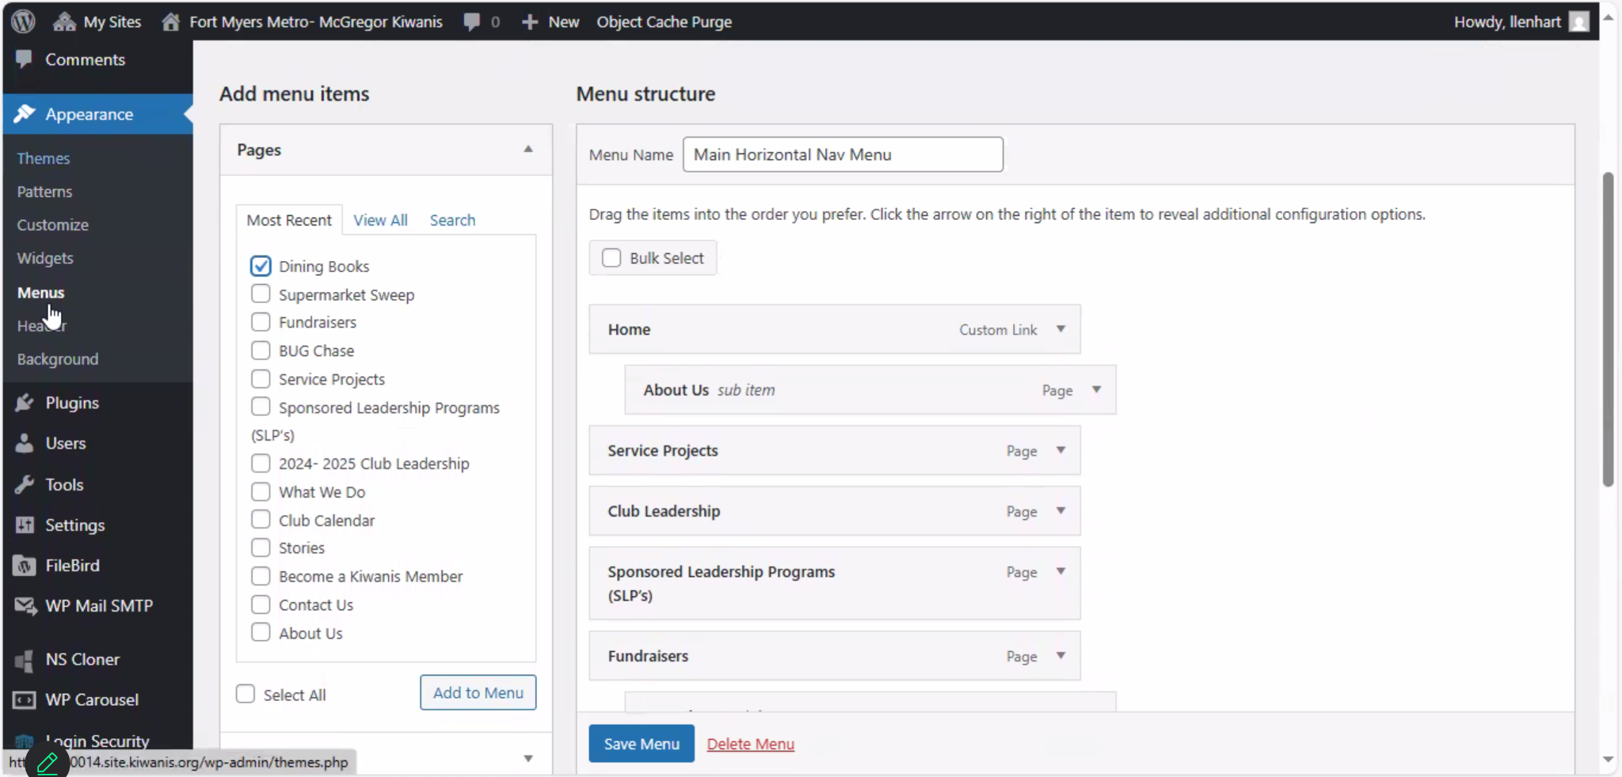
To edit banners go back to the main edit page
Click on Menus and then you can decide what is on the banner page

Slide 24
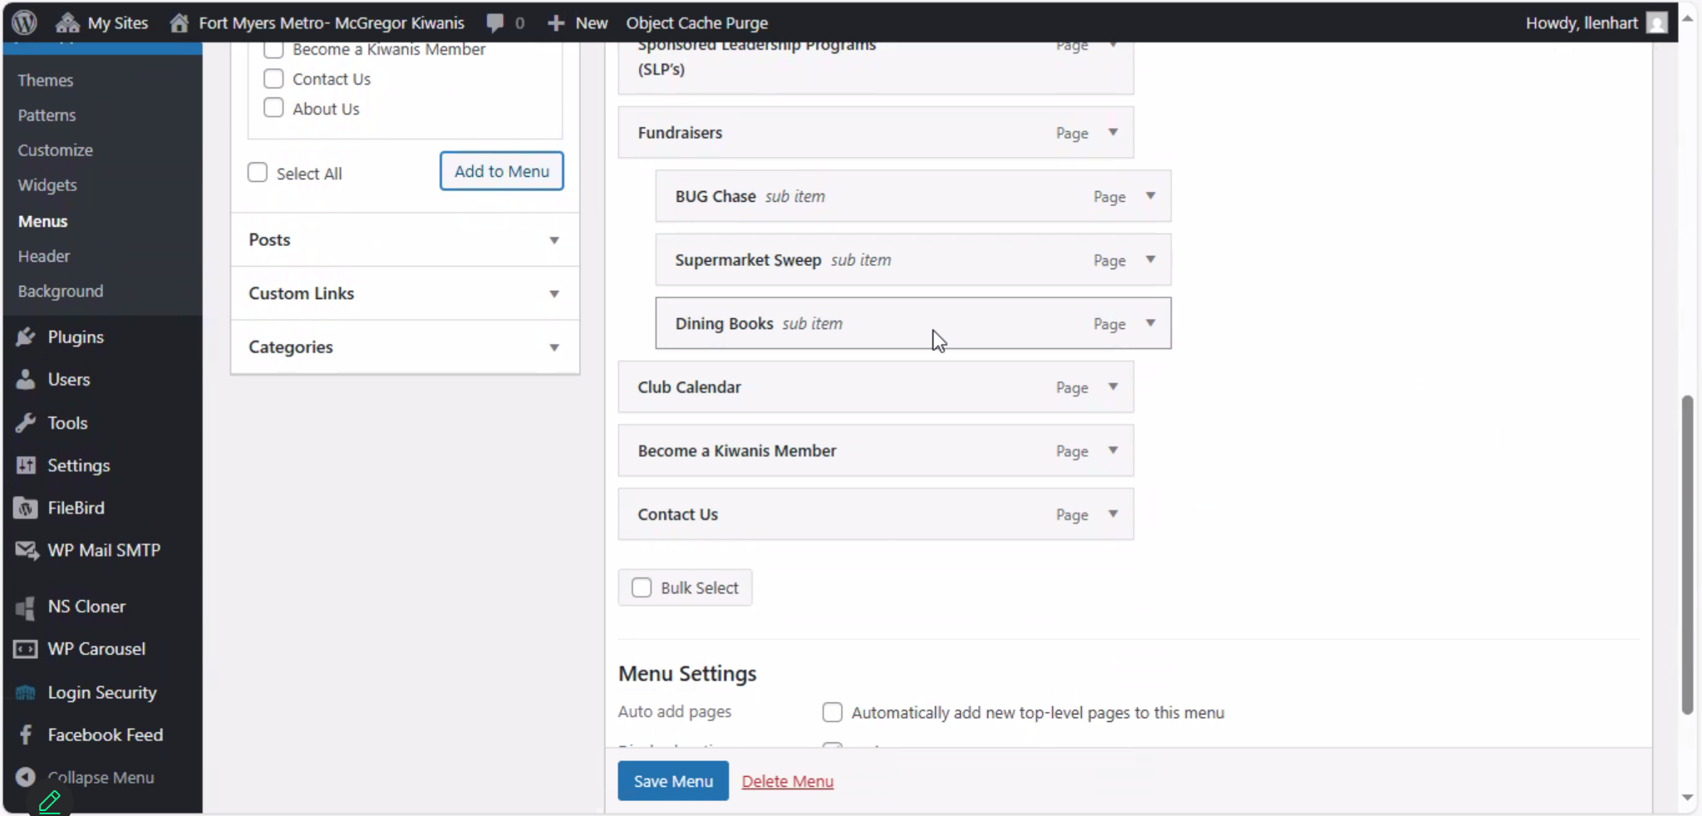
You can also make sub pages
These are pages that show up other banners

