Slide 1
How to Market Kiwanis to Your Community
August 9, 2025
Rachel Toomey, APR

Slide 2
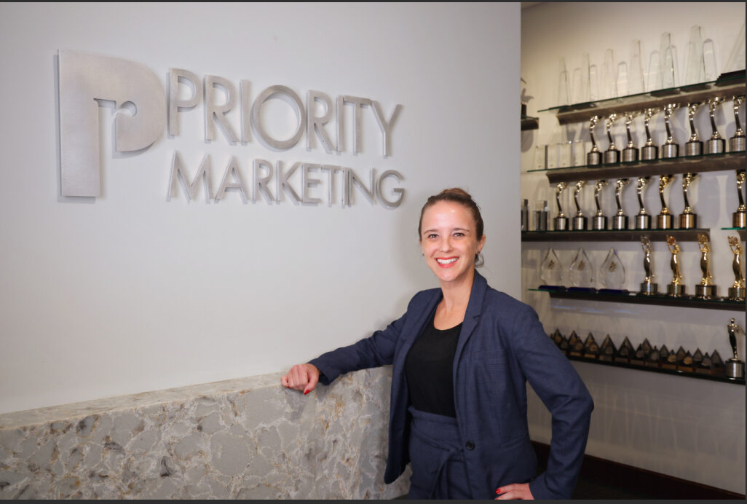
A Little About Me…
Joined the K-Family in Key Club
Was LTG in CKI
Former Kiwanis Club President
Fort Myers Metro-McGregor Kiwanis
Former Social Media Chair for FL District
ICON Chair for the FL District
Earned Accreditation in Public Relations (APR)
19 Years at Leading SWFL Marketing Firm- Senior Media Director

Slide 3
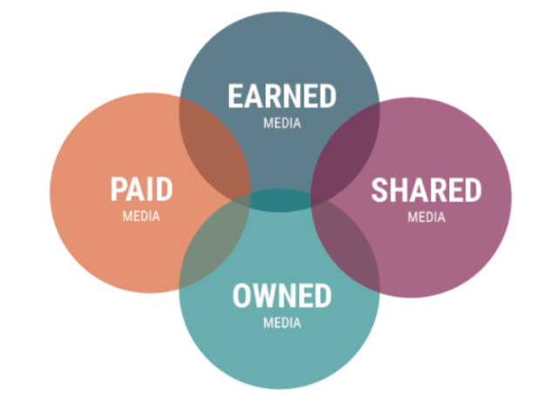
Marketing Strategies
Notes:
https://www.pewresearch.org/internet/2025/07/31/online-scams-and-attacks-in-america-today/

Slide 4


Owned & Shared
Channels that you own and control:
  Club Members- Elevator Speeches!
  Website (Free Template)
  Social media channels
  Email marketing - Club Newsletters
  Club Custom Logo (No More Birdcage!)

Slide 5
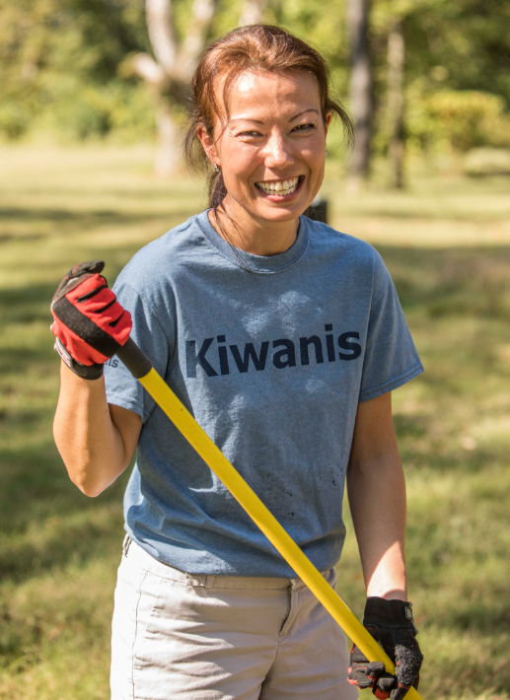
Owned & Shared
Channels that you own and control:
  Collateral materials- club brochures (Free Template), business cards
  Displays- banners, table displays
  Kiwanis apparel- shirts and pins
  Shared media includes content posted on platforms that allow external audiences to have equal control and opportunities to contribute to conversations.

Slide 6
Earned & Shared
When the press and public share your content, and there is no cost for placement. The mentions are "earned" or published by others.
Newsrooms are getting smaller and smaller so submitted content more likely to run – IF submitted in the correct format!

Slide 7
Earned & Shared
Example news release and photo tips on Kiwanis International website
Put your news releases in AP style format
Review the news websites to find the correct contact
A good photo – can take you from a blurb to a full page
Send items with plenty of lead time
Request PSAs from local Radio or TV stations

Slide 8
Paid
Paid placements
  Traditional advertising
  Digital & Social Media advertising
  Paid sponsorships
  Signage

Slide 9
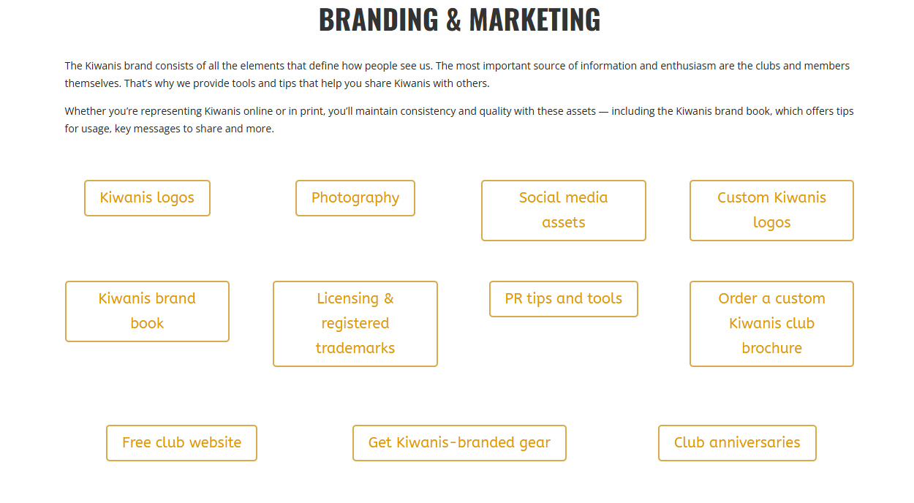
Kiwanis Assets
https://www.kiwanis.org/members/branding-marketing/

Slide 10
Case Study: BUG Chase 5K
Marketing Tactics:
Update Club Website
Race Website
Club Newsletter
Club Social Media
Facebook Event
Press Releases (Pre and Post)
Media Sponsor
Paid advertising on Facebook and Instagram
Post in Social Media Groups
Marketing Emails to Runners in Database
Race Shirts

Slide 11
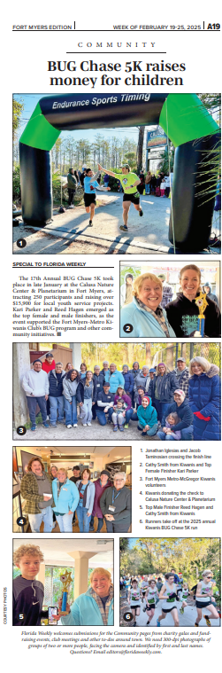
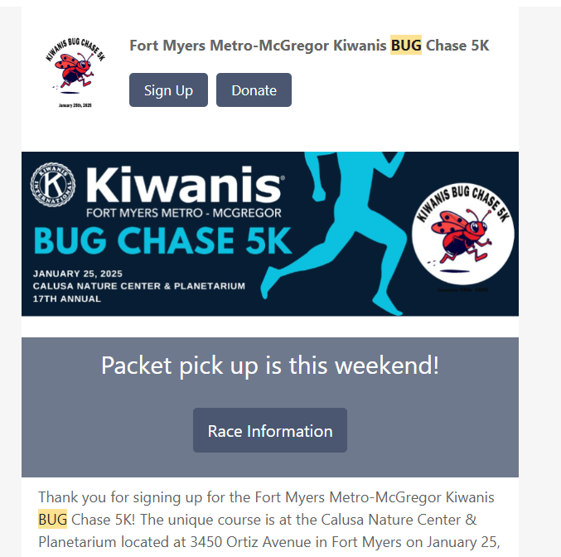
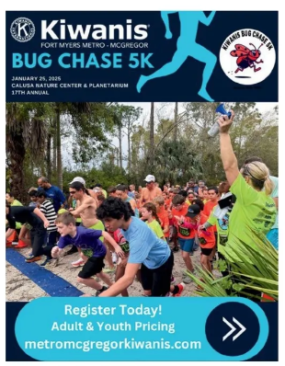
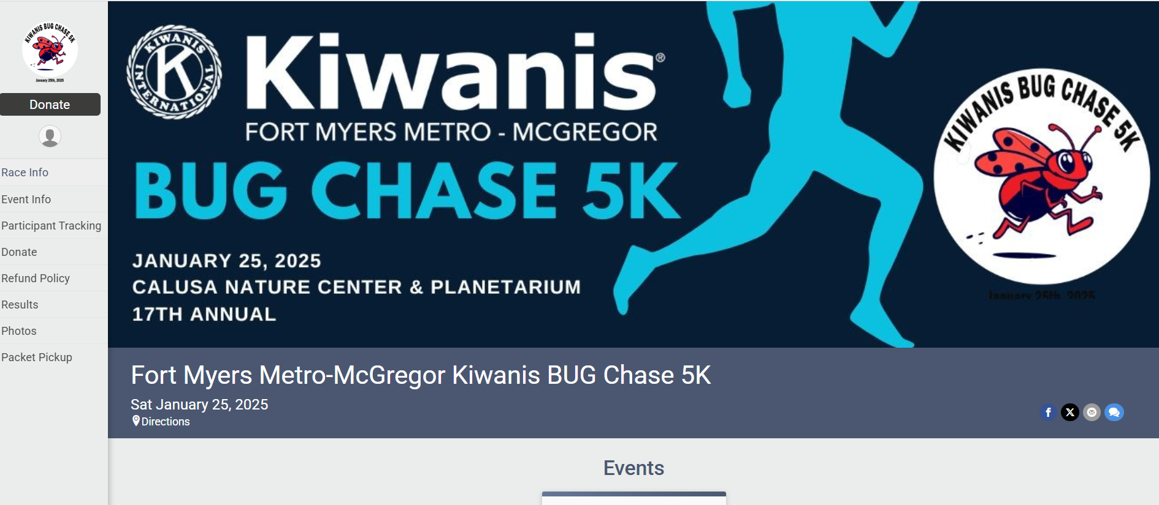

Slide 12
In Conclusion…
Marketing Kiwanis isn’t just left to the club officers. Each member of Kiwanis can market Kiwanis!
More people that know about Kiwanis=
More Potential Members=
More Service to Our Community!

Slide 13
Questions?
Rachel Toomey, Rachel.Toomey33@gmail.com

