Slide 1
How to Talk to Anyone
About Kiwanis!

Slide 2

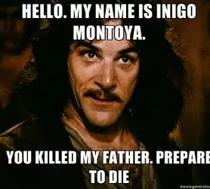
Introduction: Andrew F. Sias

Slide 3

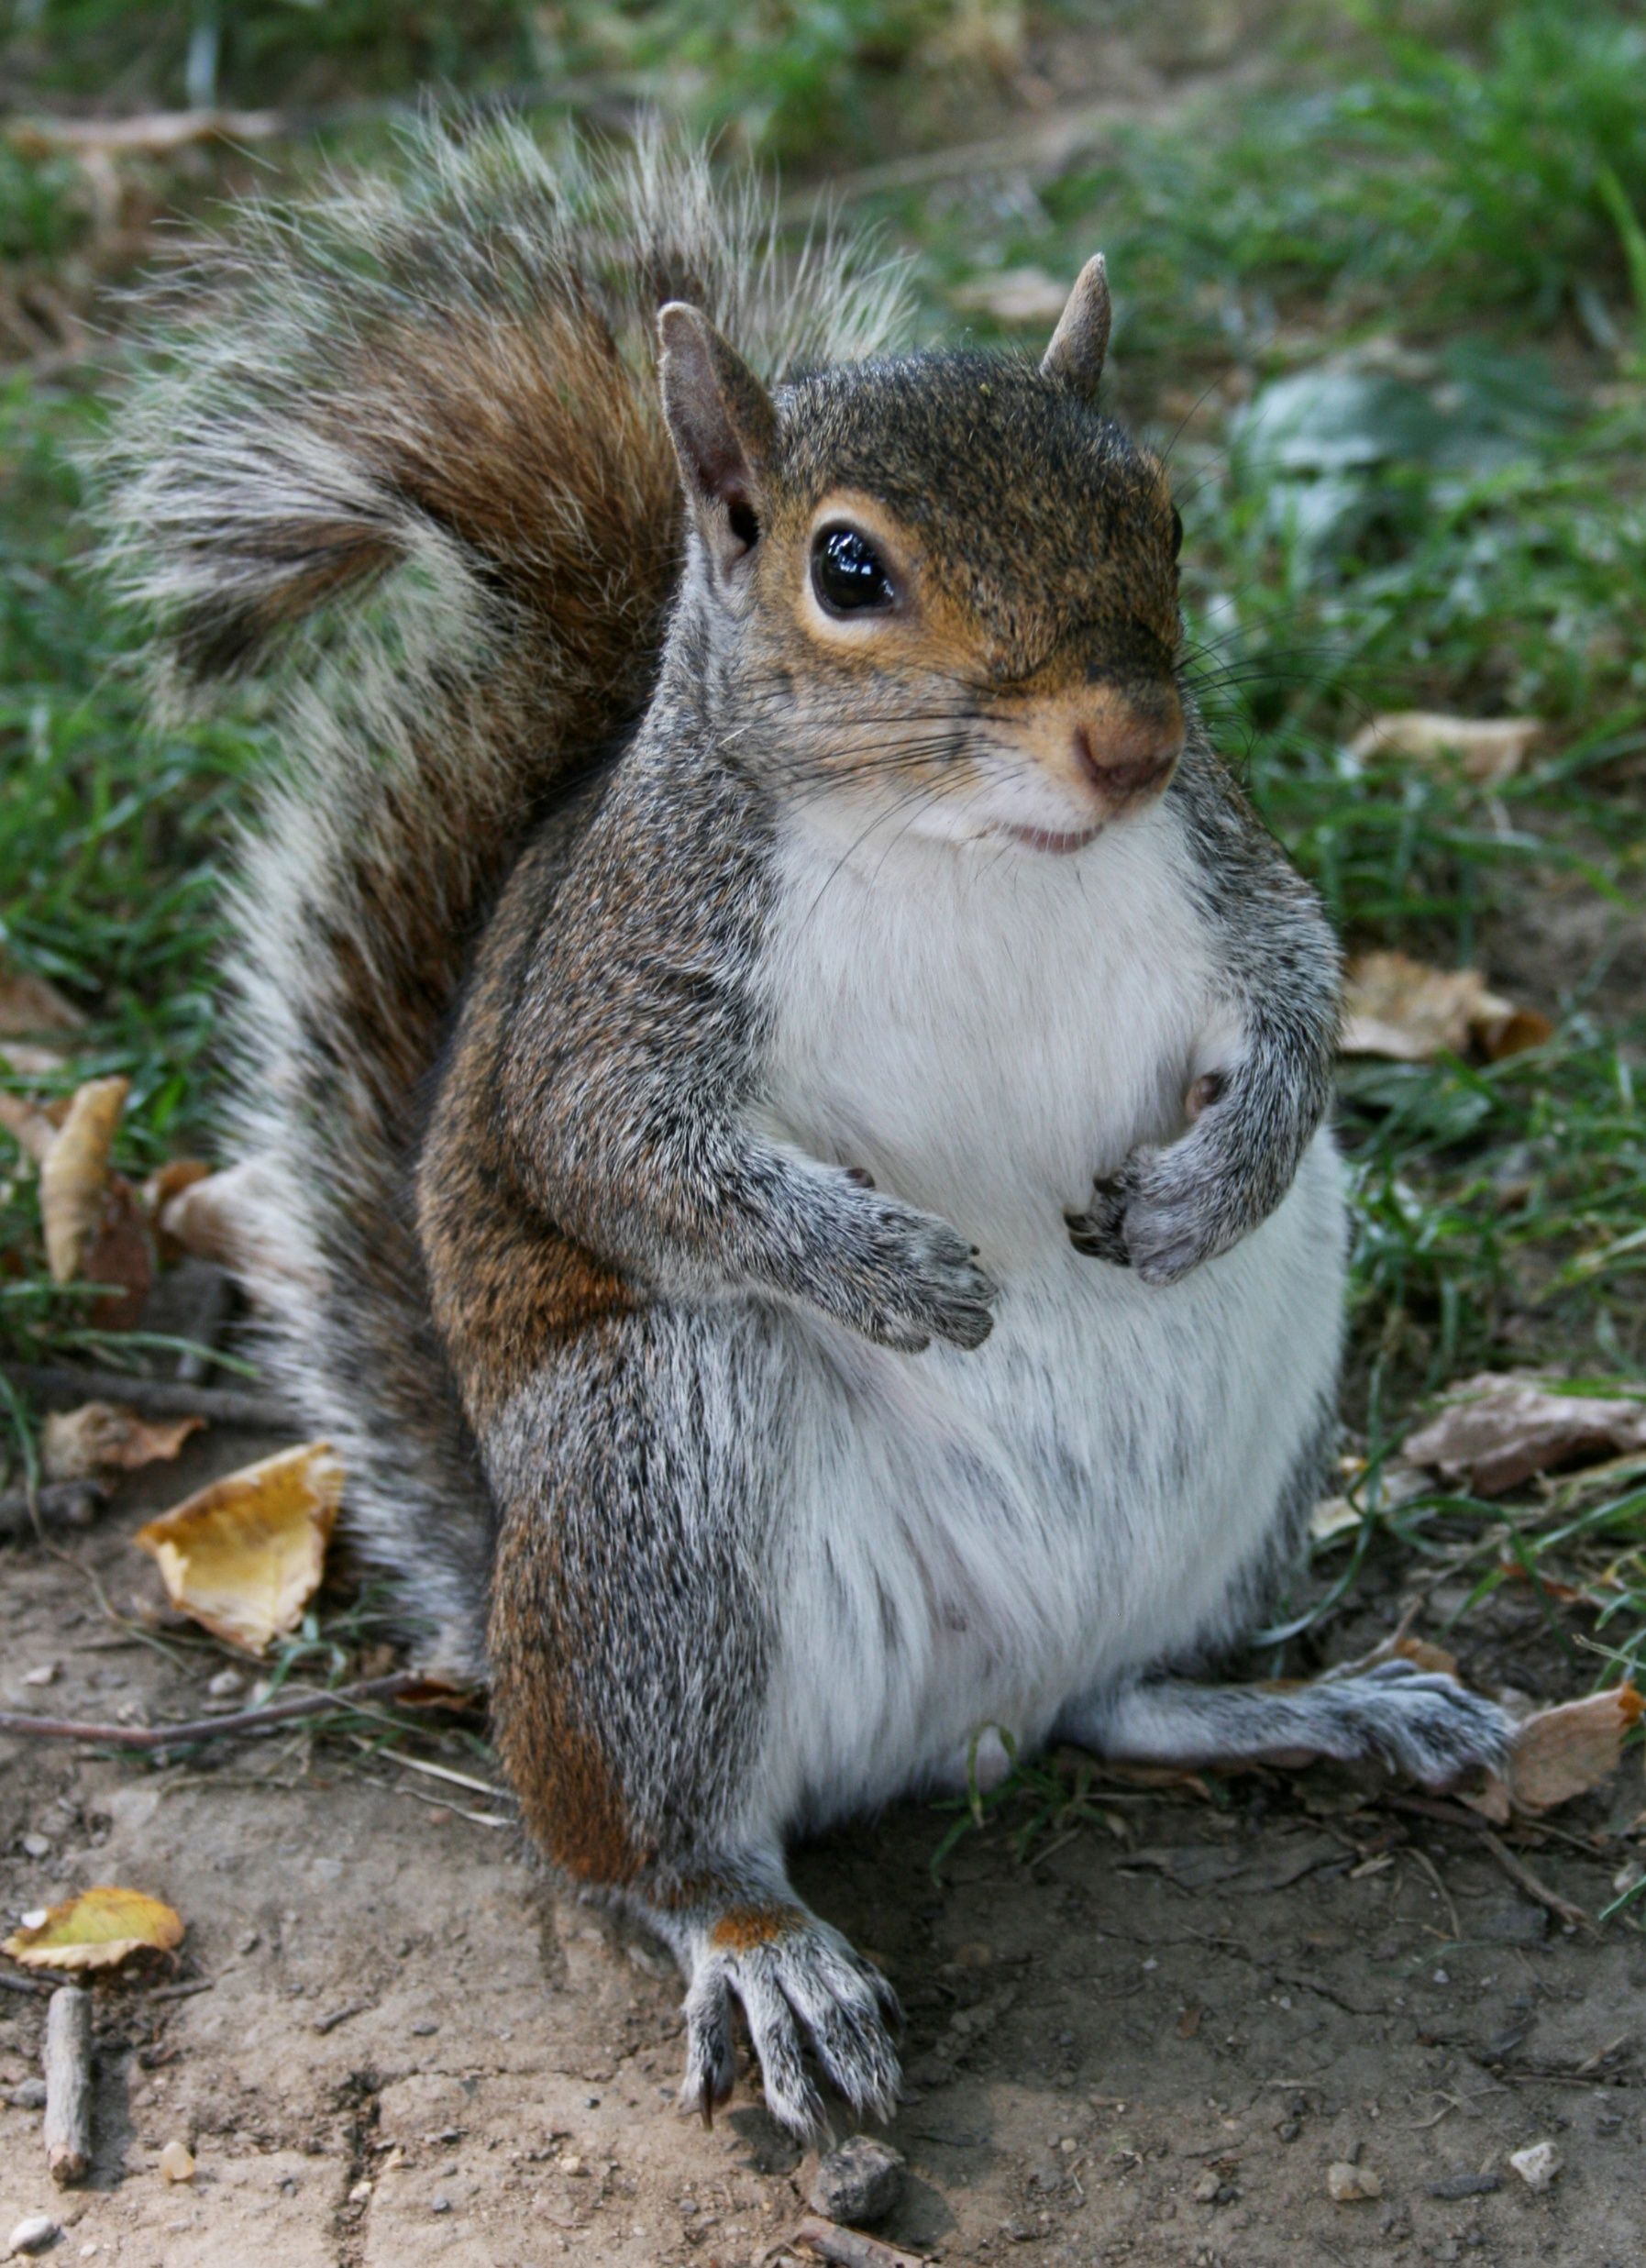
Squirrel!
This Photo by Unknown Author is licensed under CC BY-SA

Slide 4
Pre Class
Dr Frank “ The Mind can only absorb-What the Butt can endure”
Seneca ”Luck is what happens when preparation meets opportunity”
Parking Lot for Questions
Name Cards

Slide 5
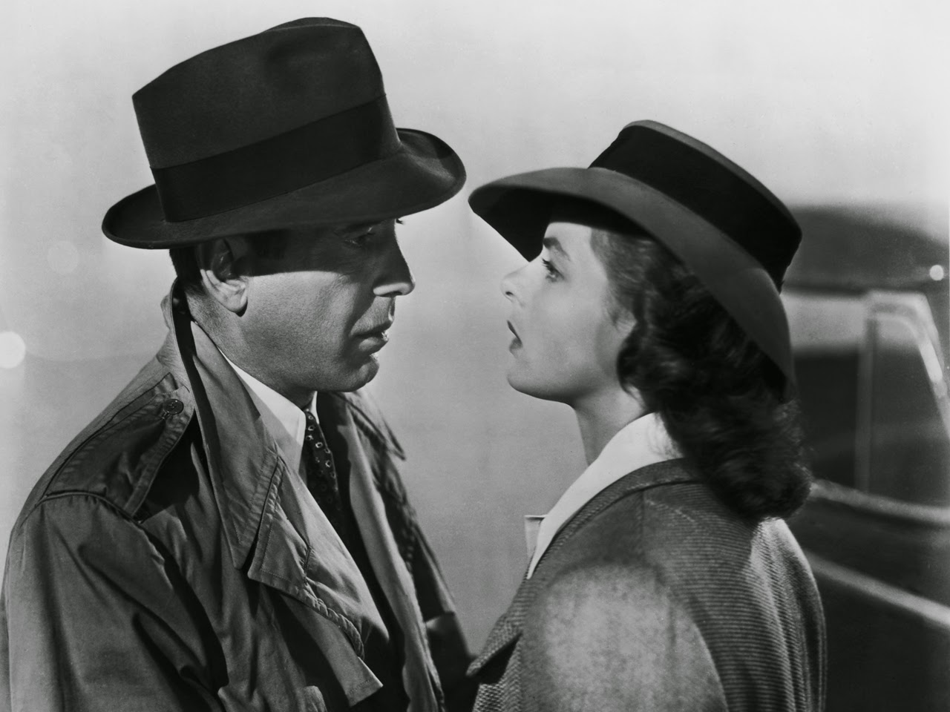
Warm Up: What is your favorite movie?
This Photo by Unknown Author is licensed under CC BY-NC-ND

Slide 6

Why?
This Photo by Unknown Author is licensed under CC BY-SA-NC

Slide 7

Kiwanis is the Best Kept Secret.
This Photo by Unknown Author is licensed under CC BY-NC-ND

Slide 8


Dan Heath “Andrew is in the Hawaiians”

Slide 9
Membership Goes Up and Down

Slide 10
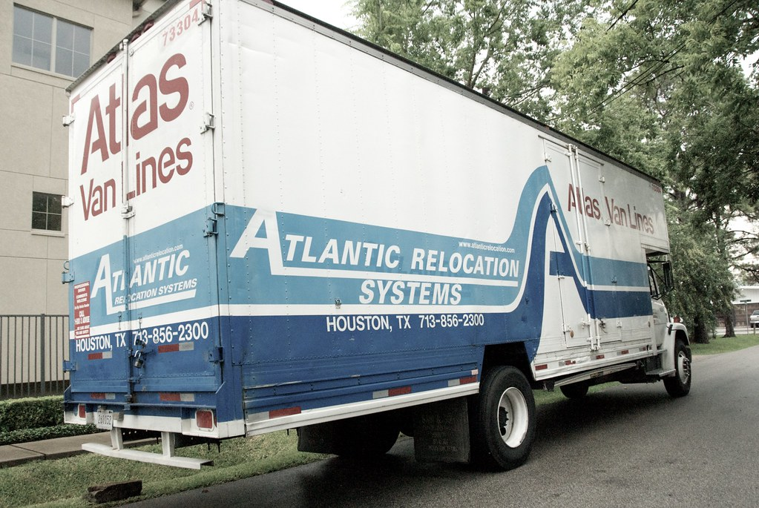
Members are lost to moving
This Photo by Unknown Author is licensed under CC BY-NC-ND

Slide 11
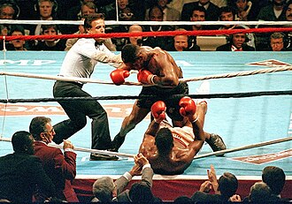
Strong Personalities
This Photo by Unknown Author is licensed under CC BY-SA

Slide 12

More Hands means helping more Kids!

Slide 13

Kiwanis will Change people’s lives Including their own!
This Photo by Unknown Author is licensed under CC BY

Slide 14
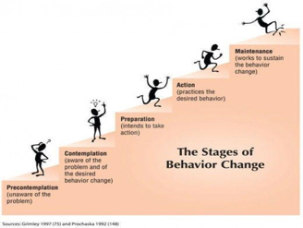
Change Behaviors Change Results
This Photo by Unknown Author is licensed under CC BY

Slide 15
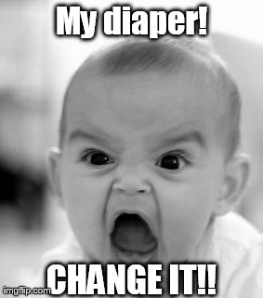
Change Is Good!

Slide 16
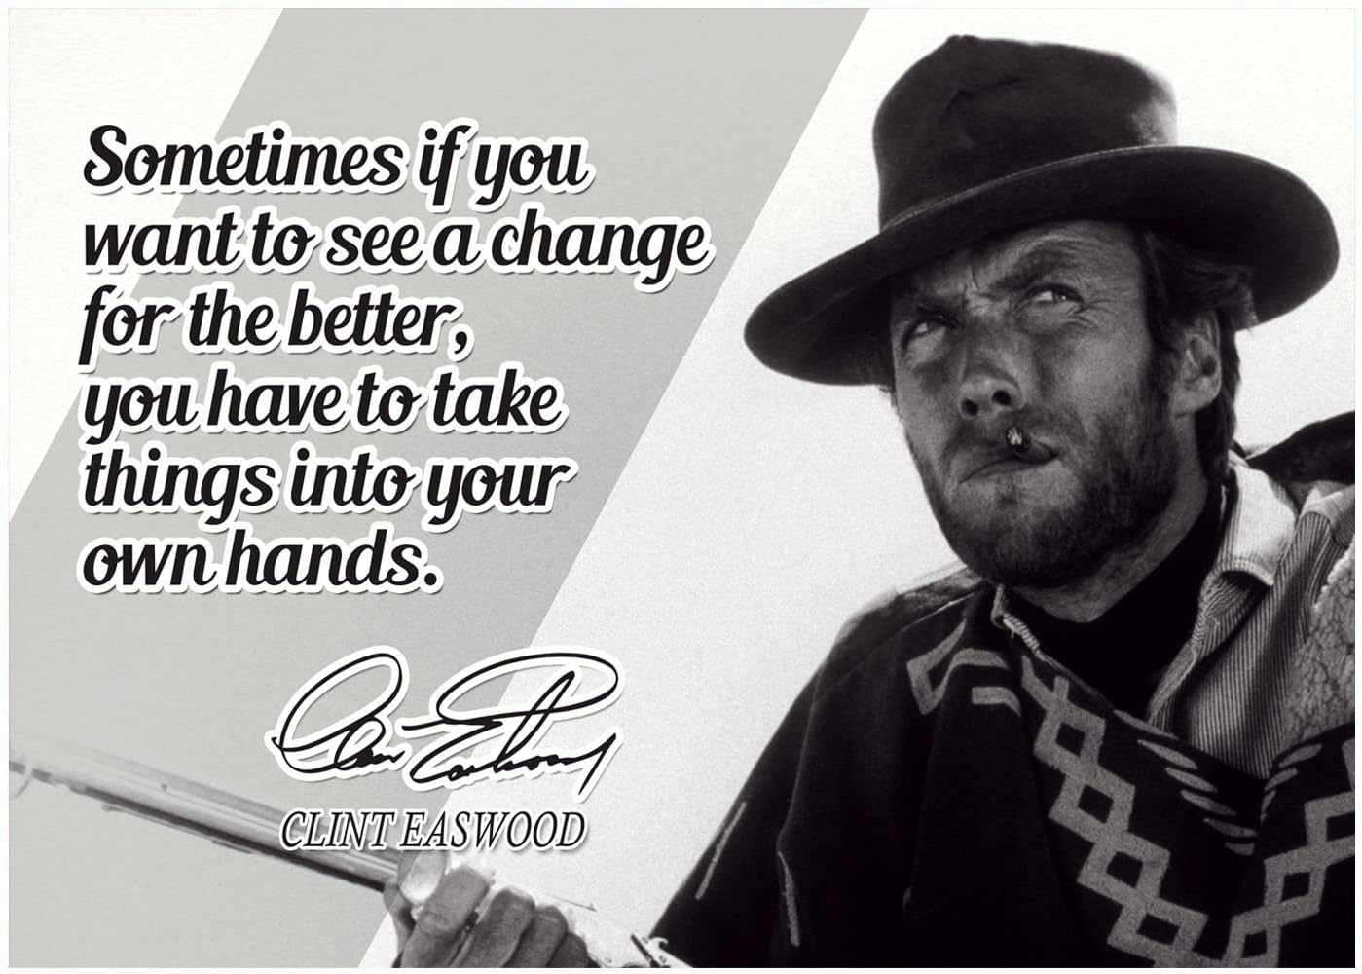
Change is Good!
You are the change maker

Slide 17
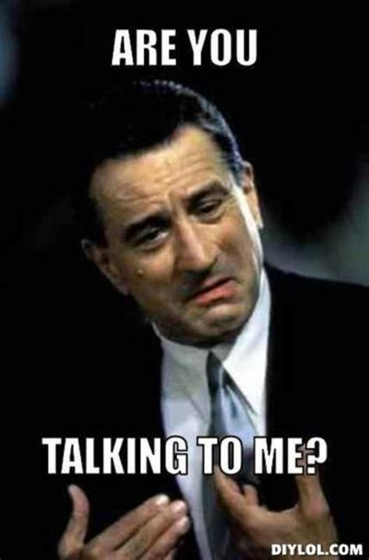
Talking to New Friends (People you don’t know. YET!)

Slide 18

Break the Ice!
Build Repour
Be Sincere
Common Interest

Slide 19
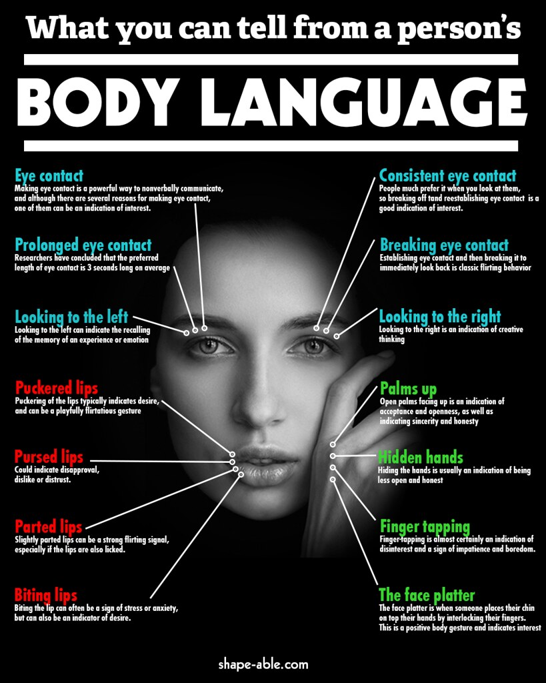
Read the Person Body Language
This Photo by Unknown Author is licensed under CC BY-NC

Slide 20
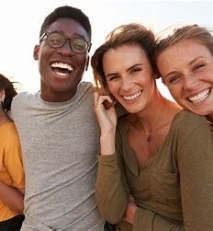
Good Body Language Signs
Eye Contact
Smiling
Open Stance
Heading Nodding

Slide 21
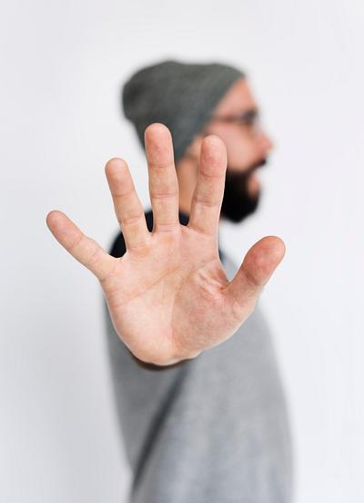
Bad Body LanuageSigns
1. Poor posture
2. Lack of eye contact
3. Negative facial expressions
Frowning, scowling, or eye-rolling
4. Lack of active listening
5. They are looking at their phone or watch

Slide 22

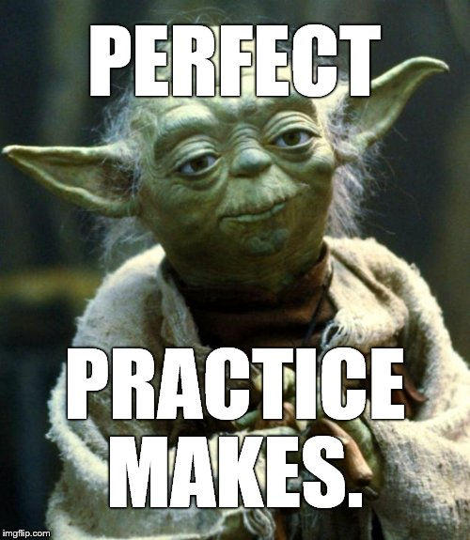
Role Play
This Photo by Unknown Author is licensed under CC BY-SA-NC

Slide 23


Transition Conversation to Kiwanis

Slide 24
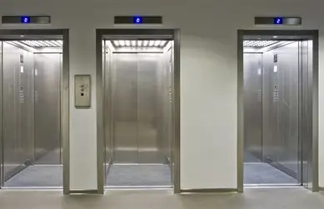
What is Kiwanis?
Elevator Speech
Be Enthusiastic
No Reciting
Speak from the heart

Slide 25



Break Out Session
Design Two Sentence Elevator Speech

Slide 26

What is Kiwanis? My Elevator Speech
Kiwanis is about helping Children!
Kiwanis is about having FUN!

Slide 27

Closing the sales
Assumptive Close
Invite to Event!
Overcome Objections

Slide 28



Responses to Objection
I don t have time.
I am afraid I would not fit in.
I am not a people person
This Photo by Unknown Author is licensed under CC BY-NC-ND

Slide 29
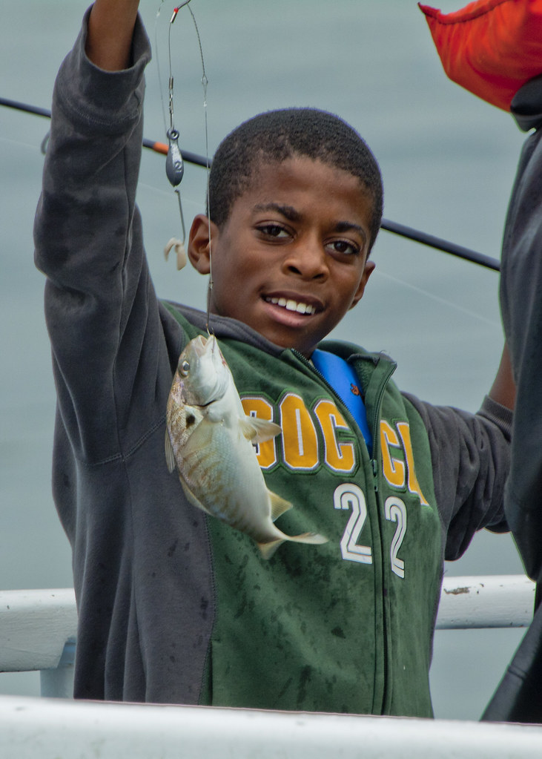
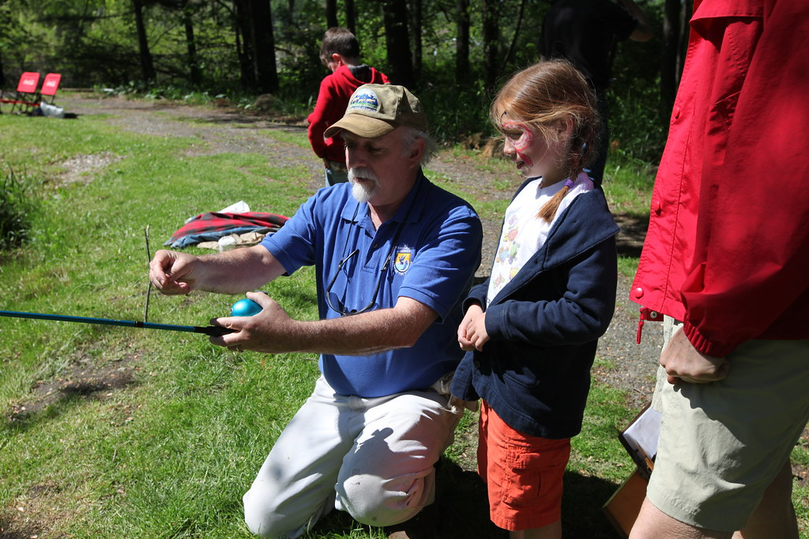
Results :
Potential New Members, Increased Community Awareness and Event Participation!
This Photo by Unknown Author is licensed under CC BY-ND

Slide 30
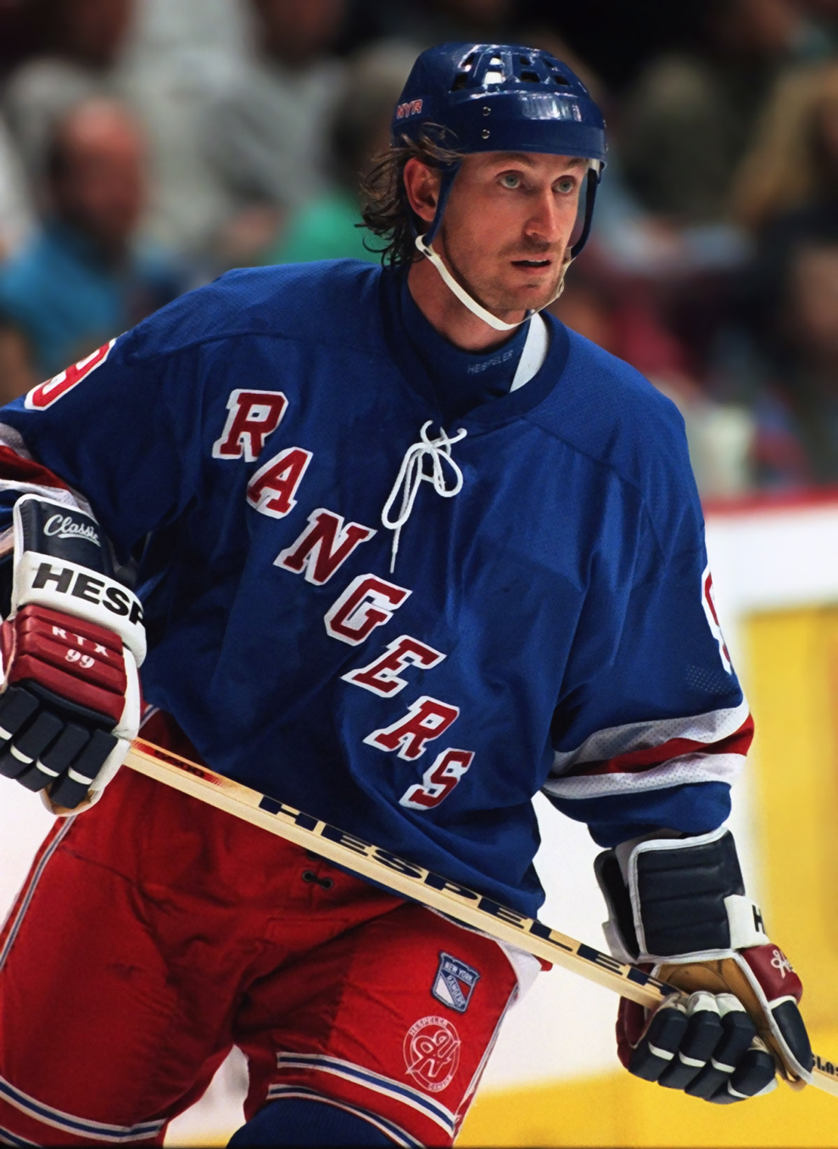
Wayne Gretzky “Every shot I did not take-I missed”
This Photo by Unknown Author is licensed under CC BY-SA

Slide 31
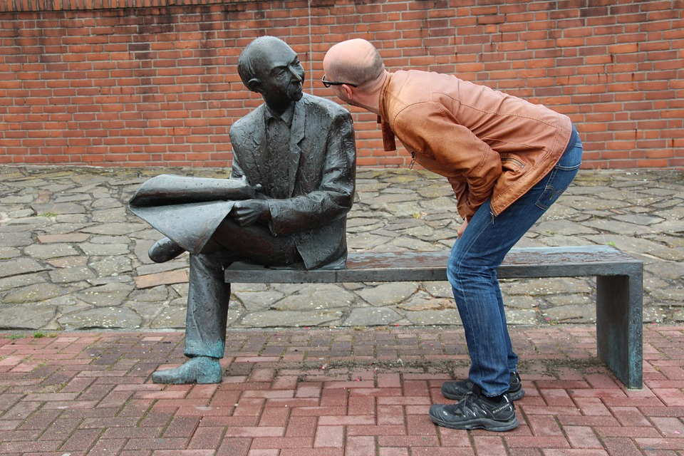
Who to talk to: Everyone!

Slide 32

Untapped Known Membership Resource:
Talk to People you Know or Should know. Reaching out to potential new members.
This Photo by Unknown Author is licensed under CC BY-NC-ND

Slide 33

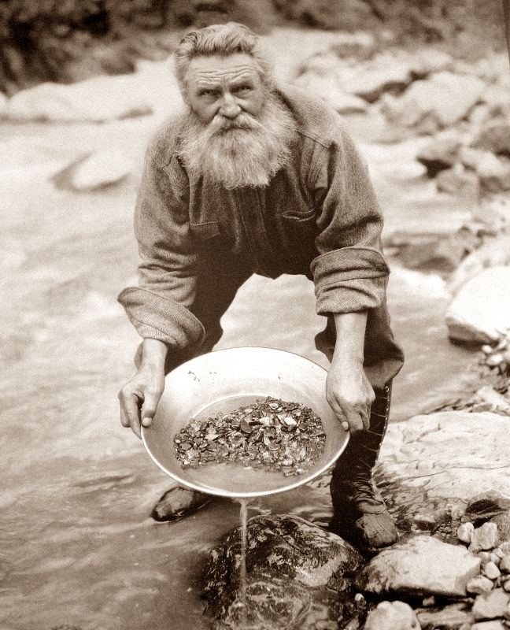

There is Membership Gold in Them Hills!
This Photo by Unknown Author is licensed under CC BY-SA
This Photo by Unknown Author is licensed under CC BY-NC-ND

Slide 34

Key Club
Invite to your Club and Events
Participate in Key Club Events
Invite to Installation ceremony
Seniors for Seniors program
Participate to their Meeting
Awards : Royal Order
of the Hot Dog

Slide 35
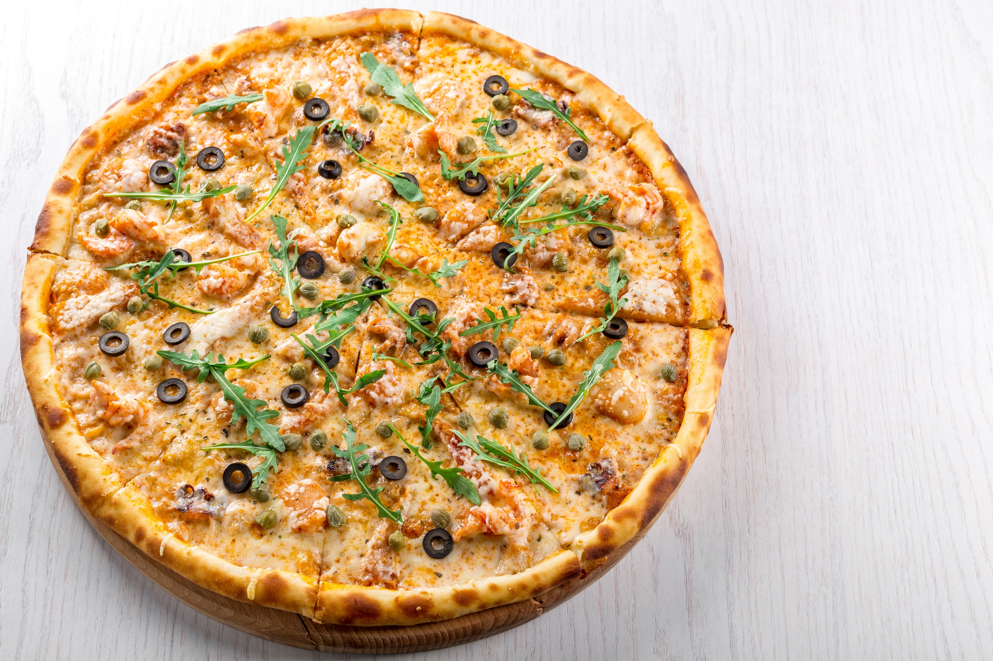
What does Key Club like?

Slide 36

Friends

Slide 37
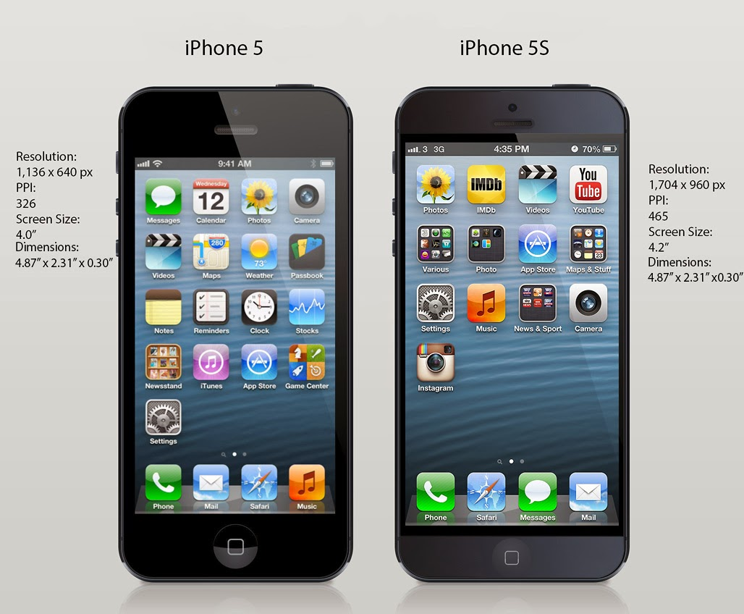
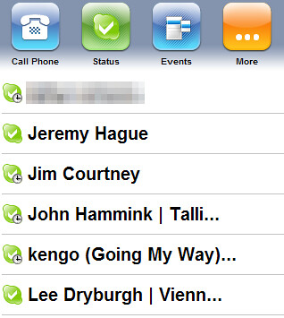
Phone-a-thon Event
This Photo by Unknown Author is licensed under CC BY-SA
This Photo by Unknown Author is licensed under CC BY

Slide 38
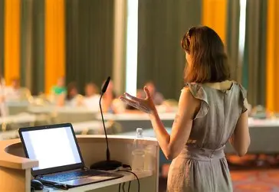
Speakers
Invite to Speak about their topic
Offer first to participate in an event
Then offer membership

Slide 39

Chamber of Commerce
This Photo by Unknown Author is licensed under CC BY

Slide 40


Other Organizations
Co sponsor events
Liaison membership
Moose, Rotary Lions ,Art Center, Boys and Girls Club Etc.

Slide 41
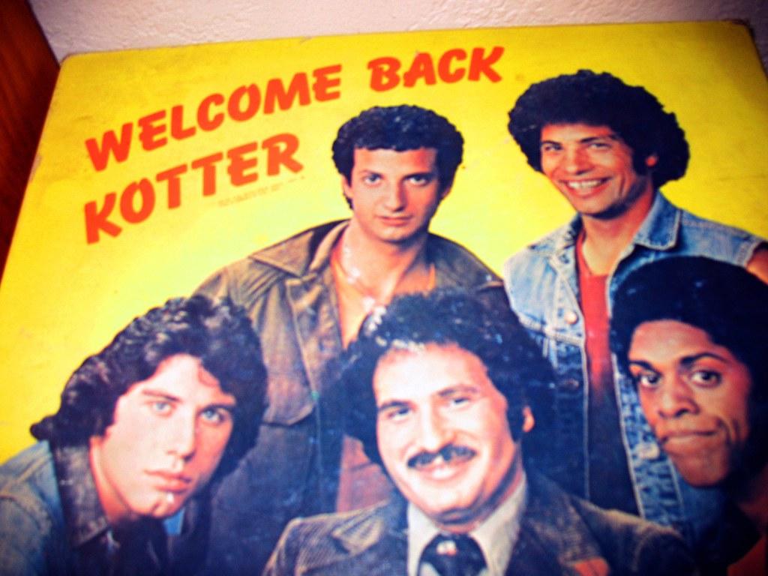
Old members---Invite Back
This Photo by Unknown Author is licensed under CC BY-SA

Slide 42
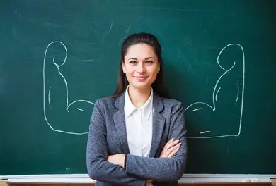
Key club advisors
Invite to Club/Installation
School Supplies\Welcome Baskets

Slide 43

New members feel awkward
No Set Seats at meetings
Assign a Welcome ambassador
Secret Greeter
Invite their Friends within 30days

Slide 44

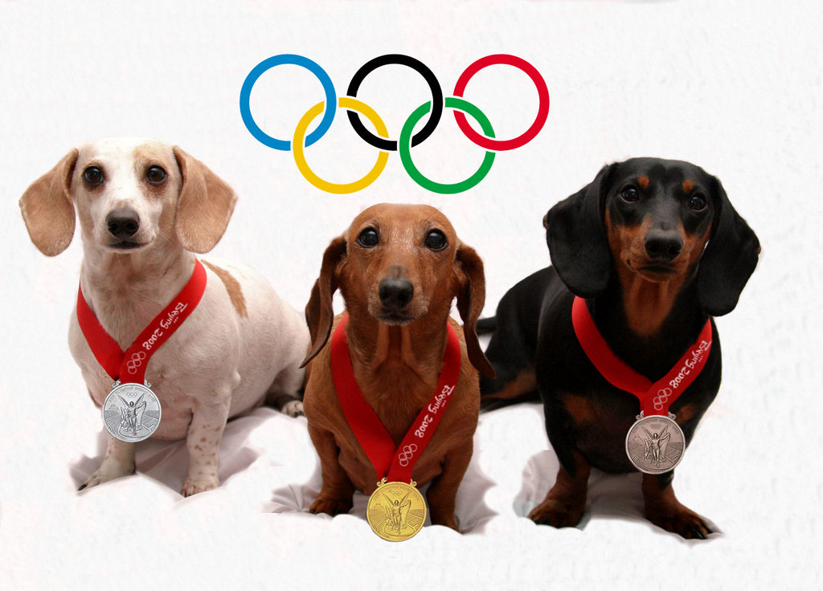
Recognize and Reinforce Success!!!!
This Photo by Unknown Author is licensed under CC BY-NC-ND

Slide 45

Keep on Talking. How many new members?:
Edward G Robinson In Key Largo "More!”

Slide 46

Ideas to create Events that get people talking with you.
Two Suggestions
Socks and Underwear Birthday
Kiwanis Birthday (Punta Gorda)

Slide 47

Parking lot and Questions
This Photo by Unknown Author is licensed under CC BY

Slide 48

Thank You!!!!!!!!

Slide 49
My Information
Andrew F Sias
asias36@gmail.com
9417403981

Slide 50

Survey
Only your friends will correct you.
1. What did I do good?
2. What can I improve?
https://www.surveymonkey.com/r/VNRNHCZ
This Photo by Unknown Author is licensed under CC BY-SA

