Slide 1



The Importance of Committees
Prairy Riehl, Past Governor
This Photo by Unknown Author is licensed under CC BY-SA

Slide 2
Goal
Learn how effective committees can streamline your club’s efforts, increase member engagement, and turn big goals into achievable actions

Slide 3

Why Committees Matter?
Distribute responsibilities
Encourage leadership development
Keep the club organized and focused
Turn plans into progress

Slide 4
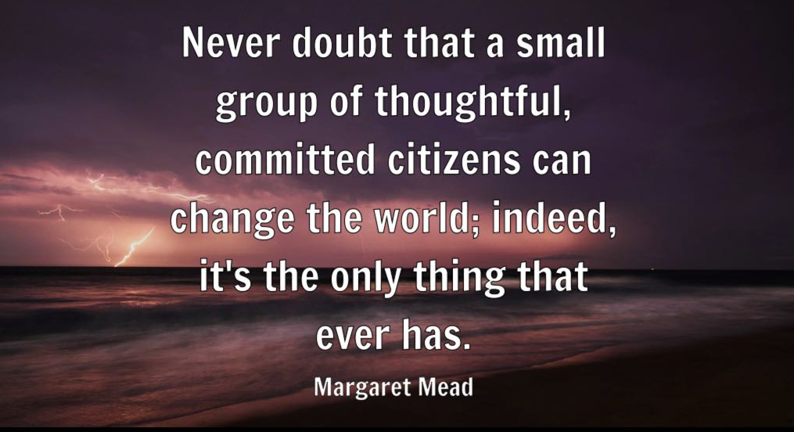

Slide 5
Benefits to Club
Streamlined operations
Increased efficiency
Diverse perspectives and skills
Clear accountability

Slide 6
Benefits to Members
Greater sense of purpose
Opportunities for involvement and leadership
Builds teamwork and relationships
Recognizes individual strengths

Slide 7
Types of Committees
Service Projects
Membership
Fundraising
Public Relations
Special Events
Service Leadership Programs

Slide 8

Google – Kiwanis International Membership Committee

Slide 9
Best Practices
Clearly define roles and goals
Appoint enthusiastic, capable chairs
Meet regularly and report to the club
Align with club’s strategic plan

Slide 10
Getting Members Involved
Match skills/interests to roles
Personally invite members to join
Highlight the value of their participation
Celebrate committee achievements

Slide 11
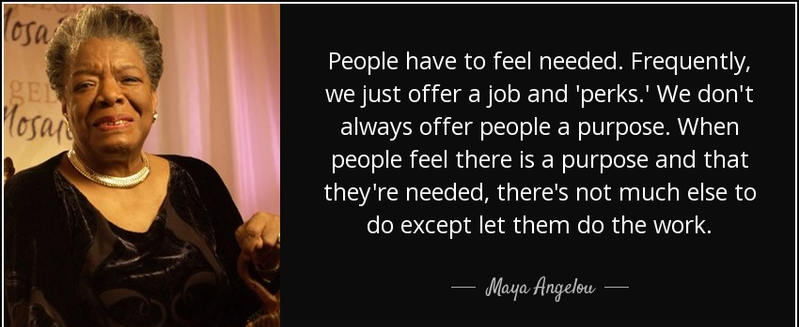

Slide 12
Action Steps
Review your current committees
Fill gaps and refresh leadership
Set clear, actionable goals
Promote committee work in meetings and newsletters

Slide 13
Reflections and Discussions
What’s working in our committees?
Where can we improve?
What new committees could strengthen our club?

Slide 14
Thank you!
Strong committees make strong clubs. Let’s work together to make every member feel empowered
and essential
Prairy Riehl
Prairy.Riehl@gmail.com
(407) 900-7779

