Slide 1

Key Club
District Governor Eleanor Koh

Slide 2
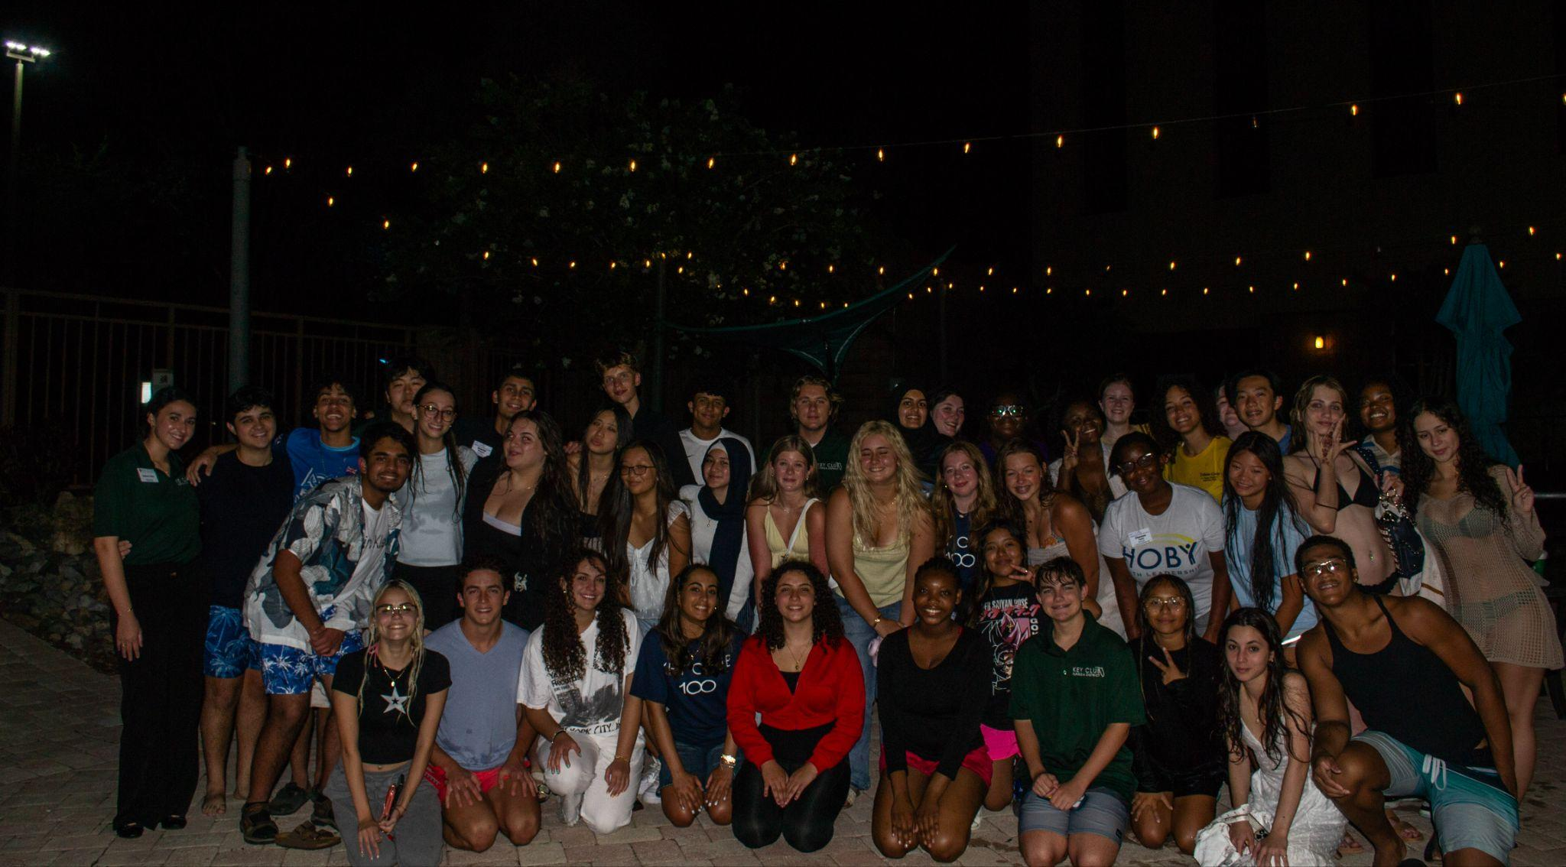
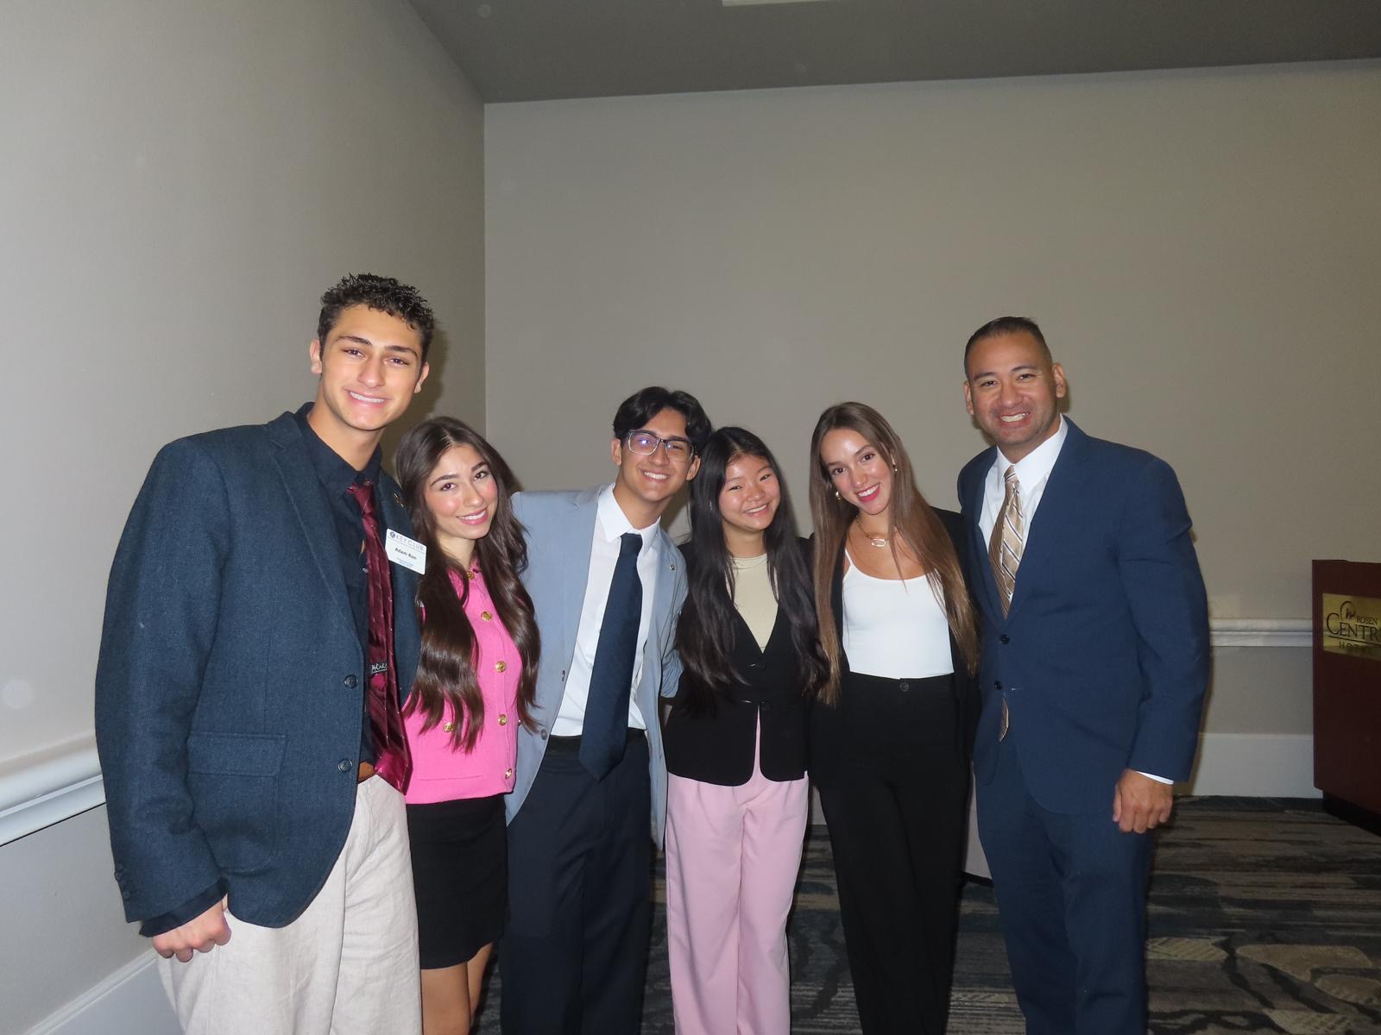
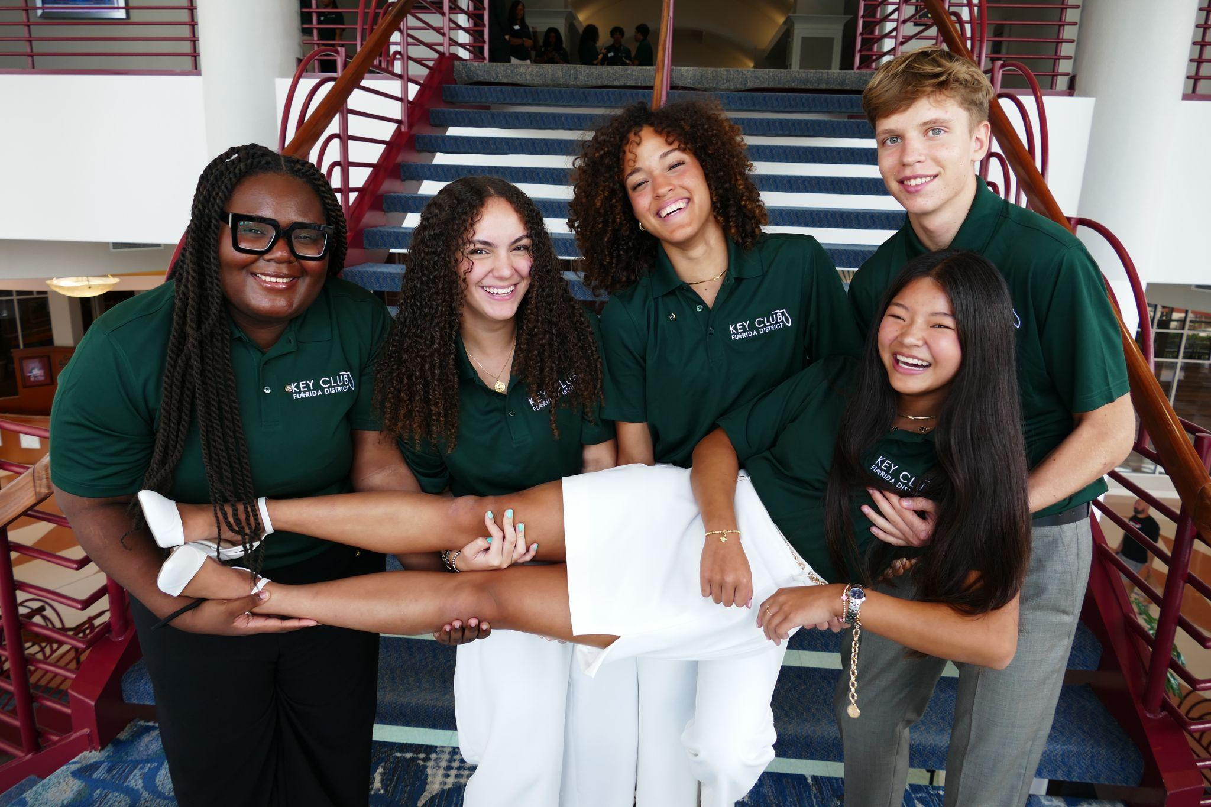
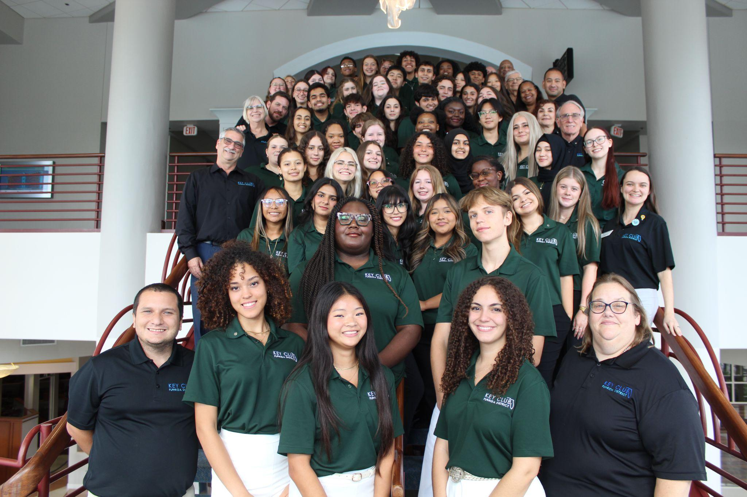
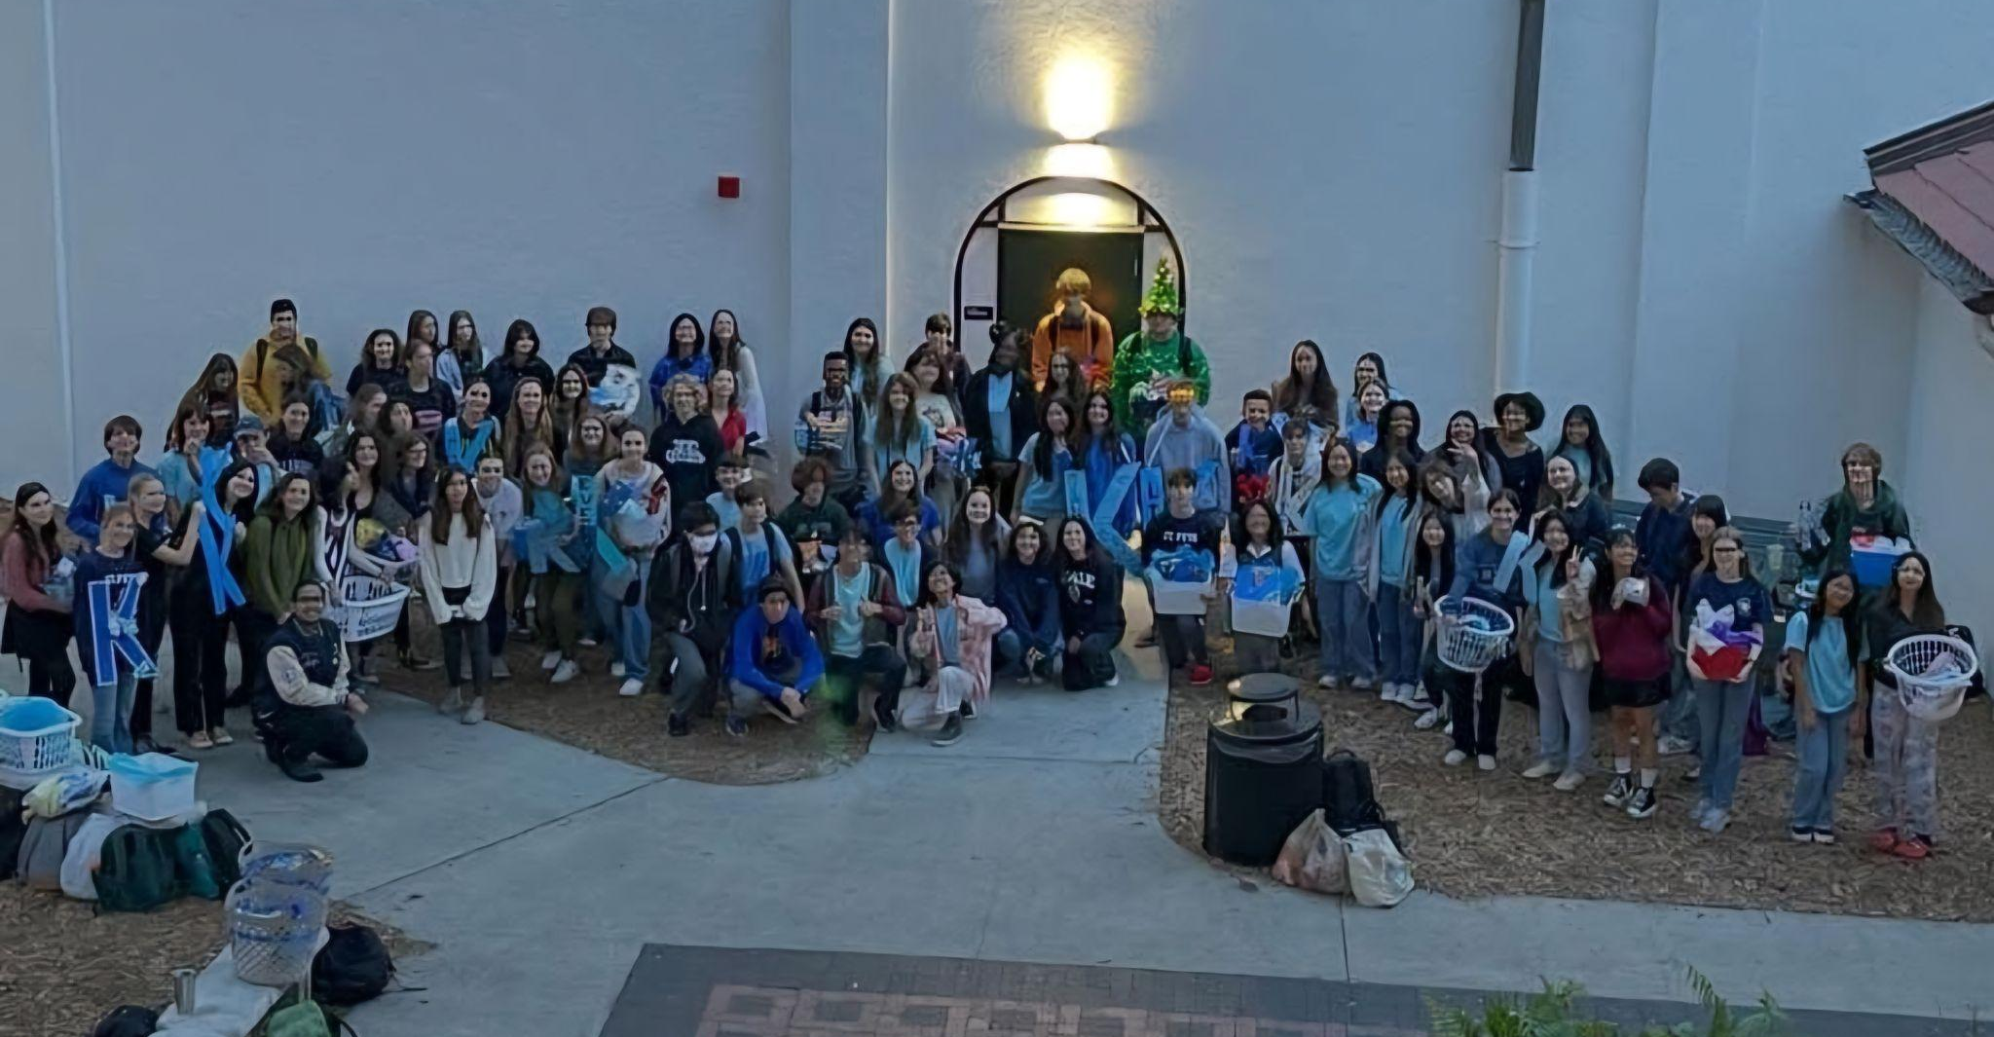
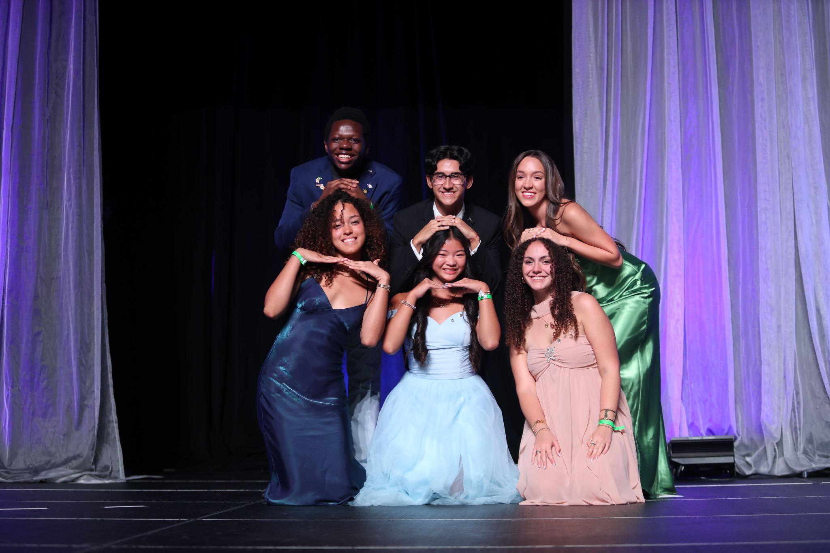
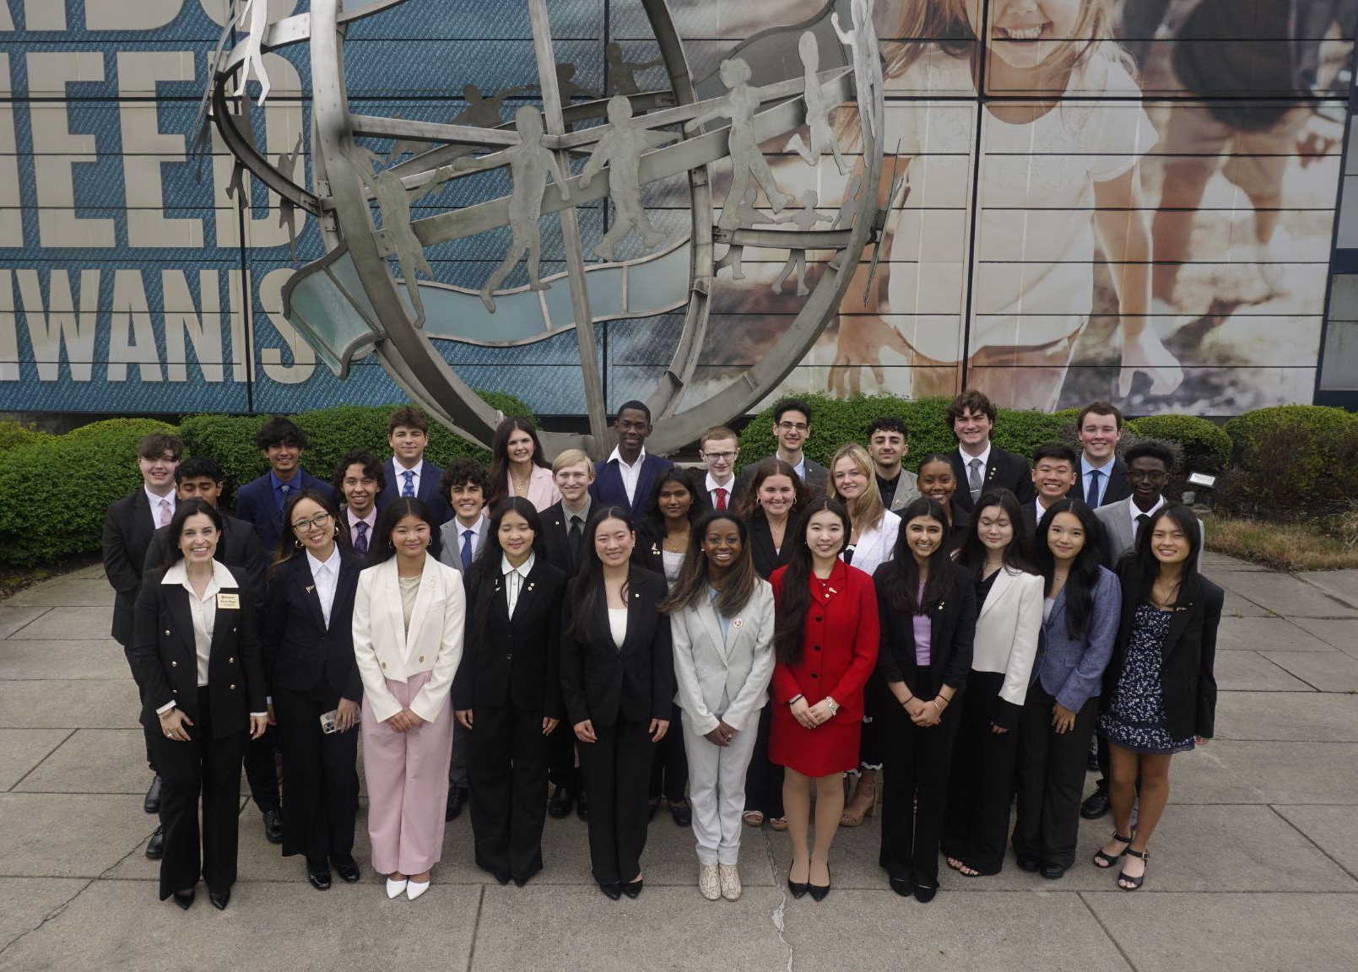
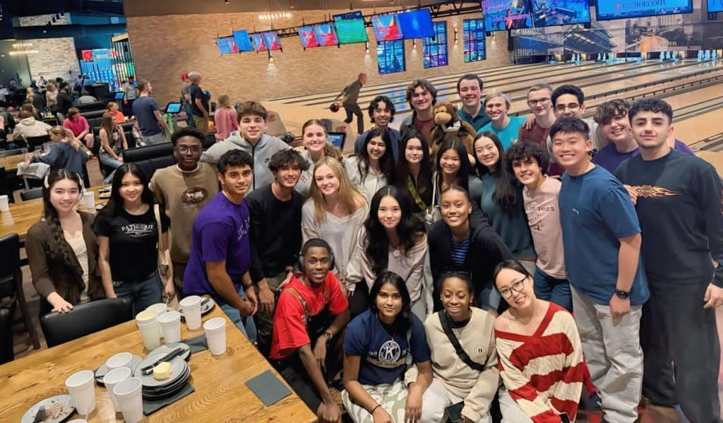
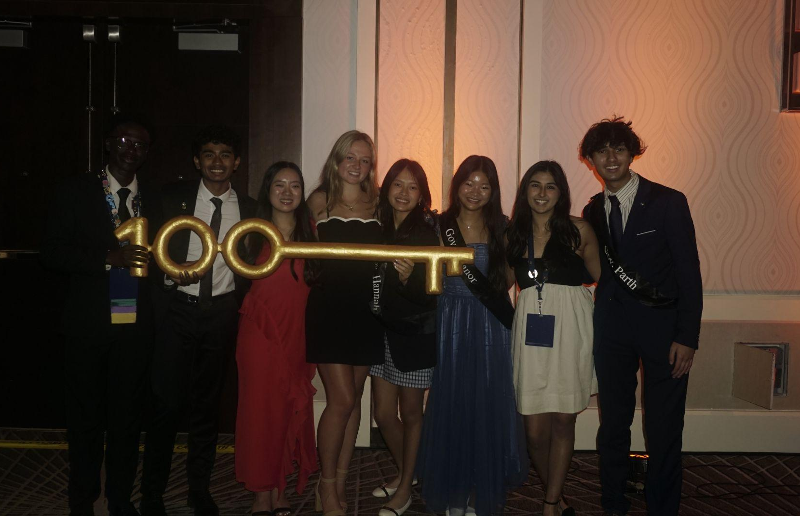
Introduction

Slide 3
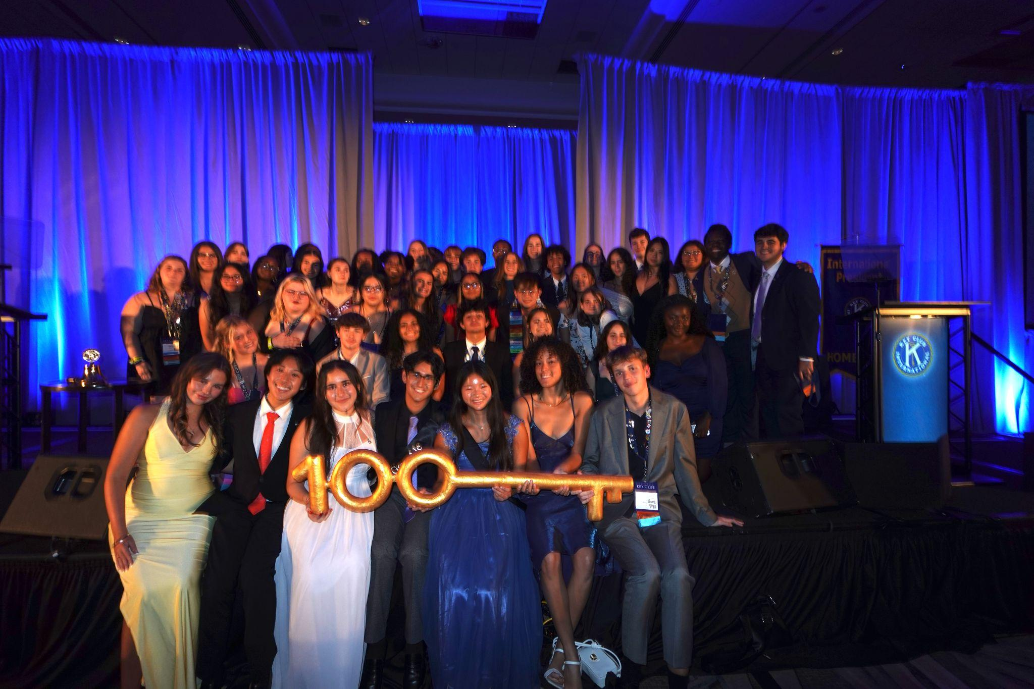
What is Key Club?
Largest student-led service organization in the world
Founded in 1925
Serves over 230,000 members in over 40 countries across 33 districts
Our core values are leadership, caring, inclusiveness, and character building

Slide 4
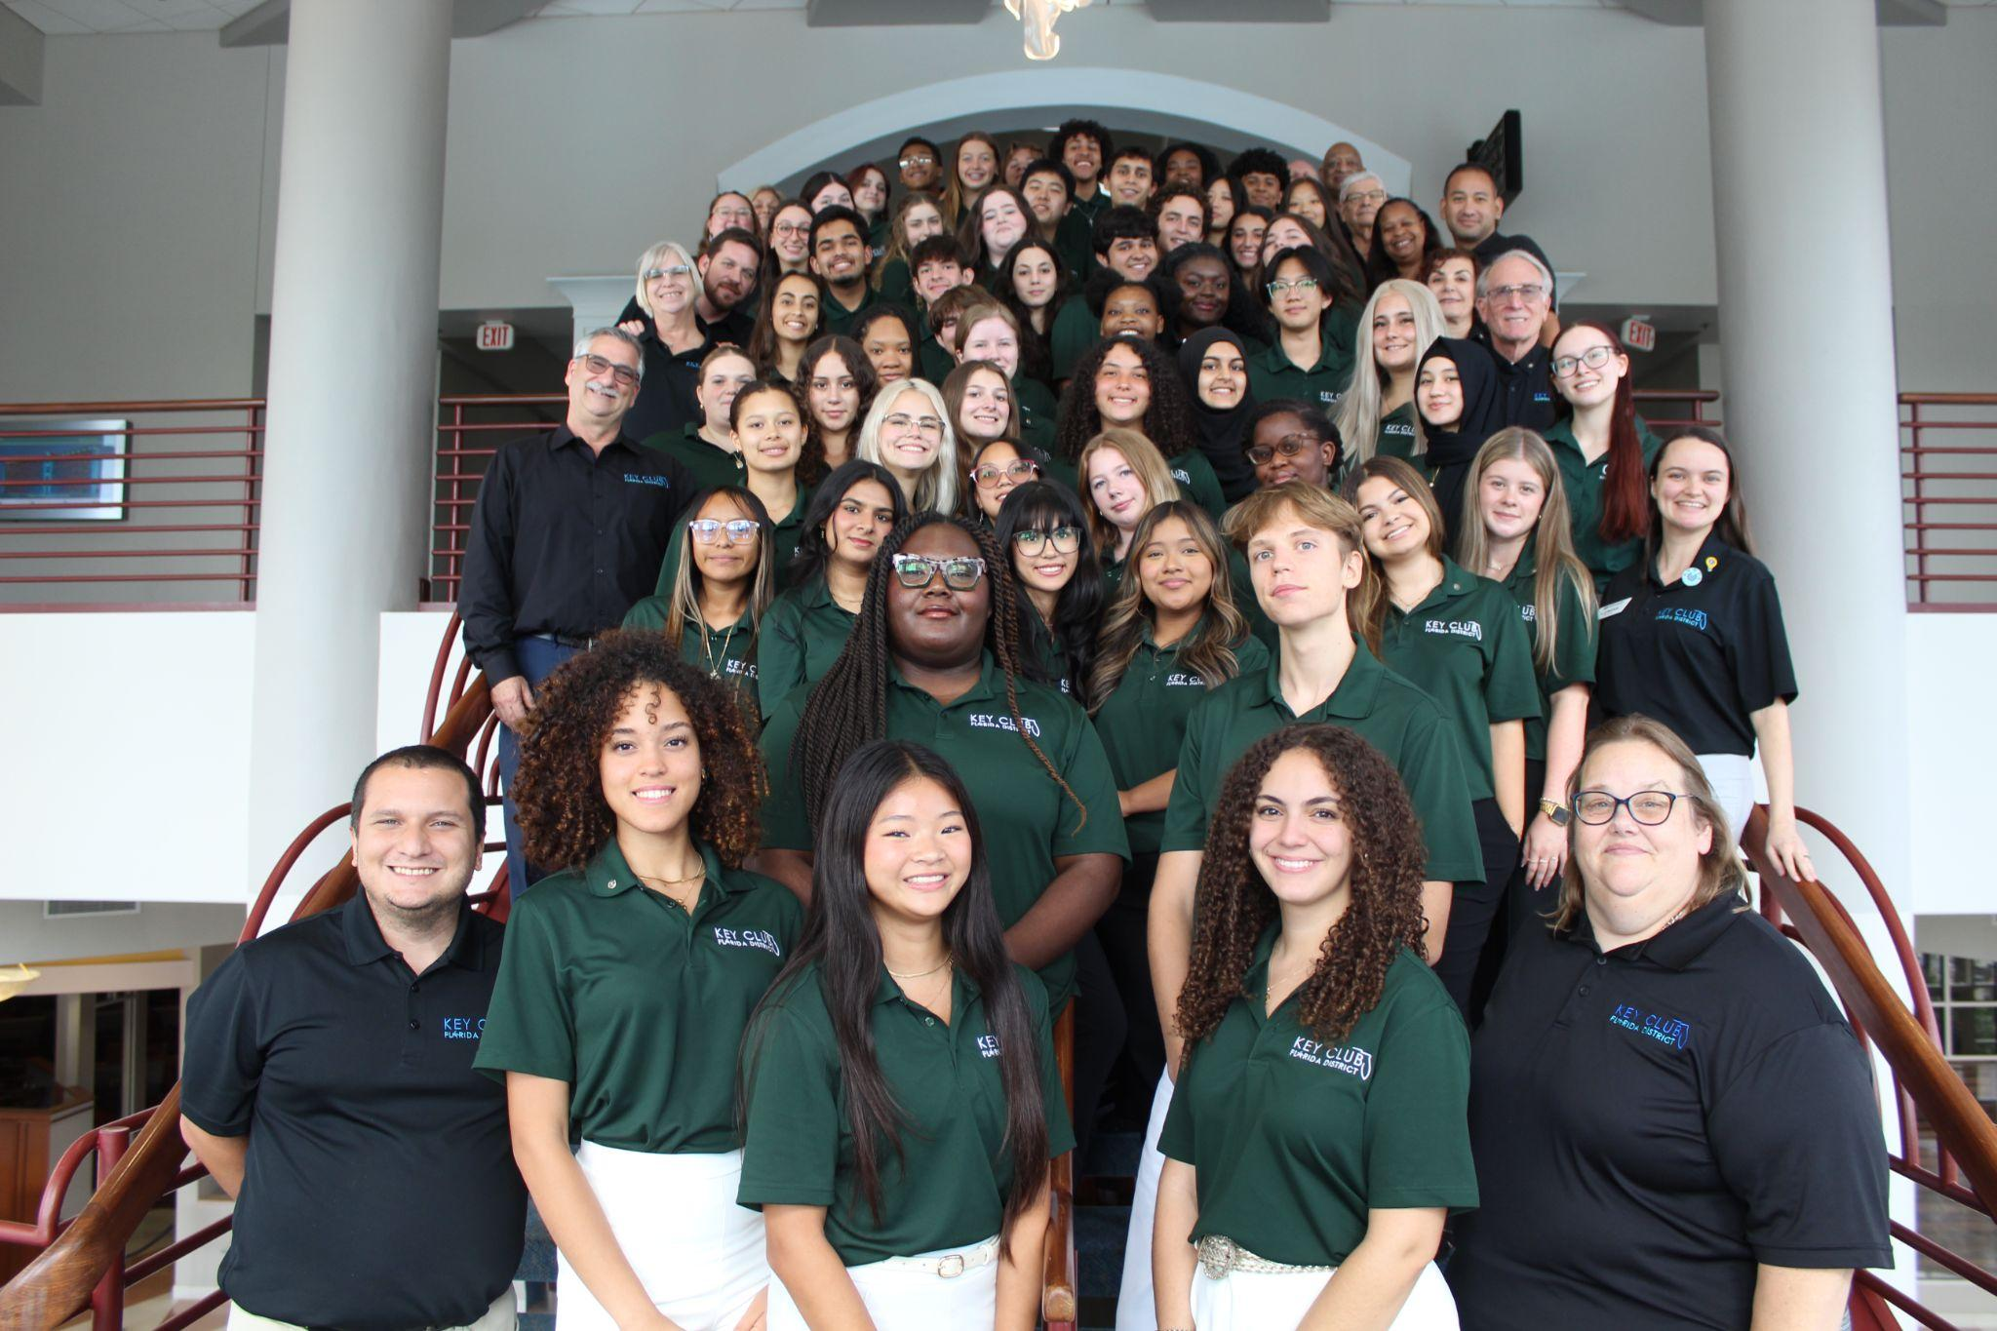
Florida Key Club
2nd largest district in all of Key Club International
Oldest district, founded in 1939
We have over 23,500 members across 400+ clubs and 41 divisions
Our Board of Trustees is comprised of 41 Lieutenant Governors, 8 Standing Committee Chairs, and 5 District Executives

Slide 5
Florida District Goals
01
02
270,000 Total Service Hours
65,000 Large-Scale Service Project Hours
03
04
25,000+ Total Members
20 Newly Chartered Key Clubs

Slide 6
Large-Scale Service Project
New initiative introduced to the Florida District this year, in place of a Governor’s Project
Will span a 4 year cycle, chosen through a feedback form and voted on by the Key Club Board
Allow for amplified impact, improved continuity, and increased participation in a meaningful initiative.

Slide 7
Strive To Thrive
Theme: Poverty
Aims to break cycles of poverty by supporting youth and families through education, community-building, and access to practical resources
Examples of Service Projects:
  Pack and distribute food baskets for families in need
  Mentor or support students at Title I schools
  Assemble hygiene kits (soap, toothbrushes, pads, etc)
  Volunteer at food pantries or help establish new ones
  Donate school supplies, backpacks, and used tech for students

Slide 8
DUES
Dues are $17 total, $10 for International, and $7 for the Florida District

Slide 9
International Partners & Preferred Charities

Slide 10

Erika’s Lighthouse
Mission: To make sure no young person feels alone in their depression and to break down the stigma surrounding mental health issues.
How to get involved:
Share free programs and mental health resources
Become a community ambassador
Educate those around you about mental health

Slide 11

Schoolhouse
Mission: Gives students free tutoring and/or allows them to become tutors themselves. Has brought tutoring to thousands of students across the world.
How to get involved:
Become a tutor
Promote tutoring through Schoolhouse to your Key Clubbers

Slide 12

The Nature Conservancy
Mission: A global environmental nonprofit working to create a world where people and nature can thrive. To conserve the lands and waters on which all life depends.
How to get involved:
Take action by signing pledges
Promote their educational resources
Plan joint service projects to volunteer with them

Slide 13

Thirst Project
Mission
Works to end the global water crisis by building freshwater wells in developing communities that need clean drinking water.
Advocate
Raise awareness about water scarcity and work with your Key Clubs to fundraise.
Key Club Walks
Walk 3.75 miles to raise $25, giving one person clean water for life.

Slide 14

UNICEF
Mission
Helps to provide for children’s needs in developing countries through services in primary health care, basic education and safe water and sanitation.
Advocate
Aid Key Clubbers in fundraising and advocating within their communities. Plan drives (food, hygiene, toys…)
Trick-Or-Treat for UNICEF
A fundraising initiative where participants collect donations for UNICEF during Halloween time.

Slide 15
DCON 2026

Slide 16
ICON 2026

Slide 17
Supporting Key Clubs
Staying Involved
Funds
Stay connected, attend their meetings, events, & service projects, invite them to meetings, events, & service projects. Plan joint projects or events to connect the K-Fam.
Support fundraising efforts, use connections to offer necessary funding for service projects or attendance at events like DCON & ICON.

Slide 18
Supporting Key Club Lieutenant Governors
Club Chartering
Club Charter goal of 20 new clubs. Be responsive and proactive if an LTG reaches out and needs help in chartering a Key Club.
Communication
Staying active with your clubs is critical to ensuring smooth communication, especially if an LTG is struggling to get in contact with a club. Communication is key.

Slide 19
Thank You!

Slide 20
Questions?
Email: governoreleanor@floridakeyclub.org

