Slide 1
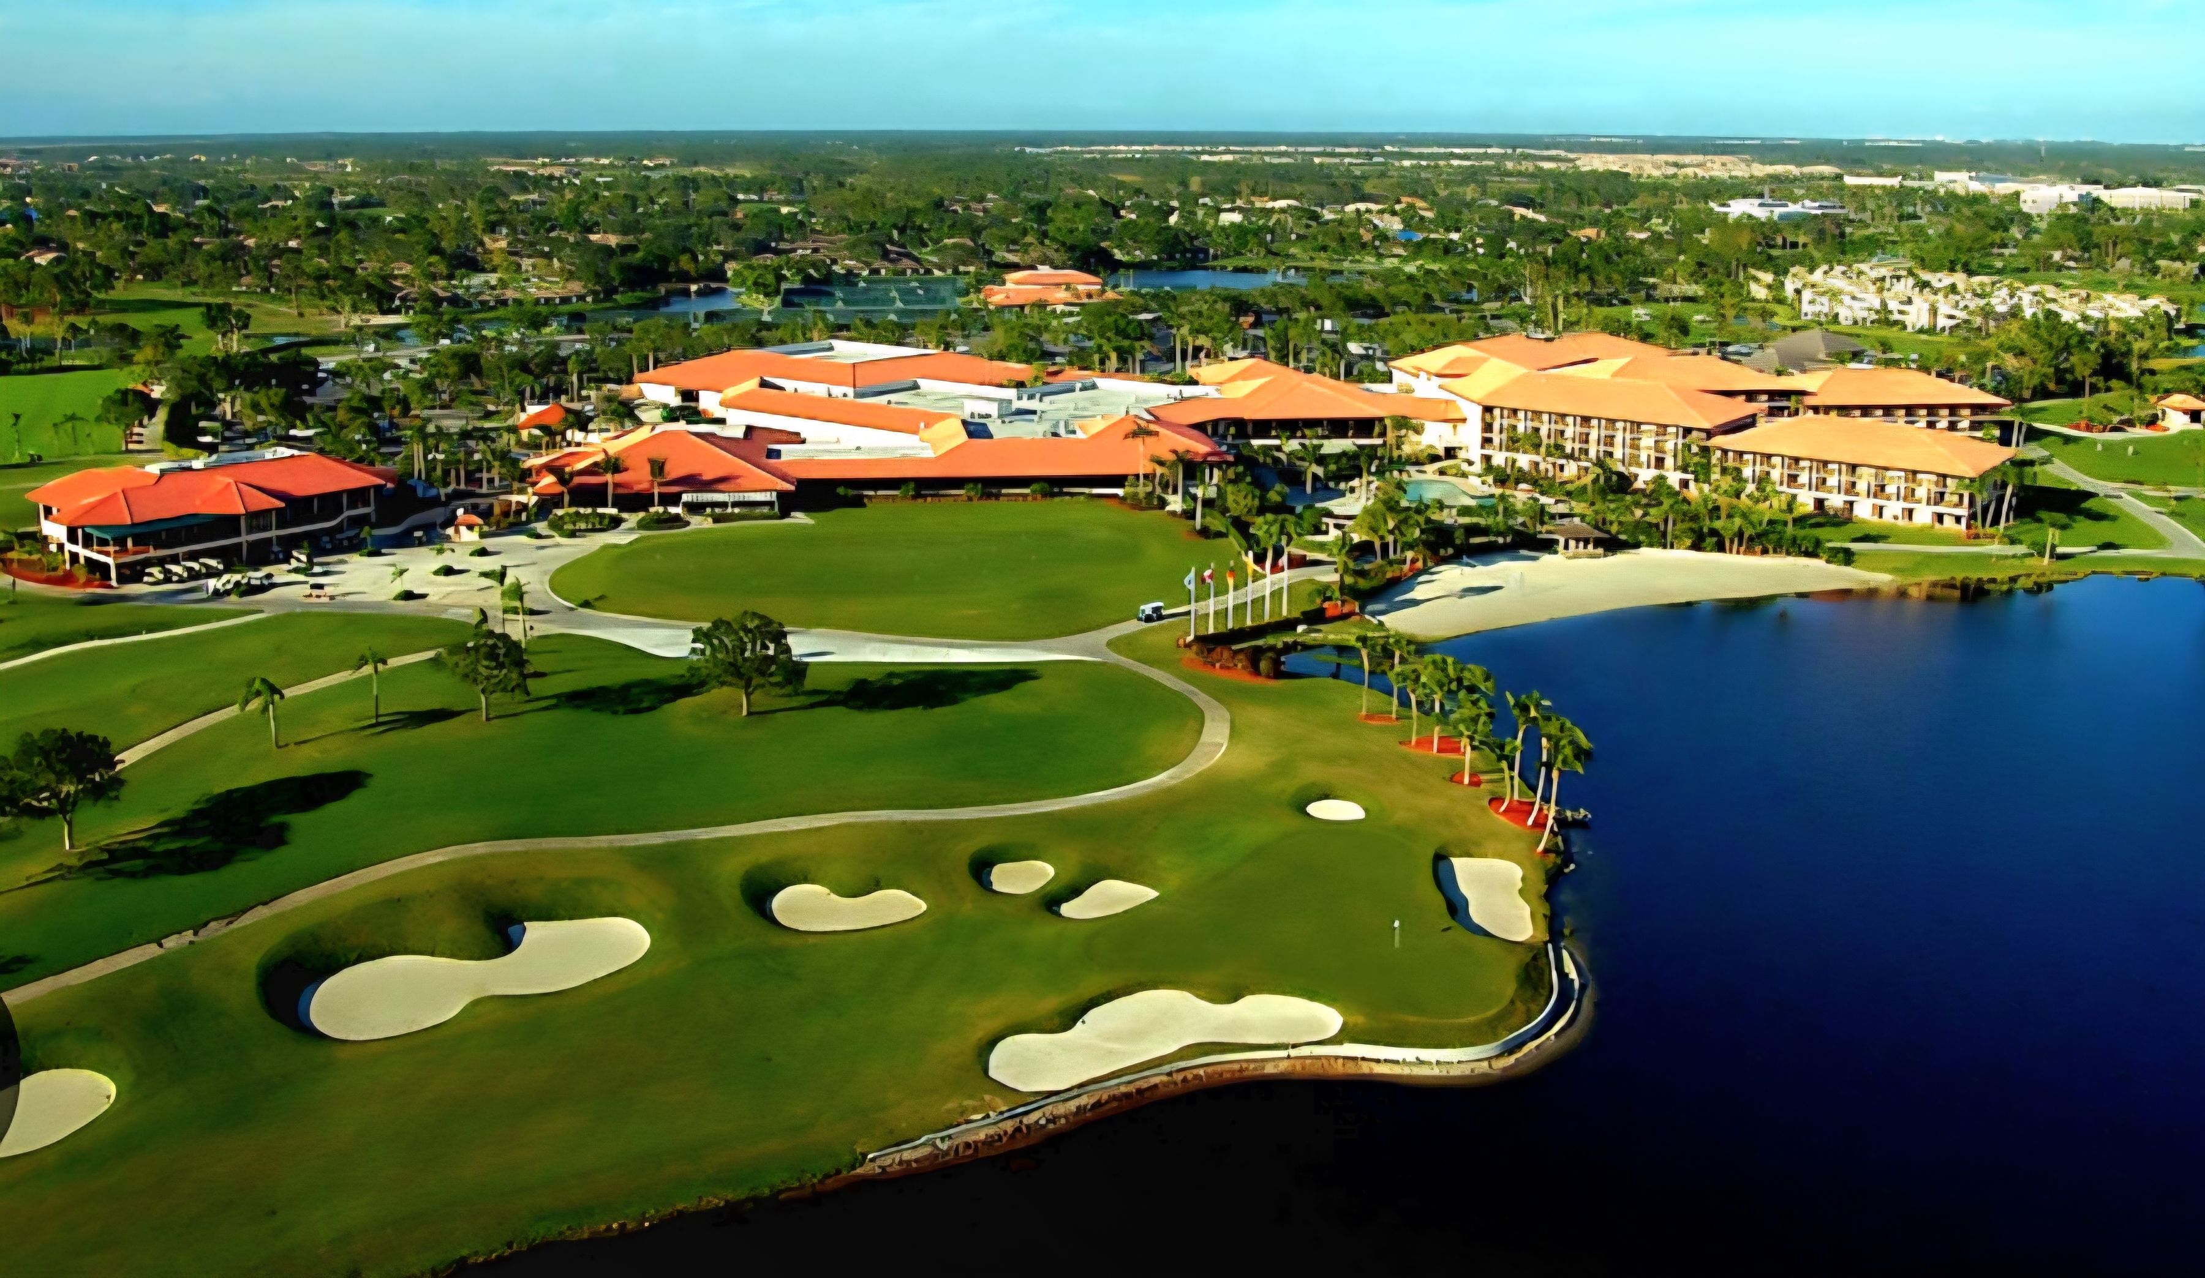


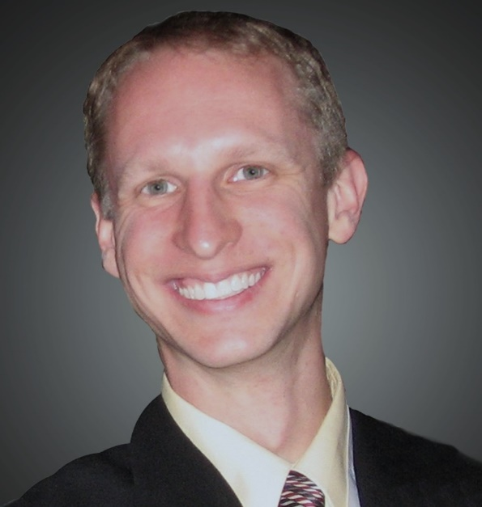

Kiwanis-101
PGA National Resort & Spa
Governor
Jeremy Reihl
2024-2025
Bob “Carp” Carpenter
Secretary 37-Years, Distinguished 20-Years
Port Charlotte Sunrise Kiwanis Club
carp813@comcast.net

Slide 2

KIWANIS HISTORY
1914: Detroit business fraternity, Benevolent Order Brothers (BOB)
Wanted New Name
Otchipow Indian phrase: “Nunc Kee-Wan-Is” means: “We have good time, make big noise” drop“Nunc,” for “Kiwanis”
    (New Focus on business networking)
Chartered: Detroit, MI Jan. 21, 1915
1916: Became International; included Canada
1919: Focus changed to service.
1962: Expanded worldwide.
1987: Women admitted to Kiwanis. (37-Years Ago)

Slide 3


MOTTO-STATEMENT-LOGO
KIWANIS MOTTO
“Serving the Children of the World” (Originally: “We Build” )
DEFINING STATEMENT
“Kiwanis is a global organization of volunteers dedicated to improving the world one child & one community at a time”
K.I. LOGOS (Branding)
“KIWANIS FAMILY” replaces “K-FAMILY”
Official Wordmark
Old Classic Seal: Meridians no longer used

Slide 4

KIWANIS ACRONYMS
(Pronounce/Write full name FIRST; then use Acronym)
BUG Bring Up Grades
CKI Circle K International
CLE Club Leadership Education
DCM Division Committee Meeting
DCON District Convention
H&SV Human & Spiritual Values (Committee)
ICON International Convention
K1D Kiwanis ONE Day
KI Kiwanis International
KIF Kiwanis International Foundation
MNT Maternal/Neo-Natal Tetanus
RAW Read Around the World
SLP Service Leadership Program (Committee)
WSP Worldwide Service Project
YC:PO Young Children: Priority One (Committee)

Slide 5
OBJECTS OF KIWANIS
The 6 permanent Objects of Kiwanis International were approved at the 1924 Convention in Denver and have remained unchanged.
Object 1 - To give primacy to the human and spiritual rather than to the material values of life.
Object 2 - To encourage the daily living of the Golden Rule in all human relationships.
Object 3 - To promote the adoption and the application of higher social, business, and professional standards.
Object 4 - To develop, by precept and example, a more intelligent, aggressive, and serviceable citizenship.
Object 5 - To provide, through Kiwanis clubs, a practical means to form enduring friendships, to render altruistic service, and to build better communities.
Object 6 - To cooperate in creating and maintaining that sound public opinion and high idealism which make possible the increase of righteousness, justice, patriotism, and goodwill.

Slide 6
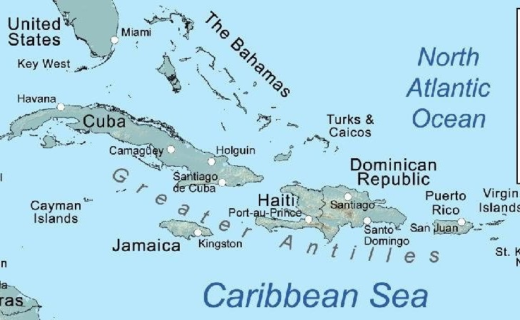
WHERE IN THE WORLD IS KIWANIS
THE AMERICAS DISTRICT:
UNITED STATES: AL, Carolinas, GA, IN,
KY-TN, MI, MS-AR, CA-NV-HI, Capital, FL,
IL, IL-E. Iowa, KS, LA-MS-W.TN, MN-Dakotas,
MT, NE-IA, NJ, OH, PA, Southwest, UT-ID,
WI-Upper MI, New England, NY, Pacific NW,
Rocky Mountain, TX-OK, WV.
Florida District: Puerto Rico; Turks & Caicos;
Grand Cayman; and St Croix, USVI.
W. CANADA, E.CANADA & CARIBBEAN DISTRICT
ANDEAN & CENTRAL AMERICA, ECUADOR DISTRICT
EUROPE DISTRICT: Austria, Belgium-Luxembourg, Czech Republic & Slovakia, France-Monaco, Germany, Iceland- Faroes, Italy-San Marino, Netherlands, NorDen, Poland., Switzerland-Liechtenstein.
ASIA-PACIFIC DISTRICT: Australia, Japan, Malaysia, New Zealand-South Pacific, Philippine Luzon, Philippine South, Taiwan.

Slide 7
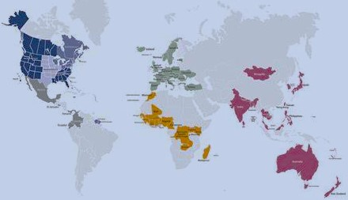
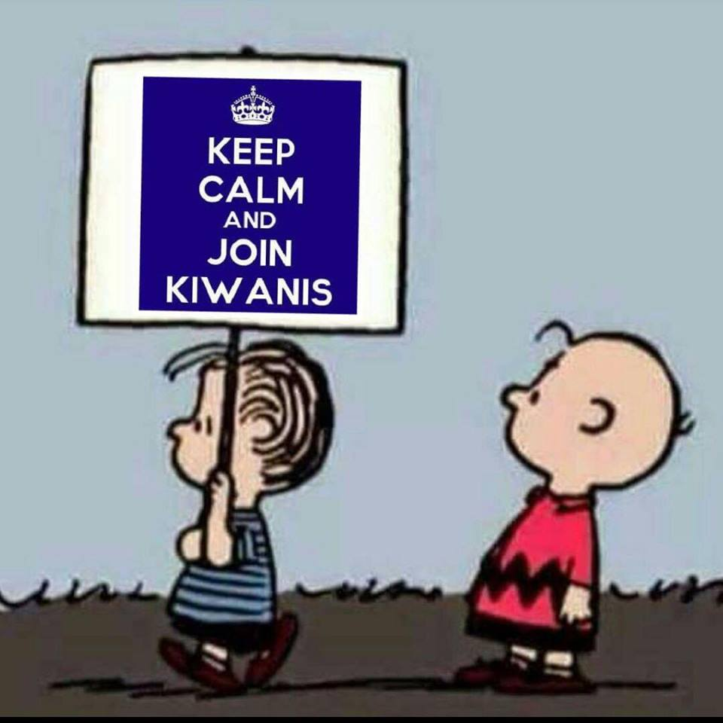
KIWANIS IN 83 NATIONS

Slide 8

KIWANIS FAMILY BY THE NUMBERS
Family Members Clubs Nations Audience
Kiwanis: 175,224 7,369 83 Adults
Circle K (CKI): 6,226 445 19 College/University
Key Club: 225,144 4,777 47 High School, ages 14-18
Builders Club: 23,231 1,062 32 Middle School, ages 11-14
K-Kids: 24,910 1,138 25 Elementary, ages 6-12
Lamar Fisher started the first K-Kids here in Florida
AKtion Club: 7,282 402 13 Adults with disabilities
Jake Swartout started the first AKtion Club in Florida,1987
TOTAL: YOUTH MEMBERS = 273,285
TOTAL: Kiwanis Family in 83 Countries: 448,509 Adult & Youth members

Slide 9

HOW DO I FIT IN?
Kiwanis International
Trustees/President
Indianapolis, IN
1-800-KIWANIS
CLUB OFFICERS:
President
Immediate Past Pres.
President Elect (or V.P.)
Secretary
Treasurer
FLORIDA DISTRICT
Trustees/Governor
DIVISION
Lt. Governor
CLUB
Board/President
“YOU” the MEMBER

Slide 10
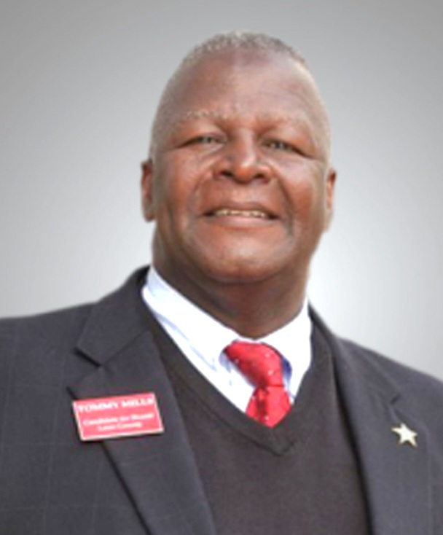
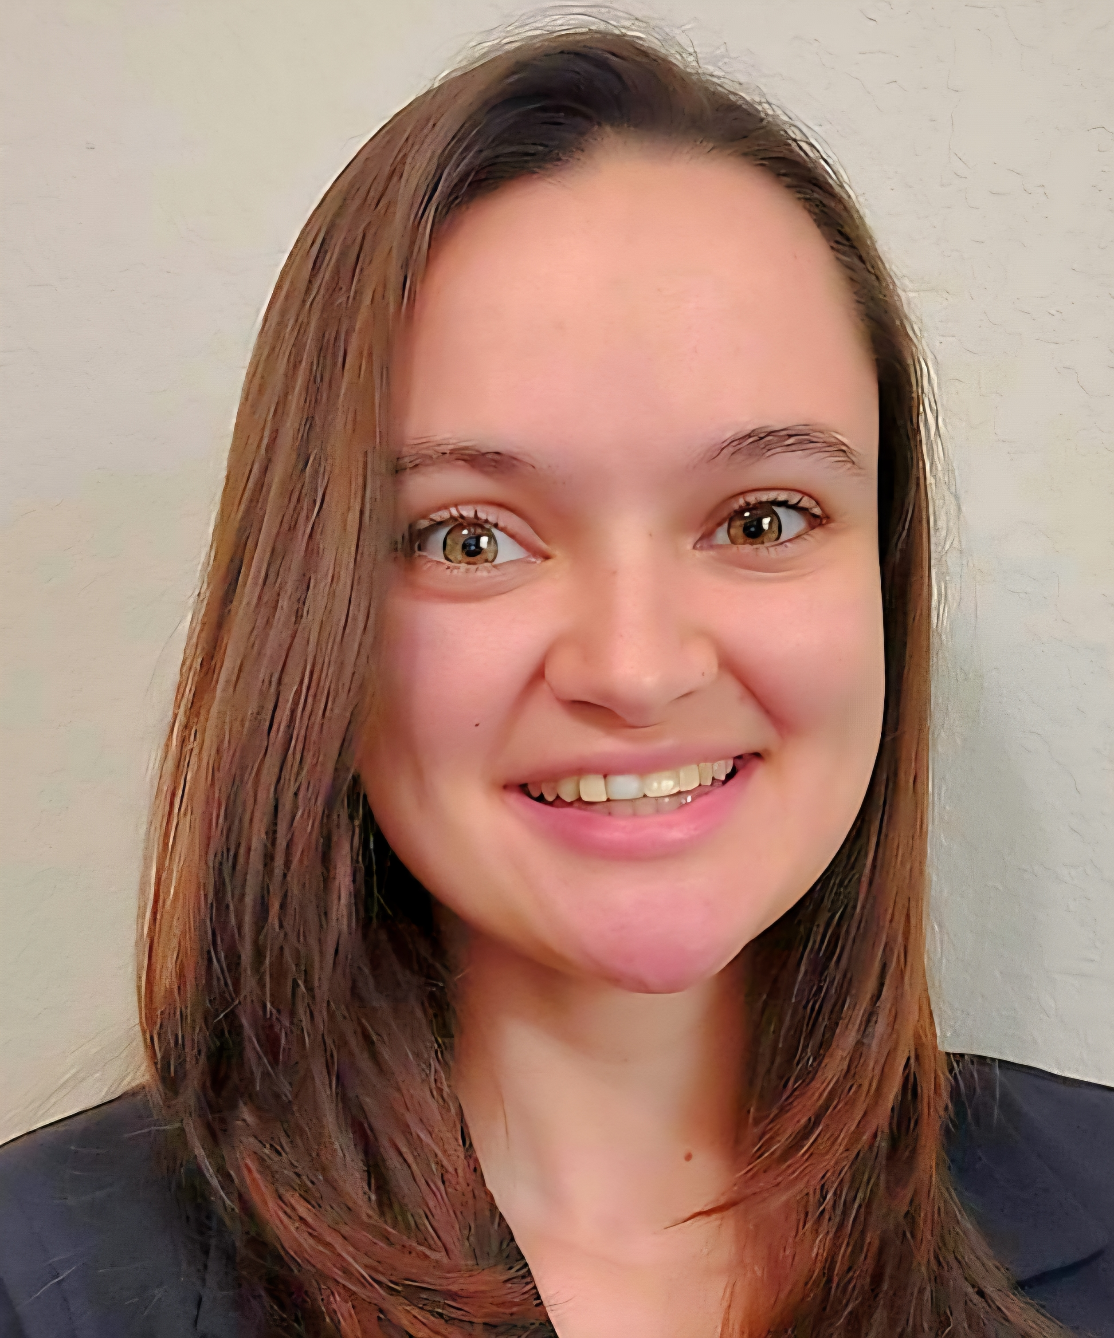
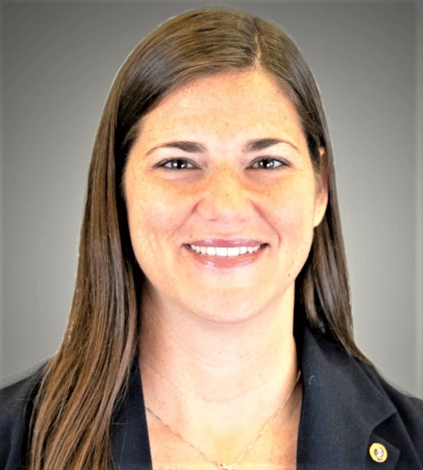
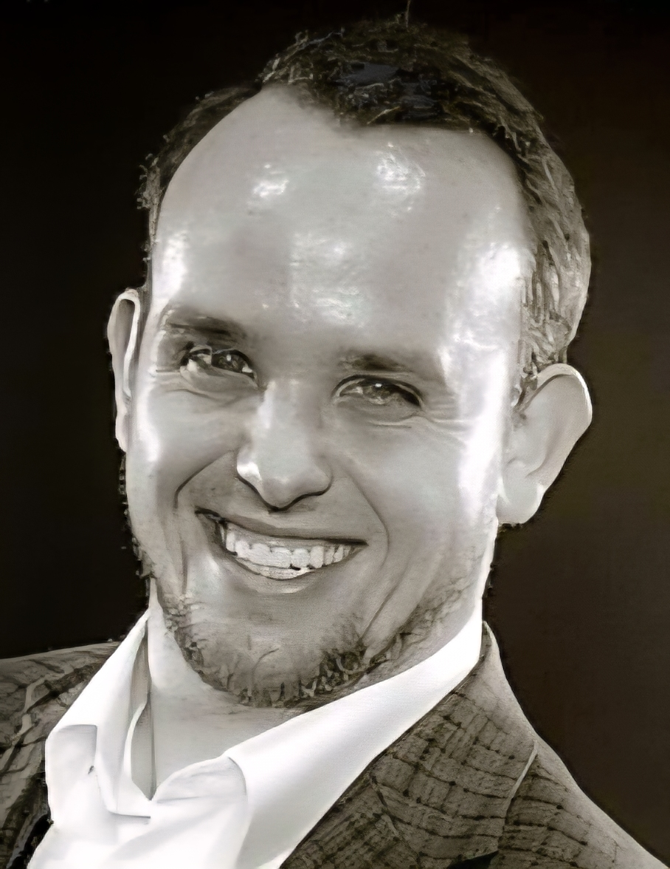
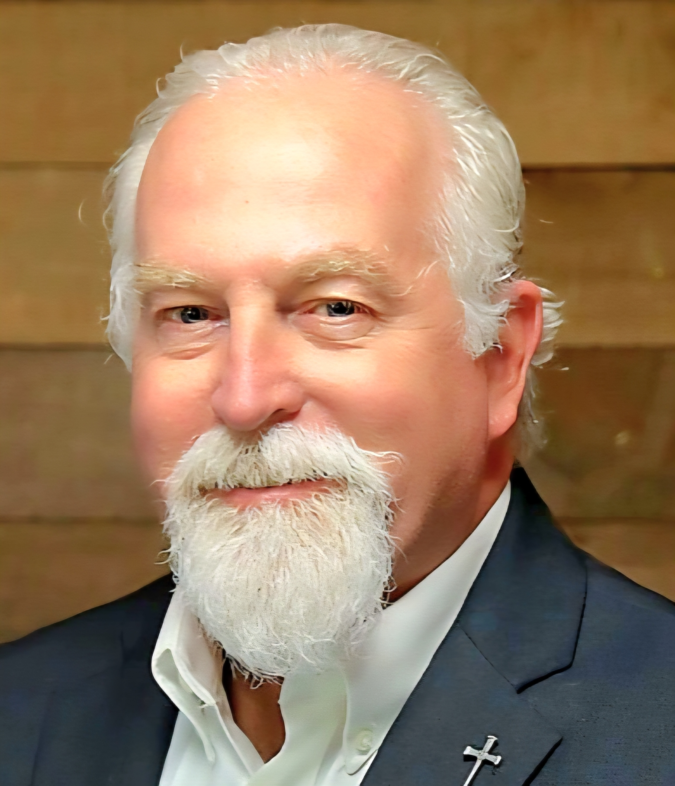

WHO’S WHO AT DCON
Jeremy Riehl
Governor (2024-25)
Tommy Mills
Gov-Designate
(2025-26)
Linda Skaathun
Vice-Governor
(2026-27)
Prairy Riehl
Imm. Past Gov.
(2023-24)
James Lewis
Dist. Secretary
Keith Hatch
Dist. Treasurer
Incoming Oct.1, 2025

Slide 11
CLUB ADMINISTRATION
Club BYLAWS define structure and operation!
Members amend club Bylaws
Members elect officers & directors
      Board determines club policies
      Board approves club projects
      Board sets & approves club budget
FINANCES
Administrative Account:
Dues, new member fees, club operating expenses, ICON, DCON, etc.
Service Account: Income from PUBLIC fund-raising, projects, contributions, CANNOT be used to pay club admin expense. (Exception: Insurance)

Slide 12


FOUNDATIONS
KIWANIS INTERNATIONAL FOUNDATION
$8 (or $160 per club) per year requested per member
Mission: Assist Kiwanis in serving children of the world.
FLORIDA KIWANIS FOUNDATION
$8 GIFT per year requested per member
PROVIDES: Financial support to SLP clubs. Seed money for club/division project.
Money for disaster relief.
Become a Sustaining Partner for $25 annually!
(Contact your Division Trustee)

Slide 13
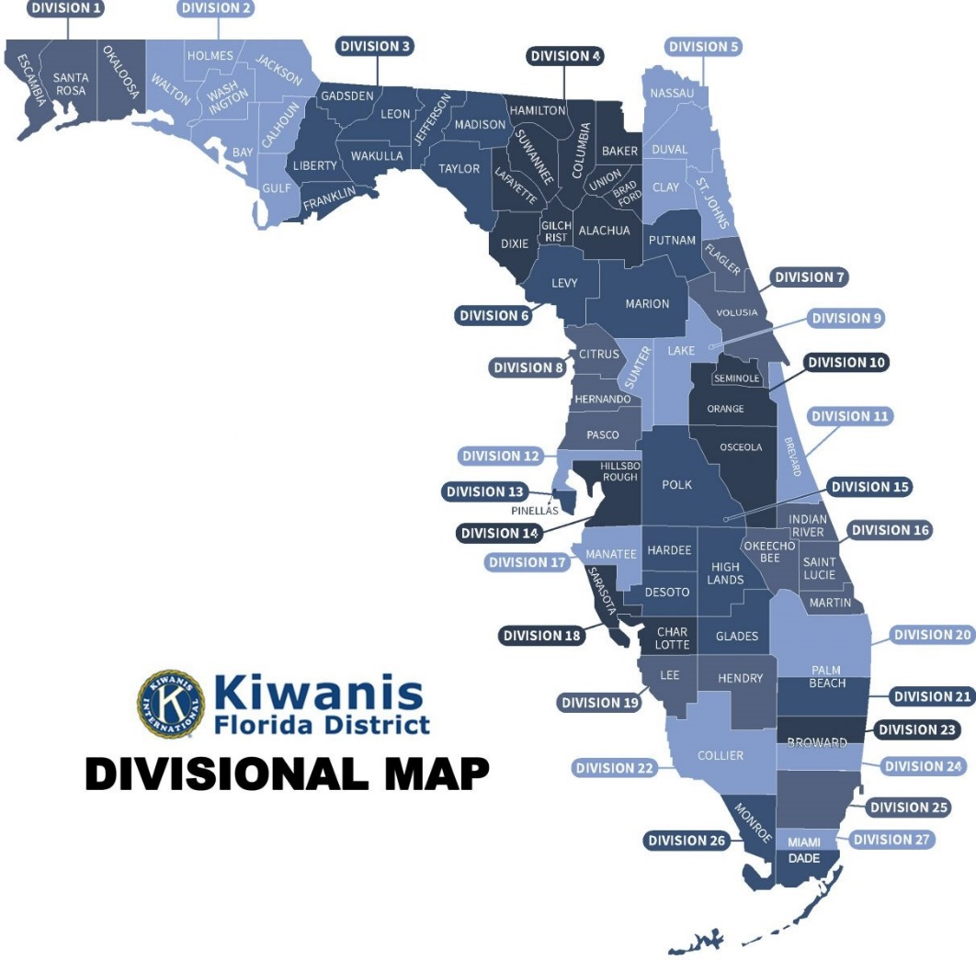
FLORIDA DISTRICT FACTS
Florida: Grand Cayman-Turks & Caicos-San Juan, Puerto Rico-St. Croix, USVI
1924 Became a District (Was Alabama-Florida District)
209 Clubs
27 Divisions
5,747 Kiwanians
  District Office
  District Secretary, James Lewis
  FLKiwanis.DistrictSecy@gmail.com

Slide 14
First Timers
PGA National Resort & Spa
Governor
Jeremy Reihl
2024-2025
Bob “Carp” Carpenter
Secretary 37-Years, Distinguished 20-Years
Port Charlotte Sunrise Kiwanis Club
carp813@comcast.net

Slide 15

FIRST TIMERS TO DCON
Understanding Your First
Kiwanis “DCON”
District CONVENTION (Aug. 7-10, 2025)
Bob “Carp” Carpenter, Secretary 37-Years; Distinguished 20-Years
Kiwanis Club of Port Charlotte Sunrise carp813@comcast.net
Program Booklet……..Get at Registration.
OR………SCAN“QR” Code:
Download EVENTEE App in Apple Store, or PlayStore.
Click on Eventee App logo, INSTALL, Continue, and open to: “Florida Kiwanis DCON”

Slide 16

REGISTRATION
MUST register & wear NAME TAGS at ALL Convention functions.
MEAL/EVENT TICKETS: Provided in Packet
Ask for 1st Timer Ribbon & wear it
(Put tickets in Name Tag case; present at door)
CREDENTIALS:
Once Registered, if you are 1 of 3 of your Clubs voting delegates,
go to Credentials Desk, get your documents.
*FIRST TIMERS CONTEST: Pick up at Registration; Get signatures from VIP’s listed.
Win Free DCON Registration next year!

Slide 17

SUGGESTED DRESS CODE
CASUAL: At all Convention events
Except : Saturday Evening RETIREMENT/INSTALLATION BANQUET
Formal Dress requested, or Dressy Casual (No Shorts)
KIWANIS GOT TALENT, 9:00pm, Casual Dress, (PGA FOYER)
AFTER PARTY with DJ (BRITISH OPEN BALLROOM)

Slide 18
MISCELLANEOUS INFO
Use Program guide on your EVENTEE App
Workshops: Which ones should I choose?
Resources Hall & Exhibits
Free Time
The Caring Corner
* SERVICE PROJECT: 2-3pm Friday Produce 50,000 Pre-Packaged Meals for Needy

Slide 19

FRIDAY ACTIVITIES
8am-5pm: REGISTRATION & CREDENTIALS
(VISTA “A” Registration) (ATRIUM Registration)
8am-5pm: Exhibits & Resources Tables
(ATRIUM Registration) & (PGA FOYER)
9am-5pm: Caring Corner (CANTERBURY)
WORKSHOPS #1, #2, #3
8:30am-9:15am (Use EVENTEE APP; Select Workshops & Location)
9:30am-10:15am “
10:30am-11:15am “

Slide 20
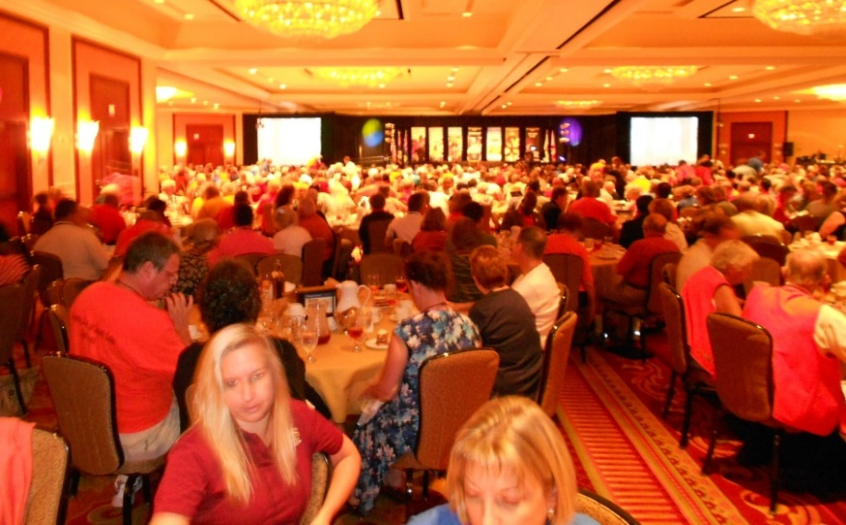
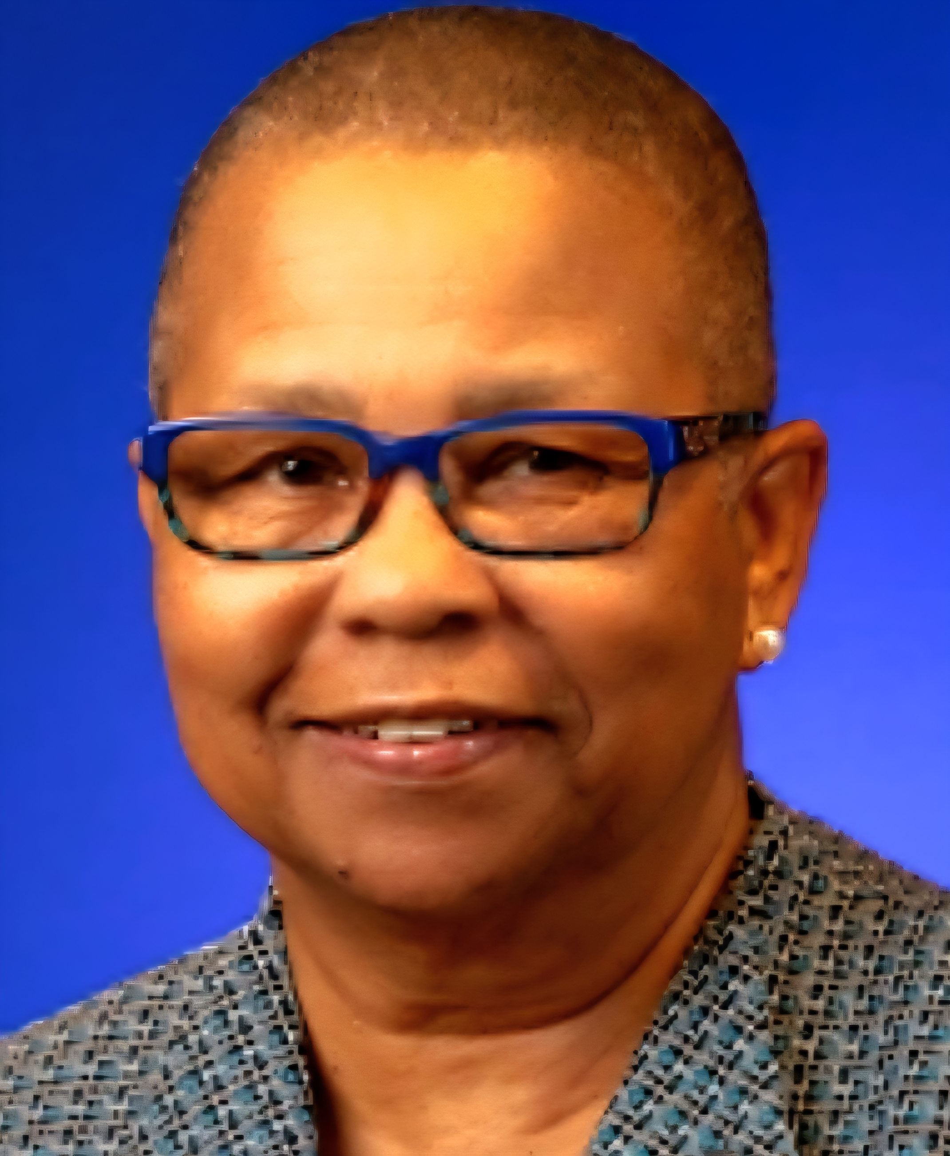
FRIDAY INTERCLUB LUNCHEON
11:30am-2:00pm LUNCHEON (Ticket Required) (PGA BALLROOM)
Accessible entry 11:00am; All doors open 11:10am
Keynote Speaker: TROY C. SMITH on “HOPE” Helping Other People Excel
2:00-3:00pm, SERVICE PROJECT (BRITISH OPEN BALLROOM)
3:15pm-4pm & 4:15pm-5pm WORKSHOPS #4 & #5
4-5pm GLOW IN THE DARK PUTT PUTT (MASTERS TERRACE)
8pm FAMILY FUED (CKI Alumni Association) (PGA NATIONAL)
10pm KIWANIS LATE NIGHT “HAPPY HOUR” (LOBBY BAR)
HOPE MARKES
K.I. Trustee for FLA 2025-26
K.I. Vice-President
Hanover, Jamaica

Slide 21
FRIDAY EVENING
Dinner : “On Your Own”
Restaurants at PGA NATIONAL, or Palm Beach Gardens

Slide 22
SATURDAY SCHEDULE
6:30am-8:30am: REGISTRATION (VISTA “A”) & CREDENTIALS (ATRIUM)
8:30am-11:00am “SHARP”: House of Delegates (BRITISH OPEN BALLROOM)
Voting Delegates : MUST present Credentials at the door.
  [District Business, Reports, Candidates, Issues & Voting]
Non-Voting Delegates: Special seating area in the room.
11:30am-1:30pm Kiwanis Family Celebration (LUNCHEON) (PGA BALLROOM)
9am-3pm: Exhibits & Resource Tables (ATRIUM) & ( PGA FOYER)
9am-5pm: Caring Corner (Basket Pickup at 4pm) (CANTERBURY)
10am-10:45am: WORKSHOP #6

Slide 23
SATURDAY INTERCLUB LUNCHEON
LUNCHEON
11:30am-1:30pm (Ticket Required)
Accessible entry 11:00am; All doors open 11:10am PGA BALLROOM)
2024-25 Farewell Remarks by
Governor Jeremy Riehl
WORKSHOPS #7 & #8
2:15pm-3:00pm:
3:15pm-4:00pm: “
9am-3pm: Exhibits & Resources closes. (ATRIUM) & (PGA FOYER)
9am-5pm: The Caring Corner closes. (Check List: Pickup winning baskets at 4pm)

Slide 24
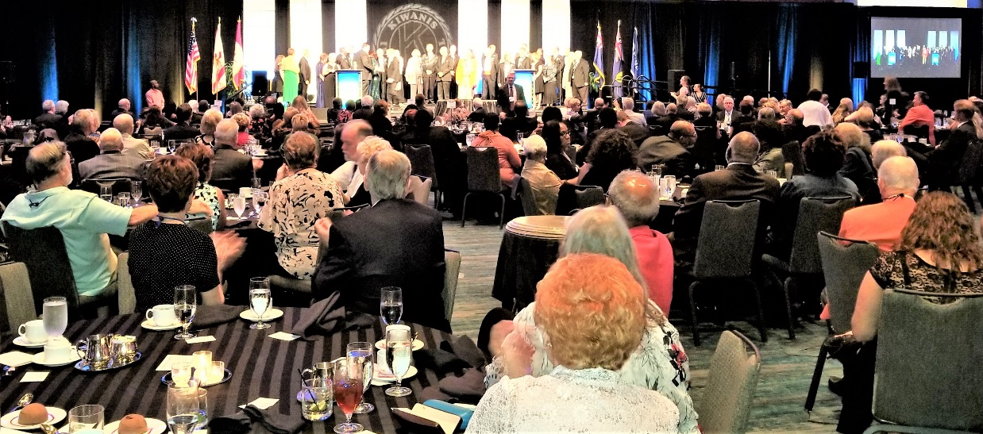

SATURDAY EVENING
6pm: District Reception (Cash Bar) (PGA FOYER)
7pm: GOVERNOR’S BANQUET (PGA BALLROOM)
(Ticket Required) Accessible entry 6:30pm/Doors open 6:40pm
Formal Dress Requested….or Dressy Casual
Inagural Address: Governor Designate TOMMY MILLS
9:00pm “KIWANIS GOT TALENT” & AFTER PARTY with DJ (BRITISH OPEN BALLROOM) (NO Ticket) Required)

Slide 25
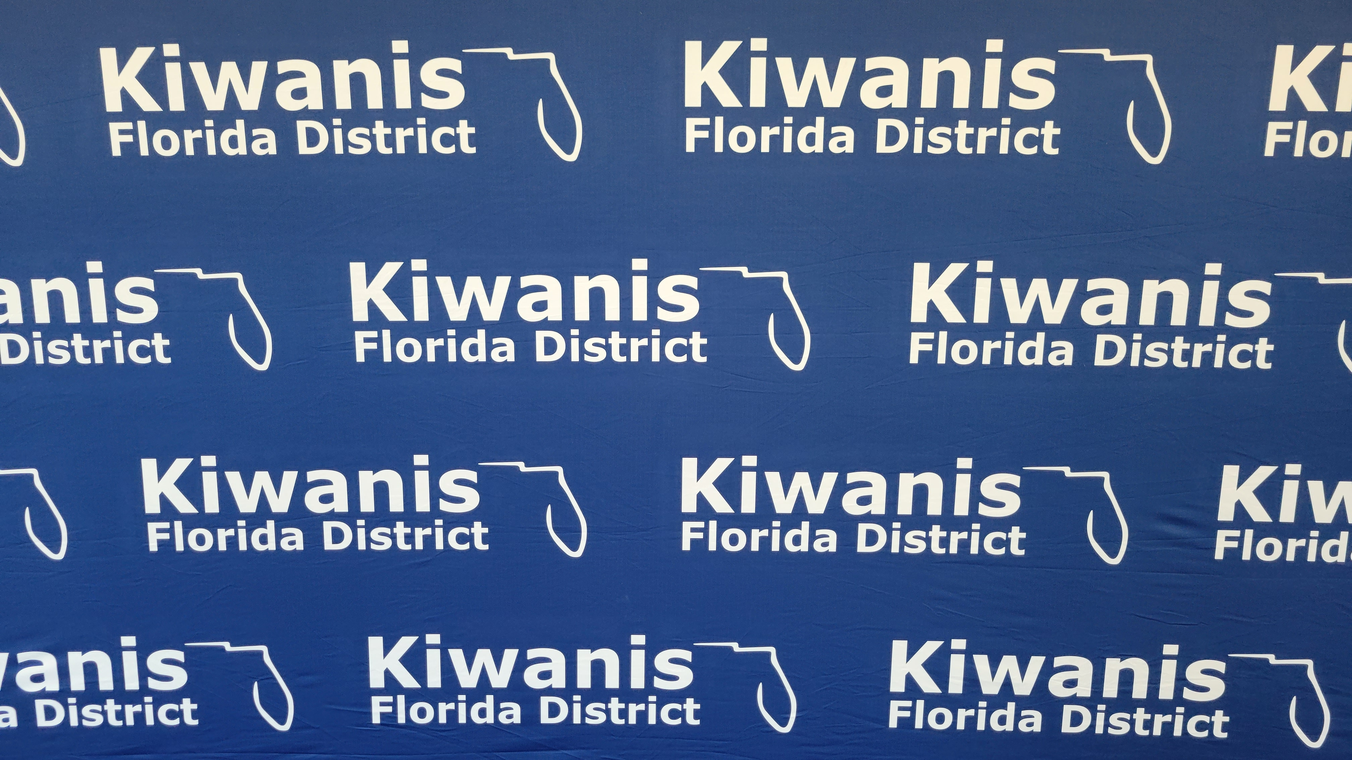
SUNDAY MORNING
7:45am-8:15am: Breakfast Buffet PGA FOYER) (Ticket Required)
8:15am-9am: CLOSING CELEBRATION SESSION (PGA BALLROOM)
SPEAKER: ALICE SIMS:
Assistant Secretary of Florida Department of Juvenile Justice.
11:00am: Hotel Checkout

Slide 26

2025-26 Gov. Tommy Mills says…
“Enjoy your FIRST DCON!”
Bob “Carp” Carpenter
Secretary 37-Years, Distinguished 20-Years
Kiwanis Club of Port Charlotte Sunrise
carp813@comcast.net

