Slide 1

Welcome & Introduction
Partners
for
Impact
Presented by:
Kerri Gordon & Winsome Radcliffe
Notes:
Kerri:
“Howdy, folks! Welcome to Partners for Impact. I’m Kerri, and this is my partner in impact, Winsome. Today, we’ll explore how we can join forces with other organizations to multiply our service, fundraising, and membership growth.”
Winsome:
“Partnerships are at the heart of what Kiwanis does best—building connections that make our communities stronger. And we promise this won’t be a lecture—there’s fun ahead!”

Slide 2



Bingo
🤠 Howdy Y’all! Here’s How It Works:
🐎 Mosey on around and mingle with the other folks over yonder
🤝 Find a gal or fella who’s partnered with an organization on your card
📝 Write their name in that square lickety-split
⭐ Fill the free space with your club’s best and most unique partner
⚡ Do it quick, sweetie—you’re in a race
📣 When you get five across, holler “YEE-HAW!”
🎉 Then Bless your Heart cuz you’re fixin’ to win this game.
Notes:
Kerri:
“Speaking of fun… we’re kicking off with Howdy Partner Bingo! Here’s how it works:
Mosey on around and mingle with the other folks over yonder
🤝 Find a gal or fella who’s partnered with an organization on your card
📝 Write their name in that square lickety-split
⭐ Fill the free space with your club’s best and most unique partner
⚡ Do it quick, partner—you’re in a race
📣 When you get five across, holler “YEE-HAW!”
Don’t forget to greet each other with a big ole Howdy Partner, Gentlemen feel free to tip your imaginary hat and ladies respond however you see fit.
Winsome:
“Let’s get to mingling! Ready? Go!”
(After the game)
Kerri:
“Look at all these partnerships already happening. That’s what this workshop is all about—building on that energy.”

Slide 3
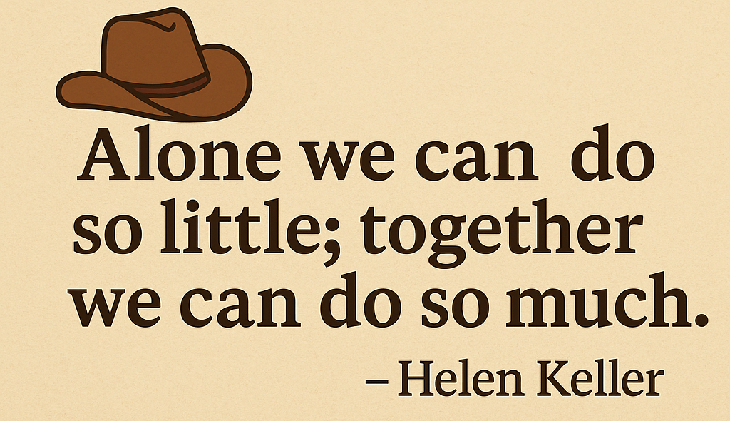
Partnerships Matter
Multiply resources
Extend reach
Amplify impact
Notes:
Winsome:
“So why do partnerships matter? Quite simply, they multiply our resources, extend our reach, and amplify our impact.”
Kerri:
“Exactly. Plus, they build relationships that can last for years. Partnerships are not just about one project—they’re about creating a network that strengthens your community. Remember: Alone we can do so little; together we can do so much.”

Slide 4
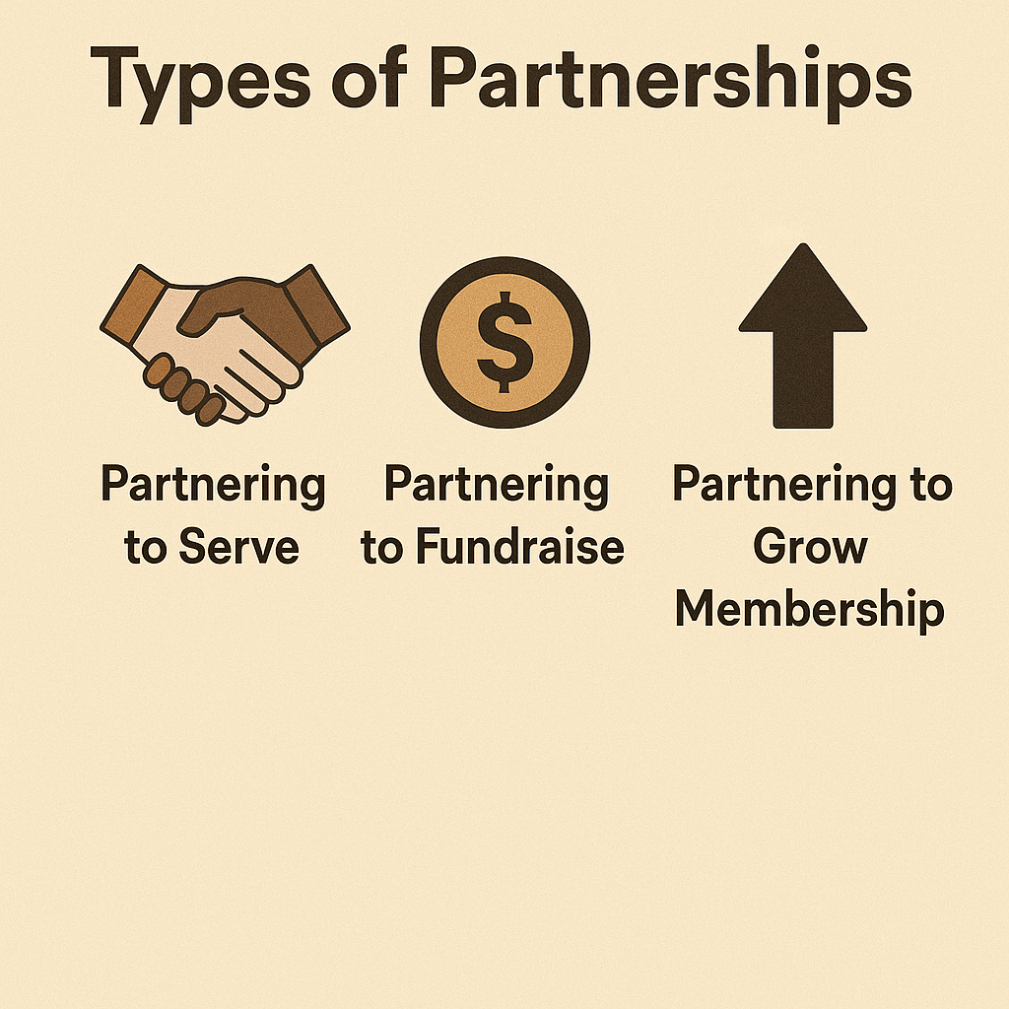
Types of Partnerships
Notes:
Kerri:
“There are three main ways partnerships can transform your club: through service, fundraising, and membership growth.”
Winsome:
“We’ll walk you through each one with examples—and then it’s your turn to think about how they fit your club.”

Slide 5
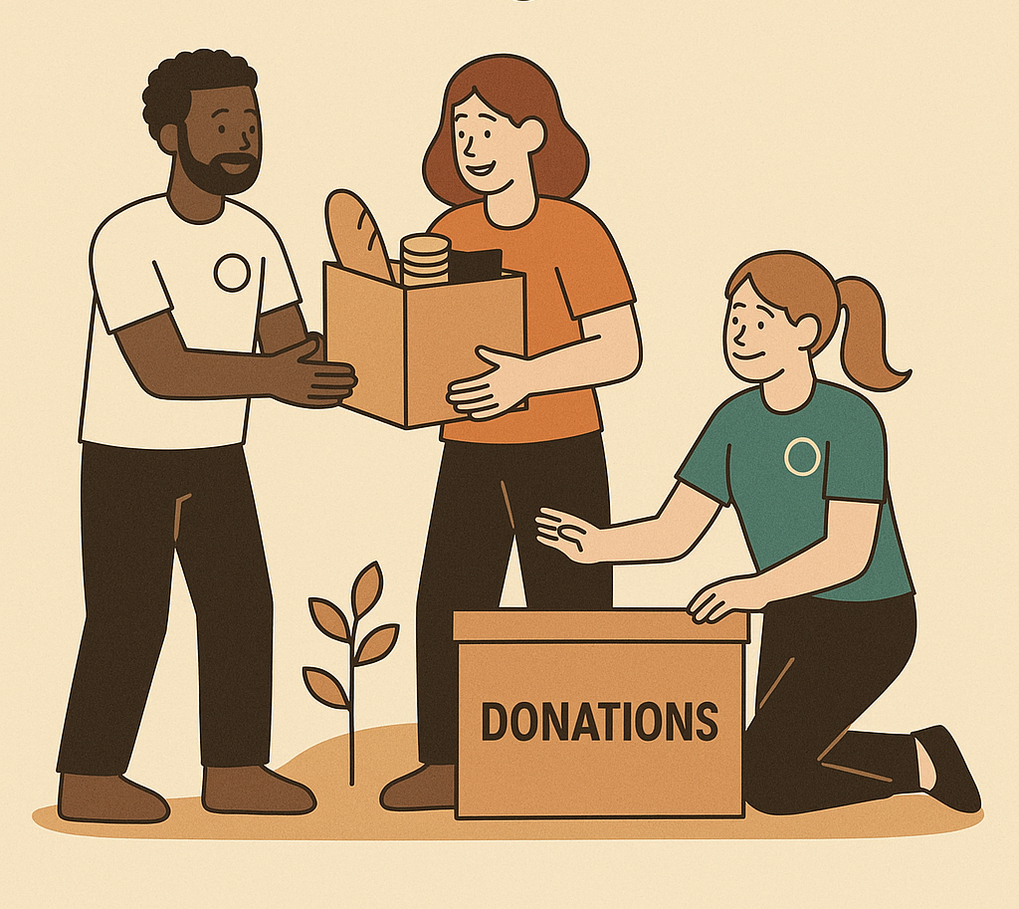
Partnering for Service:
Food distribution event
Health fair
Recycling event
Beach/park clean-up
Cpr training
Therapy dog reading
Notes:
Kerri:
“First up—service partnerships. When we team up with schools, shelters, libraries, or first responders, our projects go further.”
(Share examples: animal shelter, fire department, library)
“Who here has done a joint service project? Shout it out!”

Slide 6
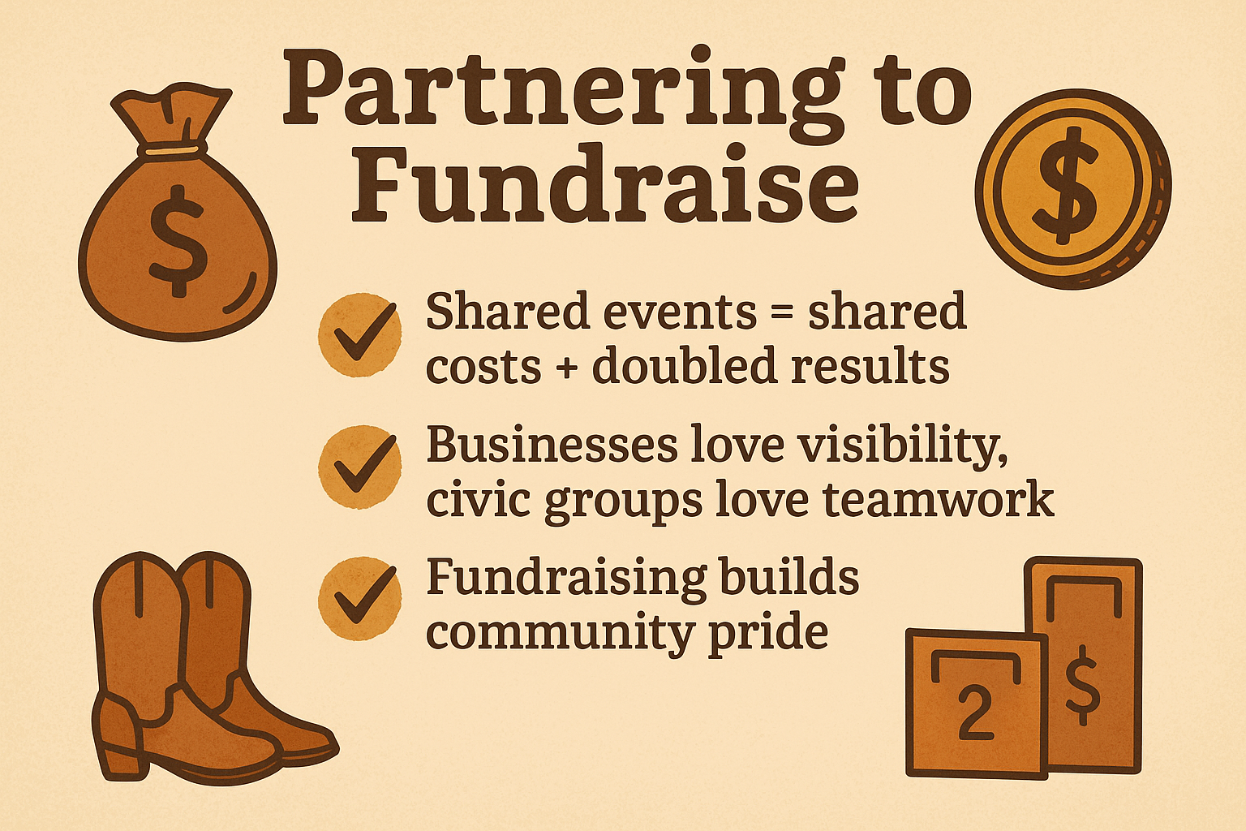
Partnering to Fundraise:
Color run/walk-a-thon
Bingo/trivia night
Cornhole/chili cook-off
Restaurant give-back night
Christmas tree sale
Retail round-up
Notes:
Winsome:
“Next—fundraising. Partnerships here are powerful. Businesses love visibility, and civic groups love working together. Shared events mean shared costs—and bigger results.”
(Give examples: restaurant give-back night, joint gala, nonprofit grant)
“Anyone have a creative fundraising collab to share?”

Slide 7
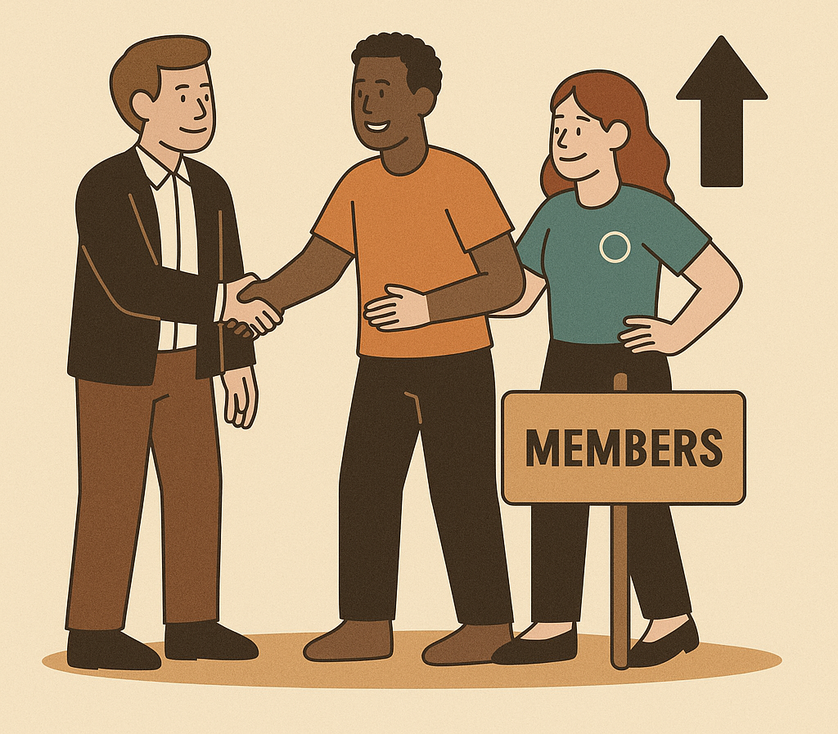
Partnering to Grow Membership
Bring a friend day
Veterans event/honor flight
Faith based/church/school
Slp parent night
Lunch and learn
Recognition events
Notes:
Kerri:
“Finally, partnerships can grow our Kiwanis family. Invite partners to meetings, co-host events, and leverage SLPs like Key Club or CKI. Many of our strongest members started as partners!”
(Brief example: Key Club parents, business sponsors)

Slide 8

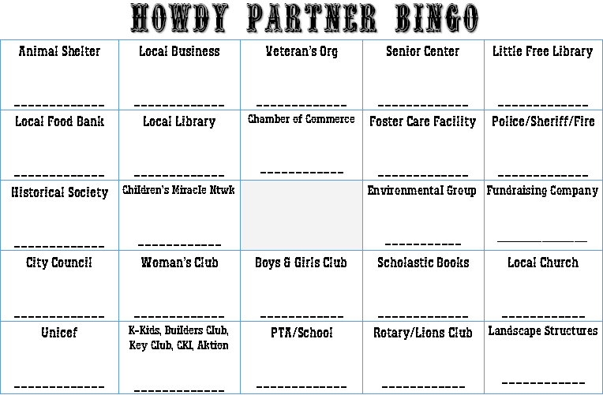
Group Discussion
Notes:
Kerri:
“Now it’s your turn. Turn to someone near you and share:
Which type of partnership would benefit YOUR club the most?
You have two minutes—go!”
(After sharing)
Winsome:
“Who’s willing to share a great idea they heard?”

Slide 9
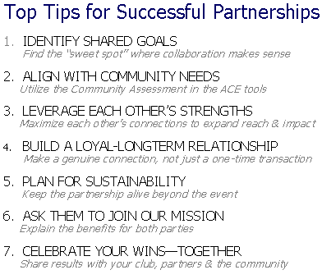
Tips for Successful Partnerships
Notes:
Winsome:
“Before you leave, here are our top tips:
Identify shared goals
Align with community needs
Leverage strengths
Build long-term relationships
Plan for sustainability
Invite partners into our mission
Celebrate wins together”

Slide 10
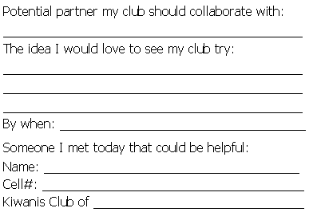
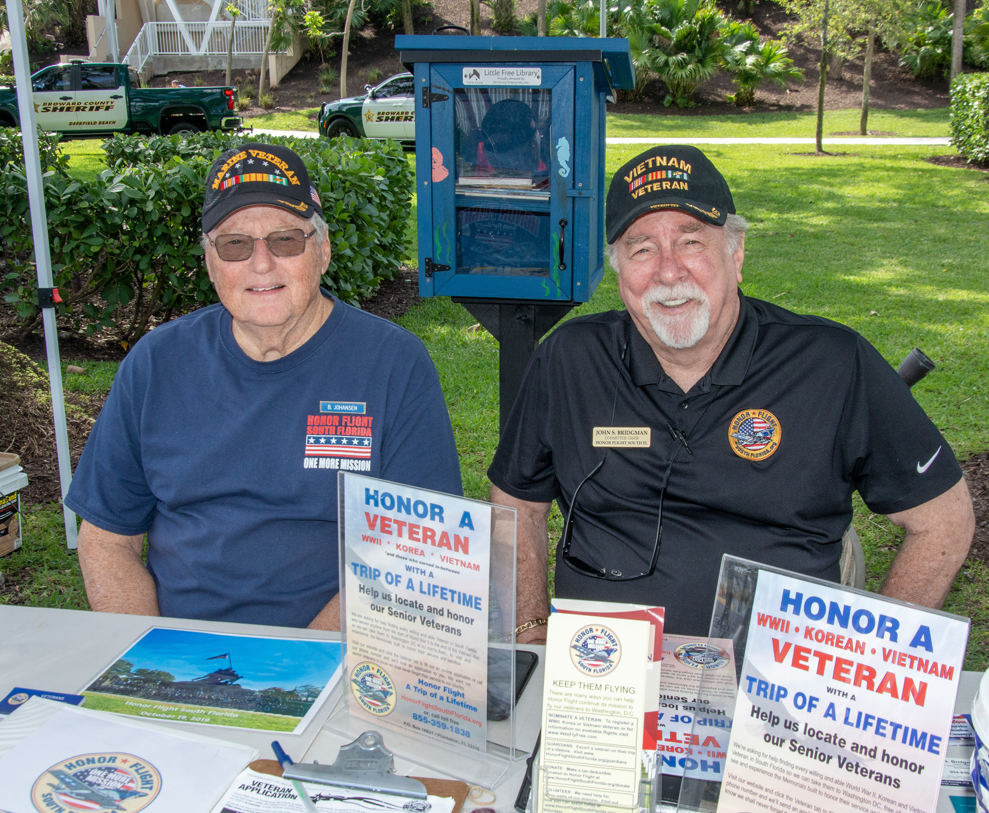
Action Planning
Notes:
Kerri:
“Now, we’re putting this into action. Take out your Partners for Impact form. Write down:
Who your club will collaborate with
The project idea
By when you’ll make it happen
Someone you met today who can help”
Winsome:
“Don’t just think about it—commit to it. This is where ideas become impact.”

Slide 11
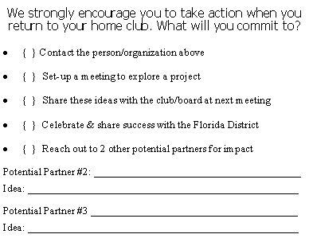
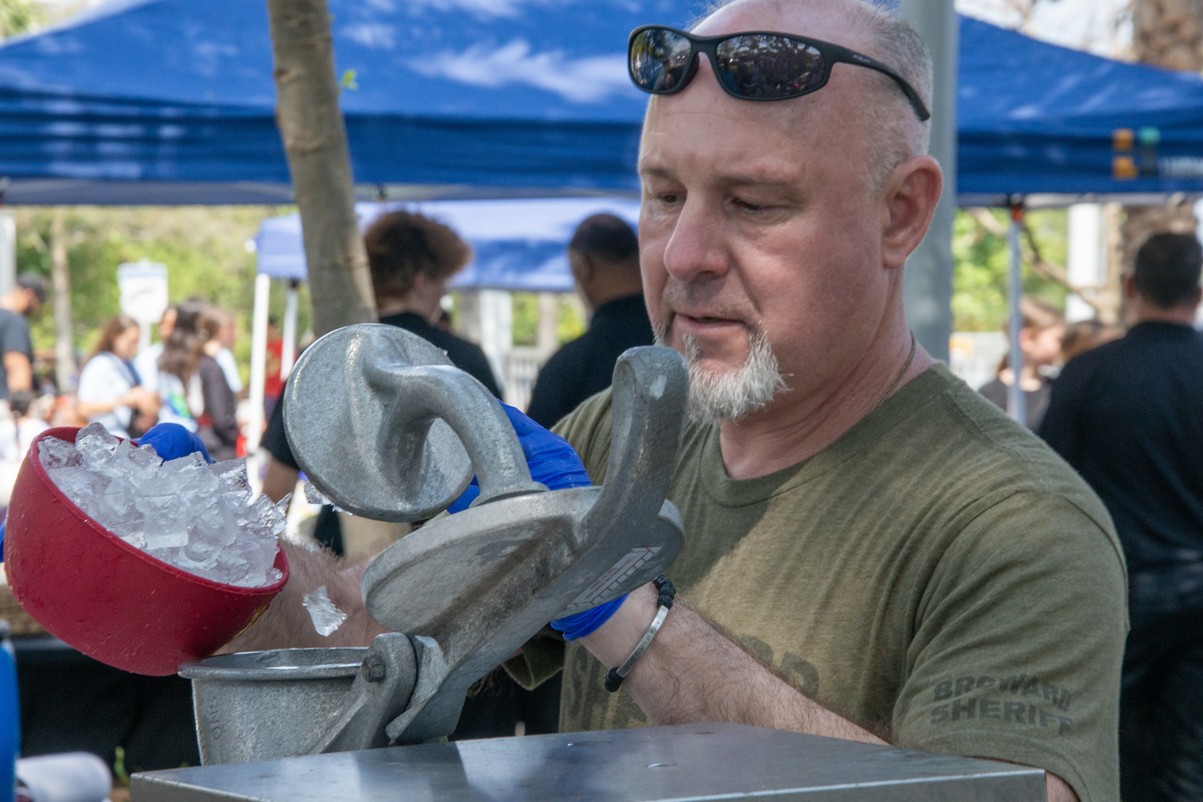
Commit & Follow-up
Notes:
Kerri:
“We’ve also included a follow-up checklist. When you get back to your club:
Contact your partner.
Set up a meeting.
Share with your club.
Celebrate success.
Reach out to two more potential partners.”
Winsome:
“This isn’t just a workshop—it’s a launchpad.”

Slide 12

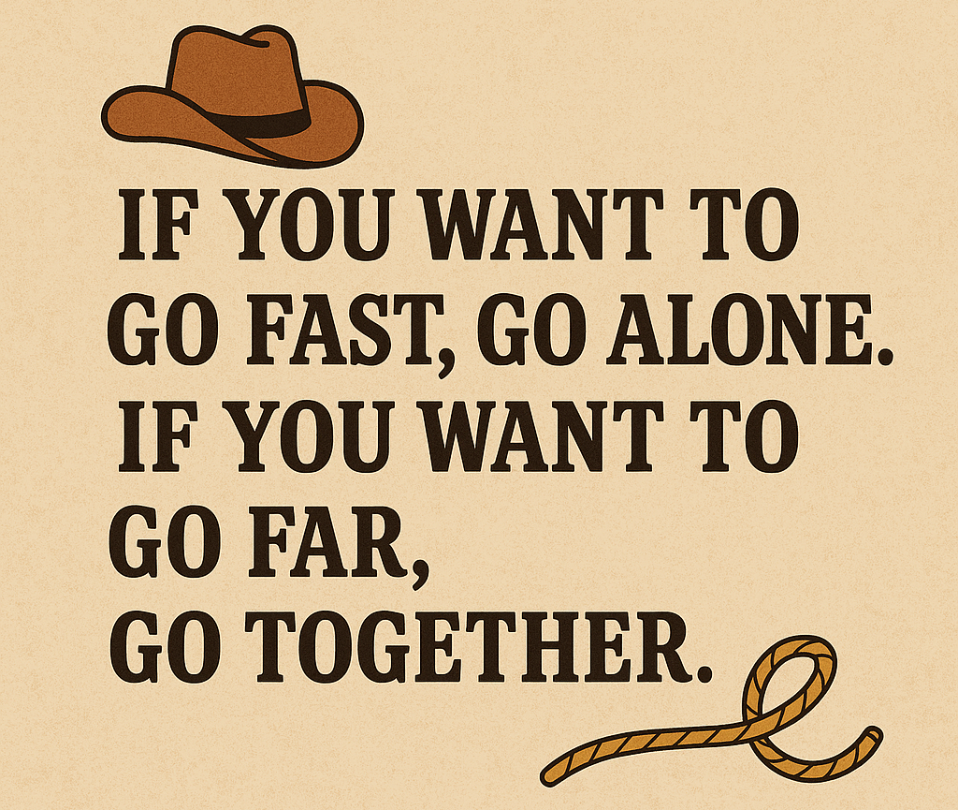
Wrap up
Notes:
Kerri:
“Partnerships build bridges—and bridges lead to greater impact.”
Winsome:
“We can go fast alone, but far together. Now—who’s ready to make some Partnerships?” Any questions or comments?

Slide 13
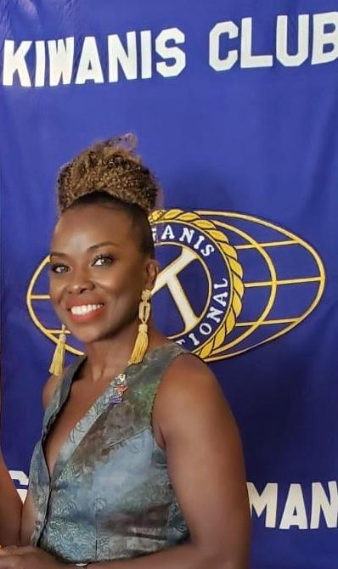
Contact Winsome
Winsome Radcliffe
Kiwanis Club of Grand Cayman
24-26 District Chair-Partnerships
Radcliffe.winsome@gmail.com
345.516.8677
Notes:
"If you have questions or planning a visit to Grand Cayman, I’m here to help. Here’s my contact info—don’t hesitate to reach out!"

Slide 14
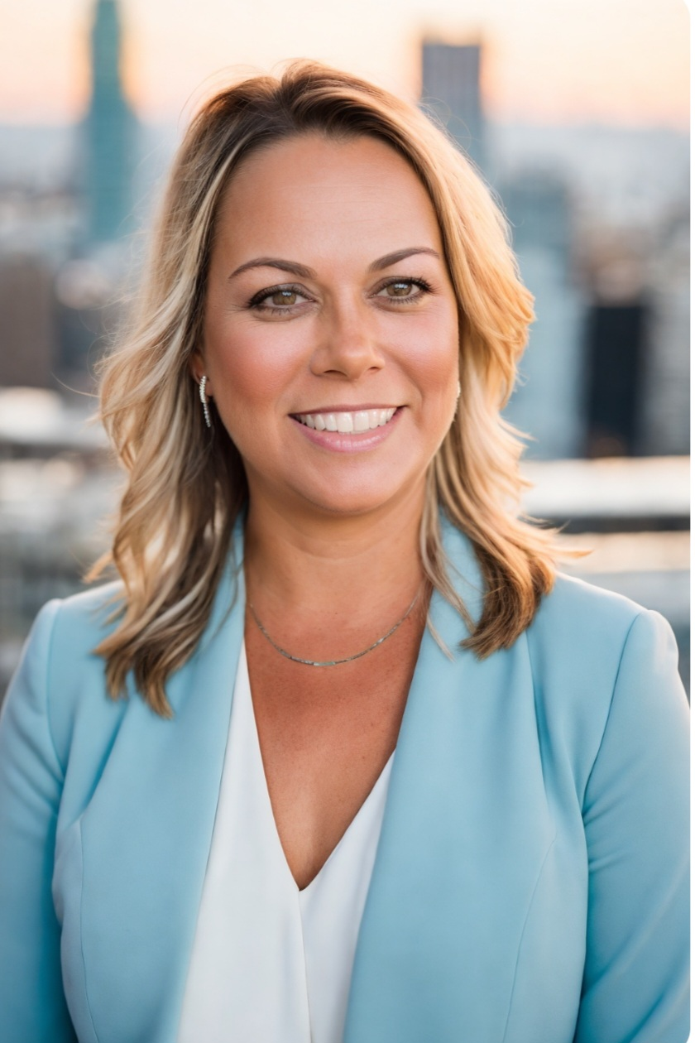
Contact Kerri
Kerri Gordon
Kiwanis Club of Deerfield Beach
24-25 Signature Project District Chair
Candidate for Florida District Vice Governor
ConnectwithKerri@gmail.com
954.980.1833
Notes:
“And of course, you can always reach me as well. I’m happy to support you in any way I can. Thank you all so much for being here today and for everything you do to make a difference!“ Please be sure to rate our workshop with 5 stars.

