Slide 1


People
First
Prairy Riehl, Past Governor

Slide 2


Goal
Discover how leading with empathy and prioritizing people can transform your club culture, boost morale, and strengthen community impact.

Slide 3

Why?
Empathy Builds Trust
Prioritizing people improves retention
A people-first mindset leads to greater impact

Slide 4
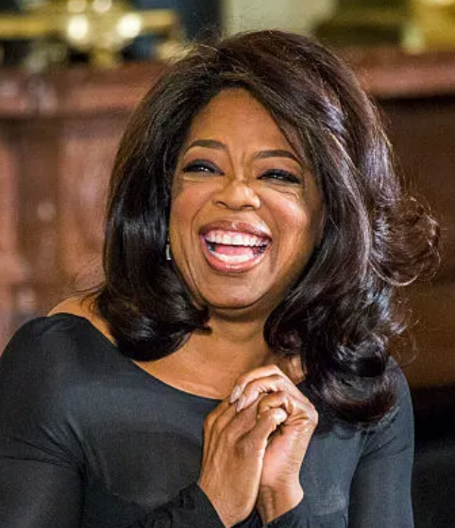
“Leadership is about empathy. It is about having the ability to relate to and connect with people for the purpose of inspiring and empowering their lives”.
Oprah Winfrey

Slide 5
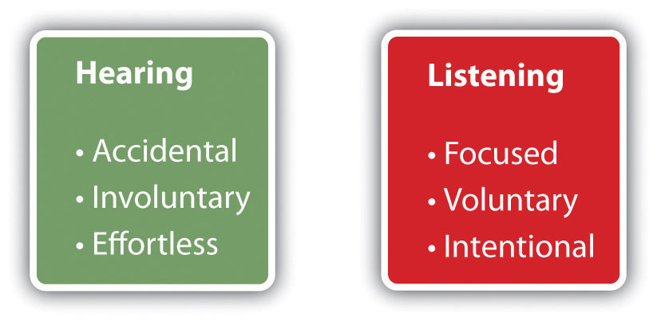
What is Empathetic Leadership?
1) Active Listening!

Slide 6
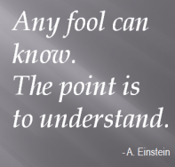

What is Empathetic Leadership?
2) Understanding different perspectives

Slide 7
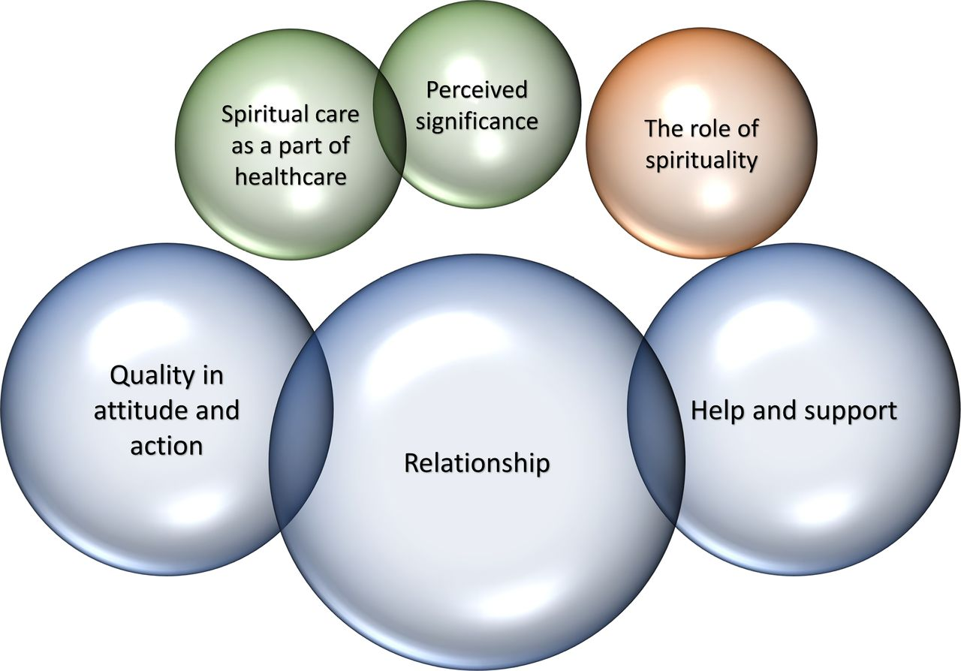
What is Empathetic Leadership?
3) Responding with care and support

Slide 8
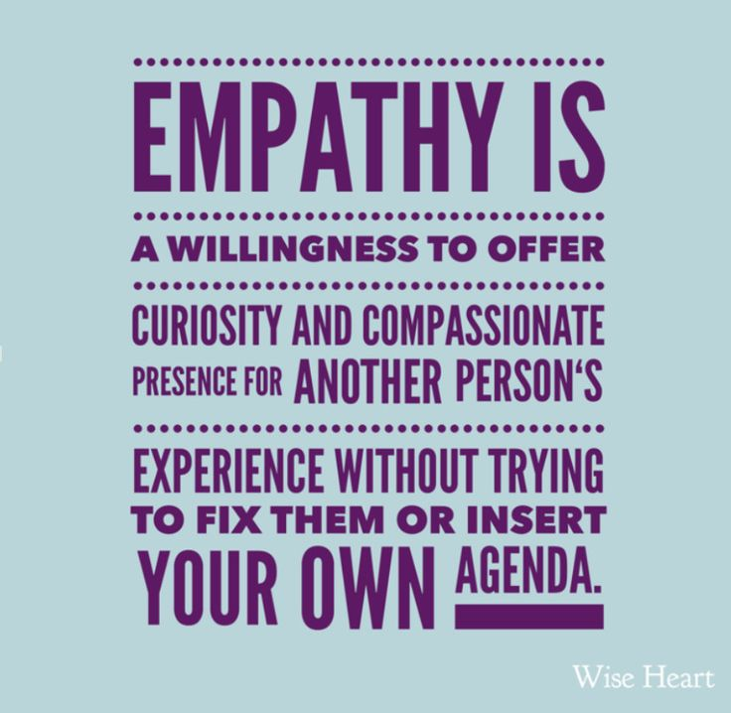
Oprah Winfrey

Slide 9
Benefits for Your Club
Boosts morale and motivation
Strengthens member relationships
Fosters a welcoming culture
Encourages engagement and participation

Slide 10
Real-World Examples
Hosting open forums for feedback
Celebrating personal milestones
Supporting members in times of need

Slide 11
Action Steps
Start meetings with a check-in
Practice active listening
Create a recognition program
Lead with compassion

Slide 12
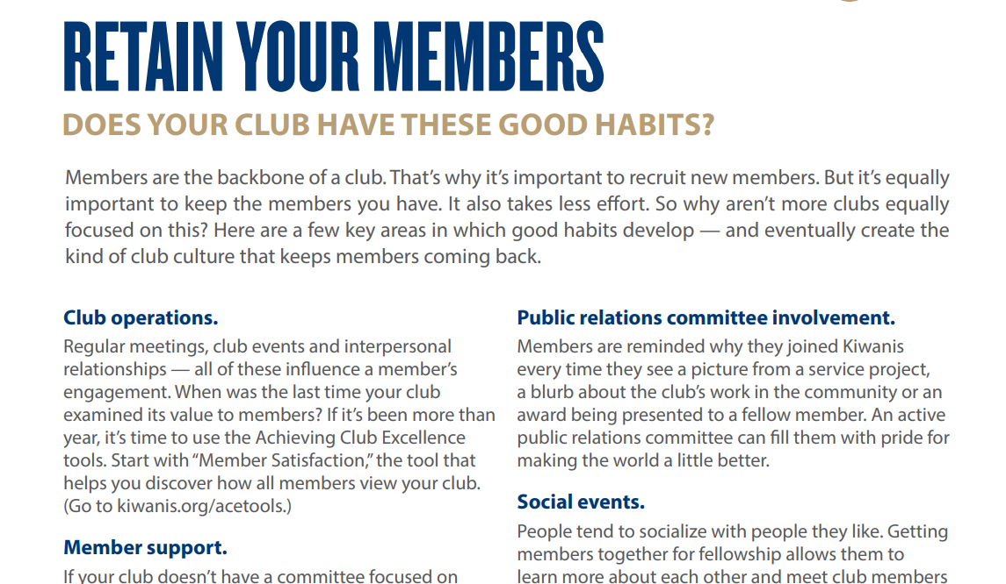
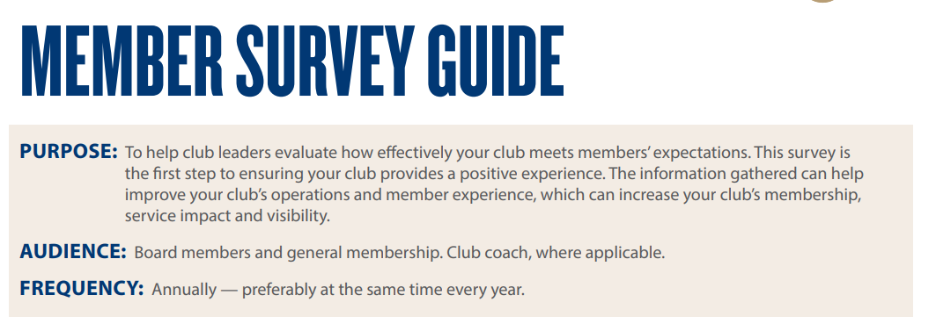
Kiwanis International Resources
Kiwanis International Member Survey
Kiwanis International Retention Tools
https://www.kiwanis.org/members/build-nurture-retain/retain-keep-members-coming-back-for-more/

Slide 13
Reflection and Discussion
How can we be more people-focused?
What support do our members need most?
Share one way you’ve seen empathy make a difference.

Slide 14

Party Planning
Prioritize
People
Lead with empathy
Make an impact

