Slide 1

THE POWER OF PLAY

Slide 2
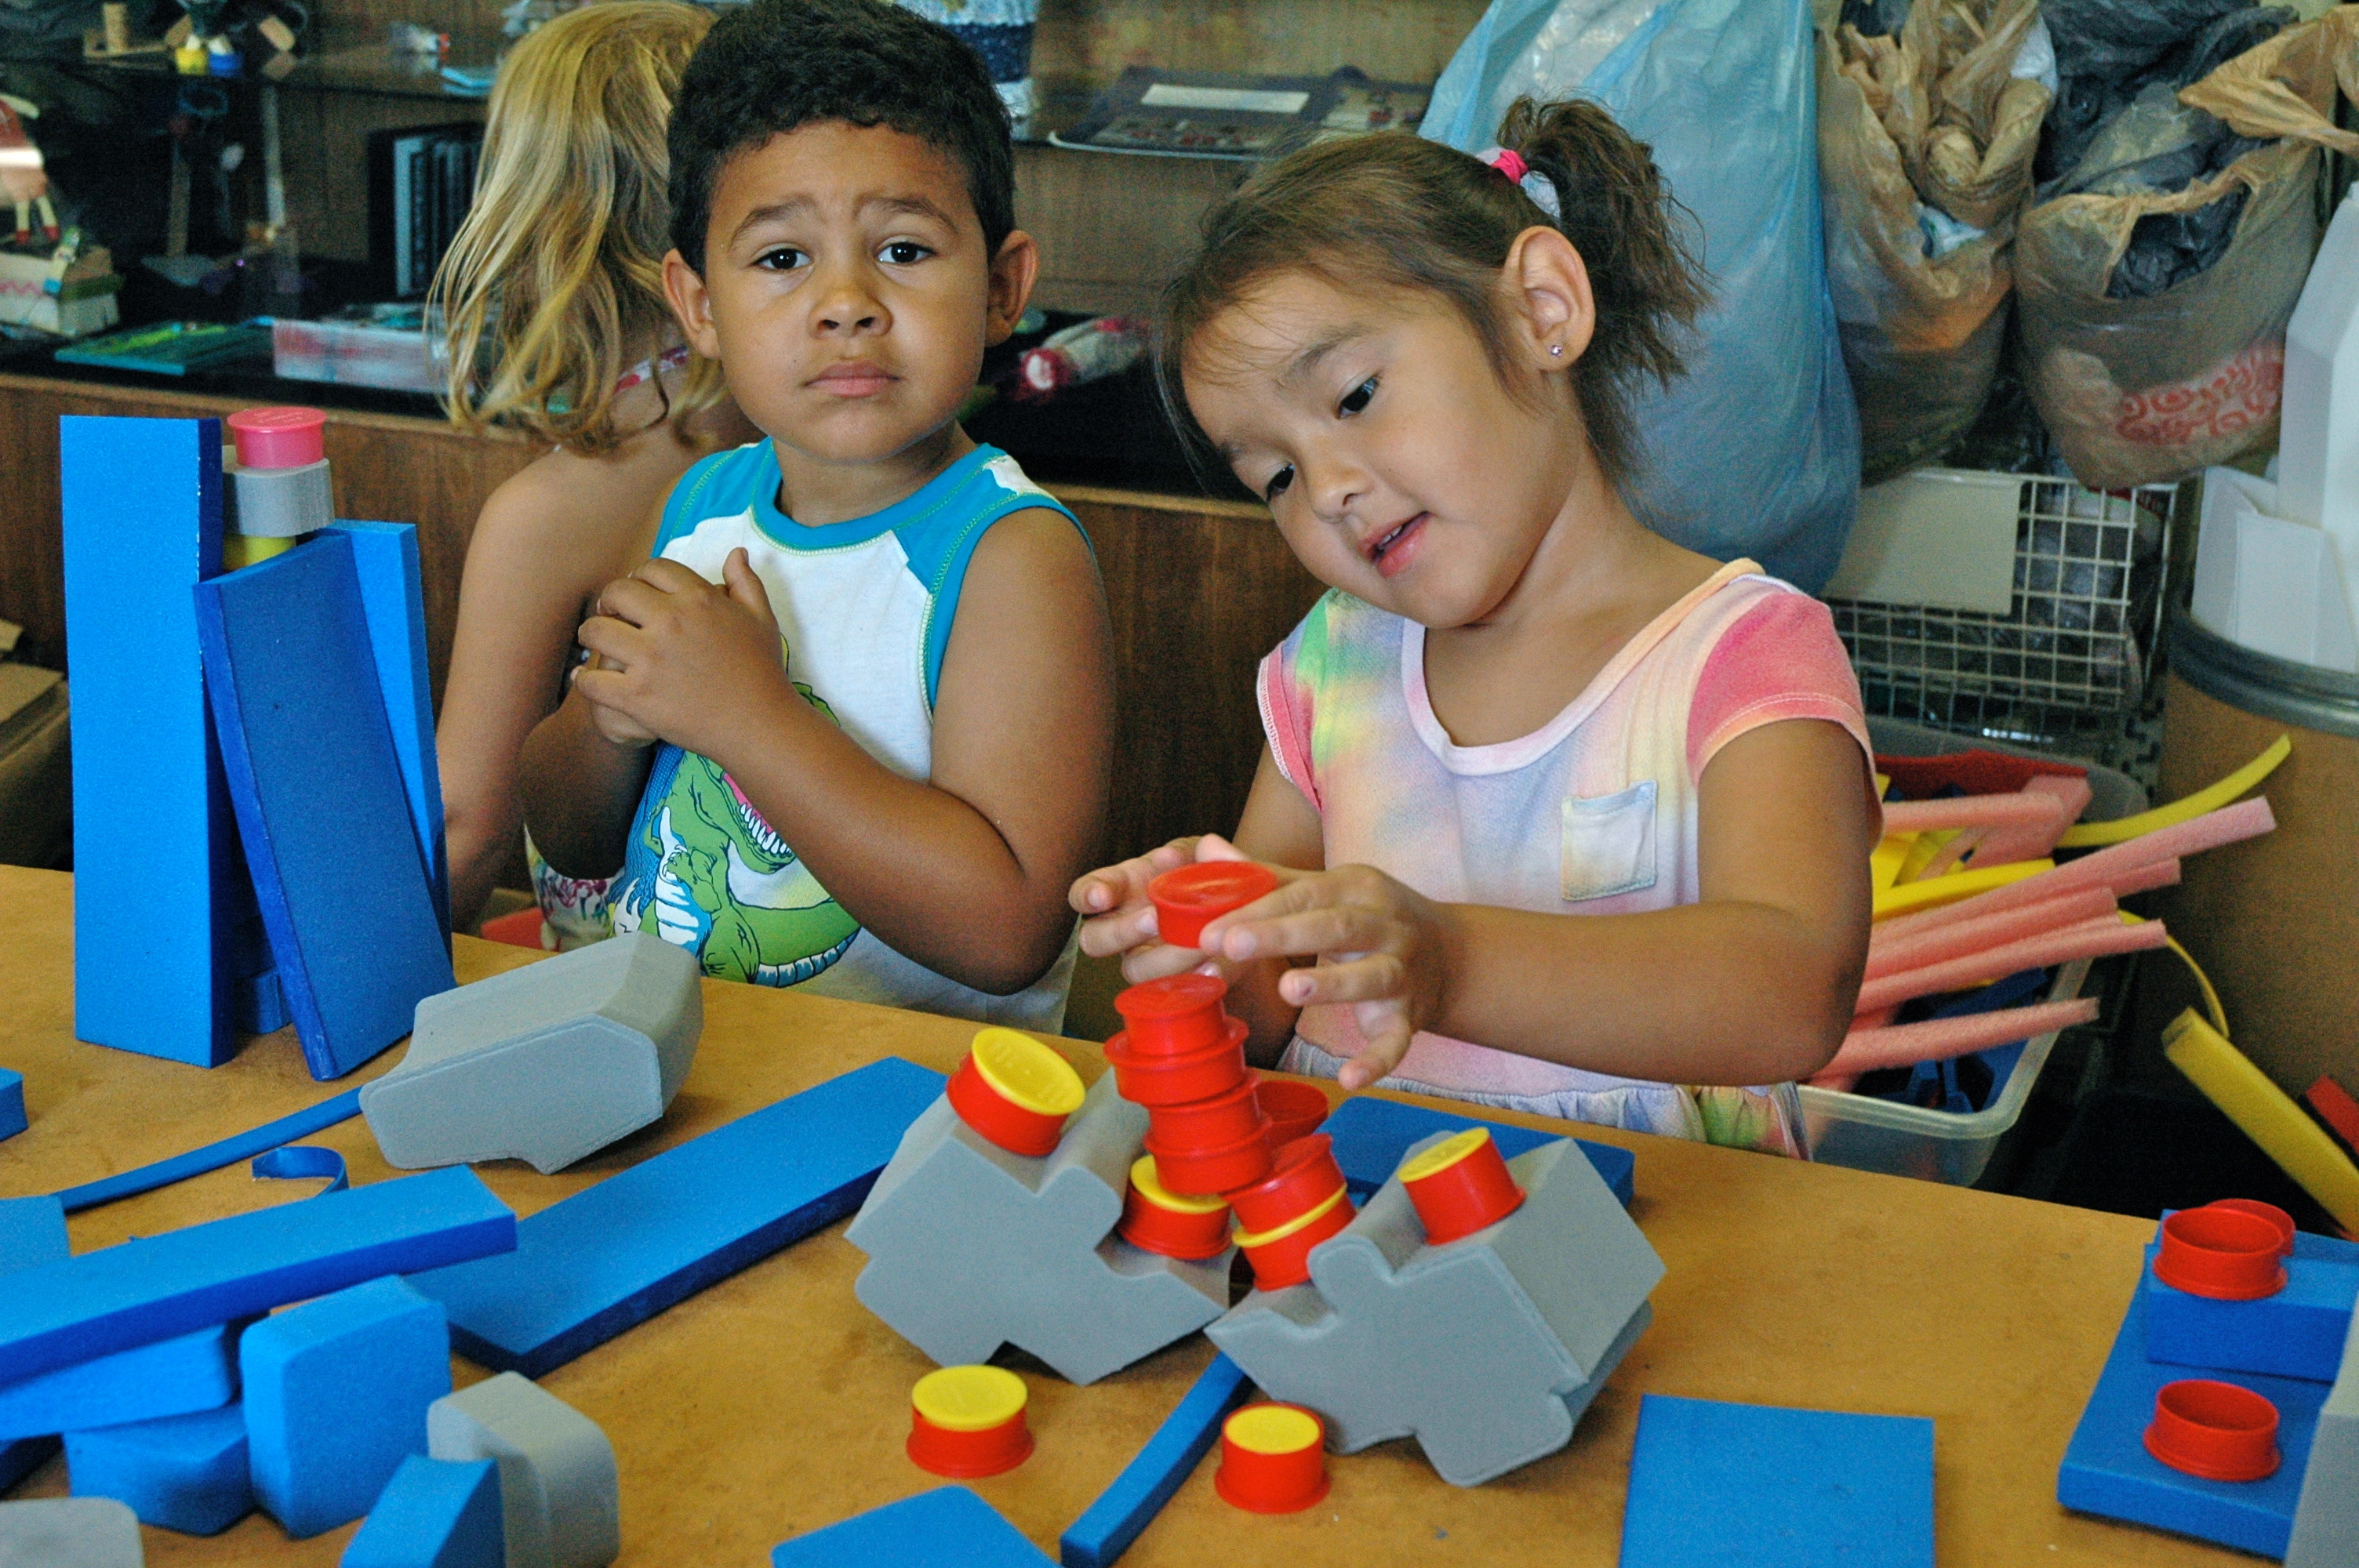

Slide 3
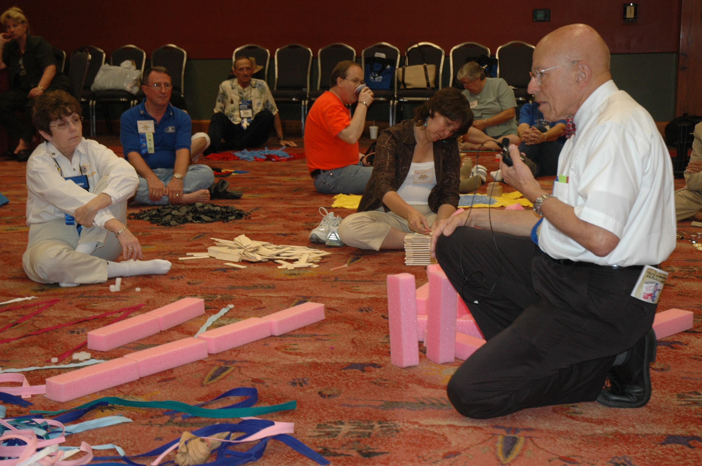
Dr. Wil BLECHMAN Self Active Play Workshop, 2007 Kiwanis International Convention , San Antonio, TX,

Slide 4
“If you've never attended one of these play sessions, you've missed out on a unique experience”.
Dr. WIL BLECHMAN

Slide 5
PLAY AWAKENS JOY IN CREATIVE EXPRESSION

Slide 6
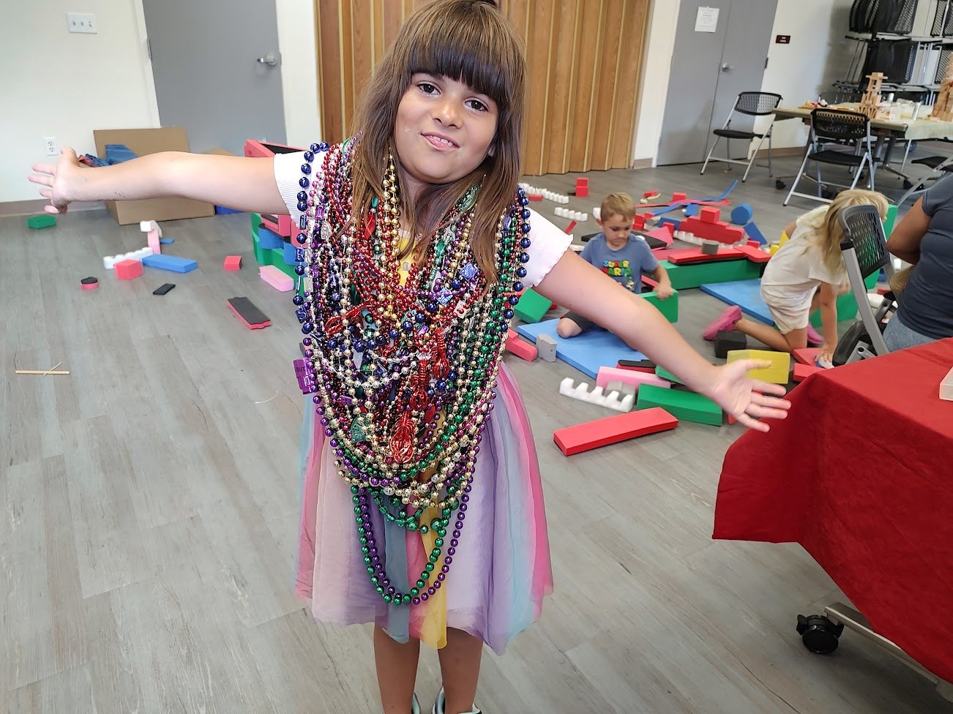

Slide 7
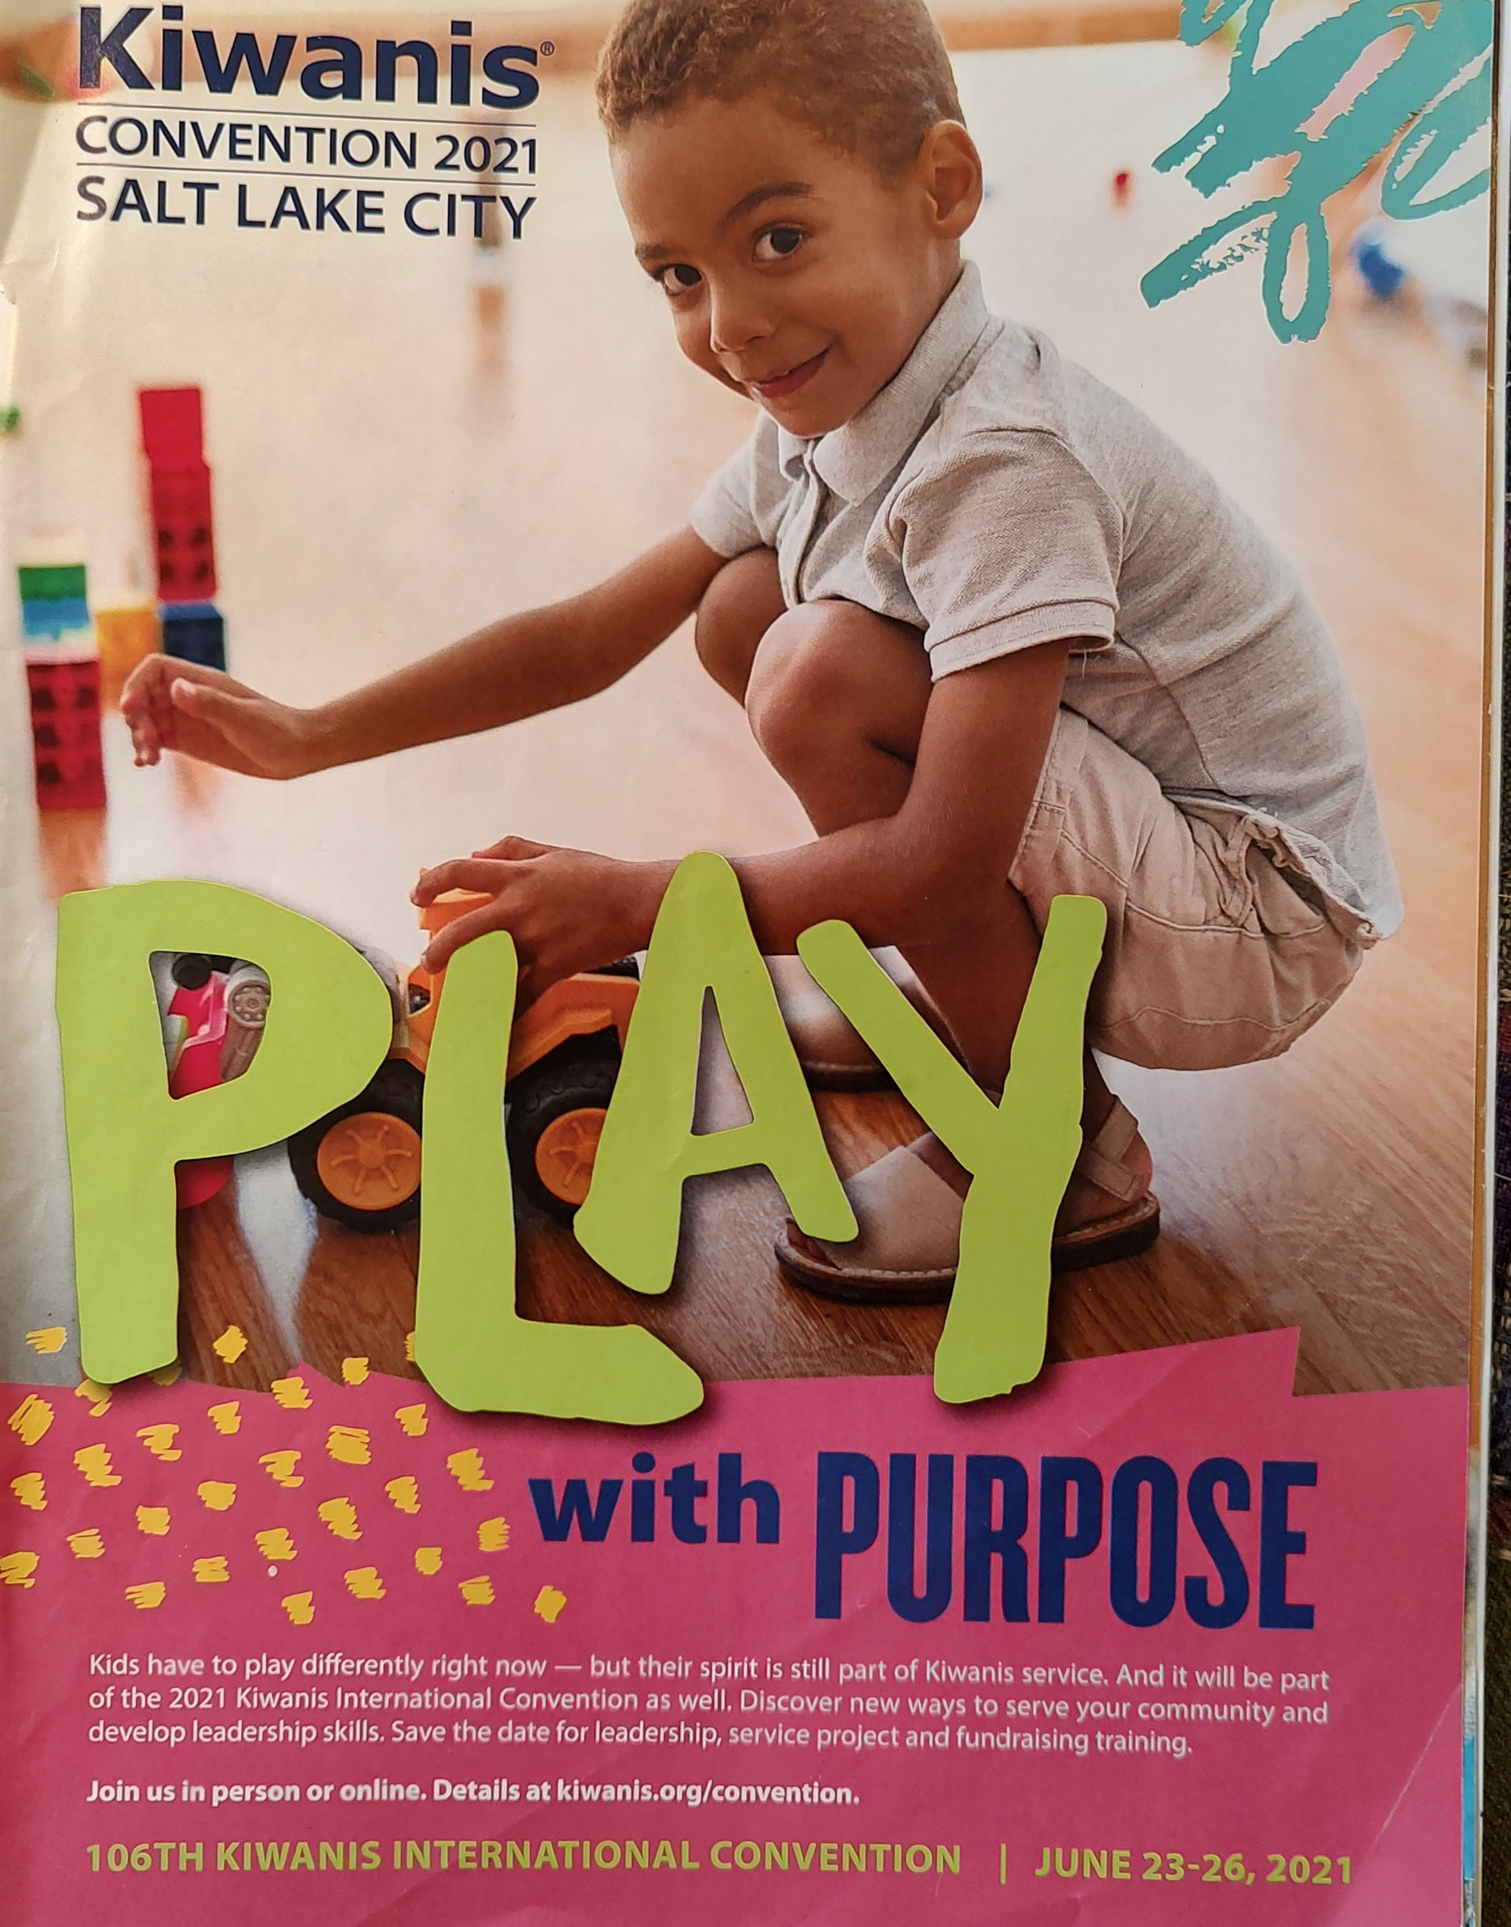
KIWANIS KEY CLUB
SERVICE LEADERSHIP PROJECT
“Inspiring New Possibilities”

Slide 8
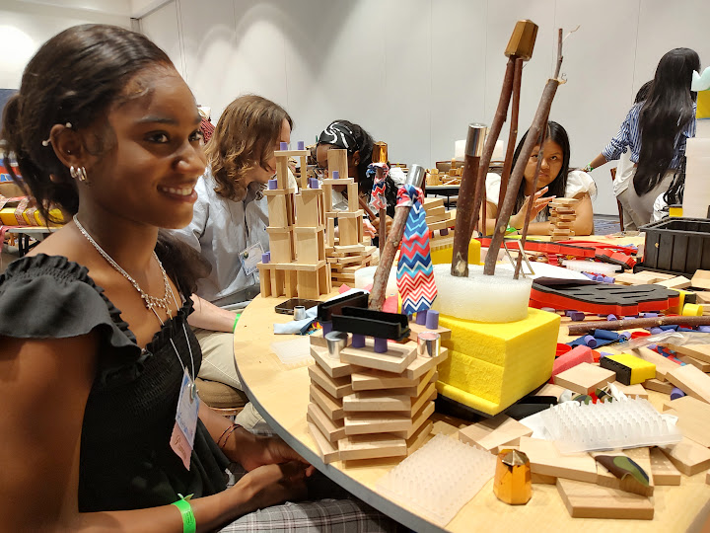

Slide 9
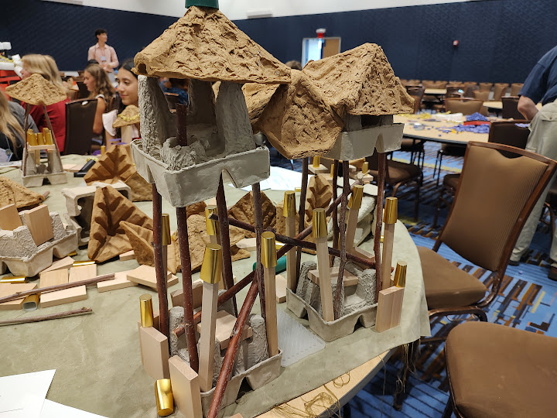

Slide 10
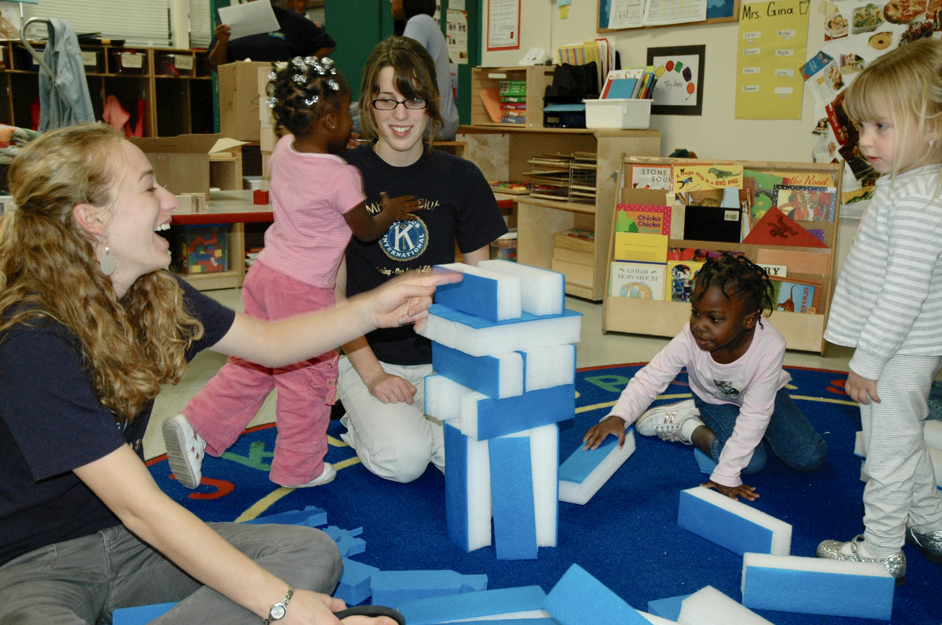

Slide 11
1. Play is a source of creative energy, a positive force and a safe context for constructing meaningful self-knowledge and revitalizing the human spirit

Slide 12
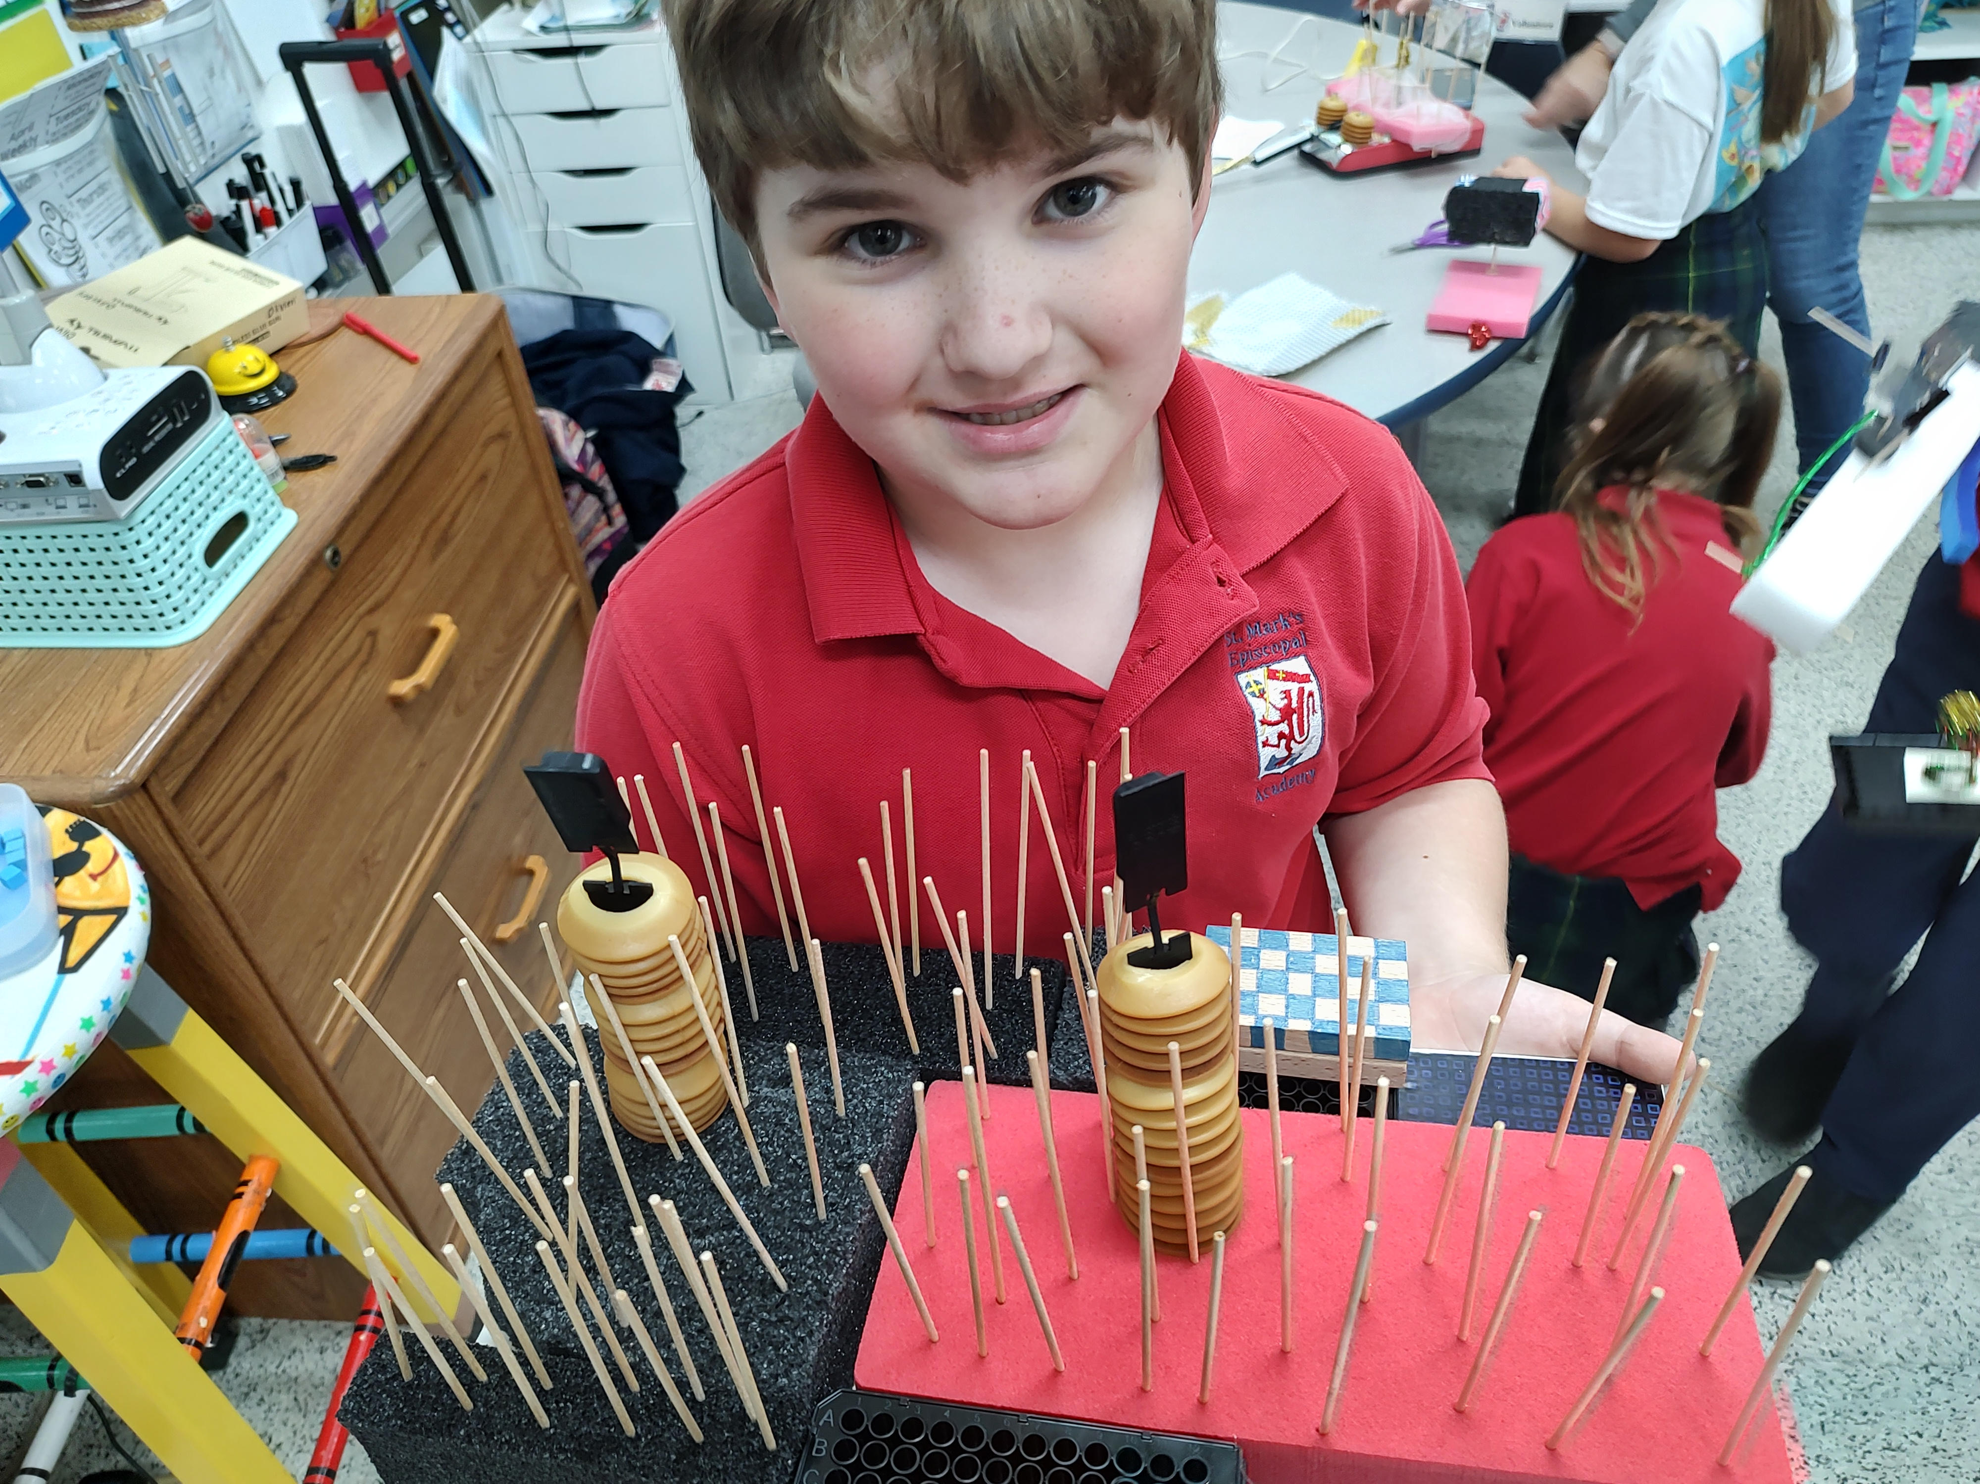

Slide 13
2. Hands-on play and art making with open ended materials reconnect individuals with earlier times of their lives, spontaneously evoking deep inner your feelings, such as hope, will, purpose, competence, fidelity, love, care, and wisdom.

Slide 14
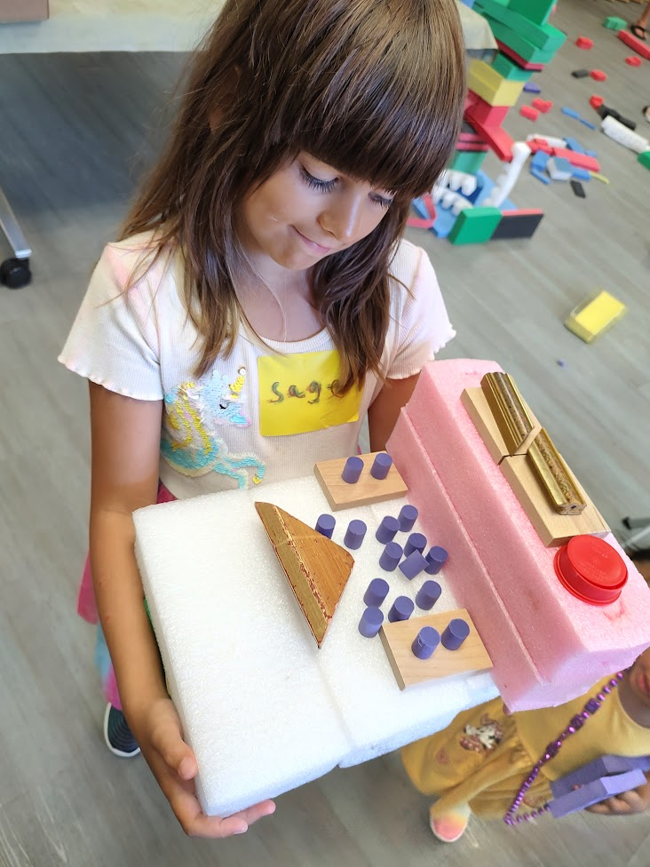
Sage at LET’S PLAY Workshop, MELBOURNE PUBLIC LIBRARY

Slide 15
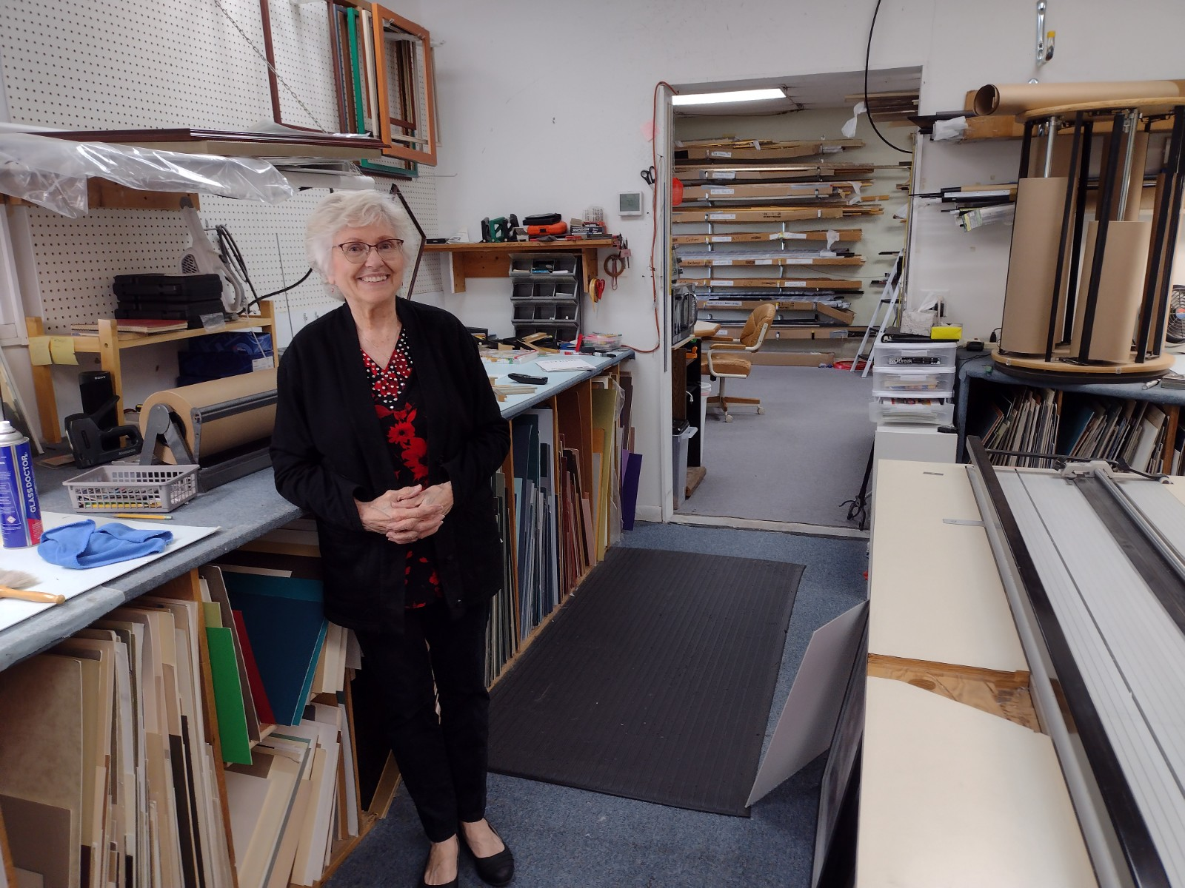

Slide 16
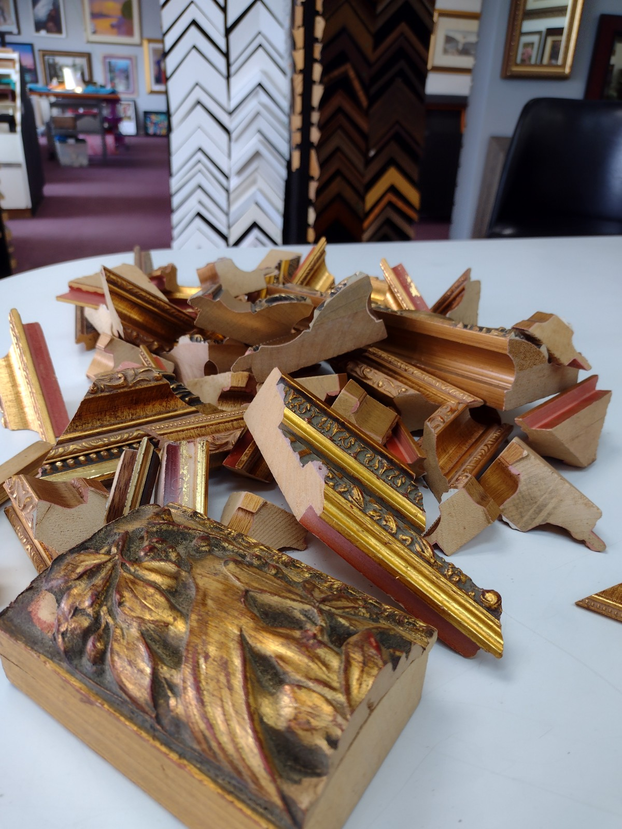

Slide 17
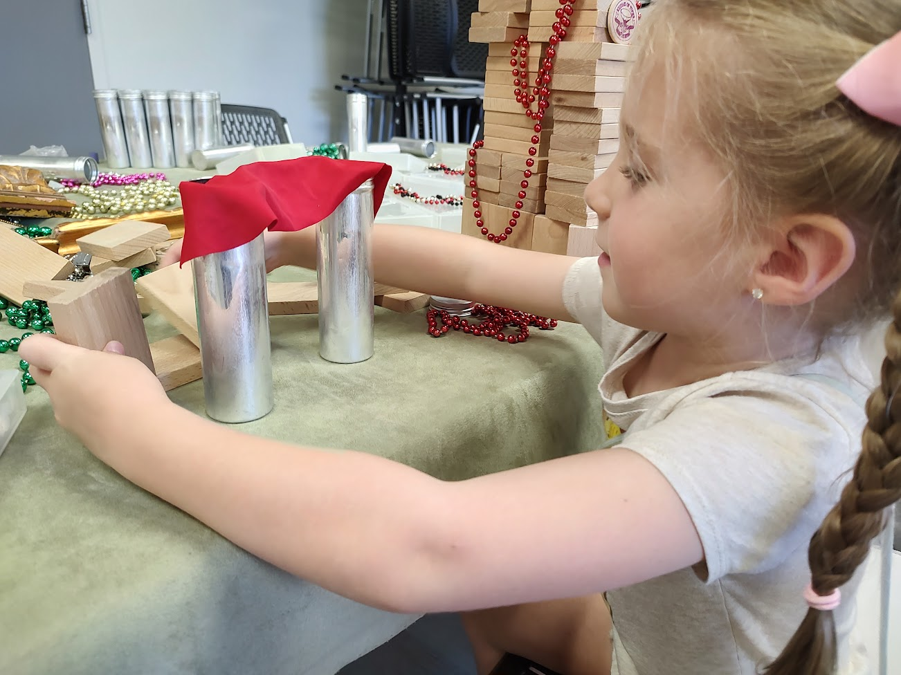

Slide 18
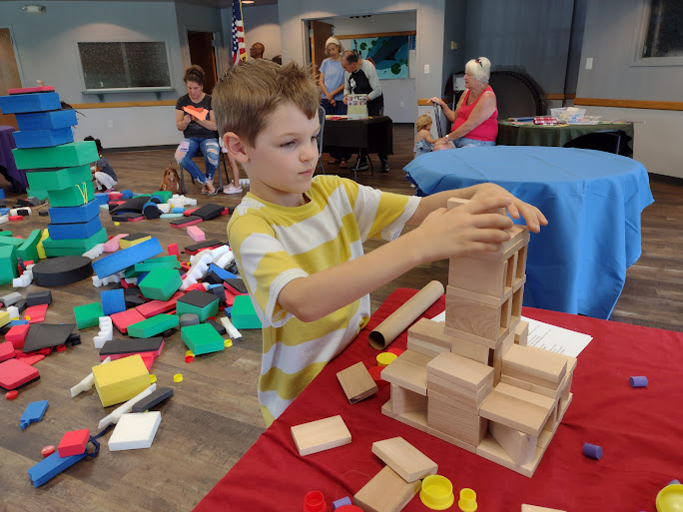

Slide 19
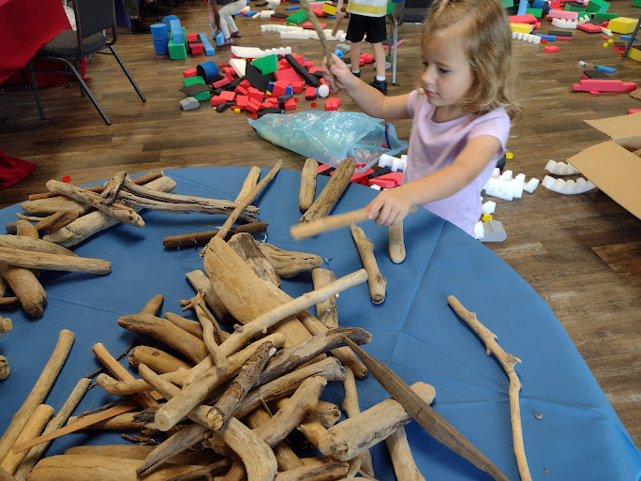

Slide 20
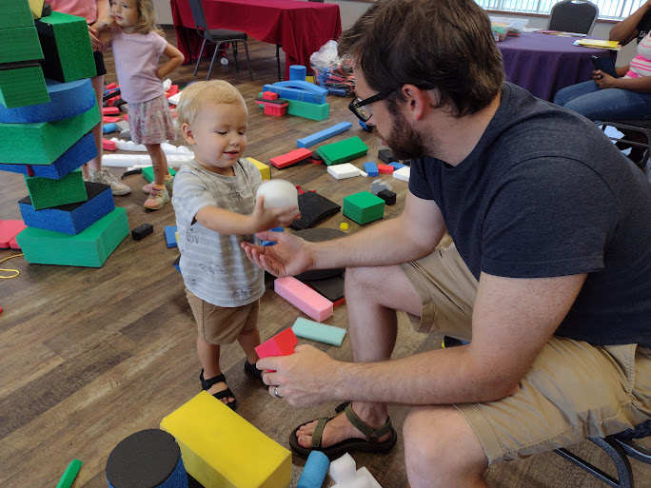

Slide 21
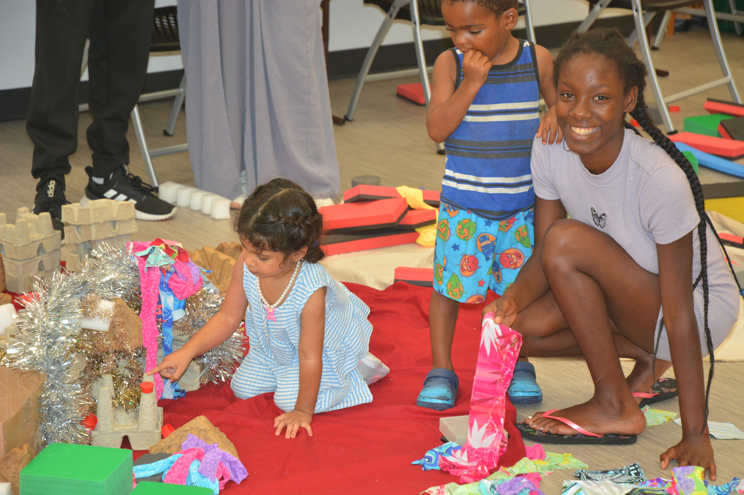

Slide 22
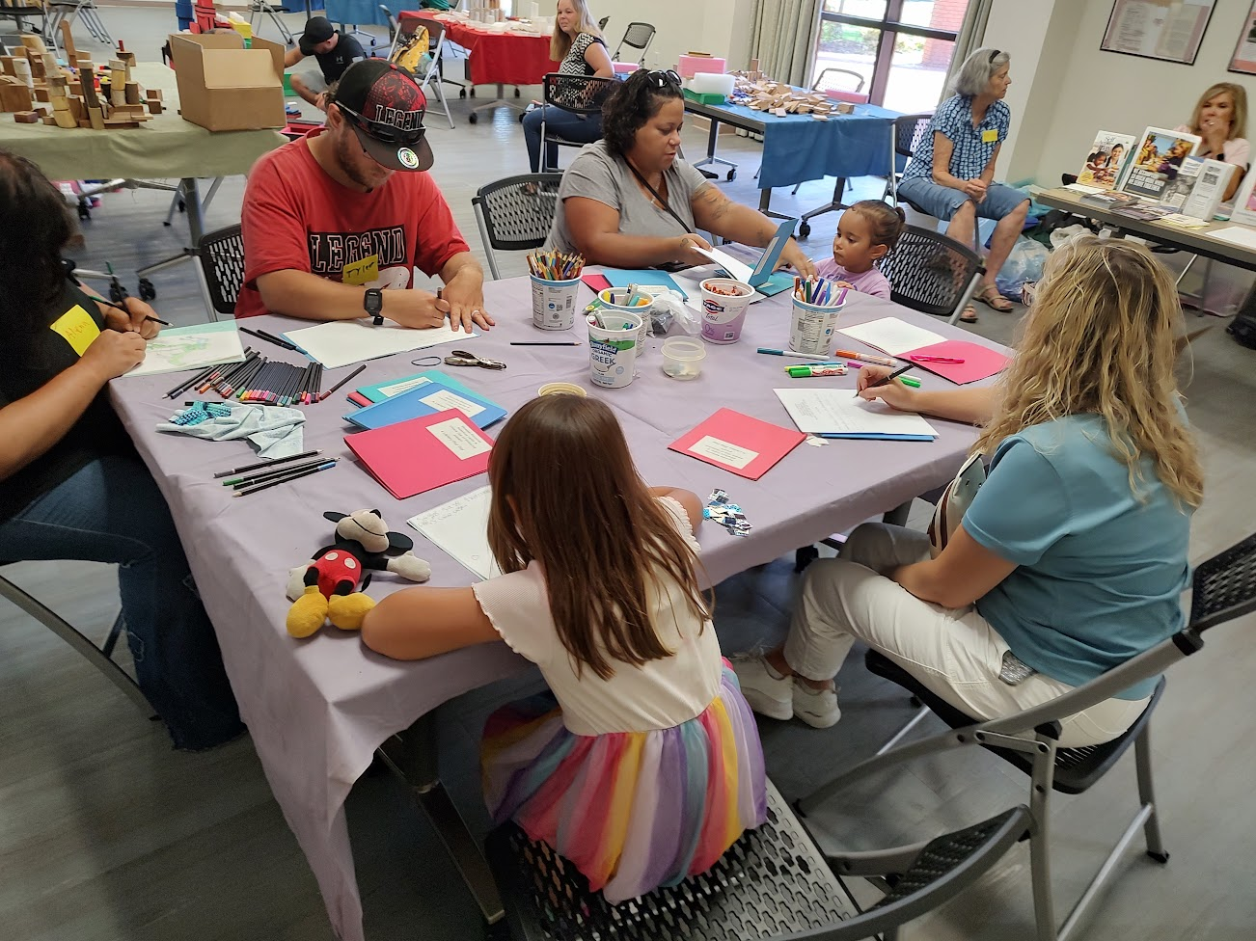

Slide 23
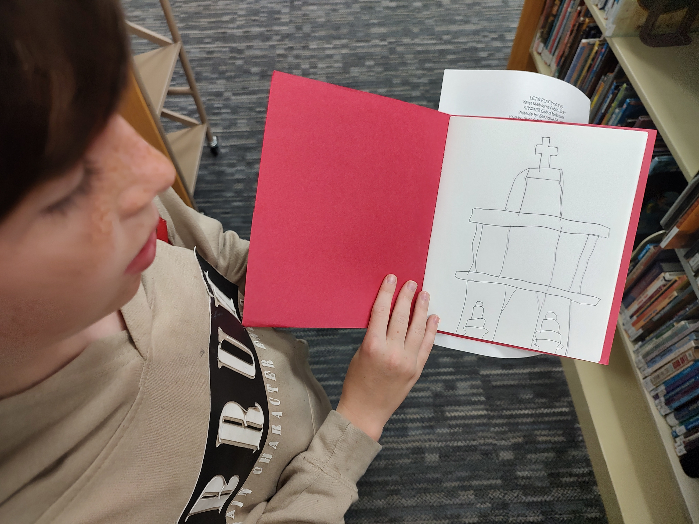

Slide 24


Slide 25
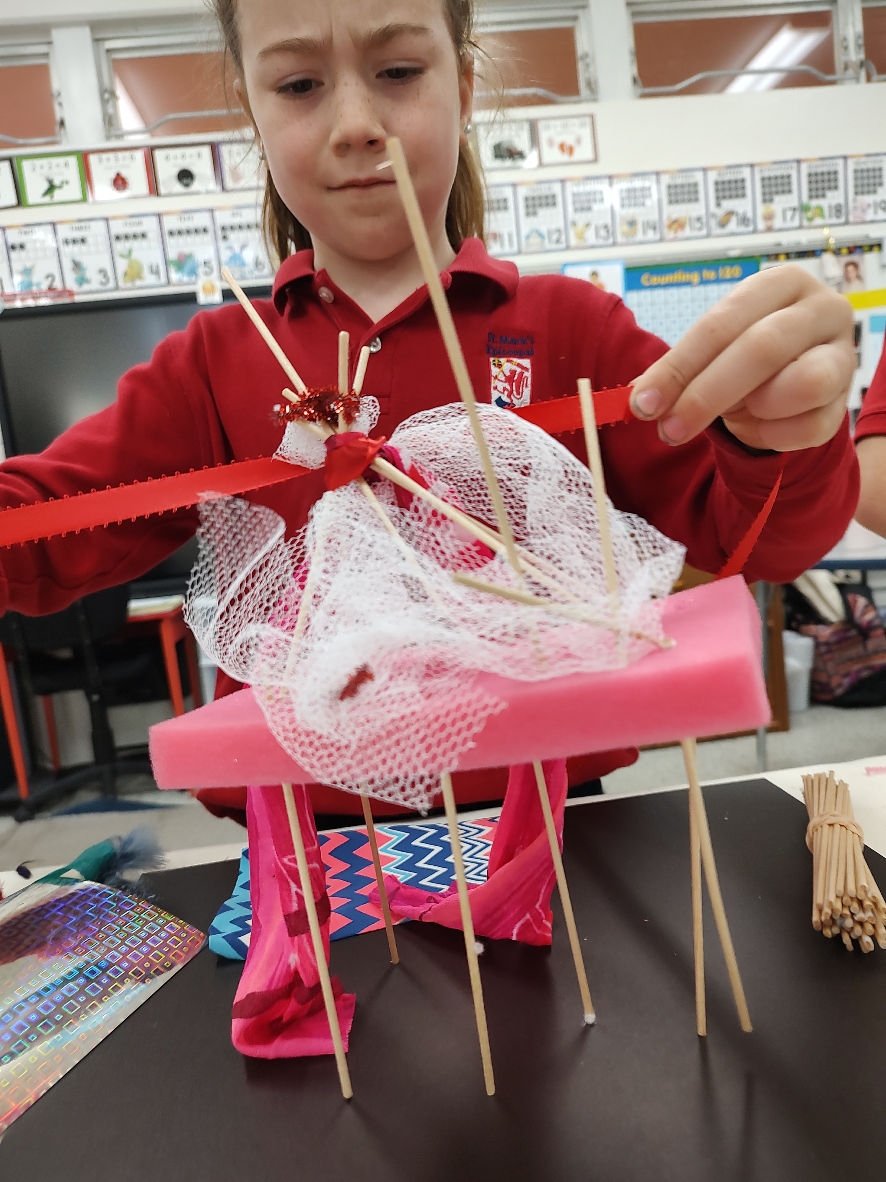

Slide 26


Slide 27
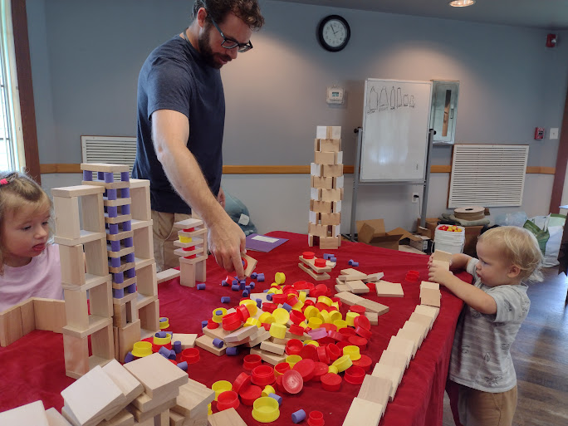

Slide 28
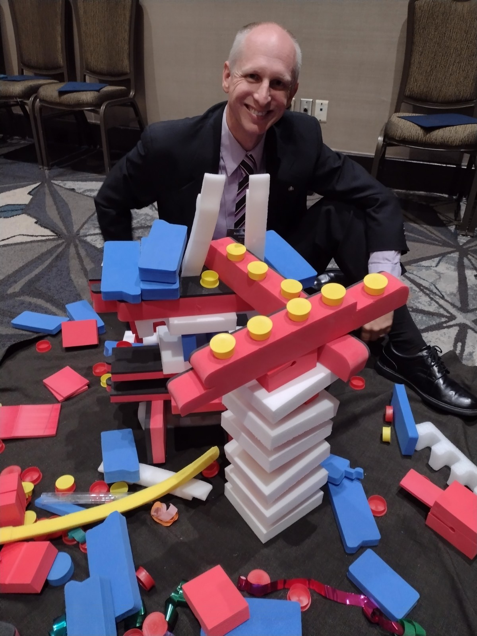

Slide 29
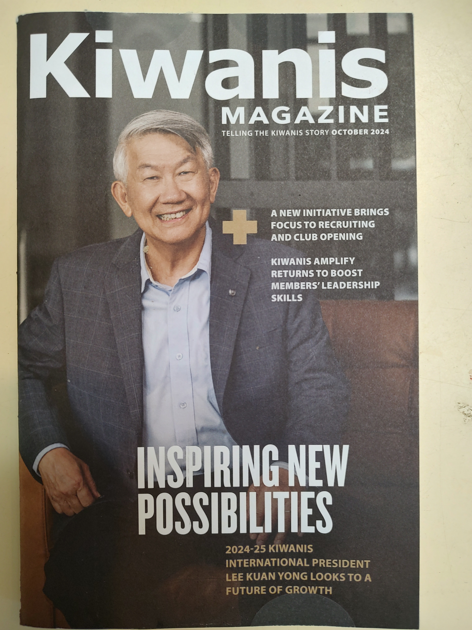

Slide 31
HANDS, HEART & MIND
SELF ACTIVE PLAY

Slide 33
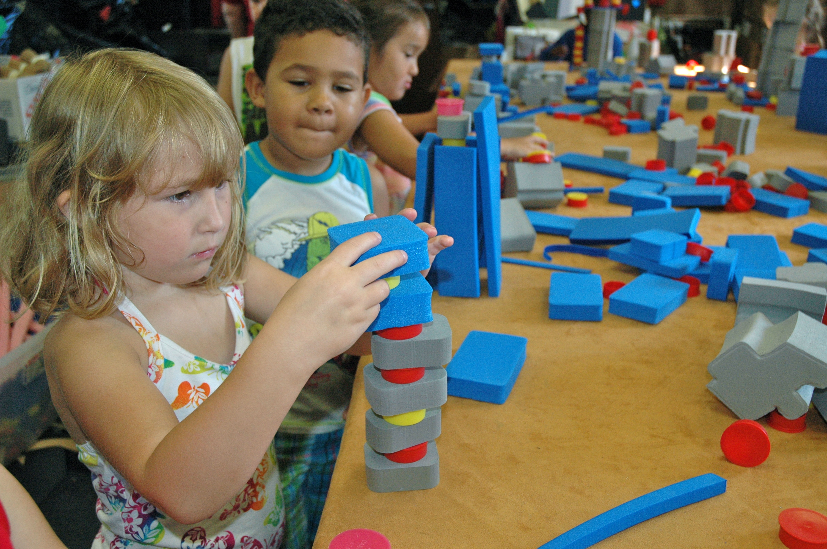

Slide 34


Slide 35
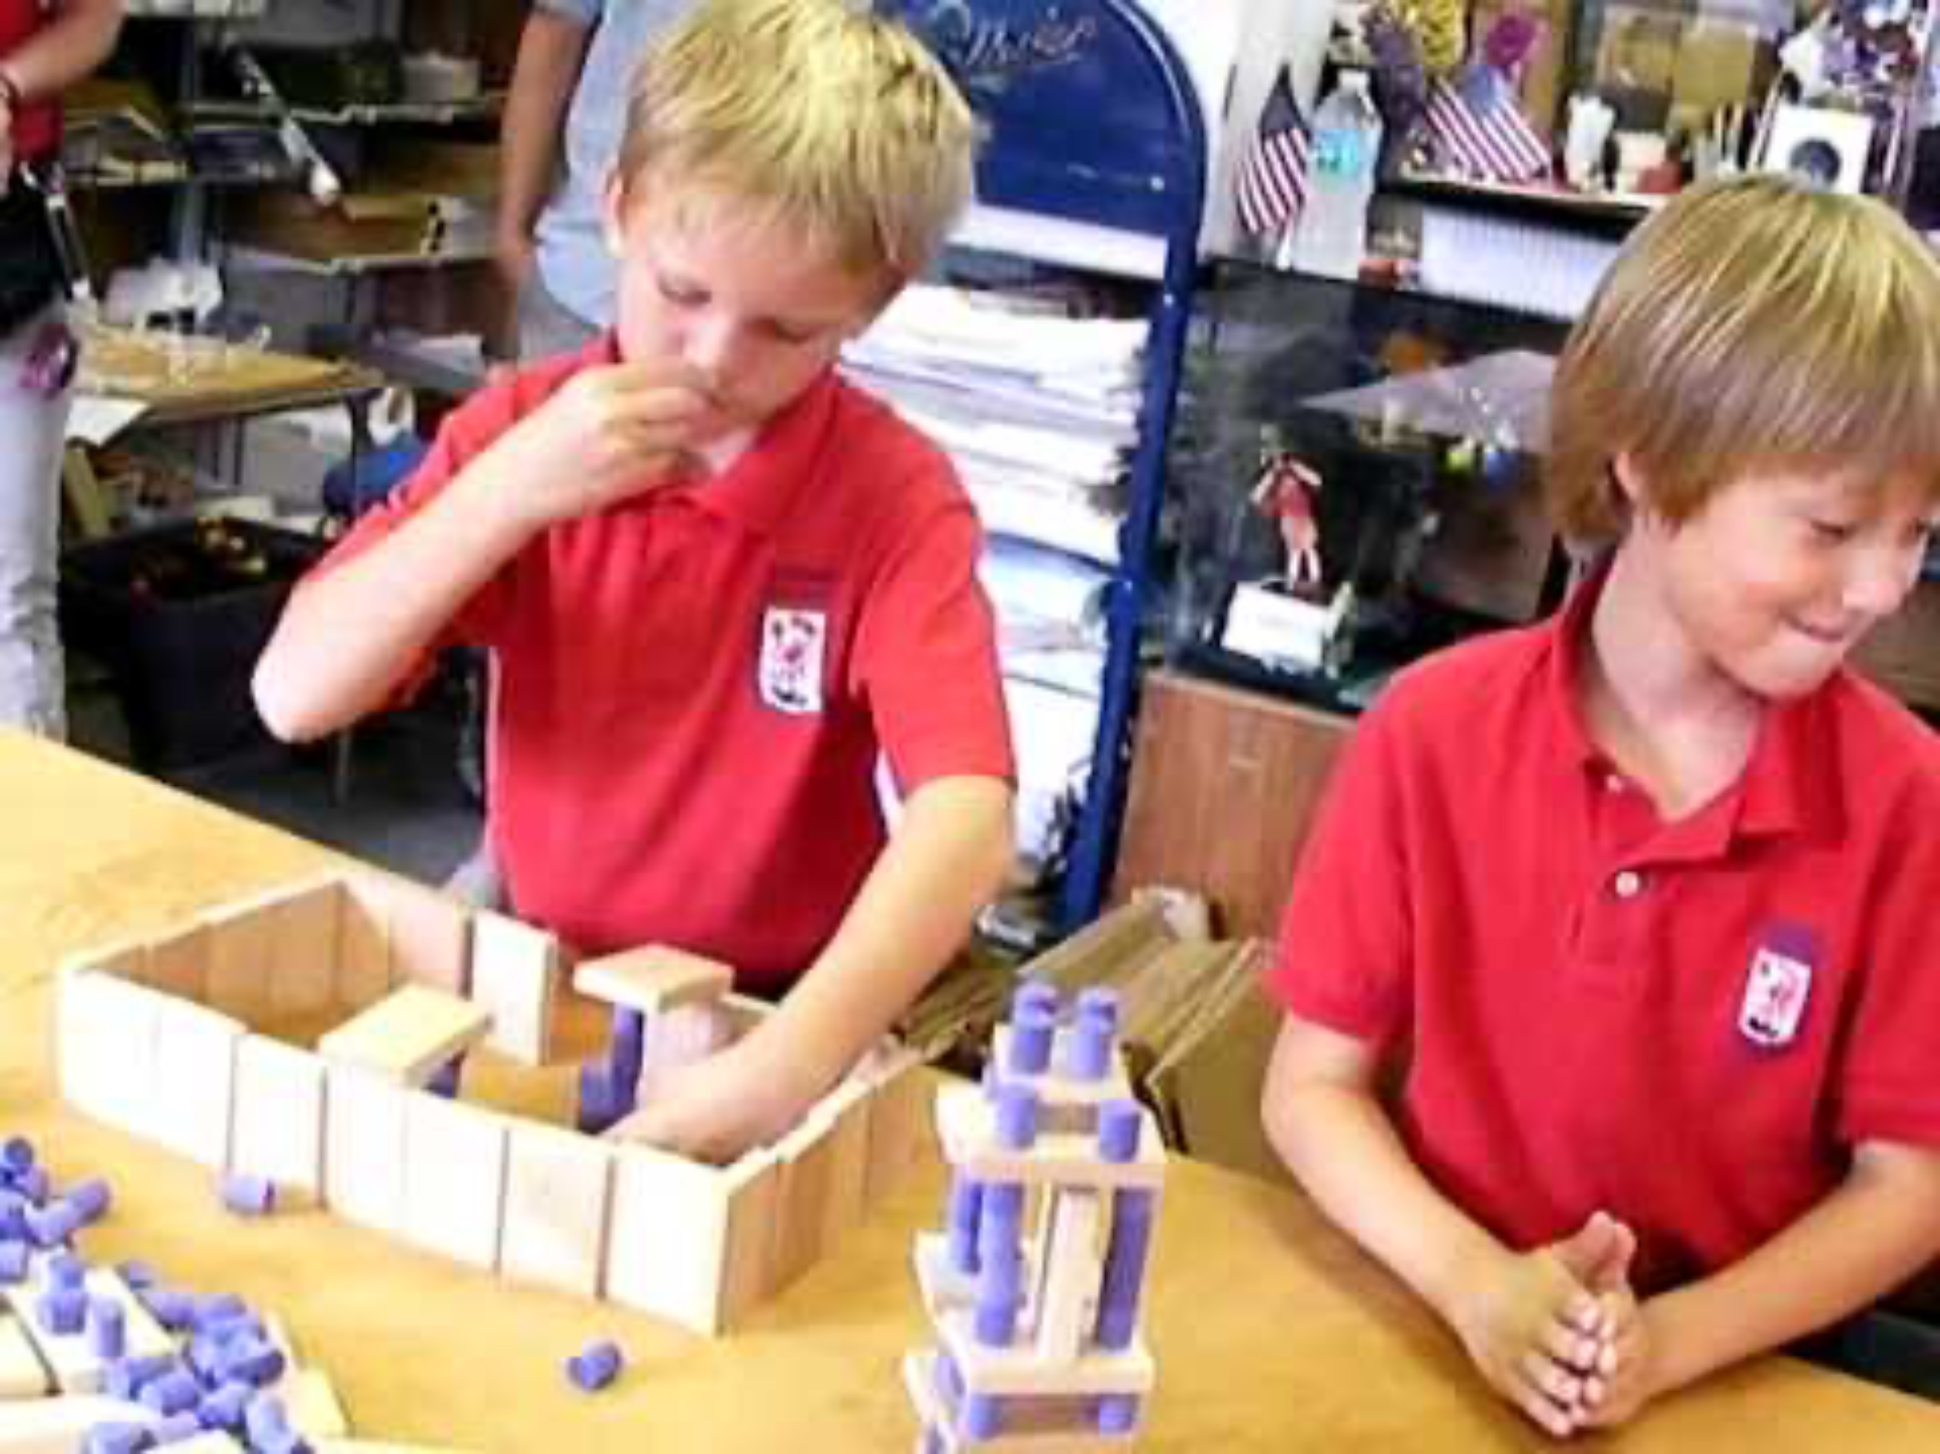

Slide 36
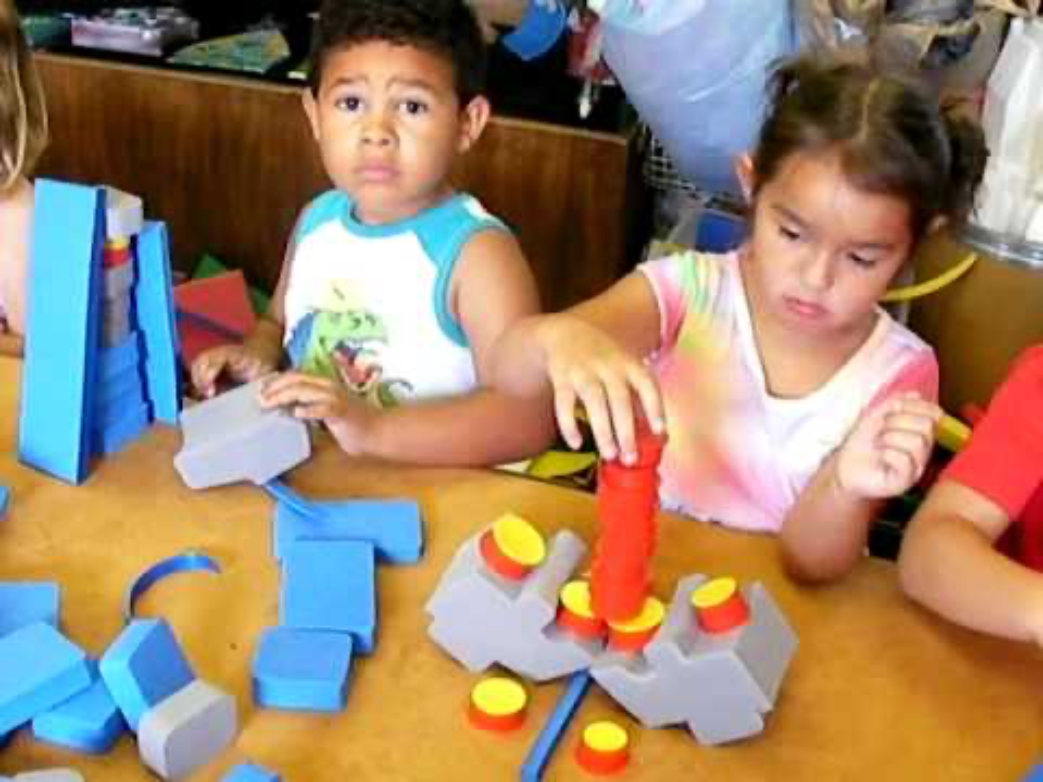

Slide 37


Slide 38
Walter F. Drew, Ed.D.
Kiwanis Club of Melbourne
Institute for Self Active Education
www.ISAEplay.org
drwalterdrew@gmaI.com

