Slide 1


Public Speaking

Slide 2

Public Speaking

Slide 3
Public Speaking
Preparation & Content
Delivery & Engagement
Managing Anxiety

Slide 4
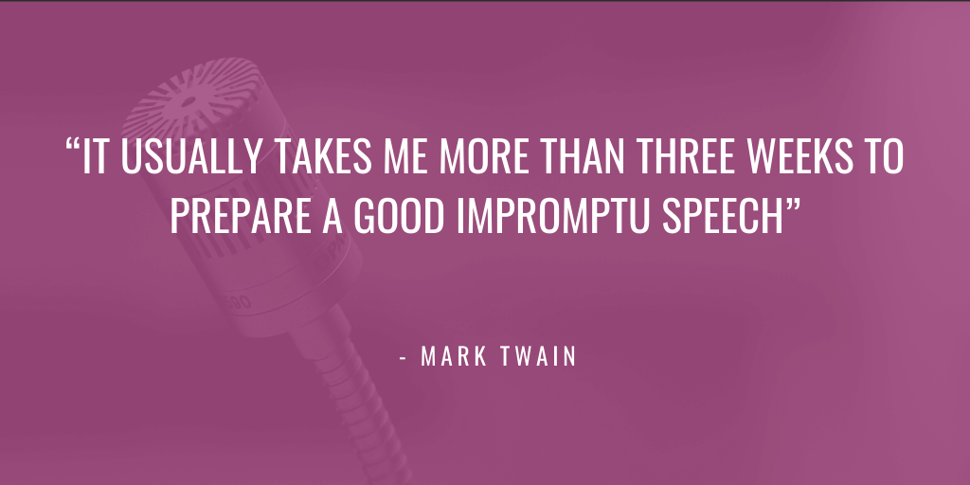
Public Speaking

Slide 5
Public Speaking
Preparation & Content
Know Your Subject
Know Your Audience
Structure The Message
Clear, Concise Language

Slide 6
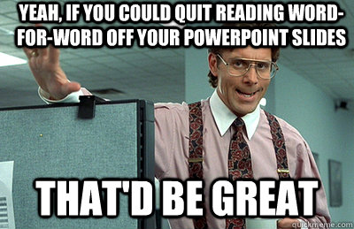
Public Speaking

Slide 7
Public Speaking
Delivery & Engagement
Speak, Don’t Read
Vary Your Voice
Engage With Audience
Practice, Practice, Practice

Slide 8
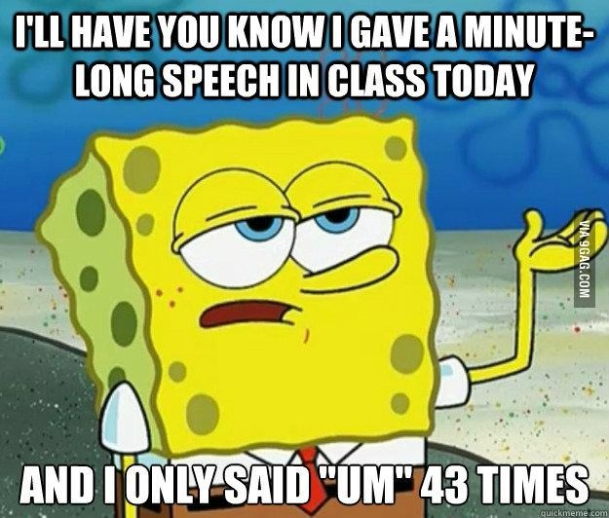
Public Speaking

Slide 9
Public Speaking
Managing Anxiety
Accept Nervousness
Focus On Task, Breathe
Minimize Gestures
Seek Support (Toastmasters)

Slide 10

Public Speaking

Slide 11
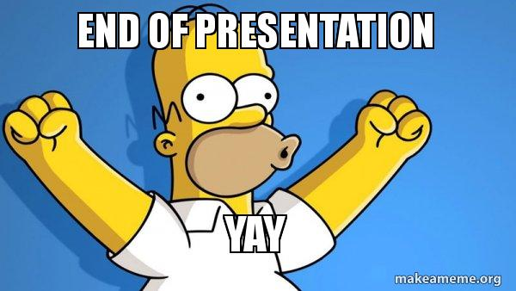
Public Speaking
Presented By: Steve LeBlanc
Email: stephenjohnleblanc@gmail.com

