Slide 1
Don’t Take the Bait
Protecting Yourself from
Phishing, Scams, and Fraud
August 9, 2025

Slide 2
How Much Money is Lost to Fraud and Scams Each Year?
$500 million
$2 billion
$10 billion
$16 billion
Answer:
d. $16 billion!
Per FBI in 2024
Notes:
https://www.pewresearch.org/internet/2025/07/31/online-scams-and-attacks-in-america-today/

Slide 3
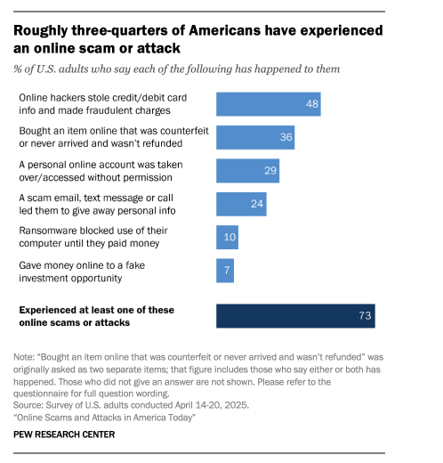
73% of U.S. adults!

Slide 4
Agenda
Why protecting yourself is important
Types of frauds and scams
How to avoid a scam
What to do if you become a victim
Questions/discussion

Slide 5
Why protect yourself?
Financial loss
Identity theft
Emotional trauma
Loss of trust and security

Slide 6
Types of Scams/Fraud
Fraud – the act of acquiring information or causing a loss through deception or other dishonest methods (identity theft, stealing credit card numbers, forging checks, etc)
Scam – refers to a type of fraud that can involve a deceptive scheme with the intention to exploit someone directly (phishing, imposter scams, etc)
  Phishing is one of the most common types of scams!

Slide 7
Phishing
Phishing – email or other message sent under false pretenses to trick users into either:
  Clicking a link that contains malicious payload
  Supplying attackers with log-in credentials
  Obtaining Personally Identifiable Information (PII)
  Obtaining business or financial information

Slide 8
How to Avoid a Scam
Look for signs in emails and texts:
  Is the email address correct?
  Use the “hover” technique
  Examine spelling, grammar and punctuation

Slide 9
How to Avoid a Scam
If you receive a suspicious email or text:
Do not forward it
Do not respond by sending money or gift cards
Delete the email or text
If you are still unsure about the request, contact the sender by telephone to confirm its legitimacy

Slide 10
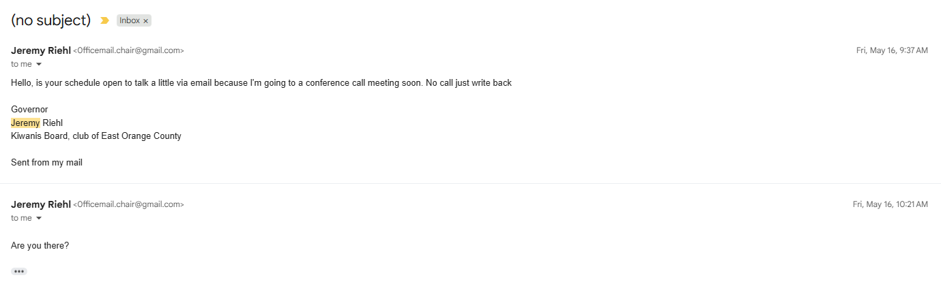
Email: Real examples

Slide 11
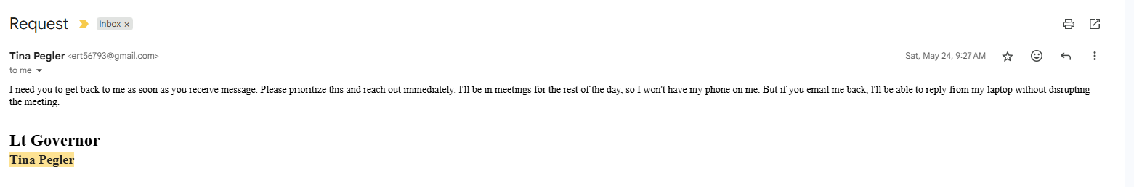
Email: Real examples

Slide 12
If You Fall a Victim
Call your local Sherriff’s office; many have scam units
Call your local State Attorney’s Office
National Fraud Information Center- 800-876-7060
Florida Department of Agriculture- 800-435-7352
Florida Department of Insurance- 800-342-2762

Slide 13
Protect Yourself!
Use strong passwords (longer is better)
Use Multi-Factor Authentication (MFA)
Think before clicking!
Monitor your accounts
Be skeptical
Never give out your credit card, checking account, or social security number to an unknown caller or text or via email

Slide 14
Club Crime Insurance
Kiwanis International offers insurance that covers several situations including:
Social Engineering - scams used by criminals to deceive and manipulate their victims into giving them confidential information
Theft of funds by dishonest volunteers, members, officers and employees
Embezzlement
Forgery of checks
Money lost in transit
Computer theft
Safe burglary
Robbery

Slide 15
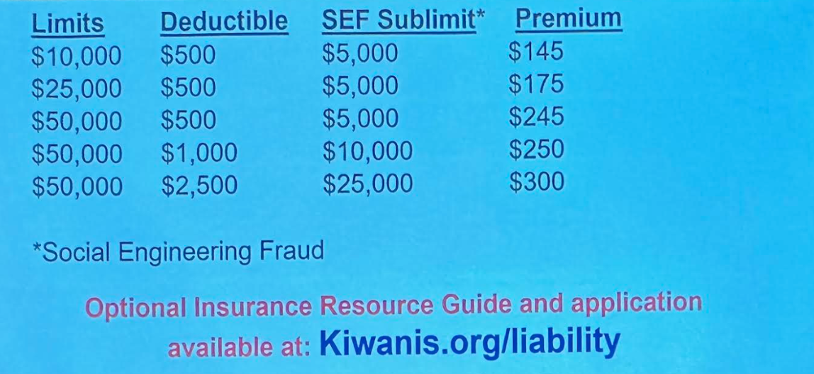
Annual Premium

Slide 16
In Conclusion…
Scamwatch, run by the National Anti-Scams Centre (NASC) says:
Stop - Don't give money or personal information to anyone if unsure
Check - Check who you're dealing with and ask yourself could the message or call be fake?
Protect - Act quickly if something feels wrong

Slide 17
Questions?
Stacy Vu, stacy.p.vu@gmail.com
Rachel Toomey, Rachel.toomey33@gmail.com

