Slide 1

Kiwanis Secretary Training
Florida District
DCON 2025
Notes:
Introduce myself
First Time Secretaries?
Repeat Secretaries?

Slide 2

Welcome!
Notes:
Add a Poll?
Expectations?

Slide 3

Objectives
By the end of this session, you will:
Be familiar with a Club Secretary’s Online Responsibilities
Know where to access important Secretary Resources.
Have a clear understanding of how you can best keep your club (and president!) on track & organized!
3
Notes:
By the end of this session, you will be able to use the online tools and additional resources to make the club secretary’s job simpler.

Slide 4

What did I get myself into?
Let’s make being Secretary a little easier!
4

Slide 5


Staying Organized
Tips & Tricks to “dot your i’s and cross your t’s”
5

Slide 6

“Constant Companions”
Items to always have on hand..
Secretary notebook
Member applications
Sign-up sheets
Copy of club roster
6
Notes:
Bring examples

Slide 7

Common Responsibilities
Discuss with your President
Club Meeting & Board Meeting Agendas
Club Communications
“Email Blasts”
Sign-up Sheets
7
Notes:
Friday Agendas
Board Meeting Agendas
Email Reminders – Upcoming meetings events & projects, Meeting Summaries / Newsletters, Interclubs, Division News
Email Meeting Summaries

Slide 8







Email Management
Organize your EMAIL!
What kind of email do you use?
Do you have a specific club email account?
8
Notes:
Discuss Email Management-
What kind of email do you use? Do you have a specific club email account?
Create Club Member Email Groups – members and board members
Scheduling emails ahead of time is VERY helpful!

Slide 9

The Assistant Secretary Role
Be sure to assign an Assistant Secretary -
The Assistant Secretary has the same access as the secretary so they can serve as a “back-up” when/if the secretary is not available.
Possible choices for Assistant Secretary:
President
Treasurer
Next year’s secretary
Potential FUTURE secretary
9

Slide 10

Important Due Dates
Oct 1 – Approval of Club Budget
Oct 10 – Updated Roster
Feb 15 – Form 990 Filing
June 1 – Annual Report Club Elections
Mid July – Submit DCON Delegate Form
Monthly Report – by the 10th of following month
10
Notes:
Explain Delegate Certificates- these are for International and District Conventions.

Slide 11

Online Reporting
Secretary Dashboard & Monthly Reports
11

Slide 12

The Online Process
Let’s walk through the Online process…
Logging into the Kiwanis Engage
Accessing the Club Management System
Updating Club Info
Managing Membership
Submitting Monthly Reports
12
Notes:
Update LINK to Kiwanis Engage
Create Cheat Sheet Handout

Slide 13
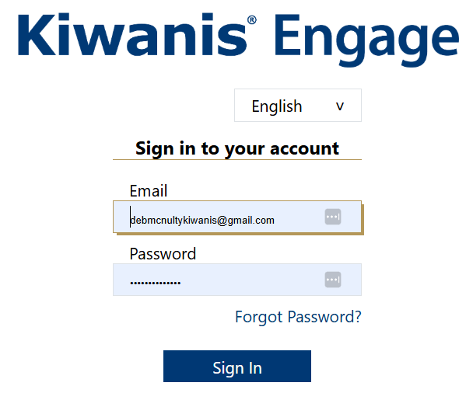

Logging into Kiwanis Engage
http://engage.kiwanis.org/
13
Notes:
http://engage.kiwanis.org/

Slide 14
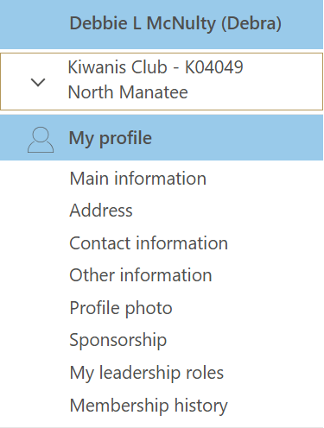
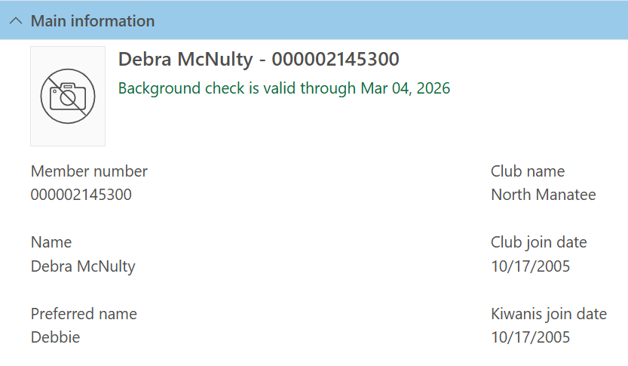
Landing Page
14
Notes:
Landing page starts with your personal information

Slide 15
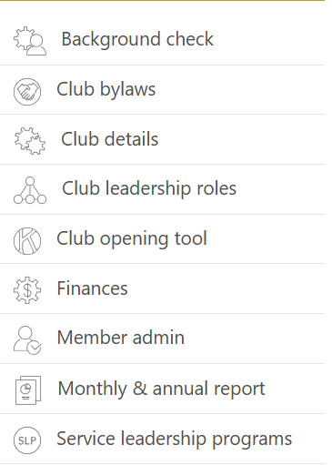
Secretary Tabs
Background check
Page Down in Landing Page!
Club details
Club leadership roles
Member admin
Monthly & annual report
Service Leadership Programs
15
Notes:
Page Down in Landing Page- look along left-hand side.

Slide 16
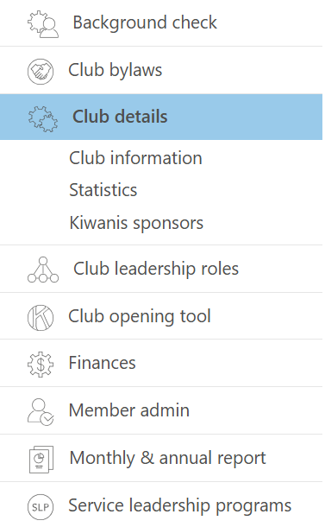
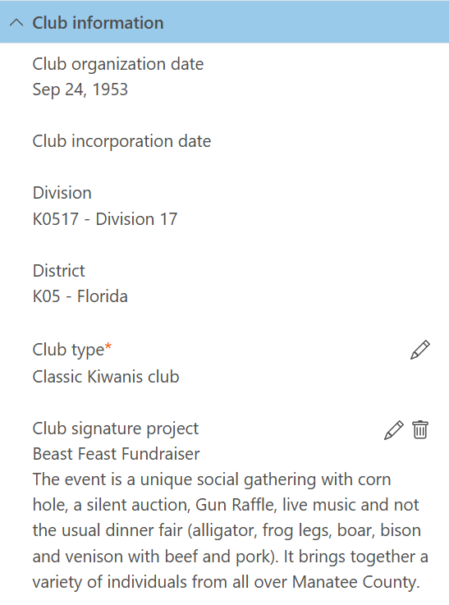
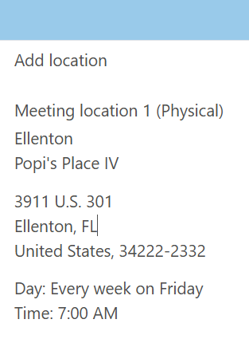

Club Details
16
Notes:
Enter Signature Project, Meeting location & time

Slide 17
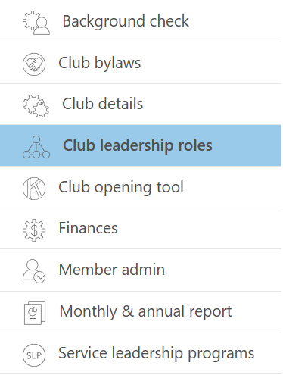
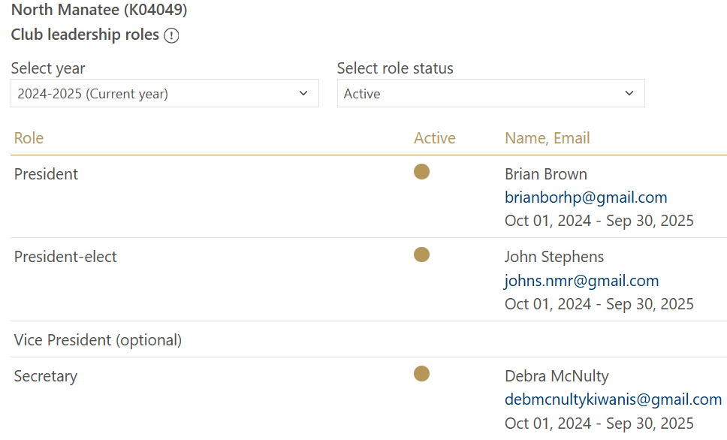
Club Leadership
17
Notes:
2024-25 & 2025-26 Officers

Slide 18
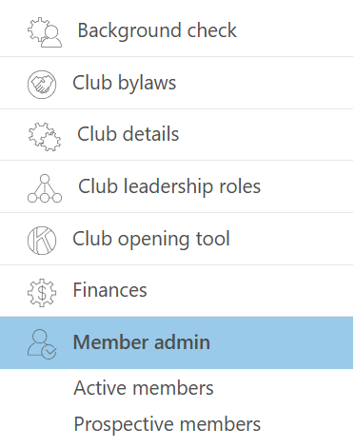
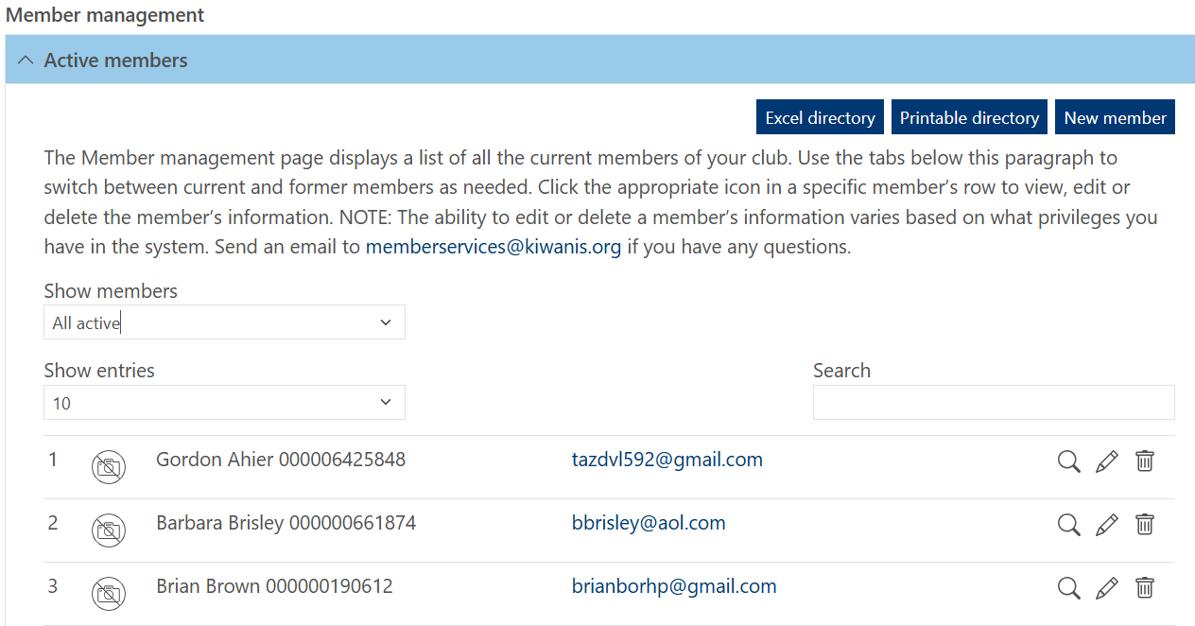
Member Admin
18
Notes:
Update, Add, Remove members
Generate Excel spreadsheet

Slide 19
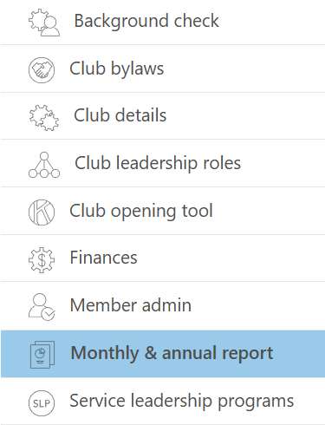
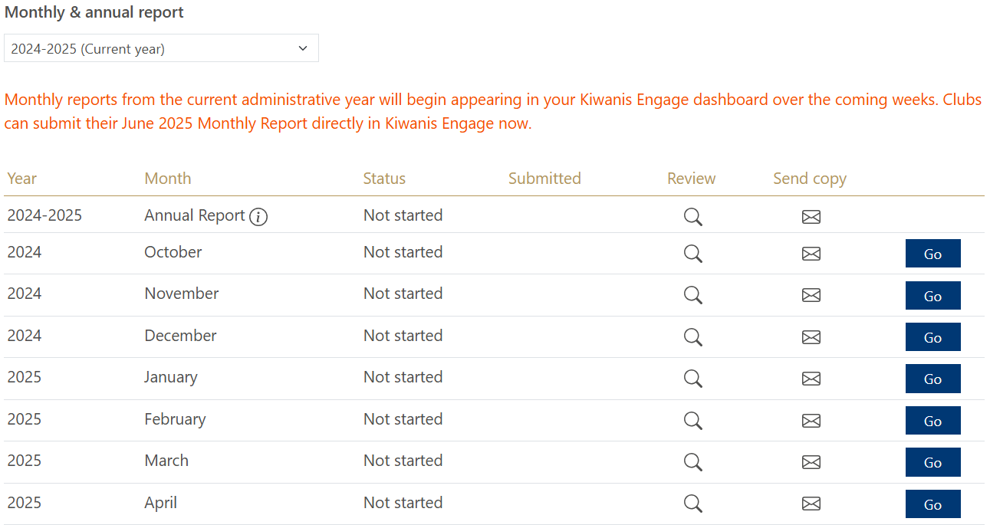
Monthly Reports
19
Notes:
Update, Add, Remove members
Generate Excel spreadsheet

Slide 20
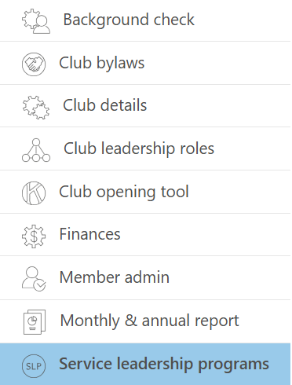
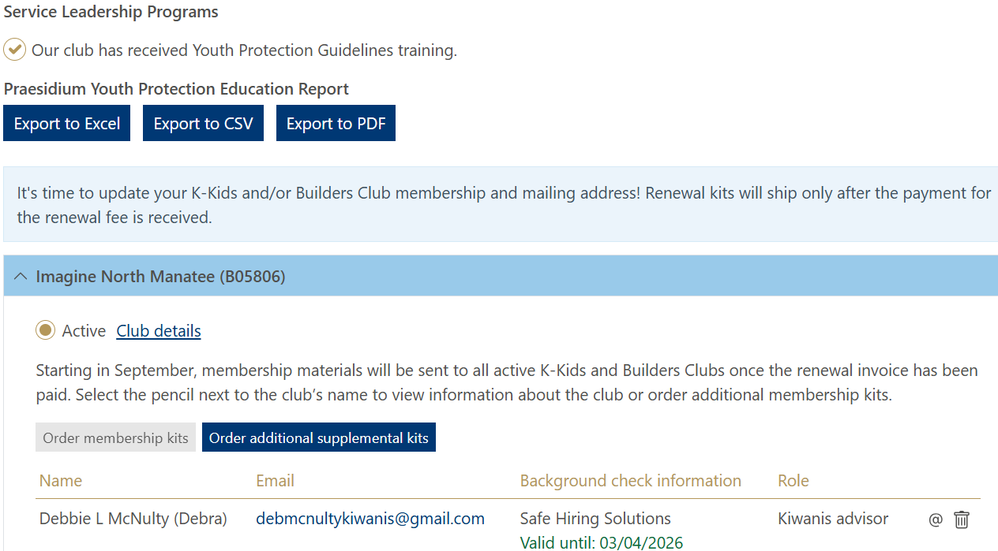
Service Leadership Programs
20
Notes:
Record SLP Advisors here – ALL ADVISORS MUST HAVE A CURRENT BACKGROUND

Slide 21

Club Management – A Quick Review
Update and Submit…
Meeting location, day, time
Current / Incoming officers
Membership changes (update/add/delete)
Monthly Reports
SLP club advisors
21

Slide 22

Monthly Reports – Key Points
Complete by 10th of the month for previous month – Always send on time, can be updated later
Incorporate into Board Meeting minutes
Need information from other sources
Do all at once or a little at a time- choice is yours
Used by LTG to track your club’s health
Used by your club to track your progress throughout the year.
Used by KI for certain statistics
22

Slide 23


Secretary Resources
Kiwanis International Online Sites

Slide 24

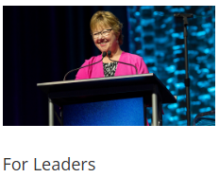


Secretary Resources Online
KI provides a special Resources Page just for you!
Kiwanis.org
Click box for link to Resources
24
Notes:
http://www.kiwanis.org/clubs/member-resources/training/club-leader/club-secretary-education
http://www.kiwanis.org/clubs/member-resources/member-login/online-reporting
https://docs.google.com/document/d/1TXaJG8kMcu0woVfAeMvijRn2B5gB_WLW-VBItrBRWYA/edit

Slide 25


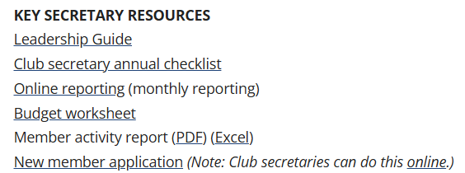

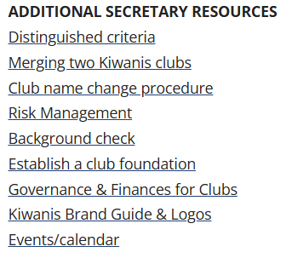
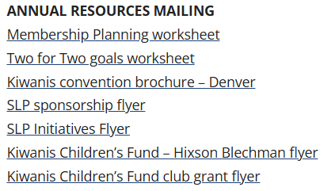
Available Secretary Resources
25

Slide 26
Questions?

Slide 27



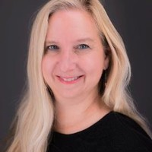
THANK YOU for being here!
Debbie McNulty
Club & Leadership Education Coordinator
debmcnultykiwanis@gmail.com
941-737-8574
Wishing you the best in a successful year of service and leadership.
27

