Slide 1
Insta-Success:
Using Technology and Social Media to Promote your club
Jose Leoncio
Social Media Chair
Florida Kiwanis

Slide 2
Objectives
Different Platforms
Kiwanis Brand
Sample Posts
Tying it back to recruiting new members

Slide 3

Social Media Platforms

Slide 4
Flash Poll - What Platform is Your Club On?
Facebook
X (Twitter)
Instagram
Others

Slide 5
Kiwanis Brand
Follow the Kiwanis Brand Guide
Ensure your club has an updated Kiwanis logo
Be mindful of the language you use throughout social media
More Resources: kiwanis.org/brand

Slide 6
Audience
Your Club’s Facebook and Instagram pages: speaking to your outer audience
Your personal Facebook and Instagram pages: speaking to your inner audience

Slide 7
Membership Recruitment
People join people
People will search your Kiwanis Club
Your club needs to be attractive on Social Media and beyond

Slide 8
Crafting Posts: Captions
Use short captions. No more than 50-100 characters.
Use emojis
Tag any organizations you partner with.
Utilize 1-3 hashtags #KidsNeedKiwanis.
On Facebook: You can use links!
Instagram: Stay away from links!

Slide 9
Crafting Posts: Posts
Use action photos! Stay away from just posting group photos.
Show of the Kiwanis Brand!
Be consistent on posting
Stay away from posting anything that can make your club look negative

Slide 10
Posts Ideas
Highlighting your club events
Showcasing your members
Giving a shoutout to your sponsors/partners
Use Social Media trends to influence your posts
Share the love of Kiwanis

Slide 11
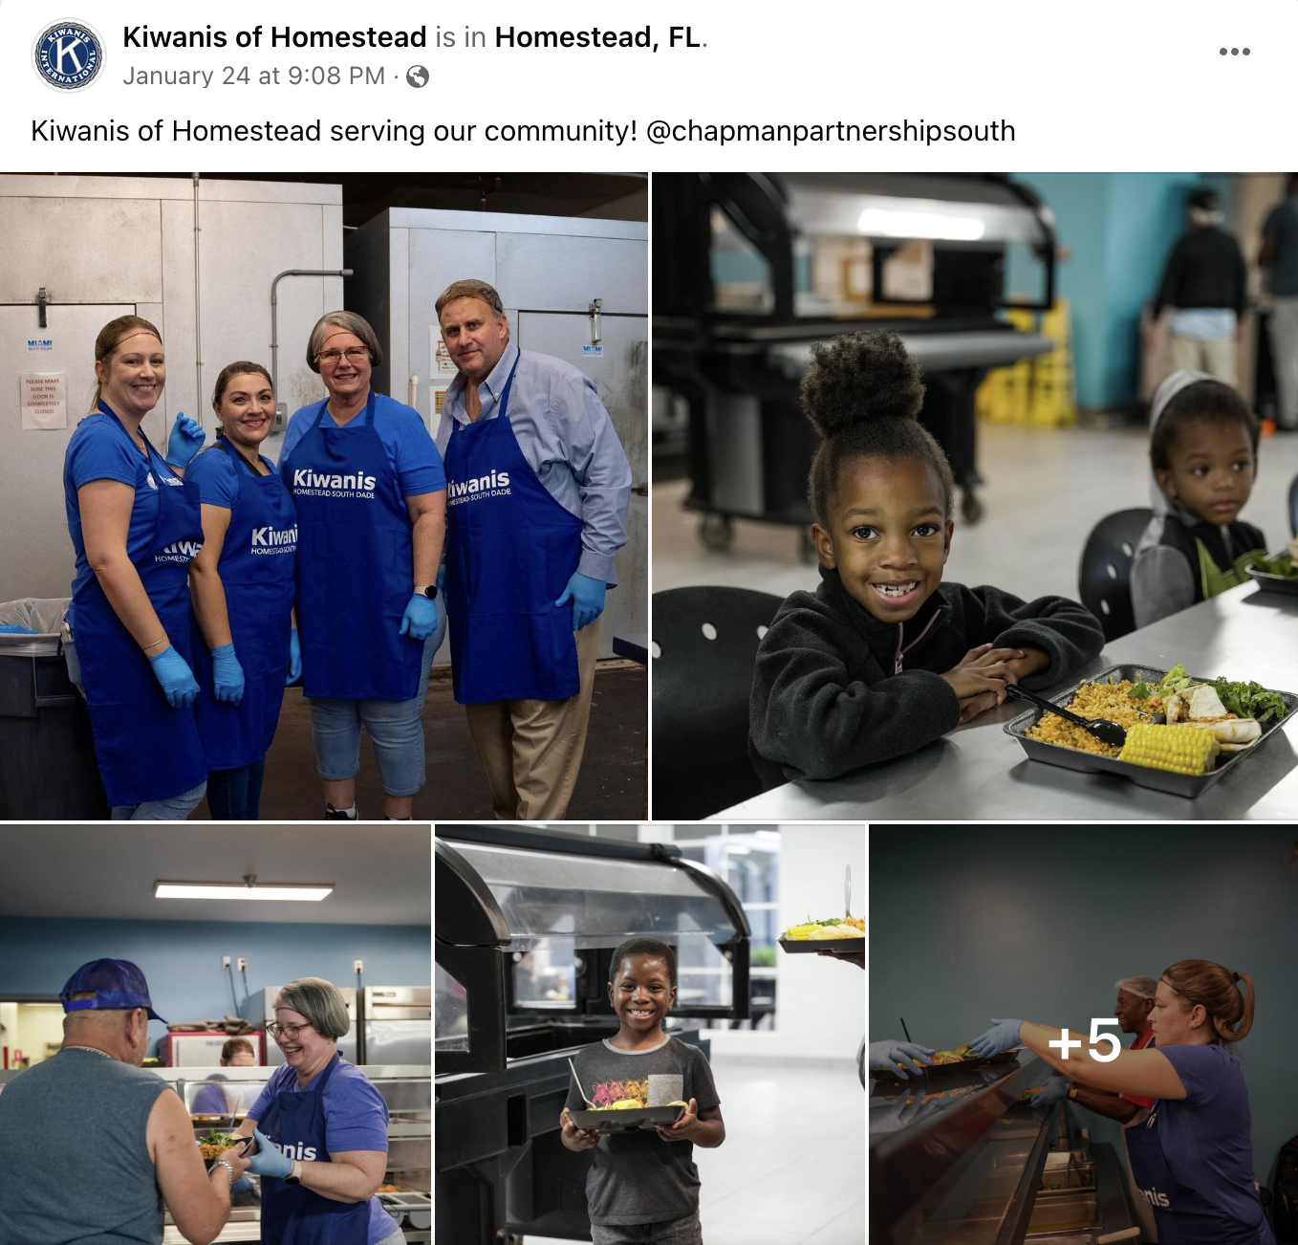
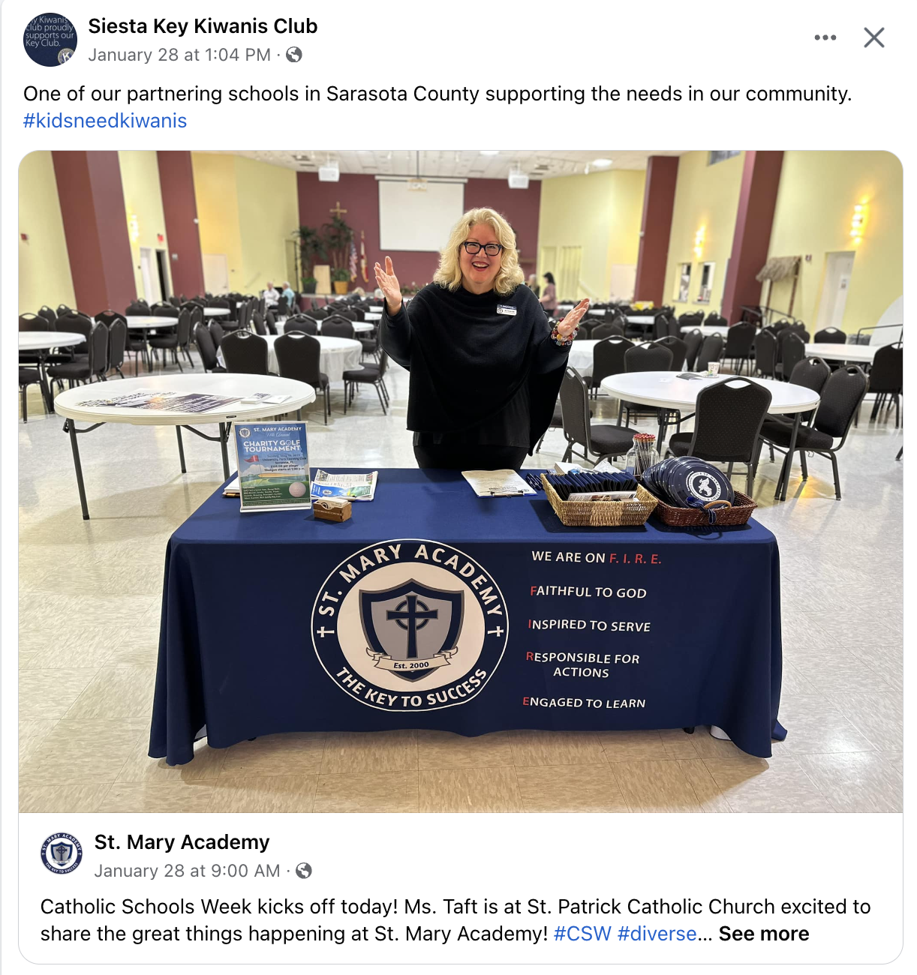
Notes:
Action shots of your Kiwanis Projects.
Highlighting your community partners.

Slide 12
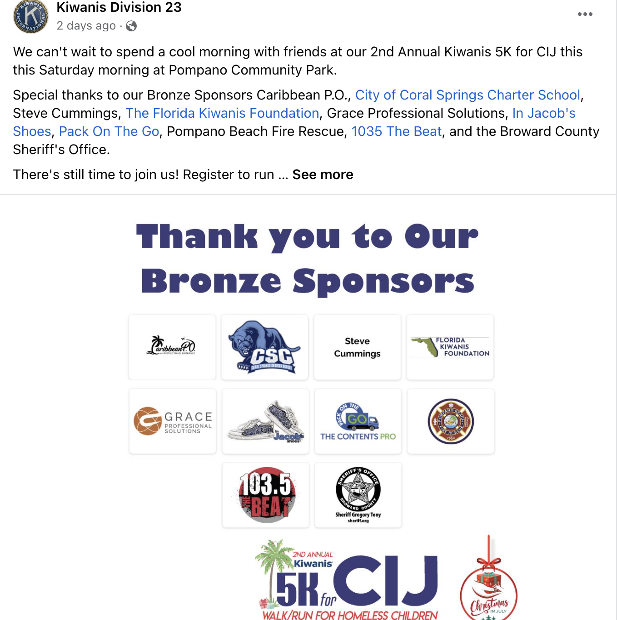
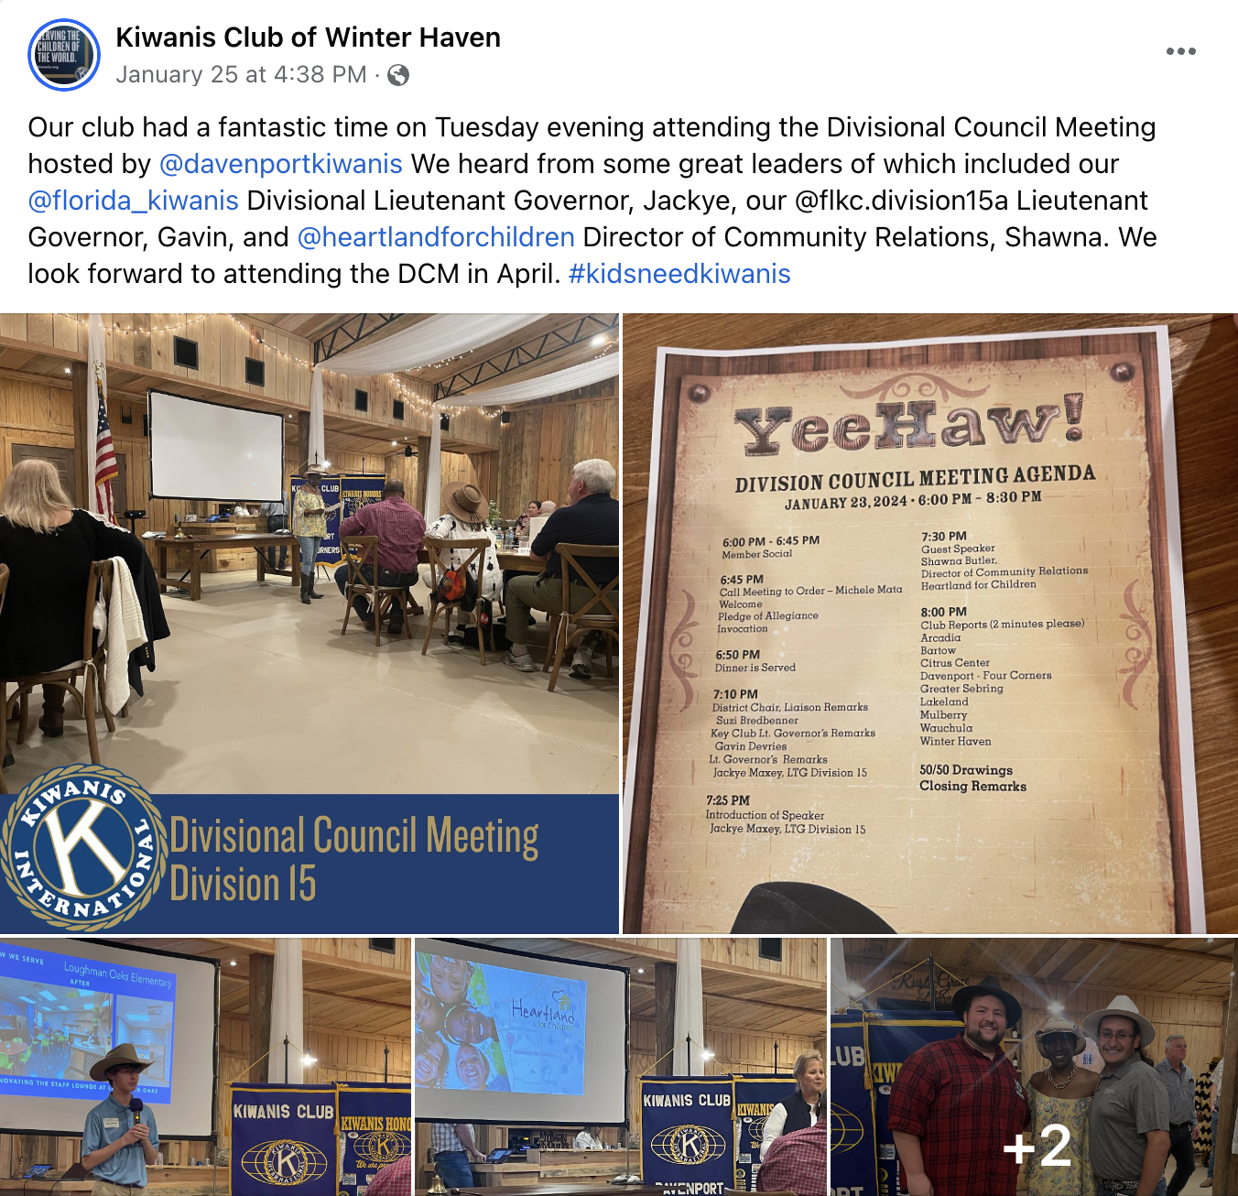
Notes:
Highlighting your event sponsors.
Posting about attending divisional meetings.

Slide 13
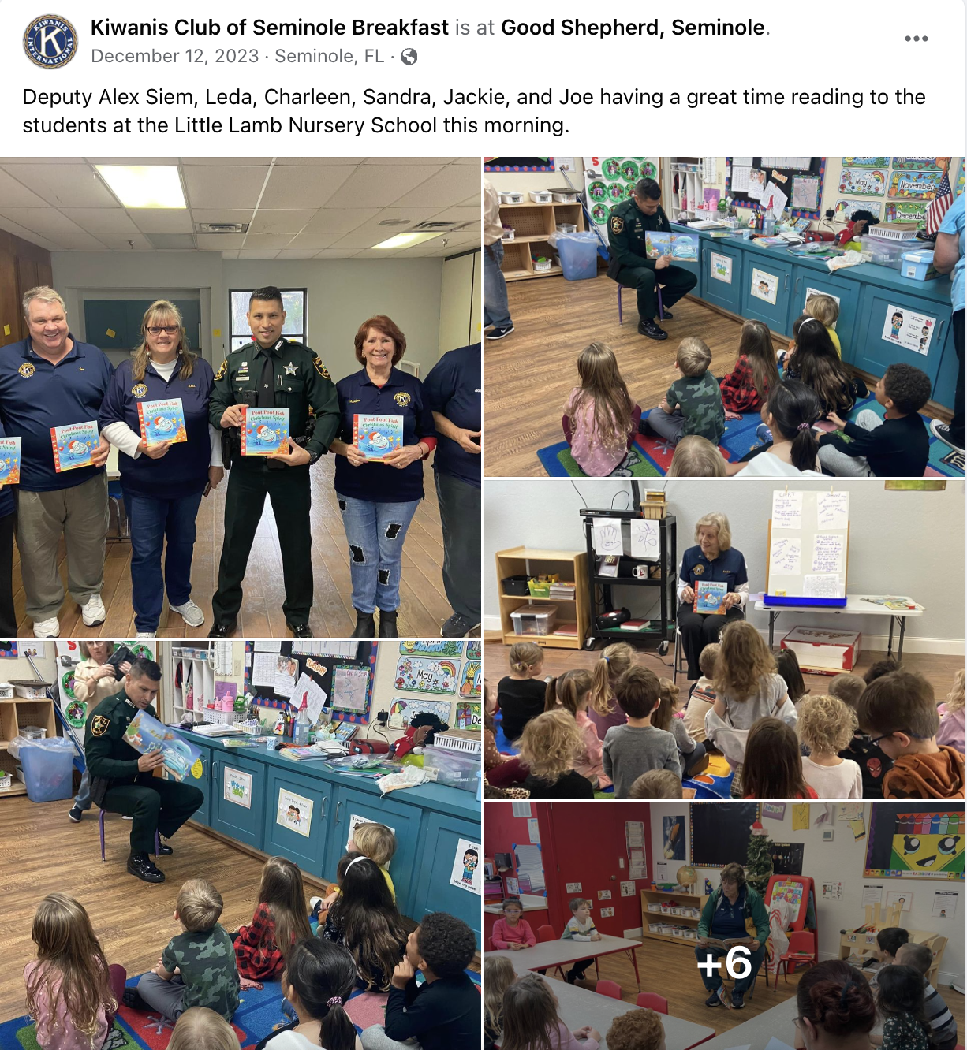
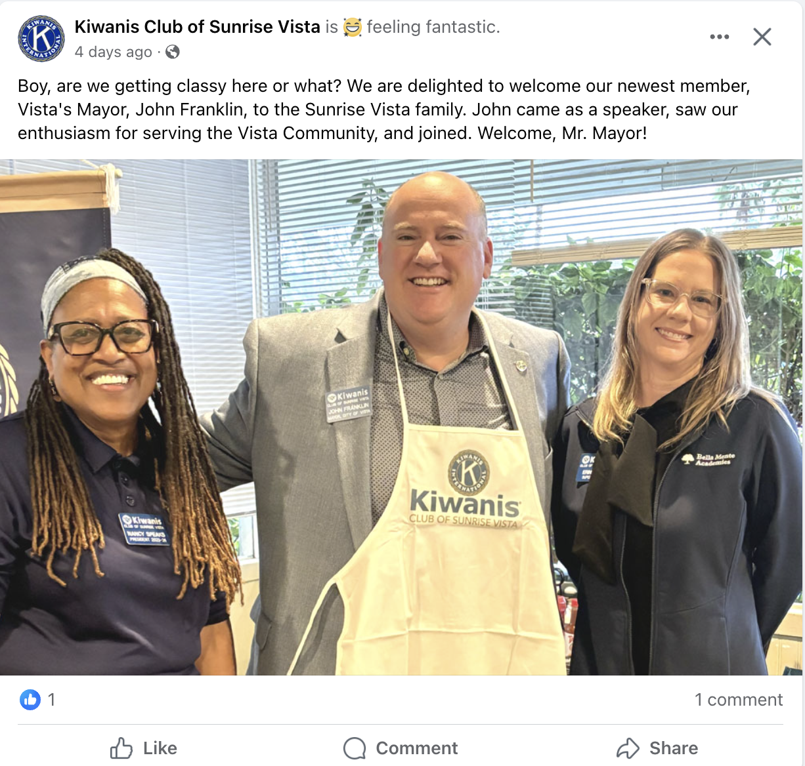

Slide 14
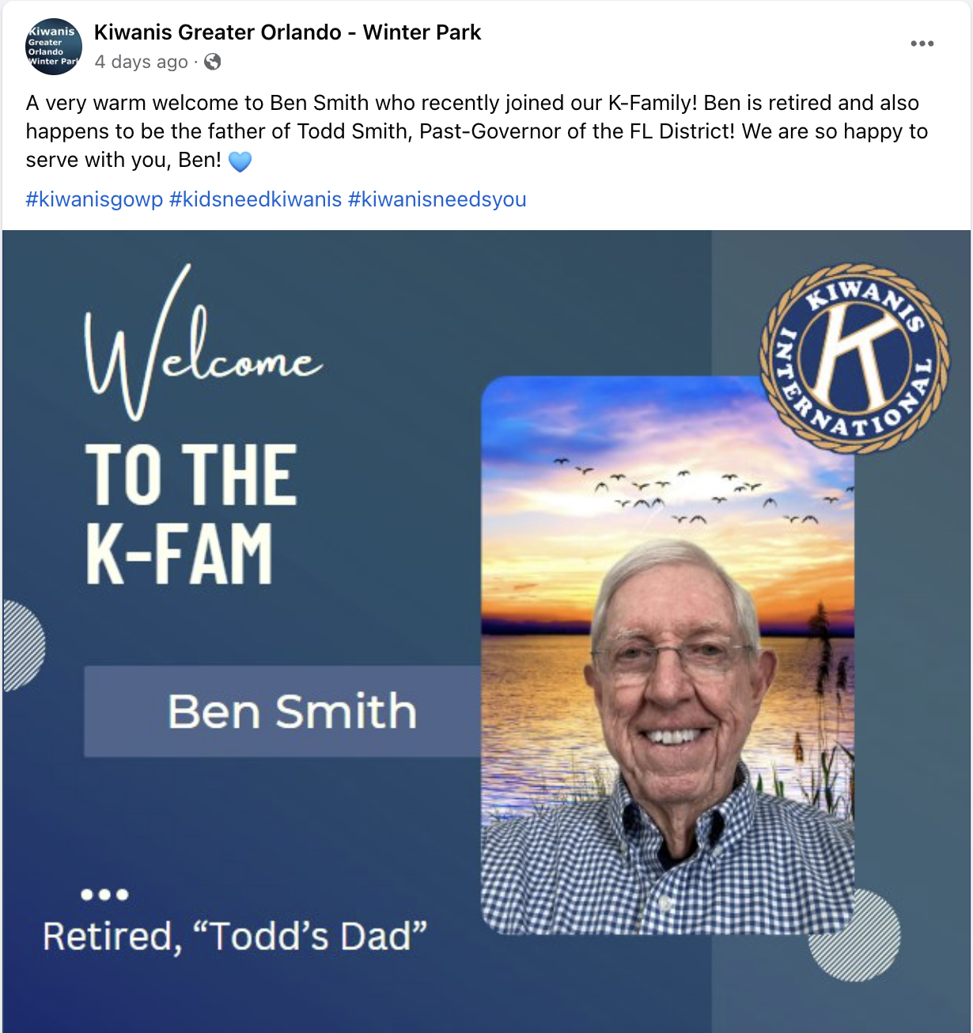
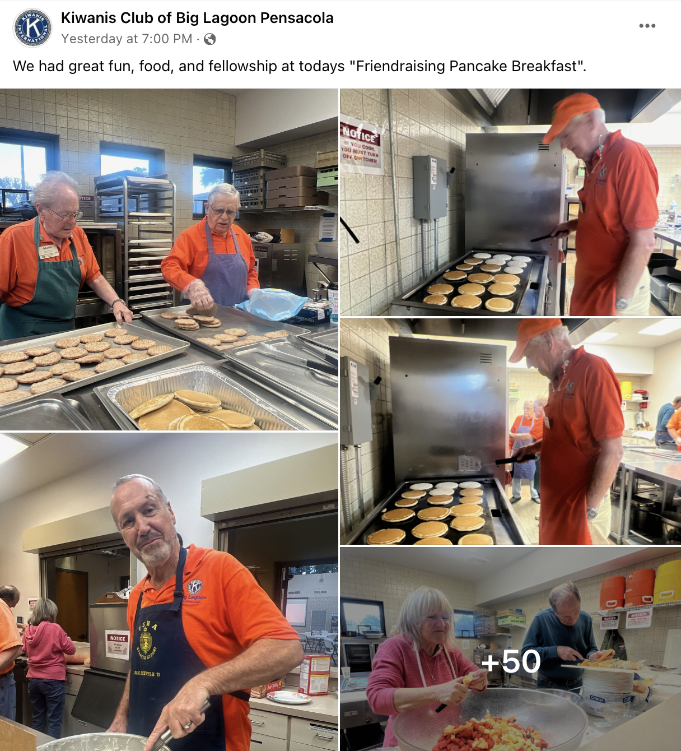

Slide 15
Facebook Events
Use them to promote your recruitment events!
You can invite members from your club, on your friend list, etc.
You can post the event page link on local community Facebook groups
If there is an update with the event, you can post it in the discussions section.

Slide 16
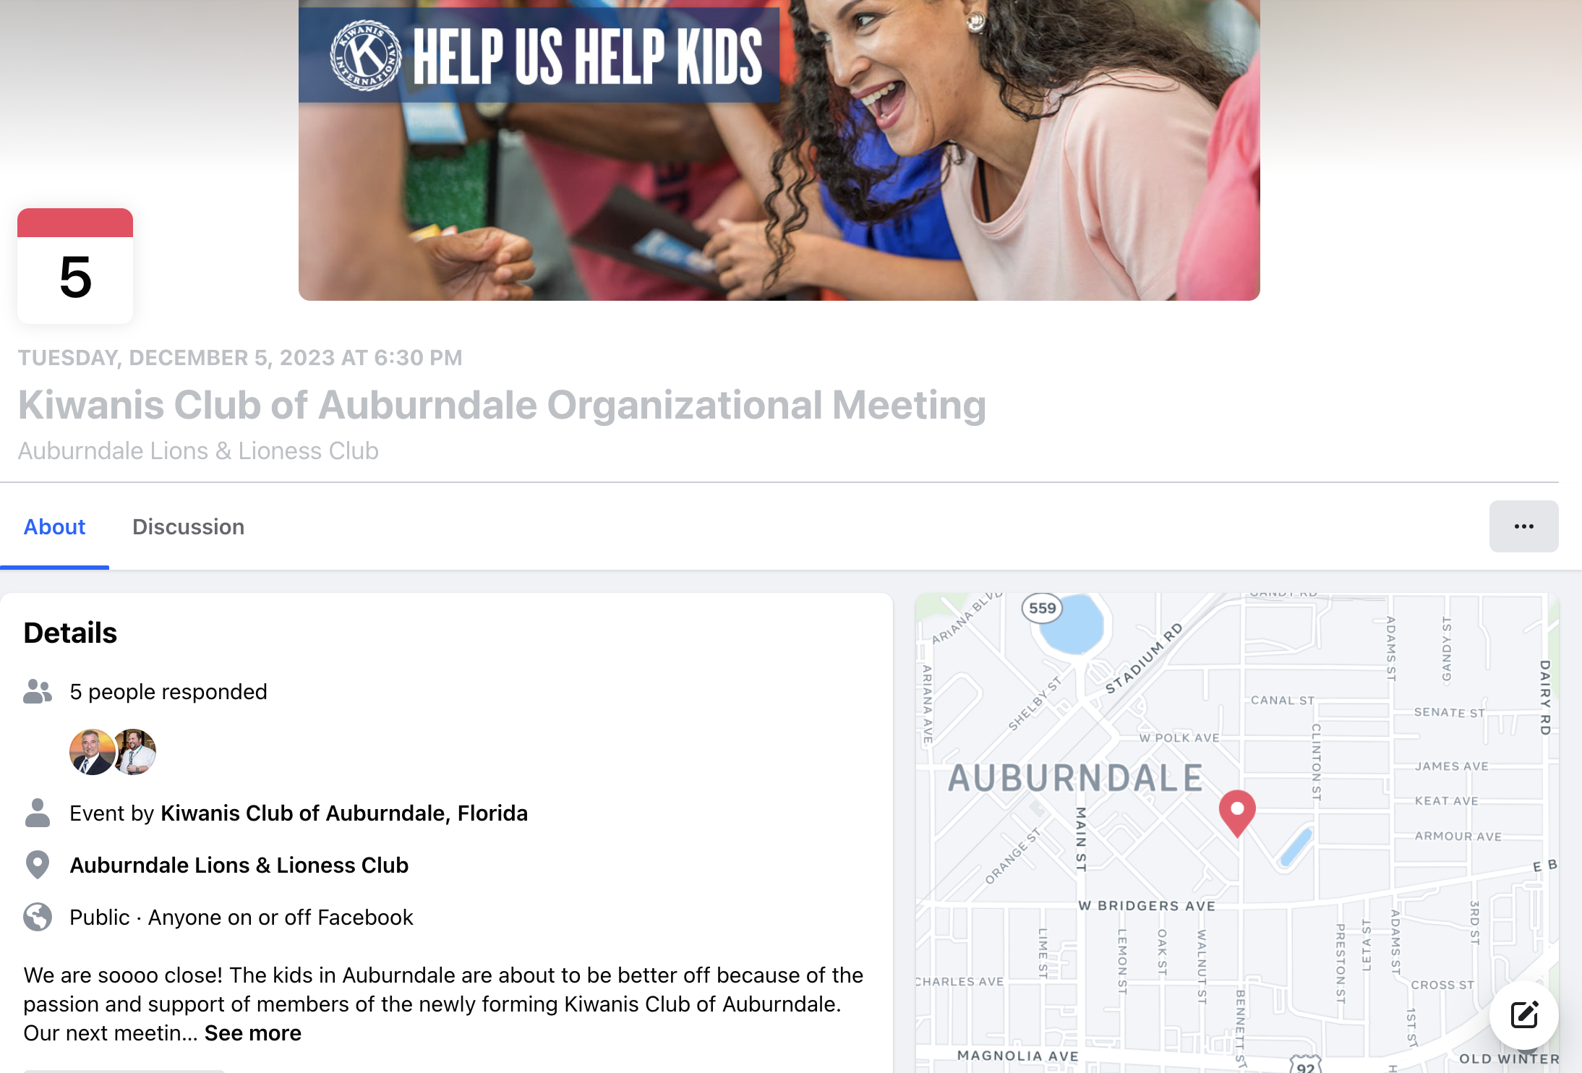
Facebook Events

Slide 17
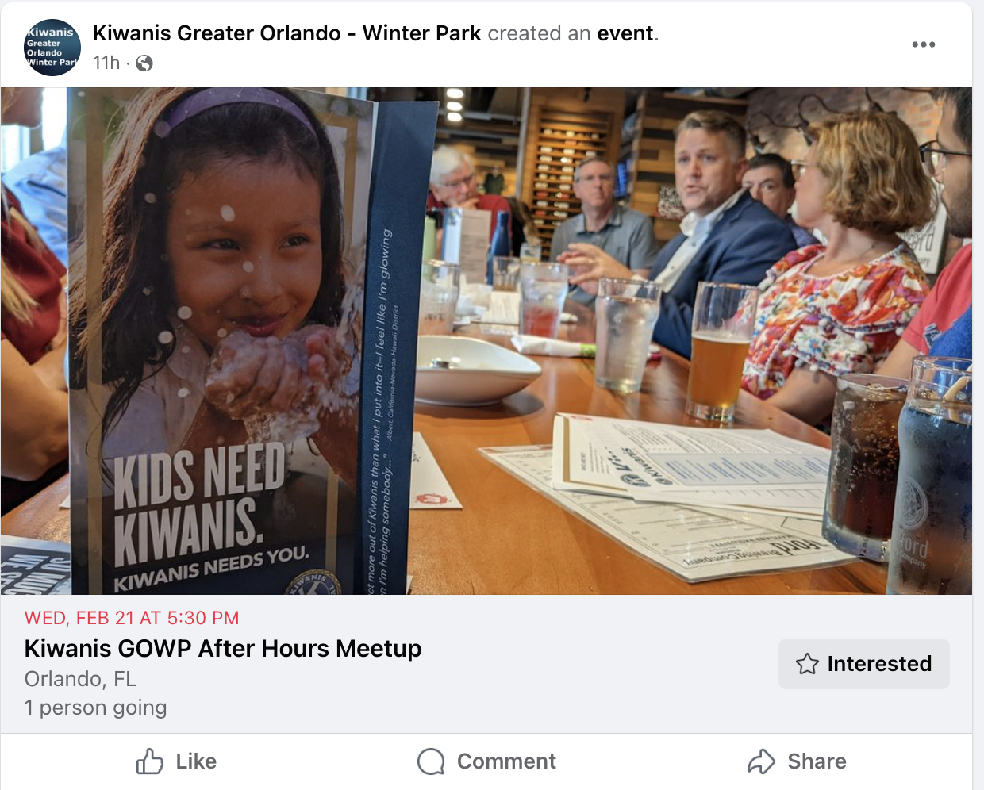
Facebook Events

Slide 18
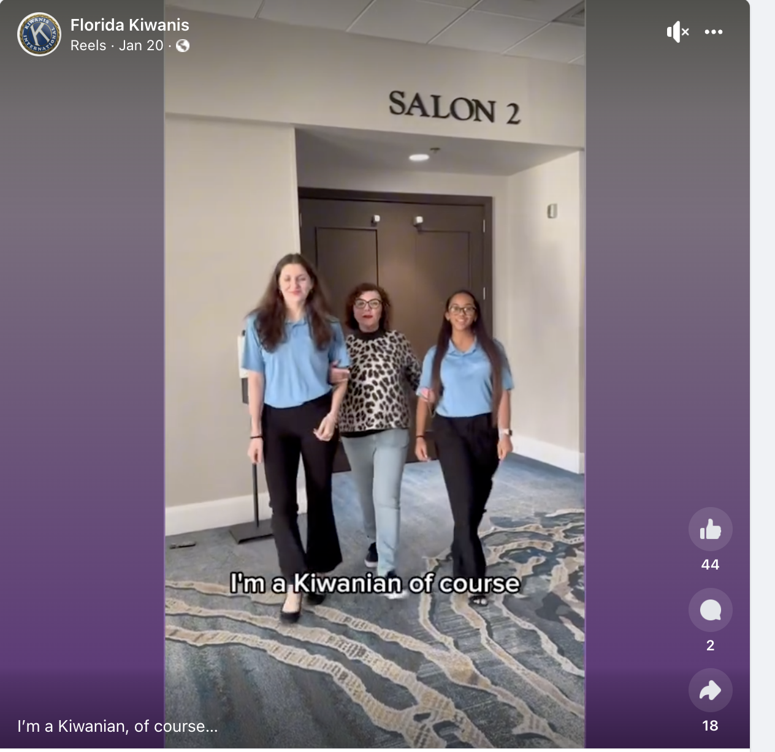
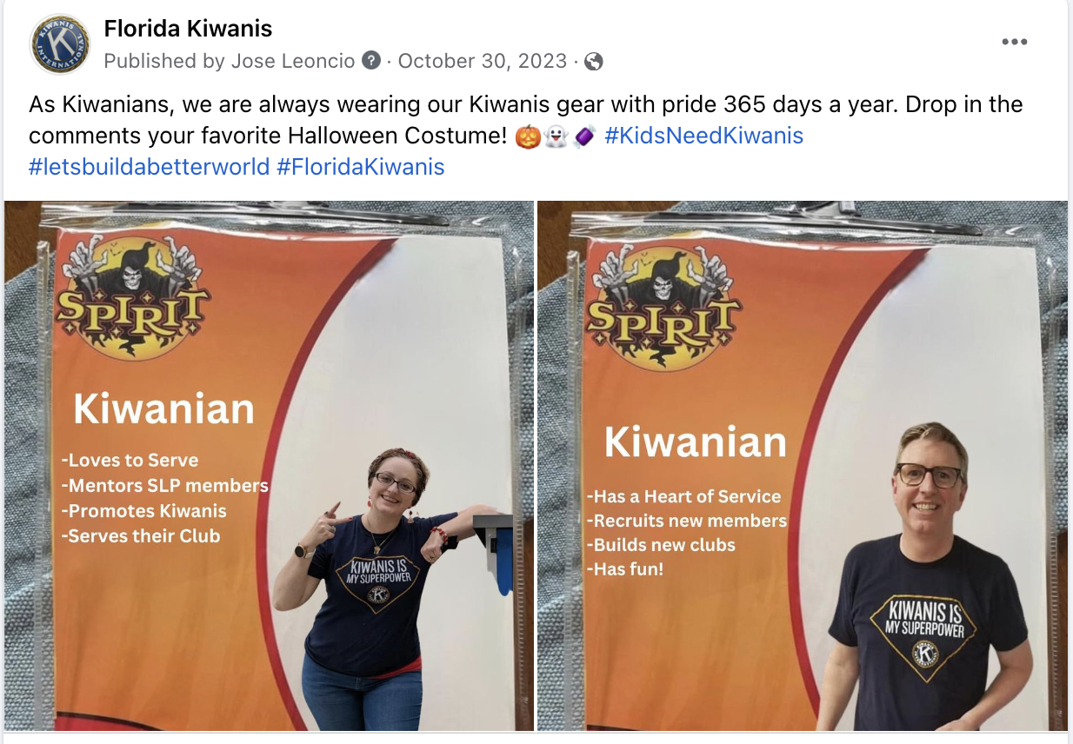
Social Media Trends

Slide 19
Boosting Your Posts
Facebook Advertising
Targeted Areas
Boosts Your Posts Impression
Amplify Your Audience

Slide 20
Resources
District Social Media Chair - Robert Brown
Kiwanis International Website
Canva
Meta Business Suite

Slide 21
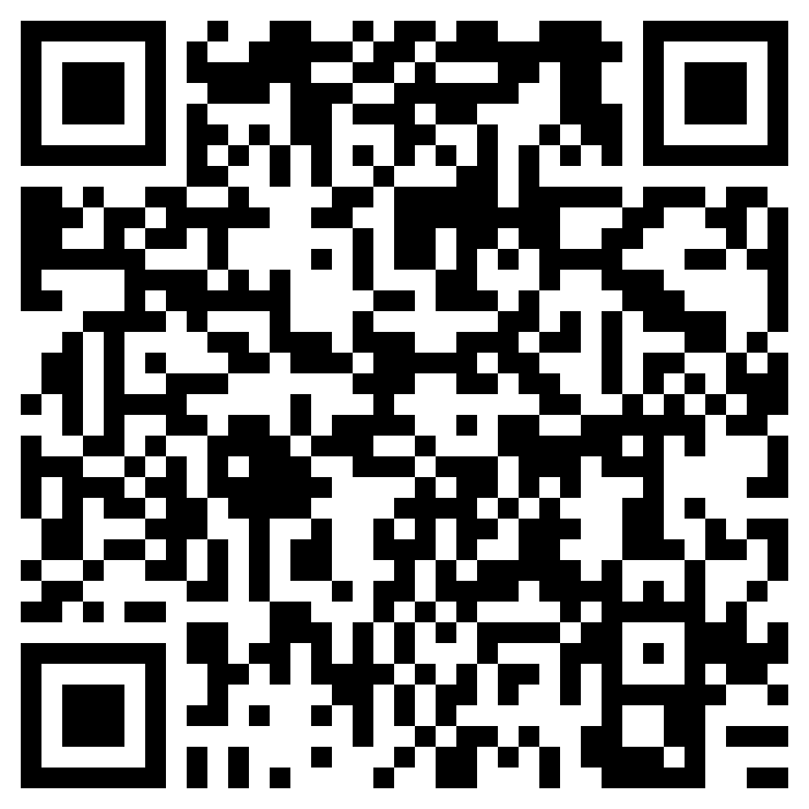
Free Graphics!

Slide 22
Final Tidbits
In need of posts to share? Share posts from Florida Kiwanis!
Utilize the posting to story feature on Instagram and Facebook
If your club gets mentioned in the press, share the article!
Use the Social Media Assets provided by Kiwanis International

