Slide 1
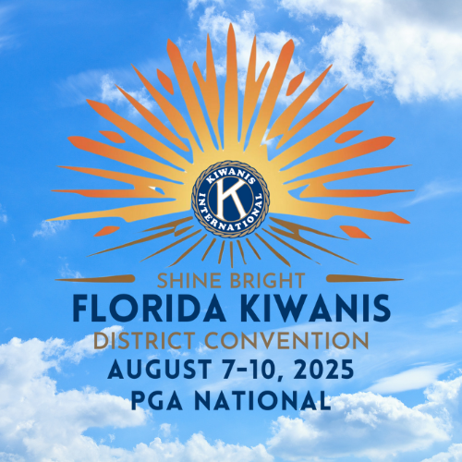

Using AI For Fundraising
2025 DCON Workshop

Slide 2

Why Talk About AI?
• AI is revolutionizing how organizations engage, fundraise, and grow
• Kiwanis can leverage AI to:
• Save time
• Raise more funds
• Reach new audiences
• Let's explore how

Slide 3
Where can AI Help in Fundraising?
1. Communications – emails, social posts, thank-you notes
2. Donor Analysis – identify likely givers
3. Event Promotion – target ideal attendees
4. Content Creation – flyers, videos, captions
5. Automation – reminders, follow-ups, CRM updates

Slide 4
Real Examples for Kiwanis Clubs
• Use ChatGPT to write:
Fundraising letters
Social media scripts
Newsletter blurbs
• Use Canva AI to create:
Flyers and event graphics
• Use tools like Mailchimp AI to:
Predict who opens emails
Schedule optimized send times

Slide 5
Ethics & Cautions
• Always review AI-generated content
• Never share donor data with public AI tools
• Keep the KIWANIS VOICE – authentic & caring
• Use AI to assist, not replace human connection

Slide 6
Getting Started-Simple & Free Tools
• ChatGPT (Free) – content generation
• Canva AI (Free tier) – graphics & social posts
• Mailchimp AI (Free for small lists) – email automation
• Pictory / Lumen5 – turn text into promo videos

Slide 7

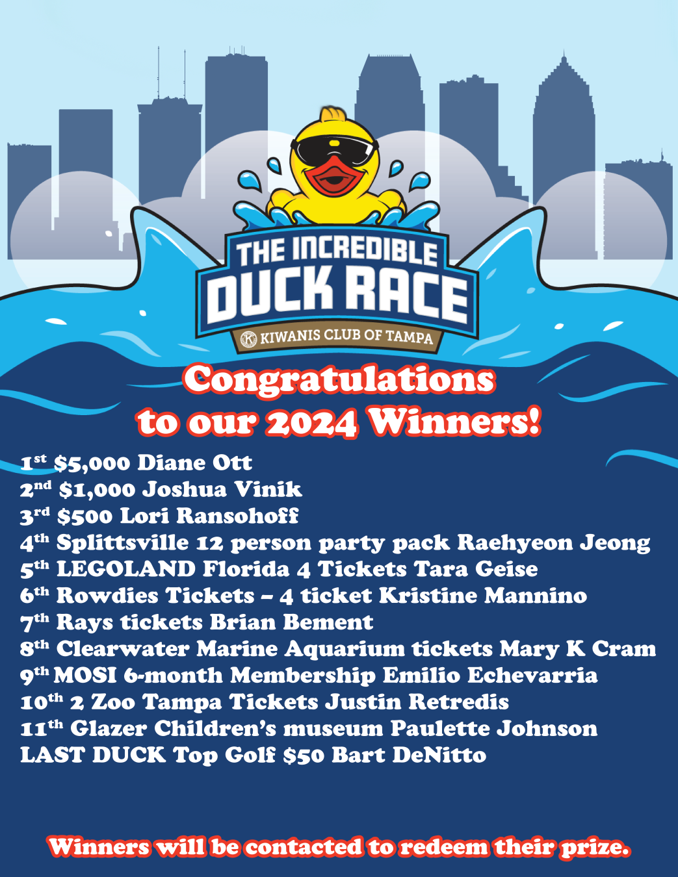

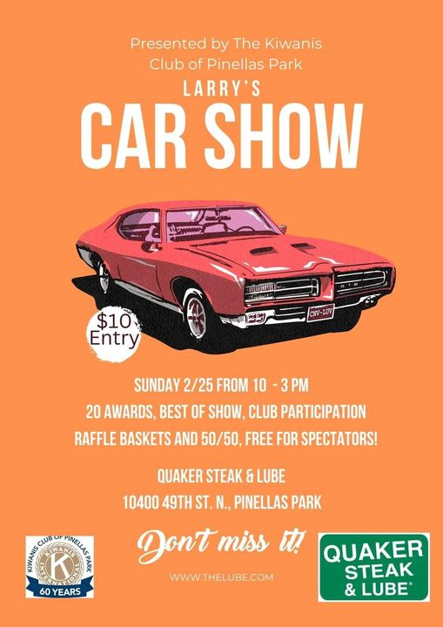

We know how to have fun

Slide 8
Example “AI-Powered Fundraiser”
• ChatGPT writes posts, emails, thank-yous
• Canva AI creates flyer
• Mailchimp sends segmented invites
• Result: Faster launch, more reach, more $ raised

Slide 9
Final Thoughts
• AI is a tool – not a magic wand
• Kiwanis values still lead the way
• But with AI, we can:
Work smarter
Grow faster
Raise more – with less burnout

Slide 10

Q&A
• Questions?
• Concerns?
• How can your club test AI this month?

Slide 11
