Slide 1


Young Children Priority One (YCPO)

Slide 2

What is Young Children Priority One (YCPO)
YCPO is an ongoing community service program of Kiwanis International that addresses the needs of early childhood (pregnancy to age five). All clubs are encouraged to carry out at least two YCPO projects per calendar year, though many clubs are able to do more – serving children, families, and communities. Young Children Priority One focuses on four key areas:
    Maternal and child health
    Childcare and development
    Parent education and support
    Safety and pediatric trauma

Slide 3


How did it begin?
From 1990-1991, Dr. Wil Blechman served as the President of Kiwanis International. Dr. Wil spent his life dedicated to medicine, but Rachel Blechman, his amazing wife, influenced and fueled Dr. Wil’s passion for early childhood. Rachel’s college background and ongoing interest in early child development inspired Dr. Wil to craft and ignite a new worldwide program focusing on these critical years. This initiative is called Young Children Priority One!

Slide 4

WHY does early childhood development and education important?
The early emotional, physical and social development of young children directly affects their overall growth and will ultimately become an influential factor in the adult they become. This alone makes it extremely critical to invest time, energy and resources in order to encourage young children and develop successful future leaders.
Early childhood education is the key to successful human development. This cannot be emphasized enough! Today there is an overwhelming amount of research supporting early childhood education and emphasizing its importance to overall development and success. The earliest years of childhood create the foundation for his or her future development.

Slide 5
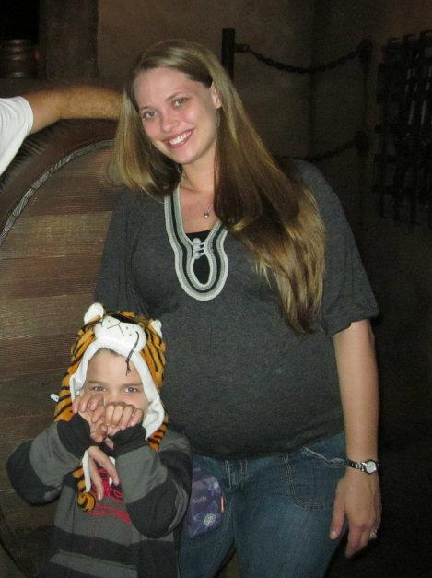
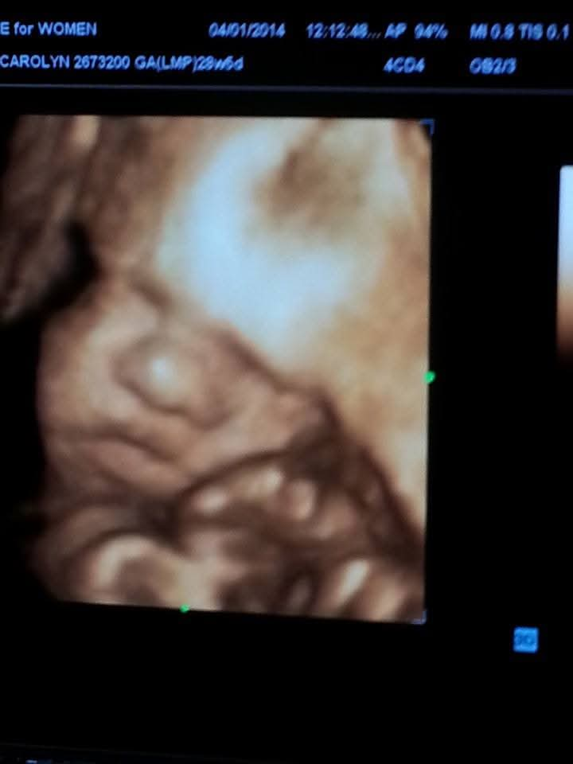

Pregnancy

Slide 6
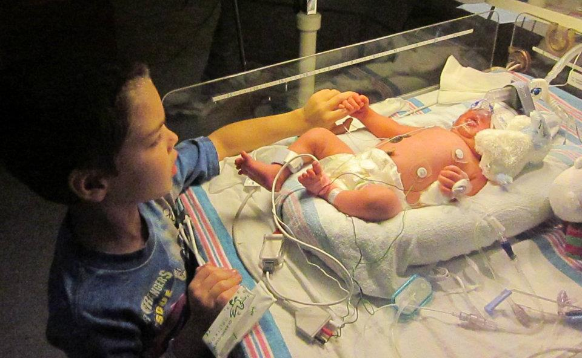
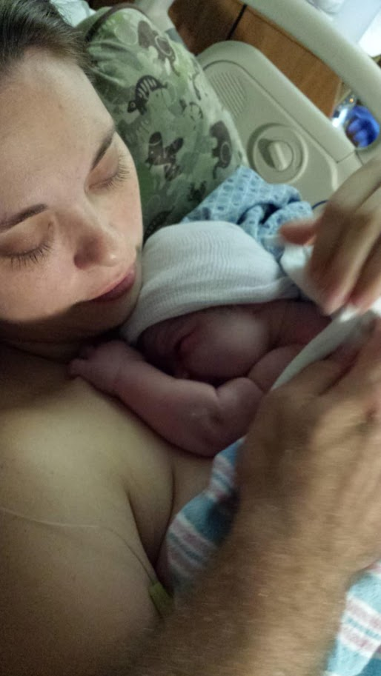
Delivery

Slide 7
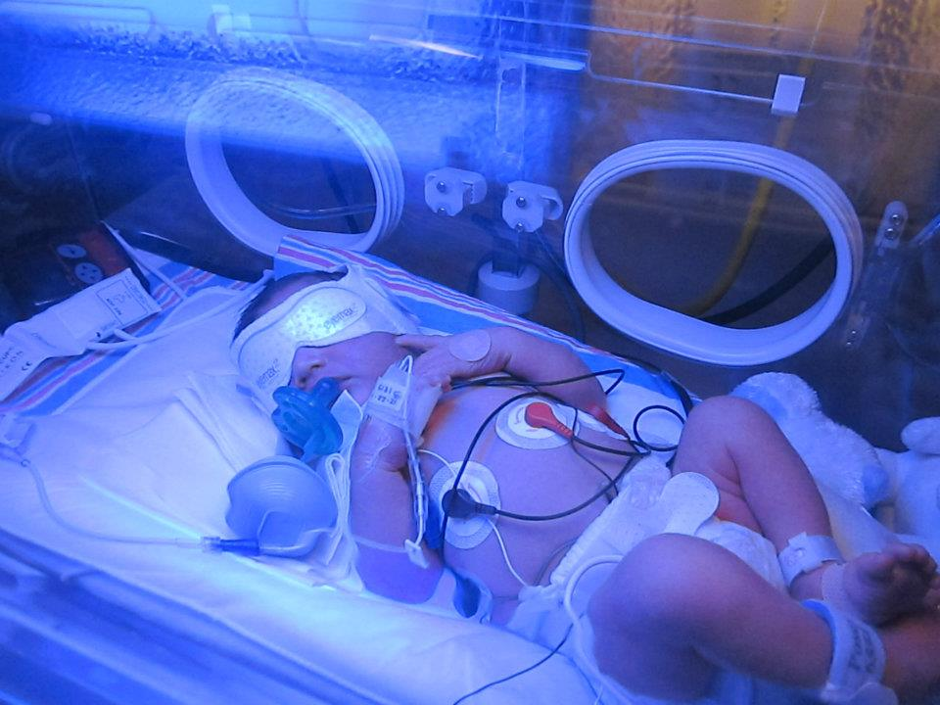
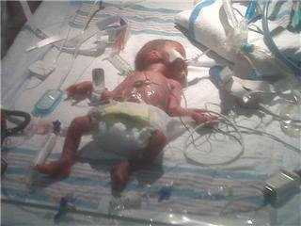
Preterm/Neurodiverse

Slide 8
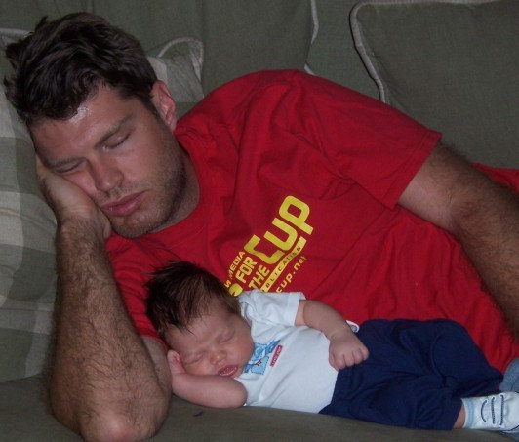

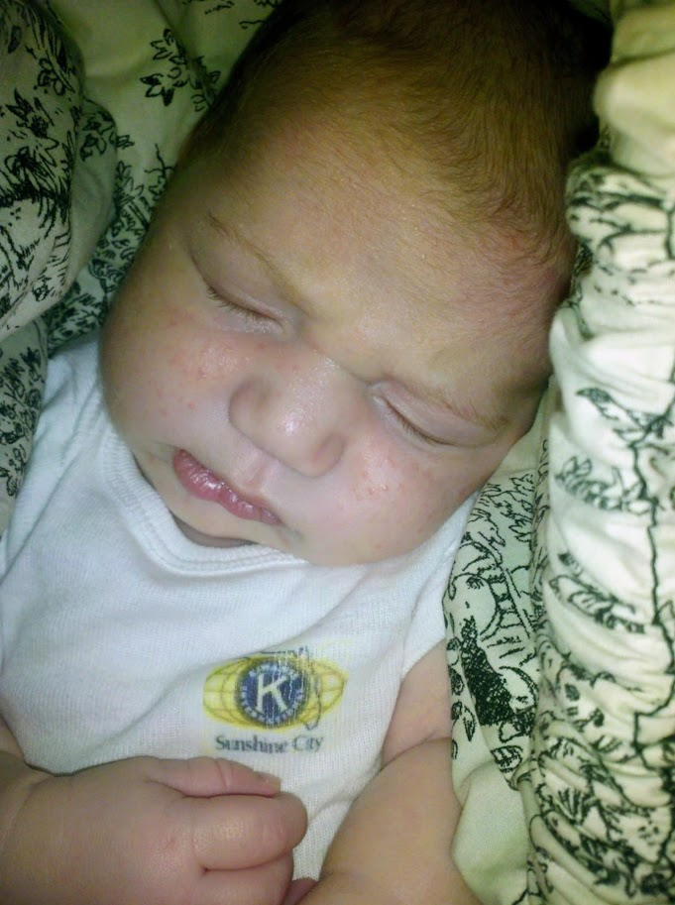
Newborn

Slide 9


Safe Sleeping
This Photo by Unknown Author is licensed under CC BY

Slide 10
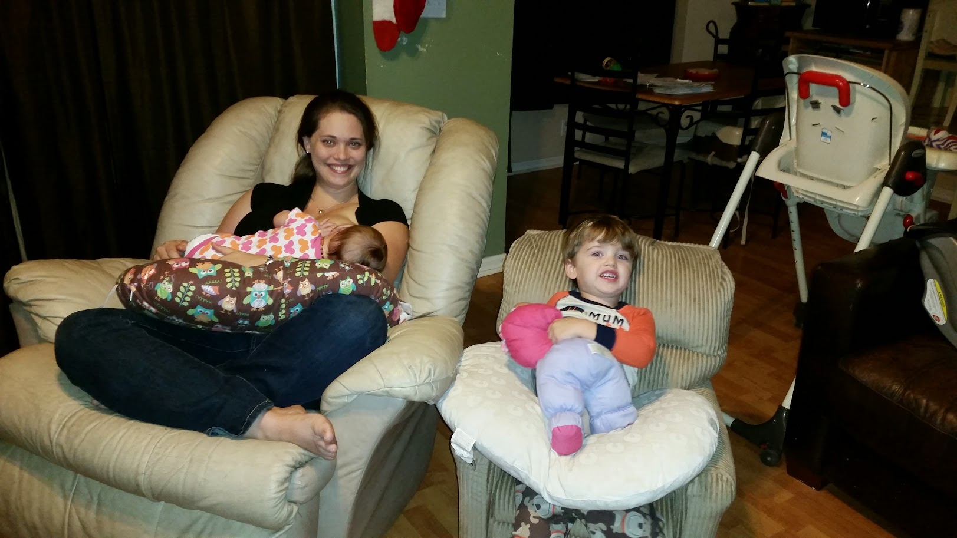
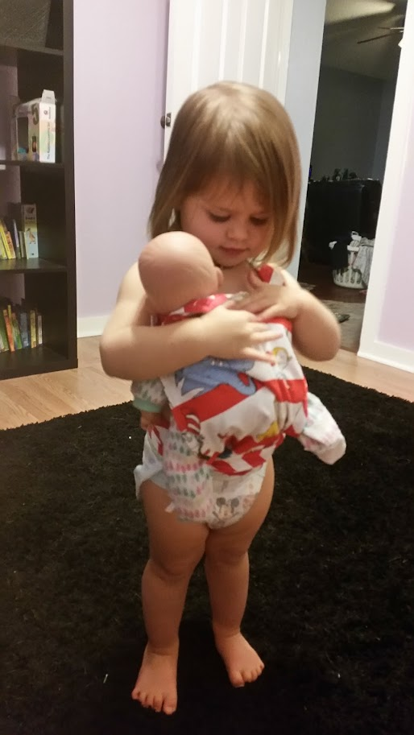

Slide 11
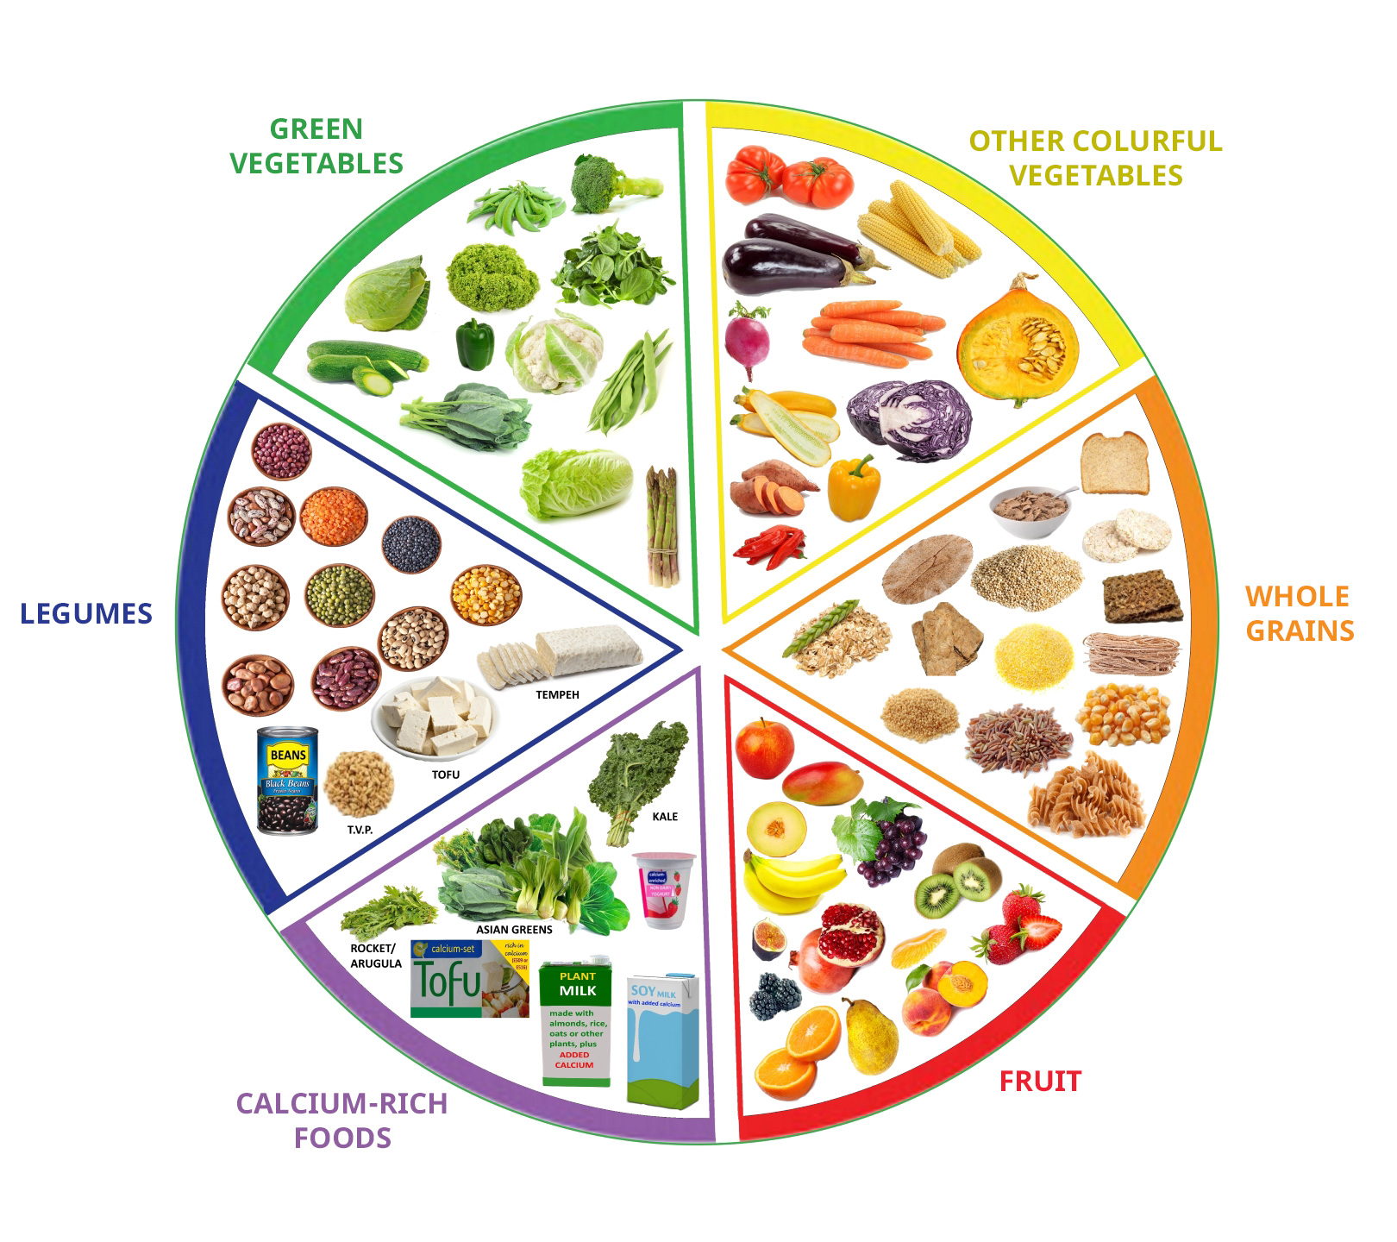


Balanced diet
This Photo by Unknown Author is licensed under CC BY-NC

Slide 12
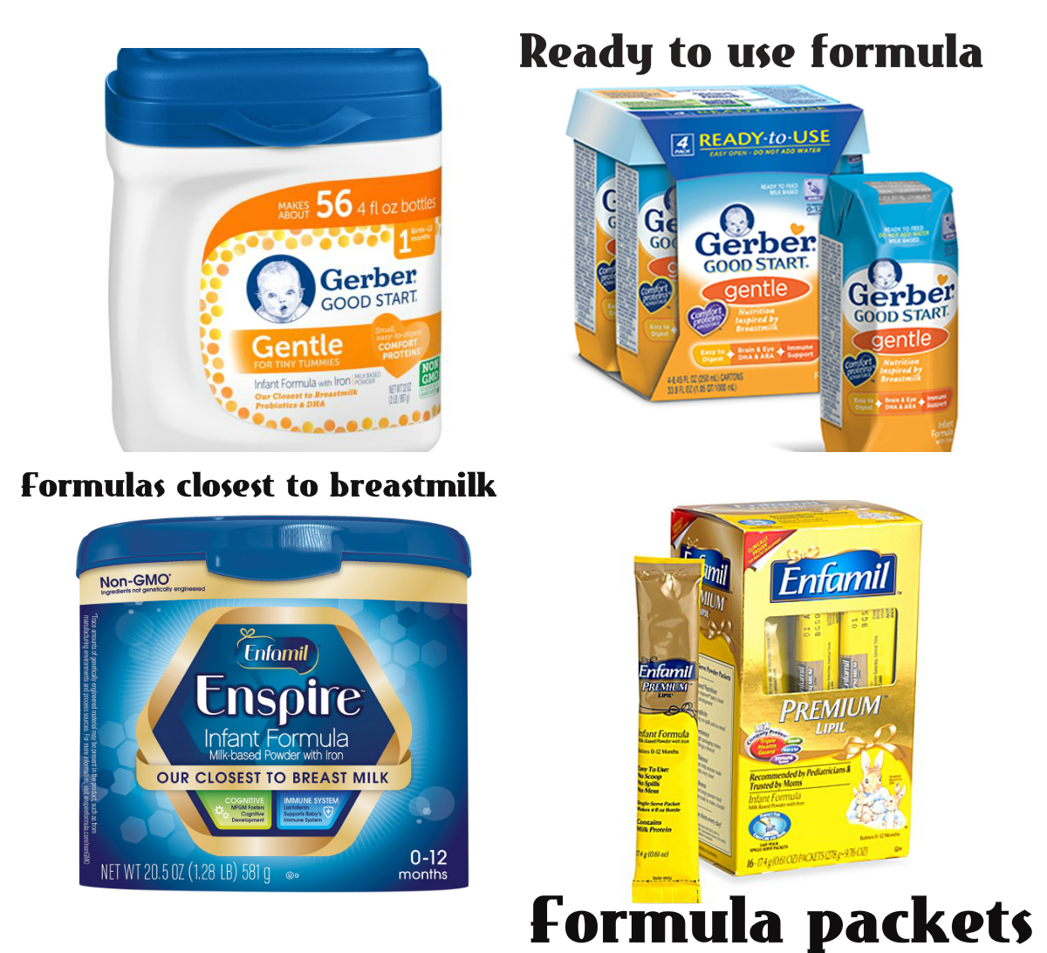
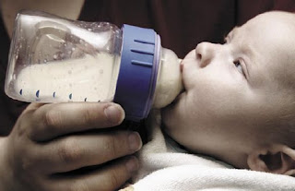
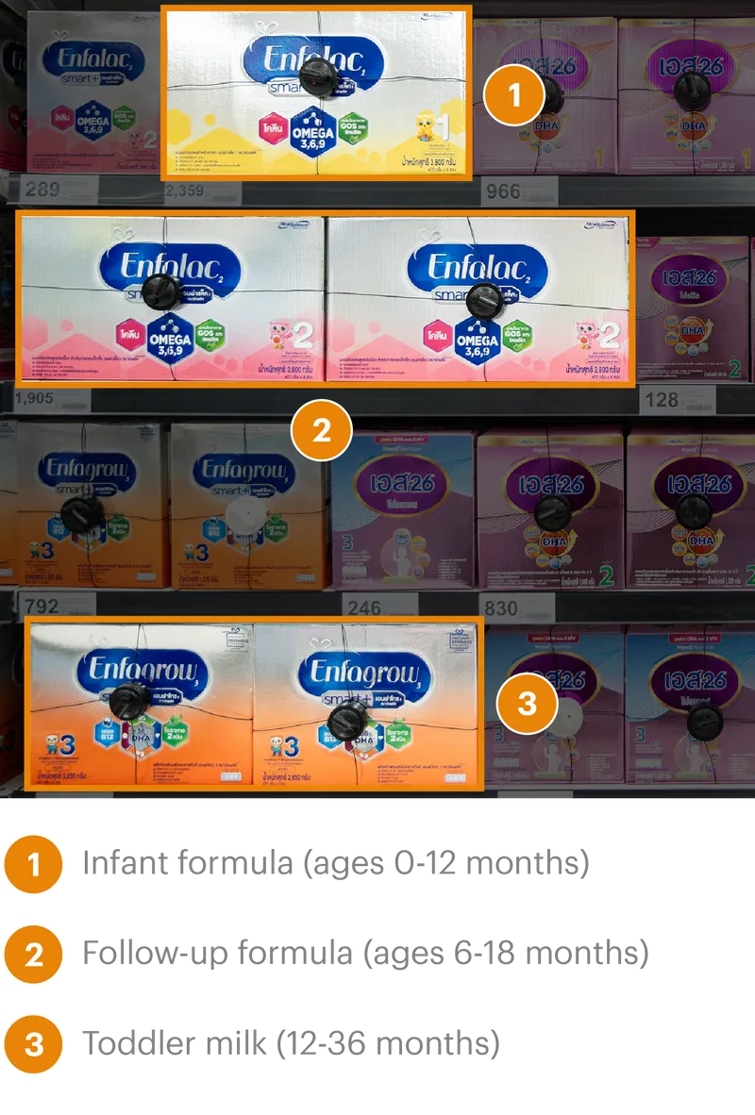
Formulas
This Photo by Unknown Author is licensed under CC BY-NC-ND
This Photo by Unknown Author is licensed under CC BY
This Photo by Unknown Author is licensed under CC BY-NC-ND

Slide 13
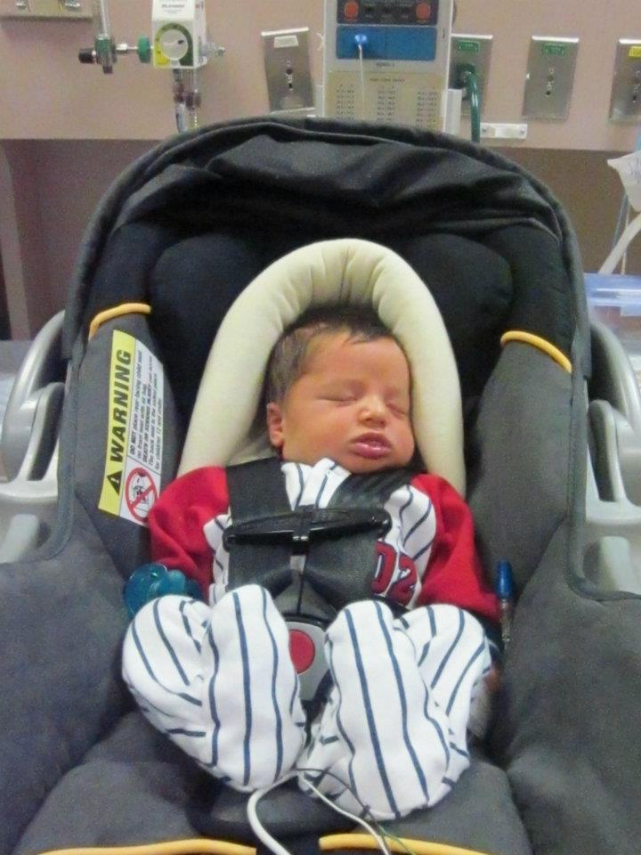
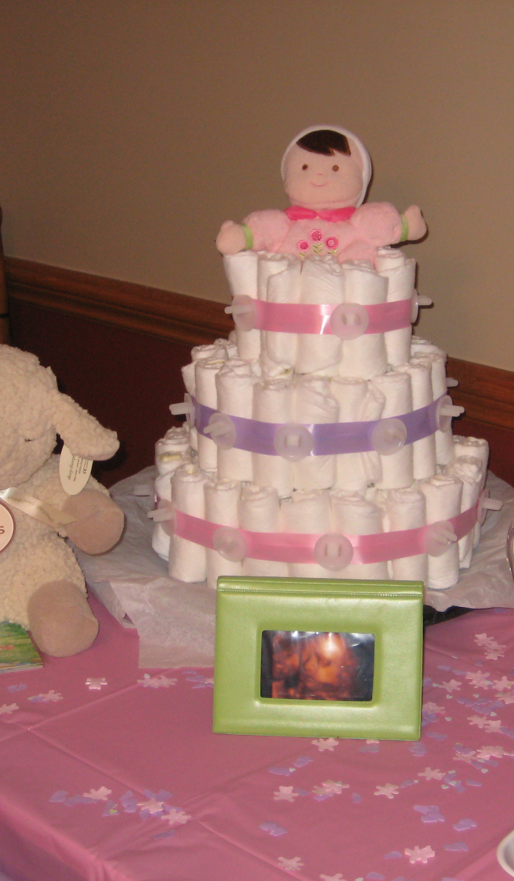
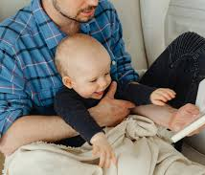
Newborn Activities

Slide 14
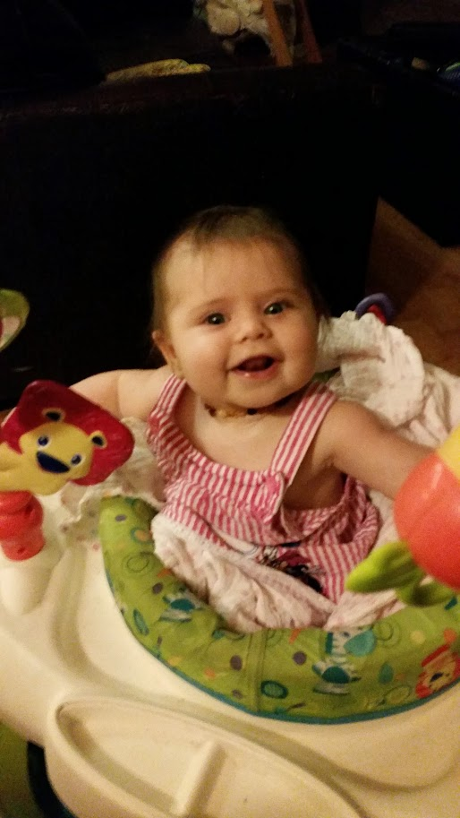

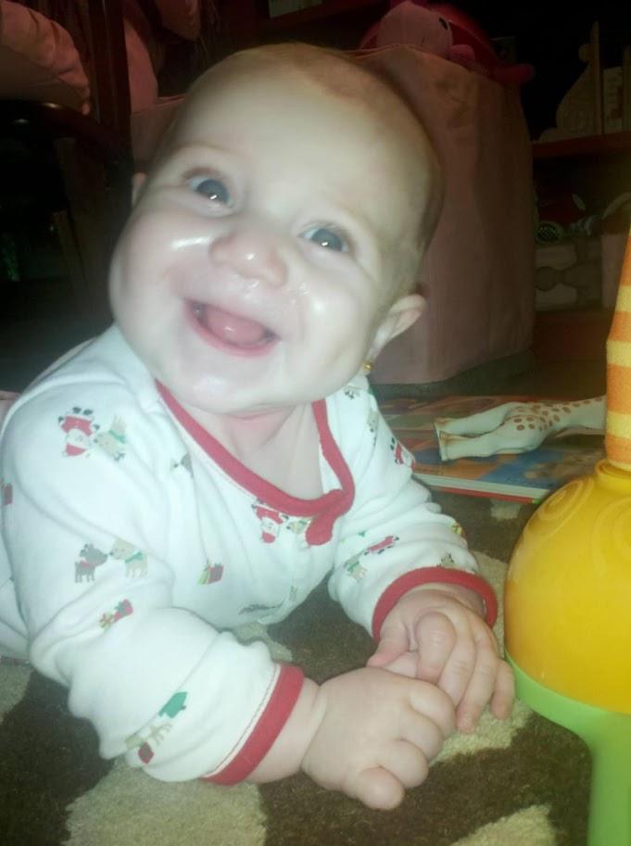
Six months

Slide 15
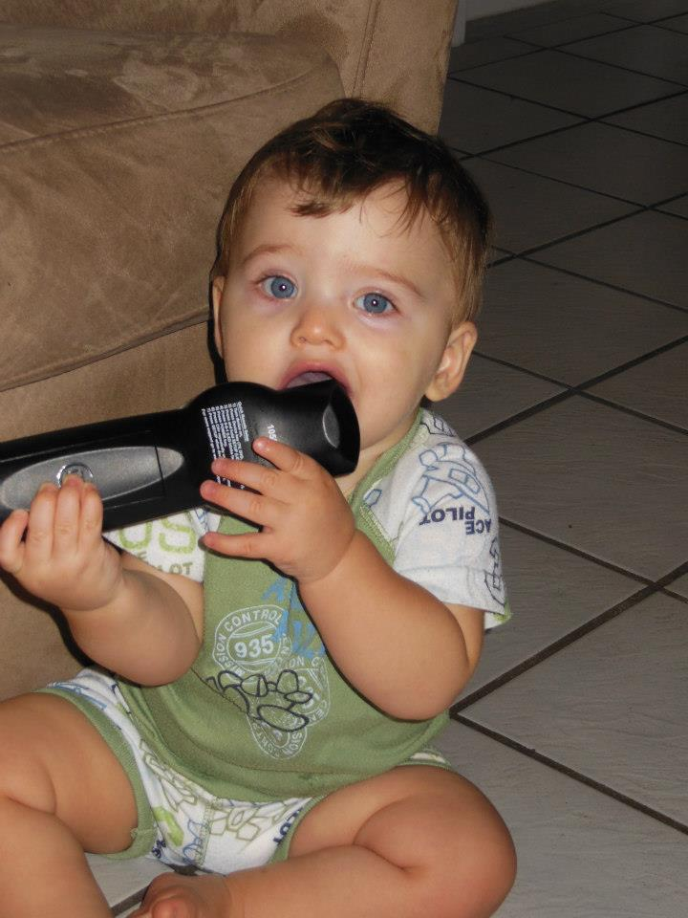
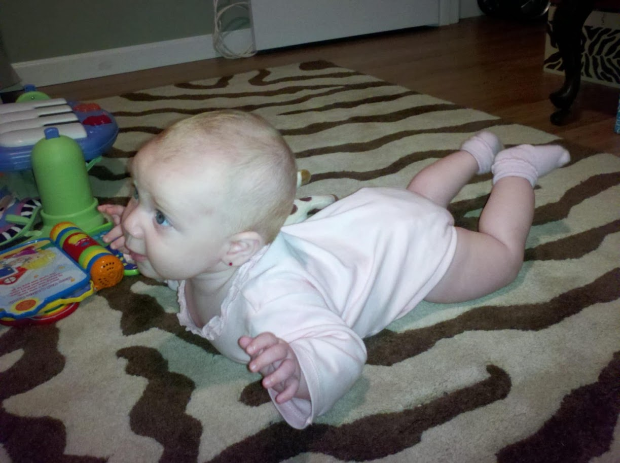
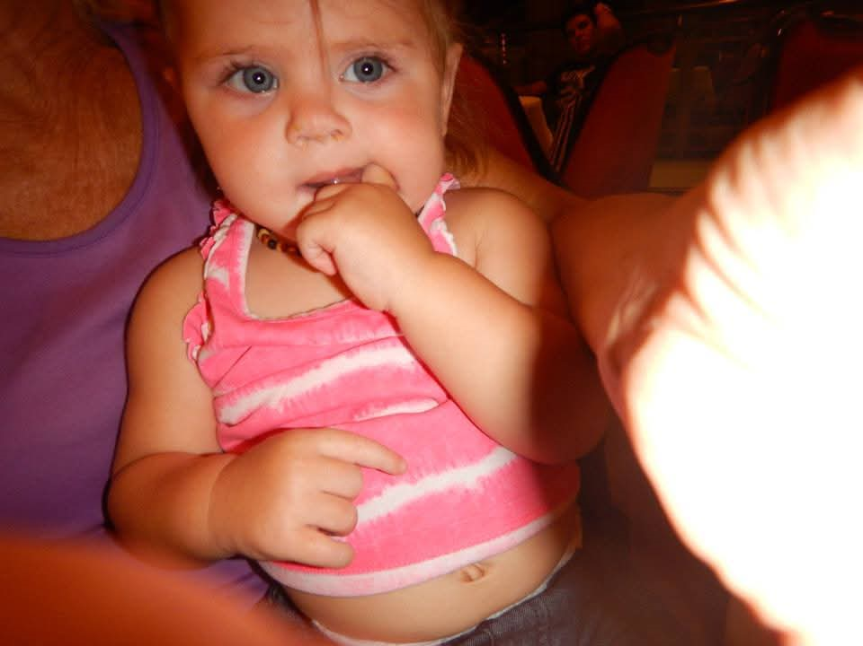

Slide 16
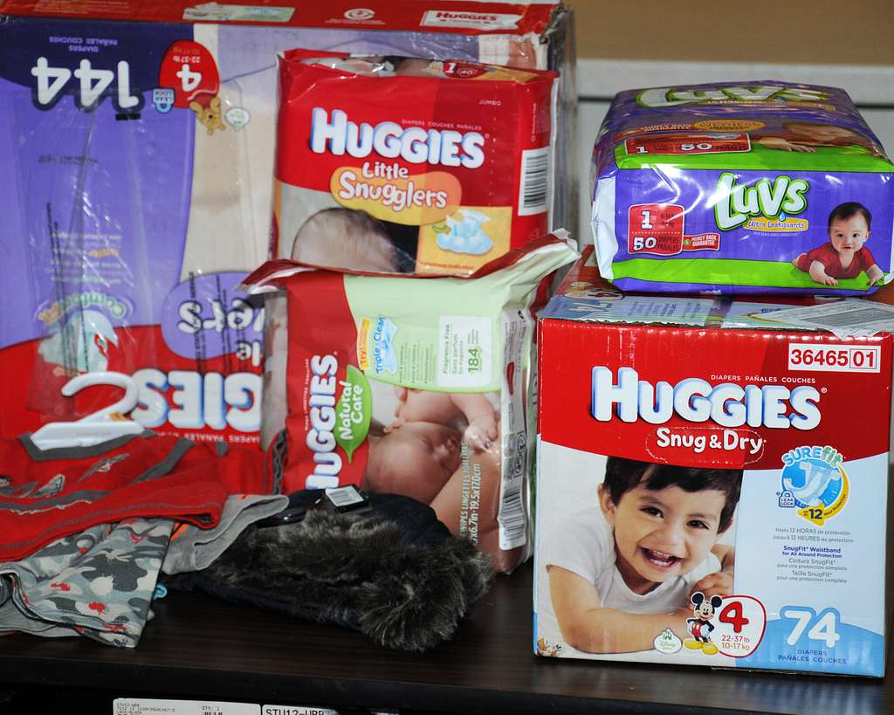
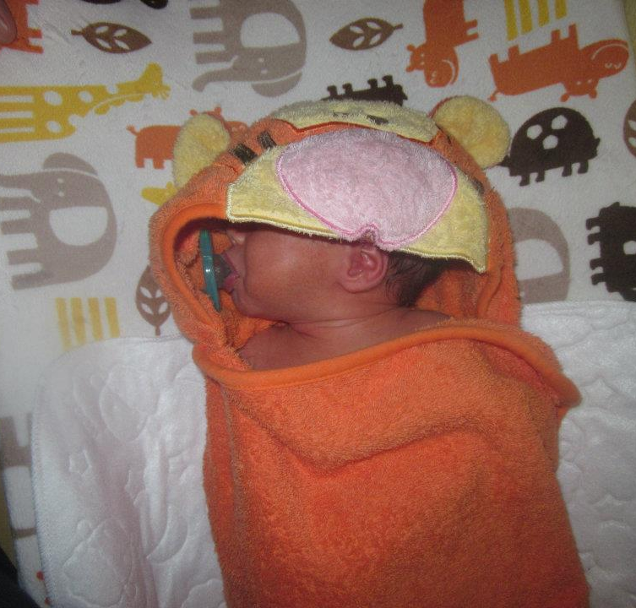
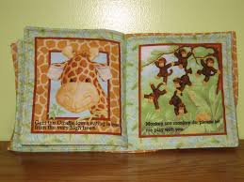
Activities for this age

Slide 17
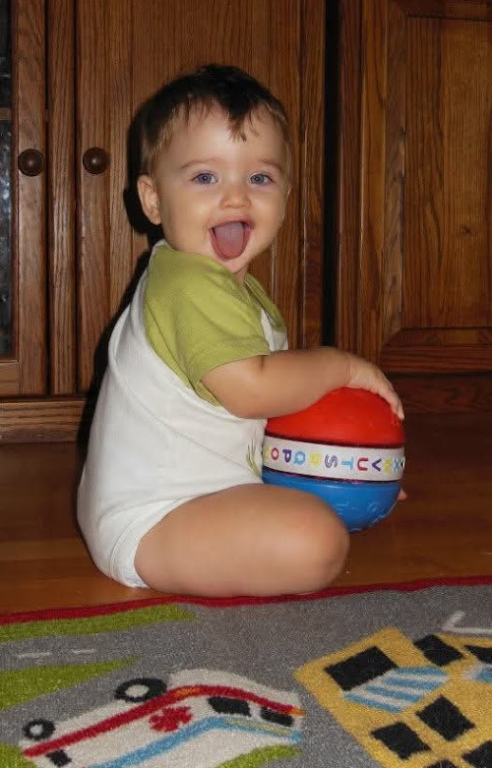

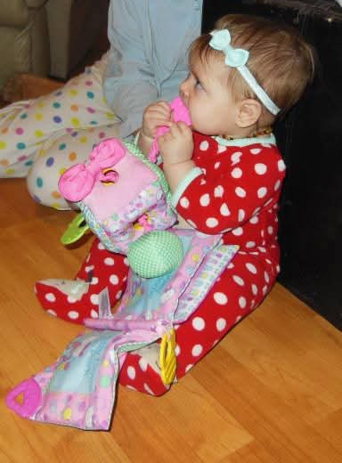
One Year

Slide 18
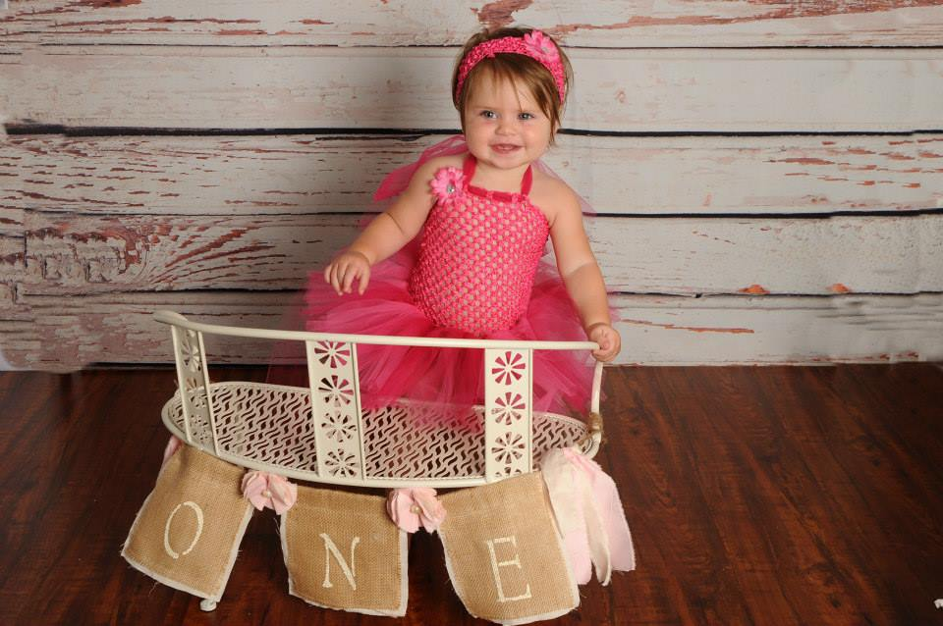
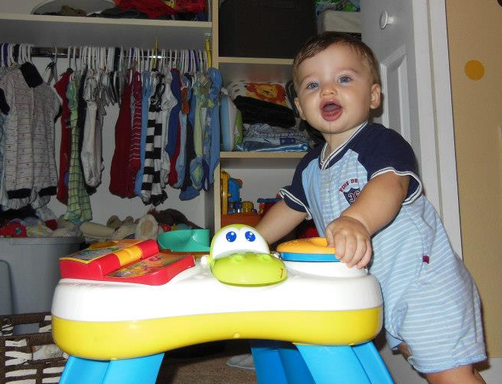

Slide 19
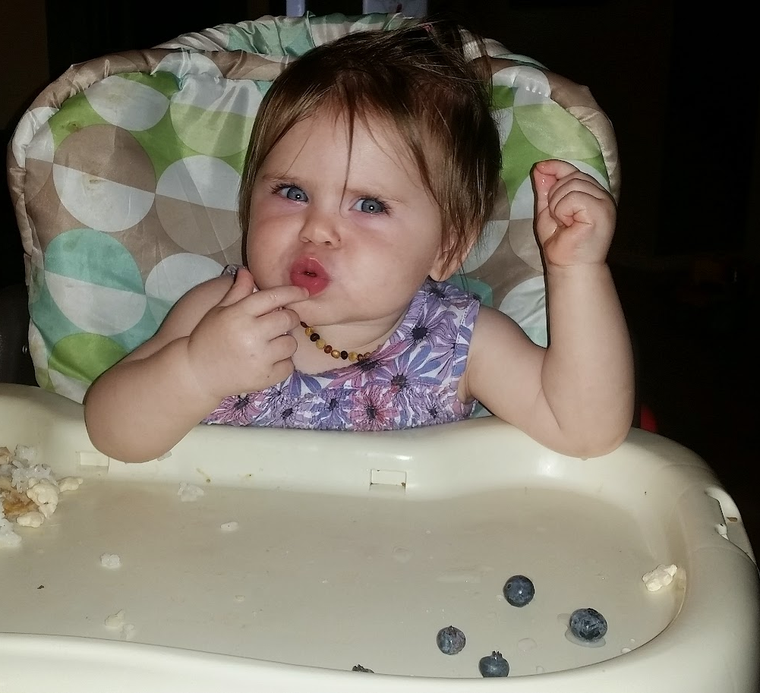
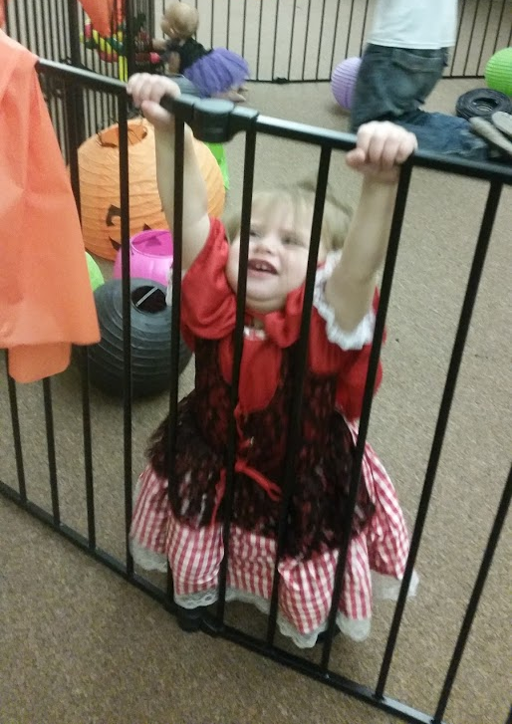
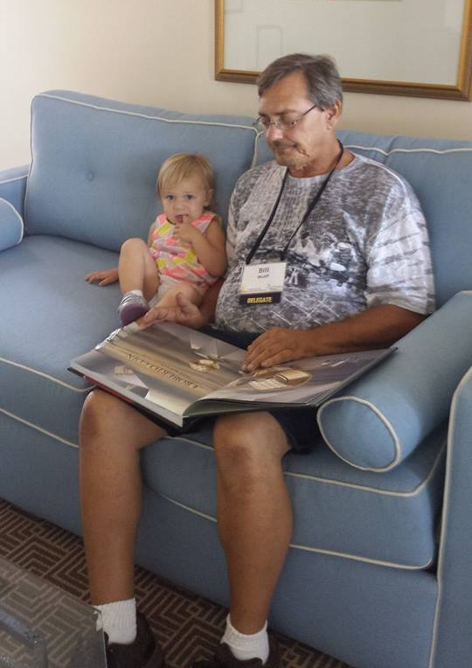
Activities for this age

Slide 20
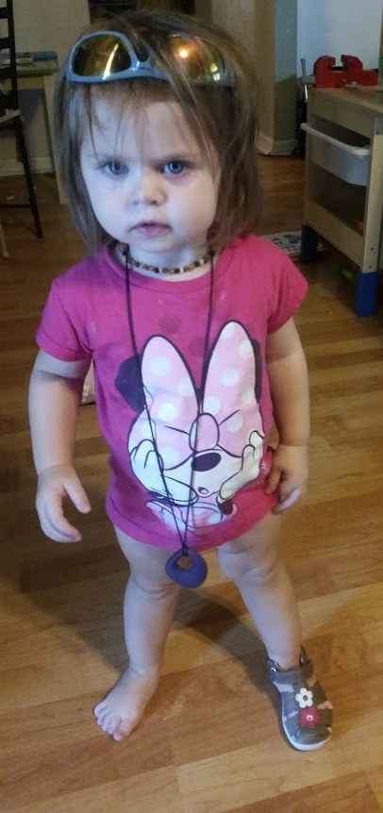
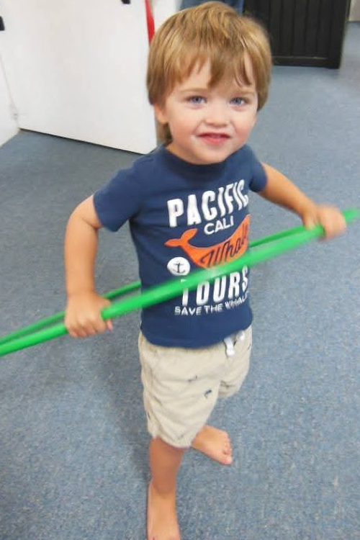
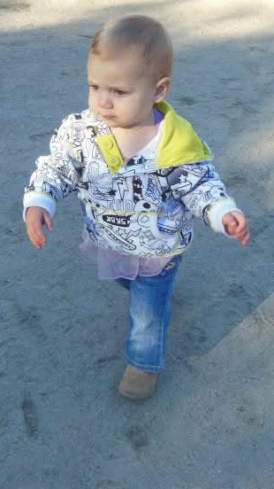
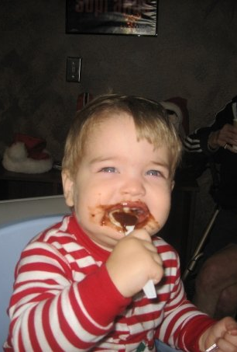
Eighteen Months

Slide 21
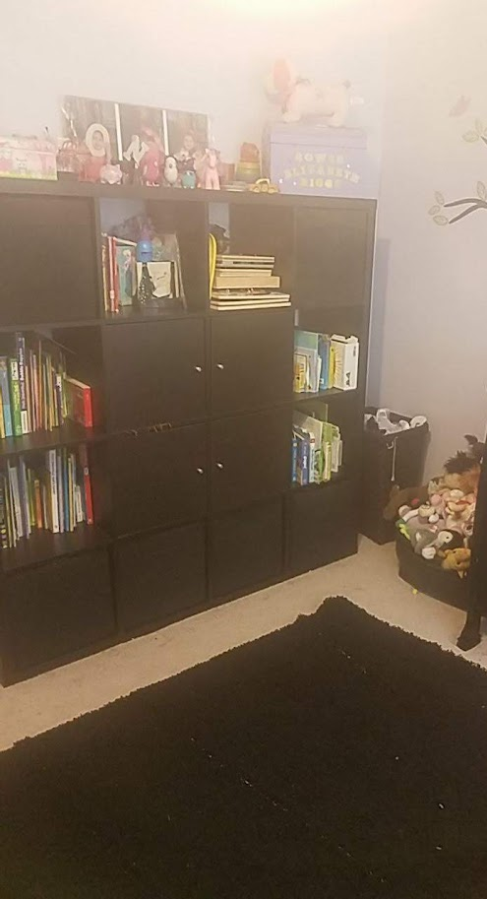
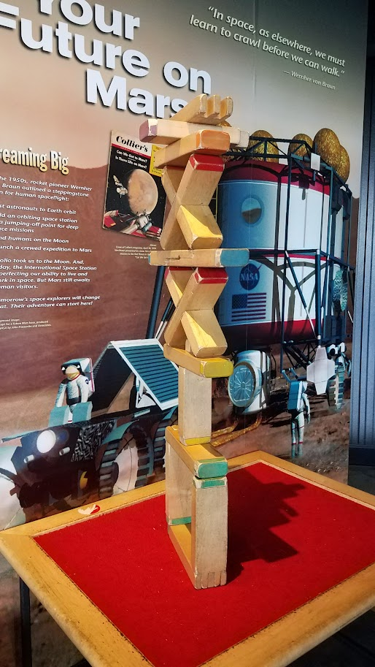
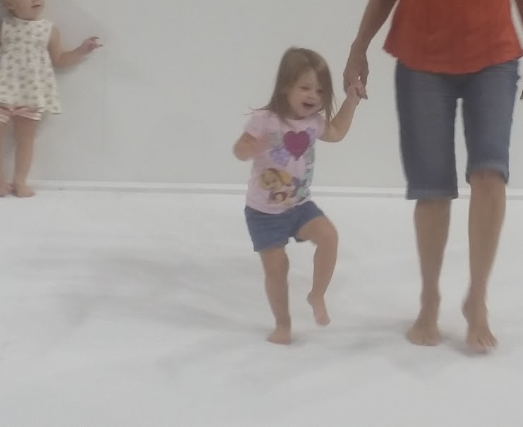
Activities for this age

Slide 22
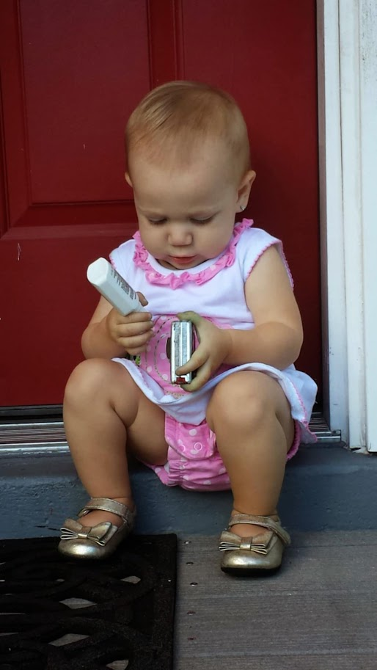
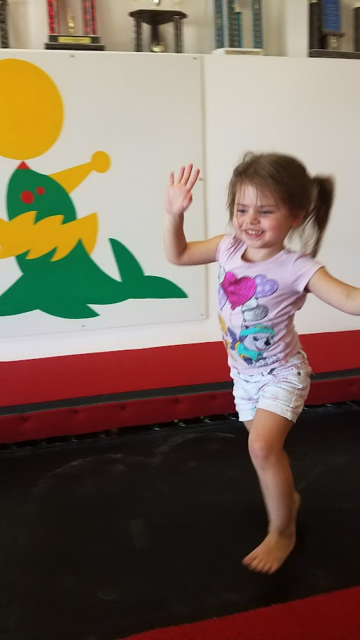
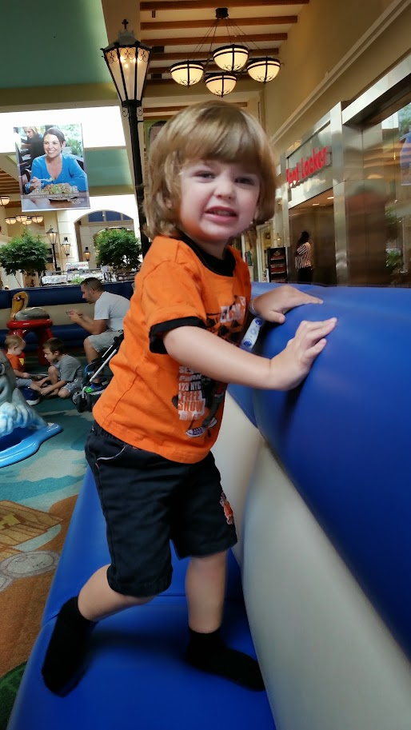
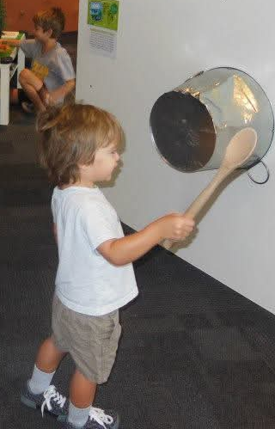
Two Years

Slide 23
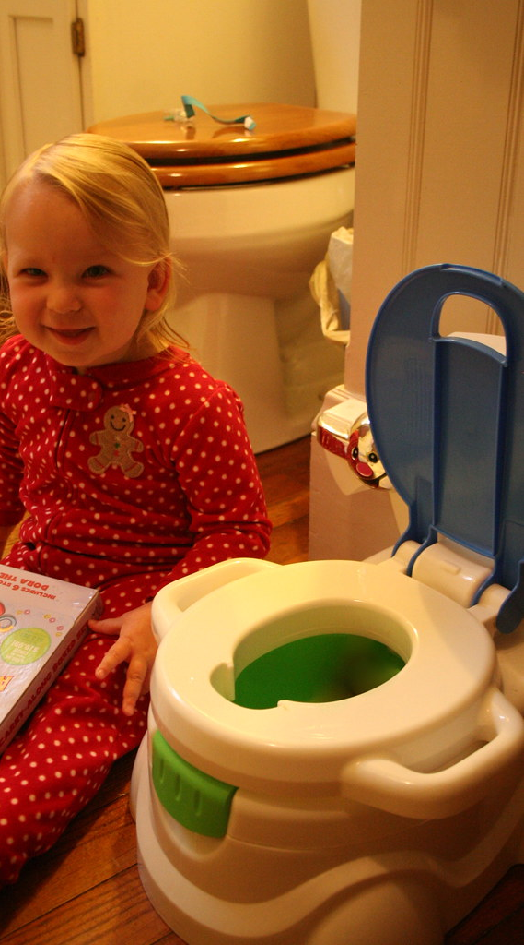
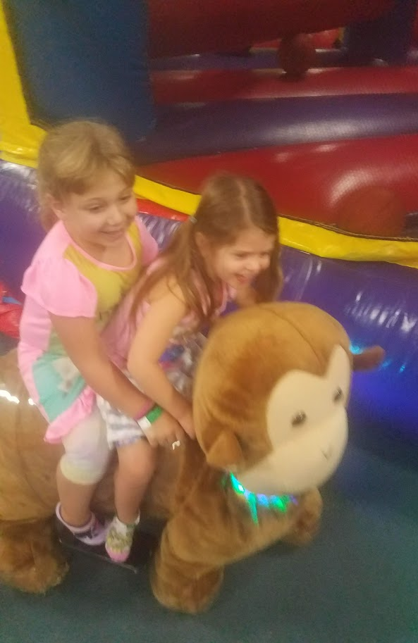
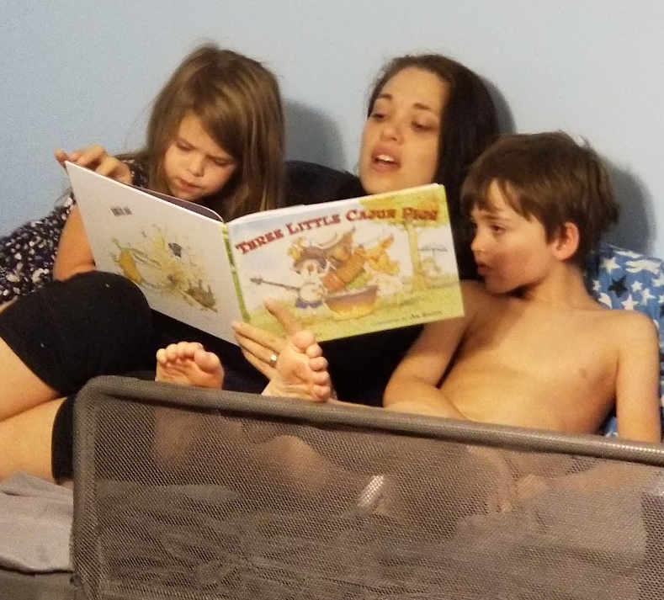
Activities for this age

Slide 24
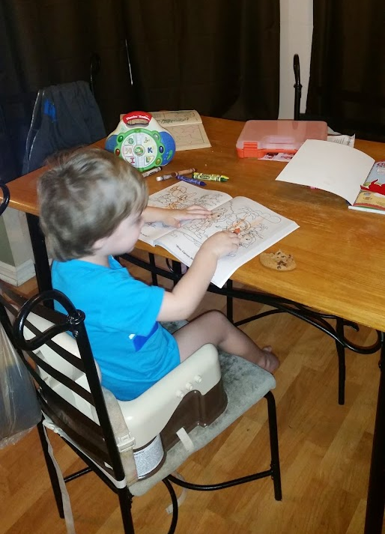
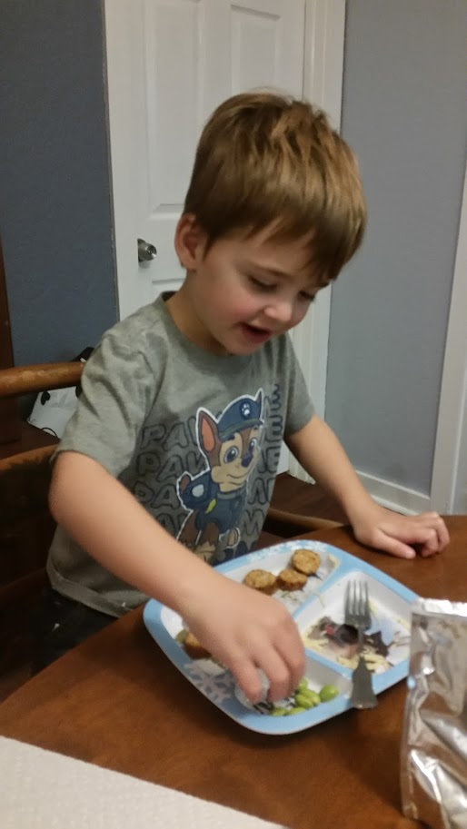
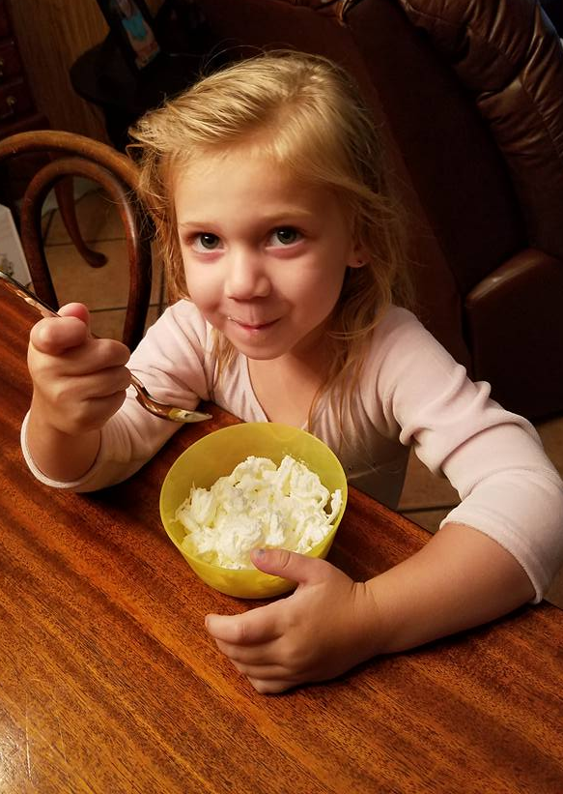
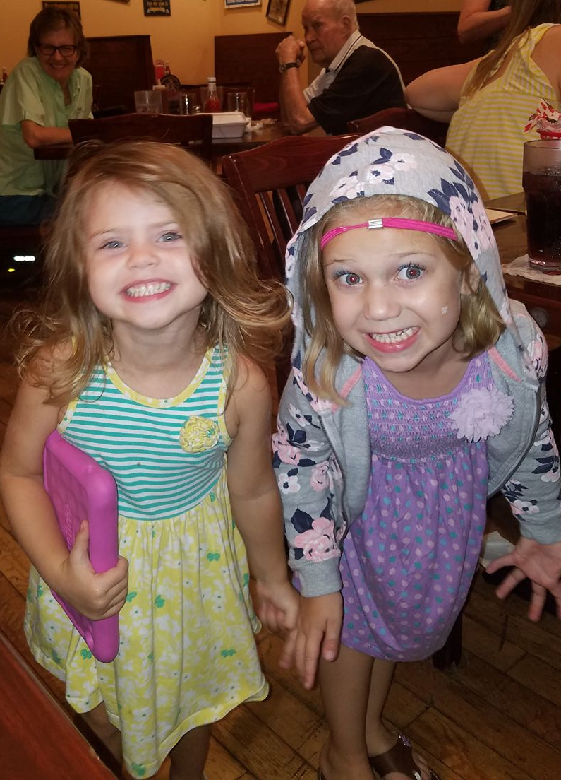
Three Years

Slide 25



Activities for this age

Slide 26




Four Year

Slide 27



Activities for this age

Slide 28



Five Year

Slide 29



Activities at this age

Slide 30




Remember the Newborn

Slide 31





Slide 32

Is your Club interested but not sure where to start?
Kiwanis Clubs and Divisions internationally create and implement projects to fill identified early childhood needs. Below are some examples of projects:
Weekly in-person or zoom reading for young children
Book drive for a class or school
Diaper party for families in need
Car seat education workshops
Supporting a mobile dental clinic for children in low-income areas
Providing support to families of young children with information and resources for parenting, health maintenance, and/or nutrition
Developing and/or maintaining playgrounds

Slide 33


Funding?
Florida Kiwanis Foundation offers Wil and Rachel Belchman Grants for Florida Clubs and Divisions!
Two Grant cycles per year
Cycle I cutoff date is December 15; Cycle II cutoff date is June 15. The Grant committee will review applications and make approvals at the mid-winter board meeting (February) and the District Convention (August)
www.floridakiwanisfoundation.org/grants

Slide 34
Reporting links
Monthly Service Report https://forms.gle/kPayp6Bc9HTxRm1u6
Service Committee Interest Form https://forms.gle/dc2HyWddMm1wj2X29
Kiwanis Achieving Club Excellence Tools Achieving club excellence | Kiwanis International
Governor's Project Report https://docs.google.com/forms/d/e/1FAIpQLSd0QsMSxCK72LE1EP-wEzoRSlNo3c8rFOn4iyxGwwMqF1Kozg/viewform
Impact Guide https://drive.google.com/file/d/1IwIoA6HYqsG4oI5GUnbcavOoLBjg5qu1/view?usp=drivesdk

Slide 35
Questions or Comments

Slide 36
Cicely Wulff
YC:PO chair 2024-2025
2025-2026
cici8370@gmail.com

