Slide 1
Kiwanis International Youth Protection
Florida District of Kiwanis
Donna & Bob Parton
Kiwanis Youth Protection Managers
Notes:
Hello. I’m Donna Parton and I’m Bob Parton. We are your Florida District Youth Protection Managers. Thank you for joining us to learn why youth protection matters and what role you can play in keeping the youth in our programs safe. Let’s get started!

Slide 2

Why Youth Protection Matters
We serve over 300,000 youth program members each year.
Youth and families count on us.
To learn and grow,
first, you need to be safe!
Notes:
Why does youth protection matter?
Together, we are the stewards for the well-being of hundreds of thousands of young people involved in Kiwanis Service Leadership Programs across the globe.
Each of us individually may be responsible for one, two, 10, or 50 young people.
SLP members are counting on us to provide educational and fun experiences so they can grow in leadership, service, and general life skills.
The foundation of this is safety. You can’t learn or grow – much less enjoy your experience – if you feel unsafe. We owe it to these vulnerable populations to protect them.

Slide 3
Our Obligations
Prevent adult-to-youth abuse and
peer-to-peer abuse
Identify concerning behaviors.
Monitor and supervision se youth.
Report emergencies or red-flag incidents.
Model safe appropriate behaviors.
Notes:
We have an obligation to equip ourselves, other adults, and SLP members with the tools to prevent adult-to-youth abuse and peer-to-peer abuse by:
Following Kiwanis youth protection policies
Identifying concerning behaviors
Mitigating risky situations with supervision.
Reporting emergencies, abuse, or concerning behaviors sooner rather than later. and
Modeling safe, appropriate behaviors.

Slide 4
Kiwanis Youth Protection Goals
Protect, educate, and engage
all Kiwanis Family members and adults working with our youth
Protect youth from predators.
Empower and educate adult members with best practices when working with youth.
Notes:
Knowing more about why youth protection matters, let's clarify our goals.
We aim to Protect, educate, and engage all Kiwanis members - youth and adult, so that we
Protect youth from predators
Provide them with skills and tools designed to inspire and engage these future leaders to be their best; and
Empower and educate the adult members with best practices

Slide 5
Kiwanis Youth Protection Goals
Provide youth with skills and tools designed to inspire and engage future leaders
to be their best!
Notes:
Knowing more about why youth protection matters, let's clarify our goals.
We aim to Protect, educate, and engage all Kiwanis members - youth and adult, so that we
Protect youth from predators
Provide them with skills and tools designed to inspire and engage these future leaders to be their best; and
Empower and educate the adult members with best practices

Slide 6
Why Youth Protection Matters
Abuse can have far-reaching effects.
    post-traumatic stress disorder (PTSD)
    substance abuse
    increased risk for suicide or suicide attempts
    increased risk of re-victimization
    twice the risk of intimate partner violence later in life
Notes:
Abuse has far-reaching effects. Experiencing sexual abuse and other forms of abuse can result in short- and long-term physical, mental, and emotional health consequences, such as:
Experiencing sexual abuse and other forms of abuse can result in short- and long-term physical, mental, and emotional health consequences, such as:
post-traumatic stress disorder (PTSD),
substance abuse,
increased risk for suicide or suicide attempts,
increased risk of re-victimization, and
twice the risk of intimate partner violence (IPV) later in life.

Slide 7




Who Experiences Abuse
During childhood, across all ages and socioeconomic levels, ethnicities, genders, and big or small communities:
      1 in 4 girls
      1 in 13 boys
      experience child sexual abuse.
Notes:
Some might ask, "Is this really a concern for my group?"
The answer is yes. Data shows us that the potential for abuse is a concern for every group working with youth. And it can happen to anyone without regard to socioeconomic level, ethnicity, gender, or the size of their community. We also know abuse happens early.
Research by the World Health Organization shows us that 1 in 4 girls and 1 in 13 boys may experience some type of child sexual abuse by the time they reach age 18.

Slide 8

Who Abuses
Abusers have in common:
Privacy
Access
Control
Abuse is usually at the hands of known acquaintances and family members - NOT strangers
More than 90% of abusers are people children know, love and trust
85% of child abuse victims never report their abuse
Notes:
Who commits abuse? More than 90% of abusers are people children know, love and trust – not strangers. This contributes to vast under-reporting, and in fact, 85% of child abuse victims never report it.
These abusers find opportunities where they have privacy with the youth, access to them, and control over them.
(World Health Organization)

Slide 9
Where Abuse Happens
Anytime, any access
Private spaces: 1-on-1 interactions, bathrooms, cars/buses, hotels, etc.
Online: texting, social media, gaming, etc.
Notes:
Abuse can happen anytime. Typically, it occurs in private spaces like 1-on-1 interactions, bathrooms, cars/buses, or hotel. Abuse or inappropriate behaviors can also happen online through texting, sexting, pornography, or social media sites.
Predators use one-on-one access to groom and assert emotional control over vulnerable youth.
As volunteers in after school, off school grounds and sometimes overnight events, there are opportunities where one-on-one, private situations could occur with youth. By educating ourselves and each other, we're better equipped to be aware of those times and spaces.

Slide 10





SLP District Admins, Advisors and Chaperone Policies
DAs/Advisors must have a cleared, current Kiwanis background check.
Chaperones must have a Kiwanis background check if they are staying overnight or volunteer off-school grounds.
Review & follow all Kiwanis youth protection policies & procedures.
Chaperones must be 21 or older.
DA/Advisors complete 6 and Chaperones complete 3 online youth protection Praesidium
courses.
Report emergencies, policy violations or red-flag incidents to SLP event coordinators or Youth Protection Helpline.
Notes:
Here, we revisit key take-aways from today’s training.
Service Leadership Programs District Administrators, Advisors and Chaperones follow these youth protection policies.
Start with a clear and current Kiwanis background check.
Review youth protection policy annually, as policies are updated annually. Make sure to follow all policies.
Complete online abuse prevention courses through Praesidium Academy. DAs and Advisors complete 6 courses, while chaperones complete three.
And finally, remember that youth members should be monitored and supervised in accordance with policies.
Report any policy or behavior issues as soon as they happen. You can also contact the club’s advisor or SLP District Administrator who can elevate it to appropriate Youth Protection staff.

Slide 11

Background Checks
Good for 2 years
May take 2+ weeks; submit names in advance
Kiwanis contracts with Safe Hiring Solution’s “Safe Visitor” online application portal
    Individual email link is sent to email on file*Check spam folder*
    US $35 processing fee for SLP advisors
    Depending on your country/state court document costs, members and non-member chaperones may pay an additional fee
    Searches county, state/province, national criminal records
Notes:
B in our ABCs is for Background checks. District Administrators, Kiwanis Service Leadership Program advisors, and chaperones to SLP events need Kiwanis background checks.
Background checks are valid for 2 years and need to be renewed to remain in a DA or Kiwanis advisor role. We recommend submitting a background check application at least 2 weeks prior to the event needed, or even longer if you have a big event. There may be requests for additional supporting documentation.
Kiwanis contracts with Safe Hiring Solution’s Safe Visitor to provide an online application portal for U.S., Caribbean, and other members to secure a background check. SLP Advisors are charged $25, and any remaining amount owed is subsidized by Kiwanis Youth Programs. Regular Kiwanis members or chaperones may be charged additional fees depending on court record costs in your state, province, or country.
Clubs often background check multiple volunteers to have backup chaperones, especially during Fall Rally time and District conventions in spring.

Slide 12

Accessible On-line Youth Protection Training www.PraesidiumAcademy.com
Some courses available in French and Spanish
Refresh every 2 years
Course | SLP Youth Protection & Risk Managers | SLP DAs & Advisors (CKI, Builders and Key Clubs) | SLP DAs & Advisors (K-Kids and Aktion Clubs) | Non-advisor Members (Gov, LTG, Club Officers) & Non-member Chaperones (Faculty, Parent, Spouse)
Abuse Risk Management for Volunteers | X | X | X | X
Social Media Safety | X | X | X | X
Preventing Sexual Activity Among Adolescents | X | X |  | X
Duty to Report | X | X | X
Meet Sam | X | X | X
It Happened to Me | X | X | X
Safety Equation: Monitoring & Supervision | X |  | X
Notes:
Another part of training is individual. Kiwanis offers free, on-demand, online abuse prevention courses. Unlike club-level youth protection policy training, these courses give examples of what abuse may look like and how to handle a situation if a student reports abuse. These courses are taken through nationally recognized Praesidium Academy, a learning management system tied to the Kiwanis membership database.
The chart in front of you shows which individuals are asked to complete which courses, based on your Service Leadership Programs role. Take a moment to identify your role in the top row of the chart.
The courses are valid for two years from the date they are completed and are offered in English, Spanish and French.

Slide 13
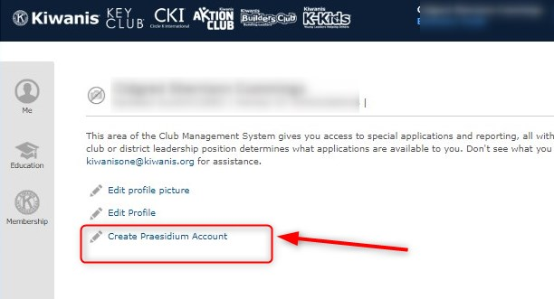
How to Log In to Praesidium Academy
Kiwanis members self-initiate a learner account:
  1. In Kiwanis Member portal, click “Create Praesidium account”
2.Check your email for invitation to access account
3. Click on forgot password to create a new password
www.praesidiumacademy.com
Notes:
To create an account in Praesidium, go to your Kiwanis Member portal home page, and click a link that says "Create Praesidium Account.“
If you get an error, it means you may already have an account in Praesidium.
You can go directly to www.praesidiumacademy.com to log in.
Any time you have questions or encounter a technical difficulty, emails us at youthprotection@kiwanis.org.
We'll show this email address again at the end.

Slide 14


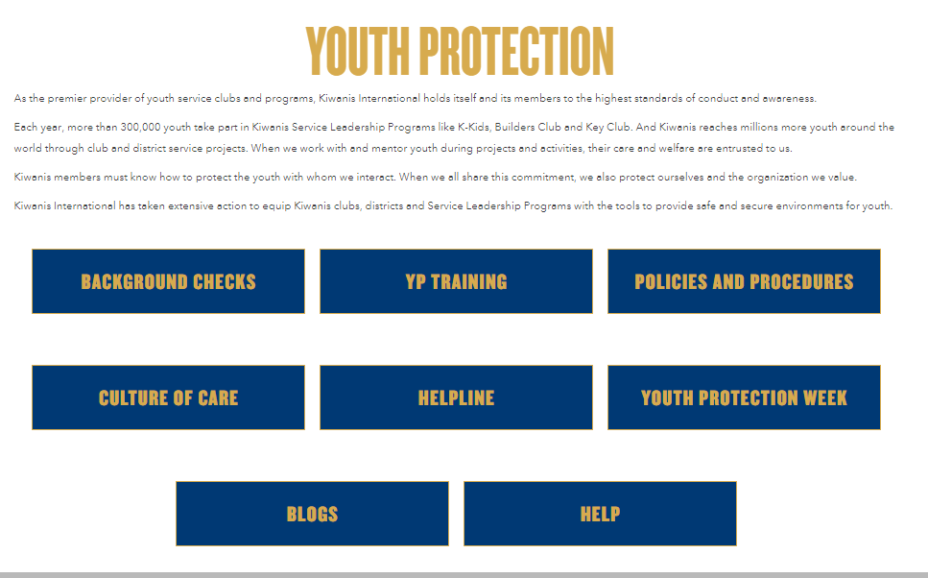
Accessible Resources
Recorded webinars
Power point slide deck
www.Kiwanis.org/youthprotection
Notes:
Wrapping up discussion of our accessible training and resources, we want you to know that recorded webinars and power point slide deck that clubs can use to train members can be found at Kiwanis.org/youthprotection.
There are also policy documents and Frequently Asked questions about background checks, youth protection and training options.
You'll also see this website again at the end of the presentation.

Slide 15
Chaperone-to-Youth Ratio Requirements
Single-day SLP event = 1 BCA (minimum) per 50 youth
Overnight SLP event = 1 BCA (minimum) per 10 youth
      1 adult male to supervise no more than 10 youth males
      1 adult female to supervise no more than 10 youth females
      Adults MUST NOT share sleeping quarters with youth unless it is their child
      * Must be 21 years or older
Notes:
Kiwanis policy requires a certain number of chaperones be involved with Service Leadership Programs events. The number of chaperones required is determined by the number of youth in attendance.
For a Single-day SLP event, there needs to be a minimum of 1 background checked adult* per 50 youth.
For an overnight SLP event, a minimum of 1 background checked adult* per 10 SLP members, which breaks down to:
1 adult male to supervise no more than 10 youth males AND
1 adult female to supervise no more than 10 youth females.
Adults chaperones must be 21 or older. CKI members younger than 21 can volunteer but can’t be an ‘’official chaperone, nor counted in the ratio.
Please note on the topic of overnights: adults MUST NOT share sleeping quarters with youth except with their own child.

Slide 16
Chaperone-to-Youth Ratio Best Practices
  2, 3, or more background-checked adults per activity Consider your ability to:
  Supervise & monitor
  Check in with members regularly
  Allow one adult to tend to an urgent situation while others lead the group
This will change depending on activity setting, agenda, and other factors.
Notes:
The previous slide showed Kiwanis policy, and we also want to share best practices to guide your decisions in addition to that. Regardless of a minimum ratio, it is best practice to always have 2, 3, or more background-checked adults at each activity. In identifying the right number for your event, consider your ability to:
Supervise & monitor the youth and various aspects of the activities and free time;
Ability to Check in with members regularly
And in case there is an urgent situation with one youth or group, the availability of other adults to lead the rest of the group
The answers to this will change depending on the activity setting, agenda, and other factors.
Remember, having 2, 3, or more adult chaperones discourages inappropriate and one-on-one engagement and can help hold youth members and other advisors/chaperones accountable to the code of conduct and other program guidelines.

Slide 17

Safe Virtual SLP Club Events
Like with in-person activities, whether you have three members or 80, we advise at least 2-3 background-checked adults in virtual programs.
Notes:
Like with in-person activities, whether you have three members or 80, we advise that you have at least 2-3 background-checked adults involved in virtual programs.

Slide 18





Social Media and Communications
Social Media Connections
Never initiate, follow, friend, or like posts or pages of individual youth
Social Media Connections
Connect via an SLP club page/ account and not an individual member account
Social Posts
Treat all social posts and interactions as professional and public
Photos
Never post pictures of youth on your personal social media pages
Rule of 3
Avoid 1:1 student to adult texts, emails, or phone calls by adding a second adult, e.g. another advisor/DA, parent or guardian
Notes:
Kiwanis has policy about social media and electronic communications with youth. Never initiate, follow, friend, or like posts or pages of individual youth. When connecting with youth on social media, do so via the SLP club page or account, and never from your personal account. Remember that everything on the internet should be kept professional, as it is a public forum.
We love seeing and posting photos of Kiwanis youth. These should only be shared on the club page or account, and not on a personal page.
Remember the rule of 3, and avoid one-on-one contact online just as you would in person. This includes via email or text, where there should always be at least two adults copied.
The National Center for Missing and Exploited Children received close to 85 million online files containing child sexual abuse material in 2021. For this, and other reasons, we want youth to know we expect their online and electronic interactions with adults to remain public.

Slide 19
Transportation
Best Practices
        At least three people in a car
Youth ride in the back seat/rows
Get parent/guardian approval prior to transporting
Follow local school and traffic safety laws
No texting or using a phone while driving
Notes:
Sometimes your activity will involve transporting youth. Again, follow the rule of three, and make sure there are always three people in the car. When possible, youth should ride in the back. Make sure you have parent or guardian approval for the transportation, that you are following local traffic safety rules and laws, and that all drivers know not to text or use the phone while driving.

Slide 20



Medication
Possession of prescription and non-prescription medications is allowed with written permission from a parent or guardian.
During overnight stays, keep parent or guardian signed medical forms safe and accessible for an emergency.
Notes:
At any Service Leadership Programs event,
Possession of prescription and non-prescription medications is only allowed with written permission from a parent or guardian
During overnight stays, we recommend that you keep the signed medical forms safe and accessible in case you need to use it in an emergency.

Slide 21
Youth Protection
Abuse Reporting Helpline
866-607-SAFE
(7233)
  Staffed 24 hours/7 days a week by trained professionals
  Kiwanis SLP and adult members can report inappropriate behavior, abuse, or policy violations
  Calls routed to the Youth Protection team
  Callers may remain anonymous
Notes:
An additional tool for reporting abuse is the youth protection helpline. Kiwanis partners with Praesidium Inc. to provide this toll-free Helpline that Kiwanis youth and adult members, advisors, or parents can call and report a policy violation or abuse.
You can also call to seek guidance if you are unsure the behavior was inappropriate or abusive.
Trained professionals will talk with you about the most appropriate next steps, and will make sure the Kiwanis youth protection team is looped in.
Calls can choose to be anonymous.

Slide 22



Mental Health Partners
Active Minds
Erika’s Lighthouse
Project Happiness
(For CKI)
(For Key Club)
(For Builders/K-kids)
Changing the conversation about mental health
Self-care resources
Depression education
Teen empowerment videos
Teen mental health awareness
Student handbooks
Videos
Pay it Forward activity
22

Slide 23
Resources
www.Kiwanis.org/youthprotection

Slide 24
Contact information
Backgroundchecks@Kiwanis.org
YouthProtection@Kiwanis.org
CultureofCare@Kiwanis.org
donnaparton@comcast.net
RAParton25@comcast.net

