Slide 1
Be Safe In Cyberspace
Bryce Kinder
MX Technology Engineer
April 22, 2024

Slide 2
Today’s presentation:
Human cybersecurity exploits and how to safeguard them
Protecting our accounts
Phishing detection
Cyber prevention tips
Q & A

Slide 3
Humans were designed with two physiological traits that can be exploited
Fight or Flight Response
Limited Memory Recall
Fight or Flight Response
Limited Memory Recall Capabilities

Slide 4
#1 Fight or Flight
We experience everything emotionally before reason kicks in. (“Fight or Flight”)
This increases the risk for being the victim of a cyber attack.
Emotional hijacking events can be phishing emails, text messages or phone calls

Slide 5
Hijacking specific Emotions
AFRAID
HAPPY
SAD
ASHAMED
ANGRY

Slide 6
#2 Limited memory recall CAPABILITIES
It’s hard to remember complex, non-contextual and abstract phrases (6p*04.ot!y9A)
So, we tend to create simple, contextual and concrete passwords (tommyC1969)
And then we tend to reuse the same, simple password for our different accounts
Which means many accounts may be attacked using the same username & password

Slide 7
Safeguarding our exploits

Slide 8
FIX: Stop, breathe, THINK, respond
BUG #1: FIGHT OR FLIGHT RESPONSE
Stimulus
Reaction
Response
Stimulus
Reaction
Response

Slide 9
FIX: CREATE PASSWORDS THAT ARE: Strong, unique, COMPLEX, LONG
BUG #2: LIMITED MEMORY RECALL
RZj9tkP6p*04.ot!
CREATE A
Strong, unique, COMPLEX, LONG
PASSWORD FOR EVERY ACCOUNT

Slide 10
Strong Unique Passwords
Random Character String
12 or more characters
At least 3 of each type
Numbers
Uppercase Letters
Lowercase Letters
Special Characters
Use a different password for each account
RZj9tkP6p*04.ot!

Slide 11
Strong Unique Passwords
Unique Phrases
12 or more characters
At least 3 of each type
Numbers
Uppercase Letters
Lowercase Letters
Special Characters
Use a different password for each account
tHeInDyCoLtSnEeDaLeFtTaCkLe.1202!

Slide 12
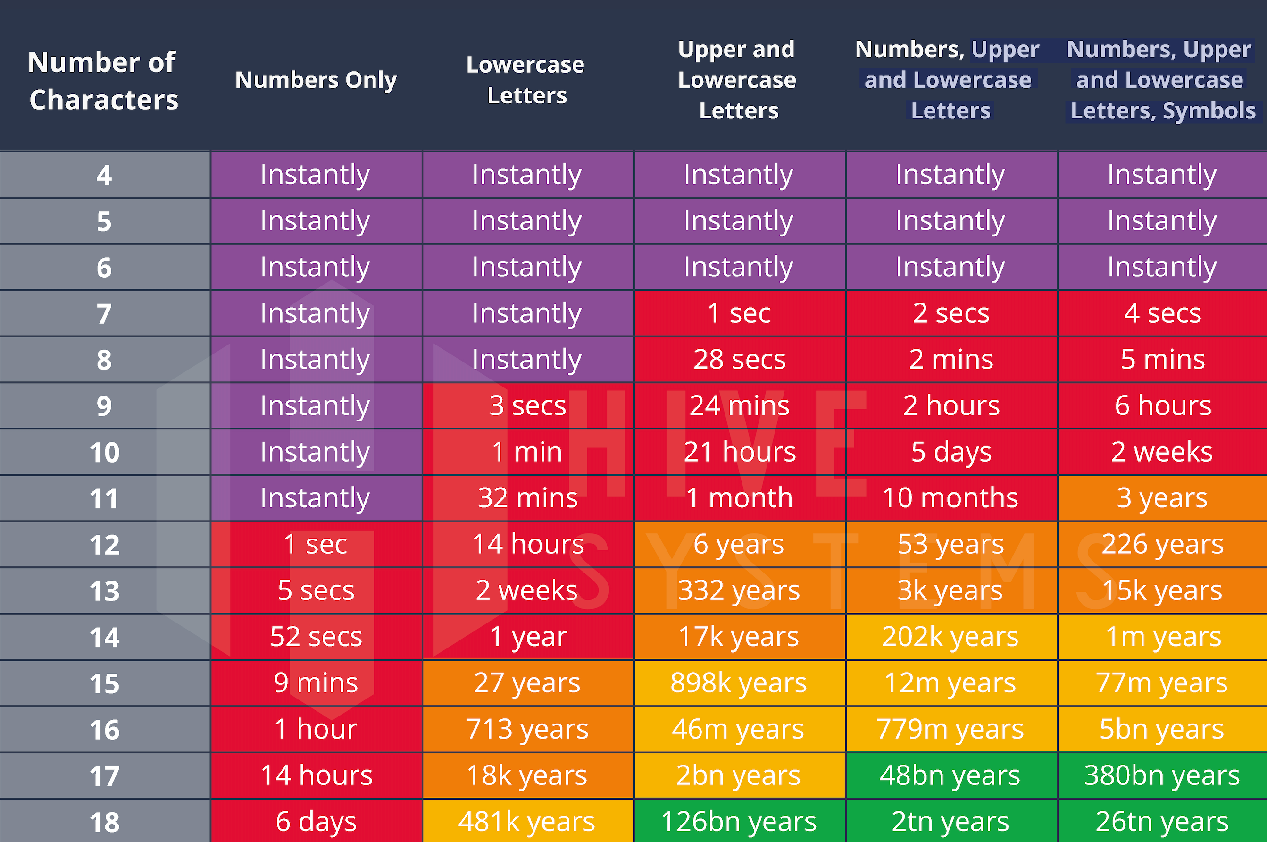
How long does it take to crack a password?
Use these 4 groups
Use at least 13 characters

Slide 13
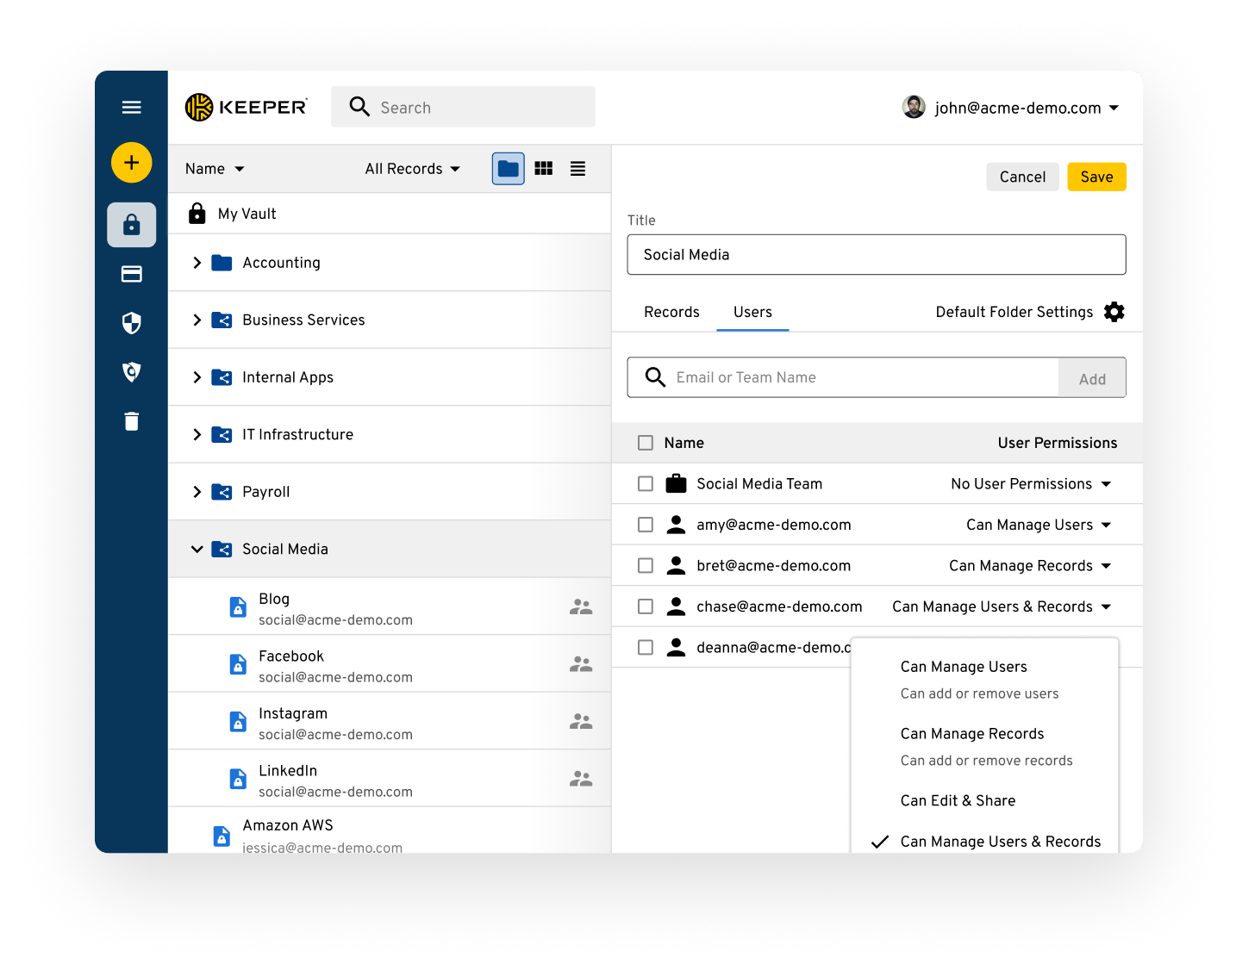
Password Managers
Manage password complexity with a password manager

Slide 14
PROTECTING YOUR ACCOUNTS

Slide 15
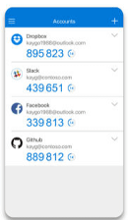
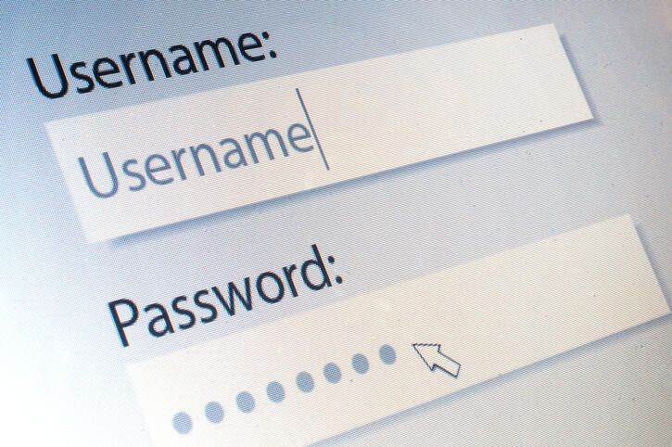
USE 2-FACTOR AUTHENTICATION on all accounts
Factor #1
Factor #2
Username & Password
Authenticator App

Slide 16
PHISHING DETECTION

Slide 17
Phishing websites
Phishing is a fraudulent practice in which an attacker masquerades as a reputable entity or person in an email or other form of communication.
Phishers use their own domains (websites) to trick users.
These tricky domains are placed as links in the Phishing email.
Phishers build websites that look like legitimate sites to trick users.
Knowing how to inspect links can save you from a cyber attack.

Slide 18
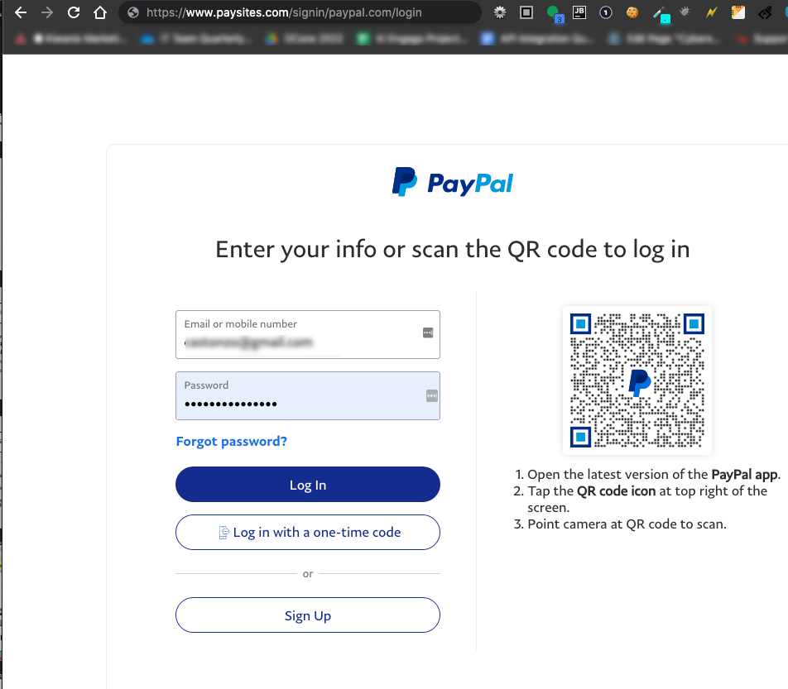
Imposter phishing site

Slide 19
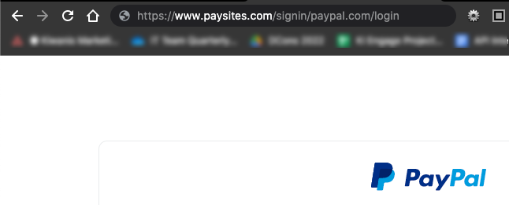

Slide 20
What is this phishing site trying to do?

Slide 21
Protocol
Sub-domain
Domain
https://www.starbucks.com

Slide 22
Protocol
Sub-domain
Domain
https://delivery.starbucks.com

Slide 23
Protocol
Sub-domain
Domain
Path
https://www.starbucks.com/menu

Slide 24
the domain is what’s important
Protocol
Sub-domain
Domain
Path
https://www.starbucks.com/menu

Slide 25
the domain is what’s important

Slide 26
the domain is what can be Phishy!
Protocol
Sub-domain
Domain
Path
https://www.star-bucks.com/menu

Slide 27
the domain is what can be Phishy! The PATH can also be phishy!
Protocol
Sub-domain
Domain
Path
https://www.payme.com/starbucks.com/order

Slide 28
Let’s try it out!
https://www.amazon.com/gp/bestsellers/

Slide 29
Let’s try it out!
Protocol
Sub-domain
Domain
Path
https://www.amazon.com/gp/bestsellers/

Slide 30
Phishy or not?
Protocol
Sub-domain
Domain
Path
https://www.micorsoft.com/en-us/windows

Slide 31
Phishy! Why?
Protocol
Sub-domain
Domain
Path
https://www.micorsoft.com/en-us/windows

Slide 32
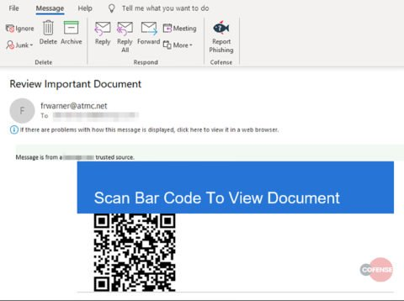
STOP, LOOK, THINK
Red flags?
Throw out?
No way to verify location!
Notes:
QR code = quick response code

Slide 33
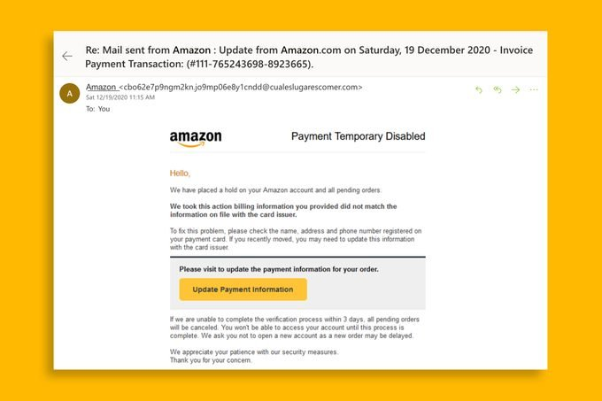
STOP, LOOK, THINK

Slide 34
STOP, LOOK, THINK
Red Flags?

Slide 35
Red Flags

Slide 36
Cyber Crime & Kiwanis
Rule #2
Several Phishing Attacks on Districts & Clubs

Slide 37
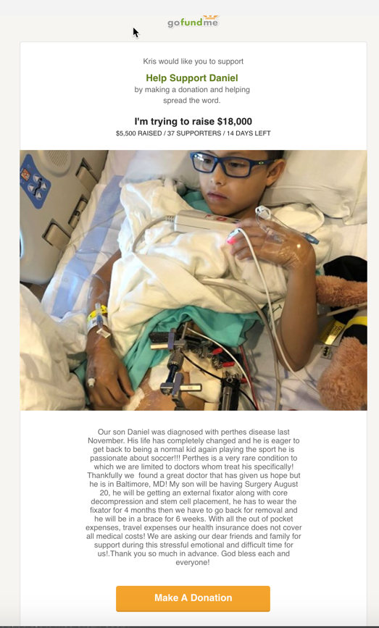
Emotional Response
Sad story
Phishing Link

Slide 38
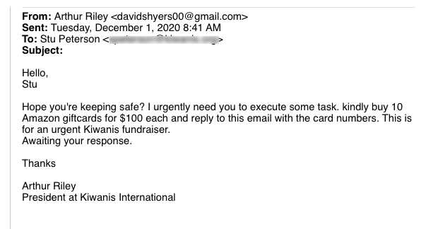
Phishing Reply-to Address
stuart@gmail.com
Urgent Fundraising Request from Art Riley
Emotional Response
Grammatical errors
Evokes a reaction
Call to action
Someone you know

Slide 39
SPOOFED Email sender NAME with BURNER EMAIL ADDRESS
Stuart Doe
stuart@gmail.com
HACKER GOAL: Target replies to the email message with a payload

Slide 40
Cyber-prevention Tips
Slow down
Use a 2-factor authentication app
Use a password manager
When in doubt, throw it out!
Don’t respond to any suspicious email, text, etc.
Don’t investigate suspicious emails on a mobile device
Don’t scan any QR codes in emails or text messages
Verify a sender directly from their company website, verified phone number or by calling the number on your debit/credit card

Slide 41
Cyber-prevention Tips
Keep all your software updated
Use anti-virus software
Disable automatic attachment downloads
Be extra careful with emails that have attachments
Verify with the sender that the attachment is legitimate
If the attachment is legit, scan the attachment with your anti-virus software before opening
Mobile devices can get infected with malware (viruses, worms, etc.) too

Slide 42
Rule #1 Stop, LOOK, THINK
Stimulus
Reaction
Response
Stimulus
Reaction
Response

Slide 43
Rule #2 RED flags

Slide 44
Rule #3 when in doubt, throw it out

Slide 45
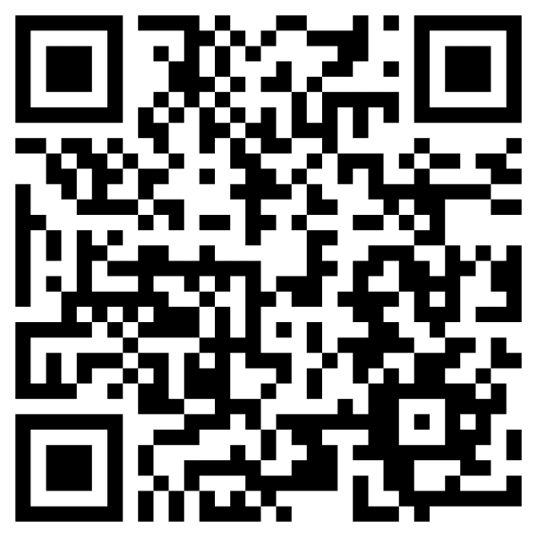
References
Cybersecurity Resources
https://tinyurl.com/kiwaniscybersecurity

Slide 46
Discussion Time

Slide 47
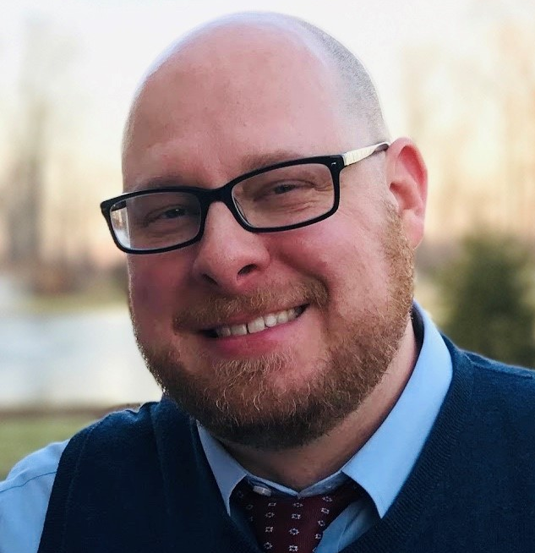
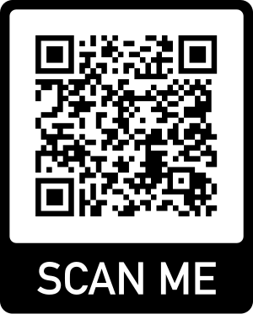
Thank you!
Bryce Kinder
bkinder@kiwanis.org
1-800-549-2647 ext. 113
317-217-6113

