Slide 1
Club Leadership Education
2024
Nebraska-Iowa District

Slide 2
Let’s Get Ready to Make a Difference!
Message from President Elect Lee Kuan Yong
District Gov. Elect John Boltz
District Goals for 2024-2025
Kiwanis 101
Our District
New for 2024-2025
Officer Training
Notes:
Agenda for the training

Slide 3
KI President Elect Lee Kuan Yong
https://youtu.be/ccxHP-f3IlU
Click Link To Play
Notes:
Hit the play button to start video. When done, advance to next slide

Slide 4
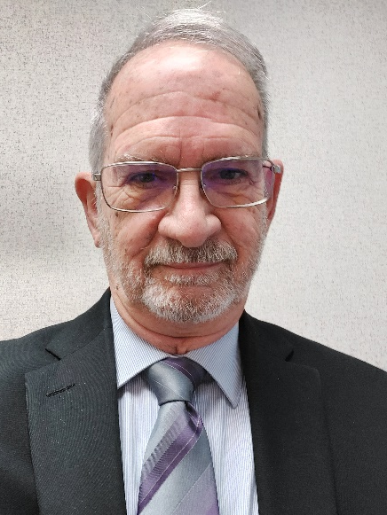
Nebraska-Iowa District Governor-Elect John Boltz
Kiwanis of Hastings, Nebraska
Joined Sept. 28, 2006
2-term lt. governor for Div. 23
Past trustee for Region 1
Spouse: Patty
Notes:
Gov. Elect John Boltz will be elected governor during the 2024 House of Delegates, to be held Aug. 3 at District Convention. He will take office Oct. 1. Per bylaws, the governor-elect is the lone candidate for governor.

Slide 5
Ask each member to invite someone to join their Kiwanis club this year.
Open at least 3 new clubs.
Governor’s visit to each division and also have each division’s council meeting be the best they can be.
Work with Service Leadership Programs to increase the number in the district.
2024-2025
District Goals
& Theme
Notes:
These are the goals outlined by Gov. Elect John for this coming year. These should be shared with all club members.
The theme is “One Can Make a Difference”. All Kiwanians can and do make a difference.

Slide 6
Kiwanis 101
Notes:
We all need refreshes on Kiwanis’ mission

Slide 7
Our Mission
MOTTO
Serving the children of the world.
DEFINING STATEMENT
Kiwanis is a global organization of volunteers dedicated to improving the world one child and one community at a time.
VISION STATEMENT
Kiwanis will be a positive influence in communities worldwide...so that one day, all children will wake up in communities that believe in them, nurture them and provide the support they need to thrive.

Slide 8
The Six Objects
In 2024, we celebrate the 100th anniversary of the adoption of the Kiwanis objects!
To give primacy to the human and spiritual, rather than to the material values of life.
To encourage the daily living of the Golden Rule in all human relationships.
To promote the adoption and the application of higher social, business and professional standards.
To develop, by precept and example, a more intelligent, aggressive and serviceable citizenship.
To provide, through Kiwanis clubs, a practical means to form enduring friendships, to render altruistic service and to build better communities.
To cooperate in creating and maintaining that sound public opinion and high idealism which make possible the increase of righteousness, justice, patriotism and goodwill.
Notes:
100th anniversary of Six Objects this year. There is a connection to Nebraska-Iowa District. Ray Crossman with Omaha Kiwanis was on committee that formed these objects prior to 1924 convention. They have not changed since adoption at the 1924 Convention, also held in Denver.

Slide 9
Kiwanis Leadership Structure
Club president, president-elect, vice-president, secretary, treasurer, board of directors
Club
Division
Lieutenant governor
Region
Trustee
District governor, governor-elect, administrator, treasurer, district chairs
District
Kiwanis International
President, president-elect, vice president, immediate past president, trustees
Notes:
Each club can have different number of directors, officers – it’s in their bylaws for who they should elect annually.
Our district has a trustee system so we have both divisions and regions.

Slide 10
Service Leadership Programs
Notes:
K-Kids – elementary; Builders – middle school; Key Club – high school; Circle K – college; Aktion – developmental disability

Slide 11
Our District

Slide 12
Organized Jan. 6, 1920 – 104 YEARS!
K16 (District K Number)
3,792 members in 136 clubs (as of June 4)
6 Regions & 25 Divisions
Notes:
Onto our second century! K16 number recognized by KI and in use on many forms.
Look at our current members – if we reach our goal of having every members ask one person to join, we can double that number!!!

Slide 13
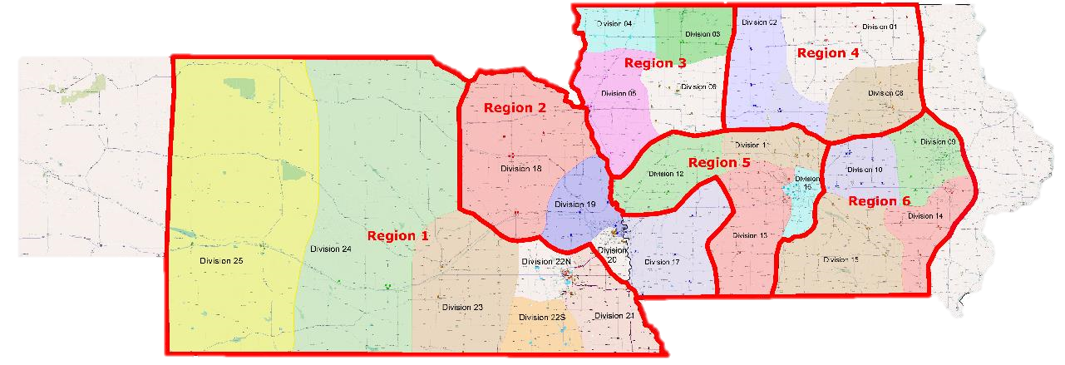
Lt. Governor elected in each division
Trustee elected in each region
Notes:
Red boundaries are regions & color shadings are divisions. Elected leader in each division and each region

Slide 14
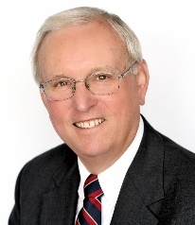
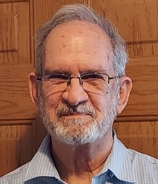
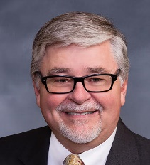
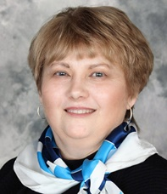
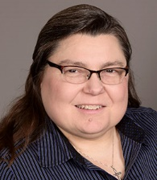
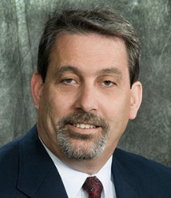
2023-2024 District Officers
Governor
Dale Doudna
Home club: Johnston
Governor-Elect
John Boltz
Home club: Hastings
Nebraska-Iowa
District Board
District Officers
Regional Trustees
R1 Keith Prettyman
R2 Linda Placzek
R3 Barb Hames
R4 Gary Lindgren
R5 Andy Webb
R6 Barrie Tritle
Vice Governor
Brian Wells
Home club: Bellevue
Imm. Past Governor
Lynda Henningsen
Home club: Omaha
Administrator
Lisa Brichacek
Home club: Wahoo Area
Treasurer
Curt Reis
Home club: Storm Lake
Notes:
Our current district board
Trustees are three year terms – elected by region
Gov. Gov Elect, Vice Gov are one year terms – elected by delegates
Admin. & Treasurer are three year terms – appointed by governor, with approval of district board

Slide 15
Communication
Monthly District
Newsletter
Clubs can submit news
by 1st of month to
Nikiwanisdistrict@gmail.com
Notes:
District announcements are made in The Kiwanian, published by email once a month; Club news and good things to share can be put in News from Around the District – submit to district office by email. These go to all members by email

Slide 16
For Club Officers
Notes:
Special newsletter for club officers. This is not monthly but quarterly or every other month at most. We will group together three or four items and try not to bombard email box. There may be items officers are asked to share with club members.

Slide 17
Not Receiving District Emails?
Check spam, junk or promotions folders!
Unsubscribed?
Contact the district
office to re-subscribe!
Check and/or update your contact information!
Notes:
Email is the primary way the district communicates with all members. If you are not receiving emails it could be for one of several reasons.
Check your spam or junk folders and mark as “primary email”
Sometimes there is an accidental unsubscribe to Constant Contact, our bulk email provider. Contact the district office to get back on the list.
You may have an old email address in your KI records. Check your online record or ask your club secretary to check your contact information.
Please ask club officers to ask members not to unsubscribe. We will try our best not to bombard your email box, but we do have important news to share throughout the year

Slide 18
Other Resources & Connections
Website:
https://k16.site.kiwanis.org/
Facebook Group:
NE-IA Kiwanis District
Instagram:
neiakiwanis
YouTube:
Nebraska-Iowa Kiwanis District Video
Notes:
These are online resources available.
Please check them out

Slide 19
Chartered Aug. 8, 1970
Grant Request: March 1, June 1, Sept. 1 & Dec. 1
Don’t forget to budget annual club donation
Notes:
The Foundation is an important partner to the district. Clubs may request grant dollars to help with projects. There are four grant cycles and requests are due on the dates listed. Clubs should also budget an annual gift to the Foundation. This usually ask is $6 per member as the club gift.
The same is true for KCF – budget for club donation – ask is $10 per member in the club.
These club gifts are separate from individual gifts made by members.

Slide 20
New!

Slide 21
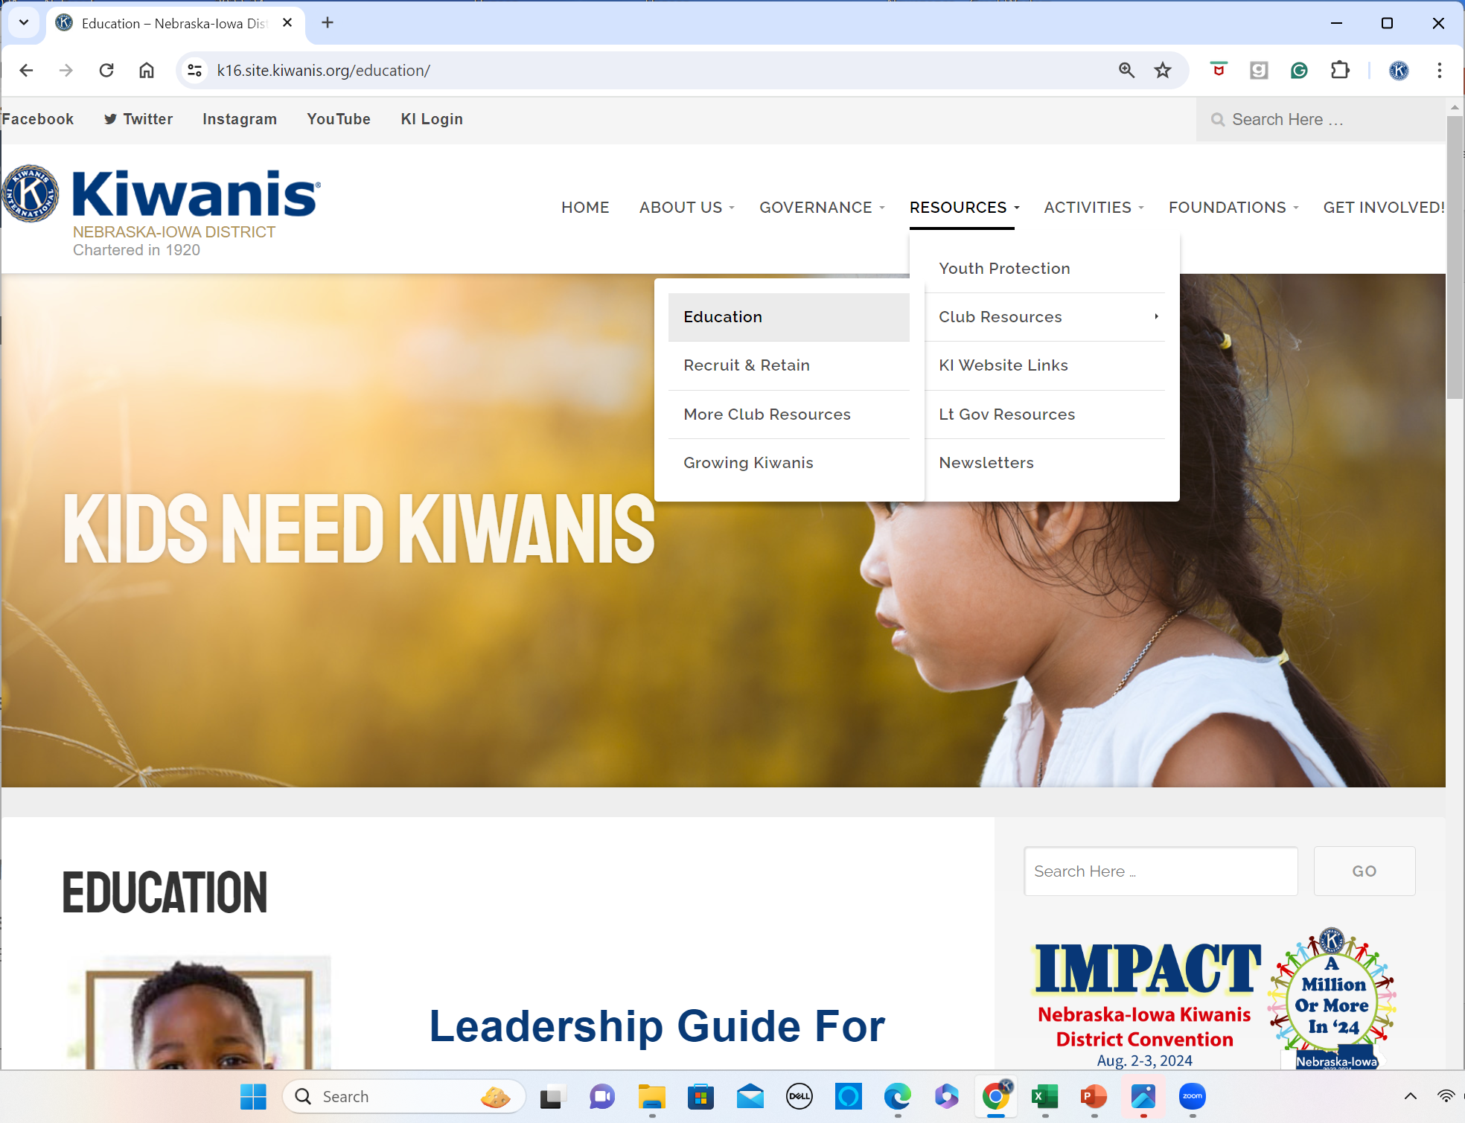
CLE GUIDES
Leadership Guides
Online Only
KI & District
websites
Notes:
The Leadership Guides have been updated this year, but in an effort to save money, they are not printed and mailed. Available online Kiwanis.org and district website.

Slide 22
Club Membership Plans
Mailed to Club Secretaries
More information in Membership
& President Training
Notes:
Each club is asked to create a membership plan. These have been mailed to club secretaries and are available online.

Slide 23
Distinguished Club & Member
Returning to KI criteria for 2024-2025
More information coming
Notes:
Kiwanis International has taken back this awards program from the districts. More information will be available soon.

Slide 24
Thank You For Being A Club Leader!!!

