Slide 1
Protecting Youth in Kiwanis Service:
Know. Protect. Respond.
Prepared by Melissa McMann,
Administrator, Service Leadership Programs’ Education and Training

Slide 2
Know Why Youth Protection Matters

Slide 3
Youth Sexual Abuse Happens Across the Globe
1 in 13 Boys
1 in 5 Girls
Report experiencing child sexual abuse (actual numbers are estimated to be higher).*
Abuse is a worldwide issue: during youth, across all ages and socioeconomic levels, ethnicities, genders, and big or small communities:
*World Health Organization, 2022
Notes:
Some might ask, "Is this really a concern for my group?"
The answer is yes. Data shows that the potential for abuse is a concern for every group working with youth. And it can happen to anyone without regard to socioeconomic level, ethnicity, gender or the size of their community. We also know abuse happens early.
World Health Organization data from 2022 is that worldwide, 1 in 5 girls and 1 in 13 boys report experiencing sexual abuse by the time they reach age 18. Actual numbers are estimated to be higher.

Slide 4
Abuse Also Happens Online
Bullying, grooming, and solicitation are concerns
Varied concerns: visually explicit material, fantasy and off-line contact
80% of perpetrators are known to victims
Generally, perpetrators portray themselves as minors
Use strategies such as gaining access and isolation
Sexual topics often introduced in first day of contact
Majority take conversations off-line
Minors who have sexual relationship off-line typically consider it consensual
Notes:
Abuse also happens online. This often comes in the form of bullying, grooming, and solicitation, and just like with in-person locations, perpetrators are typically known to the victims. It is common for adult perpetrators to pose as minors and then use strategies to gain access to the youth and isolate them. As these conversations progress, perpetrators often take the conversations off-line.

Slide 5
Where Abuse Happens
Abuse can happen anytime. Typically, it occurs in private spaces like 1-on-1 interactions, bathrooms, cars/buses or hotel.
Abuse or inappropriate behaviors can also happen online through texting, sexting, pornography or social media sites.
Predators use one-on-one access to groom and assert emotional control over vulnerable youth.
Notes:
Abuse can happen anytime. Typically, it occurs in private spaces like 1-on-1 interactions, bathrooms, cars/buses, or hotel. Abuse or inappropriate behaviors can also happen online through texting, sexting, pornography, or social media sites.
Predators use one-on-one access to groom and assert emotional control over vulnerable youth.
As volunteers in after school, off school grounds and sometimes overnight events, there are opportunities where one-on-one, private situations could occur with youth. By educating ourselves and each other, we're better equipped to be aware of those times and spaces.

Slide 6
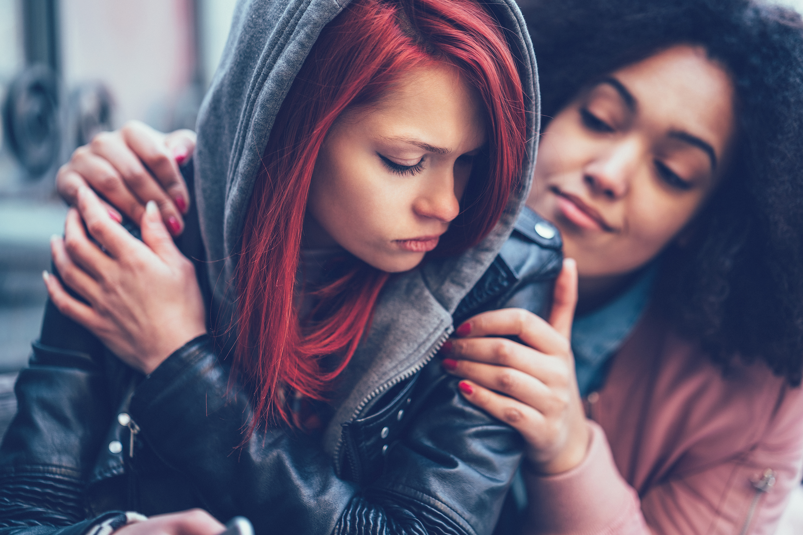
How Abuse Affects Youth
Abused youth may:
Think they can’t trust anyone
Think its their fault or that they could have stopped it
Feel angry, sad, guilty or confused
Have mood swings
Lose interest in activities
Act out in sexual ways
Notes:
Youth who are abused may be affected in a number of ways, sometimes for the rest of their lives. They may have trouble trusting others, feel guilty because they think it is their fault or that they could have prevented the abuse. They may feel or demonstrate anger, sadness, confusion, or mood swings. They can lose interest in activities and they may act out in sexual ways.

Slide 7
Know Kiwanis Youth Protection Policies and Practices

Slide 8
Kiwanis Youth Protection Goals
Protect, educate, and engage all Kiwanis members - youth and adult
Protect youth from predators
Provide youth with skills and tools designed to inspire and engage future leaders to be their best
Empower and educate adult members with best practices when working with youth
Notes:
Knowing more about why youth protection matters, let's clarify our goals for Kiwanis youth protection.
We aim to Protect, educate, and engage all Kiwanis members - youth and adult, so that we
Protect youth from predators
Provide them with skills and tools designed to inspire and engage these future leaders to be their best; and
Empower and educate the adult members with best practices

Slide 9
How to Meet our Goals – ABCs of Youth Protection
Background check adults serving with SLP members
Access policies and training
Culture of care
Prevent adult-to-youth abuse and peer-to-peer abuse
Identify concerning behaviors
Monitor and supervise youth
Mitigating risky situations with supervision.
Report emergencies or red flag incidents
Model safe appropriate behaviors
Notes:
In order to meet our goals, we need to equip ourselves, other adults, and SLP members with the tools to prevent adult-to-youth abuse and peer-to-peer abuse by:
Following Kiwanis youth protection policies
Identifying concerning behaviors
Mitigating risky situations with supervision.
Reporting emergencies, abuse or concerning behaviors sooner rather than later and
Modeling safe, appropriate behaviors.

Slide 10
Why Abuse Prevention Education Matters
When people know youth have been educated on this topic, they are less likely to target those youth.
Education increases disclosures, which leads to interrupting additional abuse and to more youth getting help.
*Source: Dr. David Finkelhor, Director, Crimes Against Children Research Center/Prof of Sociology of U. New Hampshire
Notes:
Here, we prevent several compelling reasons youth education on sexual abuse prevention is important as evidenced by the research.
When people know youth have been educated, they are less likely to target those youth.
Everyone needs to know what is OK and what is not OK for adults to do.
When adults know information, they can share it with youth.
Education increases the number of disclosures, which leads to interrupting additional abuse and to more youth getting the help they need.

Slide 11
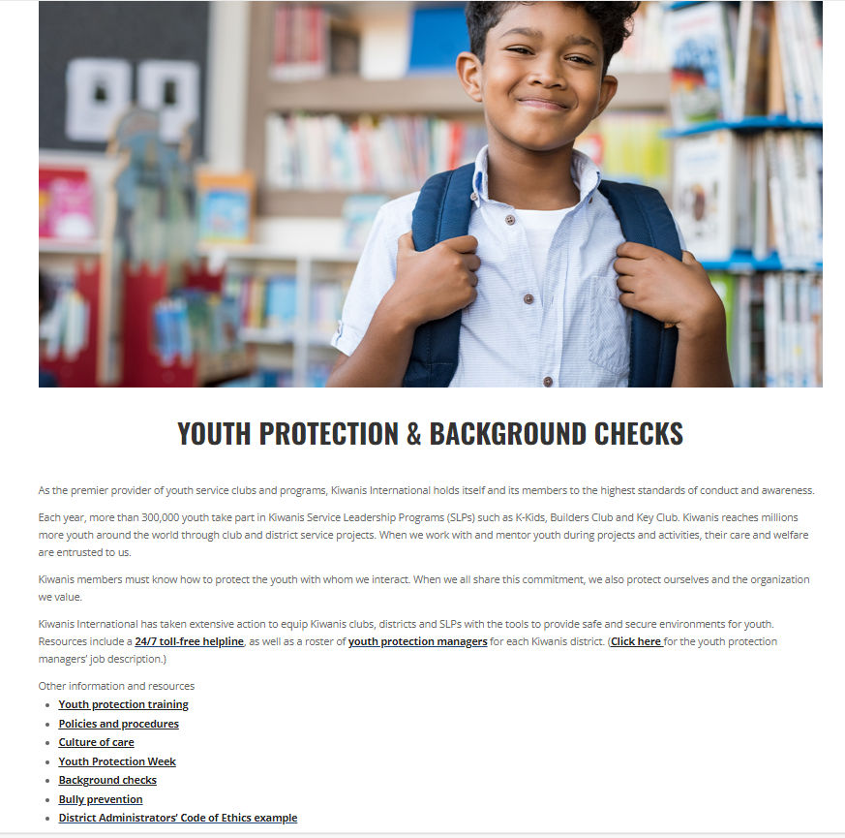
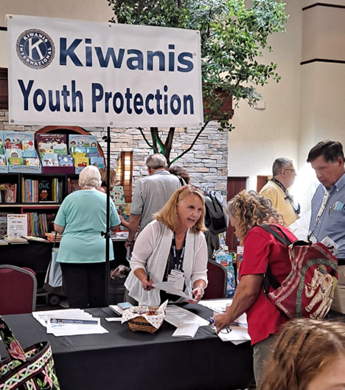
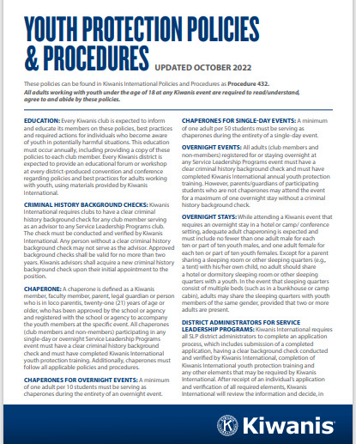
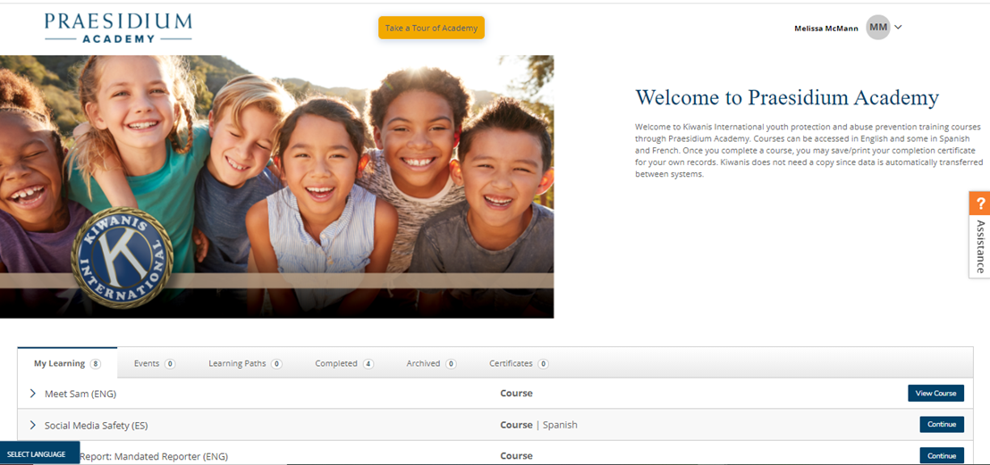
Access Policy & Prevention Training
Educate members at in-person or virtual conferences,
conventions, webinars, or club meetings
Clubs review policy annually.
Chaperone ratios
Social Media
Transportation
Educate SLP advisors, administrators & chaperones on abuse prevention best practices.
DA/Advisors complete 6 and Chaperones complete 3 online youth protection Praesidium
courses.
Kiwanis.org/youthprotection webpage has training slide deck, recordings, links to past webinars, and background check FAQ.
Notes:
Here we have snapshots of how Kiwanis and SLP strive to make policy and prevention training accessible to volunteers and leaders working with our SLPs.
Kiwanis Youth Protection policy document. Latest version was updated October 2023
Kiwanis new website with links to multiple YP resources
Praesidium abuse prevention online course portal
District youth protection manager exhibiting a table her district Kiwanis convention.

Slide 12
Accessible On-line Youth Protection Courses www.PraesidiumAcademy.com
Refresh every 2 years
Some courses available in French and Spanish
Course | SLP Youth Protection & Risk Managers | SLP DAs & Advisors (CKI, Builders and Key Clubs) | SLP DAs & Advisors (K-Kids and Aktion Clubs) | Non-advisor Members (Gov, LTG, Club Officers) & Non-member Chaperones (Faculty, Parent, Spouse)
Abuse Risk Management for Volunteers | X | X | X | X
Social Media Safety | X | X | X | X
Preventing Sexual Activity Among Adolescents | X | X |  | X
Duty to Report | X | X | X
Meet Sam | X | X | X
It Happened to Me | X | X | X
Safety Equation: Monitoring & Supervision | X |  | X
Notes:
Another part of training is individual. Kiwanis offers free, on-demand, online abuse prevention courses. Unlike club-level youth protection policy training, these courses give examples of what abuse may look like and how to handle a situation if a student reports abuse. These courses are taken through nationally recognized Praesidium Academy, a learning management system tied to the Kiwanis membership database. The chart in front of you shows which individuals are asked to complete which courses, based on your Service Leadership Programs role. Take a moment to identify your role in the top row of the chart.
Kiwanis International recognizes courses for two years and are offered in English, Spanish and French.

Slide 13
Access Youth Protection Policy Training
What is the training?
Kiwanis policy requires Kiwanis clubs to review youth protection policies each year.
Group activity as a Kiwanis club
Every year (Oct. 1 – Sept. 30)
Education sessions at district conferences
Find a policy training slide deck, recording and background check FAQ at Kiwanis.org/youthprotection

Slide 14
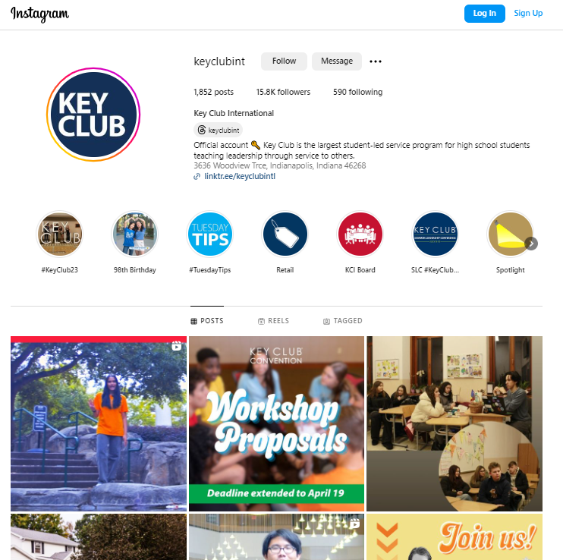
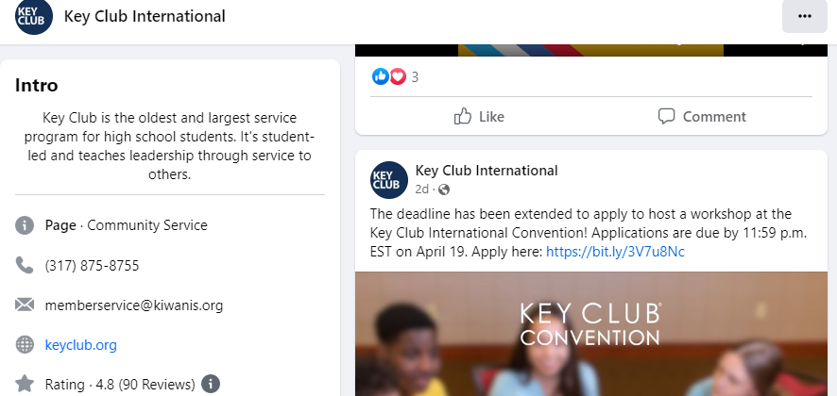
Understand Policies: Online & Electronic Communication
Social Media Connections
Never initiate, follow, friend, or like posts or pages of individual youth
Social Media Connections
Connect via an SLP club page/ account and not individual member account
Social Posts
Treat all social posts and interactions as professional and public
Photos
Get parent/ guardian permission; never post on personal social media
Rule of 3
Avoid 1:1 youth to adult texts, emails, or phone calls by adding a second adult, e.g. another advisor/DA, parent or guardian
Notes:
The National Center for Missing and Exploited Children received close to 85 million online files containing child sexual abuse material in 2021. For this, and other reasons, we want youth to know we expect their online and electronic interactions with adults to remain public.
Kiwanis has policy about social media and electronic communications with youth. Never initiate, follow, friend, or like posts or pages of individual youth. When connecting with youth on social media, do so via the SLP club page or account, and never from your personal account. Remember that everything on the internet should be kept professional, as it is a public forum.
We love seeing and posting photos of Kiwanis youth. Make sure you have signed permission, and even then, these should only be shared on the club page or account, and not on a personal page.
Remember the rule of threes and avoid one-on-one contact online just as you would in person. This includes via email or text, where there should always be at least two adults copied.

Slide 15
Understand Policies: Requirements for Kiwanis Advisors, member/non-member Chaperones
Must be 21 years or older. *Some districts’ age requirement is 25 years old to chaperone a SLP event.
Maintain clear Kiwanis background check
Review Kiwanis Youth Protection Policy
Complete abuse prevention online courses through Praesidium Academy
Consider your ability to: Supervise & monitor, check in with members regularly
Allow one adult to tend to an urgent situation while others lead the group

Slide 16
Understand Policies: Adult Chaperones to Youth Ratios
Single day volunteering on school premises =
At least 1 *chaperone to 50 members. And follow school background check & chaperone requirements
SLP single day off school premises event =
1 *Chaperone
to 50 SLP members
Overnight SLP event = minimum 1 background checked adult* per 10 youth
1 adult male to supervise no more than 10 youth males
1 adult female to supervise no more than 10 youth females
Notes:
Kiwanis policy requires a certain number of chaperones be involved with Service Leadership Programs events. The number of chaperones required is determined by the number of youth in attendance.
For a Single-day SLP event, there needs to be a minimum of 1 background checked adult* per 50 youth.
For an overnight SLP event, a minimum of 1 background checked adult* per 10 SLP members, which breaks down to:
1 adult male to supervise no more than 10 youth males AND
1 adult female to supervise no more than 10 youth females.
Adults chaperones must be 21 or older. CKI members younger than 21 can volunteer but can’t be an ‘’official chaperone, nor counted in the ratio.
Please note on the topic of overnights: adults MUST NOT share sleeping quarters with youth except with their own child. An exception would be a bunkhouse or camp cabin setting.

Slide 17
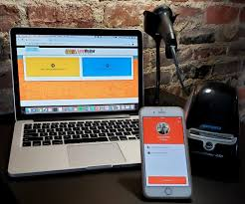
Background Checks: What are they?
Kiwanis contracts with Safe Hiring Solution’s “Safe Visitor” online application portal
Individual email link is sent to email on file. *Check spam folder*
Searches county, state/province, national criminal records
Good for 2 years. Check secretary dashboard for expiration dates.
May take 2+ weeks to process; submit names in advance of event
California residents have a different process. See: https://www.kiwanis.org/policy-requirements-for-california-volunteers/
Notes:
Kiwanis International background checks are valid for 2 years and need to be renewed to remain in a DA or Kiwanis advisor role. We recommend submitting a background check application at least 2 weeks prior to the event needed, or even longer if you have an event with many names to be submitted. There may be requests for additional supporting documentation.
Kiwanis contracts with Safe Hiring Solution’s Safe Visitor system to provide an online application portal for U.S., Caribbean, and other members to secure a background check. Clubs often background check multiple volunteers to have backup chaperones, especially during Fall Rally time and District conventions.
Note that due to California state law, California residents have a different background check process. Please see our website for instructions. You can get there from Kiwanis.org/youthprotection.

Slide 18
Background Checks: How do I get one?
U.S. Kiwanis secretaries or members click link in Kiwanis Connect/Engage to generate individual member link (check spam folder)
International/Caribbean Kiwanis advisors or members send request individual links to emailing backgroundchecks@Kiwanis.org
*Canadian members send vulnerable sector check to Kiwanis for verification
Faculty advisors email a request to backgroundchecks@kiwanis.org
Notes:
There are multiple ways to begin the background check application process so the Kiwanis level of screening can be done by Safe Hiring. Depending on which country you live in, your country may have slightly different laws and processes. US members can self-initiate a link or ask their club secretary to send a link to the online background check application.
In the Caribbean, South America, Europe, Asia and the Pacific region, individuals or secretaries can request an individual link to start an online application by emailing backgroundchecks@kiwanis.org
Canada and France do not allow a third-party search, so Safe Hiring isn’t able to screen records. As an alternative, those members are asked to visit their local police station to get a vulnerable sector check (as it’s called in Canada) and send it to Kiwanis International for verification by email or post.

Slide 19
Know How to Protect and Respond

Slide 20
Reporting Troubling Behaviors
See Something.
Hear Something.
Say Something.
Notes:
If you observe or learn of behavior that is inappropriate, unsafe, violates policy, or is illegal, event if the event has passed, the answer is simple. If you see something or hear something, you must say something. You may be the one person who can make a difference.
Reporting, or “saying something,” when you see concerning behavior could prevent further harm and save other children from abuse, and it contributes to the safety of members and clubs.

Slide 21
Contact Event Leader
Immediately stop abuse or inappropriate behavior.
Separate youth from the accused.
Contact the event leader (if it’s not you).
Decide whether you or the event leader will report the incident.
Gather notes before call: i.e., time of incident, information of individuals involved, action that was taken. (This is different from investigating.)

Slide 22
Call Helpline
Step 3
Put this number in your phone!
Helpline is staffed 24/7 by intake professionals at Praesidium Inc. They provide guidance about follow-up and report back to the Kiwanis Youth Protection team.
Anyone can call Helpline, including members, chaperones, parents and others. Callers may remain anonymous.
Notes:
Your first call is to the Kiwanis Praesidium Helpline at 1-866-607-SAFE (7233). You may want to pause and put this number in your phone.
Before your call, make sure you have notes you’ll need for the conversation: i.e., time frame of incident, information of individuals involved or having knowledge of the situation, and any action that was taken.
The Helpline is staffed 24/7 by intake professionals at Praesidium Inc. as part of our partnership with them. They will provide you with support and guidance about necessary follow-up. They will also make a report to the Kiwanis Youth Protection team.
Note that the Helpline is available for anyone to make a report or seek guidance, including members, chaperones, parents and others. Callers can choose to remain anonymous.

Slide 23
Follow Helpline recommendations
Follow all local and national reporting laws.
Follow Helpline next steps and recommendations.
Depending who is involved in alleged incident, peer youth-to-peer youth or adult-to-youth, as appropriate contact parents/guardians, advisors or school administrators of affected youth.
Notes:
After you report to the Helpline and follow their recommendations, including reporting to law enforcement if applicable, contact the following as appropriate.
Remember to follow all local, state/provincial and national reporting laws.
The Kiwanis International Youth Protection team at youthprotection@kiwanis.org

Slide 24
Important Reminders
Maintain confidentiality of the accused, accuser and others.
You are not an investigator, but a support and guide.
You are not a judge; record and report the information to others.
Notes:
Maintain the confidentiality of the accused, accuser and anyone else who may be involved. Inform individuals on a need-to-know basis only. It is not appropriate to discuss incidents with youth beyond what is necessary to provide care to those who need it.
You are not an investigator. We appreciate you making reports and sharing with Praesidium the information you have. Your role is to support and guide youth. Please do not place yourself in the role of an investigator.
You also are not a judge. As a support and guide, you want to gather and present information, but not interpret it. If inappropriate behavior or abuse is reported to you, ensure your response is one of accepting information and showing empathy. Sometimes people think, “What was reported to me may not be true,” or “That doesn’t sound like a big deal to me.” However, the report still needs your action, and the individual needs your support and empathy. What seems inconsequential to one person can be traumatic to another.

Slide 25
Scenarios to Apply Policy
Notes:
Turn to the person beside you and discuss the next few slides.

Slide 26
Scenario 1
Your Kiwanis Club is very excited to sponsor two students to attend Key Leader at Kamp SoHo over Veteran’s Day Weekend. You could use a weekend in the pines, so you volunteer to drive.
Discussion Questions:
Do you need a Kiwanis International background screen?
Do you need to complete KI’s chaperone training?
Do you need permission from the students’ parents?
The day before you are scheduled to leave, one of the students cancels. What happens to your trip?
What are other things to consider?
Notes:
If you are staying over night or designated as a chaperone, yes, you need background check.
Yes, you need to review youth protection policy and complete 3 Praesidium chaperone courses.
Yes, parent permission is needed for youth to attend overnight event.
If one students still attends, that student needs a chaperone. Contact the Kamp Kiwanis coordinator to notify them of the cancellation. If you are the same sex as the student attending, you can go as chaperone. If you are opposite sex of student attending, ask event coordinator if student can be chaperoned by a same sex adult or find another chaperone to replace you.

Slide 27
Scenario 2
A member of your Kiwanis Club is being honored at the Key Club District Convention, so four members of your Club sign up to attend to celebrate your friend’s accomplishment.
You won’t be staying the entire weekend, but you will be staying at the hotel Saturday night after the award ceremony.
#2
Discussion Questions:
Do you need a Kiwanis International background screen?
Do you need to complete KI’s chaperone training?
Can you and your Club members go to the bar for a celebratory drink? Is there a different answer if you have your drink in one of your hotel rooms?
What are other things to consider?
Notes:
Answers:
1. As an adult staying in the Key Club DCON hotel, you need to have a background check.
2. If you are not a designated chaperone supervising youth, you do not need to complete chaperone training. You should review youth protection policies.
3. Alcohol is not permitted at a SLP sponsored event. You should be a role model for Key club members.
4. Ask DCON registration staff if it is okay that Kiwanis club members attend recognition session. Typically, the event is limited to students, advisor, chaperones and district leadership. Request your background check application at least 2 weeks prior to the event.

Slide 28
Scenario 3
Your Builders Club is doing a park clean-up at the park down the street from their school.
Discussion Questions:
Does the Faculty Advisor need a Kiwanis International background check?
If the Kiwanis Advisor attends, does the Kiwanis Advisor need a background check.
Would the Kiwanis Advisor attending as the chaperone change your answer to whether the Faculty Advisor needs a screen?
If other members from the Kiwanis club attend, do they need a KI background check?

Slide 29
Questions & Answers

Slide 30
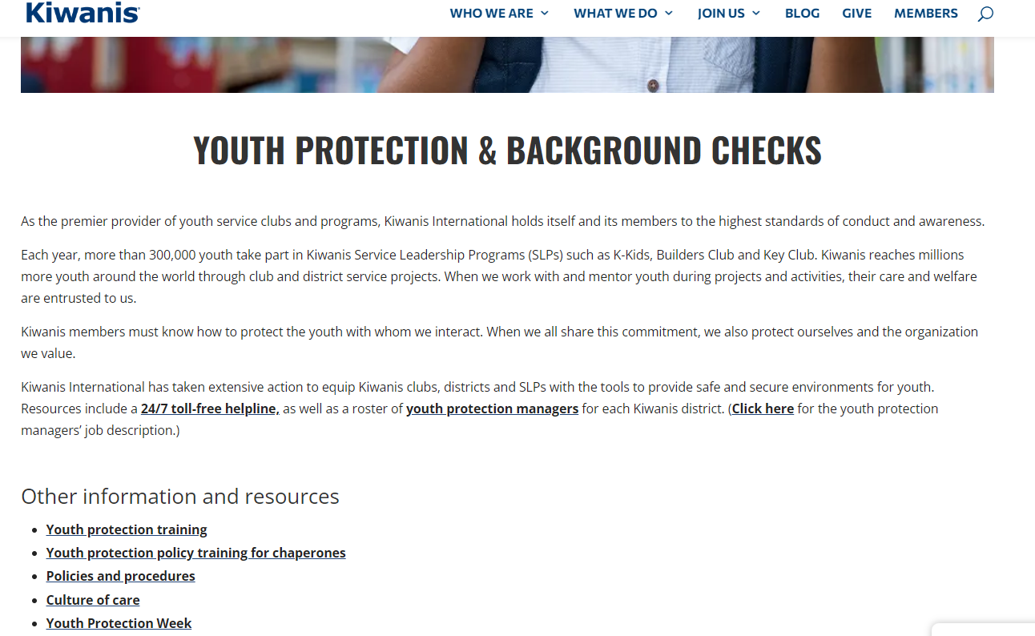
Melissa McMann
Service Leadership Programs Education & Training Administrator
mmcmann@kiwanis.org
www.Kiwanis.org/youthprotection or search for “Kiwanis youth protection” in your favorite web browser
youthprotection@kiwanis.org
backroundchecks@kiwanis.org

Slide 31
For More Information
Linda Placzek
Youth Protection Manager, Nebraska-Iowa District
laplaczek@cox.net

