Slide 1

Club Leadership Education
June, July & August 2025

Slide 2
Welcome
Today’s CLE includes
2025-2026 information
District information
Kiwanis 202
Officer Information

Slide 3
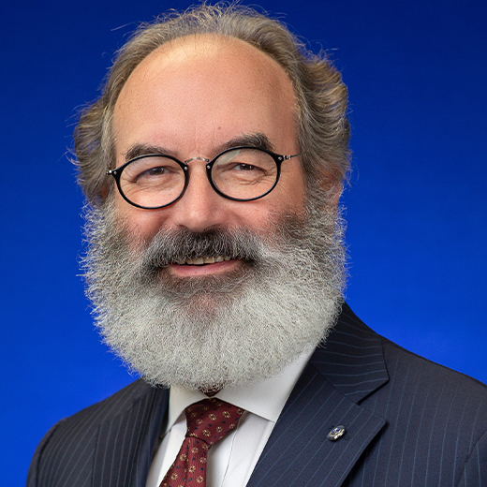
International
President Elect
Michael Mulhaul
Meet Michael mulhaul
Interlaken, New Jersey (New Jersey District)
33-year Kiwanis member
Also a Kiwanis Children’s Fund trustee
Elected 2025-26 president at Pittsburgh convention
Notes:
Other info on Michael:
He is a financial investment professional and his wife also belongs to Kiwanis

Slide 4
2025-2026
Distinguished
Clubs
ACHIEVEMENT QUALIFICATIONS
Membership & Engagement
Leadership & Education
Community Impact
Financial Viability
Branding & Image
www.kiwanis.org/members/awards-recognition/
Notes:
Clubs earn points under each category; achieve 100 points for distinguished status; clubs must also be in good standing with international and district. Distinguished member also available and more info can be found on website

Slide 5
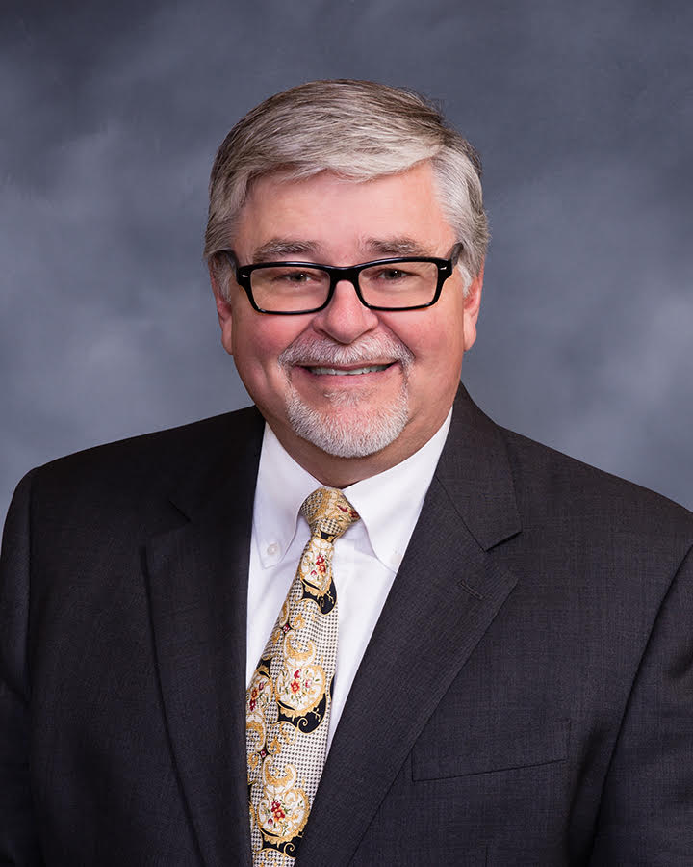
Nebraska-Iowa Governor Elect
Brian Wells
Meet Brian wells
Bellevue Kiwanis Club
Joined February 2015
Wife, Joyce, also a member
Elected governor in Lincoln during Aug. 2 House of Delegates meeting
Notes:
If Brian is in attendance, he will cover this slide

Slide 6
2025-2026
District Theme
Kiwanis Rocks!!!
Notes:
Kiwanis Rocks is Brian’s theme for his year as governor. His love of music and excitement for Kiwanis makes this a natural fit for his year and goals.
If Brian is in attendance, he can explain more about why he chose this theme.

Slide 7
2025-2026
District Goals
All NE-IA clubs finish the 2026 Kiwanis year with a +1 membership
All NE-IA clubs sponsors/co-sponsors an SLP club
Establish a Governor’s Award for Excellence for clubs sponsoring all 5 levels of SLPs
Open three new Kiwanis clubs within the NE-IA District
Each club/division offers to assist the music department of their local school district in some fashion to benefit the children and community musically (Kiwanis Rocks theme)
Grow Kiwanis Leadership Culture by using ACE Tools, CLE, Amplify and Dynamic Example Leadership at all levels of the Kiwanis Family from Clubs to SLPs to Division to District and beyond
Make Kiwanis fun and to remember Kiwanis Rocks!!
Notes:
Brian will go through if in attendance,
or:
These are the district goals for 2025-2026. Gov. Elect Brian is asking clubs to start planning now to have success this coming Kiwanis year. If every club would grow, even by just one member, that would be positive energy for the entire district. Opening new clubs and recognizing clubs that could sponsor all five SLP clubs are also on the radar for him this coming year.

Slide 8
Nebraska-Iowa District

Slide 9
Who We Are
Organized Jan. 6, 1920
K16 – District ID
As of July 3, 2025: 3,614 Members, 135 Clubs
Notes:
105 years of service --- yeah!!!!
Just like every club has a “K” number and every member has a member ID, the district’s id number is 16. You will see this on various forms and information from KI and the district.
Membership is an ebb and flow number,; we are currently are above where started Oct. 1, thanks to new members and a new club in Mahaska County (Iowa).

Slide 10
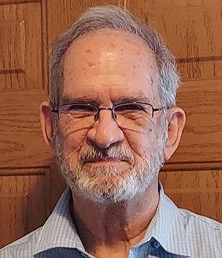
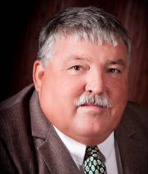
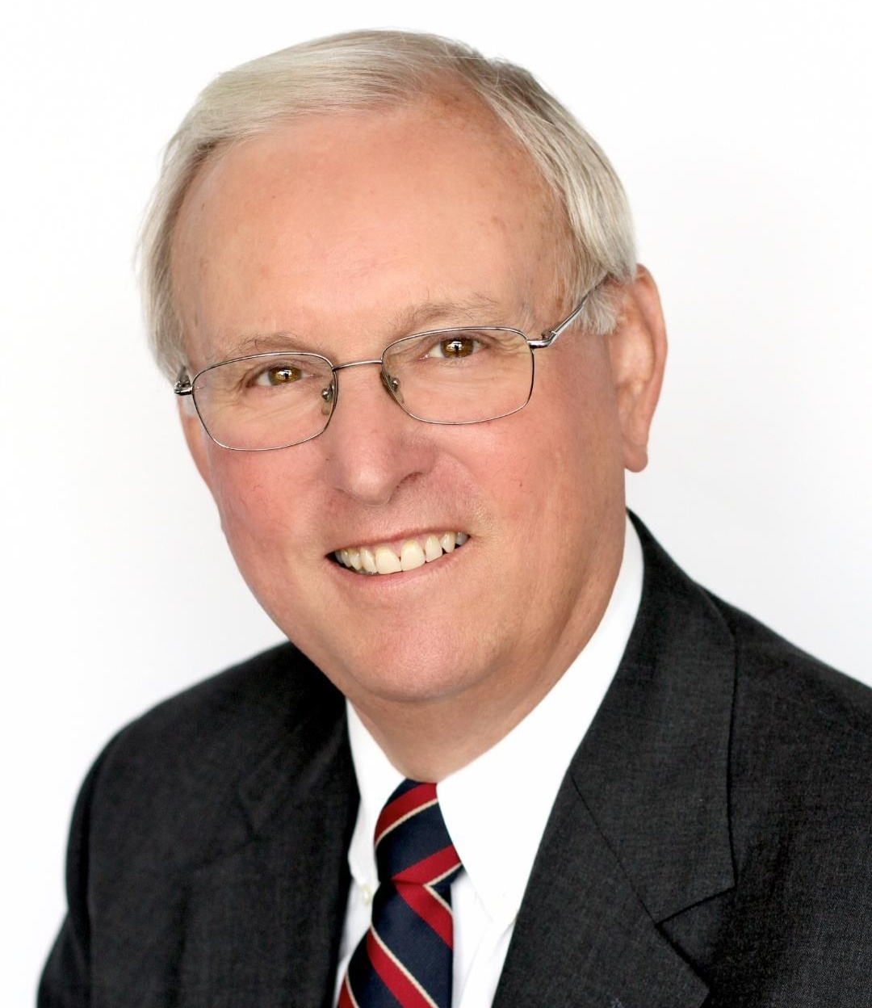
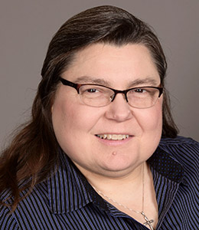
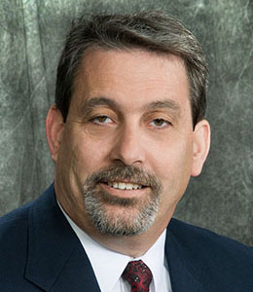
2024-2025 District Officers
Governor
John Boltz
Home club: Hastings
Vice Governor
Tim McGee
Home club: Chariton
Governor-Elect
Brian Wells
Home club: Bellevue
Imm. Past Governor
Dale Doudna
Home club: Johnston
Administrator
Lisa Brichacek
Home club: Wahoo Area
Treasurer
Curt Reis
Home club: Storm Lake
Notes:
Executive Officers of the district. Gov. Gov Elect and Vice Gov are elected every year during House of Delegates at convention and serve one year terms
Administrator and Treasurer are appointed positions and serve three year terms.

Slide 11
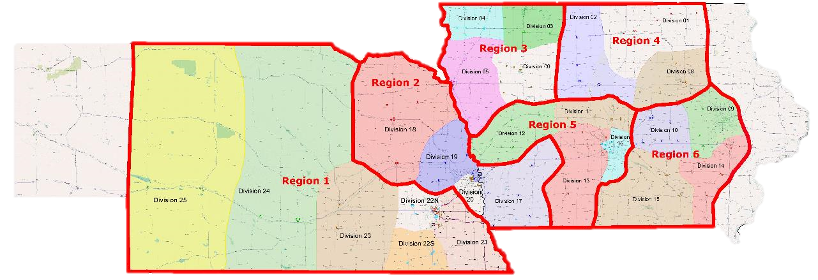
Nebraska-Iowa District Board
District Officers
Regional Trustees
R1 Keith Prettyman
R2 Linda Placzek
R3 Barb Hames
R4 Gary Lindgren (Rep.)
R5 Andy Webb
R6 Barrie Tritle
Notes:
In addition to the executive officers, there are six trustees on the district board. Each trustee represents a region.
The red boundary lines for the six regions will not be changing come Oct. 1. The color shaded divisions will be changing. Currently, there are 25 divisions and, although modified a few times over the years, have largely stayed unchanged since the early 1980s. The recommendation of a redivisioning committee was to move to 16 divisions and on a majority vote, the District Board in January made that official come Oct. 1. Decreasing membership numbers, dwindling volunteers for lt. governor and other changes in the past 40 years drove the decision to redivision.

Slide 12
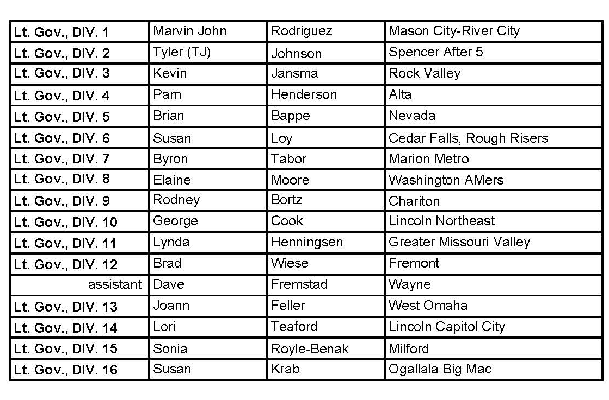
Oct. 1, 2025:
25 > 16 Divisions
Division Leadership
2025-2026 Lt. Governors
Notes:
These are the divisions and lt. governor leaders for coming Kiwanis year.
Move to next slide to see “new” divisions.

Slide 13
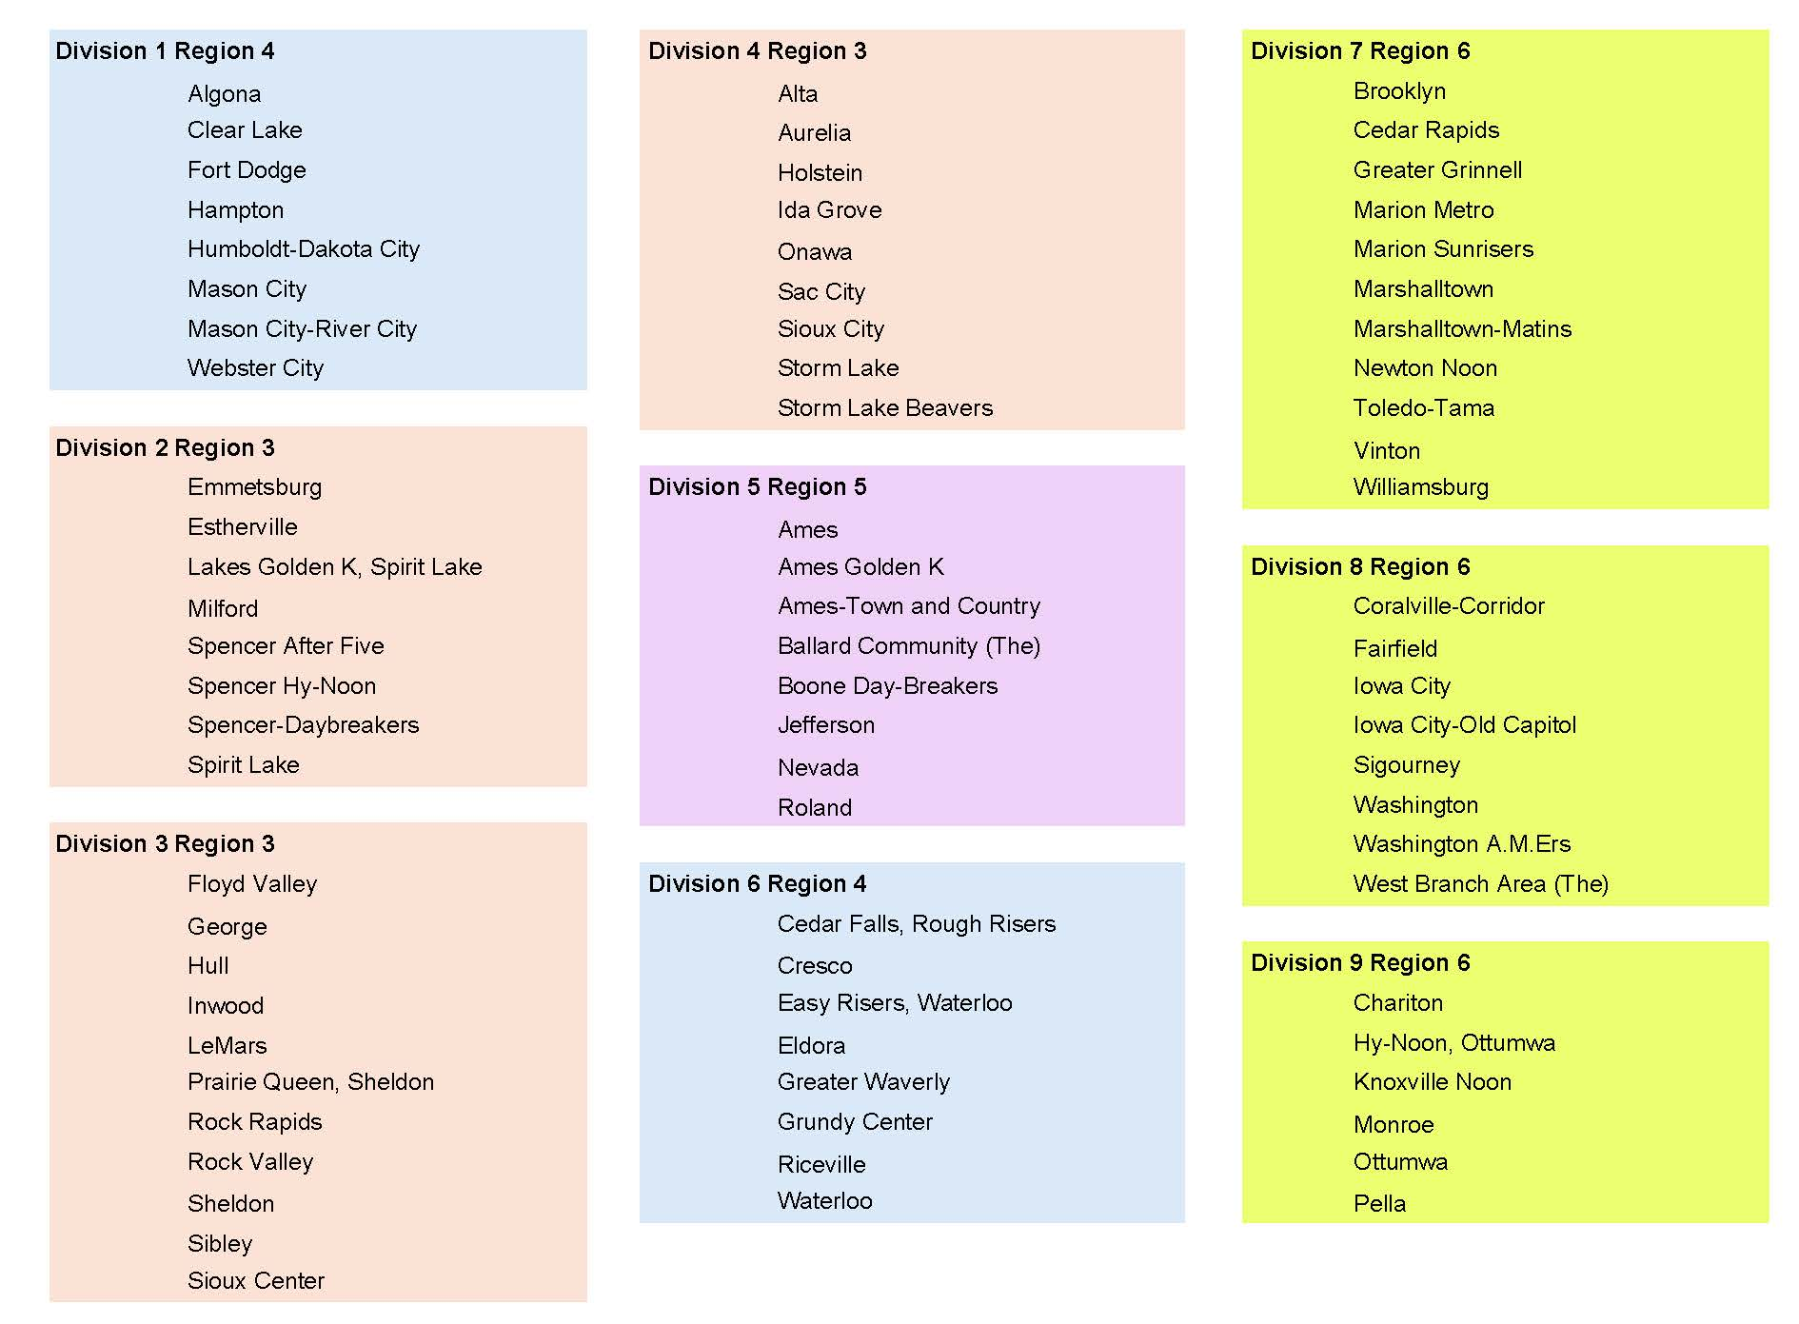
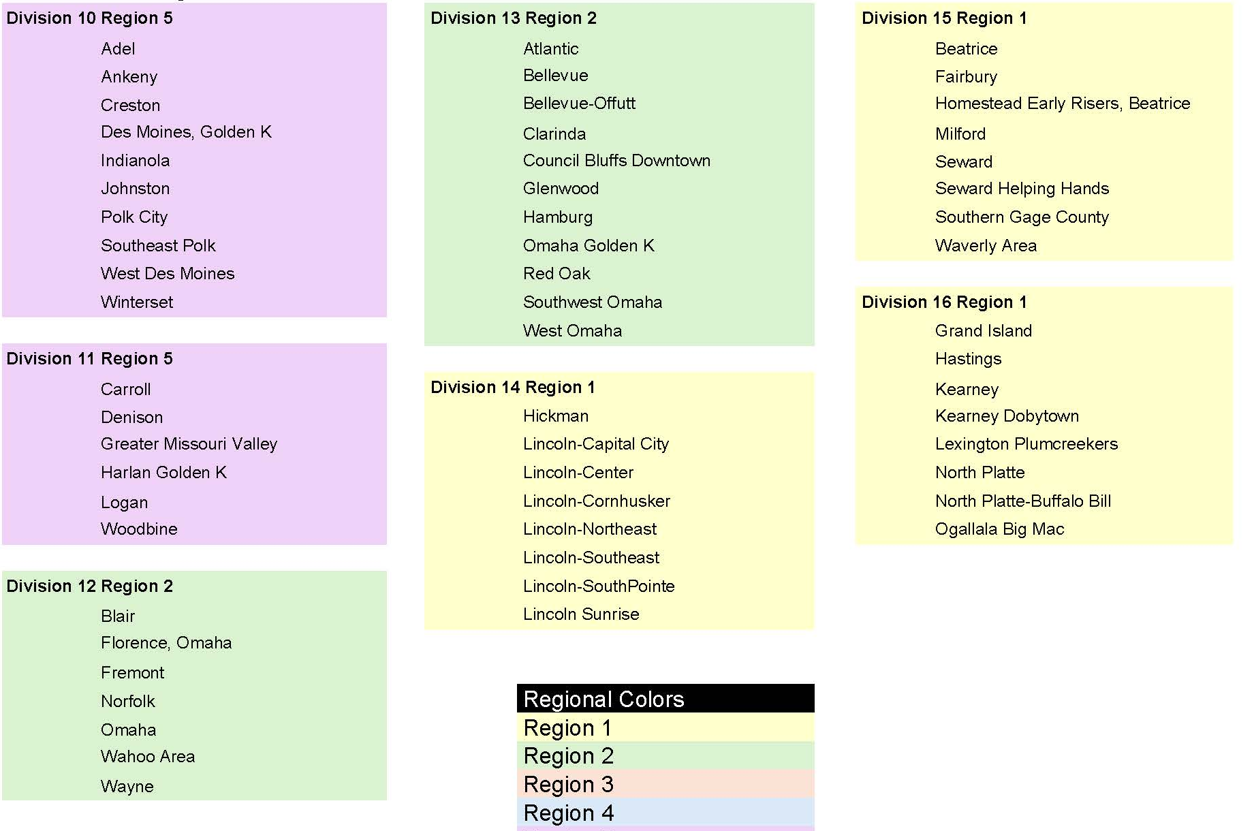
Divisions – Effective Oct. 1
PDF On Website
Notes:
Acknowledge this is small and hard to read on screen but this is a pdf on the front page of the District website.
A map will also be redrawn with the new divisions.

Slide 14
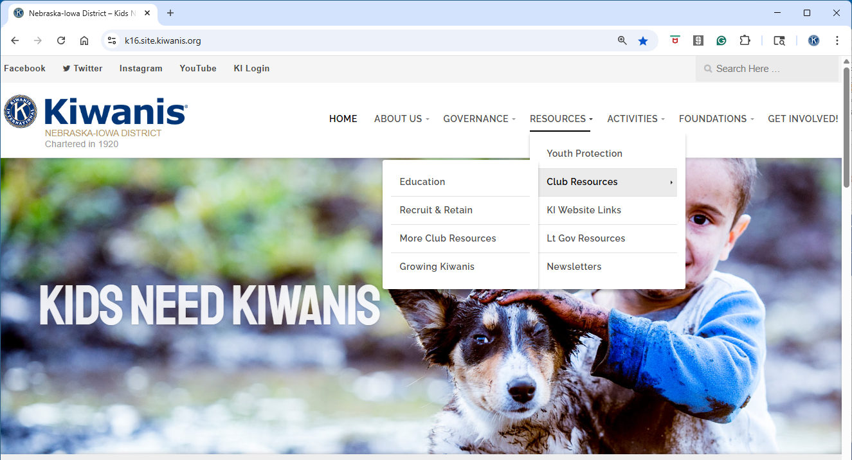
Website: k16.site.kiwanis.org/
Notes:
This is the address for district website.
PRESENTERS OFFER THIS BRIEF OVERVIEW: About us has a lot of info about the district, plus a listing of clubs. Find district board, trustee, lt. governor, bylaws and other governing-type info under governance. Tell them to heck out the activities and Foundation tabs for great information as well.
ALSO PLEASE POINT OUT that there are multiple pages on the website for clubs to get a variety of resources.

Slide 15



Other Online Connections
Facebook Group:
NE-IA Kiwanis District
Instagram:
neiakiwanis
YouTube:
Nebraska-Iowa Kiwanis District Video
Notes:
These are all ways that members can stay connected to the district, other clubs and other members.
There are some educational videos on our YouTube channel that would also work out for a club meeting, should a last minute need or program cancellation happen.

Slide 16


Communication
Monthly District
Newsletter
Clubs can submit news
by 1st of month to
Nikiwanisdistrict@gmail.com
Notes:
The Kiwanian comes out once a month, usually first full week of the month, and is for district and international announcements.
News From Around the District is the newsletter for clubs to share their successes, announcements and great things going on. With the exception of a couple months, this will come out in conjunction with The Kiwanian.
Both of these newsletters go to every Kiwanian in the district who continues to subscribe to emails.

Slide 17

Club Officer Buzz
Notes:
“Club Officer Buzz is YOUR newsletter” This goes to club officers and is emailed periodically. There are usually three or four important items that club officers need to be aware of that are grouped into this newsletter.

Slide 18

Not Getting District Emails?
Possible reasons…
Check spam, junk or promotion folders
Update your contact information with KI
Did you accidently unsubscribe from Constant Contact? Contact district office
Primary Communication
Through Email So
Stay In The Know!
Notes:
Email is the primary means for the District to communicate with all members. We do hear that members are not getting district emails, and there may be a couple of reasons for that. Constant Contact sometimes is flagged by emails and it may drop into a spam folder, check there first. Or, a member may have accidently unsubscribed. Lisa can get you subscribed again, but you need to contact her in the district office to make that happen. Or, sometimes members have an outdated or incorrect email address listed with their KI records. Once updated, emails can flow again.

Slide 19


Chartered Aug. 8, 1970
Grant Requests
  March 1, June 1, Sept. 1 & Dec. 1
Don’t forget to budget annual club donation - $6 per member
Checks made out & mailed to Foundation
Notes:
The District Foundation is a very important organization. It is a separate organization from the Nebraska-Iowa District, but we work hand in hand together when it comes to serving our communities and clubs.
The foundation turns donations into grants to clubs throughout the district. Many communities have benefited from the service project aided by Foundation grants. There are four grant cycles each year. And each year, clubs are asked to budget a donation to the foundation to ensure they can continue with their mission.

Slide 20
Dates of Note

Slide 21

District
Conventions
2026 Convention
Aug. 7 & 8, 2026
Mid America Center
Council Bluffs, Iowa
Notes:
Registration for this year’s district convention is being accepted through July 25 so there is still time to get signed up. We have great education sessions, special guest speakers, two service projects and plenty of fellowship and fun.
And, mark your calendars for next year’s convention. We are going to “rock” the Mid America Cener in Council Bluffs Aug. 7 and 8, 2026.

Slide 22
International
Conventions
2025 – Pittsburgh, PA June 25-28
2026 – Manilla, Philippines June 25-27
Notes:
Pittsburgh was an awesome convention. There were about 1,400 Kiwanians from around the globe in attendance. More than 30 Nebraska-Iowa Kiwanians made the trip.
The excitement is building for 2026. This will truly by an international convention as we can travel to the Philippines.

Slide 23
More Dates
2026 Leadership Retreat
March 14, 2026
  Lake Wanahoo Education Building
  Wahoo, Nebraska
Club Leadership chats
October – A new year begins
November – TBD
January – Presidents
February – Treasurers
March – Secretaries
April – Of interest to general membership
Notes:
Here are some additional items to put on your calendar for next Kiwanis year.
The Leadership Retreat will again be open to all Nebraska-Iowa Kiwanians. Seating will be limited to about 85 so watch for those details coming out in January.
Club Leadership Chats are an extension of CLE and are open to all members. CLCs are signature sessions of the Nebraska-Iowa District and are offer updates and new information from both the district and international levels.

Slide 24
Kiwanis 202
A Few Quick Items

Slide 25





Kiwanis Family – Service Leadership Programs
Notes:
Ok, so our five SLPS are Kiwanis 101. But, our SLPs are what make our organization unique.
K-Kids – elementary; Builders Club – middle school; Key Club – high school; CKI- college; and Aktion Club – adults with disabilities

Slide 26
Traditions and Protocol For Special Guests
- International officer or board member
- District officer, trustee or lt. governor
- Distinguished Kiwanian or other speaker
Club officer or meeting host: greet special guest & assist with meeting/event orientation
Club president or other officer: introduce during meeting/event & offer opportunity to say a few words
Club members: rise and applaud in respect when visitor introduced
Notes:
With the rise in virtual meetings and activities, we sometimes forget the protocol when we have an in person meeting or activity and have special guests present.
It is important to recognize our special guests, make them feel important and give them an opportunity to share. These are just a few protocol tips

Slide 27








Kiwanis Branding
Notes:
THIS SLIDE IS AMINATED AND WILL TAKE SEVERAL CLICKS TO GET THROUGH
First, second and third click: These are the current Kiwanis logos. This is the branding we should be using.
Fourth click: Gives the “yes” use these
fifth click: Shows the old bird cage logo and the squeezed image; Fourth click: Do Not use these

Slide 28
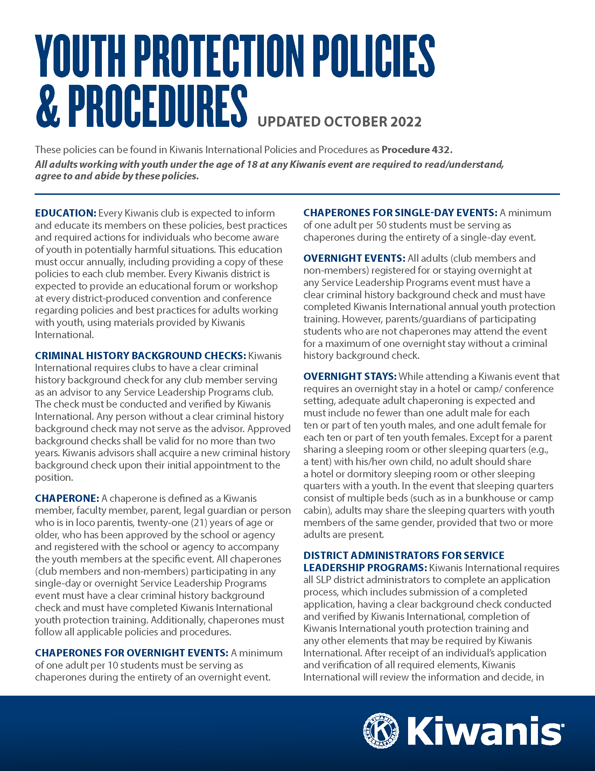
Youth Protection
District Youth Protection Manager
Linda Placzek
All members need to receive training annually
Information & training slides available on District & KI websites
Notes:
You have hopefully herd this before, and you are going to hear it again. Every club needs to provide Youth Protection training to members every year, preferably in October or November. There are resources on both district and KI websites to guide you through the training. At minimum, every member needs to get a copy of the Youth Protection Guideliens every year.

Slide 29
Kiwanis Engage (formerly Kiwanis Connect)
Available to all Kiwanis members
Officer portal for reports, member management & more – more officer access
Member info: contact information, profession, leadership roles, background check, club information, sponsored members & more
Engage available for training now
Engage live: July 15
Learning Resource Webpage
www.kiwanis.org/members/kiwanis-engage/kiwanis-learning-resources/
Notes:
Kiwanis Connect is disables and Kiwanis Engage starts July 15. ALL MEMBERS CAN USE ENGAGE AND ARE ENCOURGED TO DO SO.
There will be more on this offered in individual officer training MESSAGE TO EVRYONE: ALL MEMBERS HAVE ACCESS

Slide 30
Club Membership Plans
Make it a board activity
Make it a club activity
Separate, simplified form that gets submitted!
Notes:
The 8-page Membership Workbook was new this year, and it will be back in 2025-2026. Every club will be asked to review their membership plan – or create it if you didn’t get it done this year – and submit their goals for 2025-2026. The district saw less than half of its clubs report this year, and we want to increase participation this coming year. This really is a good tool to help strengthen and grow your club.

Slide 31
Report to breakout room
Thank you
For Helping
To Make
KIWANIS
ROCK!!!
Dismiss following individual officer training
https://k16.site.kiwanis.org/2025-cle-handouts/

