Slide 1
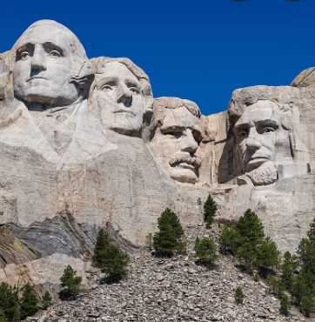
President’s Roundtable
Krista Latchaw
Capital District Education Coordinator

Slide 2
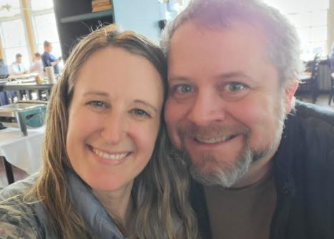
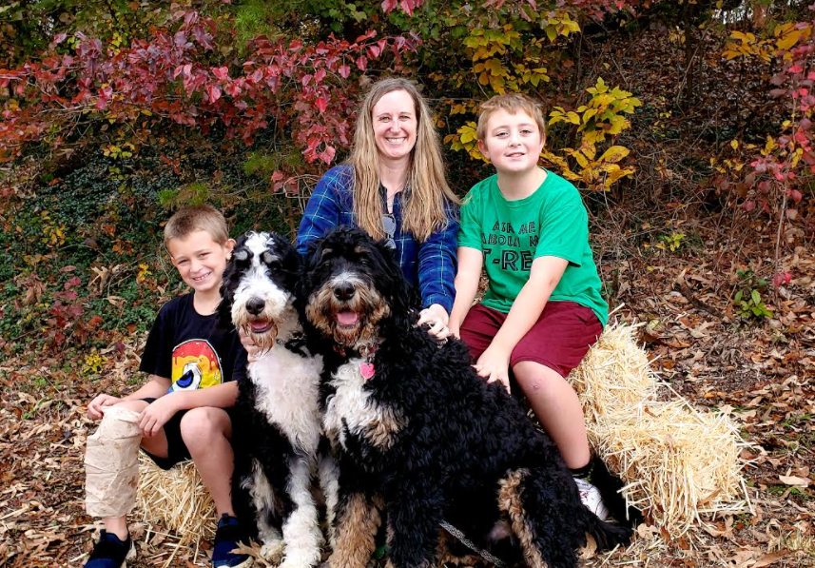
Who’s that Girl?

Slide 3
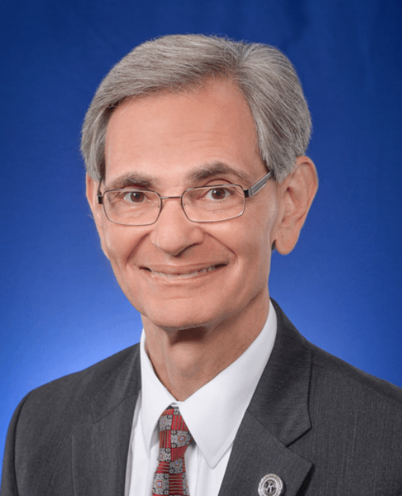
Warning
You get out what you put in
This only works if you SHARE
Speak up –
We’re all friends here

Slide 4
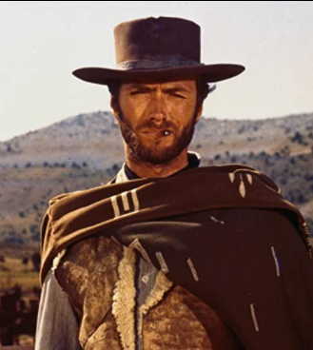
AGENDA
Introductions
The Good – What’s working Well
The Bad – What’s not Working as Well as you Thought
The…..Advice You Need
Feedback to the District
Questions

Slide 5
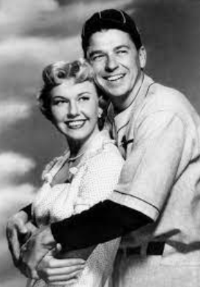
Introductions
Name
Club
What you’re watching now or – favorite movie

Slide 6
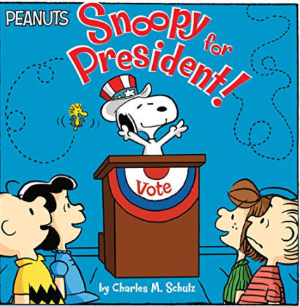
The Good – What’s Working Well?
Communications
Membership
Meetings
Service Projects
Lt. Governor Visits
Education
Enthusiasm
Your Team

Slide 7
What Could be Going Better?
Commun-Ications
Membership
Meetings
Service Projects
Lt. Governor Visits
Education
Enthusiasm

Slide 8
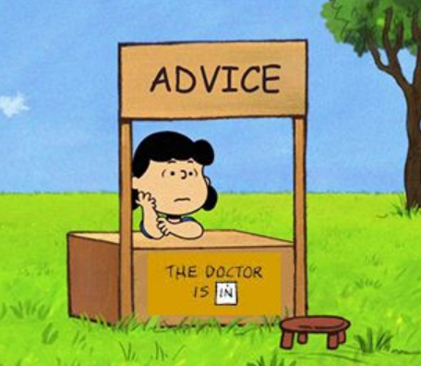
The Advice You Needed What would you tell your younger self? The Advice You Need What do you need to finish out your term?

Slide 9
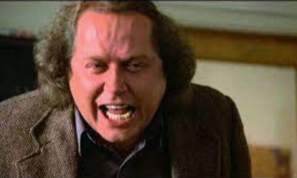
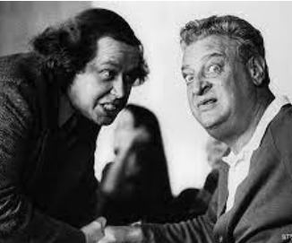
Feedback to the District
What do you want to say?
Say it!

Slide 10
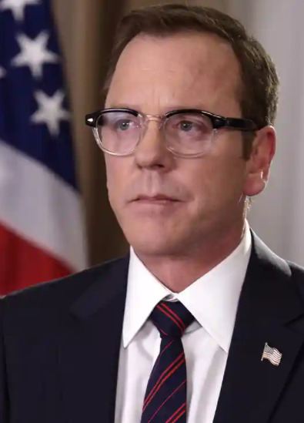
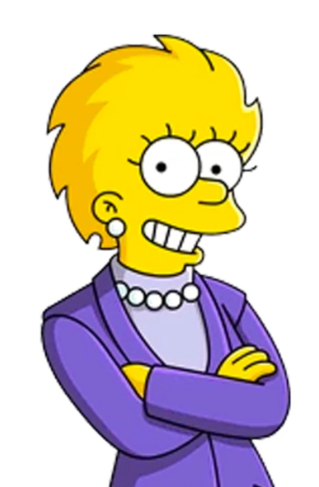
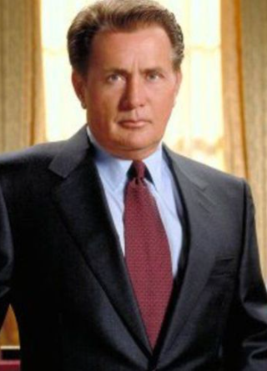
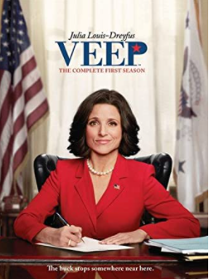
Take-aways What did we learn today?

Slide 11
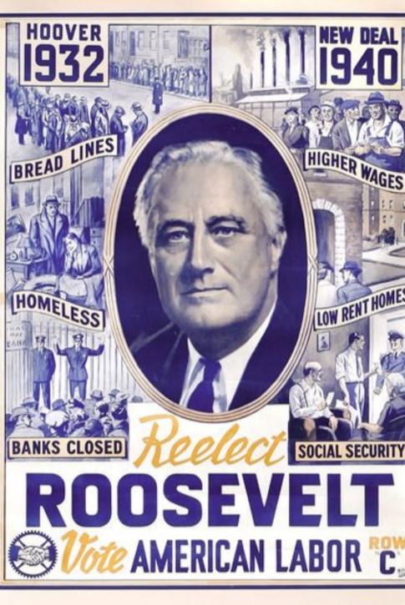
Questions?
Thank You Presidents
We owe you a great debt for your service
KristaLatchaw@gmail.com

