Slide 1
Notes:
5, 10,15 years ago I could not have imagined I’d be standing here today. However, my life’s journey has brought us together and I’m very glad it has!
I’m Susan Knick, LTG-Designate for Division 9, Immediate past president of the KC of the Jackson River Area, and Division 9’s representative to the Heart of Virginia Membership Committee.
For those wishing to know of my credentials to lead this discussion: I hold a Master of Human Relations with a concentration in Organizational Psychology from The University of Oklahoma; Master of Education with a concentration in Adult Learning from Boston University and a Bachelor of Arts in Political Science from Rivier University. I am retired from the U.S. Army as well as from the University of Mary Washington in Fredericksburg VA where I worked in the President’s Office handling major University events.

Slide 2
Thank You to our
Education Sponsor

Slide 3
OUN
ENT
ANN
S!
CEM
Notes:
So, how are we going to tackle the subject of club energy in less than 1 hour?
I have the privilege of being a founding member of a relatively new Kiwanis club; in fact we’re celebrating our 2 year anniversary later this month. When I reflect back over the adventure so far I realize it’s energy that brought us together, has kept us together, and is moving us forward in a fairly successful manner.
We all know about energy: negative, explosive, positive.
And we all know of the group dynamic philosophy of forming/storming/norming/performing. It’s an okay philosophy but it doesn’t address the element of energy and energy is needed for any group to move through those 4 stages.
So, let’s look at why energy is important for us and our clubs and how we can keep that energy level building and high.
There is no right/wrong approach; what I offer is what has worked for me and my club.
In preparing for today, I came down to 3 basic questions which I will address as we move forward:
What is energy?
How do we have fun while discussing this subject? And
What is the one take away I hope you’ll remember?
So…..

Slide 4
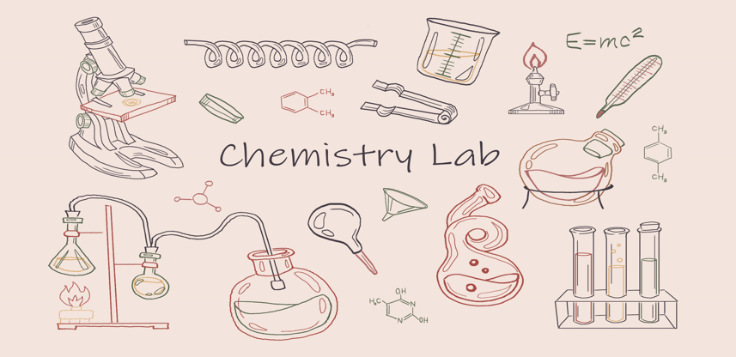
OUN
ENT
ANN
S!
CEM
Notes:
What is energy? The science of physics defines energy as: THE ABILITY TO DO WORK! Energy is how things change and move!

Slide 5
U
R
E
K
A
!
OUN
ENT
S!
CEM
Notes:
EUREKA! Energy is us!
And, as I came upon this eureka moment I realized that the energy of the club is very similar to the energy displayed by other teams be they athletic or workplace teams.
TAKE a look

Slide 6
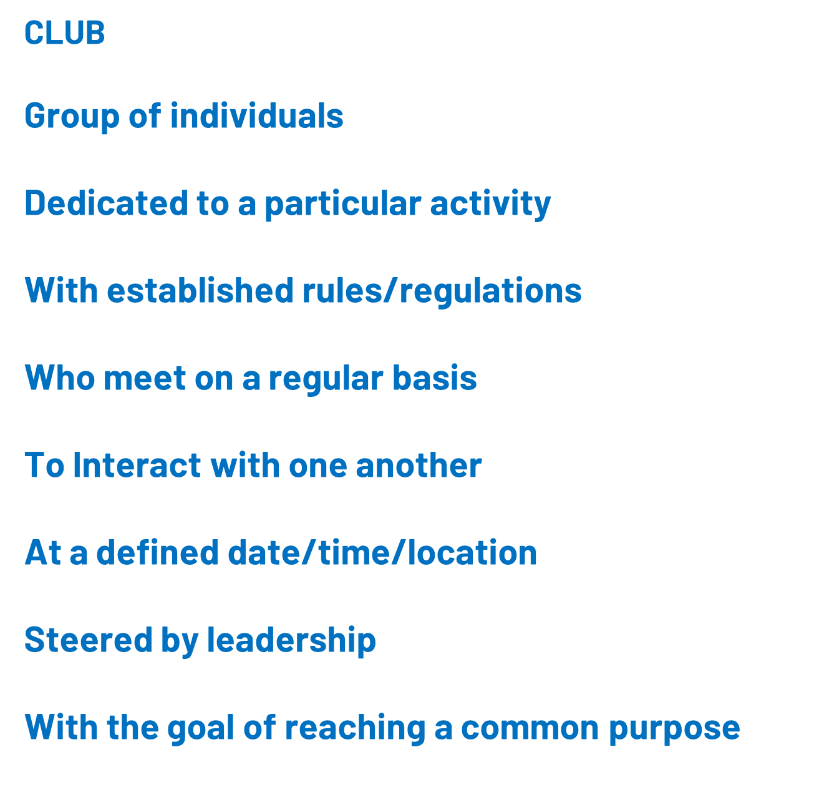
Similarities of Clubs and Teams
Notes:
So, you will hear me use the words club and team interchangeably today but let’s try to have fun with all this and think of our clubs as teams.
Remember I wondered how we will tackle the subject of energy in less than an hour?
Well, we’re not going to be just any old teams….

Slide 7
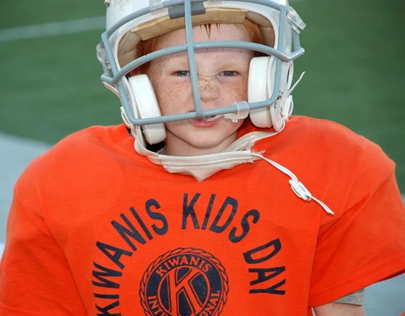
Notes:
We’re going to be Kiwanis FOOTBALL teams!
PLAY music (29 seconds)

Slide 8
Notes:
That’s right! It’s GAME TIME
Everyone stand up along the perimeter of the room
Divide into teams by color of the chosen envelope (allow time for everyone to reseat)
Now, 1 of the important parts of being a team member is identity/swag. Look around – most of us have on apparel identifying us as a member of Kiwanis. If everyone will open their envelope and take out the wristbands you will find you now have team colors by which to identify your team! You may place them on your wrists, pens, desktop, etc.
Game rules:
Inside your envelopes will find sheets with business logos
These logos have hidden meanings/pictures that subconsciously reinforce the corporate brand
Everyone has exactly the same sheets
When I give you the signal to begin, it is your teams goal to identify as many of the hidden meanings as your team can in 5 minutes
As you identify each logo’s hidden meaning, let out a cheer at your table to let the other teams know you just kicked a field goal
At the end of our 5 minutes, we’ll review the hidden meanings and the team with the most correctly identified logos will be crowned our logo mvps

Slide 9
Guild of Food Writers
Notes:
Here’s an example – Guild of Food Writers
Everyone understand?
Ok, begin

Slide 10
Notes:
Review logos
Name MVP team
What did you experience?
Esprit de Corps Frustration
Drive Boredom
Action Pep
Fun Energy
What did we do?
Membership - Shared swag
Communication – explained, example, clarifying questions
Shared goal/vision
Working among an eclectic group
Motivation
Celebrated success; Recognition of individuals (winners) as well as the entire group
ENERGY!

Slide 11
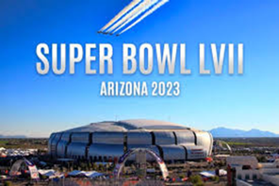
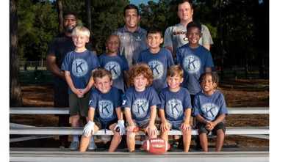
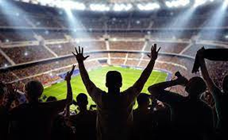
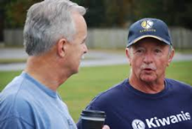
Notes:
Back to our football analogy
The Super Bowl just ended a few weeks back. Think of the experiences you were a part of whether watching on tv at home, while at a super bowl party, or even attending in person.
Think of the energy involved in the Super Bowl: fans, cheerleaders, players, coaches – everyone on the team had a very specific role and all those roles came together onto that 1 playing field with enthusiasm and a crescendo of energy. AWESOME
Fans – these are our potential members as well as our communities and beneficiaries.
Players – each of US! The players/members who are doing the work, moving the action, energizing our clubs toward common goals
Cheerleaders – keep energy level high; pick us up when it wanes. Great marketers and media relations
Coaches – our formal and informal leadership
Invested in the success of each individual on the team
Educate, train, & develop those around them
Share the big picture; set the goals
There were the fans, players, coaches, referees and cheerleaders
Each of these groups had a role as part of each overall team. Just like our clubs – everyone has an important role which keeps our team energized and moving forward.
So, let’s take our Kiwanis Football team to the Energy Building Super Bowl

Slide 12
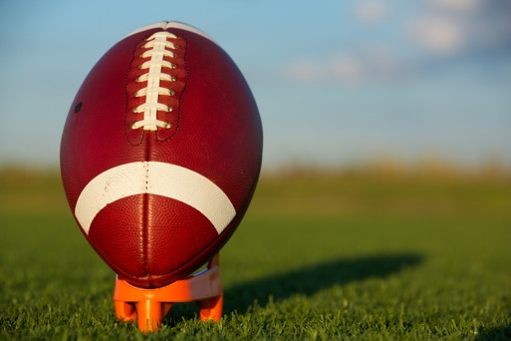
Notes:
We’re ready for the kick off.
In football there is a kick off that starts the game (chartering a new club), at the start of the 2nd half, the start of OT, and after each goal (service projects and fundraisers).
Now, think of the kicker (president) surrounded left & right by his team. As the kicker moves forward, the team moves with him building energy to the kick (fundraiser, service project) and, after the kick continue moving down the field (we can think of this a moving on to the next fundraiser/service project)

Slide 13
Notes:
The ball is in play… how do all the pieces of our team come together to build energy collectively rather than randomly going their own way?
Play books – KI even has one on the website, mission statements, meetings: COMMUNICATION.
And not just communication but a very special discipline of communication known as ACTIVE COMMUNICATION. You may already practice this but if not it is something that can be learned and used.

Slide 14
Notes:
My experience is that to create, build, sustain or re-invigorate club energy we must engage and be grounded in ACTIVE Communication: verbal, listen, hear, OBSERVE AND FEEL.
Eric’s quote: 2 eyes, 2 ears, 1 mouth
Much like our football coach I believe we should strive to be member-centric, prioritizing our members’ experience to the greatest extent possible.
The process of building & developing a high performing team never happens by accident.
AND, neither does excitement (also known as energy)!
The best teams are dynamic with members seeking to understand each other more fully, contribute more effectively and function in a more productive way both individually and as part of the team.
THIS CAN BE EXHAUSTING work at times. Build a support team around yourself. Pass off to another coach when you need to; have a confidant or team of confidants you can go to when your energy wans; find mentors.

Slide 15
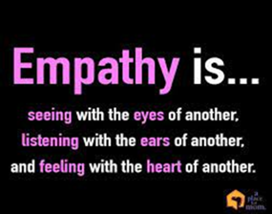
Notes:
In practicing active communication we strive to
Get to know your members – their personalities and their communication style; personalize communications and ensure you send that communication to right people at the right time in their member journey.
I often send private messages/emails to individual members or a small group of members: may be encouraging words, check in on how a project is going or a simple thinking of you today message.
Think how you feel when you receive a special acknowledgement: energized, proud, want to do more, etc.
Doing this leads to members who are actively engaged with and want to work with our clubs. They have been energized!
Encourage creativity – members feel they are making a difference in the club and have ownership in the club’s goals
Ask for feedback – and act on it
Celebrate special occasions and milestones; not just the big ones but the little ones as well. Happy $s
Do not underestimate the energizing connectedness of in-person interactions; try to offer in person meetings whenever possible
Learn from your members as each one brings something new & unique
Be empathetic - ability to sense other people's emotions, coupled with the ability to imagine what someone else might be thinking or feeling.
Shift strategies when needed. Don’t be so ingrained in the ‘we’ve always done it that way’ philosophy that you miss opportunities to try something new.
Be a role model
ALWAYS take time to say thank you. Members will know their work is making a difference

Slide 16
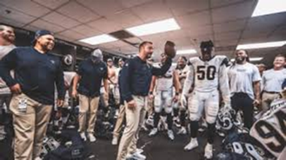
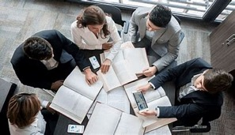
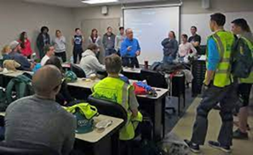
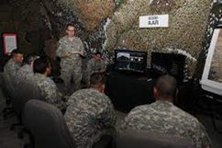
Notes:
After each meeting, service project or fundraiser, take time to reflect. Hot wash/post game recap/after action review/meeting no matter how successful the day was.
Show respect and recognition, take interest in what the individual is saying, give PLENTY of positive feedback (especially if event was less than successful), discuss/don’t argue, question

Slide 17
ENERGY
Notes:
Remember our 3 basic questions?
What is energy - It’s the ability to do work; how things change and move
Thanks to our football fun, we have discovered that the way to build and sustain energy in our club is through OUR active communication coupled with celebrating our members and our clubs achievements big and small.
(PASS OUT KEYS)

Slide 18
Today’s take away?
YOU
Notes:
Start music
Today’s big take away I hope you will remember is that YOU are the key to active communication which will sustain and build your club’s energy!
Thank you for coming today, for being such wonderful colleagues and for making my day very special.

