Slide 1
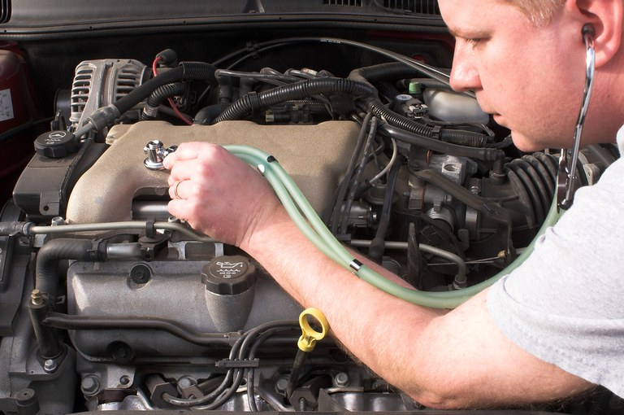

“How To Know If you Club Needs a Coach/Techniques”
Capital District Midyear Conference 2023
Dennis Baugh, PG
dennis.cdkypm@gmail.com

Slide 2

Thank you to our Education Session Sponsor

Slide 3

Why would our club need or want a Club Coach?

Slide 4
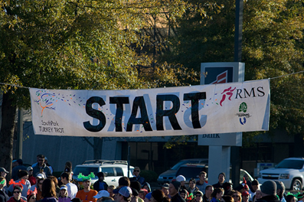

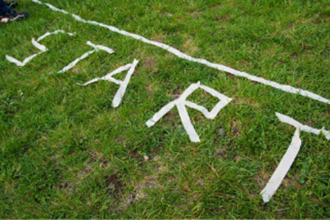
Start where you are…
“Your present circumstances don’t determine where you can go…..they merely determine where you START.” Nido Qubein

Slide 5


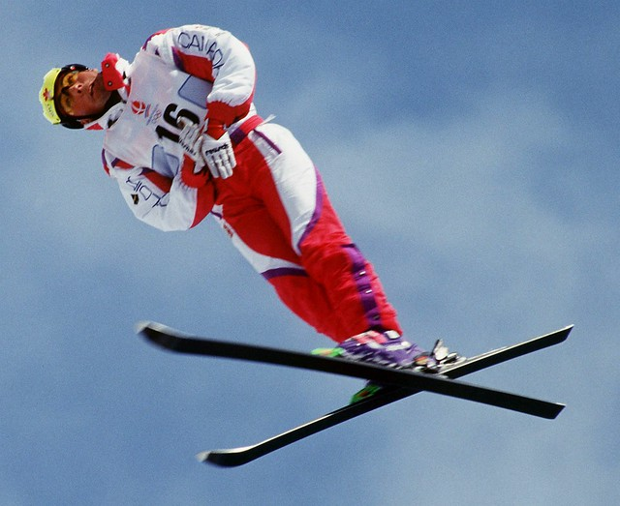
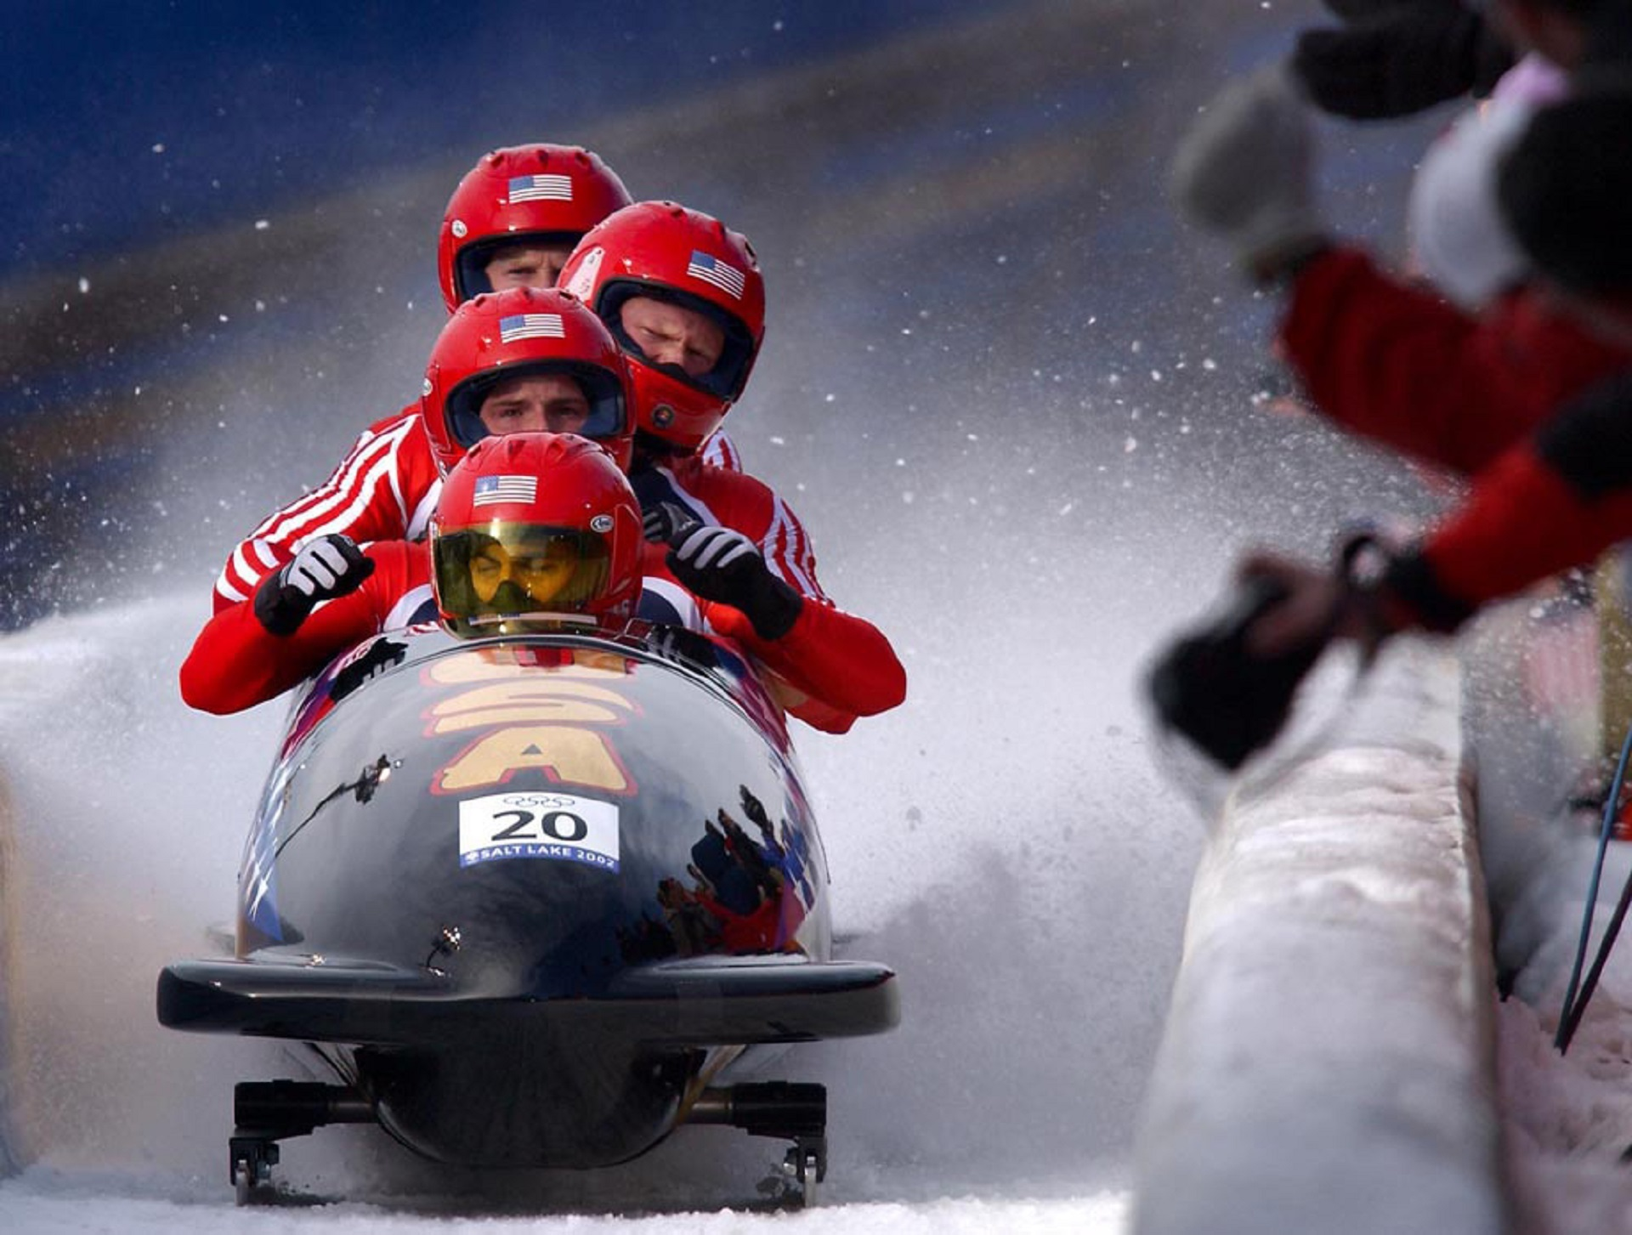
Think about the Olympics

Slide 6

My club is open for help...
Buy-in comes from:
The members
Identifying the gaps/challenges
Asking for help
Notes:
Whether it’s a newer club that can’t quite get off the ground or an established club that once enjoyed growth and excitement, its members must first figure out what’s wrong and why. Then they take the necessary steps toward club health.

Slide 7

What do coaches do?
A club coach will:
Monitor
Celebrate
Encourage growth
Notes:
As club coach, they will:
Monitor the club scorecard and encourage the club to celebrate success.
Encourage the club’s membership committee to invite new people on an ongoing basis and schedule annual membership drives.

Slide 8
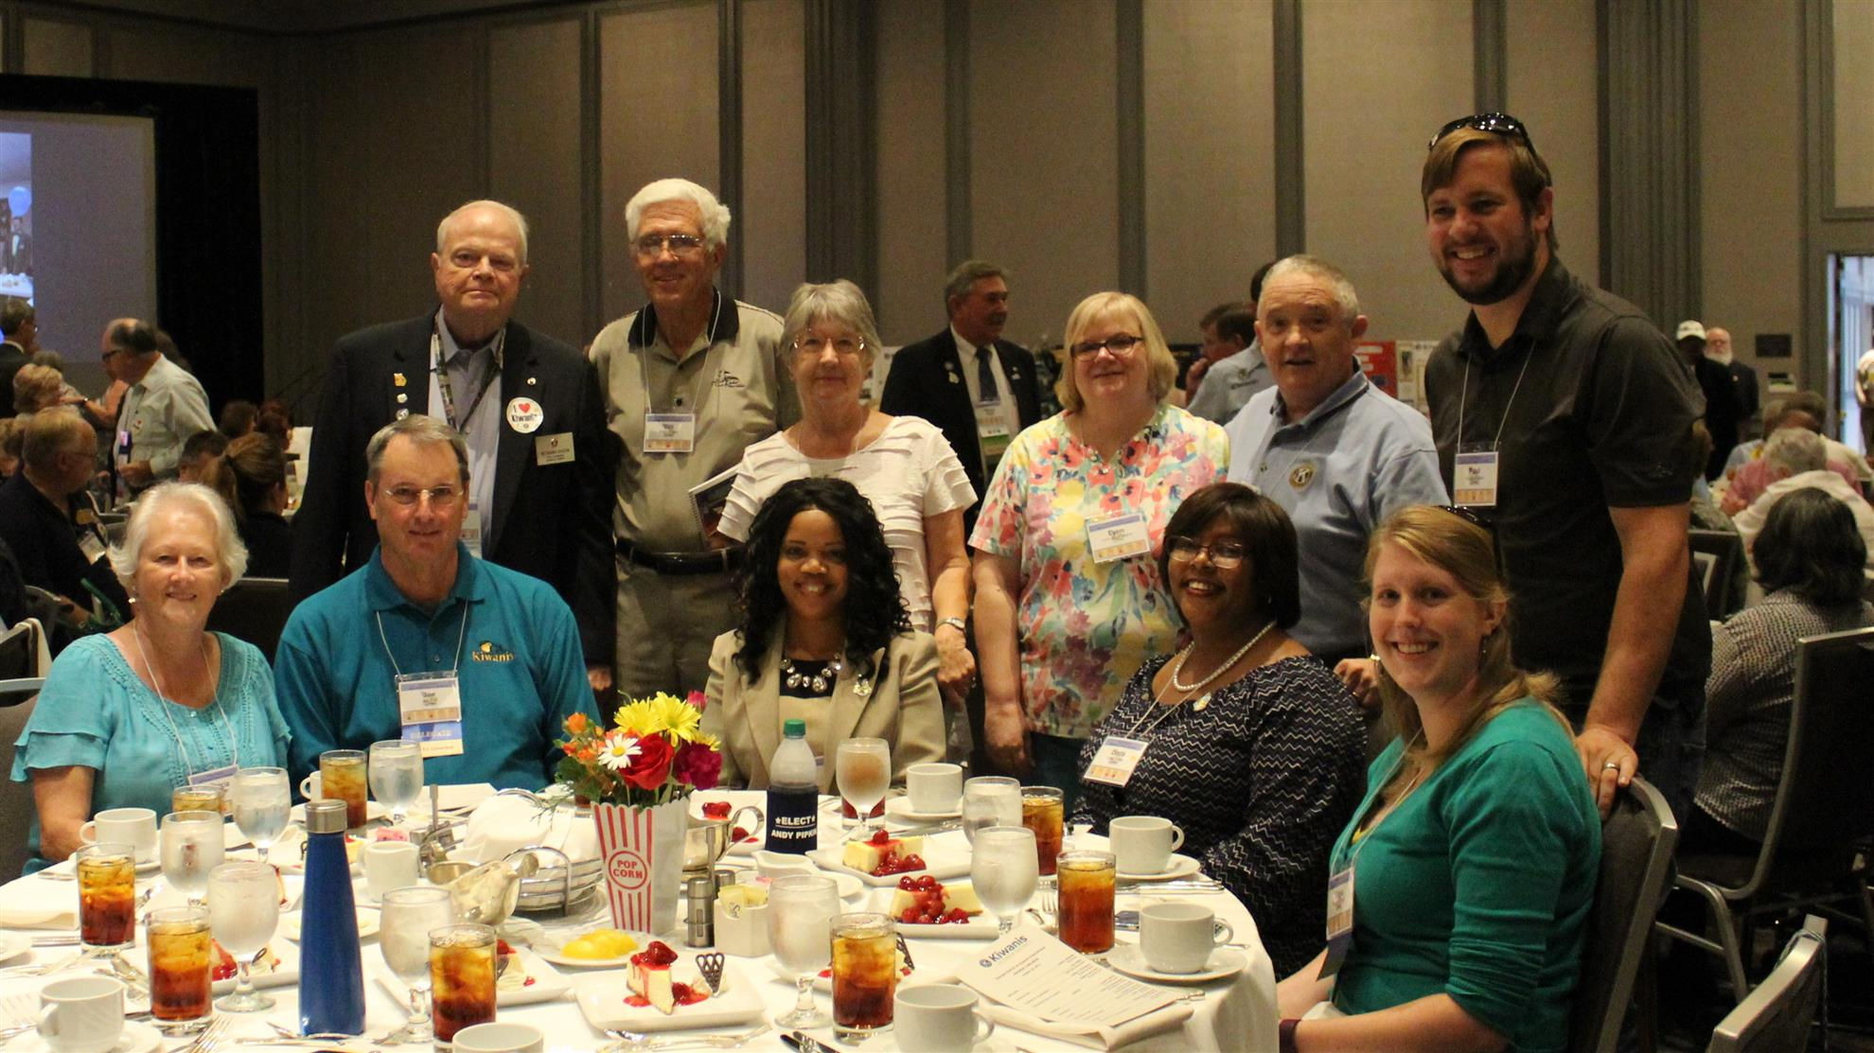
Support and Guidance
Look for:
Participation
  Club
  Division
  District
Key habits:
  effective?
  focused on the right stuff?
Notes:
Recommend participation in division, district and Kiwanis International activities and events.
NOTE TO PRESENTER: Put emphasis on attending events outside of their club!
Review key habits with the club — focusing on member satisfaction, community impact and continuous planning for club excellence.

Slide 9
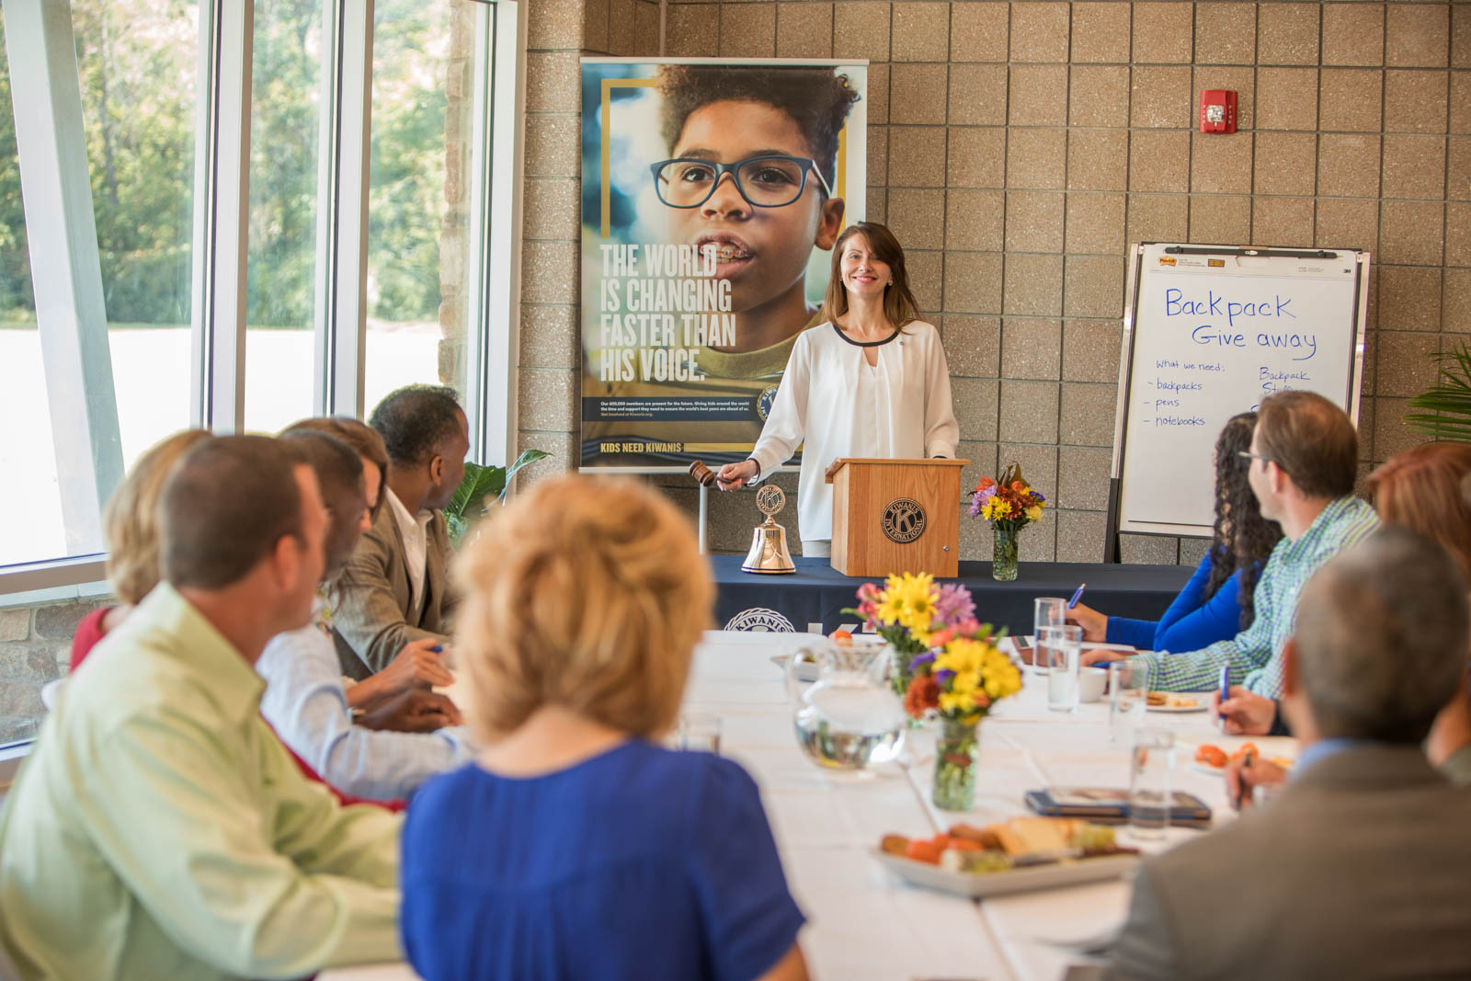
Support and Guidance
Officer transition & Club Leadership Education
Notes:
Monitor selection and transition of officers and directors, ensuring that incoming leaders partake in Club Leadership Education and prepare incoming officers and directors for the new administrative year.

Slide 10

The club’s cheerleader!!
A club coach is the club’s main supporter!
Notes:
You’ll be there to help celebrate successes and recognize member achievements.
Most of all, you’ll help members become self-sufficient — urging them to talk to each other, share observations and push each other forward.

Slide 11
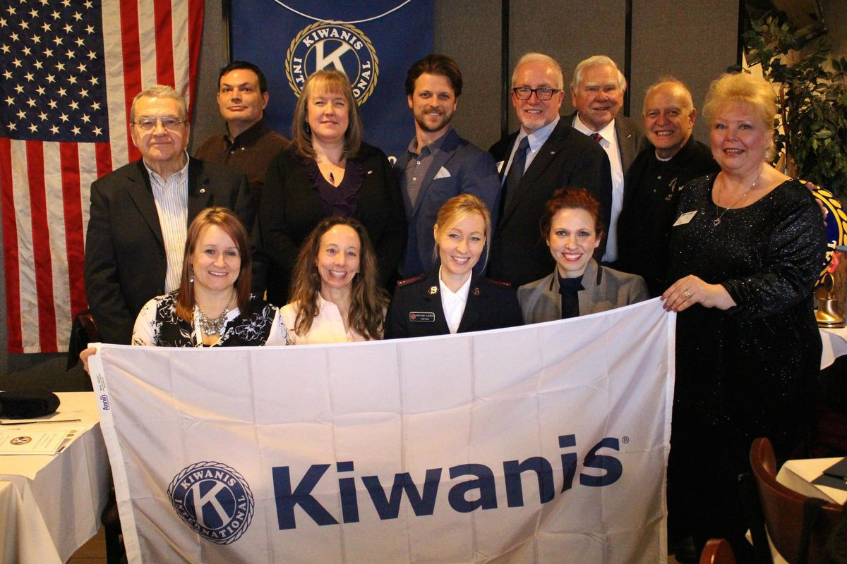
Measuring Success
Membership Growth And Retention
Develop a culture that encourages invitation and recruitment will help a club retain current members — and consistently add more.
Notes:
For a club under the 15-member chartering minimum, it means reaching charter strength or greater. After that, a culture that encourages invitation and recruitment will help a club retain current members — and consistently add more.

Slide 12

Measuring Success
Community Impact
Kiwanis-led projects
Hands-on service experience
New or strengthened partnerships
Requests for support
Recognition by others in the community.
Notes:
Kiwanis-led projects give members hands-on service experience. That leads to new or strengthened partnerships, requests for support from other community organizations and/or recognition by others in the community.

Slide 13

Measuring Success
Visibility
Community leaders and citizens are familiar with Kiwanis
People ASK about joining
Notes:
Visibility
When a club’s service succeeds, community leaders and citizens are familiar with Kiwanis — and people ask about joining.

Slide 14
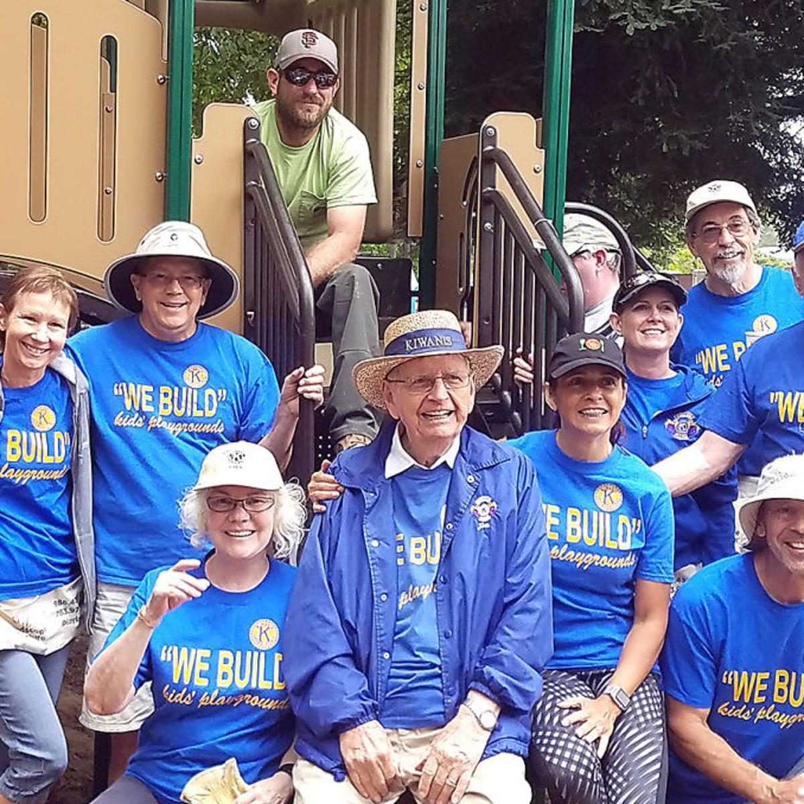
Measuring Success
Satisfied Members
When members are engaged, they participate widely in service projects, volunteer for committees, and attend meetings and other activities.
Notes:
When members are engaged, they participate widely in service projects, volunteer for committees, and attend meetings and other activities.

Slide 15
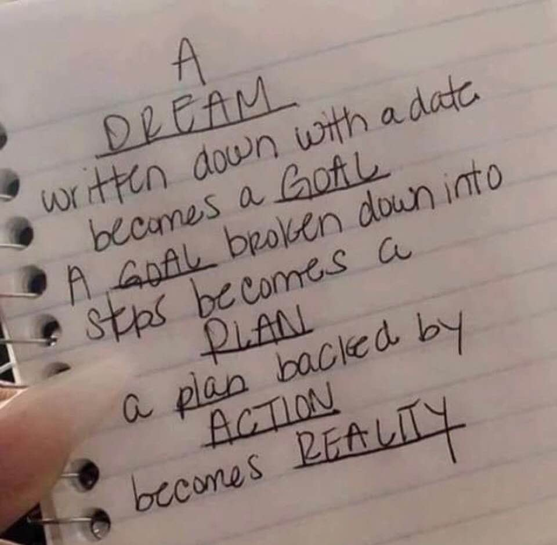
Achieving Club Excellence Tools – using these tools to bring club dreams to reality

Slide 16

Diagnosing The Possibilities
ACE
Notes:
For a club like that, it’s time to diagnose the club’s needs. Once again, our ACE tools are ready for you.

Slide 17
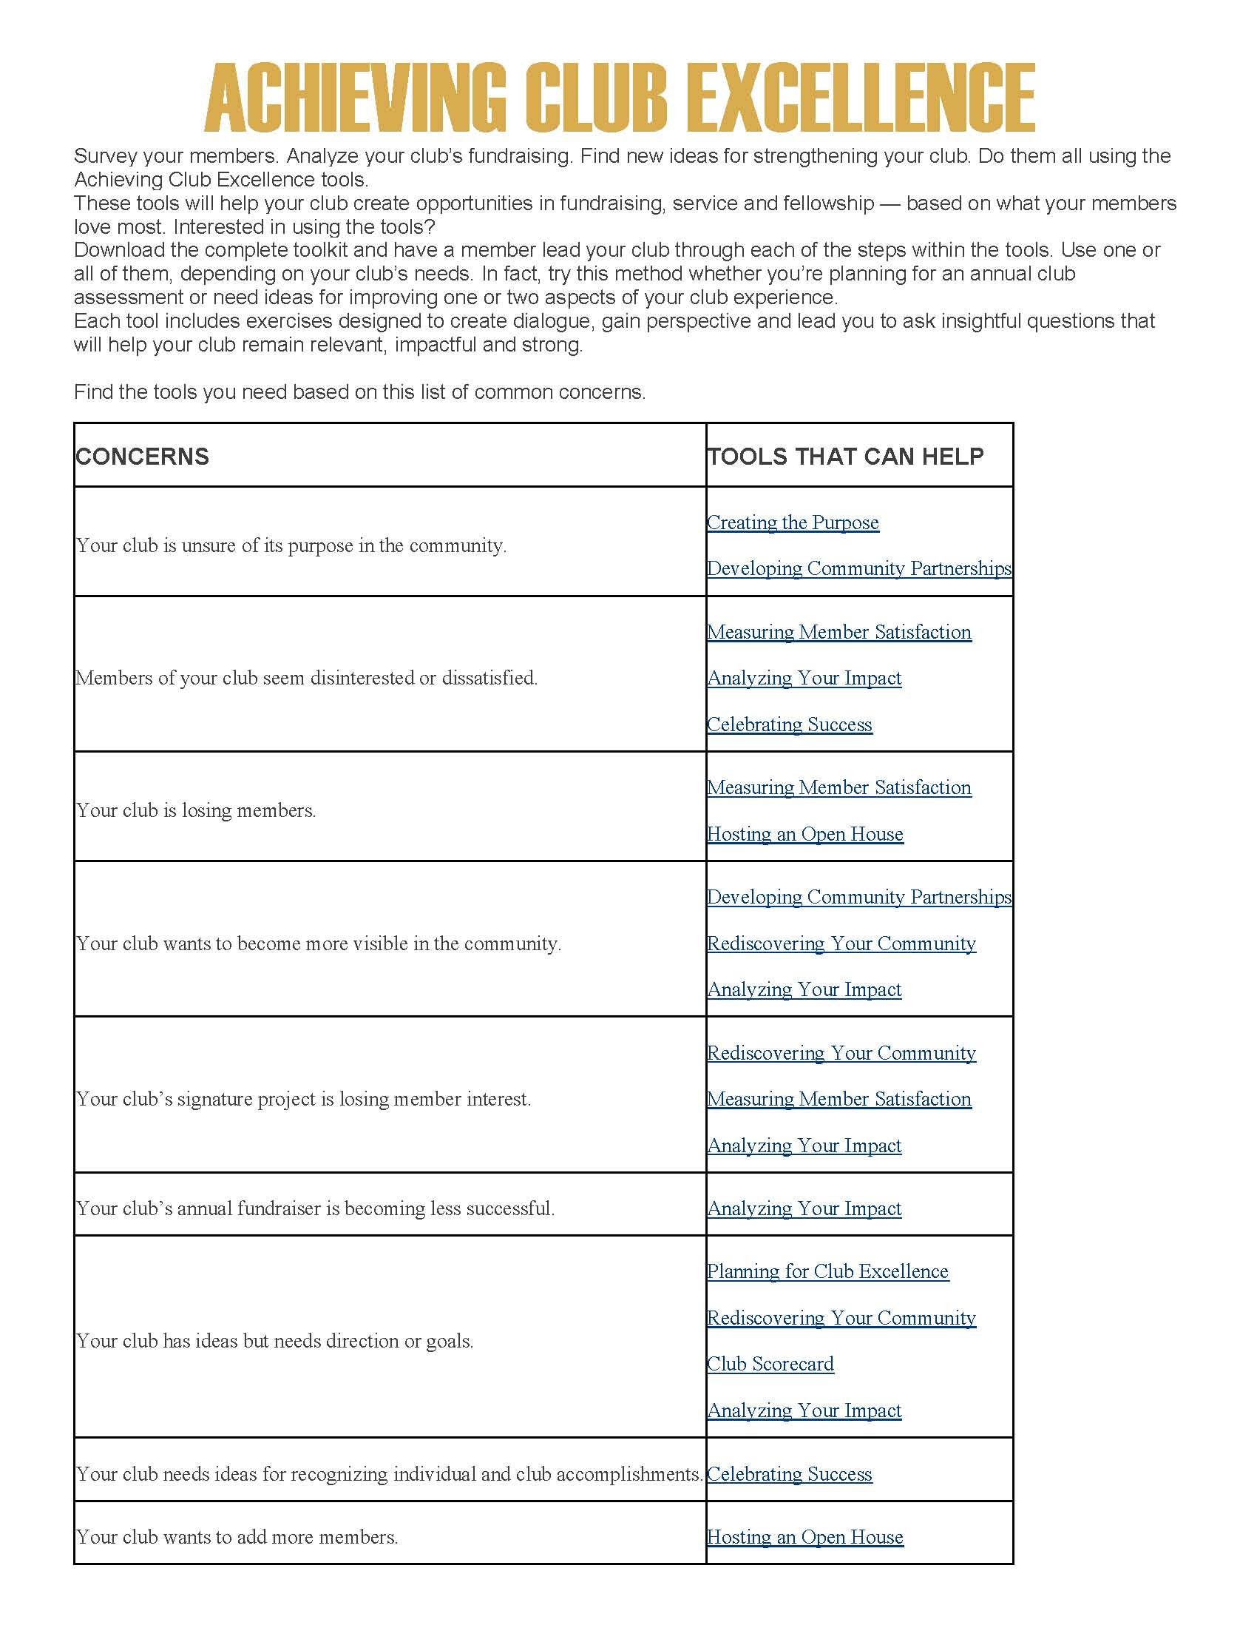
Achieving Club Excellence Tools – complete tool box available at the KI website
https://www.kiwanis.org/clubs/member-resources/training/division-leader/club-strengthening/achieving-club-excellence

Slide 18
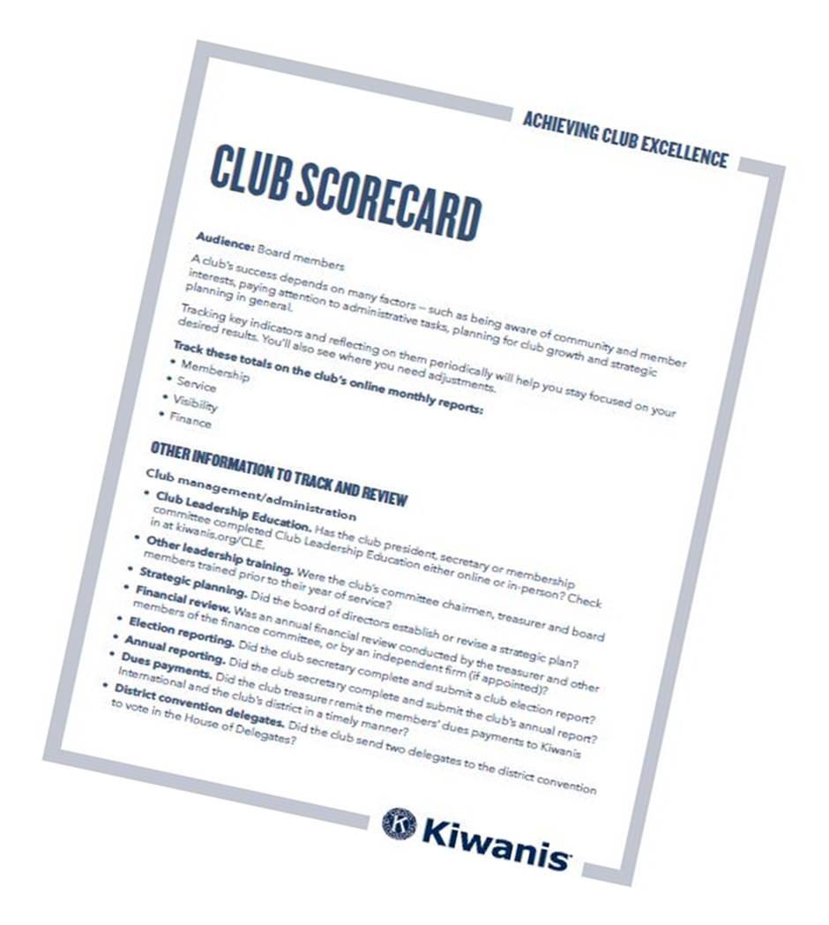
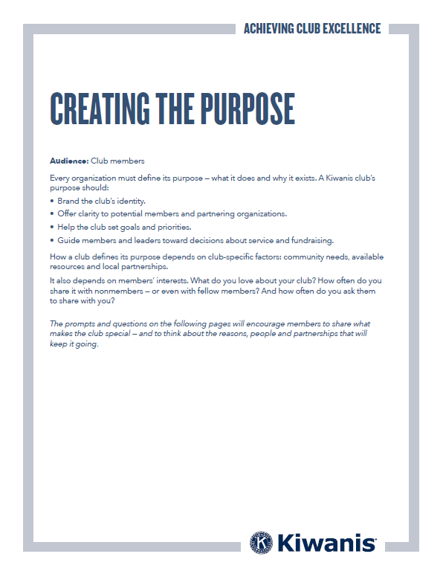
Where To Start
All ACE tools are available at https://www.kiwanis.org/clubs/member-resources/training/division-leader/club-strengthening/achieving-club-ex
Notes:
Then it’s time to assess the situation. At this stage, two of our Achieving Club Excellence (ACE) tools can be helpful:
If you’re connecting with members, use the “Creating the purpose” tool.
If you’re working with leaders, use the “Club scorecard” tool.
All ACE tools are available at https://www.kiwanis.org/clubs/member-resources/training/division-leader/club-strengthening/achieving-club-ex
Once you’ve completed an assessment and have an idea of the work that lies ahead, it’s time to determine the value club coaching might have for the club.

Slide 19

Diagnosing The Possibilities
Notes:
Club scorecard.
In the beginning, it can help club leaders (and yourself) understand the situation. But it’s useful for tracking progress throughout the process. Ultimately, it’s a way to start conversations with club leaders about where and how to improve

Slide 20


Diagnosing The Possibilities
Notes:
Creating the purpose.
Use it to start conversations about what inspires members to continue serving the community as Kiwanians. It will also help a club define its purpose in the community for members, donors, partners and potential members.

Slide 21

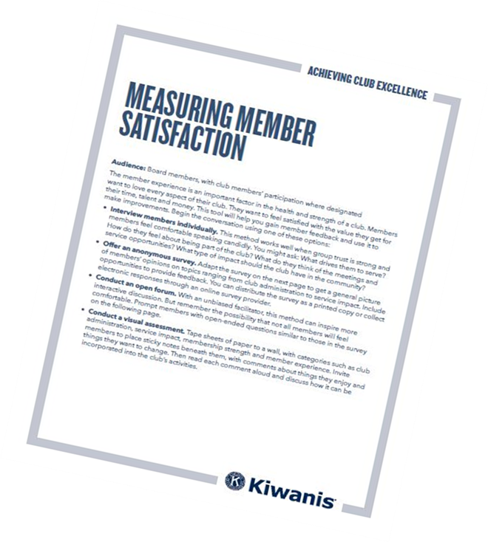
Diagnosing The Possibilities
Notes:
Measuring member satisfaction.
You can assess the club experience in four areas: club management/ administration, membership strength, community service impact and member experience. You’ll also show club leaders how to use member feedback to improve the club.
Rediscovering your community.
Gather information about community needs and how the club can help address them. You’ll assess a club’s current service activities and reveal potential opportunities for new partnerships, sponsorships and service projects.

Slide 22
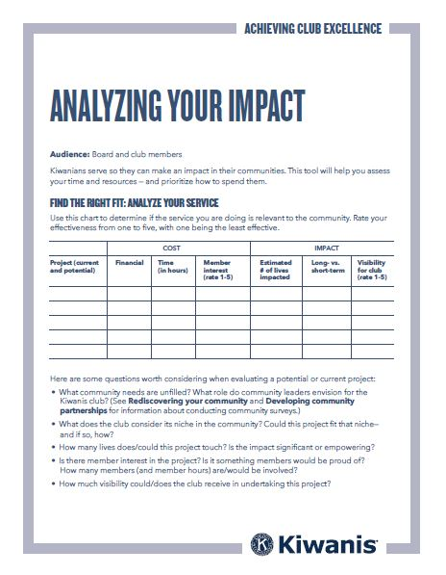

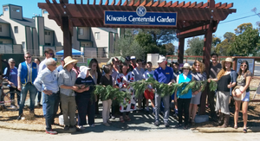
Diagnosing The Possibilities
Notes:
Analyzing your impact.
Help improve the impact a club makes in the community by assessing the success of a club’s service and fundraising activities.

Slide 23
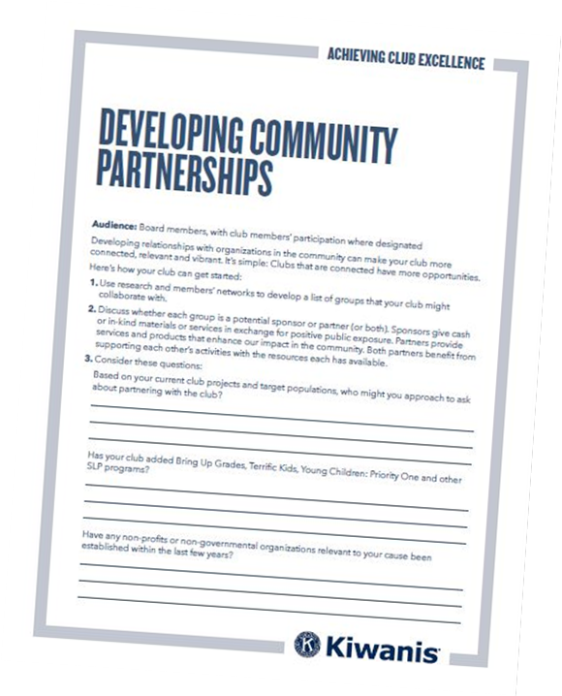

Expanding our Hands of Service
Notes:
Developing community partnerships.
Use it to help with exploring ways to increase the club’s partnerships and sponsorships.

Slide 24
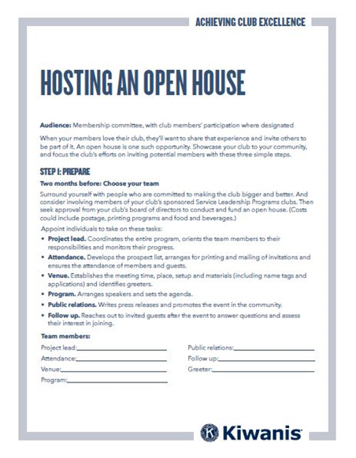

Sharing Service with others...
Notes:
Hosting an Open House!
Provide step-by-step guidance and strategies to increase membership, generate ideas about potential members and create a culture of ongoing inviting.

Slide 25

If we don’t ASK….
…most talented community members will work together, enjoy life, create momentum in changing the world..
BUT in some other organization!!

Slide 26
INVEST in your community and look for new members!!
Help them experience service!!
RESULT
We will get new members!
…and more service will be accomplished!!
The Positive Side….. +

Slide 27
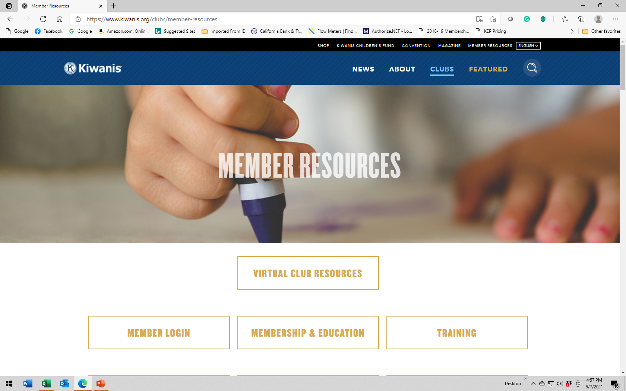
One additional Resource……the KI website!!
https://www.kiwanis.org/news/covid-19-kiwanis-suggestions/covid-19-RESOURCES

Slide 28
RUMOR vs. REALITY
RUMOR
Once we pick a time and date
for our meetings, we can never
change it.

Slide 29
THEN:
Reality:
As clubs grow, we encourage them to review their TRADITIONS – including the time and date they meet – to be sure they work for EVERYONE. Many clubs don’t meet once a month, sing songs, say a prayer or say the Pledge of Allegiance, yet they are strong clubs that give back to the community.

Slide 30
RUMOR vs. REALITY
RUMOR
Don’t waste your time visiting
other clubs, they’ve got nothing
to teach us.

Slide 31
THEN:
Reality:
Other clubs may be successful in areas where your club is struggling – so reach out and take advantage of their knowledge. We can all learn from one another.

Slide 32
RUMOR vs. REALITY
RUMOR
If you don't hold a traditional
Kiwanis meeting, you aren’t a
“real” Kiwanis club.

Slide 33
THEN:
Reality:
Each club reflects the members in it. You can borrow from old club traditions or create entirely new traditions unique to your club.

Slide 34
RUMOR vs. REALITY
RUMOR
You don’t need training to lead
in Kiwanis, you just need a
loud voice and commanding
attitude.

Slide 35
THEN:
Reality:
We can all improve how we lead as we take on a leadership role. That’s why Kiwanis has invested heavily in education and training. We encourage our leaders to take advantage of all that we have to offer.

Slide 36
RUMOR vs. REALITY
RUMOR
Clubs must do the same service
projects over and over, or they will
never become known for anything.

Slide 37
THEN:
Reality:
Service projects should reflect the interests of your members as well as the needs of the community. Since communities and clubs both change, it is always smart to review your projects for member interest and community impact.

Slide 38
RUMOR vs. REALITY
RUMOR
Kiwanis club attendance is mandatory.

Slide 39
THEN:
Reality:
Attendance is not mandatory, though members are encouraged to attend meetings and events. We understand that things come up and you may not make it to every meeting or activity.

Slide 40
RUMOR vs. REALITY
RUMOR
Kiwanis members and leaders who
ask for help are generally thought
of as weak and ineffective.

Slide 41
THEN:
Reality:
We are all volunteers taking on responsibilities we may never have had the chance to take in before, Save time and energy by asking for help and learning from others.

Slide 42
RUMOR vs. REALITY
RUMOR
When I became the club President,
I can do whatever I want, and my
club must do whatever I decide.

Slide 43
THEN:
Reality:
Becoming club President does not make you the dictator of your club. Members are volunteers and they need to be consulted, appreciated and recognized. Clubs that run on the “dictatorship” model tend to fade quickly. If they had momentum, it may be hard to get back.

Slide 44
RUMOR vs. REALITY
RUMOR
If members miss more that a couple
of meetings, they are probably not
strong members and you should just
let them go.

Slide 45
THEN:
Reality:
If members start to miss meetings – reach out! Something in their personal life may be preventing their attendance. One of the strengths of Kiwanis is the relationships we form. Offer to fill them in on what they missed and ask if the club can do anything to help them.

Slide 46
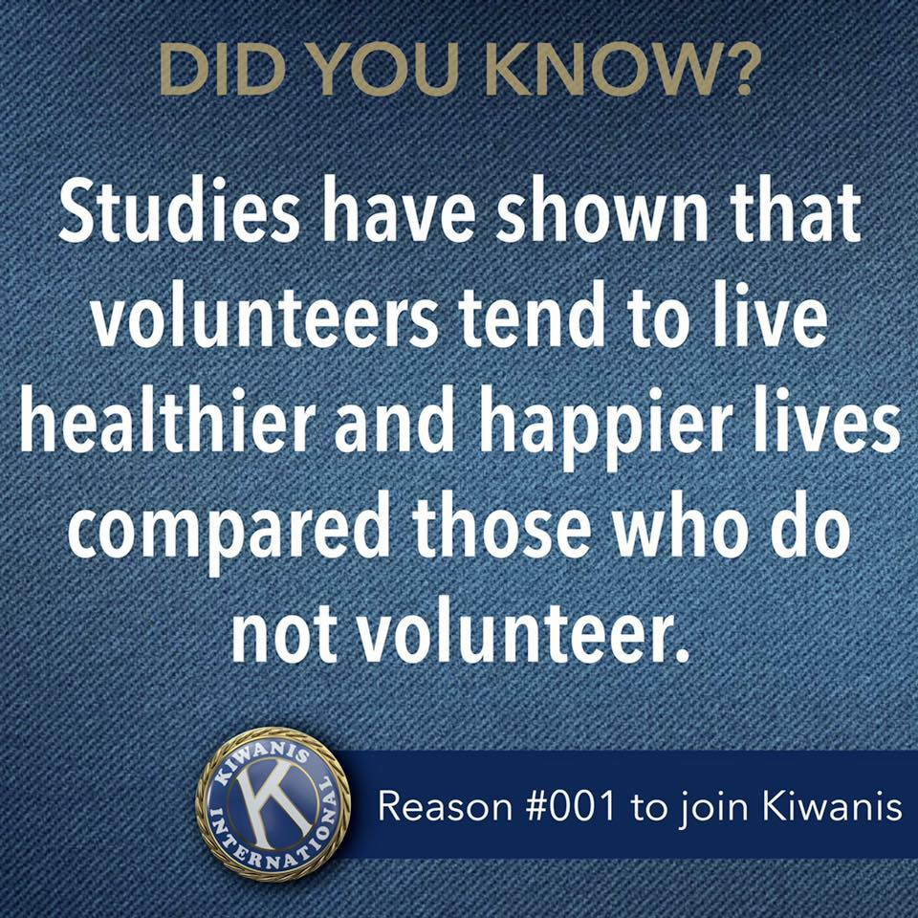

Slide 47

A REMINDER…..
Wrapping it up
Notes:
Thank you for taking time to participate in lieutenant governor education. We hope the education you receive here will be of great value to you in the days and weeks ahead.

Slide 48
REMEMBER…..
“The Only Person Who Likes Change is a Wet Baby.”
Von Oech, 1986

Slide 49


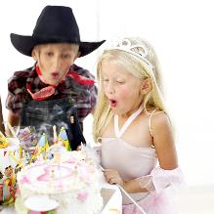


  These kids are the reason to succeed!!

Slide 50

THANKS….for being here today!
And….THANK YOU for being a Kiwanian!!

Slide 51
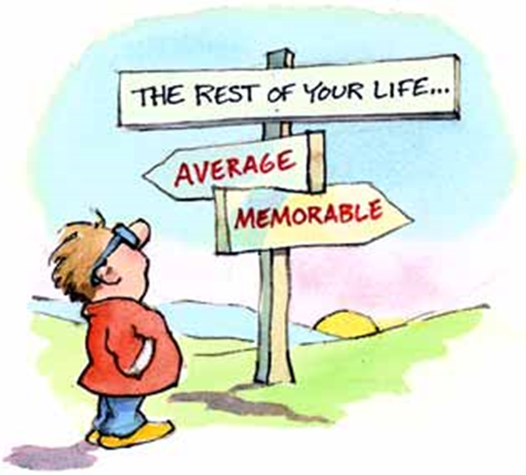
THANKS….for all you do for your local community!
Capital District Team
John Morris, District Membership Chair
jmorris@bealelaw.com
Dennis Baugh, Club Strengthening Chair
dennis.cdkypm@gmail.com
James Shackleford, Club Opening Chair
jcs.Kiwanis@gmail.com

