Slide 1
Effective Communications
The Who, What, How, Why, & Where
Gets You There
Krista Latchaw
Kiwanis Club Member of Severna Park
KristaLatchaw@gmail.com

Slide 2
Education Sessions Brought to You By:

Slide 3
Think About This….
Simon Sinek

Slide 4
Goal & Agenda
Finish Line
Goal
To effectively communicate with your club members, potential club members, and the public
Agenda
Why
Who
What
Where
How
How
Where
What
Who
Why

Slide 5
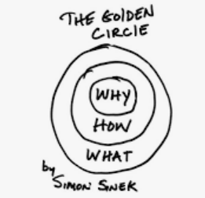
Why – The Starting Line
“Very few people or companies can clearly articulate WHY they do WHAT they do. By WHY I mean your purpose, cause or belief
WHY does your company exist?
WHY do you get out of bed every morning?
WHY should anyone care?
People don’t buy WHAT you do, but they buy WHY you do it.”

Slide 6
Why
To add new slides
Under the home tab, click on the arrow next to “new slide.”
Select the template you would like to use. A new slide will be inserted.
Click in the box to add your content.

