Slide 1
Generative Artificial Intelligence [AI]
for Kiwanis Clubs
Jeffrey Wolff
Capital District Executive Director

Slide 2
Agenda
Definition & Brief History of Artificial Intelligence (AI)
Differences in the Commercial Offerings
Writing Effective AI Prompts
Hands-on Generative AI
Kiwanis AI Resources
Q&A

Slide 3
What is Artificial Intelligence (AI)
Simulation of human intelligence in machines that are programmed to think, reason, and problem-solve like a human.

Slide 4
Who has used Artificial Intelligence (AI)?
Everyone

Slide 5
When was AI computer technology first created?
1955

Slide 6
Types of Artificial Intelligence (AI)
Artificial Intelligence (AI)
Narrow
Generative
Artificial General Intelligence (AGI)
aka Strong AI or Deep AI

Slide 7
Artificial General Intelligence (AGI)
Smart as humans with consciousness.
Can learn, reason and solve problems on its own.
Does not exist yet, outside of research institutions.
May exist as soon as 2040

Slide 8
Narrow Artificial Intelligence (AI)
Specialized: Highly efficient and fast at the specific task it was designed for. Much faster than humans.
Limited Flexibility: Cannot perform tasks outside its designated area.
Ubiquitous: Most current AI applications fall into this category.

Slide 9
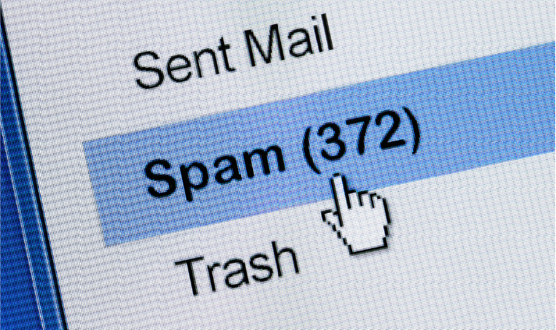
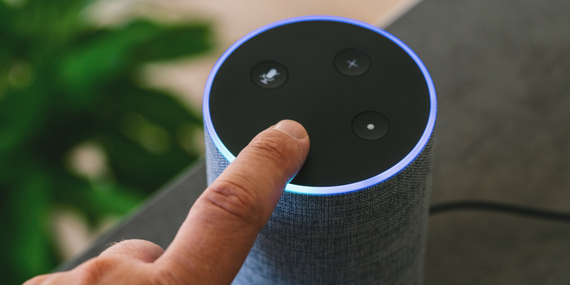
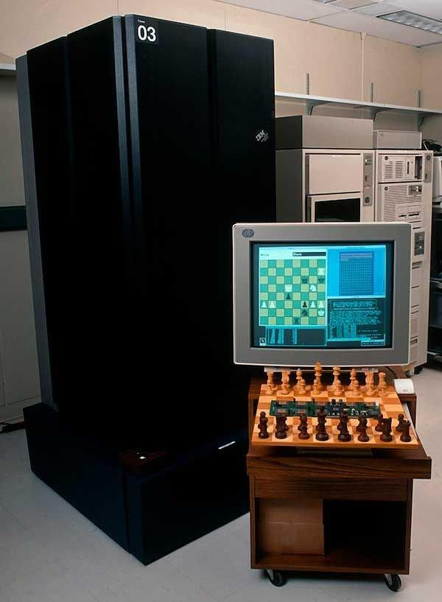
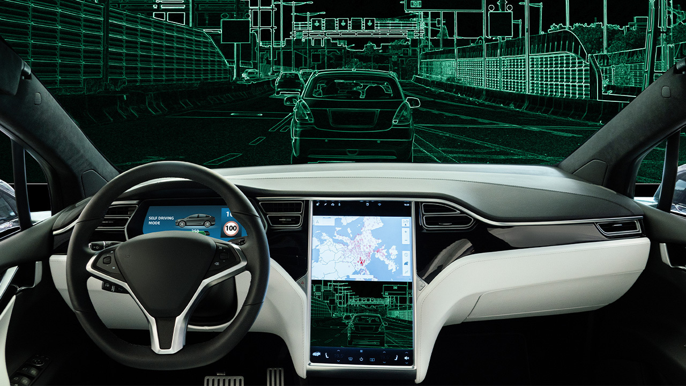
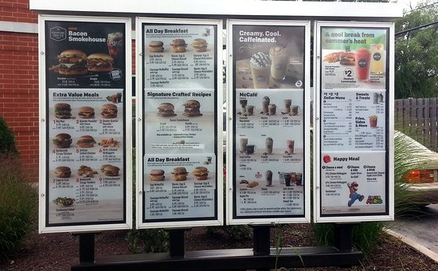
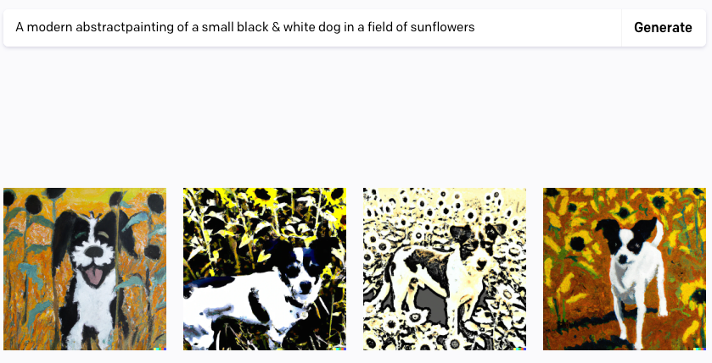
Examples of Narrow AI

Slide 10
Generative Artificial Intelligence (AI)
Artificial Intelligence that can generate new content ranging from text and images to music and code.
Provides a natural, novel, conversational and contextual style of communication.
Popular Generative AI platforms: ChatGPT, Bing Copilot and Google Gemini

Slide 11
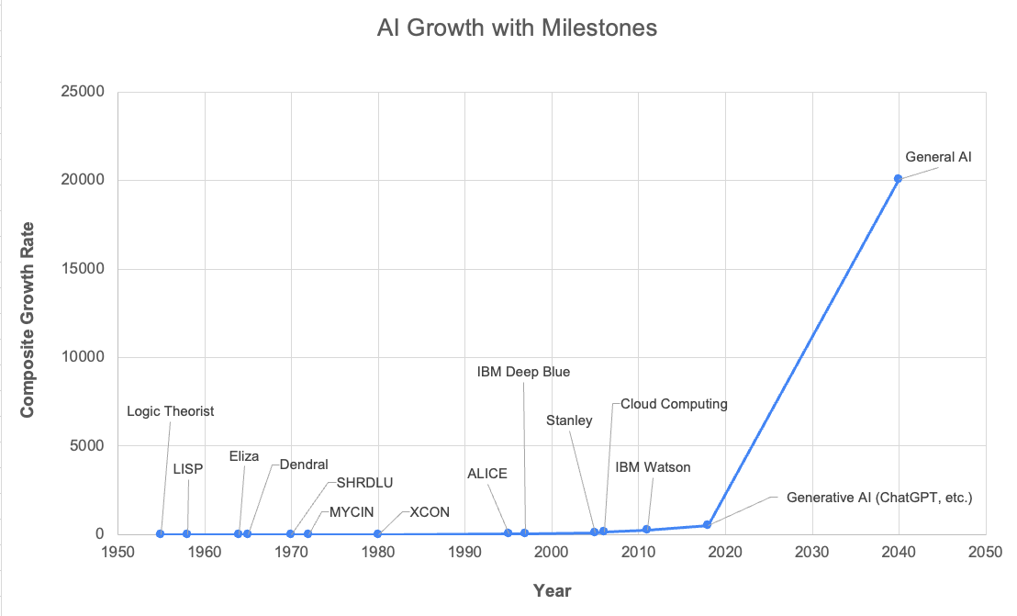

Slide 12
What are LLMs?
LLMs or Large Language Models are a type of artificial intelligence that is designed to understand and generate human-like text based on the input it receives.
These models are trained on vast amounts of text data and use complex algorithms to learn patterns in language, which allows them to perform various language-related tasks such as answering questions, generating text, translating languages, summarizing information, and more.

Slide 13
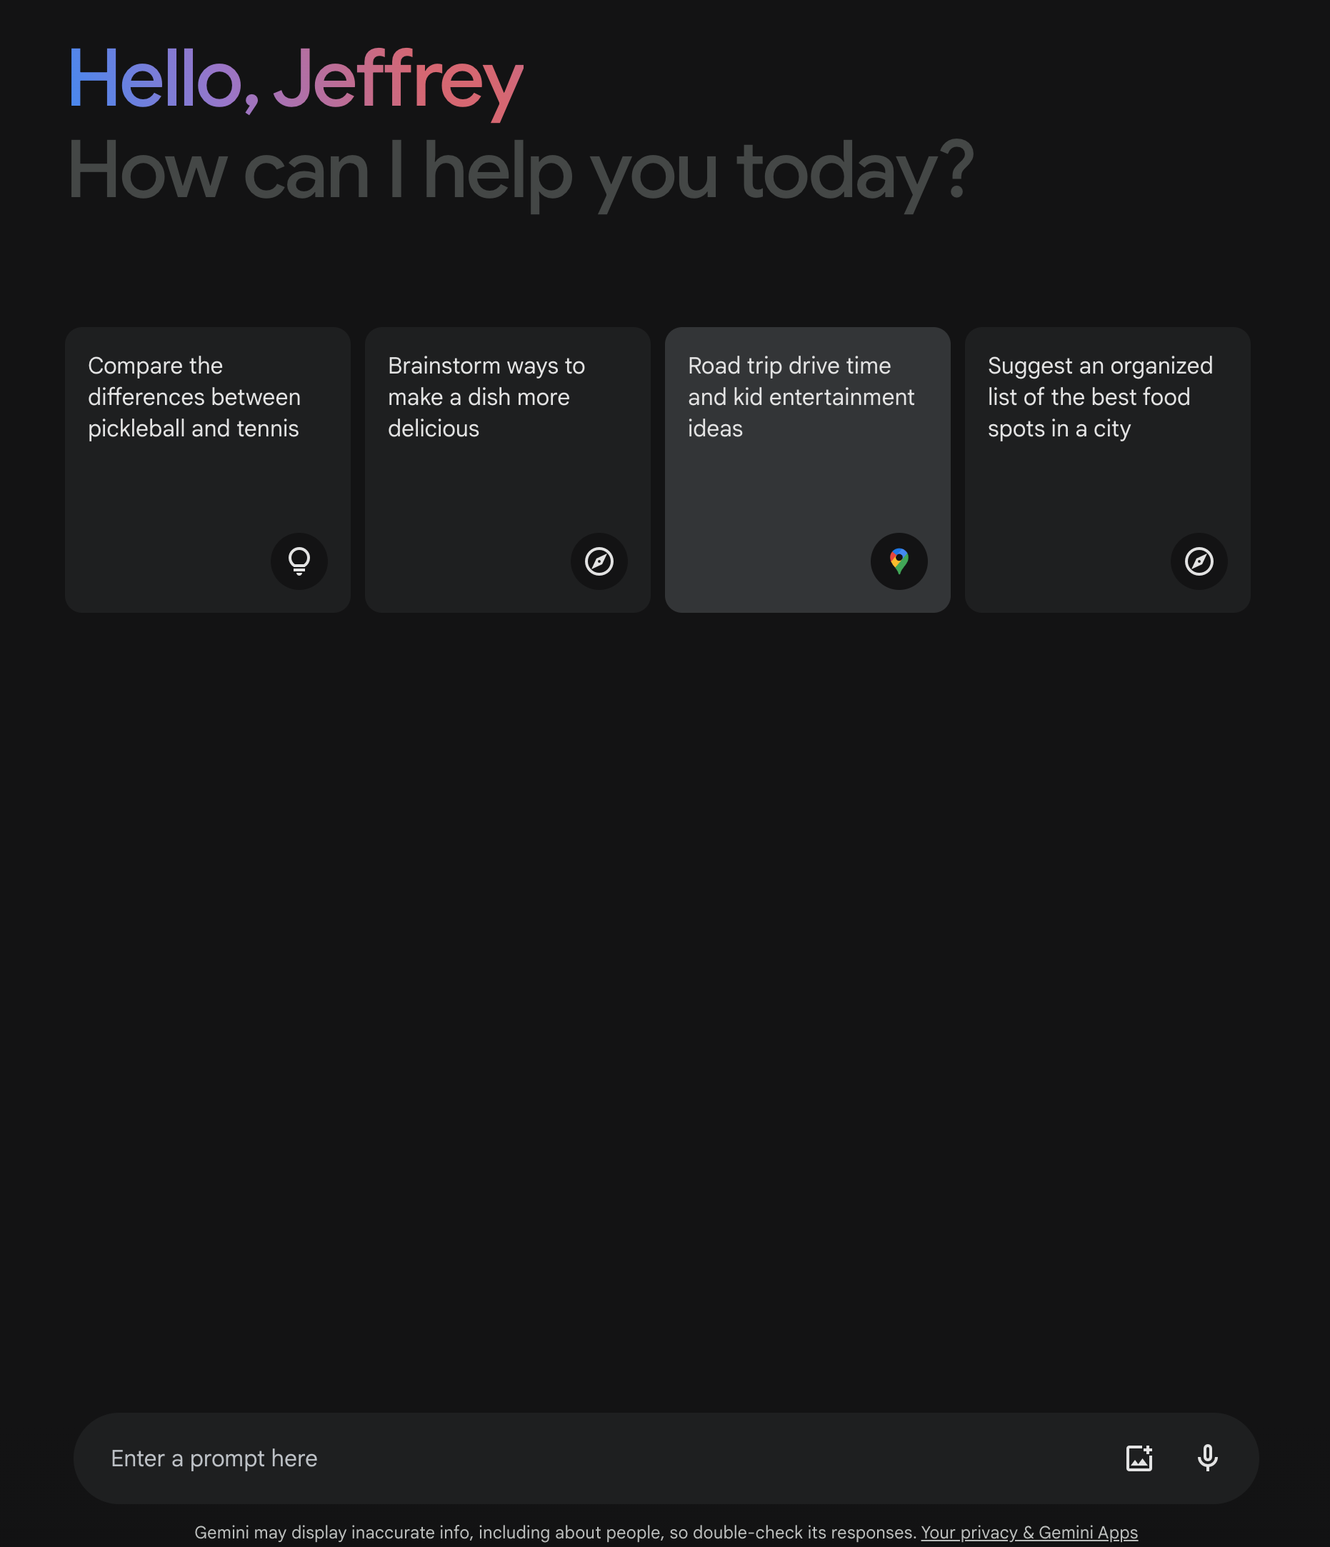
Prompt writing
Drafting a concise and specific set of instructions or descriptions to guide an artificial intelligence program to answer a question, solve a problem, generate content, or perform a task.

Slide 14
Human In The Loop
You must provide oversight, corrections and feedback to the AI as it generates content, ensuring the results have a ‘human touch’, align with your specific goals, ethical standards, and contextual accuracy.

Slide 15
Commercial GenAI Offerings
OpenAI ChatGPT
Google Gemini
Microsoft Copilot

Slide 16
 | Google Gemini | Microsoft CoPilot | ChatGPT
Cost | Free with Google account | Free but limited without a MS account | Freemium
Live Internet Searches | Yes | Yes | Yes, with ChatGPT Plus subscription and plug-ins
Image Creation | Yes | Yes, free | Yes, with a ChatGPT Plus subscription
Data Analysis | Yes. Analysis and data visualizations. Limited to prompt input of 2048 characters max and no data file uploading allowed. Images can be uploaded and analyzed. | Limited. Does analysis but cannot create data visualizations. Limited to a prompt input of 4000 characters max and no data uploading allowed | Yes, Analysis and data visualizations via plug-ins with ChatGPT Plus. Data and image uploads allowed in paid version.
Token Input Limit | 2048 | 4000 currently but increasing to 8000 | 4096 to 128,000 depending on plan

Slide 17
Prompt writing examples
Ask a Question | Solve a Problem | Generate Content | Perform a Task
Who was Kiwanis International's first president? | Fix this Excel formula: =IF((AND(D96<1, F96>90), "EXCEEDS", IF(F96<=90, "NEW HIRE", IF(I96<>"", IF(I96>1, "DOES NOT MEET", "MEETS"), "EXCEEDS"))) | Write an email to my Kiwanis club reminding them of our upcoming meeting, topic, and location. | Research which counties in Indiana have a median average income below the national average then list the results in a table.

Slide 18
Prompt writing recipe
1.
2.
3.
4.
5.
6.
Role & Goal
Contextual Information
Specific Instructions
Open-ended Questions
Constraints
Human in the Loop

Slide 19
Purpose or goal
1.
2.
3.
4.
5.
6.
Role & Goal
Contextual Information
Specific Instructions
Open-ended Questions
Constraints
Human in the Loop
What is AI's role & main goal or purpose of the AI prompt you want to create?
You are a data analyst. Determine an optimal fundraiser event ticket price that maximizes profit while remaining affordable.

Slide 20
Contextual information
1.
2.
3.
4.
5.
6.
Role & Goal
Contextual Information
Specific Instructions
Open-ended Questions
Constraints
Human in the Loop
What is the relevant background or contextual information?
Include event host, event location, event season, event theme, event capacity, etc.

Slide 21
Specific instructions
1.
2.
3.
4.
5.
6.
Role & Goal
Contextual Information
Specific Instructions
Open-ended Questions
Constraints
Human in the Loop
Are there any specific instructions for the AI?
Ensure your research uses reliable data sources, explaining how you incorporated the data into your calculations.

Slide 22
Open-ended questions
1.
2.
3.
4.
5.
6.
Role & Goal
Contextual Information
Specific Instructions
Open-ended Questions
Constraints
Human in the Loop
Are there any open-ended questions you’d like the AI to consider?
Given our specific event and location, what creative ideas could be provided around ticket pricing?

Slide 23
Constraints
1.
2.
3.
4.
5.
6.
Role & Goal
Contextual Information
Specific Instructions
Open-ended Questions
Constraints
Human in the Loop
Are there any constraints or limitations of the AI’s response?
Only use trusted and accurate data sources in your research and explain how you used the data in your calculations.

Slide 24
Human in the loop
1.
2.
3.
4.
5.
6.
Role & Goal
Contextual Information
Specific Instructions
Open-ended Questions
Constraints
Human in the Loop
Be sure to review the response and either use it, edit it, or ask the AI to change it

Slide 25
DEMO
Kiwanis Duck Splash

Slide 26
Role and goal
This is AI’s role and goal
You are planning an event for a Kiwanis club. The event will be called Duck Splash, and the goal is to raise as much money and have as much engagement in the event as possible.

Slide 27
Contextual information
What is the background or contextual information?
A Duck Splash event is where people will buy a little rubber duck and decorate it however, they want with their name on the bottom. We will then drop them into a creek and the ducks will float down the creek. There are a lot of areas where the duck can get caught up. First duck to cross the finish line at the end wins.

Slide 28
Specific instructions
Are there any specific instructions for the AI?
Create the ticket price per rubber duck that will help us make as much money as possible with sales but also remain affordable. Also, produce ideas that will help make this event more engaging and fun.

Slide 29
Open-ended questions
Are there any open-ended questions that you would like the AI to consider?
Consider things like vendors, music, food, other options for us to make money at the event, is there a way to incorporate these into our Duck Splash event?

Slide 30
Constraints
Are there any constraints or limitations to the AI’s response?
This event needs to be inclusive to all kinds of people and to all ages.

Slide 31
Final prompt
You are planning an event for a Kiwanis club. The event will be called Duck Splash, and the goal is to raise as much money and have as much engagement in the event as possible. A Duck Splash event is where people will buy a little rubber duck and decorate it however, they want with their name on the bottom. We will then drop them into a creek and the ducks will float down the creek. There are a lot of areas where the duck can get caught up. First duck to cross the finish line at the end wins. Create the ticket price per rubber duck that will help us make as much money as possible with sales but also remain affordable. Also, produce ideas that will help make this event more engaging and fun. Consider things like vendors, music, food, other options for us to make money at the event, is there a way to incorporate these into our Duck Splash event? This event needs to be inclusive to all kinds of people and to all ages.

Slide 32
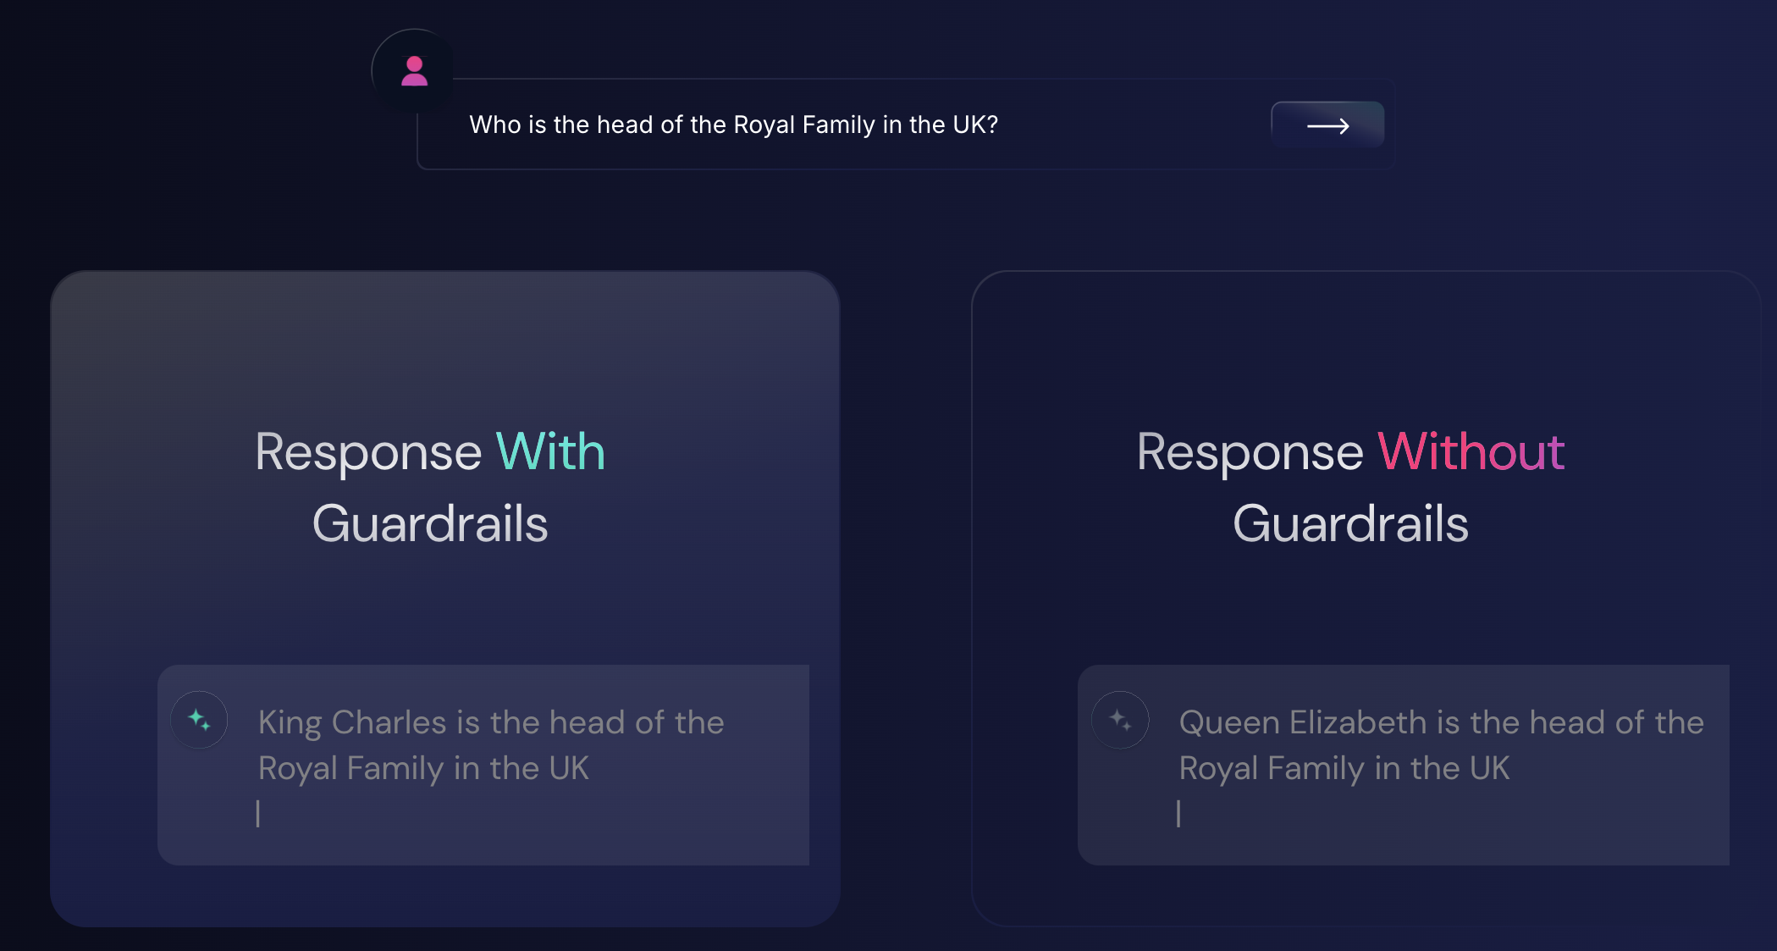
Human In The loop
Be sure to review the response and either use it, edit it, or ask the AI to change it.
GenAI can “hallucinate” if the information used to train it is out of date or incorrect.

Slide 33
Tips for using AI
If your output gets cut off or stops, type ‘continue’
Follow the prompt recipe
Play with several AI chatbots and compare the results
Use a prompt generator for creating images
Your prompts will get better with practice
Check every result you get from AI including grammar and facts
Check out AI page for resources

Slide 34
Generative AI Resources
https://dcon-resources.site.kiwanis.org/generative-ai-prompt-builder/
How the Kiwanis Generative AI Prompt Builder works:
Define the Role: Assign a role to the AI. Will it act as a marketing pro, a fundraising expert, an event organizer, a data analyst?
Your Goal: Articulate what you aim to achieve. Your goal guides the AI’s focus
Provide Context: Offer background information to help the AI understand your goal more deeply
Specific Instructions: Specify format, medium, and data sources for the AI’s task.
Ask Open-Ended Questions: Encourage the AI through its own creativity and exploration.
Constraints: Provide guardrails for the AI to conform to.
Receive a Complete Prompt: Copy & paste the generated prompt into your favorite Generative AI tool (ChatGPT, Gemini, Copilot, etc.)

Slide 35
Generative AI Resources
https://dcon-resources.site.kiwanis.org/kiwanis-generative-ai-image-prompt-builder/
How the Kiwanis Generative AI Image Prompt Builder works:
Artist: Specify which artist will create your artwork (optional).
Style: Select the artistic style of your artwork.
Medium: Specify the medium your artwork will be created on.
Subject Matter: Describe the subject matter of your artwork
Prepositional Phrase: Describe how your subject will interact in the composition.
Composition: Describe how your artwork subject(s) are structured.
Colors: Describe what type of colors will be in your artwork.
Lighting: Describe how your artwork will be lit.
Receive a Complete Prompt: Copy & paste the generated prompt into your favorite Generative AI Image tool (Dall.e, Leonardo.ai, MidJourney, etc.)

Slide 36
Generative AI Resources
https://dcon-resources.site.kiwanis.org/practical-ai-prompts-for-kiwanis-clubs/
Attracting New Members for an Existing Kiwanis Club
Optimal Event Ticket Price Research
Letter of Support
Social Media Post – Generic
Social Media Post – Member Recruitment
Press Release
Strategies for Building a New Kiwanis Club
Build a Plan for Building a New Kiwanis Club
New Service Project Ideas
New Fundraising Ideas
Community Engagement Ideas
Recruitment
Club Theme Song

Slide 37
Q&A

