Slide 1


Club Secretary & Treasurer Check-In
Educational Sponsor
Capital District Midyear Conference
Jeffrey Wolff
February 28, 2026

Slide 2
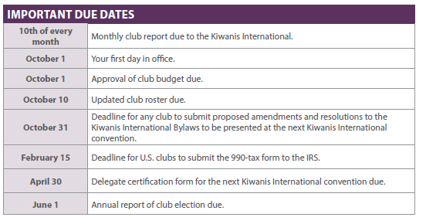
Important Dates

Slide 3
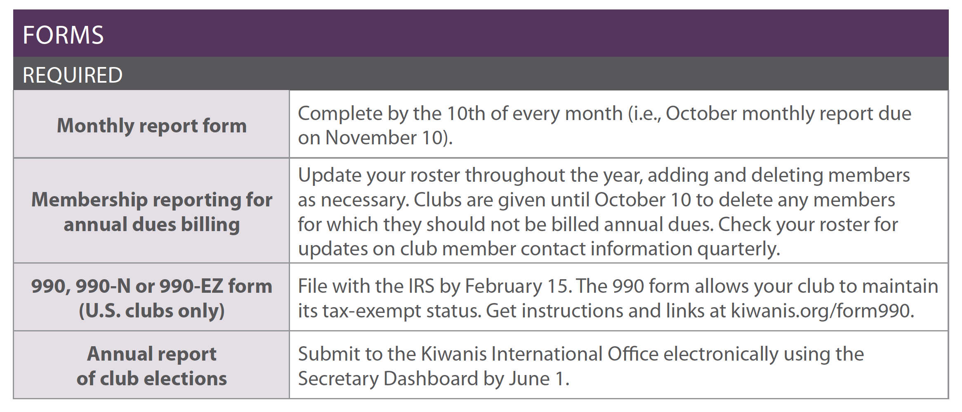
Required forms

Slide 4
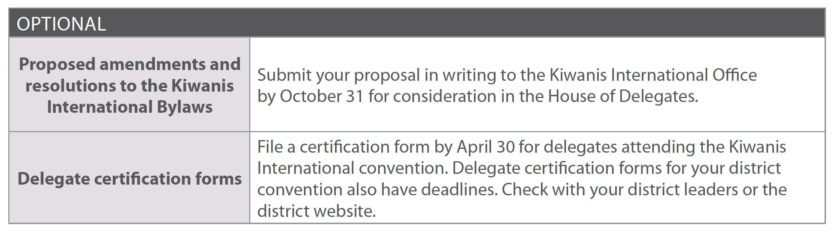
Optional submissions

Slide 5
Common Club Administration Questions

Slide 6
Common Question #1
“Who has access to update club data online?”

Slide 7
Club dashboard user access:
Club president (on Oct 1)
Club secretary (on Oct 1)
Club assistant secretary (on October 1)
Club treasurer - Finances Only (on October 1)
Lieutenant Governor (once reported)
Executive Director (always)

Slide 8
Common Question #2
“What do my clubs pay when they submit a new member?”

Slide 9
Dues simplification facts:
A simplified dues policy began on October 1, 2021.
The flat new member fee was eliminated from Kiwanis International and all Kiwanis districts.
Instead, a new or rejoining Kiwanis member is charged prorated dues and fees, based on the month they join.
On each subsequent October 1 (the first day of the Kiwanis year), all members will then be assessed the annual dues-and-fees amount

Slide 10

Dues and fees:
Kiwanis International Dues: $77 USD
Kiwanis magazine subscription: $8 USD
General Liability insurance: $18 USD
D&O insurance: $4 USD
Capital District Dues: $32 USD
TOTAL: $139.00

Slide 11
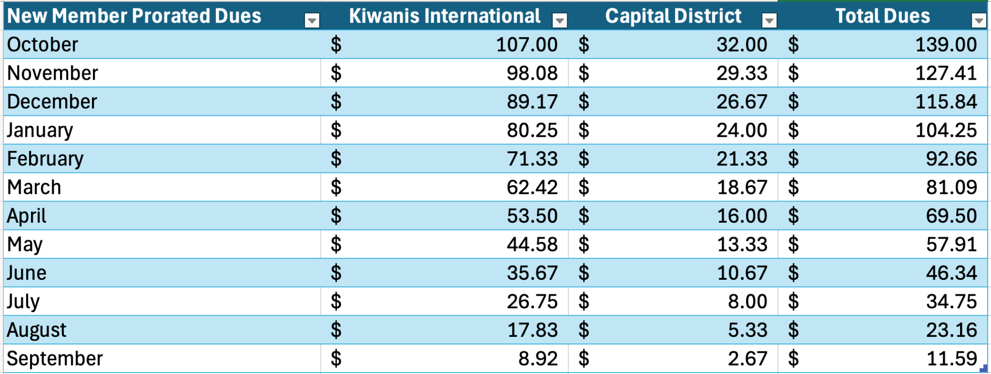
Prorated dues for new members:
Dues and fees decrease by 1/12th each month

Slide 12
Common Question #3
“How much is Kiwanis life membership, and how does it work?”

Slide 13
Kiwanis Life Membership:
15 x the current annual dues amount (US$77) = $1155.
Once given life status, the member will not have to pay the annual dues portion in their primary club for the remainder of their time in Kiwanis (still pay magazine, insurance, and risk management).
Only applies to their primary club (multi-club members).
Life member application online at https://bit.ly/3zYy3Rs.

Slide 14
Capital Life Membership
15 x the current annual dues amount (US$32) = $480.
Once given life status, the member will not have to pay the Capital District dues portion in their primary club for the remainder of their time in Kiwanis.
Only applies to their primary club (multi-club members).
Life member application online at district website.

Slide 15
Common Question #4
“How are club official year-end membership numbers calculated?”

Slide 16
Year-end membership figures include:
Member additions received into the Kiwanis International office by 11:59 p.m. EST September 30th.
Member deletions received into the Kiwanis International office by 11:59 p.m. EST October 10th.
Year-end certified membership: net number as of October 10th (after all updates have been processed by KI) .

Slide 17
Common Question #5
“Who is required to have a background check?”

Slide 18
Background checks required:
Kiwanis advisor to an SLP club.
Chaperones: all adults working with youth (club members and non-members) participating in any single day off-school premises or overnight SLP sponsored event. Includes faculty advisors.
District administrators/committee members.
District Officers: Vice Governor, Governor-elect, Governor, Immediate Past Governor, Regional Trustees, Lt. Governors
Kiwanis International Trustees/Officers.

Slide 19
Common Question #6
“What is the process to transfer a member to another club?”

Slide 20
Member Transfer:
2 steps
First: club that member is leaving should delete them from their roster.
Second: once removed, club that the member is transferring into can add them, designating them as a “transfer”.
If both steps are done within 6 months of each other, no additional fee is assessed.

Slide 21
Non-Traditional Membership Options

Slide 22
Corporate membership
Company or organization is the member, with an individual as primary representative
Club is billed the same amount as traditional members by KI
Allows for “swapping out” the representative at no additional cost

Slide 23
Corporate membership
Types of individuals corporate membership can be a good fit for:
Bank staff, organization representatives, and other positions that might see high transfer or turnover
Faculty advisors – for your SLP!
Others?

Slide 24
Satellite membership
Members who can’t attend a regular club meeting due to day or time, or location – but want to be a part of the club
Those seeking different meeting dynamic

Slide 25
Satellite membership
Governed by parent club bylaws, officers and directors
May a meet at different time or location
Pay dues through parent club
May operate similar to a “committee”

Slide 26
Former SLP member
Former member of a Service Leadership Program club (CK, KC, AK, BC, or KK)
Joining their first Kiwanis club
Exempt from paying KI dues and district dues – only pay for magazine, insurance and Risk Management fee ($30) for first two years they would normally pay

Slide 27

Discussion Time!

Slide 28



Kiwanis Online Reporting
Submit information from computer
Send reports to leaders automatically
Add, view, edit and save information easily, even from previous months’ reports
Communicate with Kiwanis International and district offices in a variety of areas
Compile monthly reports for annual report
View club’s Service Leadership Programs

Slide 29

Club Information
Club secretary view displays:
Current and incoming club officers
Club district and division details
Sponsored service leadership program clubs
Meeting location, day and time
Signature project details
Online profiles (club website, social media accounts)
Club statistics

Slide 30

Functionality
Club secretaries have the following abilities:
Update official club detail information
Update club membership
Complete monthly reports
Submit Kiwanis convention voting delegates

Slide 31

Additional Functionality
Club secretaries have the following abilities:
View and pay club membership charges
View member background check status information
Submit officers
Update service leadership program advisor information
See club historical data
Share files

Slide 32

Member Information
Club secretaries can update membership data in the following way:
Add new members of various types (regular, former SLP, corporate, satellite, transfer, former, honorary, spousal, dual).
Edit existing member information (address, phone, email, birthdate, sponsor, spouse/partner, gender)
Delete members
Download/export member listing

Slide 33

Monthly Reports
Club secretaries can work with monthly reports in the following ways:
Provide club meeting information and attendance
Provide service project/fundraising data
Provide partnership data
Answer annual administrative questions
Provide donation/giving data
Share monthly reports with other individuals

Slide 34
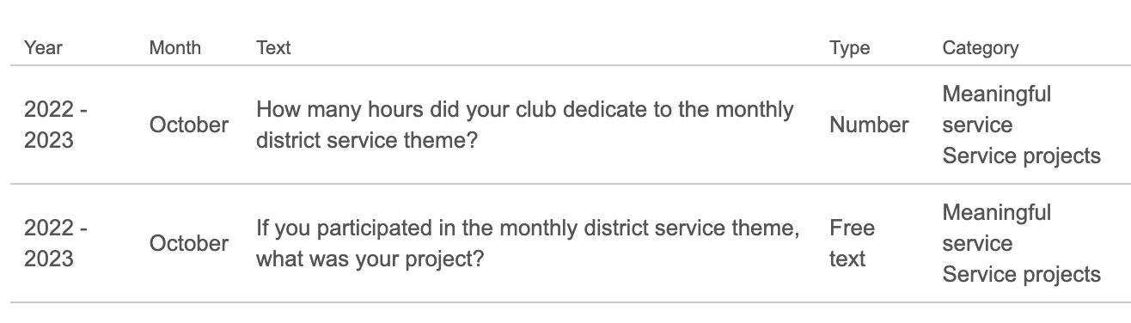
Monthly Reports
New this year:
Custom questions asking about participating in monthly district service project themes

Slide 35

Finances
Club secretaries can access financial data in the following ways:
View and print open invoices
View and print past paid invoices
Pay open invoices by credit card
Request invoice adjustments
View payment history

Slide 36
Club Secretary & Treasurer Check-In
Educational Sponsor
Capital District Midyear Conference
Jeffrey Wolff
February 28, 2026

