Slide 1
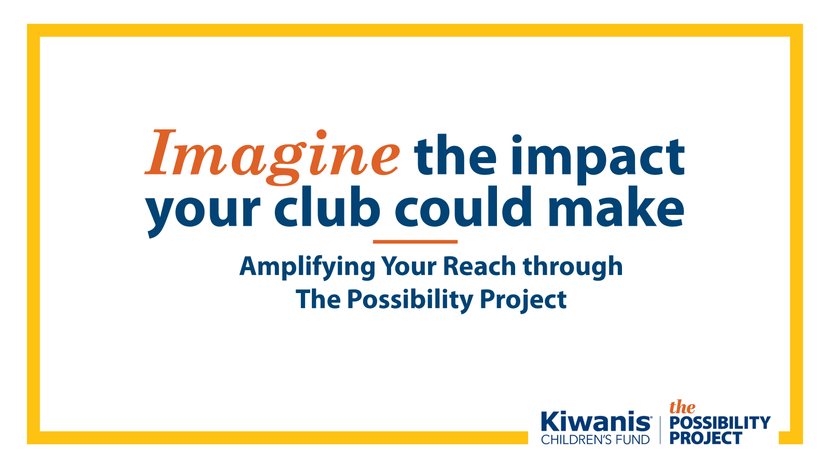
Notes:
Good afternoon. My name is [YOUR NAME] and I am a volunteer for the Kiwanis Children’s Fund.
Today, I am excited to share our new campaign, The Possibility Project, which is raising money to impact 10 million children worldwide through Kiwanis Service Projects.
I will also share how your club can support The Possibility Project as an Impact Club—this campaign’s only club recognition level—and how you can use a multiyear fundraising plan to reach your Impact Club goals.

Slide 2


Slide 3
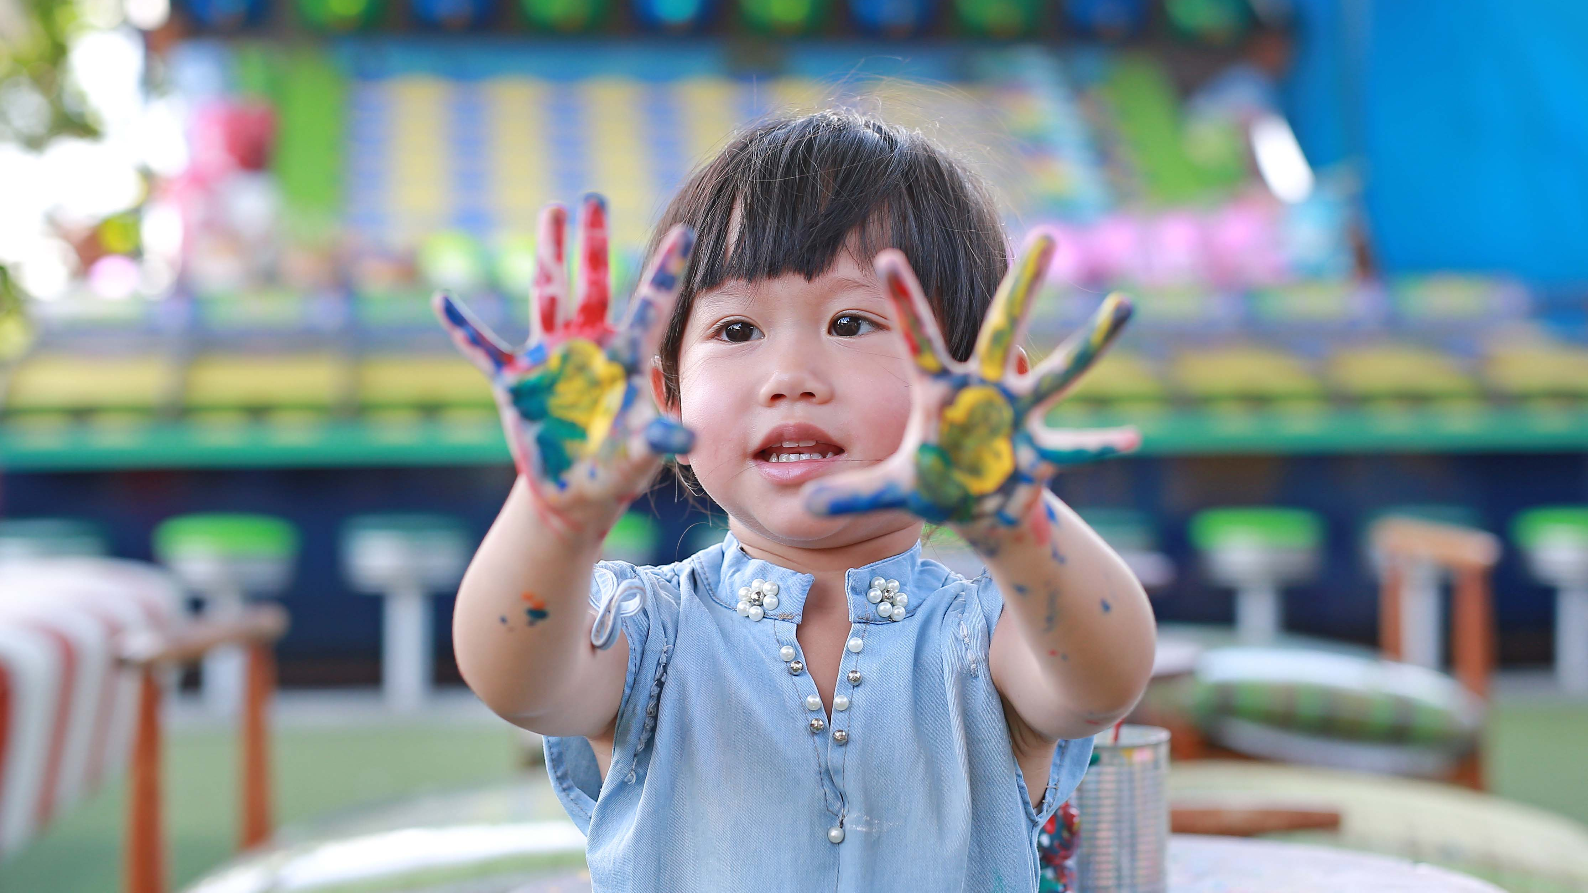
WHAT IS POSSIBLE?
Notes:
When we say, “Kids need Kiwanis”, it’s not just a motto. It’s the truth we live by. You, as a Kiwanian, understand the needs of children in your community better than anyone. You see the student struggling in school without the support they need. You see the child with an empty stomach, who doesn’t have enough food at home. You witness the isolation of a child with a disability who can’t join their classmates on the playground.
Imagine if every Kiwanis club around the world had more funding and resources to help these kids. Imagine new service projects springing up all over the world to help the children who need Kiwanis the most. Together, Kiwanians can make a global impact on the lives of children—and turn possibilities into realities.

Slide 4


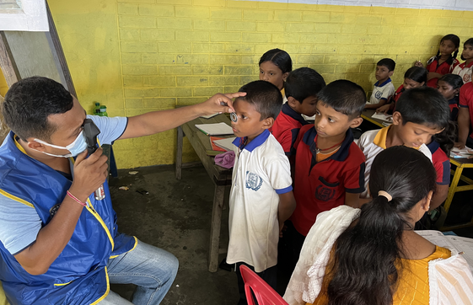
UNICEF
$261M for global children’s health and nutrition since 1990s
Notes:
There is no doubt that when Kiwanians work together, we can achieve great things—and the Kiwanis Children’s Fund is here to help turn your generosity into projects that reach kids all over the world.
When Kiwanians last came together to support the Kiwanis Children’s Fund, we helped UNICEF eradicate Maternal Neonatal Tetanus in 49 countries through The Eliminate Project. Before that, our work with UNICEF raised the global IQ by 5 points by establishing sources of iodine around the world through the Iodine Deficiency Disorder campaign.
In fact, since 1994, the Kiwanis Children’s Fund has raised and leveraged a quarter of a billion dollars for global childhood health and nutrition!

Slide 5
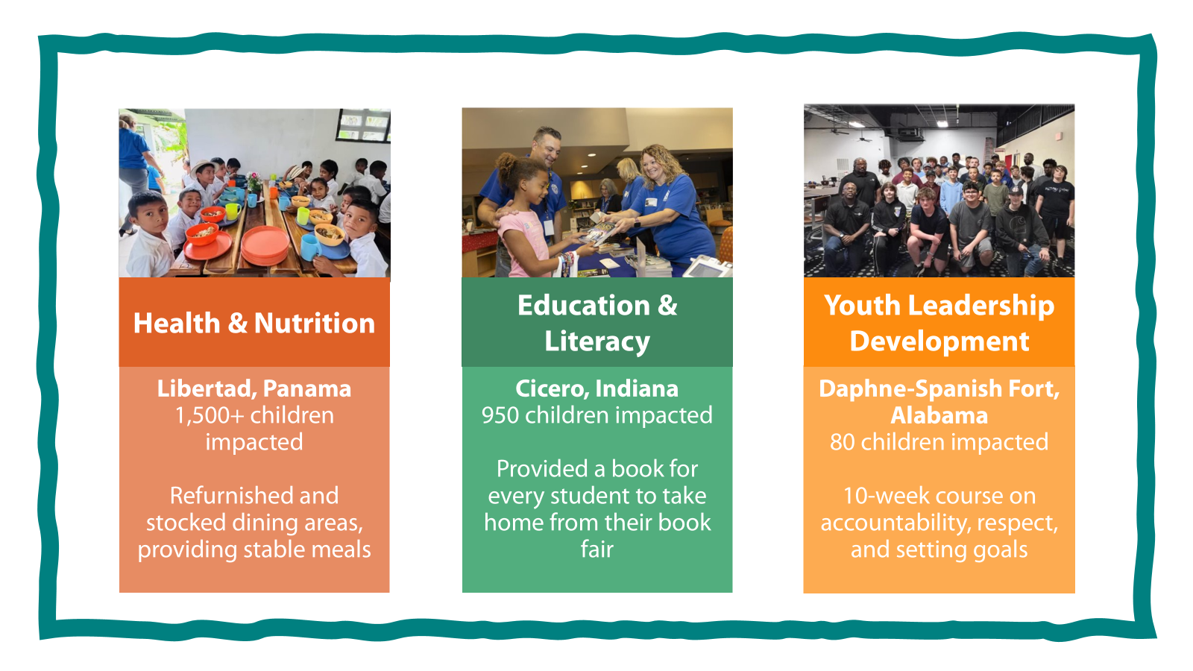
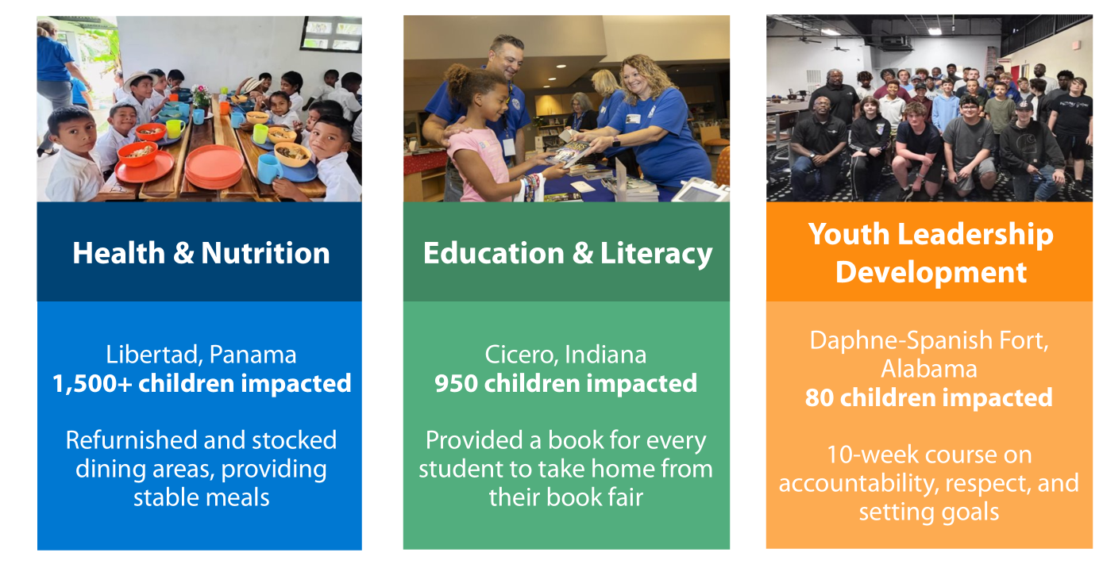
Notes:
We know that Kiwanians are experts on the challenges facing the children where they live—and that looks different wherever you go!
That is why when we grant funds to a club, we aren’t telling them what your service projects must look like to receive a grant beyond making an impact in at least one of our three cause areas, health and nutrition, education and literacy, and youth leadership development.
Kids need help now, and we aren’t waiting to start providing support to service projects for clubs like:
The Kiwanis Club of Libertad, Panama, where we helped their club to rebuild, refurnish, and restock their local school’s dining area and provided stable meals for more than 1,500 students,
The Club of Cicero, Indiana, where a grant helped the club to buy a book all 950 students during their book fair,
and the Daphne-Spanish Fort club in Alabama, which was able to host a 10-week program for middle school students to learn respect, conflict resolution, and goal setting
By supporting the Children’s Fund, you expand your impact beyond your doorstep and into communities wherever a Kiwanis club exists.

Slide 6


Kids Need Help Now
$1
available for every $2 requested
10x
Increase in requests in the last 5 years
Notes:
The Kiwanis Children's Fund proudly supports service projects that meet urgent needs. But the reality is, millions of children still need our help.
Consider this:
Over 14 million children in the U.S. alone live in households without enough food.
Two out of five 4th graders can't read at a basic level.
Two out of five high school students report feeling lonely, sad, or hopeless.
Grant requests to the Children's Fund have increased tenfold in recent years, but we've only been able to fund $1 for every $2 requested.
Kiwanis clubs relentlessly show up for kids every day, and the Children's Fund wants to show up for you to make a better life possible for children in Kiwanis communities.

Slide 7

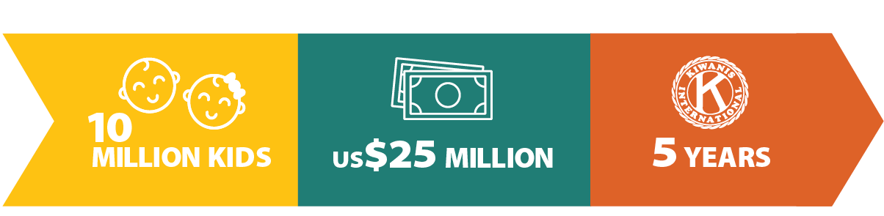
Notes:
The Possibility Project is designed to meet these growing needs by supporting Kiwanis service projects in health and nutrition, education and literacy, and youth leadership development.
We have a big goal: to impact over 10 million children by raising $25 million over 5 years.
This means more support than ever for clubs like yours to get funding for life-changing projects. With a grant from The Possibility Project, it takes only about $2.25 for a Kiwanian to change a single child's life.
When we come together, we can ensure every club has the possibility to impact the children who need Kiwanis the most.

Slide 8
OVER
$10 MILLION
RAISED IMPACTING
OVER
4 MILLION CHILDREN
Notes:
The good news is that we started fundraising for The Possibility Project on October 1st, 2022—which means we are well on our way to our goal.
We have already raised more than $10 million. That means Kiwanians have already come together to support club service projects that could reach more than 4 million children.

Slide 9
Momentum is Building
OVER 140 CLUBS
HAVE PLEDGED
$2.8+ MILLION
Notes:
Imagine the impact your club could have by helping your greater Kiwanis family to serve children in their own communities. The Possibility Project embodies the Kiwanis spirit by supporting one another to do more for children.
Over 140 Kiwanis clubs have already joined our effort to reach 10 million children by pledging a combined $2.8 million dollars! I would like to thank the following clubs from our district who have already committed to being an Impact Club.

Slide 10
Top 10 Capital Clubs Donated to
The Possibility Project to Date
#1 -- Rockville [03] $81,154
#2 – Westminster [04] $24,020
#3 -- Tysons [02] $21,613
#4 -- Richmond [10] $18,679
#5 -- Arlington [02] $15,637
#6 – SW Waterfront [01] $15,500
#7 -- Crofton [04] $10,990
#8 – Shepherd Park [01] $9,090
#9 – Wheaton-SS [03] $8,376
#10 – Colonial Capital [12] $8,256
Notes:
Momentum is building, including here in Capital.

Slide 11

Lead the Way
Notes:
Imagine the impact your club could have by helping your greater Kiwanis family to serve children in their own communities. The Possibility Project embodies the Kiwanis spirit by supporting one another to do more for children.
The clubs I mentioned a moment ago imagined that impact and took action by becoming Impact Clubs, making a 5-year pledge to support The Possibility Project.
By signing an Impact Club pledge, your club sets a goal to raise $100 per member each year for five years. Impact clubs will lead the way to serve 10 million children worldwide. We cannot reach our goal without your help.

Slide 12

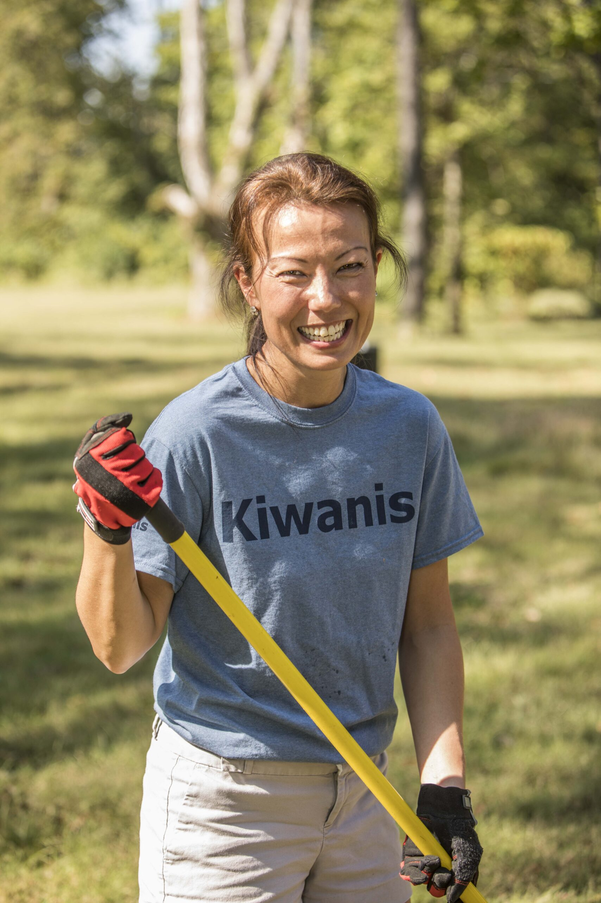
The Kiwanis Club of Small Town, USA
20 members
2 large fundraising events
Supports one Key Club, local children’s hospital, and Kiwanis Children’s Fund
Notes:
I’m going to walk you through an example that you can apply to your own club.
Today, we’ll talk about the Kiwanis Club of Small Town, USA.
As you can see, we have 20 members. We have two big fundraisers, which help us give to our 3 main causes: our Key Club, our local children’s hospital, and the Kiwanis Children’s Fund.
Our club wants to support The Possibility Project, but it is important to us that we are able to continue our support of the Key Club and the local children’s hospital.

Slide 13

The Goal
$100 per year, per member for 5 years
$500 x 20 members =
Overall Goal: $10,000
$2,000 per year
Notes:
BUT! We don’t know how to fundraise that much, and we don’t want to decrease our support for the causes we already care about. So how can we do both?​
Kiwanis clubs of all sizes have already made the commitment to support The Possibility Project as Impact Clubs, and no club’s plan to fundraise looks the same.
If your plan is to fundraise directly from your members, you can break down that individual annual goal of $100 per member. Per month, that is an $8.33 donation—roughly one trip to Starbucks.
But you don’t have to solely rely on members to give out of their own pockets. We encourage clubs to be creative. Beyond member donations, look to your fundraising events, club treasuries, and club foundations, if you have one.
When you use multiple methods to fundraise and set annual goals for five years, your Impact Club Pledge total becomes a lot less daunting.
No matter how you choose to fundraise, remember that your real goal is to help kids. As we shared earlier, it takes roughly $2.25 for a Kiwanian to make an impact on a child through a service project.
So, divide your pledge by $2.25. Suddenly your goal is no longer in dollars, but in the number of children your club can help. As a club, ask yourselves: how many kids do you want to help?

Slide 14

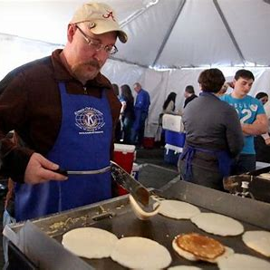
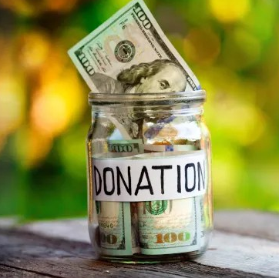
Determine Fundraising Sources
Annual Club Funds
25%
Fundraising Events
50%
Member Giving
25%
Notes:
Now we have a goal of the dollar amount we hope to raise over 5 years. But where will that money come from? ​
​
The Kiwanis Club of Small Town, USA has decided to source our funds from three main areas: our annual budget, fundraising events, and member giving. These are just a few common examples. Some clubs may choose to make a gift from their Club foundation as well. Or maybe they don't want to touch the budget and only use funds from events or member donations. It can look different for every club, and your club can choose what works best for you. ​
​
The first step is deciding what percentage of each funding source will make up the total pledge! ​We went ahead and put suggested percentages on each funding source. You may end up doing it differently with your club.
They’re planning to reach that goal by combining three funding sources: about 50% will come from events, 25% will come from member giving, and 25% from the club’s annual fund.

Slide 15

Annual Club Funds
Annual gift
Add, continue, or increase annual gift
Leverage club gift
Challenge members to match your club gift
Cause focus
Happy dollars: Once a month to Impact Club goal
Notes:
If you remember the club is going to break it down to $2,000 annually, annual fund (or your club’s annual budget) is one of the ways that the Impact Club giving level will be met.
If the club isn’t already, consider making an annual gift from club funds to the Kiwanis Children’s Fund.
Furthermore, instead of just making an outright gift, you can challenge your members to give and leverage those funds as matching funds. Instead of sending in $1,000, offer two $500 matching gifts to members of your club. Match those two $500 gifts with two $500 gift from club members and the club had turned $1,000 into $2,000.
Happy dollars are a great way to also generate matching funds.

Slide 16



Events
Existing Fundraisers
Low-Lift Ideas
Add Impact Club goal
Allocate extra funds raised
New Fundraisers
Start the new event you’ve always wanted to do!
Notes:
Fundraising events are a club’s bread and butter and the ideas are almost endless. They’re a great way to support an Impact Club pledge.
A club can commit to making an existing fundraising more successful and donating the extra funds raised to our Children’s Fund toward the club’s Impact Club pledge.
An Impact Club pledge can be a great spark to start another fundraising event for a club. Use it to reach your club’s Impact Club pledge and keep it going over The Possibility Project ends to support local causes identified by the club.
You can use social media to spread the message to seek donations. Also, you can dine for donations, which is popular and easy. Partner with a local restaurant to receive a portion of every sale on a specific night of a month. The club’s responsibility is simply to spread the word so people eat at the restaurant on that night.

Slide 17
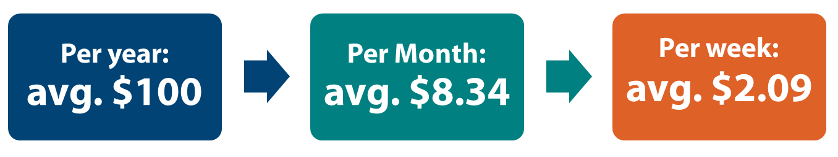
Individual Gifts
Personal donation
Online recurring gifts
Any donations made from any of your members to the Children's Fund will automatically be credited towards your club's goal.
Notes:
Members are excited to do their part as well to help the club reach its goal of impacting over 4,000 children with their pledge. ​
​
Since the club has found a way to fundraise half of the pledge through the club budget and events, club members will commit to collectively fundraising 5,000 dollars of the total goal over 5 years, or $1,000 each year. Using other sources in this case decreases the per member responsibility from $100/year to $50/year​.
​
This is a collective effort of club members. Not everyone is expected to contribute the same amount. We know we have one person who gives $250 every year, and at least a few members already give want to continue their donations or make their own pledge to increase their giving. Some members are able to donate in small amounts, like Happy Dollars once a month toward the Impact Club goal.​
​
Remember that any donations made from any of your members to The Children's Fund will automatically be credited towards your club's goal, as long as they have your club as their home club. So, if a member makes a $10 donation online at any time, it will automatically be credited to the Kiwanis Club of Small Town, USA. ​
There are many ways that individual members can choose to give personally and fundraise on their own:
-Individual fundraising efforts, like reaching out to friends and family
-Personal donations of any size, even if that means setting aside spare change at the end of the week
-Individual pledges, like the Cornerstone pledge, or $15,000 over 3 years—or small pledges made to your club that you will commit to giving a specific amount to the Children’s Fund
-Recurring gifts by setting up an automatic donation on the Kiwanis Children’s Fund’s website
and
-Honoring a club member or outgoing president with a Blechman or Hixson Fellowship

Slide 18
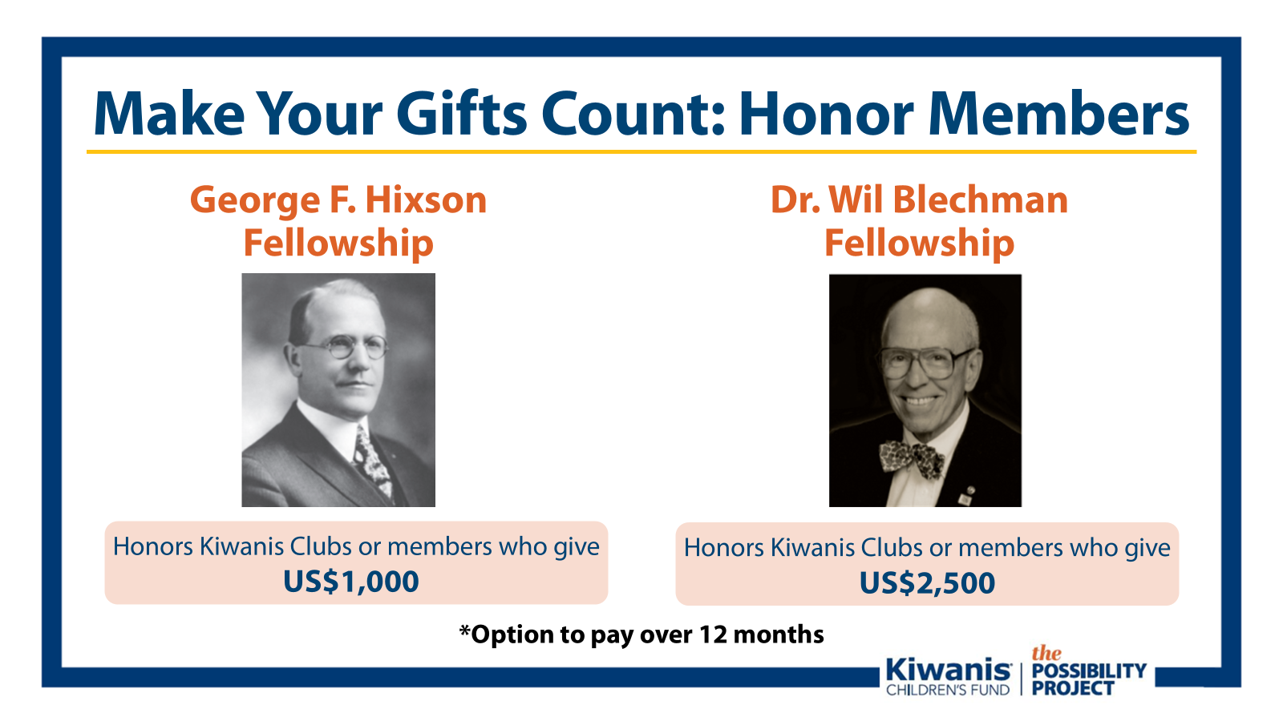
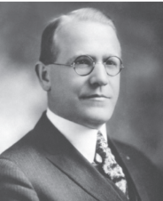
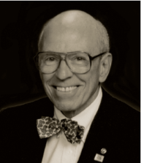
Make Your Gifts Count: Honor Members
George F. Hixson Fellowship
Dr. Wil Blechman Fellowship
Honors Kiwanis Clubs or members who give
US$2,500
Honors Kiwanis Clubs or members who give
US$2,500
US$1,000
*Option to pay over 12 months
Notes:
What is a Hixson or Blechman Fellowship?
At the Children's Foundation, we want to make your gifts count and mean even more. Kiwanians can make an impactful gift that will help a child in need, while also honoring themselves, or someone else who is dedicated to service. The Hixson fellowship honors a member with a gift of $1,000 dollars. A Blechman fellowship honors a member with a gift of $2,500. Multiple people can come together to collectively donate Hixson or Blechman to a current or past member who embodied the service of these two great past international Kiwanis presidents.
Challenging your club members to donate at least one Hixson or Blechman each year is a great way to help meet your member giving goal, while honoring a deserving Kiwanian for all of their great work they do for children.

Slide 19
Kiwanis Club of Small Town’s Annual Fundraising Plan
Goal: $10,000
 | Year 1 | Year 2 | Year 3 | Year 4 | Year 5
Club Totals | $2,000 | $2,000 | $2,000 | $2,000 | $2,000
Events (50%) | $1,000 | $1,000 | $1,000 | $1,000 | $1,000
Club Funds (25%) | $500 | $500 | $500 | $500 | $500
Membership (25%) | $500 | $500 | $500 | $500 | $500
25% Events
Notes:
Here’s how the Club of Small Town put this all together. Again, breaking it down, they set a clear goal: raise $10,000 over five years, which breaks down to $2,000 each year.
They’re planning to reach that goal by combining three funding sources: about 50% will come from events, 25% will come from member giving, and 25% from the club’s annual fund.
You can see how it is broken down by dollar amount here. (read off some of the members and explain how this is attainable)
This shows how a mix of fundraising activities can add up to a realistic, achievable plan that everyone in the club can contribute to ensure over 4,000 children are impacted through The Possibility Project.

Slide 20

Notes:
By using multiple fundraising sources and breaking down your goal by year, your club can make an extraordinary difference by becoming an Impact Club.
Kiwanians have come together before, saving millions of lives from preventable diseases, reshaping the world.
Imagine what we can do when we come together to support each other, to help clubs do more to turn possibilities into realities.
Imagine what’s possible if we trust our fellow Kiwanians to live our vision: to be a positive influence in communities worldwide, so that one day, all children will wake up in communities that believe in them, nurture them, and provide the support they need to thrive.

Slide 21
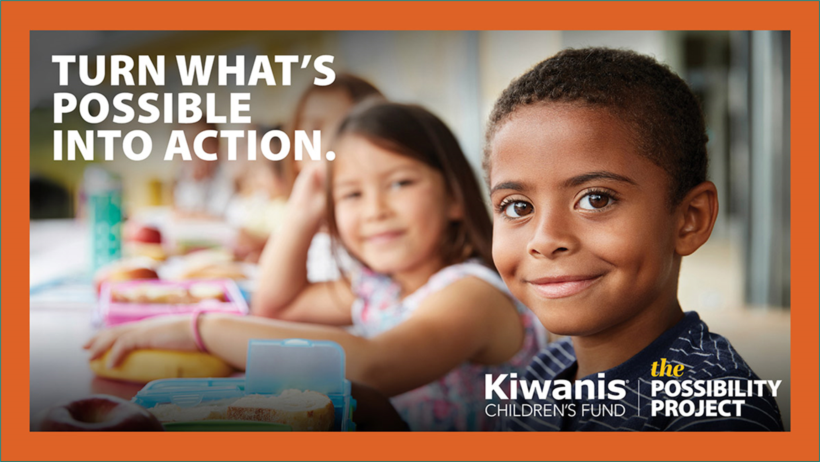
Notes:
Clubs in our district have already received support from The Possibility Project, like the Kiwanis Club of [X]:
[INSERT LOCAL GRANT STORY]
This is what’s possible when we come together.
Think about our mission and who we are: a global organization of volunteers, dedicated to improving the world, one child and one community at a time.
One child, one community at a time.
That is The Possibility Project: One child, one Kiwanis club service project at a time—to show 10 million kids what’s possible.
Make a bold statement that you believe in the power of Kiwanis—in the power of clubs to make a meaningful and positive difference in the lives of children in their communities—and amplify your club’s impact beyond here in [DISTRICT] to Kiwanis communities worldwide.

Slide 22
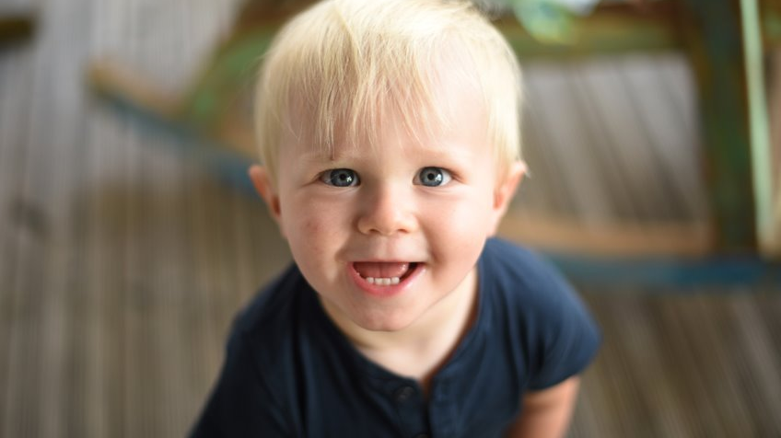
QUESTIONS?
Notes:
Pause for Questions here

Slide 23
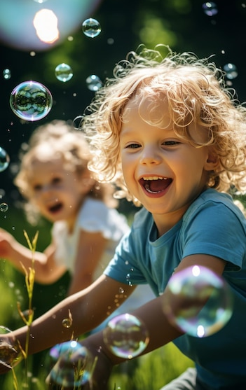
Thank You

