Slide 1



Using
Jeffrey Wolff
Kiwanis Club of Tysons
Educational Sponsor

Slide 2

Review: What Is Kiwanis Engage?
Kiwanis Engage is the organization’s new online web platform that will allow the entire Kiwanis family to more easily perform the administrative and reporting tasks related to their roles.
This new resource was designed by Kiwanis members for Kiwanis members and is a return on the investment that you have made to the organization.

Slide 3

During today’s session, we will:
Become familiar with the various education resources for Kiwanis Engage.
Learn how to log in to both the live and testing versions of Kiwanis Engage.
Find out how to ask for help while using Kiwanis Engage.
Take a look at Kiwanis Engage.

Slide 4

Discovering education resources

Slide 5

Education resources
kiwanis.org

Slide 6
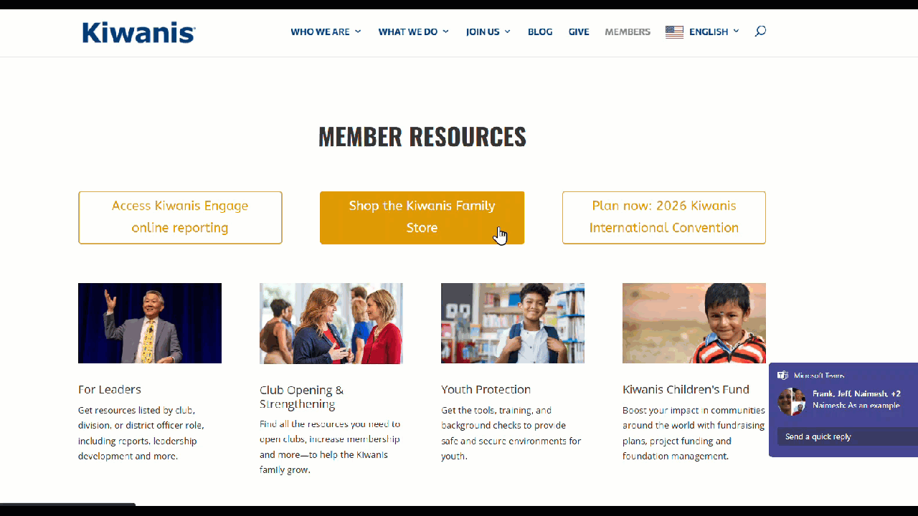
Education resources
kiwanis.org/members

Slide 7

Education resources
SLP
Kiwanis
kiwanis.org/kiwanis-engage

Slide 8
Education resources
The Kiwanis Engage Learning Resources page includes:
Short training videos: Take you through how to complete specific tasks within Kiwanis Engage. You may follow by officer track or skip around. Videos are typically no more than 1-3 minutes long.
Recorded webinars: Previous live virtual sessions that you can rewatch or view if you missed the original.

Slide 9
Education resources
The Kiwanis Engage Learning Resources page also includes:
A training “playground” version of Kiwanis Engage: Here, you can test what you are learning.
This will require a login using your Kiwanis email address and a new password which you will set up.
IMPORTANT: Changes made in this version will not impact your official club or district records.

Slide 10
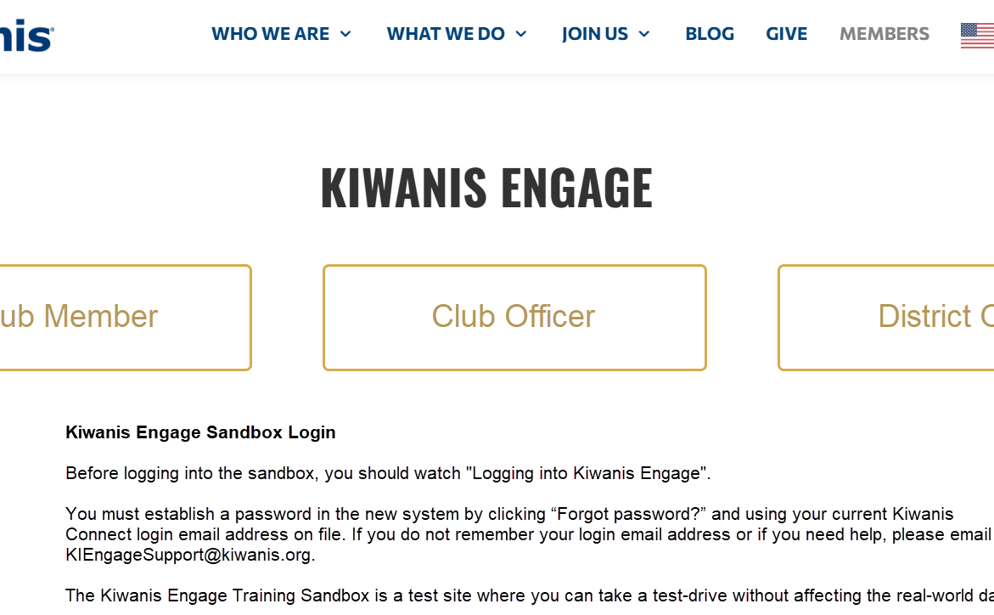
Education tracks
Follow a course syllabus for club members, club officers or district officers.
Everyone should watch the club member videos!

Slide 11
Video topic examples
My Profile overview
Select language
Change profile photo
Switch between profiles
Delete members
Background checks for active members
Members - edit member information
Club details overview
District Dashboard overview
Manage club officer positions
Reports and reporting overview
Monthly Reports overview
Annual membership totals overview

Slide 12
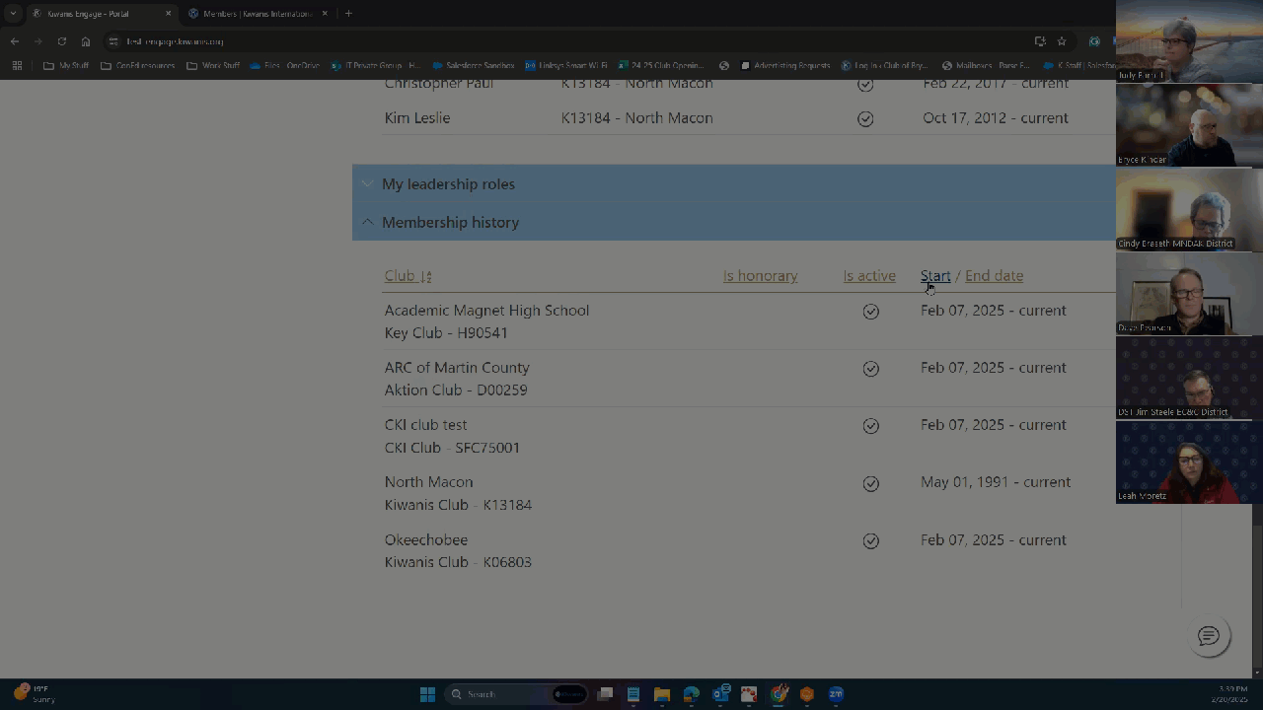
Webinar recordings

Slide 13
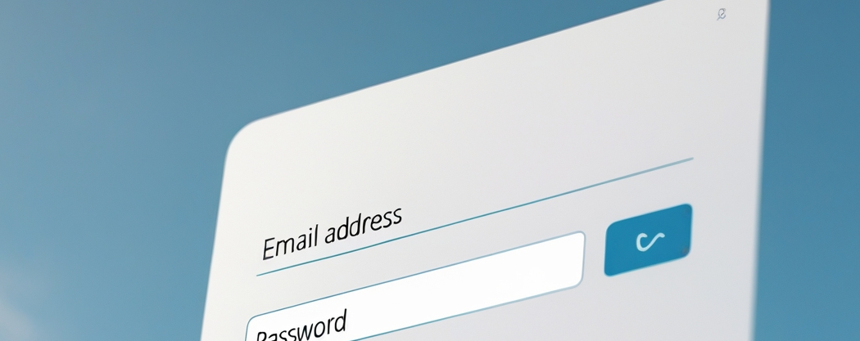

Logging in

Slide 14
Two versions of Kiwanis Engage
The live version of Kiwanis Engage is now available, once users set up a new password.
Users have access to the training “playground” of Kiwanis Engage through a separate login.
Make sure you know which one you’re using!

Slide 15




Telling Kiwanis Engage versions apart:
The “playground” environment is clearly marked with a yellow banner.
The website address has “training” in it.
The log-in to the “live” version can be found on the Members section of Kiwanis.org.

Slide 16
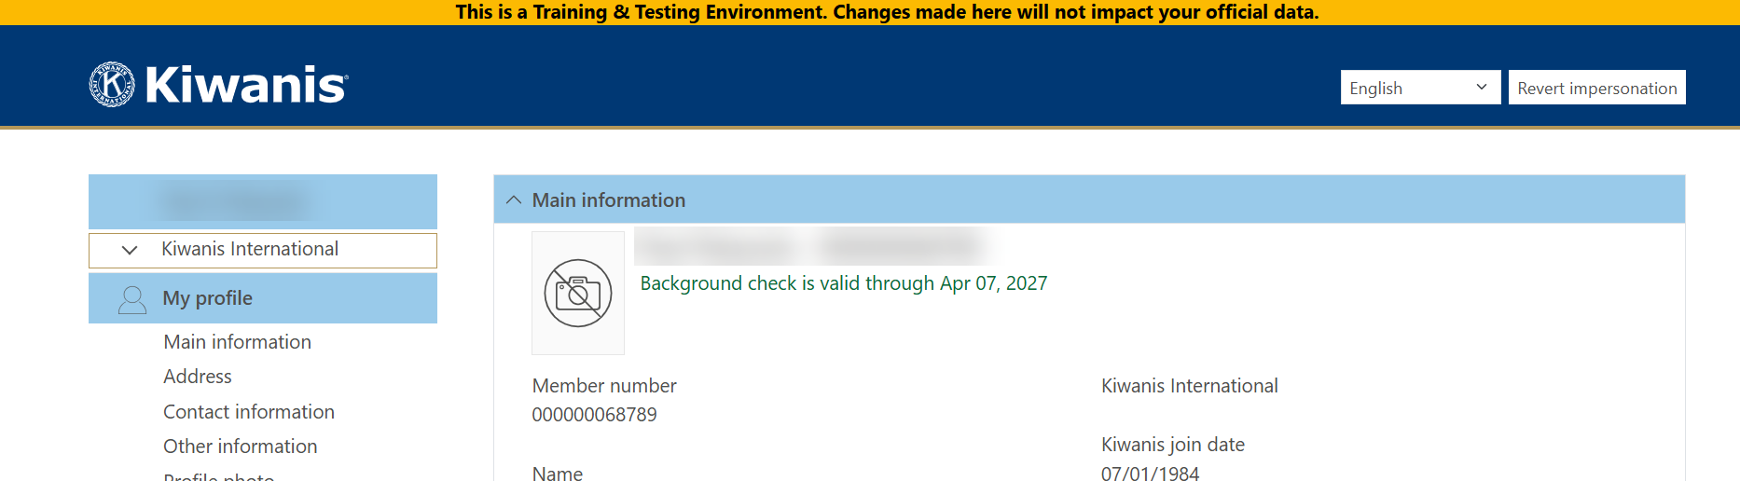
Kiwanis Engage Training Playground

Slide 17
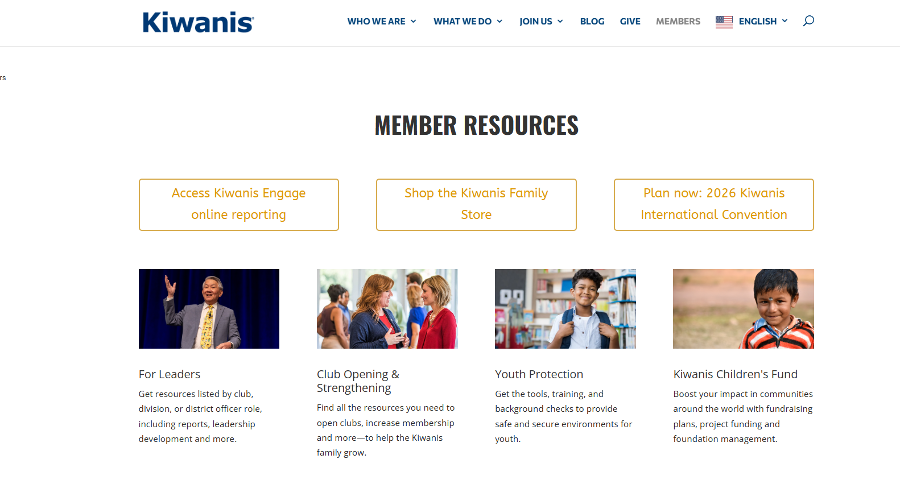
Accessing Kiwanis Engage
Or Visit https://engage.kiwanis.org

Slide 18
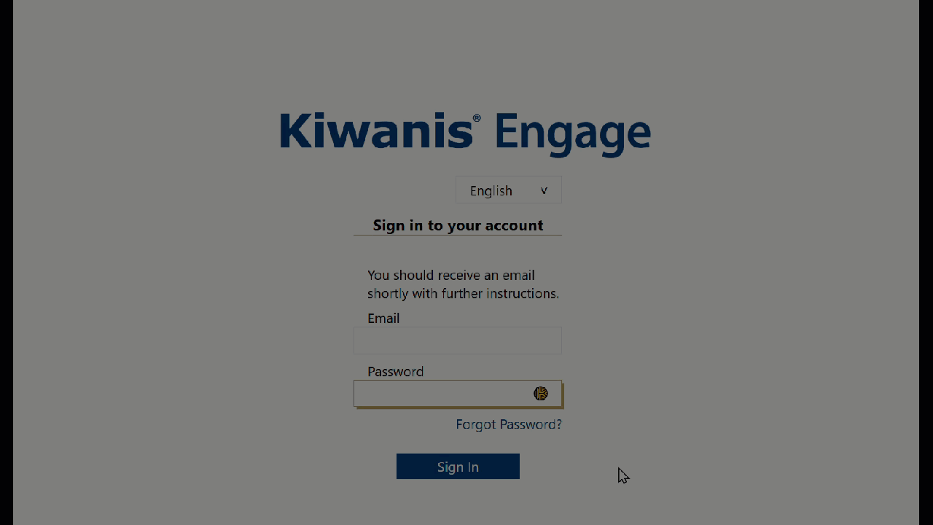
Creating a login
Select “Forgot Password?” to create your login.

Slide 19

Requesting support

Slide 20
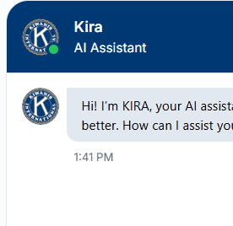


How to ask for further help
Ask our kiwanis.org chat agent KIRA
Contact us via the Kiwanis Engage training page
Message our staff from within Kiwanis Engage

Slide 21




Frequently asked questions
Who can access the club officer section of Kiwanis Engage?
Do I need to upload my profile picture again?
Where did my past monthly reports go?
Notes:
Presenter: Greg Smith

Slide 22

Your No. 1 support resource
kiwanis.org/kiwanis-engage
The home page for all your Kiwanis Engage training needs.

Slide 23

A closer look at Kiwanis Engage

Slide 24
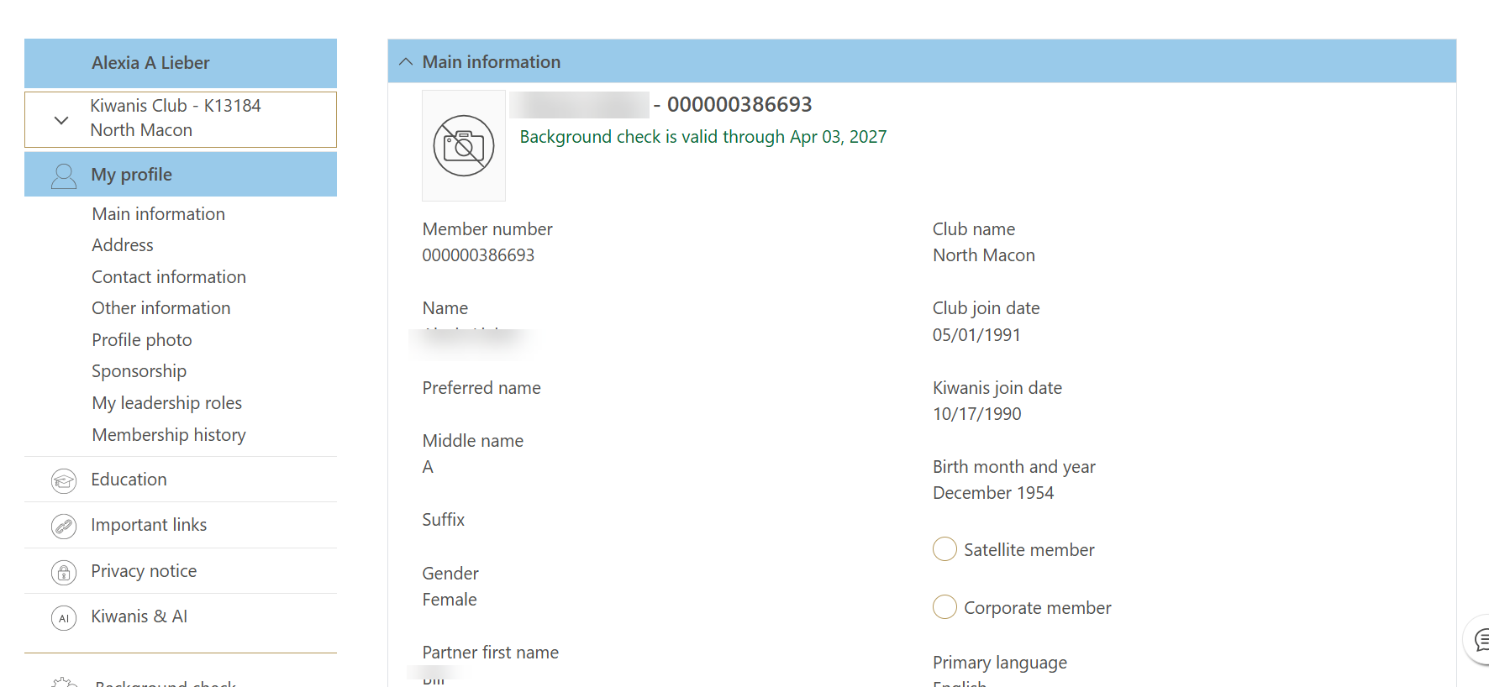
Member Profile

Slide 25
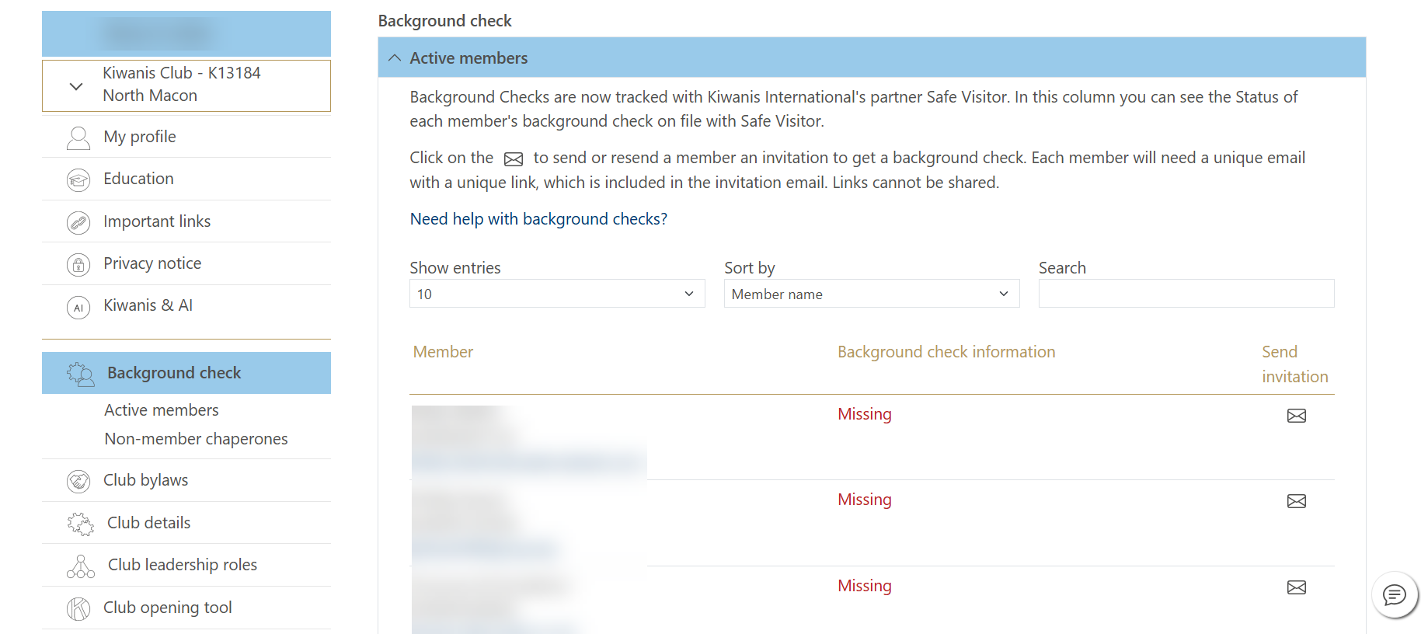
Background checks

Slide 26
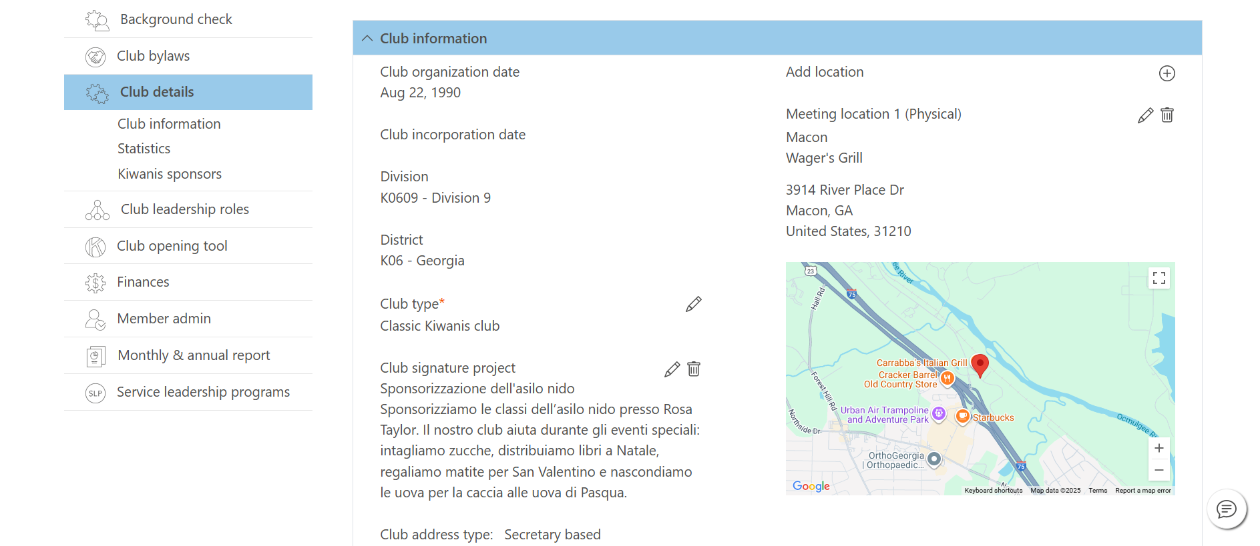
Club Details

Slide 27
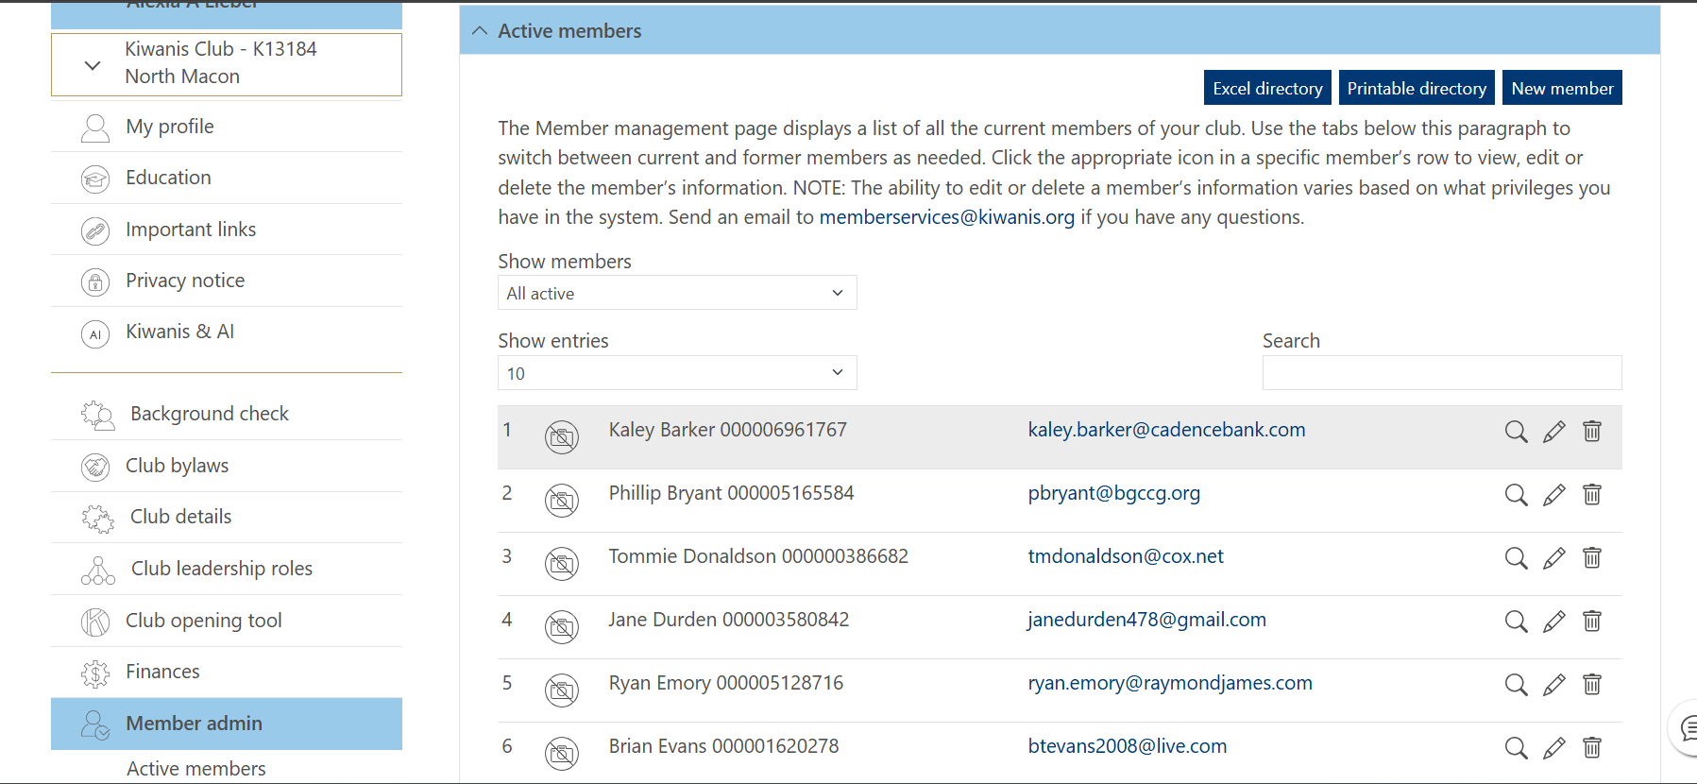
Member Admin

Slide 28
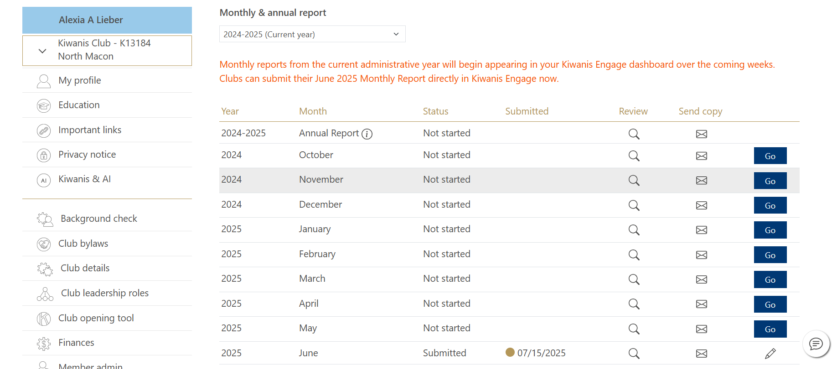
Monthly Reports

Slide 29
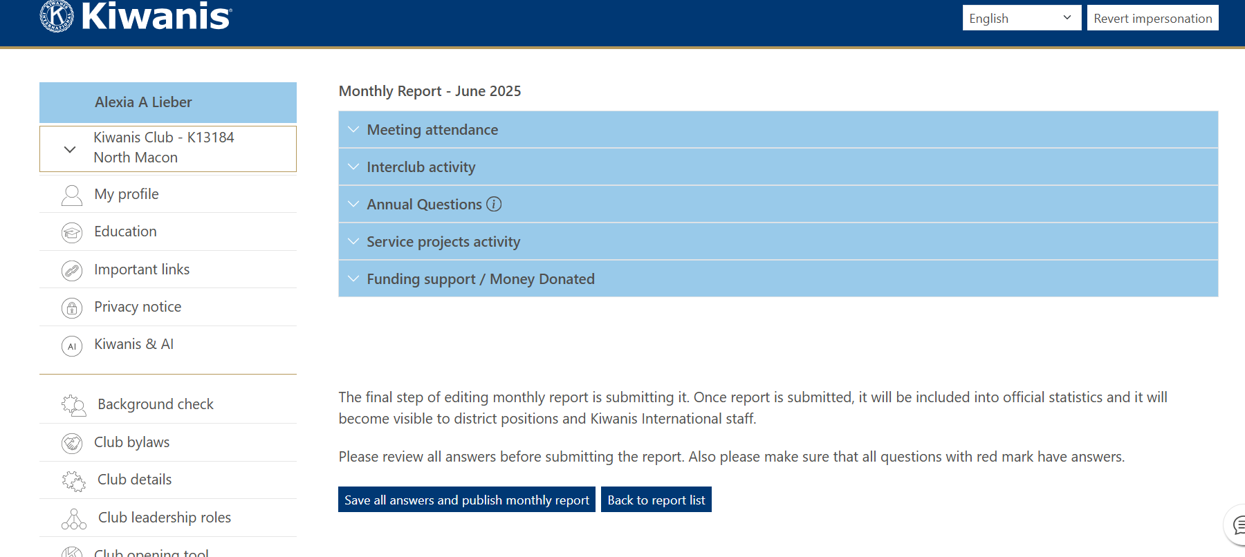
Monthly Reports

Slide 30
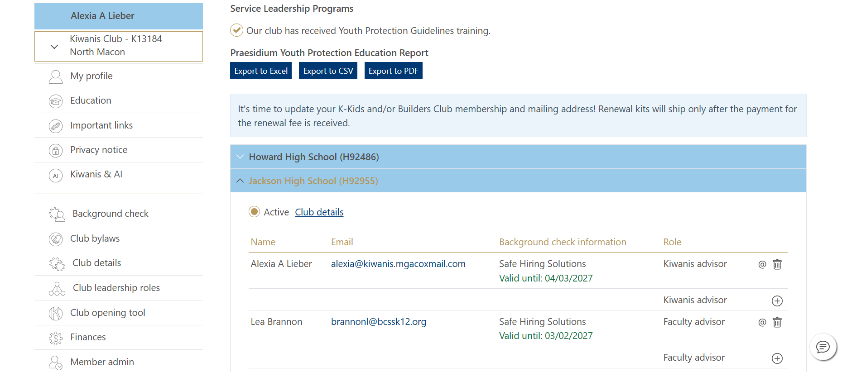
Monthly Reports

Slide 31

What questions do you have?

