Slide 1
Protecting Youth in Kiwanis Service:
Know. Protect. Respond.
Capital District Convention
August 21-23, 2026
Annapolis, MD
Dennis Baugh, Trustee
Kiwanis International

Slide 2
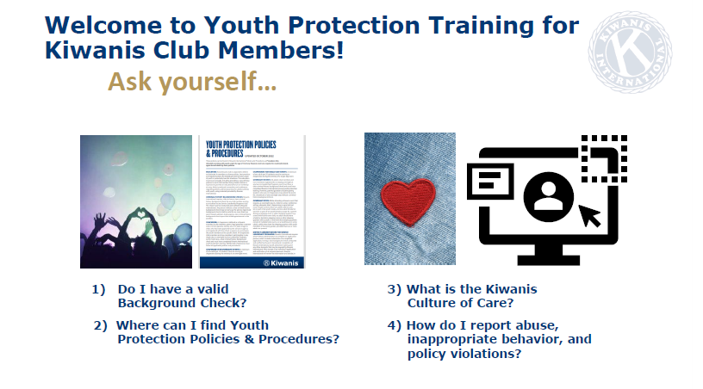

Slide 3


Slide 4
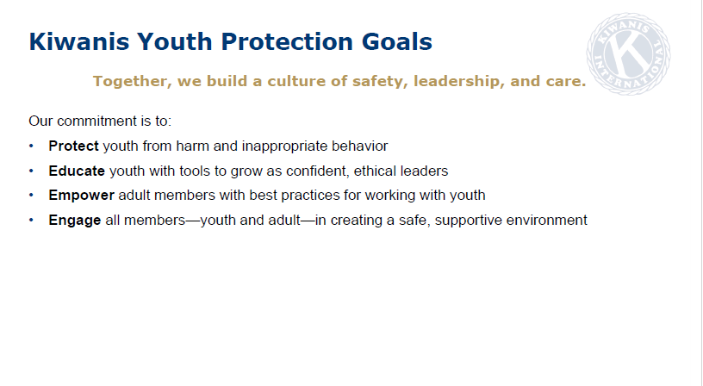

Slide 5
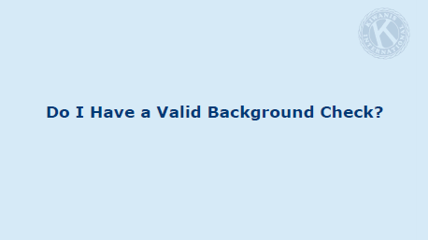

Slide 6
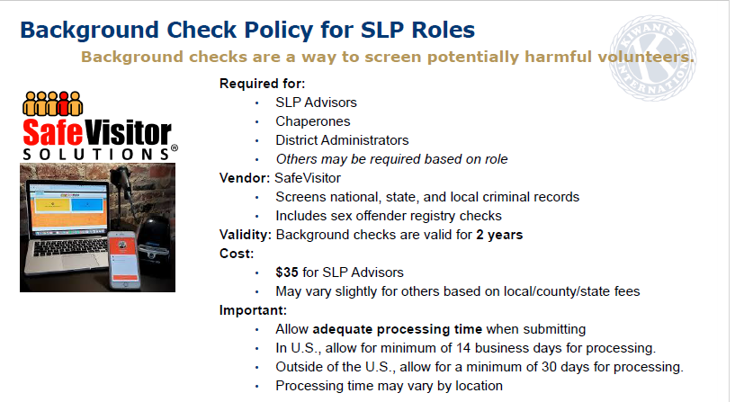

Slide 7
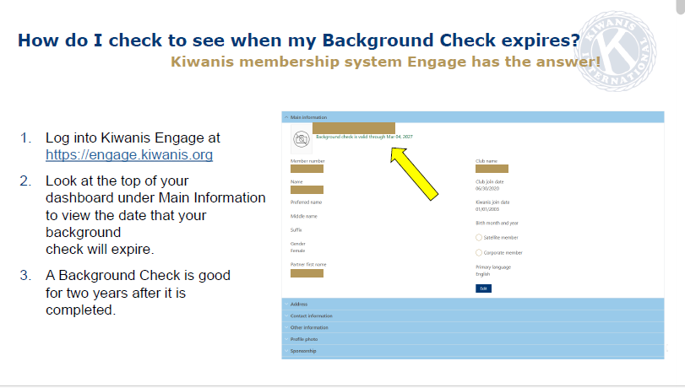

Slide 8
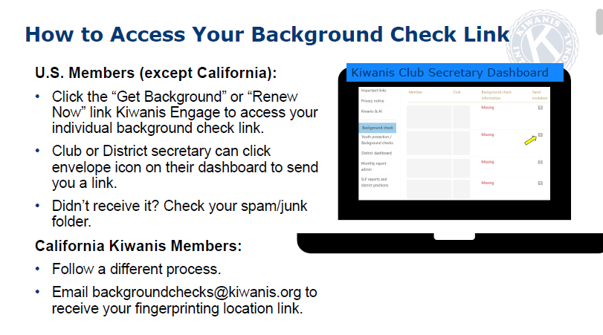

Slide 9
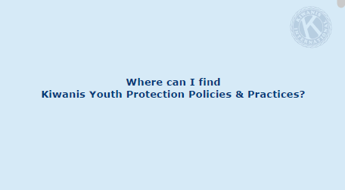

Slide 10
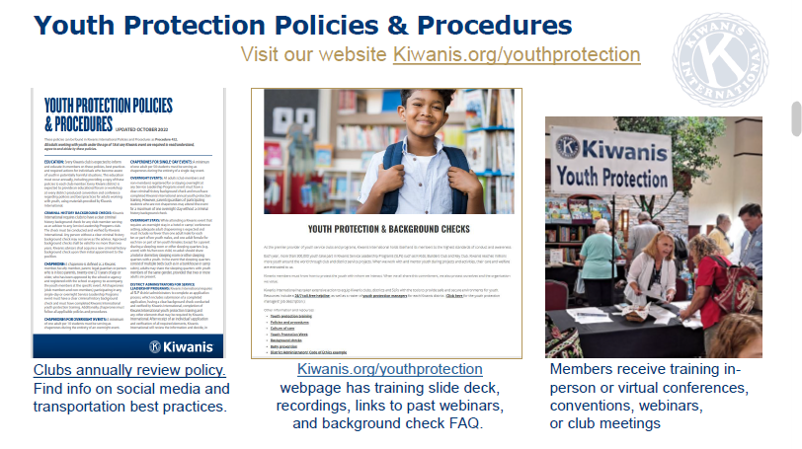

Slide 11


Youth Protection Polices
  Secretaries Responsibilities:
  Enter in Engage!!
Resources:
Youth Protection guidelines
Notes:
Finally, the Youth Protection Guidelines outline the required policies and background-check expectations for any volunteer who works directly with youth.
As a club officer, it is essential to review these guidelines regularly to ensure you and your club—including all members and SLP advisors—remain up to date and in full compliance.
Please visit the Youth Protection website to confirm your understanding of current requirements.

Slide 12
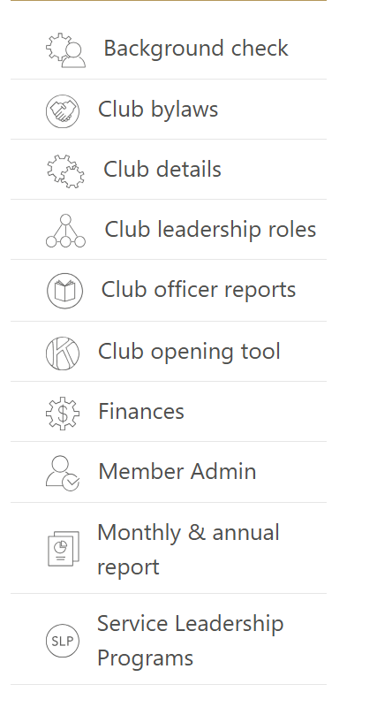

Kiwanis Engage – Youth Protection Reporting
.
This is on the main page of Engage for the club.
The Secretary will click on Service Leadership Program
Notes:
Before we begin, here’s what you can expect to walk away with from today’s session.
Club Treasurer 201 focuses on the how — the practical steps that support accurate, transparent and dependable financial operations.
First, you’ll learn the key priorities for starting your year strong, including how to set up your financial systems and review the information you’ll rely on throughout your term.
You’ll also see how to manage club accounts with accuracy — tracking income and expenses, coordinating dues with the secretary and supporting the president and board during budgeting.
Next, we’ll talk about what financial transparency looks like in practice: preparing clear financial reports, knowing what needs to be documented and understanding when those updates should be shared with your leadership team.
And finally, you’ll learn what’s required at the end of the year — closing out the books, completing required filings, preparing for the annual review and organizing records so your successor can start with confidence.

Slide 13
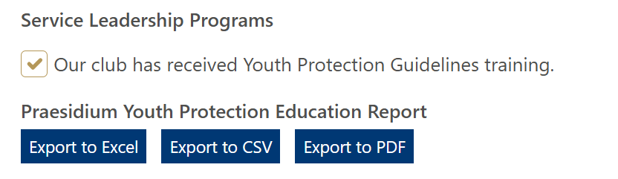
Kiwanis Engage – Youth Protection Reporting
The below screen is on the top of the page when you click on Service Leadership Programs.
ONLY THE SECRETARY OR PRESIDENT CAN CHECK THE BOX!!
Notes:
Before we begin, here’s what you can expect to walk away with from today’s session.
Club Treasurer 201 focuses on the how — the practical steps that support accurate, transparent and dependable financial operations.
First, you’ll learn the key priorities for starting your year strong, including how to set up your financial systems and review the information you’ll rely on throughout your term.
You’ll also see how to manage club accounts with accuracy — tracking income and expenses, coordinating dues with the secretary and supporting the president and board during budgeting.
Next, we’ll talk about what financial transparency looks like in practice: preparing clear financial reports, knowing what needs to be documented and understanding when those updates should be shared with your leadership team.
And finally, you’ll learn what’s required at the end of the year — closing out the books, completing required filings, preparing for the annual review and organizing records so your successor can start with confidence.

Slide 14
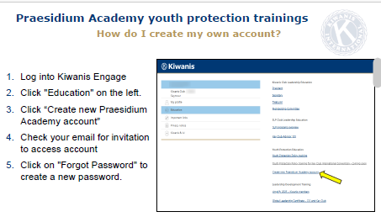

Slide 15
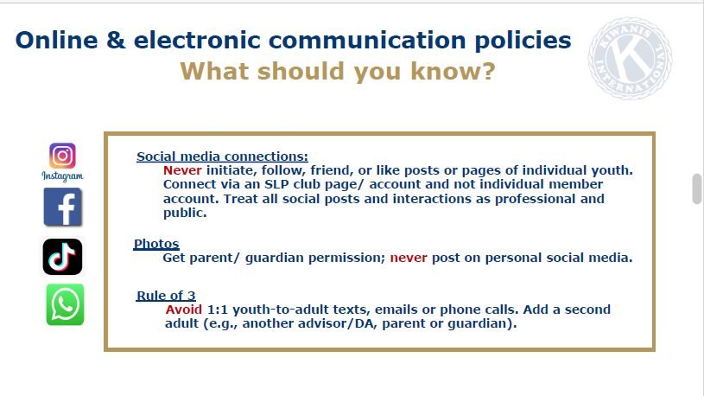

Slide 16


Slide 17
How do I report troubling behaviors?

Slide 18
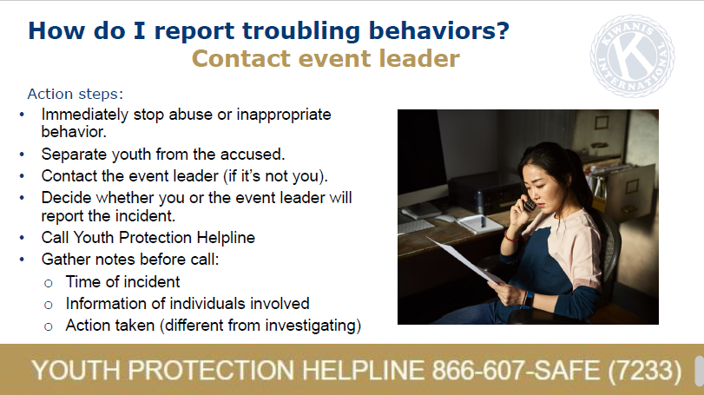

Slide 19


Slide 20
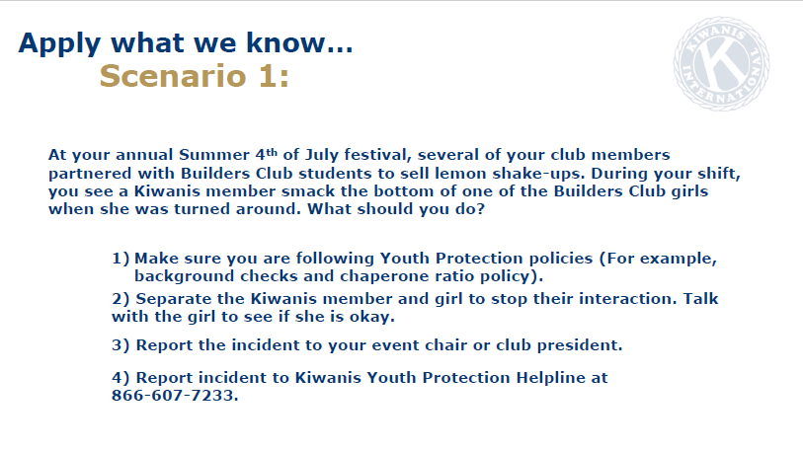

Slide 21
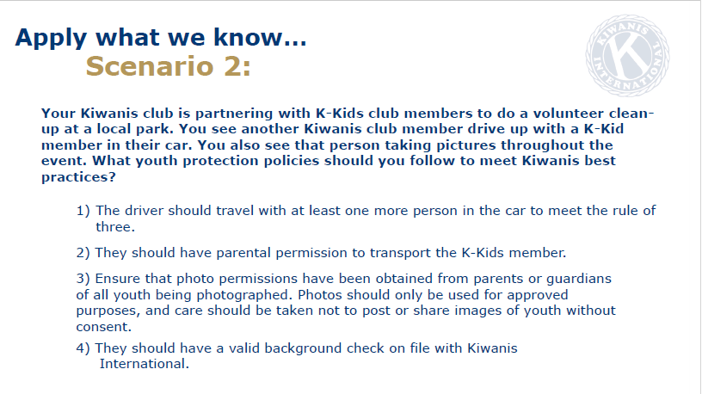

Slide 22
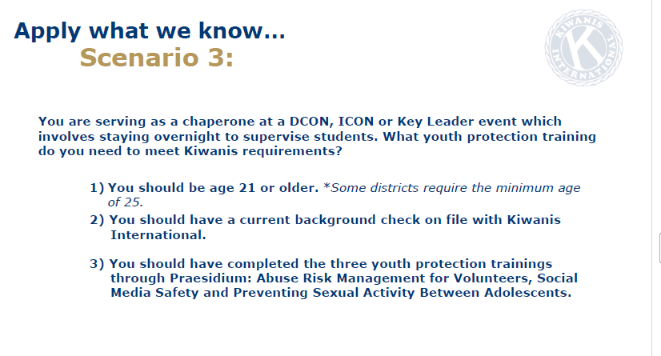

Slide 23


