Slide 1

2024 CLUB LEADERSHIP EDUCATION
Club Membership Chair
<<Insert District>>
<<Insert Date>>
Notes:
Welcome to Club Membership Chair training. We will spend this time together reviewing the role and responsibilities of a club membership chair and the resources that are available to you.

Slide 2
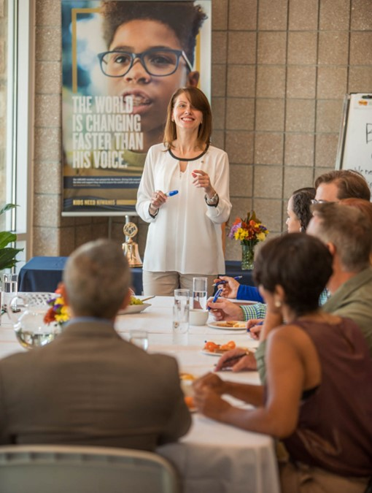
Welcome and agenda
Roles and expectations
Membership planning
Recruitment
Retention
Marketing your club
Tools and resources
Notes:
FACILITIATE
Today we’ll discuss the following topics:
Roles and Expectations
Membership planning
Strategies for Membership
Recruitment
Retention
Marketing Your Club
Tools and Resources

Slide 3
ROLE & EXPECTATIONS
Club Membership Chair
Notes:
FACILITATE
As the membership chair, you are the face and voice for membership activities in your club.
Your role is to create a strong and vibrant membership experience that’s rewarding for current members and inviting to others. To be successful, you need to set realistic membership goals, create a membership action plan and have it approved by your board, and plan member drives and events.
The first resource that we want to bring to your attention in the Leadership Guide. The most updated version of this document (updated in January 2024) is available online at kiwanis.org/leadershipguide. The club membership chair section begins on page 51.

Slide 4

Your role
Set goals.
Develop action plan.
Communicate importance of membership efforts.
Plan membership events.
Teach others how to invite.
Plan and conduct member inductions.
Notes:
Our goal today is to provide you with guidance to undertake these tasks as your club works to meet established membership goals. In your role you will:
Set realistic and measurable goals.
Develop action plan for meeting goals.
Communicate importance of membership efforts to members.
Plan membership drives and special recruitment events.
Teach others how to invite community members to club events.
Plan and conduct new-member inductions.
In your role as membership chair, you’ll also serve as a spokesperson on membership topics. When the club bylaws were updated in 2012, Kiwanis leadership defined a club membership committee’s role as one that:
Recruits or invites new members.
Works to retain existing members.
Increases the visibility of the club in the community.
It’s common for a club to have a separate public relations or marketing committee. If that’s the case in your club, be sure to incorporate the marketing/PR committee in your membership committee’s plans. Also, if your club has a separate social media manager, be sure that member is also involved as you will work together on visibility in the community.
Membership and PR/marketing are very connected, and working together will help both committees accomplish their goals.

Slide 5

Important dates
Club President’s Planning Conference
October 1 – Start of Kiwanis year
Annual meeting
April 1 – World Reporting Day
May Membership Month
August and September
Notes:
Club President’s Planning Conference– This traditionally occurs in July, August or September to plan for the year ahead. Make sure that membership is on your retreat agenda. Set membership goals.
Annual meeting – Your club bylaws state that one meeting each year between January 1 and May 15 will be designated as the annual meeting for club elections. It’s also a great time to discuss the future of your club’s membership.
April 1 - is the midpoint of the Kiwanis year and has been deemed “World Reporting Day”. Clubs from all over the world will be asked to call the Kiwanis International Headquarters on this day to report their membership successes. Please watch kiwanis.org/club-toolbox for more information as it becomes available.
May Membership Month – May has historically been known as Membership Month. Some clubs plan recruitment events in May. Other clubs use the month of May to strategically plan membership events or recruitment efforts for the rest of the year. No matter what, it’s a great month to evaluate and plan next steps for seeking new members in your club.
August and September – This is not a good statistic. 39% of our members who left Kiwanis last year were deleted from club rosters in September. Clubs need to be deleting members throughout the year to give a good indication where the club stands in its membership. Some members move or pass away, but some members do not feel engage. Use August and September to make sure everyone believes they have a vital role to play in the club and, more importantly, in the lives of children your club impacts in the community. This is especially important for newer members. Perhaps they have not seen the full scope of your work. Engage new members immediately in a project. Re-engage any member who may feel burned out or too busy – the best Kiwanis members are those who volunteer in many organizations. We appreciate everyone’s time and talent they give a Kiwanis club. Keep them coming back year after year.

Slide 6
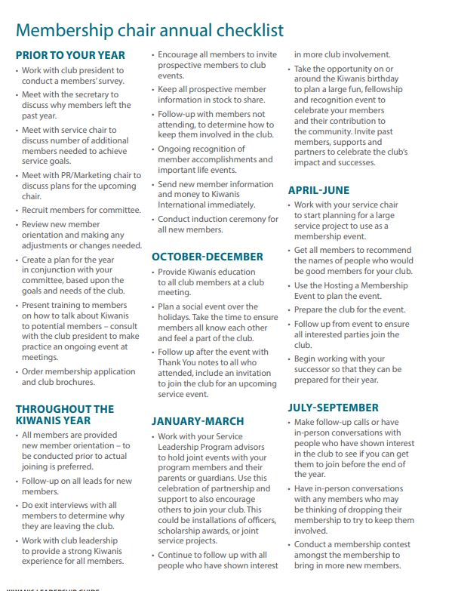

Checklist
Prior to your year
Throughout the Kiwanis year
Quarter 1 (October-December)
Quarter 2 (January-March)
Quarter 3 (April-June)
Quarter 4 (July-September)
SEE PAGE 64 – LEADERSHIP GUIDE
Notes:
FACILITATE
One resource you will need is a checklist for you to use.
This list has specific things to do each quarter, as well as what to do prior to the year beginning and a few things that should be done throughout the year.
You can find this valuable resource on page 64 of the Leadership Guide.

Slide 7
MEMBERSHIP PLAN
Every club needs a strategy to recruit and retain members
Notes:
FACILITATION GUIDE
Creating a membership plan is essential for club growth and overall club health.
Clubs may begin the process of creating a membership plan with the officers and board of directors.
The club leadership may task the membership chair to examine overall member efforts.
A focus group may be formed to look at recent membership trends and envision future potential.
The entire club can take part in a membership retreat or series of planning sessions to grow the club.
No matter how you begin creating your membership plan, eventually all club members need to be working together—challenged to provide a club experience that keeps members coming back and motivates new members to join.
Once the initial membership plan is created, it is imperative to schedule regular updates on the progress.
Kiwanis International provides tools and some staff or volunteer support to assist clubs with recruitment and retention.
We are going to take a quick tour of the membership plan. You should have access to an electronic version or a printed copy in front of you.
https://www.kiwanis.org/wp-content/uploads/2024/03/Membership-Planning-Worksheet.pdf
Where does your club begin?
Creating your club’s membership plan is your starting point to:
Examine where your club is today.
Strategize where you want your club to be in the future.
Analyze which membership strategies work best for your club.
Decide how you plan to meet your goals.

Slide 8
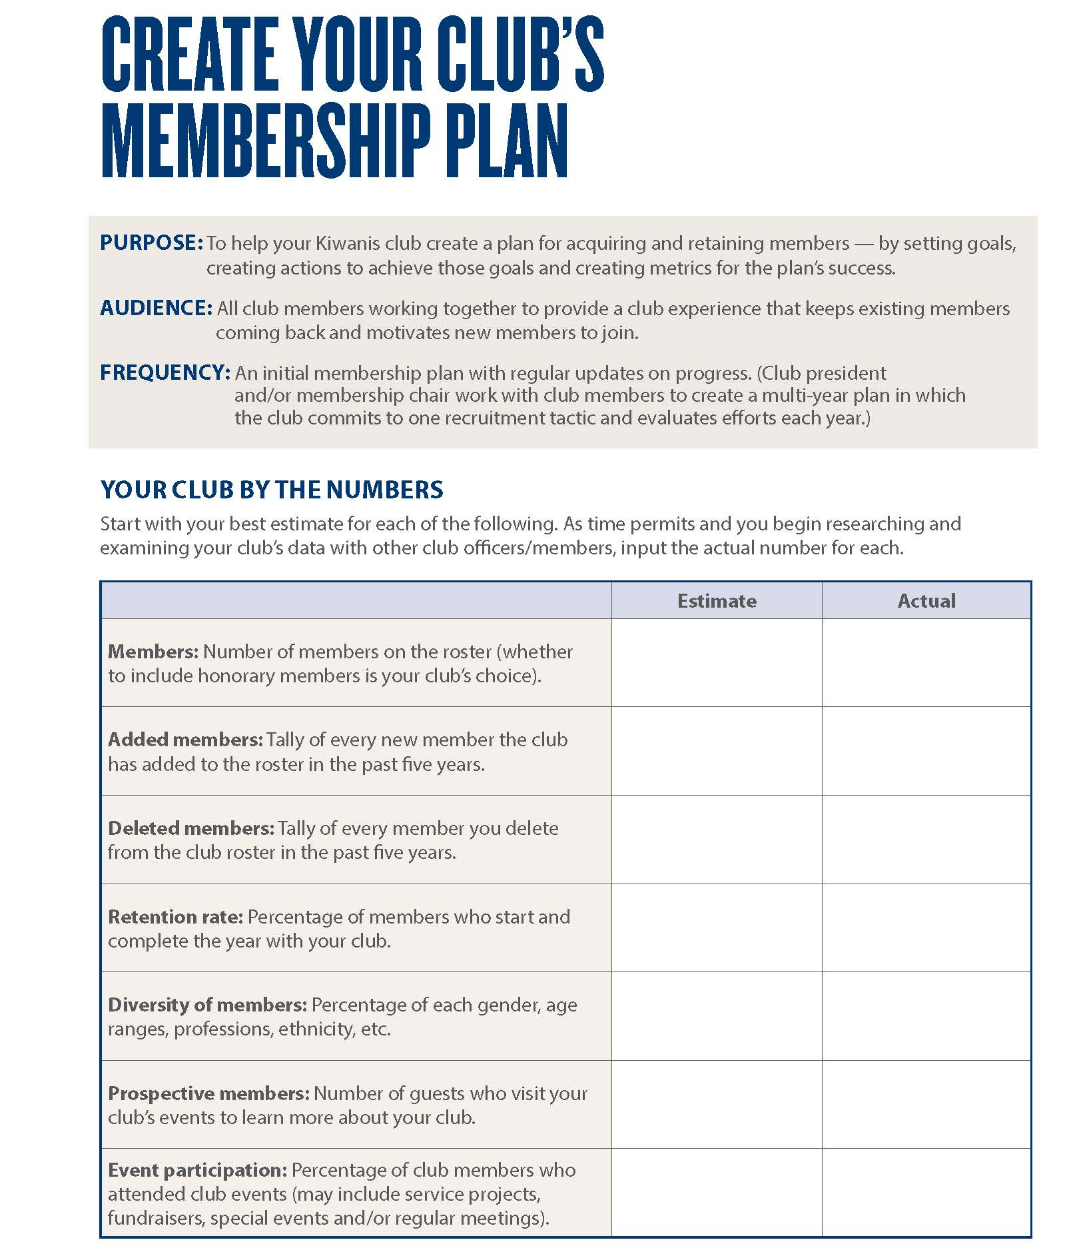
Create a membership plan
YOUR CLUB BY THE NUMBERS
Estimate and then research
Number of members on the roster.
New members added in the past five years.
Members deleted in the past five years.
Percentage who continue each year.
Gender, age ranges, professions, ethnicity, etc.
Number of guests who visit.
Percentage of members who attend events.
Notes:
WORKBOOK INFORMATION/QUESTIONS
Start with your best estimate for each of the following. As time permits and you begin researching and examining your club’s data with other club officers/members, input the actual number for each.
Members: Number of members on the roster (whether to include honorary members is your club’s choice).
Added members: Tally of every new member the club has added to the roster in the past five years.
Deleted members: Tally of every member you deleted from the club roster in the past five years.
Retention rate: Percentage of members who start and complete the year with your club.
Diversity of members: Percentage of each gender, age ranges, professions, ethnicity, etc.
Prospective members: Number of guests who visit your club’s events to learn more about your club.
Event participation: Percentage of club members who attended club events (may include service projects and fundraisers).

Slide 9
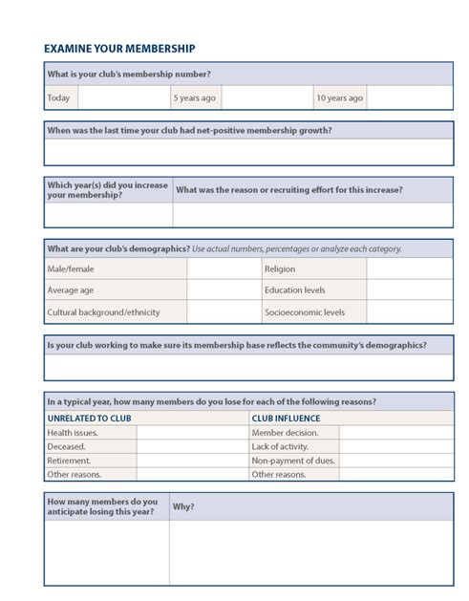
Create a membership plan
EXAMINE YOUR MEMBERSHIP
Your club will analyze
Your club’s membership number
Last time your club had net-positive growth
Club’s demographics
Number of members you lose annually and reasons
Notes:
WORKBOOK INFORMATION/QUESTIONS
What is your club’s membership number?
Today? 5 years ago? 10 years ago?
When was the last time your club had net-positive membership growth?
Which year(s) did you increase your membership?
What was the reason or recruiting effort for this increase?
What are your club’s demographics? Use actual numbers, percentages or analyze each category.
Male/female
Average age
Religion
Education levels
Cultural background/ethnicity
Socioeconomic levels
Is your club working to make sure its membership base reflects the community’s demographics?
In a typical year, how many members do you lose for each of the following reasons?
UNRELATED TO CLUB CLUB INFLUENCE
Health issues. Member decision.
Deceased. Lack of activity.
Retirement. Non-payment of dues.
Other reasons. Other reasons.
How many members do you anticipate losing this year?
Why?

Slide 10
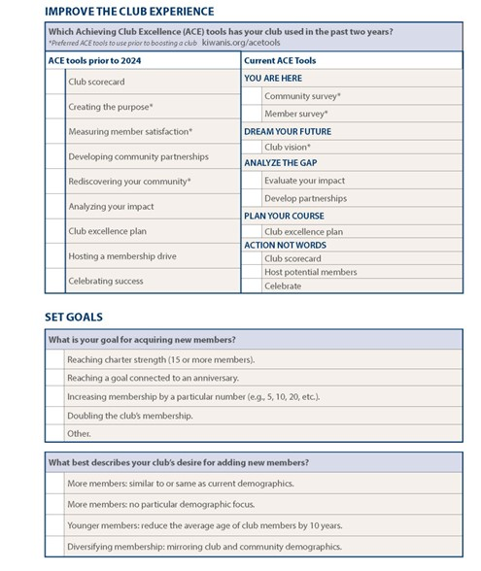
Create a membership plan
IMPROVE THE CLUB EXPERIENCE
In-depth look at all your club does
Operations
Service and fundraising
Community outreach
kiwanis.org/ACEtools
Notes:
FACILITATION GUIDE
Review Page 3 of club membership plan document.
Improving the club experience is essential for staying relevant with the changing needs of your community – plus, it’s vital for increased membership recruitment and retention. The Achieving Club Excellence, or ACE Tools help your club create opportunities in fundraising, service and fellowship — based on what your members love most. You can access the ACE Tools at kiwanis.org/acetools.
Has your club been using any of the ACE Tools to help your club improve and grow? If so, which ones have you found helpful and why?

Slide 11
Create a membership plan
SET GOALS
Your plan’s intent and outcomes
Determine quantitative goal
Examine your club’s qualitative objective
Notes:
WORKBOOK INFORMATION/QUESTIONS
What is your goal for acquiring new members?
Reaching charter strength (15 or more members).
Reaching a goal connected to an anniversary.
Increasing membership by a particular number (e.g., 5, 10, 20, etc.).
Doubling the club’s membership.
Other.
What best describes your club’s desire for adding new members?
More members: similar to or same as current demographics.
More members: no particular demographic focus.
Younger members: reduce the average age of club members by 10 years.
Diversifying membership: mirroring club and community demographics.
What are your membership plan’s intents and desired outcomes? (Beyond “more members.”)

Slide 12
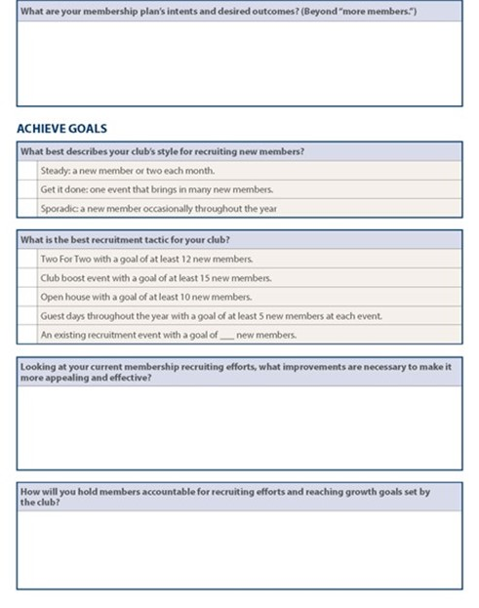
Create a membership plan
ACHIEVE GOALS
Create a plan
Determine best recruiting style and tactic.
Assess necessary club improvement.
Create an accountability plan.
Develop operational steps to achieve goal.
Define how to measure progress.
Notes:
WORKBOOK INFORMATION/QUESTIONS
What best describes your club’s style for recruiting new members?
Steady: a new member or two each month.
Get it done: one event that brings in many new members.
Sporadic: a new member occasionally throughout the year
What is the best recruitment tactic for your club?
Two For Two with a goal of at least 12 new members.
Club boost event with a goal of at least 15 new members.
Open house with a goal of at least 10 new members.
Guest days throughout the year with a goal of at least 5 new members at each event.
An existing recruitment event with a goal of ___ new members.
Looking at your current membership recruiting efforts, what improvements are necessary to make it more appealing and effective?
How will you hold members accountable for recruiting efforts and reaching growth goals set by the club?
What operational steps will the club take to accomplish the goal?
How will you measure your progress? Milestones/check-ins?
ADDITIONAL INFORMATION
This information is added for assistance answering questions about recruitment tactics. You do not need to go in-depth about each during this presentation.
Two for Two – Goal of adding at least 12 members annually
The club begins the year by identifying 24 people in its community to recruit. The club is divided into teams of two for each month. These teams visit two of these prospective members during the month and ask them to join the club. The goal is that the club convert at least one prospective member each month to new member – at least a 50% success rate.
Club boost – Goal of at least 15 members per club boost
A boost can be done with district or division help or with assistance from Kiwanis International in a Facebook marketing campaign. A club prepares for a week of intense recruiting by making sure the club is preparing for new members, creating a list of potential members, setting appointments, and being trained. The weeks leading up to the boost will preferably have a Facebook campaign advertising the informational meeting following the recruitment week. During the recruitment week, members of the club – along with experienced members from outside the club – canvas the area by recruiting prospective members at appointments, following up on referrals, and conducting pop-in visits.
Open House – Goal of adding at least 10 members per open house
A large event is planned to invite potential members with the objective of recruiting them at the event. This event is traditionally a special club function; however, a service project or fundraiser can create a stronger reason for the individual to join. This event is well planned, advertised and prepared for maximum impact.
Guest days – Goal of adding at least 5-10 members per guest day
Guest days are like the Open House, with the same type of preparations; however, it consists of smaller events, each targeted to a specific audience. These audiences could be educators, ministers, non-profits, partners, etc. Clubs that typically host guest days schedule them on a regular basis such as quarterly or semi-annually.
Improving existing recruitment efforts – Goal increasing last year’s results by at least 20%
Many clubs already host amazing recruitment events that are not listed above, generally are specific to the local club and culture and net several new members each year. The club is asked to continue hosting these events and challenge itself to increase its effectiveness by at least 20% more than the previous year.

Slide 13
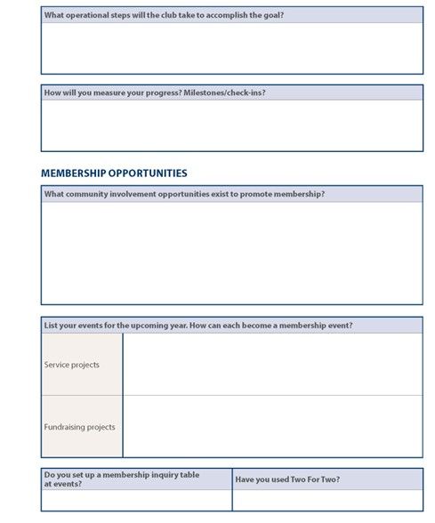
Create a membership plan
MEMBERSHIP OPPORTUNITIES
Capitalize on occasions and flexibility
Community opportunities
Service projects and fundraisers
Two For Two, club boosts or open house
Reconnecting former members
Corporate membership
Satellite membership
Notes:
WORKBOOK INFORMATION/QUESTIONS
What community involvement opportunities exist to promote membership?
List your events for the upcoming year. How can each become a membership event?
Service projects
Fundraising projects
Do you set up a membership inquiry table
at events?
Have you used Two For Two?
Watch your membership grow with Two For Two. Review the example below and then calculate your own club’s Two For Two goals.
These calculations illustrate gross membership growth — not net growth.
See chart on page 6 for explanation.
How many former members still live in your community?
Your club secretary can pull a list of former members from the secretary dashboard. Approach them about renewing their membership. Life changes for people who left Kiwanis — perhaps their life situations now allow more time for a service organization.
Are you familiar with Kiwanis International’s corporate membership classification?
If so, has your club recruited any corporate members in the past year?
kiwanis.org/corporatemember
Does your club or would your club welcome satellite members?
If so, has your club recruited any satellite members in the past year?
kiwanis.org/satellitemember
ADDITIONAL INFORMATION
This information is added for assistance answering questions. You do not need to go in-depth about each during this presentation.
reMember – Goal of adding at least 25% of former members still residing in the area
This is a series of tactics used to re-connect former members of the club. Options can consist of starting a satellite group for those whose scheduling do not allow for regular meeting attendance, having a special guest day targeted to past members, creating an online component to the club for members whose lifestyle is more conducive a club they can join virtually from anywhere, promoting corporate memberships, etc.
Satellite members – Goal of hosting at least 7-10 members or increase existing satellite membership
Satellite member is type of membership for someone who cannot make the regular meetings. Often satellite members become a group that meets separately from the main club. These groups can act either as a committee of the main club or more independently, depending upon how it is set-up. For more information view the satellite member tools on the website.

Slide 14
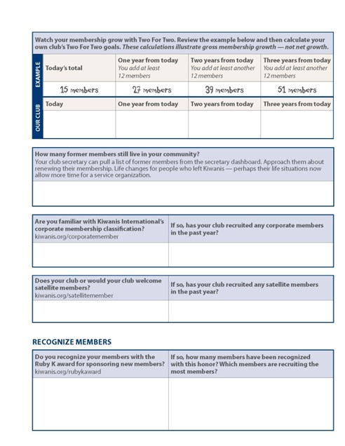
Create a membership plan
RECOGNIZE MEMBERS
Recognition is the greatest motivator
Recognize members with the Ruby K award
for sponsoring new members.
Simple order form.
It’s free.
kiwanis.org/ACEtools
Kiwanis.org/rubykaward
Notes:
WORKBOOK INFORMATION/QUESTIONS
Do you recognize your members with the Ruby K award for sponsoring new members?
If so, how many members have been recognized with this honor? Which members are recruiting the most members?
kiwanis.org/rubykaward

Slide 15
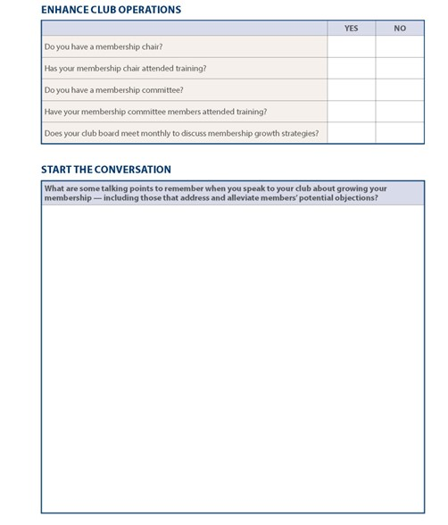
Create a membership plan
ENHANCE CLUB OPERATIONS
Great plans need great leaders
Do you have a membership chair?
Has the membership chair attended training?
Do you have a membership committee?
Have committee members attended training?
Does your club board meet monthly to discuss membership growth strategies?
✓
✓
Notes:
WORKBOOK INFORMATION/QUESTIONS
Do you have a membership chair?
Has your membership chair attended training?
Do you have a membership committee?
Have your membership committee members attended training?
Does your club board meet monthly to discuss membership growth strategies?

Slide 16
Create a membership plan
START THE CONVERSATION
Remember key messages
Excite and engage club in membership efforts.
Develop talking points specific to your club about community impact.
Address and alleviate potential objections.
Notes:
WORKBOOK INFORMATION/QUESTIONS
What are some talking points to remember when you speak to your club about growing your membership — including those that address and alleviate members’ potential objections?

Slide 17
MEMBERSHIP STRATEGIES
Recruitment
Notes:
In order to complete your membership plan, you need to be familiar with a variety of membership growth and retention strategies that are proven to work for Kiwanis clubs.

Slide 18
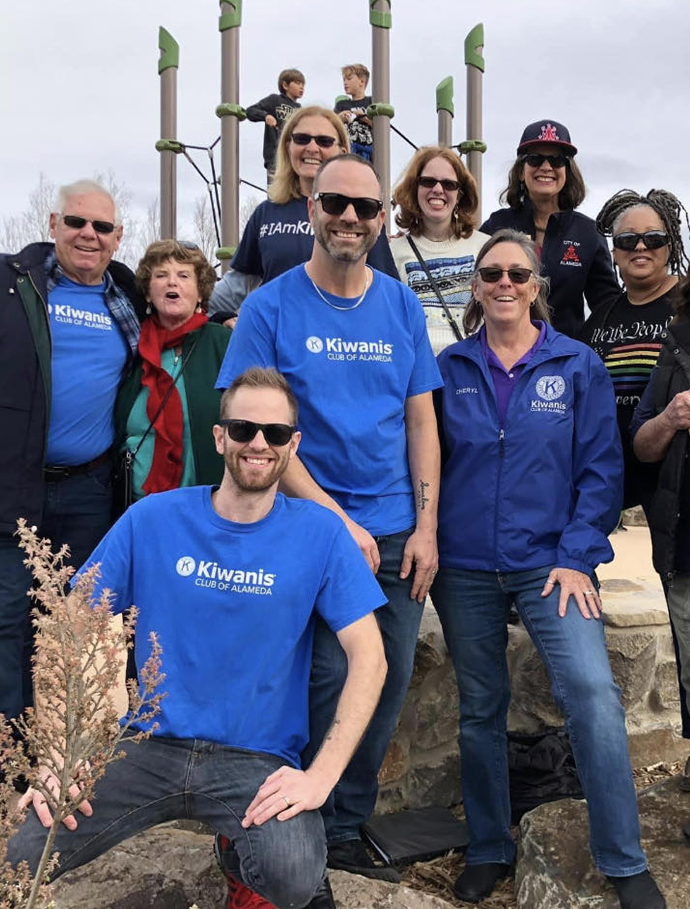
Build. Nurture. Retain.
DISTRICT GOVERNORS
Expected to build new clubs
LIEUTENANT GOVERNORS
Expected to nurture new and existing clubs
Ensure clubs are receiving the attention needed to strong
CLUB PRESIDENTS
Provide a club experience that keeps members coming back for more
Notes:
FACILITATION NOTES
There are three pillars in the membership initiative and a leadership role accountable for each.
Build. District governors are expected to build new clubs.
Nurture. Lieutenant governors are expected to nurture new and existing clubs to ensure they are receiving the attention they need to be strong clubs.
Retain. Club presidents and other club leaders are responsible for providing a club experience that keeps members coming back for more.
The goal of this initiative is to grow our organization’s community impact capacity through membership growth, by investing in and institutionalizing proven club opening tools, methods, and retention efforts.

Slide 19
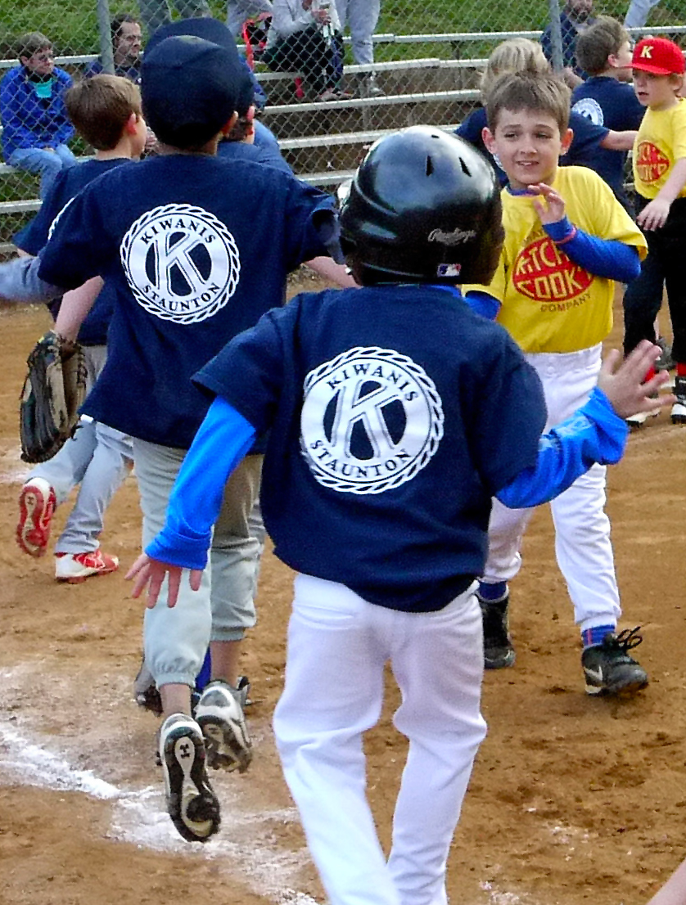
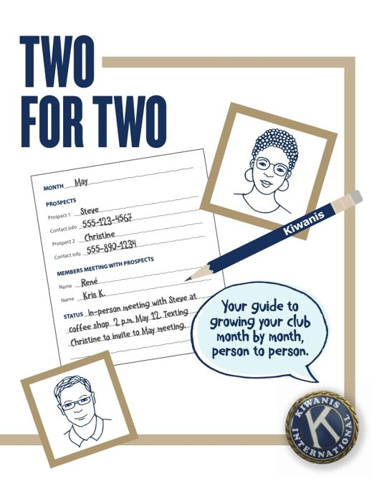
Two For Two
GOAL – AT LEAST 12 NEW MEMBERS
Begin by identifying 24 people to recruit.
Identify two members to reach out to two prospects for each month.
Two existing members visit two prospective members during the month and ask them to join the club.
  Kiwanis.org/TwoForTwo
Notes:
FULL SLIDE INFORMATION
The club begins the year by identifying 24 people in its community to recruit.
Identify two members to reach out to two prospects for each month.
The club is divided into teams of two for each month. These teams visit two of these prospective members during the month and ask them to join the club. The goal is that the club convert at least one prospective member each month to new member – at least a 50% success rate.
FACILITATE
Two for Two – Goal of adding at least 12 members annually
The club begins the year by identifying 24 people in its community to recruit. The club is divided into teams of two for each month. These teams visit two of these prospective members during the month and ask them to join the club. The goal is that the club convert at least one prospective member each month to new member – at least a 50% success rate.

Slide 20
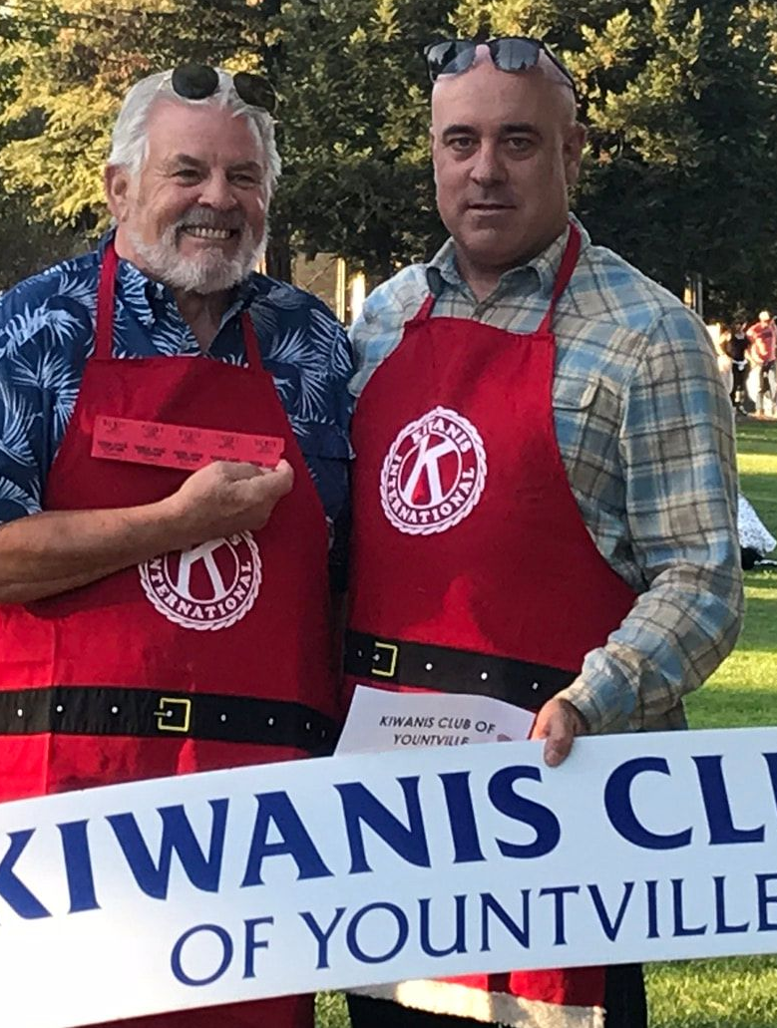
Club boost
GOAL – AT LEAST 15 NEW MEMBERS
A boost can be done with district or division help.
Club prepares for a week of intense recruiting—creating a list of potential members, setting appointments, and being trained.
A Facebook campaign is encouraged.
During the recruitment week, members of the club canvas the area at appointments, following up on referrals, and conducting pop-in visits.
Notes:
FULL SLIDE INFORMATION
A boost can be done with district or division help or with assistance from Kiwanis International in a Facebook marketing campaign. A club prepares for a week of intense recruiting by creating a list of potential members, setting appointments and being trained. The weeks leading up to the boost will preferably have a Facebook campaign advertising the informational meeting following the recruitment week. During the recruitment week, members of the club – along with experienced members from outside the club – canvas the area by recruiting prospective members at appointments, following up on referrals, and conducting pop-in visits.

Slide 21
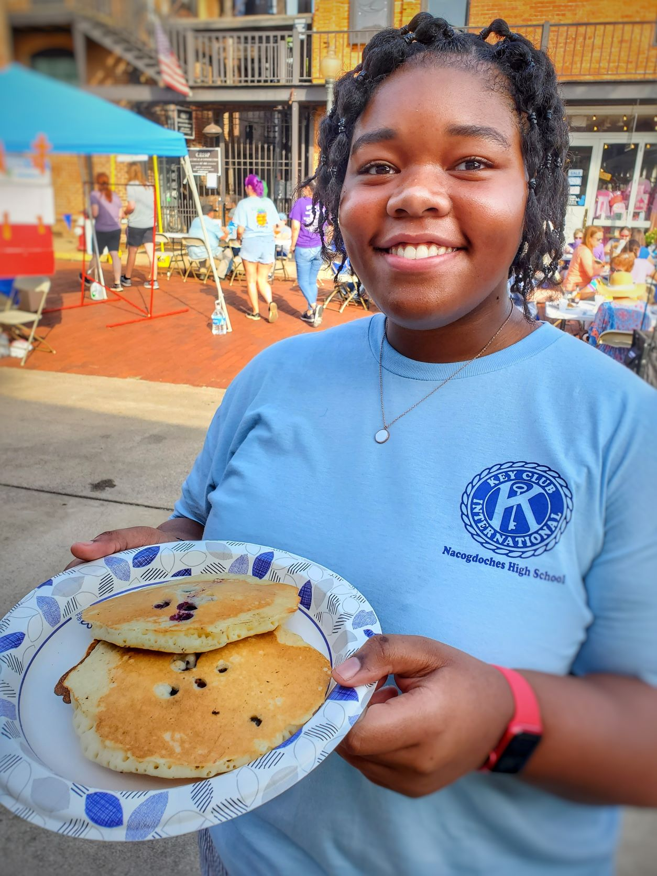
Open house
GOAL – AT LEAST 10 NEW MEMBERS
Event is planned to invite potential members with the objective of recruiting.
This event is traditionally a special club function; however, a service project or fundraiser can create a stronger reason for the individual to join.
This event is well planned, advertised and prepared for maximum impact.
Notes:
FACILITATE
Open House – Goal of adding at least 10 members per open house
A large event is planned to invite potential members with the objective of recruiting them at the event. This event is traditionally a special club function; however, a service project or fundraiser can create a stronger reason for the individual to join. This event is well planned, advertised and prepared for maximum impact.

Slide 22
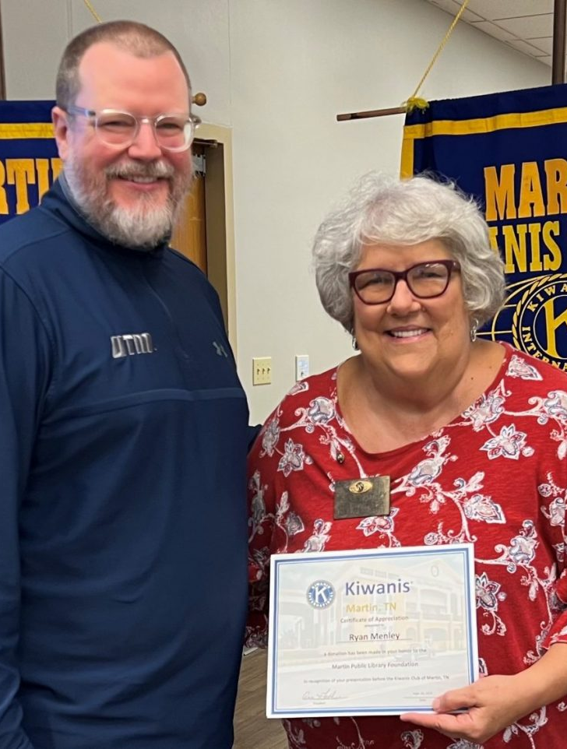
Guest day
GOAL – AT LEAST 5 NEW MEMBERS PER EVENT
Guest days are like the open house, with the same type of preparations; however, it consists of smaller events, sometimes targeted to a specific audience.
Audiences could be educators, ministers, non-profits, partners, etc.
Clubs that typically host guest days schedule them on a regular basis such as quarterly or semi-annually.
Notes:
FACILITATE
Guest days – Goal of adding at least 5-10 members per guest day
Guest days are like the Open House, with the same type of preparations; however, it consists of smaller events, each targeted to a specific audience. These audiences could be educators, ministers, non-profits, partners, etc. Clubs that typically host guest days schedule them on a regular basis such as quarterly or semi-annually.

Slide 23
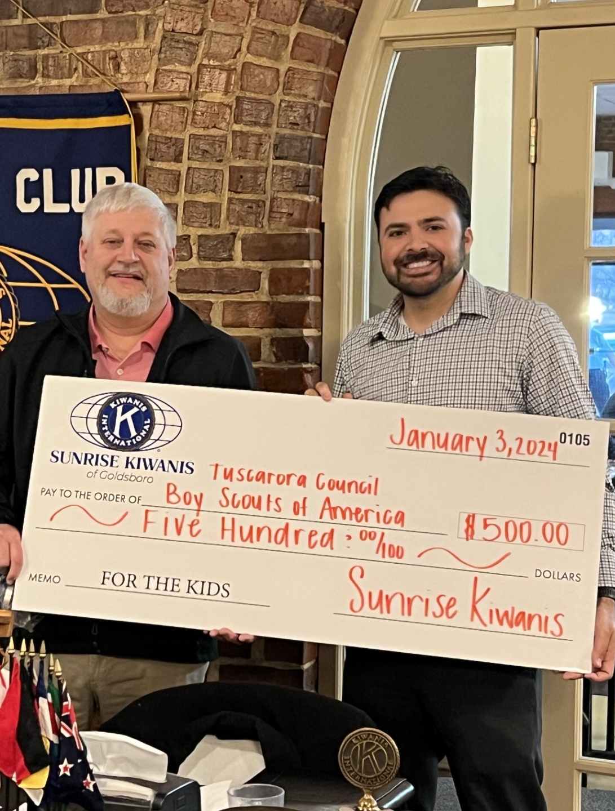
Existing club efforts
GOAL – INCREASE AVERAGE BY AT LEAST 20%
Many clubs already host amazing recruitment events
These generally are specific to the local club and culture and net several new members each year.
These clubs are asked to continue hosting these events and challenge itself to increase its effectiveness by at least 20% more than the previous year.
Notes:
FACILITATE
Improving existing recruitment efforts – Goal increasing last year’s results by at least 20%
Many clubs already host amazing recruitment events that are not listed above, generally are specific to the local club and culture and net several new members each year. The club is asked to continue hosting these events and challenge itself to increase its effectiveness by at least 20% more than the previous year.

Slide 24
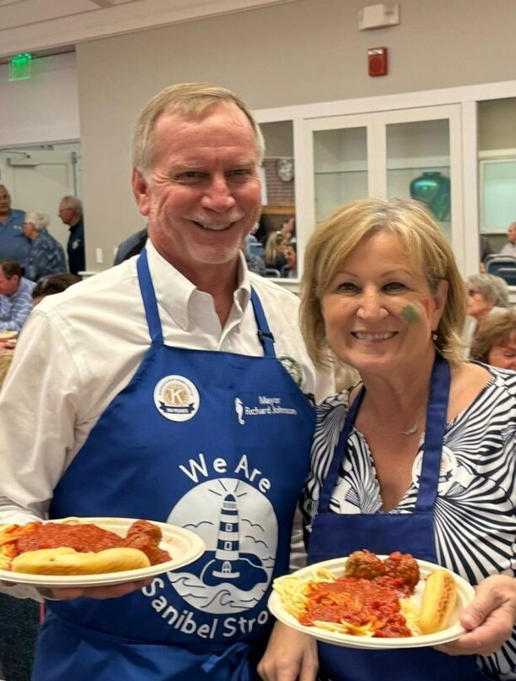
reMember campaign
GOAL – TBD
Former member reunion, open house, etc.
Connect members who have moved.
Promote satellite membership for those who current club model does not fit.
SOMETHING TO THINK ABOUT
Divisions or districts can create a former member virtual club – begin with former members as charter group and then expand.
Notes:
FACILITATE
reMember – Goal of adding at least 25% of former members still residing in the area
This is a series of tactics used to re-connect former members of the club. Options can consist of starting a satellite group for those whose scheduling do not allow for regular meeting attendance, having a special guest day targeted to past members, creating an online component to the club for members whose lifestyle is more conducive to a club they can join virtually, promoting corporate memberships, etc.

Slide 25
MEMBERSHIP STRATEGIES
Retention

Slide 26
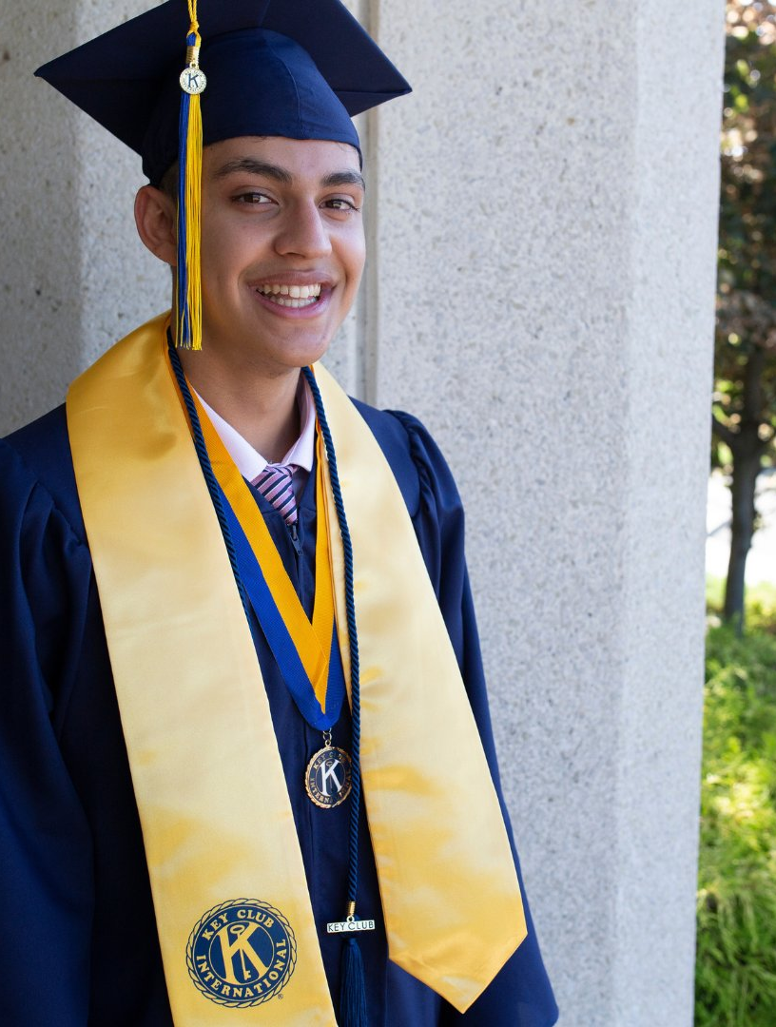
New members
Orientation
Mentoring
Induction ceremony
Engagement
Notes:
FACILITATE
When you attract new members, it's important to keep them and that takes special care and attention.
Orientation: Providing new-member orientation is an important part of helping new members understand what a great organization and club they’re joining. A fillable new member orientation presentation available for download at kiwanis.org/orientation. If you have an education committee in your club, work with that committee to make sure each new member is able to go through an orientation process in a timely manner.
Mentoring: Find a member — maybe it’s the sponsoring member — who will take a special interest in helping them stay connected, especially in those initial months.
Induction ceremony: Make induction into membership a special event. It’s a once-in-a lifetime experience; so, treat it that way. Publicly let the new members tell their reasons for joining the club. Invite the new members’ family and friends. Recognize the sponsoring members.
Involvement: Getting new members involved in an area that’s meaningful for them is key to getting them emotionally connected to the club and the work your club does for the community. Find the right committee, discover each member’s talents and figure out where you need those talents. Show the member they are valued and be sure to ask for their feedback. Expand their horizons by taking them to a nearby club's meeting or to a division or district event.

Slide 27
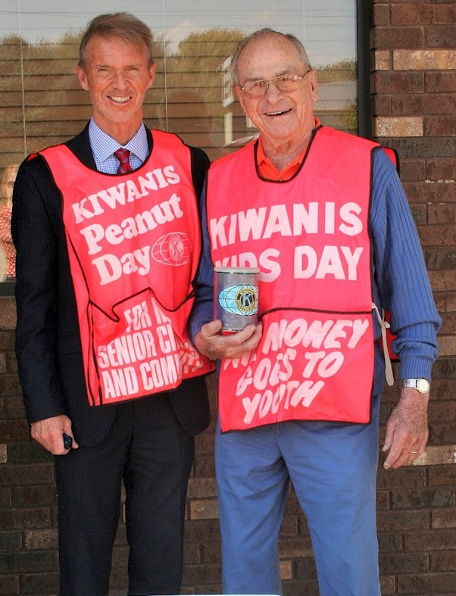
Existing members
Retaining members
Club meetings
Assessments
Re-engage members who become inactive
Celebrate club and member accomplishments
Kiwanis.org/acetools
Notes:
FACILITATE
Strong membership requires a two-pronged approach. Attention has to be given to inviting new members, but there’s the other aspect – keeping the members you have.
Every year, your members make a decision to continue their club membership. So how can we influence their decision to stay?
Work to re-engage those who have become inactive. Assign someone to reach out to find out how they are and find out what's going on with them and let them know what's going on with the club. Invite them to an event! Make sure they know what's going on with the club's projects and events.
Make sure your club remains relevant, both within your community and to your members. Use some of the ACE Tools to help with that process.
Keep existing members engaged by celebrating accomplishments and making sure members are excited and interested in what your club is doing.

Slide 28
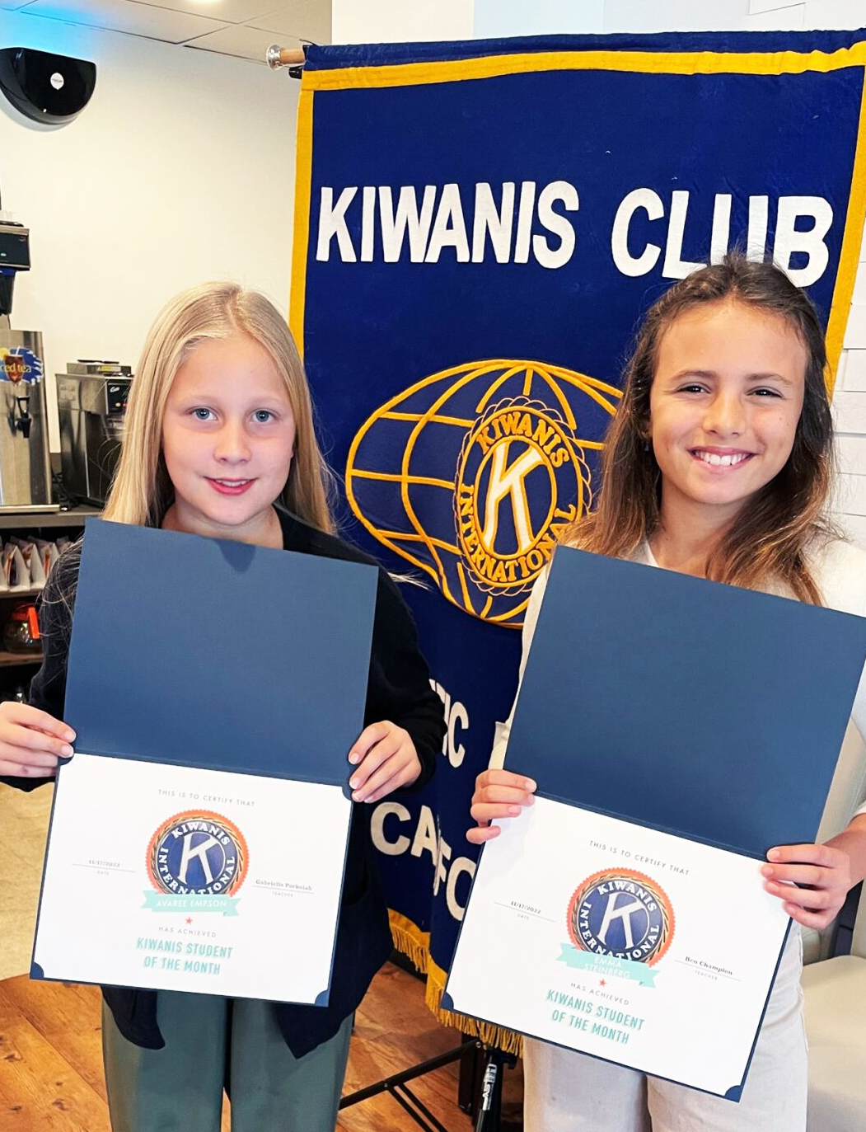
Various membership types
Corporate members
Business/organization is the member
Appointed representative
Designed for transient positions
Satellite members
May meet at different times
May do different service projects
May conduct different fundraisers
Opportunity to “Kiwanis differently”
Kiwanis.org/club-toolbox
Notes:
FACILITATE
Corporate members
Corporate membership is an opportunity for a company to hold a position in a Kiwanis club.
The organization joins the club as a member, following the usual process. The company is represented at meetings and events by a designated employee. If the designated employee changes jobs, a new employee can be designated to take his or her place without being charged a new member fee.
Remember to use your best judgment when offering this option. You don’t want to lose multiple individual memberships by immediately offering the corporate option.
FAQs:
Can an employer have a corporate membership and send different employees to the meetings each week?
Yes, but only as guests. Different employees from the same employer can be invited to meetings as guests of either the corporate member or the club.
Can one employer have multiple corporate memberships?
Yes. Each membership would have a specific person named to the membership. There is no limit to the number of member- ships in a club.
Satellite members
Satellite member is type of membership for someone who cannot make the regular meetings. Often satellite members become a group that meets separately from the main club. These groups can act either as a committee of the main club or more independently, depending upon how it is set-up. For more information view the satellite member tools on the website.

Slide 29

Recognition and Awards
Birthdays
Personal anniversaries
Join date anniversaries
Club awards
REMEMBER
You can never smile and say thank you too often to your fellow members!
kiwanis.org/members/awards-recognition/
Notes:
FACILITATE
Everyone wants to feel good about themselves. One way we can help everyone feel good is to provide recognition whenever it’s appropriate. It’s important to prioritize recognition in your clubs.
Some clubs invest their effort in awards, such as the distinguished club recognition. Whatever motivates the members in your club, use this to encourage positive behaviors for both membership and club involvement. Make it personal. Make it timely. Don’t wait until end-of-year ceremonies. Develop ways to recognize your members at every get-together.
Encourage members to sponsor new members by making special mention of them during the induction ceremony. Remember the Ruby K program as a way to honor those people who sponsor numerous members.
By recruiting five or more new members during a member’s Kiwanis career, a Kiwanian is eligible for the Ruby K award. Ruby K pins are available for recruiting 5, 10, 15, 20, 30, 40, etc., up to 100 and in multiples of 25 over 100. The award is cumulative, so previous recipients are eligible for a new Ruby K when they recruit additional members.
Learn more about Kiwanis International’s awards and recognition programs at https://www.kiwanis.org/members/awards-recognition/.

Slide 30
MARKETING YOUR CLUB
Showcase your club to the community
Notes:
In order for you to be successful at growing your club, you must be able to market your club and Kiwanis effectively. Let’s explore how you can spread the word about Kiwanis in your community.

Slide 31
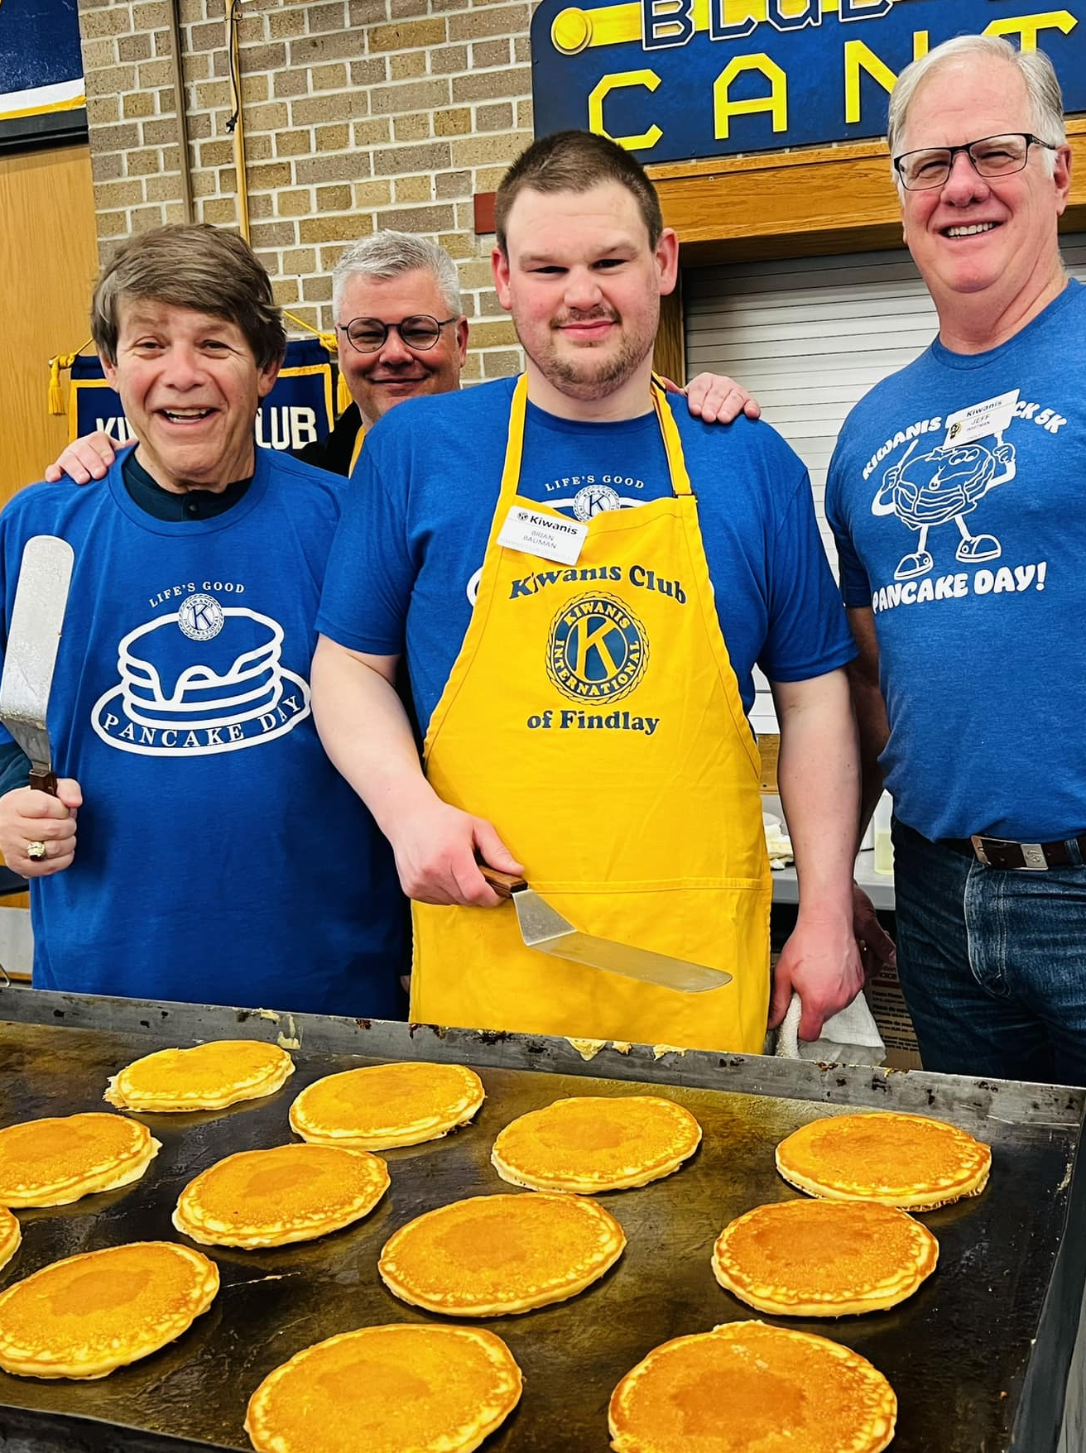
Branding
kiwanis.org/brand
Standard and custom logos
Photography
Social media assets
Brand book
Public relations tips and tools
Custom club brochure
Celebrating club anniversaries
Licensing and trademarks
Notes:
WHAT’S AVAILBLE ONLINE
Standard and custom logos
Photography
Social media assets
Brand book
Public relations tips and tools
Custom club brochure
Celebrating club anniversaries
Licensing and trademarks
FACILITATION
Visit kiwanis.org/brand to see all of the tools and resources that Kiwanis International already has made for your club to use! On the website you will find:
Standard and custom logos.
Stock Kiwanis photos.
Pre-made social media posts, graphics, videos and more.
A brand guide.
Public relations tips and tools.
Custom club brochure template.
Branding for celebrating club anniversaries.
Licensing and trademark information.

Slide 32

Conversations
Elevator speech
Grab a prospect’s interest
Respect their time
Ask yourself
Why my club?
What’s our community impact?
How do we make that impact?
Notes:
FACILITATE
Potential members need to know what you do, how you do it, why the community needs them and where they can immediately fit in the process.
Make it personal
Choose the service project that makes you proudest to be a member.
Remember your Kiwanis “aha moment.”
Think of a child your service impacted.
IF TIME, USE THIS ACTIVITY TO HELP OTHERS UNDERSTAND HOW TO INVITE NEW MEMBERS TO THEIR CLUB.
Using the elevator speech or one-minute speech, practice sharing why you love your club and why someone else would want to join.
Address these three questions in one minute or less:
1. Why my club?
Think about what you love most about your club — and your community. Consider how the two matter to each other.
2. What’s our community impact?
Pick the service project that makes you proudest of your club. Think of a young person — or group — your club has mentored.
3. How do we make an impact?
By working together with people in our community who care. More hearts and more hands mean more opportunities for service and partnership.
Instructor: This activity will take probably 5 minutes to complete. Give participants a minute or two to gather their thoughts. The goal is to be intentional about what they share and to share it in the time allotted.

Slide 33

Newsletters
Thing about…
Content
Frequency
Distribution list
Content…
Send content about volunteering, projects, fundraisers, working with youth to partners.
Ask partners to share among their mailing lists. Offer to do the same with their content.
Notes:
FACILITATE
Newsletters
How many clubs have newsletters, either weekly or monthly?
How many members receive Kiwanis International email newsletters? Do you re-use our content – you can, and should. Share the stories and information with your club members who may not receive our emails and with your broader audience – it might make them want to join us.
Do you send your email to your partners, to the parents of SLP members, to city and county government officials? To people who attend your events, support your fundraisers? Make it a practice to collect email addresses at every event or sign up.
Emails should be short and sweet – three or four content blocks. Longer stories should be on the website and you can link to them, or to a Facebook event page or regular page. Use a photo or one of our social media squares to get attention when the recipient opens the email.
Always have a call to action – what do you want them to do? Support an event? Volunteer for a project? Attend a meeting? Give them something to react to.
If you have an email address for questions, who is answering those emails? Are they answering quickly?

Slide 34
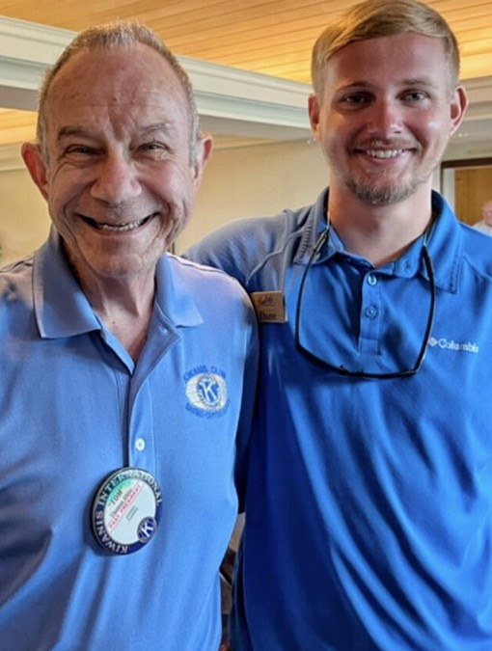
Your club’s digital presence
Keep websites updated
Keep social media sites fresh
Respond to inquiries, emails, etc. immediately
Use all digital platforms to engage potential members
Who engages on
social media?
Community members
Friends of your members
Anyone who reacted to an event invitation
Past club speakers
Members of service partner organizations
Facebook page | X | Instagram | LinkedIn | YouTube
Notes:
FACILITATE
However you choose to market your club, keep it fresh and exciting.
One way to generate excitement is to have that digital presence on social media. Keep your accounts updated with helpful information. Try to post two to three times a week. If you club does not have lots of content, post ours. If you don’t have a club member who can do this, ask an SLP member of a club you sponsor for some help! Make it their service project.
The most important thing to remember is to respond to requests ASAP. If you get an email from the email address on your Facebook page, or get a message via Messenger, respond right away.

Slide 35
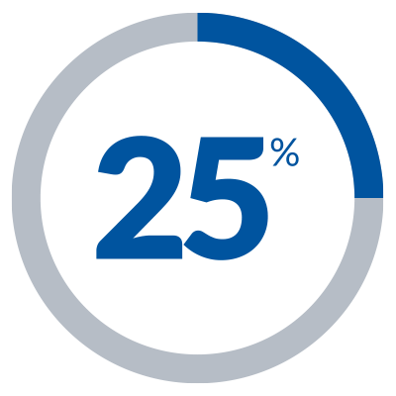
Social Media - Facebook
          Create content that makes people want to “like,” share, or comment
          Visually appealing posts
          Showcase projects
          Tag people and use hashtags
          Call to action – when is your next service project of this nature?
Something to
think about…
25 percent of Facebook leads convert to members.
Facebook resources online
kiwanis.org/club-toolbox
Notes:
FACILITATE
The most important thing about social media is having fresh, fun content. Look for content that is engaging and visually appealing – what would you look at? A photo or a post of all words?
Create your own content – take photos, make short videos, anything that showcases the work and projects your club does.
Videos are gaining in popularity. Consider a short video every week with a club member – ask them about their Kiwanis moment, why they volunteer or why they feel they are making a difference.
If you’re new to the Facebook game, we have info sheets that you can use, with very basic information – Facebook 100, Facebook 101, Facebook 102 and even maximizing digital leads - how to respond and how to make the most of this feature.
Kiwanis has seen great success with advertising on Facebook. We advertise by ZIP code over a period of two weeks. When someone asks for more information, we capture their information – they fill out a form, and we send it to the members we’re working with. We ask them to respond to that request and return a call, text or email within a few hours.
Kiwanis will do this for clubs for free as part of an organized club boost.

Slide 36
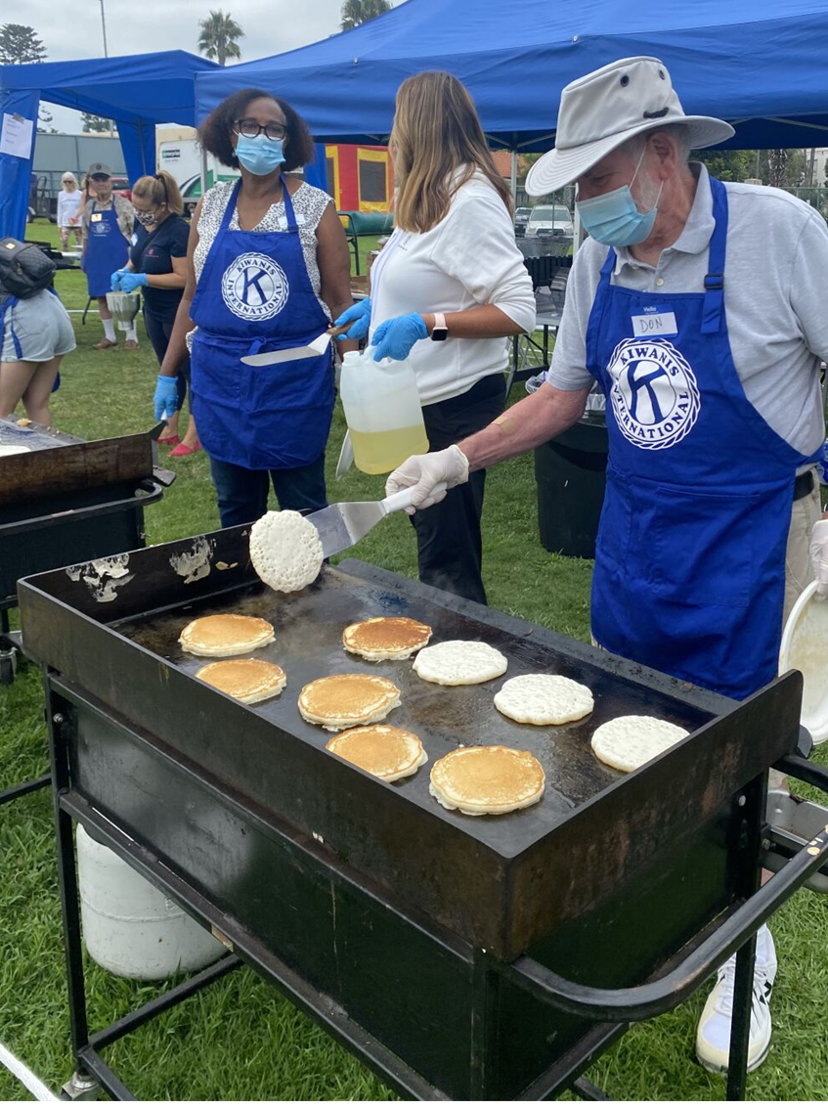
Social Media - Facebook
Facebook events
Special pages that are established
to promote an event
More than an invitation
Events should be created from the club’s page—not a member’s personal page.
Post often. Make your posts relevant. Make posts inviting.
Create a club hashtag and use #KidsNeedKiwanis.
Engaging with
non-members
Find someone in your club to engage with non-members who react or comment on posts or photos.
React immediately
Invite them to an event
Stay connected
Notes:
FACILITATE
Facebook events are special Facebook pages that are established just to promote an event. Promote via Zip code to certain demographics you want to attend your event or participate in your club. If anyone likes or shares the post, you can see that information and connect with that person and gauge their interest. It’s important to act quickly. Invite them to an event, and if they don’t come right away, stay connected. Maybe something else will click later.

Slide 37

Social Media - LinkedIn
Longer posts with “thought pieces”
Position club members as thought leaders and community leaders
Ask questions; create surveys/polls
Generate leads for businesses
Professional focus.
Opportunities to connect.
Position leadership as thought leaders in volunteering, working with kids, service.
Notes:
FACILITATE
It does have a business focus and it offers opportunities to connect, like Facebook or X, you can like or share a post, or comment. However, it offers the opportunity to connect with a different and perhaps broader part of your community than other social media platforms.

Slide 38

Social Media - Instagram
Relies on visual images that can be used in a slide show or reel
Add music and graphics
Ask questions—get engagement with viewers
Call to action—what do you want viewer to do?
Something to
think about…
Instagram is used mostly by Key Club and CKI. Kiwanis also has an account, and similar content is posted as on Facebook. Content attracts a younger demographic because of focus on visuals
Notes:
FACILITATE
If you are aiming to recruit or connect with a younger audience, Instagram is your best option. This platform focuses on using exciting visuals - pictures or videos (reels) to draw attention to your post. Keep your posts simple and and explore hashtags that may draw more attention to your activities.
If you are new to Instagram, ask a Key Club or CKI member to show you how to use it.

Slide 39
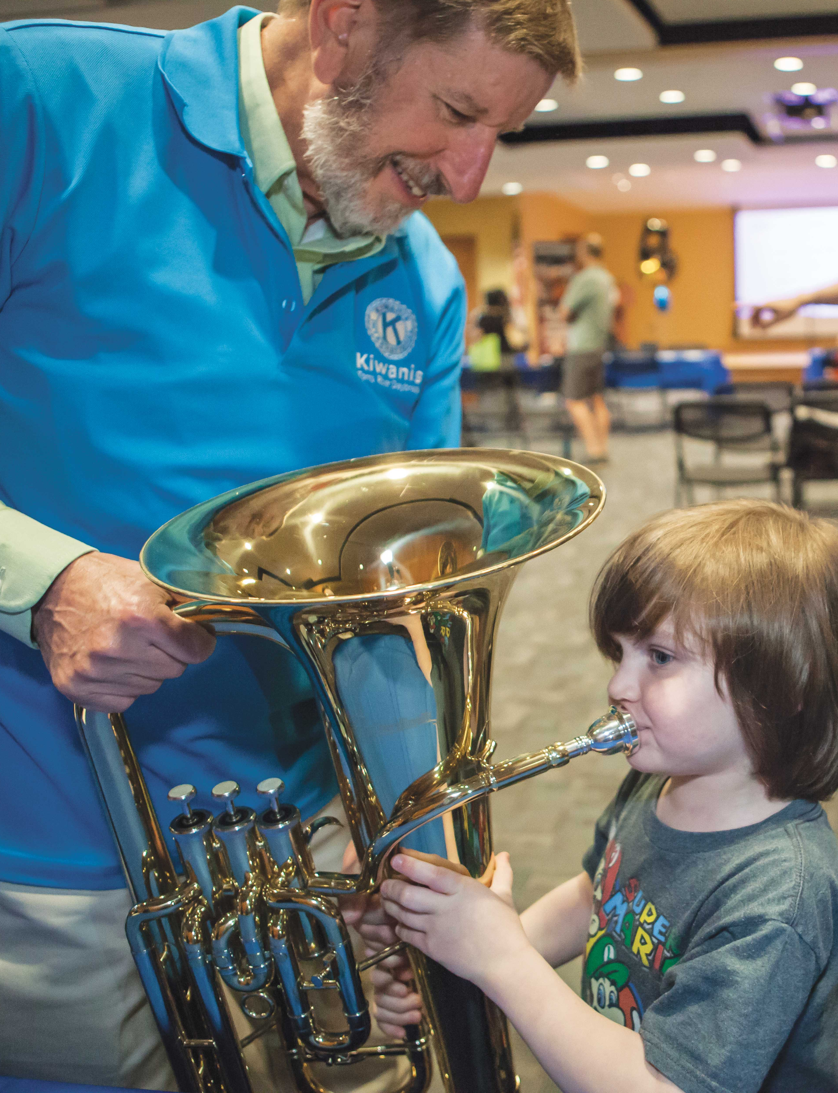
Tools & Resources
Club toolbox
kiwanis.org/club-toolbox
Membership leaders Facebook page
facebook.com/groups/kiwanismembershipandengagement
Notes:
FACILITATE
These are two important resources club membership:
Everything you need to know about club strengthening is in the club toolbox on Kiwanis.org.
Membership Leaders Facebook page
Please use this group to share updates with and ask questions to your peers as we work together to strengthen our organization. Staff monitor this group and will periodically ask you questions to spur discussion and excitement.

Slide 40
THANK YOU
Best of luck as the 2024-2025 membership chair
Notes:
Thank you for participating in the membership chair’s session of Club Leadership Education. We will provide you with these slides so that you have all the information shared today at your fingertips. As you continue to prepare for your term, please do not hesitate to reach out if you have any questions.
Be sure to email your slides or provide them with handouts at the conclusion of the training.

