Slide 1
Club Bylaws
LaMissTenn District
August 26, 2024

Slide 2
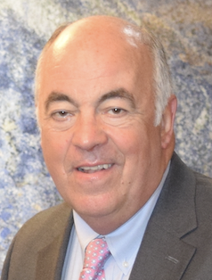
Facilitator
B. J. Kruse III
bjkruseiii@bellsouth.net
Kiwanis Club of Metairie Dawn Busters
2024 - 2025 President
Notes:
Introduce yourself

Slide 3
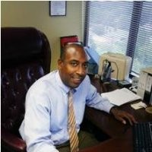
2024-2025 LaMissTenn District Governor
Claude Vinson

Slide 4
kiwanis.org

Slide 5
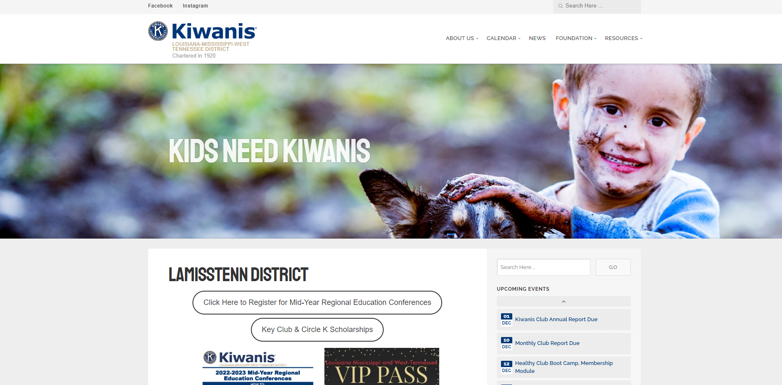
lamisstenn.org
Notes:
https://k11.site.kiwanis.org/
Or
lamisstenn.org

Slide 6
Bylaws
A set of rules adopted by an organization chiefly for the governance of its members and the regulation of its operation or affairs.

Slide 8
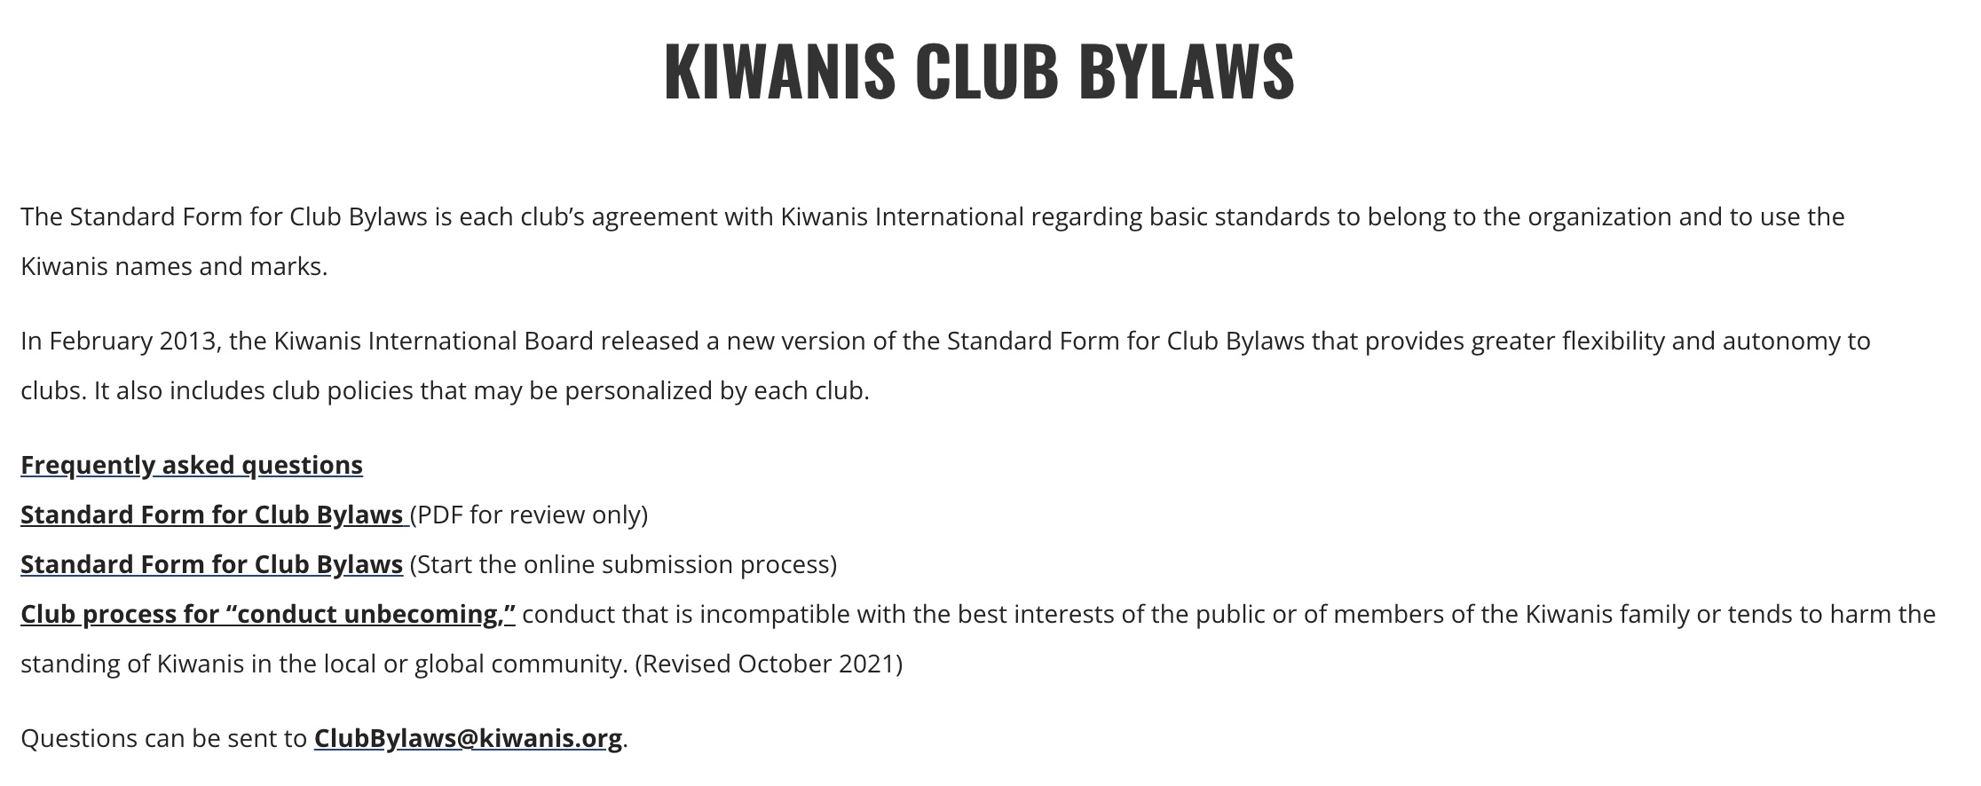

Slide 9
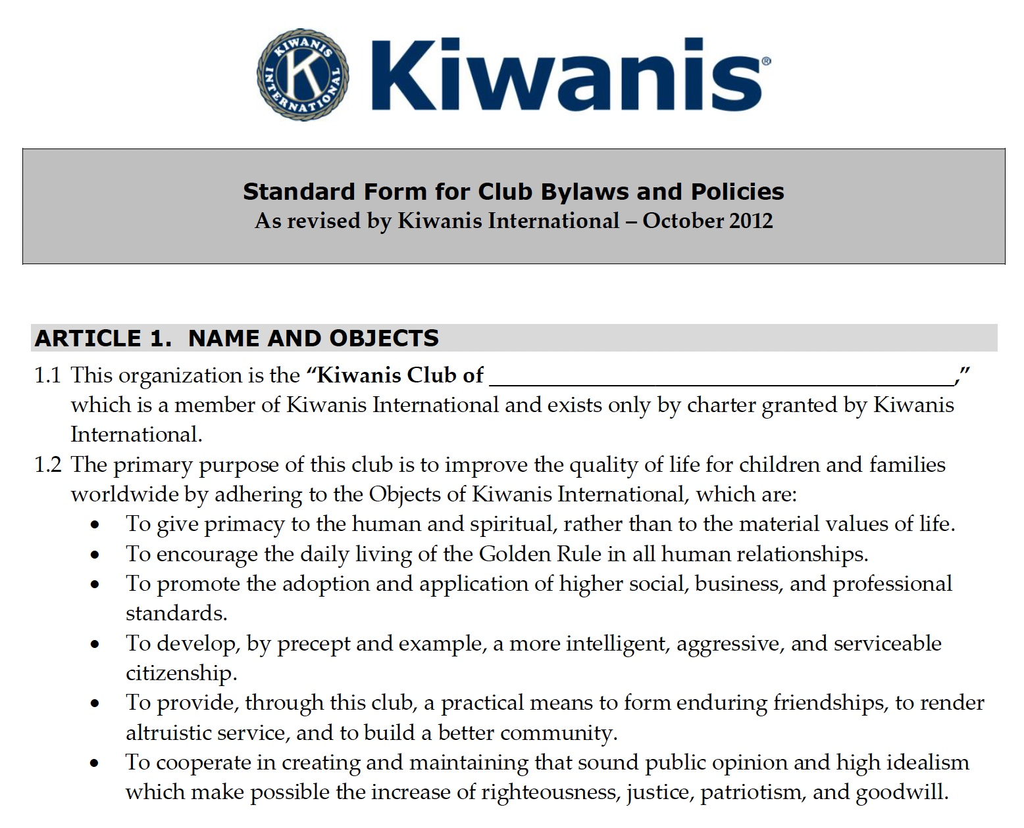

Slide 10
QUESTIONS
Contact the Kiwanis International governance specialist with any questions regarding KI International Bylaws.
Contact ClubBylaws@kiwanis.org for any questions regarding Club Bylaws.

