Slide 1
Club Board Member, Bylaws & Policies
LaMissTenn District
June 10, 2025

Slide 2
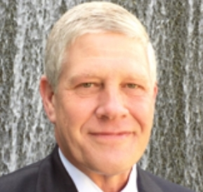
Facilitator
John Gherardi
jgherardi1959@yahoo.com
Kiwanis Club of Lafayette
2025 - 2028 Region IV Trustee
Notes:
Introduce yourself

Slide 3
2025-2026 LaMissTenn District Governor
Marcel Lashover

Slide 4
kiwanis.org

Slide 5
lamisstenn.org
Notes:
https://k11.site.kiwanis.org/
Or
lamisstenn.org

Slide 7
8 Basic Responsibilities of a Nonprofit Board
Setting an actionable mission and an inspiring vision for the organization
Hiring an executive and supporting their efforts, and evaluating their performance
Partnering with staff to create short- and long-term plans, monitoring results, and modifying when needed
Ensuring the effectiveness of programs and services
Helping to secure operating funds and providing ongoing financial oversight
Managing and improving board performance
Meeting or exceeding legal and ethical standards and expectations
Maximizing stakeholder and community support
Notes:
While every nonprofit has a unique mission and organizational structure, boards typically share common, basic responsibilities.
Nonprofit boards typically take responsibility for these 8 key tasks.

Slide 8
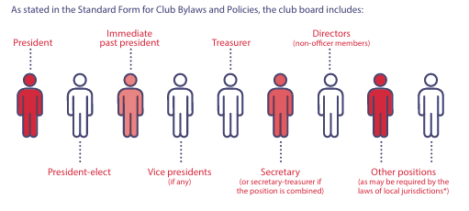
Structure of the Club Board
Notes:
While every nonprofit has a unique mission and organizational structure, boards typically share common, basic responsibilities.
Nonprofit boards typically take responsibility for these 8 key tasks.

Slide 9
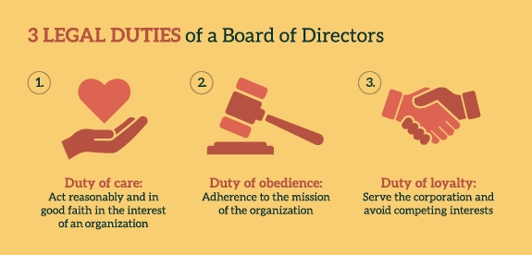
Notes:
Summary of the 3 legal duties

Slide 11
Bylaws
A set of rules adopted by an organization chiefly for the governance of its members and the regulation of its operation or affairs.

Slide 12
Kiwanis International bylaws, policies and procedures
Kiwanis International is governed by a set of rules called bylaws. The bylaws inform and compliment the Kiwanis International Policies and Procedures. These documents guide the governance decisions made by the Kiwanis International Board of Trustees.
Kiwanis International Bylaws (revised October 2024)
Kiwanis International Policies and Procedures (revised January 2025)
How to propose a bylaw amendment or resolution
Amendments to the Kiwanis International Bylaws as acted upon by the 2023 Kiwanis International convention

Slide 13
KIWANIS CLUB BYLAWS
The Kiwanis International Bylaws state that all Kiwanis clubs must conform to the accepted standards for clubs. Those standards are captured in the Standard Form for Club Bylaws, which is each club’s agreement with Kiwanis International regarding basic standards for belonging to the organization and for using its names and marks.
Each club submits the Standard Form for Club Bylaws to Kiwanis International for approval of its club bylaws. The form provides flexibility and autonomy, with club policies that can be customized by each club.
When your Club is ready to start the online submission process, log on to Kiwanis Connect and navigate to the “Club Bylaws” tab. Kiwanis Connect will transition to: “Kiwanis Engage” after the International Convention.
Before you begin the submission process, you can:
Review a non-fillable version of the form.
Read answers to frequently asked questions about the form.
Review Kiwanis International’s definition of “conduct unbecoming” and the process to be followed when an allegation of such conduct is made.
The Standard Form for Club Bylaws was most recently updated in March 2025. To see a non-fillable version of the form that specifies what was changed, click here.
Questions can be sent to ClubBylaws@kiwanis.org.

Slide 14
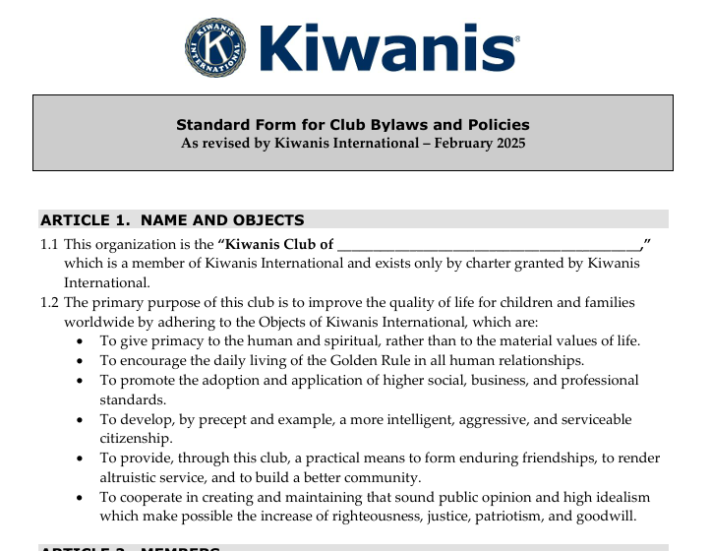

Slide 15
QUESTIONS
Contact the Kiwanis International governance specialist with any questions regarding KI International Bylaws.
Contact ClubBylaws@kiwanis.org for any questions regarding Club Bylaws.

