Slide 1

2026 CLUB LEADERSHIP EDUCATION
CLUB PRESIDENT
LaMissTenn District
July 21, 2026
Notes:
Welcome, everyone, to Club President 101.
I’m so glad you’re here and choosing to invest in your leadership. Whether you’re stepping into the role for the first time or you’re returning with fresh eyes, this session is all about helping you start your year strong.
Today is meant to feel comfortable, welcoming, and very practical. You don’t need to know everything right now — that’s why this training exists.
But by the end of today, you’ll have a clear picture of what the president does, where to focus your energy and what tools can support you throughout the year.
Most importantly, I want you to feel confident that you are not doing this alone.
Kiwanis has a whole network of people ready to support you.
Let’s go ahead and get started.

Slide 2



Housekeeping notes
  Welcome and Introductions
  Questions and Answers
  Zoom Etiquette
    Cameras
    Mute
    Chat Box
Notes:
(In person training: Please include any notes in this section, such as the location of the bathroom, availability of snacks in the back and how breaks will be managed, among other details.)
(If offering virtual training: please mute participants and use the chat box for virtual education participation.)

Slide 3

Parking lot
  Questions during the presentation?
  Insights or examples to share?
Put them in the chat box parking lot!
Notes:
(PRESENTER NOTES: USE THIS SLIDE FOR A VIRTUAL TRAINING SESSION. DELETE SLIDE 4 IF USING THIS SLIDE.)
As we move through the presentation today, please all type your questions and comments into the chat box.
Our team will be keeping an eye on it, and we’ll do our best to address your thoughts and questions.

Slide 4
Agenda
    Expectations
    Club President role
    Year at a Glance
    Resources
    Planning and goal setting
    Committees and delegation
    Meetings
    Membership growth and care
    Service projects and fundraising
    Leading inside and beyond the club
    SLPs (Service Leadership Programs)
    Sustainability and succession
    Q&A
Notes:
We’ll begin with expectations to ensure we have a respectful training environment.
Then we'll jump into looking at what the club president does in our club president 101 training.
From there, we move into a year-at-a-glance so you can see how your responsibilities shift over time.
Then we’ll look at the key resources that support you throughout the year, followed by time for questions.
My goal is that you leave today feeling supported and able to start strong.
And please keep in mind, there will be more in-depth training available in Club President 201, where we’ll take an even closer look at how to carry out each responsibility with accuracy and confidence.

Slide 5
Group expectations
  Be present.
  Respect contributions.
  Listen actively.
  Ask questions.
Notes:
(Presenter note: Add in any of your own expectations in the last bullet point before the presentation.)
To make this a meaningful session for everyone, here are just a few expectations.
First, be present. We know life is busy. Give yourself permission to be here fully — today is about your growth.
Second, respect the perspectives shared by others. Every club is unique, and we can all learn from different experiences.
Third, listen actively, not just waiting for your turn, but truly hearing others.
And lastly, ask questions whenever you need to. We are here to learn together.
Are there any other expectations you would like to ask of the group today?

Slide 6
Learning outcomes
  Understand the president’s core responsibilities.
  Know the key priorities for the year.
  Identify resources available to support the president.
Notes:
Before we get started, I want to give you a clear picture of what you’ll walk away with by the end of today’s session.
Club president 101 is all about understanding what the role includes and the responsibilities you’ll be managing throughout the year.
First, you’ll have a clear picture of what the club president is responsible for and the core duties that define the role.
Second, you’ll have a clear understanding of the key priorities that will guide your year as club president.
And finally, you’ll know which resources are available to support you throughout your term, so you always have a place to turn when you need information or guidance.
You don’t need to memorize everything today — you just need to understand what matters most and where to find support when you need it.

Slide 7

Notes:
(Insert international president-elect's video)
Before we begin our next section, we want to share a brief message from the Kiwanis International president-elect.
This welcome video is a reminder that your role as club president is part of something much larger than any one club.
As you watch, listen for the themes of leadership, service and connection—because those values are at the heart of everything we do in Kiwanis, and they’re reflected in the work you’ll carry out this year.
Let’s go ahead and play the video.
(Presenter note: play the video.)

Slide 8
The role of club president
What the club president does:
  Guides officers and committees.
  Keeps the club organized.
  Ensures meetings are effective.
  Supports member experience.
  Represents the club.
Notes:
The club president’s responsibilities include keeping the club organized and moving forward by providing clear direction, steady leadership and consistent follow-through.
They support smooth operations by guiding officers and committees, coordinating efforts across the leadership team and ensuring everyone understands their roles and responsibilities. This creates the structure that helps the club function effectively throughout the year.
Presidents also play a key communication and experience-shaping role, helping members feel informed, connected and engaged. They set the tone for meetings, reinforce the club’s mission and make sure the member experience stays positive and welcoming.
They help keep the club on track by preparing effective agendas, leading focused meetings, monitoring progress toward goals and addressing challenges early so the club maintains momentum.
Finally, presidents represent the club within the community and the Kiwanis family—building relationships, fostering partnerships and ensuring the club’s work reflects its values and purpose. They help maintain continuity by supporting leadership transitions and strengthening the club’s long-term direction.
In every aspect of the role, the club president provides the guidance, coordination and vision that allow the club to operate confidently and achieve meaningful impact.

Slide 9
CLUB PRESIDENT
YEAR AT A GLANCE
Notes:
Let’s walk through the essential focus areas of your year as club president, breaking them into beginning-of-year, mid-year and end-of-year priorities.

Slide 10
The first 90 days
  Prioritize connection.
  Gather insight early.
  Establish effective systems.
Notes:
The first 90 days of a club president’s term are truly foundational. They set the tone for trust, clarity and momentum — and that work begins the moment a president is elected.
Right after the election, one of the president’s first priorities is connecting with the people who help lead the club. This means meeting individually with current officers and committee chairs to understand ongoing projects, challenges, strengths and goals.
It also means talking with the incoming secretary, treasurer and membership chair so everyone starts the year with shared expectations around communication, reporting and responsibilities.
The next priority is reviewing the documents and reports that show how the club currently operates. Presidents should take time to look through the bylaws, the budget, recent financial reports, current service and fundraising commitments, and membership trends.
This is also a good time to attend a board or committee meeting as an observer. It gives the president a feel for how decisions are made and where leadership support may be needed.
This early preparation ensures the president begins the term with a clear picture of the club’s operations and the people who are leading the work.
When October 1 arrives and the term officially begins, the focus shifts to strengthening alignment. The president should continue meeting with officers and committee chairs to confirm goals, roles and responsibilities for the year ahead.
This is also a good time to review updated project plans, fundraiser timelines, financials and membership reports so everyone is working from the most current information.
Staying aware of district and Kiwanis International deadlines also helps the club remain on track.
Finally, the president needs to establish the systems that will guide the year. This includes setting communication routines like weekly officer updates and monthly board meetings, finalizing the club calendar and confirming expectations for committee reporting.
The president should also determine the meeting formats and processes that will be used throughout the year.
By approaching the first 90 days with clear priorities — connecting with leaders, understanding the club, establishing systems and aligning goals — the president sets the stage for a confident, organized and successful year.

Slide 11
Middle of the year
  Support committees.
  Encourage participation.
  Strengthen the member experience.
  Keeping communication flowing.
Notes:
In the middle of the year, the club president’s focus shifts to supporting committees as service projects, fundraisers and member activities get underway. They check in regularly, offer guidance when it’s needed and celebrate progress as those activities move forward.
Presidents also keep a close eye on member satisfaction — noticing when someone seems less involved, listening to feedback and creating opportunities for members to feel seen, appreciated and connected. A happy, energized membership is essential to a strong club.
This is also a good time to stay intentional about membership growth. Presidents encourage inviting guests, support onboarding new members and help ensure the club remains welcoming and vibrant.
And throughout all of this, consistent, timely communication becomes incredibly important. As new events, goals, club updates and service opportunities arise, clear communication helps members stay informed, stay engaged and stay connected to the club’s success. Strong communication is what keeps the momentum going into the second half of the year.

Slide 12
End of the year
  Celebrate and recognize members.
  Support your successor.
Notes:
Toward the end of the year, the club president’s focus shifts to celebration and transition.
This is the time to highlight the club’s accomplishments—both large achievements and the smaller victories that made a difference—and to recognize the contributions of officers, committee chairs and volunteers.
Genuine appreciation helps members feel seen, valued and motivated to continue serving.
At the same time, the president prepares for a seamless handoff by gathering materials for the next leader, including important documents, notes, contacts, calendars and lessons learned.
A thoughtful and organized transition empowers the incoming president to lead with confidence and to build on the successes of the year.

Slide 13
CLUB PRESIDENT
KEY RESOURCES
Notes:
The good news is — you don’t have to do this alone. Kiwanis International provides excellent resources to help you succeed.
Let's dig in what is available to you.

Slide 14
Resources
  Support system
  Annual checklist
  Club membership planning document
  Club president website
  Leadership Guide
  Online membership resources
  Youth Protection guidelines
Notes:
(Presenter notes: Adjust this slide ahead of time to include any additional resources you want to share. You don’t need to read the entire list aloud, as each item will be covered in more detail on the following slides.)
Clubs rely on several key resources to support a successful year under the leadership of the club president.
It is helpful for presidents to begin familiarizing themselves with them early on.
Now, let’s explore each resource in detail and see how they can help you lead your club to success.

Slide 15

Support system
  Former club officers
  Current club officers
  Board members
  Lieutenant governor
  District secretary
  District leaders
  Kiwanis network
Notes:
The club president never leads alone.
Former club officers are an invaluable source of insight, perspective and lived experience.
Checking in with them throughout the year gives you a safe place to test ideas, talk through challenges and learn from what worked—and what didn’t—in previous administrations.
Your current club officers are your day-to-day partners.
They share the workload, provide specialized knowledge in their roles, and help keep the club organized, compliant and moving forward.
Alongside them, your board members serve as your broader leadership team, offering guidance, feedback and decision-making support that ensures you never have to navigate tough choices by yourself.
Your lieutenant governor is another key resource, ready to troubleshoot issues, answer questions and connect you with what’s happening across your division.
The district secretary also serves as a critical support, helping you understand reporting requirements, deadlines and best practices so that administrative tasks don’t become overwhelming.
District leaders—including club coaches, certified instructors and membership specialists—are there to provide training, resources and practical strategies that strengthen your club’s growth and stability.
And finally, the wider Kiwanis network, from other presidents to international-level staff, offers mentorship, fresh ideas and a sense of community that reminds you that you’re part of something much bigger.
When you lean on this full support system, you reduce burnout, build confidence and lead your club with far more clarity and impact than you ever could alone.

Slide 16
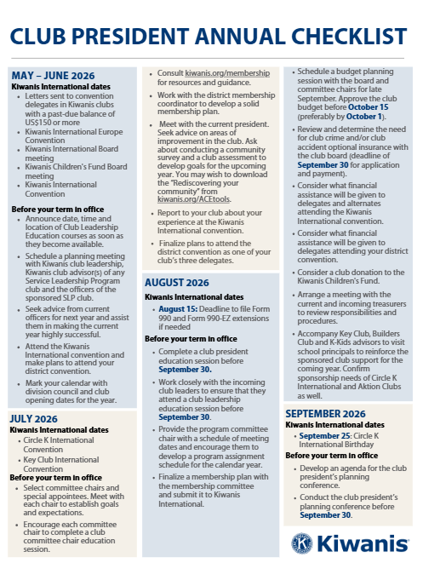

Annual checklist
  Roadmap
  Accountability partner
Resources:
Annual checklist
Notes:
The Annual Checklist is an essential tool for tracking important activities throughout the year.
It provides a month-by-month roadmap, ensuring that nothing is overlooked and helping the president stay organized and on schedule.
A strong club president uses the checklist as both a planning guide and an accountability tool—reviewing it at the start of each month to plan ahead and again at the end of the month to confirm progress.

Slide 17
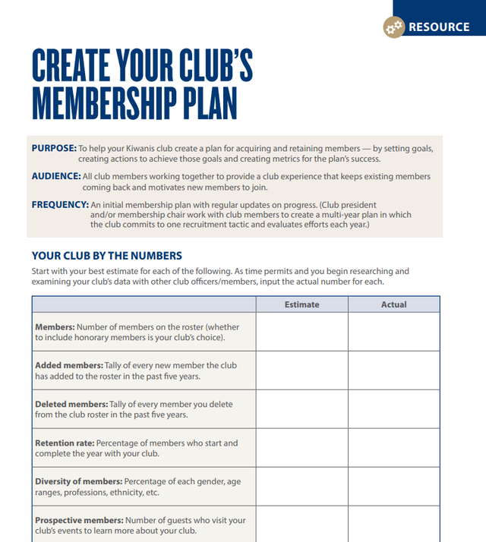
Club membership planning document
  Goal-setting and data-driven
  Member-focused and engagement-aligned
  Strategic and growth-oriented
Resources:
Club membership planning document
Notes:
The Club Membership Planning Document supports intentional membership growth and engagement.
Completed during the president’s planning conference and submitted to Kiwanis International, it helps the club map out a strong, strategic approach for the year.
It guides the president in reviewing membership trends, identifying outreach opportunities and setting realistic recruitment and retention goals.
It also prompts the team to consider how service projects, partnerships and meeting formats align with the needs of current and potential members.
Throughout the year, this document becomes a valuable reference point for tracking progress and adjusting strategies to maintain a vibrant, engaged membership.

Slide 18
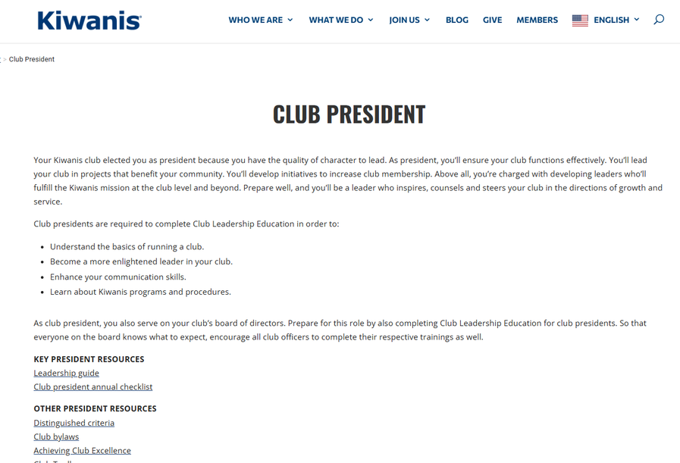
Club president webpage
  Resource-rich and easy to navigate
  Supportive and leadership-focused
Resources:
Club president website
Notes:
The club president webpage on kiwanis.org provides clear, easy-to-access guidance and best practices designed specifically for club presidents.
It includes monthly checklists, training materials, sample documents and practical tools that help presidents stay organized, informed and on track throughout the year.
The broader Kiwanis website also connects presidents with key resources such as reporting reminders, membership support tools and helpful links to district and international programs.
By using the webpage regularly, presidents can reduce guesswork, simplify planning and lead with greater confidence and efficiency.

Slide 19
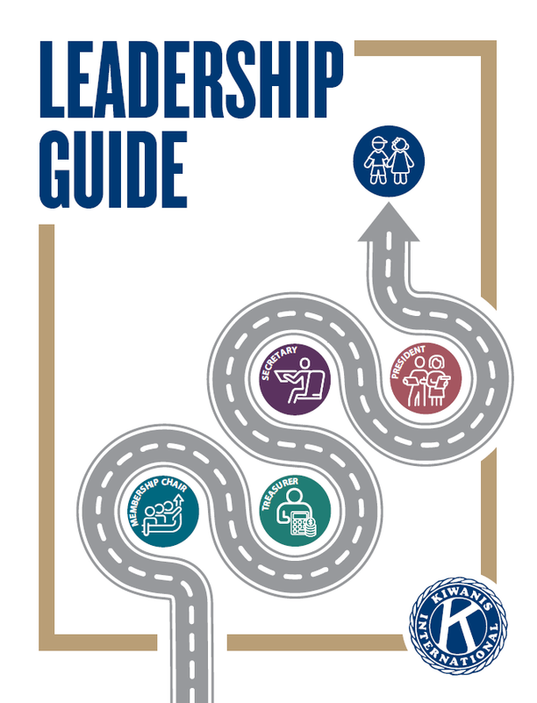
Leadership Guide
  Kiwanis 101 information
  Club president section
  Club treasurer, secretary and membership
chair sections
  Resources section
Resources:
Leadership Guide
Notes:
The next resource we want to highlight is the Leadership Guide.
This guide is available only in a virtual format. If you have an older printed version, please discard it — much of the information is out of date.
You can access the Leadership Guide at kiwanis.org/leadershipguide.
The club president section begins on page 16.
Inside the Leadership Guide, you will find:
Kiwanis 101 and essential background information about Kiwanis International.
A club president section that outlines your responsibilities, expectations and tools to help you lead effectively.
Additional sections for the club secretary, treasurer and membership chair, which show how your leadership role connects with theirs.
A detailed resources section covering youth protection, awards and recognition, insurance, branding and other important operational information.
So please take time to review this entire document.
It offers the structure, clarity, and guidance needed to help presidents lead with confidence, foster strong club operations and ensure a successful year.

Slide 20
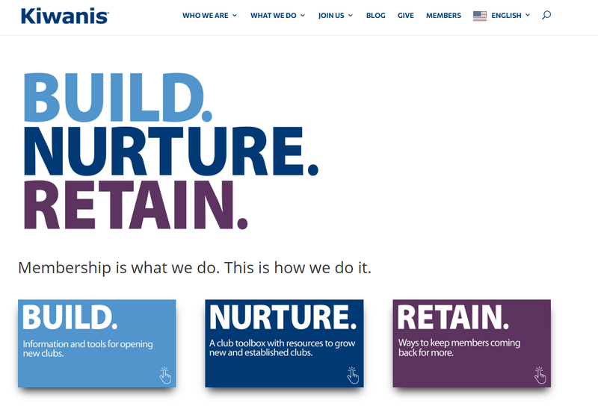
Online membership resources
  Streamline operations.
  Monitor club health and progress.
  Strengthen the member experience.
Resources:
Online membership resources
Notes:
Online member resources—including the Club Toolbox, ACE Tools and Build. Nurture. Retain. materials—give club presidents practical, ready-to-use support for running an effective club.
These tools offer surveys, planning templates, checklists and engagement strategies that help presidents streamline operations and stay organized throughout the year.
They also allow leaders to track progress in areas like club health, member satisfaction and service impact, giving presidents clearer insight into what’s working and where adjustments may be needed.
Most importantly, these resources help strengthen the member experience.
From welcoming new members to nurturing current ones and retaining those at risk of disengaging, the Build. Nurture. Retain. initiative provides actionable strategies that presidents can use to keep their club vibrant, connected and growing.

Slide 21
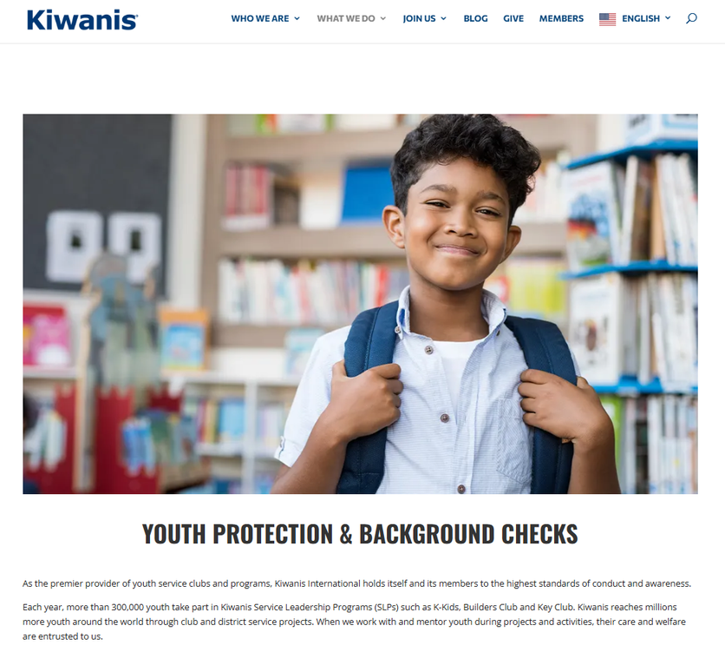
Youth protection guidelines
  Ensures safe, compliant practices.
  Outline mandatory requirements.
  Provide clear procedures.
Resources:
Youth Protection guidelines
Notes:
Finally, the Youth Protection Guidelines outline the required policies and background-check expectations for any volunteer who works directly with youth.
As a club officer, it is essential to review these guidelines regularly to ensure you and your club — including all members and Service Leadership Programs advisors — remain up to date and in full compliance.
Please visit the Youth Protection website to confirm your understanding of current requirements.

Slide 22
Learning outcomes
Presidents will know strategies to:
  Stay organized through planning
  Lead and support committees effectively
  Run productive club and board meetings
  Coach officers and collaborate with leaders
  Grow and retain membership
  Plan and oversee service and fundraising projects
  Recognize and celebrate members
Notes:
Before we get started, here’s what you can expect to take away from today’s session.
Club President 201 focuses on the how—the practical leadership strategies that help you guide your club with confidence.
First, you’ll learn how planning brings structure to your year—helping you stay organized, set priorities and keep your club moving forward.
You’ll also understand how to lead and support committees, ensuring chairs have clear expectations and the momentum they need to carry out your club’s goals.
Next, you'll hear how to run productive club and board meetings—meetings that are efficient, engaging and grounded in your bylaws and strategic direction.
From there, you'll learn about collaboration with your leadership team and coach officers, and how to strengthen communication across the club.
You'll also hear about how to grow and retain membership, oversee meaningful service and fundraising projects and recognize members in ways that build a positive, connected club culture.

Slide 23
CLUB PRESIDENT
PLANNING AND GOAL SETTING
Notes:
In this section, we’ll look at how to set meaningful goals and create a focused plan that aligns your officers, committees and members from day one.

Slide 24

Club president planning conference
Before the meeting:
  Schedule prior to the start of your term.
  Invite all officers, board members and key committee chairs.
  Gather key documents.
  Send the agenda.
Resources:
Goal setting resource
President planning conference guide
Membership planning guide
Notes:
Planning is the single most powerful thing you can do as president. When you invest intentionally in planning, you avoid chaos later and give your leadership team confidence.
To make this happen, schedule your president's planning conference before you take office (by October 1) and invite all officers, board members and committee chairs.
Helpful tools you'll want to include at the meeting are the Leadership Guide (president planning section), the Club President Checklist for monthly actions, your club's current strategic plan and the membership plan template.
You can also collaborate with your club secretary and treasurer to help access these resources: last year's budget, current member roster, committee reports and current club bylaws.
Your agenda may cover items like:
-Reviewing the Club Mission and Strategic Plan
-Discussing the current strategic plan
-Identifying priorities for the upcoming year
-Reviewing officer, board member and committee chair duties
-Completing the membership plan template
-Review of club finances and budget
-Club calendar planning

Slide 25

Strategic plan
At the planning conference:
  Review your mission.
  Set clear annual priorities.
  Update action steps.
  Monitor, adjust and celebrate.
Resources:
Kiwanis International’s strategic plan
Your club’s strategic plan
Notes:
The strategic plan is your club’s long-term compass. It should align with Kiwanis International’s and your district's strategic priorities and keeps your club focused on what truly matters.
Unlike a president’s individual goals for their term, the strategic plan reflects the club’s direction over multiple years. Updating the strategic plan during the president’s planning conference offers a strong foundation for your year. It gives your leadership team a reference point for making decisions — helping you determine what to start, what to stop and what to strengthen. This shared document is different from your personal presidential goals, but the two should support each other.
Before your planning session, review the club's current strategic plan with your officers. Identify which long-term goals were achieved, which are still in progress, and which no longer align with your club’s direction.
Reconfirm your club’s mission and purpose and keep it visible throughout the discussion to ensure every decision supports that foundation. Then, choose three to five club-wide priorities for the coming year — such as service projects, membership growth, fundraising or communication. For each priority, connect it back to your presidential goals, update the action steps, set deadlines and assign responsible leaders so everyone knows their role.
Once the plan is finalized, communicate it to your members both in a meeting and in writing. This transparency builds trust and ensures everyone understands the club’s long-term goals and how they can contribute.
Throughout the year, revisit the strategic plan to monitor progress. Adjust as needed, and celebrate milestones along the way.
The strategic plan anchors your club, while your presidential goals help move it forward — together, they create continuity, clarity and momentum.

Slide 26

Membership plan
At the planning conference:
  Analyze trends.
  Set retention and growth goals.
  Assign strategies.
Resources:
Membership plan template
Club Toolbox
Notes:
Your club's membership plan is the heart of a healthy Kiwanis year. It helps you understand who is thriving in your club, who may be slipping away and what actions you need to take next. With clear retention and recruitment goals outlined in the plan, your membership chair and officers can make informed decisions instead of guessing.
Start by pulling your membership roster and looking for patterns such as age groups, attendance, tenure and involvement. From there, identify any at-risk members who may need personal outreach. Set a clear retention goal — for example, aiming for 90% member retention — and establish a realistic recruitment goal, such as adding four to six new members.
Next, choose three to four recruitment strategies, such as personal invitations, connecting with Service Leadership Programs or building community partnerships.
Do the same for retention by selecting three to four strategies, such as milestone recognition, personal check-ins and encouraging member involvement.
Finally, assign each strategy to a specific person and set deadlines to ensure accountability.

Slide 27
CLUB PRESIDENT
COMMITEES AND DELEGATION
Notes:
In this section, we’ll look at how to build, support and guide committee leaders so your club operates with energy, clarity and collaboration.

Slide 28
Building the committee engine
  Review the Strategic Plan.
  Confirm which committees are needed to meet goals.
  Choose committee chairs.
  Encourage committees to meet regularly and keep their work visible to the club.
  Provide encouragement and recognition to keep momentum strong.
Resources:
Select committee chairs
Notes:
Committees turn plans into action, engage members and drive the service, fundraising and membership work that defines your year.
Review your club's Strategic Plan to determine which committees are needed to accomplish the club’s goals. Confirm which committees are required in your club bylaws—such as service, membership and finance—and then identify any additional committees or project teams that would strengthen your work.
For smaller clubs, a full committee structure may not be practical. In these cases, use the president's planning conference to match members’ strengths to specific tasks and appoint project leads rather than formal chairs. This approach still distributes responsibility effectively and respects your club’s capacity.
Throughout the year, support your chairs by encouraging regular meetings, clear communication and visible updates to the club.
Recognition and encouragement help build momentum, strengthen leadership and create a club culture where members feel valued, useful and invested.

Slide 29

Choosing a committee chair
  Choose reliable chairs or project leads.
  Match roles to members’ strengths.
  Appoint chairs early.
  Meet with each chair.
  Establish routines and processes.
  Support and guide.
Resources:
Choose a committee chair &
support committees
Notes:
After you've reviewed which committees are needed, the next step is to select the right committee chairs. Each committee chair sets the tone for how effectively your club’s work moves forward. In smaller clubs, you may appoint project leads instead of full committees — and this can work just as well when roles match members’ strengths.
When choosing chairs or project leads, look for dependable members who follow through, communicate clearly, collaborate well and show genuine interest in the committee’s purpose. Seek people who demonstrate initiative and a commitment to the club’s mission.
Chairs are typically appointed in July so they have time to prepare, set goals and align their work with the Strategic Plan.
Once chairs are selected, your next step is helping them begin strong. Meet with each chair early to clarify responsibilities, set expectations and connect their work to the club’s broader goals. Work with them to create a brief written description of the committee’s purpose and annual objectives, and outline what they are responsible for—such as coordinating meetings, reporting progress and keeping their team informed.
Help establish how and when updates should be shared at board or club meetings, and confirm the process for submitting budget requests, project proposals or membership ideas.
After reviewing expectations together, allow chairs to take the lead with their teams. Your role is to guide, support and keep them aligned— not to run the committee for them. Investing time in choosing and preparing the right chairs strengthens your club’s success this year and naturally builds a leadership pipeline for the future.

Slide 30

Delegation and support that builds confidence
  Delegate with clarity.
  Support without micromanaging.
  Build confidence through trust.
  Keep work moving through follow-up.
Notes:
Delegation is one of the most powerful tools you have as a club president—not to lighten your workload, but to activate the strengths of your members.
Start by choosing tasks intentionally. Ask yourself, ‘Does this truly require presidential oversight?’ If not, pass it on.
Begin with your officers—ask the treasurer to own financial follow-up, the secretary to manage communication timelines, the vice president to lead project coordination and your committee chairs to drive their areas without waiting for direction. When officers are already carrying a full load, broaden your circle.
Many members are eager to help but don’t know where to start until someone asks.
When you delegate, be clear and specific. Explain the task, outline what success looks like, and share any deadlines or tools they might need. Then—and this part is essential—give them permission to complete the work in their own style instead of replicating your approach.
People feel more confident and creative when they have room to lead rather than feeling supervised.
Your job after delegating isn’t to hover; it’s to support. Ask, ‘What do you need from me to be successful?’ rather than, ‘Did you get this done?’ Schedule agreed-upon checkpoints so follow-up feels collaborative, not controlling.
A quick text, a five-minute conversation, or a shared checklist keeps the work moving and shows you care about their success.
Committee chairs especially thrive when expectations are clear from the start.
And always recognize progress. A thank-you during a meeting, a shout-out in a newsletter, or a short note of appreciation does more than reward work—it reinforces that leadership is shared and valued in your club.

Slide 31
CLUB PRESIDENT
MEETINGS
Notes:
In this next section, we will look at how to build effective and meaningful meetings.

Slide 32

Club meetings
  Meetings set the tone.
  Members deserve clarity.
  Engagement balances structure with fun.
Resources:
Club meeting agenda
Notes:
Meetings are often the first experience guests have—and the consistent touchpoint members rely on.
For a prospective member visiting for the first time, the meeting sets the tone for what Kiwanis feels like.
The way you run that meeting shapes your club’s culture.
Members deserve clarity and need to know what to expect when they come to the meetings.
It can be helpful to send an organized agenda ahead of time.
When meetings are organized, welcoming and purposeful, people want to participate.
When meetings feel long, confusing or repetitive, members naturally drift away.
Adding fun doesn’t mean losing focus.
An engaging meeting means creating moments that make people smile and feel connected.
A quick icebreaker, a member spotlight or even a short trivia question can energize the room and break up the routine.
Fun builds relationships—and relationships build engagement.

Slide 33
Club meeting agenda – example
  Welcome and Inspiration (5 min): Greeting, brief thought or quote, and a quick icebreaker question
  Celebrate Wins (5 min): Recognize member milestones, recent service projects or achievements
  Club Business (20 min): Officer reports (finance, membership, service projects). Updates from committees
  Program or Speaker (15 min): Educational topic or community partner presentation
  Engagement Moment (5 min): Fun trivia, member spotlight, or short game
  Next Steps and Closing (10 min): Review upcoming events, assign tasks and express gratitude
Notes:
Now let’s take a look at a simple example of a club meeting agenda.
This will give you an idea of how the flow of a meeting can stay organized, engaging and predictable for members.
(Briefly explain how the example club meeting agenda is organized.)

Slide 34

Board meetings
  Focus on strategy.
  Follow bylaws.
  Keep discussions purposeful.
Resources:
Board meeting agenda
Robert’s Rules
Notes:
Board meetings should stay focused on the club’s strategic goals, follow bylaws and keep discussions purposeful.
Many clubs choose a consistent monthly meeting time to build reliability.
As president, a best practice is to draft the agenda about a week in advance and send it to the board along with the previous minutes and financial reports.
You can ask officers and committee chairs to submit updates beforehand so the meeting can stay efficient.
During the meeting, start on time, state the objectives clearly and follow the agenda.
The club should use Robert’s Rules of Order for motions and voting and keep discussion centered on policy, strategy and the club’s strategic plan.
As the leader of board meetings, you can encourage balanced input, manage time respectfully and address conflict professionally, referring to bylaws when necessary.
And don't forget the importance of regularly reviewing key areas, such as —membership, service projects and finances.
Before adjourning, summarize major decisions and encourage the club secretary to send follow-up action items within 48 hours.

Slide 35
Board meeting agenda – example
  Welcome and Meeting Purpose (2 minutes): Remind the board of the meeting’s purpose: strategy, decisions and alignment with goals.
  Approval of Previous Minutes (2 minutes): Keep this quick. Minutes should have been sent in advance.
  Treasurer’s Report and Financial Review (5 minutes): Review key financial highlights, budget status and upcoming financial commitments.
  Strategic Plan Updates (5 minutes): Review progress toward annual goals; Confirm alignment between decisions and the club’s Strategic Plan.
  Committee Reports — Strategic Highlights Only (10 minutes): Chairs share updates focused on progress, decisions needed and alignment with goals.
  Old Business (5 minutes): Address follow-up on previous decisions or unresolved items.
Notes:
Now let’s take a look at a simple example of a board meeting agenda.
This will give you an idea of how the flow of a meeting can stay organized and predictable for members.
(Again, briefly go over each item of this example board meeting agenda.
Encourage them to adapt the board meeting agenda for their club, its membership and their needs.)

Slide 36
Board meeting agenda – example
  New Business — Decisions and Action Items (10–15 minutes): This is the decision-making moment using Robert's Rules of Order.
    Motions
    Voting
    Resource allocation
    Project approvals
  Upcoming Priorities and Key Dates (3 minutes): Review the next month’s events, deadlines, and responsibilities. Confirm who is doing what and by when.
  Summary of Decisions and Assigned Tasks (2 minutes)
    Reinforce:
      What was decided
      Who is responsible
      Deadlines
      Next steps
  Adjournment (1 minute)
Notes:
(Again, briefly go over each item of this example board meeting agenda.
Encourage them to adapt the board meeting agenda for their club, its membership and their needs.)

Slide 37

Club bylaws and policies
  Purpose of club bylaws
  When to reference them
  Decisions that require bylaw authority
  Where leaders can access them
Resources:
Standard Form for Club Bylaws
Frequently asked questions
Notes:
Your club bylaws matter most when you’re running meetings because they outline exactly how decisions are made — who votes on what, when motions are required and what authority the board has versus the full membership. Think of them as your club’s operating manual; as president, it’s your job to ensure meetings follow those rules.
Your club secretary supports this by keeping the current bylaws accessible, tracking needed updates and submitting revisions to Kiwanis International once they are approved.
To understand what requires a club vote versus a board vote, always refer to your bylaws. A simple guideline is:
The board handles routine governance, internal operations and items delegated to them.
The full membership votes on anything involving bylaws, dues or fees, member rights or major commitments.
This distinction protects transparency and prevents a few people from making decisions the entire club should own.
Each year, review the Standard Form for Club Bylaws with your board so everyone is clear on the rules that guide your work. Your secretary can locate the current version in Kiwanis Engage and ensure all officers have access. If your club has a bylaws committee, involve them when needed.
Your job isn’t to rewrite bylaws — changes can only be made within the options allowed by Kiwanis International for consistency across all clubs. When updates are needed, the board recommends changes, but the full membership votes on them. Members must receive at least 14 days’ notice before a bylaws vote. At that meeting, confirm you have quorum (one-third of active members), present the recommended changes and call for a vote. Adoption requires a two-thirds majority of those present.
After approval, the secretary finalizes the edits in Kiwanis Engage, submits them for confirmation and stores the updated bylaws in the club’s permanent files so all officers can access them. The same process applies to any future amendments.
When presidents reference their bylaws during meetings — to clarify a motion, guide a decision or confirm voting requirements — it creates fairness, consistency and trust.

Slide 38

Transparency and communication
  Communicate decisions.
  Build trust.
  Keep members informed.
Notes:
Clear communication builds trust, transparency, and connection within your club.
When members understand what’s happening in meetings and why decisions matter, they feel included and empowered.
The goal isn’t lengthy reports—it’s simple, consistent updates that keep everyone informed and involved.
Share highlights after each board or club meeting through your secretary’s recap and reinforce them with quick verbal updates during club meetings.
Follow up with newsletters, texts, or group messages so members receive information in the way that works best for them.
Communicate upcoming events, deadlines, responsibilities and needs clearly so members can plan ahead and participate confidently.
Celebrate progress along the way to keep the tone positive and show that their efforts make an impact.
Invite feedback and suggestions to remind members that communication goes both ways and their voices matter.

Slide 39
Handling conflict with confidence
  Stay calm and address issues early.
  Listen actively and ask clarifying questions.
  Redirect focus to shared goals and the club’s mission.
  Guide the discussion with structure and respect.
  Seek consensus or compromise when possible.
  Move sensitive conversations to a private setting if needed.
Notes:
Conflict is normal in every club — especially during meetings. Most conflict isn’t personal; it usually stems from miscommunication or differing expectations. Your steady leadership helps members move through moments of discomfort and refocus on what truly matters.
With your help, a club can handle conflict effectively:
Take a breath and stay composed — your demeanor sets the tone.
Listen without interrupting so members feel heard and ask clarifying questions to understand different perspectives.
Redirect attention to the club’s mission or strategic priorities to bring the focus back to common goals
.
If a conversation becomes sensitive, offer to continue it privately after the meeting.
End with gratitude and reinforce the club’s shared purpose so everyone leaves feeling respected and aligned.

Slide 40
CLUB PRESIDENT
MEMBERSHIP GROWTH AND CARE
Notes:
In this section, we’ll look at how to grow membership with intention and how to care for members so they want to stay and serve alongside you.

Slide 41

Retaining your members
  Warm culture matters.
  Everyone plays a role.
  Belonging drives retention.
Resources:
Build. Nurture. Retain.
Notes:
Membership is the heartbeat of your club — and keeping it strong starts with a warm, welcoming culture. People stay where they feel seen, appreciated and connected. When members experience kindness and genuine community, they don’t just stay active — they naturally invite others to join them.
Retention grows from intentional actions and small moments of care. As president, you model this by greeting members and guests warmly, making introductions and ensuring no one sits alone. These simple gestures send a powerful message that people matter.
But culture is a shared effort. Encourage members to check in on someone they haven’t seen, sit with new faces and reach out when someone drifts away. A quick “We miss you” can be all it takes to bring someone back.
Inside meetings, build an atmosphere that keeps people engaged. Recognize contributions, invite participation and leave space for social connection. Help members find roles that match their strengths so they feel useful, supported and not overwhelmed. Pair members on projects to deepen relationships and keep communication inclusive.
Connection outside the meeting room matters too. Casual coffees, dinners or small group outings give people space to relax, laugh and build friendships — relationships that bring them back even after busy or difficult seasons.
Don’t forget former or inactive members. Many stepped away simply because life got full. A personal invitation — a phone call, handwritten note or warm message — can reopen the door. Share what’s new and exciting in the club and give them an easy, low-pressure way to re-engage, like a single service project or social event.

Slide 42

Membership growth as team effort
  Share responsibility.
  Build excitement.
  Make growth visible.
Resources:
Build. Nurture. Retain.
Create your club’s elevator speech
Notes:
Membership grows strongest when it’s a shared responsibility, not the job of one membership chair. When the whole club participates, the work feels lighter, energy increases and momentum builds.
Start by inviting more people into the process. Ask officers, committees and members to help welcome guests, follow up with prospects and share opportunities. When everyone sees they have a role, engagement rises.
Make growth visible. Share monthly membership updates and celebrate new members and milestones. Highlight progress in newsletters and add a brief “Membership Moment” to meetings to recognize people who brought guests or helped someone get involved.
Bring membership activity into the community as well. Host open houses, invite prospects to service projects and use social media to showcase your impact. The more people see Kiwanis in action, the easier it is to attract new members.
At the same time, make inviting simple. Provide members with tools like a short elevator speech, digital invitations or talking points they can share. Encourage committees to greet and connect with guests at meetings and events. Have a membership committee track prospects and follow up so no one slips through the cracks.
Finally, make the joining process clear and welcoming. Explain steps, dues and benefits, and pair every new member with orientation and a mentor to help them feel supported from the start.
When people feel welcomed, included and involved, they stay— and they naturally invite others to join them.

Slide 43

New member orientation and engagement
  Orient promptly.
  Assign a mentor.
  Involve immediately.
Resources:
New member orientation PowerPoint (please download and edit)
New member orientation checklist
New member orientation kit
Club mentor resources
Notes:
Bringing in a new member is only the beginning — the first few weeks determine how connected and confident they feel. The goal is to create an experience that makes them want to stay.
Start with a prompt orientation. This is your chance to introduce the club’s mission, values and expectations, explain how the club is structured and walk through practical details like meeting schedules and service opportunities.
Holding orientation within the first month helps new members understand how they fit into the bigger picture.
Next, assign a mentor. A mentor checks in regularly, answers questions, introduces the new member to others and helps them feel comfortable. A strong mentoring relationship can quickly turn curiosity into confidence.
Then, involve new members right away. Invite them to a service project, a committee meeting or another hands-on activity so they can experience the club in action.
Introduce them publicly at meetings and welcome them in newsletters or on social media so they feel seen and included.
Provide a simple welcome packet with upcoming dates, contacts and key resources, and add them to your communication channels so they never feel out of the loop. A casual coffee with the president or membership chair can deepen the personal connection.
As they participate, recognize their early contributions — even small ones — to reinforce that they matter. Follow up after their first few meetings to ask how things are going and what they’re curious about next. From there, offer clear next steps such as joining a committee or helping with a project.
When you orient promptly, assign a mentor and involve new members immediately, you set the stage for long-term engagement, stronger connection and a thriving club.

Slide 44

Induction and installation
  Make it meaningful.
  Make it personal.
  Make it inspiring.
Resources:
Installation of club board members and officers
Induction of new members
Notes:
Induction and installation ceremonies are important moments in the life of your club. Induction welcomes new members, and installation honors the new club officers who will lead in the year ahead. These ceremonies help people feel connected to your mission and excited about the future.
You don’t plan them alone.
The club secretary can organize details, prepare membership information and help the event run smoothly.
Your lieutenant governor also may assist — and in many districts, they even conduct officer installations using scripts that add tradition and significance.
As you prepare, make each moment personal. Invite a new member’s sponsor or mentor to introduce them and share why they’re a great fit.
Encourage inductees and incoming officers to invite family or friends. Use a simple script that calls each person by name and affirms the value they bring. Small touches — a Kiwanis pin, certificate or welcome card — make the moment memorable.
Keep your remarks high-level: share the club’s mission, the importance of service and the meaning of belonging to Kiwanis. For officers, briefly highlight the trust the club is placing in their leadership.
A thoughtful induction or installation leaves people proud of their commitment and energized for the year ahead, strengthening club culture and setting a positive tone for your new Kiwanis year.

Slide 45
CLUB PRESIDENT
SERVICE PROJECTS AND FUNDRAISING
Notes:
In this section, we’ll explore how meaningful service projects and effective fundraising strengthen your club’s impact and visibility in the community.

Slide 46

Engaging members through projects
  Make projects meaningful and fun.
  Offer flexible ways to participate.
  Match roles to members’ strengths.
  Build pride and community engagement.
Notes:
Members stay engaged when they feel their efforts matter, so start by making service and fundraising projects both meaningful and enjoyable.
When people understand the impact their work has on children and the community, they participate with far more enthusiasm and pride.
As president, you can strengthen engagement by offering a variety of ways members can contribute—planning, volunteering, promoting, supporting behind the scenes, or even bringing family and friends to help. This flexibility makes participation possible for busy members and introduces potential new members through positive, hands-on experiences.
To help members feel confident stepping in, match tasks to their interests and strengths, keep responsibilities manageable and provide clear instructions so no one feels overwhelmed. Throughout the project, communicate the purpose and the progress so members can see the difference they’re making in real time. Afterward, recognize contributions publicly in meetings, newsletters, and social media and share photos and success stories that highlight the impact of their involvement.
When members can clearly see the results of their efforts—and feel appreciated for them—they stay connected, energized and excited to participate again.

Slide 47

Signature and service projects
  Distinguish signature vs. service projects.
  Identify community needs.
  Set goals, build a team and plan well.
  Promote, execute and celebrate impact.
Resources:
Launch a service project
Signature Project Contest
Signature Project ideas
Grants
Notes:
As club president, it’s important to understand the difference between a signature project and a service project. A signature project is large-scale, long-term and highly visible — something unique to your club and carried out annually or on an ongoing basis. A service project is typically smaller and occasional, such as hosting a food drive, but still meets an important community need.
Regardless of size, every successful project begins with identifying a real need. Talk with community partners, listen to schools and families, and use Achieving Club Excellence (ACE) Tools to determine where your club can make the greatest impact. Make sure the project aligns with your mission and strategic plan so members understand why it matters.
Involve members early by inviting committees and volunteers into the conversation. Select a capable project chair and build a team with clear roles like volunteer coordinator, supply manager or communications lead. Create a simple project plan outlining the purpose, goals, timeline, resources, budget and needed partners. Clear expectations keep the project organized and reduce stress.
As planning continues, communicate regularly with your club and the community through updates, promotions and partnerships. Monitor progress, adjust timelines as needed and keep the team informed.
Once the project is complete, recognize volunteers, celebrate the impact publicly and document lessons learned for future leaders.
Whether it’s a signature project or a smaller service activity, success comes from identifying a need, engaging members early, assigning clear roles, communicating well and celebrating the results.

Slide 48

Fundraisers
  Set clear, realistic financial goals.
  Match fundraiser to capacity.
  Track performance.
Resources:
Launch a fundraiser
Fundraiser budget
Notes:
Purposeful fundraising begins with clarity and transparency. Members and the community should always understand how funds will be used—whether for service projects, scholarships, charitable donations or essential administrative needs. Clear communication builds trust and strengthens support.
Start by determining exactly how much money your club needs for the year. With clear financial goals, you can choose fundraisers that match your club’s size, energy and capacity instead of overwhelming volunteers.
A strong fundraising chair and committee are essential. Equip them with a simple plan that outlines goals, budget, marketing strategies and volunteer needs. Planning early gives time to promote the fundraiser across multiple channels and build excitement.
During the fundraiser, track participation, revenue, expenses and community engagement. This helps your club see what’s working and what may need adjustment. After the event, evaluate results and celebrate success to encourage continued growth and motivation.
When fundraising is intentional and transparent, it strengthens your club’s sustainability and increases your impact throughout the year.

Slide 49
CLUB PRESIDENT
LEADING INSIDE AND BEYOND THE CLUB
Notes:
In this section, we’ll cover how to lead effectively inside the club and how to connect confidently within the Kiwanis community.

Slide 50
Support fellow club leaders
  Clarify Kiwanis officer roles up front.
  Hold monthly officer leadership check-ins.
  Set shared leadership goals for the year.
  Coach officers to lead, not just complete tasks.
  Celebrate their successes.
Notes:
Supporting your fellow club leaders is one of the president’s most important responsibilities. Your goal isn’t to micromanage — it’s to build a strong leadership team that grows throughout the year.
Start by clarifying officer roles and ensuring all officers complete their Club Leadership Education (CLE) training. Clear expectations give everyone the foundation they need to succeed.
From there, move into setting shared leadership goals. During the president’s planning conference, involve officers in creating goals for the year and assign ownership so each leader knows what they are responsible for.
Throughout the year, hold brief monthly check-ins to keep everyone aligned and address challenges early. These should be supportive conversations that encourage officers to think through their options. Use coaching questions like, “What options do you see?” or “What support would help you move forward?” to build confidence and leadership skills.
Finally, celebrate officer progress regularly. Recognizing both small wins and major accomplishments keeps motivation high and reinforces a positive, collaborative leadership culture.

Slide 51

Engage with other Kiwanians
  Host an interclub event.
  Attend a division council meeting.
  Attend a mid-year/mid-winter conference.
  Attend district convention.
  Attend international convention.
Notes:
Engaging with other Kiwanians is one of the best ways to spark new ideas, strengthen motivation and build collaboration.
Interclub visits and joint events let members see how other clubs run meetings, engage members and serve their communities—often inspiring fresh energy and creativity.
To plan a shared event, choose an activity that appeals to multiple Kiwanis-family clubs, such as a service project, fundraiser or social gathering.
Invite clubs early, confirm participation and assign clear responsibilities for planning, communication and setup. Share details widely through email, social media and meeting announcements. If youth are involved, ensure all adults follow Kiwanis Youth Protection Policies.
During the event, encourage members to connect, exchange ideas and learn from one another. Capture photos and stories and highlight the collaboration in newsletters and online platforms.
Afterward, thank each participating club and share the impact so everyone sees the value of working together.
Regular interclub activities strengthen relationships across your division and remind members that Kiwanis is more creative, joyful and effective when we collaborate.
Other optional ways to connect include attending division council meetings, mid-year or district conventions and Kiwanis International Convention—all great opportunities for networking, learning and building meaningful Kiwanis relationships.

Slide 52

Working with your district team
  Communicate regularly.
  Ask for support.
  Share your club’s successes.
Notes:
Your lieutenant governor is one of your most important district partners. Their role is to keep you connected to district goals, share ideas that have worked for other clubs and direct you to resources when challenges come up.
Consistent communication makes this partnership effective. A short monthly update—your club’s recent projects, membership activity, concerns or questions—gives your lt. governor the information they need to support you. With that context, they can connect you with another club for ideas, recommend strategies, or point you to leadership or membership tools that address your specific needs.
Be open about both progress and problems.
Let them know when you add new members, complete a major service project or reach an SLP milestone. And be honest about issues like declining attendance, officer burnout or difficulty filling roles. They can only help with what they know.
The district secretary is equally important. They guide you through reporting deadlines, membership and officer updates, dues questions, required forms and procedural details. When you’re uncertain about administrative steps, the district secretary is the person who ensures you remain accurate and compliant.
These district partners help you solve problems faster, stay aligned with Kiwanis expectations and keep your club running smoothly. Consistent communication with them makes your leadership stronger and your year far easier to manage.

Slide 53
CLUB PRESIDENT
COMMITTMENT TO SERVICE LEADERSHIP PROGRAMS
Notes:
In this section, we’ll explore what it takes to open, support, and grow great SLP clubs in partnership with your local schools and advisors — including the Youth Protection requirements that keep every student safe.

Slide 54

Service Leadership Programs (SLPs)
  Open and support SLP clubs.
  Collaborate on meetings and projects.
  Provide funding and scholarships.
Resources:
Engage with an SLP
Start an SLP
Notes:
Supporting SLP clubs is one of the most meaningful contributions you can make as a Kiwanis president. Opening and supporting an SLP begins with relationships — noticing where students would benefit from leadership, service and a sense of belonging, and inviting schools into a simple conversation about partnering with Kiwanis.
When a school is interested, help the staff identify an enthusiastic advisor and work with your district’s SLP administrator to complete the charter paperwork. Your role is to make the process smooth by guiding the advisor, explaining expectations and reassuring them that your club will support them.
Your board should approve the sponsorship and commit to providing both relational and financial support.
Once chartered, celebrate the launch and begin collaborating. Attend the club’s first meeting, install student officers and introduce your Kiwanis club as their partner. Invite students to your projects and join theirs to build early connection.
Ongoing support is key. Assign a liaison to communicate with advisors, attend meetings when possible and keep your club updated. Recognize SLP achievements during your meetings and look for ways to serve together.
Finally, ensure your club budgets for SLP support — whether that means supplies, dues assistance or scholarships. These investments help students feel valued and strengthen the bond between your Kiwanis club and the young leaders you serve.

Slide 55

Youth protection
  Training on safe interactions and clear boundaries
  Advisor awareness and support
  Importance of tracking compliance and reporting any concerns immediately​
Resources:
Youth protection helpline
866-607-SAFE (7233)
Youth protection policies
Notes:
It’s essential for every club president to stay informed about current Youth Protection requirements.
These policies exist to keep young people safe and to guide adults in creating a secure, respectful environment.
Requirements include things like completing volunteer training, following safe-interaction practices and clear boundaries, ensuring advisors are supported in their roles, monitoring compliance and addressing concerns promptly.
Because these policies do receive updates, your responsibility is to review the most current Youth Protection Guidelines regularly by visiting the Kiwanis International website. This ensures your club remains compliant and that every young person you serve is protected.

Slide 56
CLUB PRESIDENT
SUSTAINABILITY AND SUCCESSION
Notes:
In this section, we’ll look at how to build long-term sustainability for your club and create a strong succession plan for future leaders.

Slide 57

Sustainability starts with intentionality
  Build simple, repeatable systems.
  Share leadership.
  Document everything.
Notes:
Sustainability begins with the mindset that your club should run smoothly with or without you. As president, your job is to build simple systems that anyone can follow, not carry everything on your shoulders. That means keeping information organized, documenting decisions, and sharing responsibilities so the club isn’t dependent on one person.
Work with the club secretary to create shared folders for minutes, budgets, project plans and membership data so future leaders can find what they need instantly. Use agendas, templates and repeatable processes instead of starting over each month. When you arrange your work this way, you make your own year easier while giving next year’s team a solid foundation to build on.
Sustainability isn’t about doing more — it’s about creating a club that works well long after your term ends.

Slide 58

Strengthening leadership throughout the year
  Develop officers.
  Empower committees.
  Encourage growth opportunities.
Notes:
Sustainable clubs don’t wait until election season to think about leadership — they develop people all year long.
You begin by developing your officers. Remember, you want to meet with each officer early in your term to clarify expectations, review their monthly responsibilities and ask what support they need to feel confident. Show them how to use the Leadership Guide and checklists as practical tools, and then hold brief monthly check-ins to review progress, deadlines and discuss challenges. This steady rhythm builds accountability and helps officers grow into their roles rather than relying on you for every decision.
Next, focus on empowering your committees. Give each chair clear goals, the authority to lead their area, and the freedom to bring forward new ideas. Encourage them to run meetings, track progress, and ask for help when needed. When committees function independently and effectively, they become natural training grounds for future board members and reduce the workload on the president.
Finally, look for ways to encourage growth opportunities across the entire club. Invite emerging leaders to shadow officer roles, lead small projects, participate in planning conversations or attend district training events.
These experiences help members understand the broader Kiwanis structure, build confidence and see themselves as future leaders.

Slide 59

Succession
  Develop future leaders early.
  Prepare election candidates.
  Transition by reviewing calendars, projects and tools.
  Support your successor with resources, access and thoughtful improvements.
Resources:
Succession planning
Officer nomination form
Notes:
The most important part of your transition is meeting directly with your successor — but strong transitions actually start long before that.
Succession planning isn’t about choosing the next president at the last minute; it’s about steadily developing leaders so no one feels unprepared.
Throughout the year, notice members who show curiosity, reliability, or leadership potential. Invite them to join committees, take on small tasks, or shadow officers so they can build confidence and see how the club operates. Talk openly about leadership opportunities so members clearly understand what roles exist and how they can grow into them.
A few months before elections, check in privately with potential candidates to answer questions and ease concerns. Your goal is to make leadership feel achievable, not intimidating.
After elections, schedule a dedicated transition meeting with the incoming president. Walk through key documents, calendars, club traditions, and ongoing projects so they understand the structure you’ve used to guide the work.
Review annual goals, major events, and any commitments already in motion so they know what to expect in their first several months.
Show them how to access shared drives, communication platforms, membership tools, and other systems the club relies on. Update permissions, transfer any necessary logins securely, and ensure leadership roles are properly reassigned.
Provide copies of agendas, strategic plans, reports, evaluations, and checklists so they have a clear record to reference. Share the President Annual Checklist or planning guide you use to stay organized, and reassure them that you’ll be available for questions as they find their footing.
Finally, encourage them to embrace improvement thoughtfully. Continuity matters, but small, sensible enhancements that strengthen systems or communication should be welcomed. Progress happens when improvements build on what already works.
A thorough, encouraging handoff builds confidence and keeps your club moving forward smoothly.

Slide 60

Leaving a legacy
  Celebrate progress.
  Hand off tools.
  Maintain support.
Resources:
Awards
Notes:
The end of your term is just as important as the beginning.
A strong finish sets the tone for the next year and reinforces the idea that leadership is a gift passed from one person to the next.
Begin by celebrating your members’ accomplishments — acknowledge progress, highlight growth and remind everyone how their work changed the community.
As you transition out, hand over everything the next president needs. The goal is not to stay in charge but to stay supportive.
When you end your year by passing on clarity, organization and encouragement, you leave behind a club that feels proud, prepared and ready for whatever comes next.

Slide 61
CLUB PRESIDENT
MORE KEY RESOURCES
Notes:
Before we close today’s session, we’re going to take a moment to revisit the key resources introduced in Club President 101.
Even if you’ve seen them before, it’s helpful to refresh your understanding now that you’ve learned more about the president’s responsibilities and how these tools support your leadership throughout the year.

Slide 62
Resources
  Mentorship by other Kiwanis leaders
  Annual Checklist
  Club membership planning document
  Club president website
  Leadership Guide
  Club Toolbox
  ACE Tools
  Youth Protection guidelines
Notes:
(Presenter notes: Adjust this slide ahead of time to include any additional resources you want to share.)
The links in this slide deck will take you directly to resources, so you can explore them at your own pace and use them whenever you need guidance, templates or clarification.
Mentorship by other Kiwanis leaders provides valuable guidance, perspective and support from past officers, district leaders and fellow presidents.
The Annual Checklist gives presidents a month-by-month roadmap to stay on schedule with required tasks and responsibilities.
The Club Membership Planning Document helps presidents evaluate membership trends and set clear goals for recruitment, retention and engagement.
The Club President Website centralizes tools, checklists and best practices specifically created to support club presidents.
The Leadership Guide serves as a comprehensive reference outlining officer roles, procedures and essential Kiwanis policies.
Online member resources offer easily accessible tools, forms and information to help manage effective club operations.
The Club Toolbox supplies practical templates, guides and downloadable materials for leading meetings, projects and committees.
ACE Tools provide assessments, surveys and planning aids that strengthen member engagement and overall club health.
And finally, the Youth Protection Guidelines outline the required policies and background-check expectations for any volunteer who works directly with youth.
As a club officer, it is essential to review these guidelines regularly to ensure you and your club—including all members and SLP advisors—remain up to date and in full compliance.
Please visit the Youth Protection website to confirm your understanding of current requirements.

Slide 63
CLUB PRESIDENT
QUESTIONS?
Notes:
In this final section, we will take time to address your questions, clarify any remaining details and talk through real situations you may encounter as a club president.
(Virtual training): Please put your questions in the chat box and our team will do our best to address them.

Slide 64

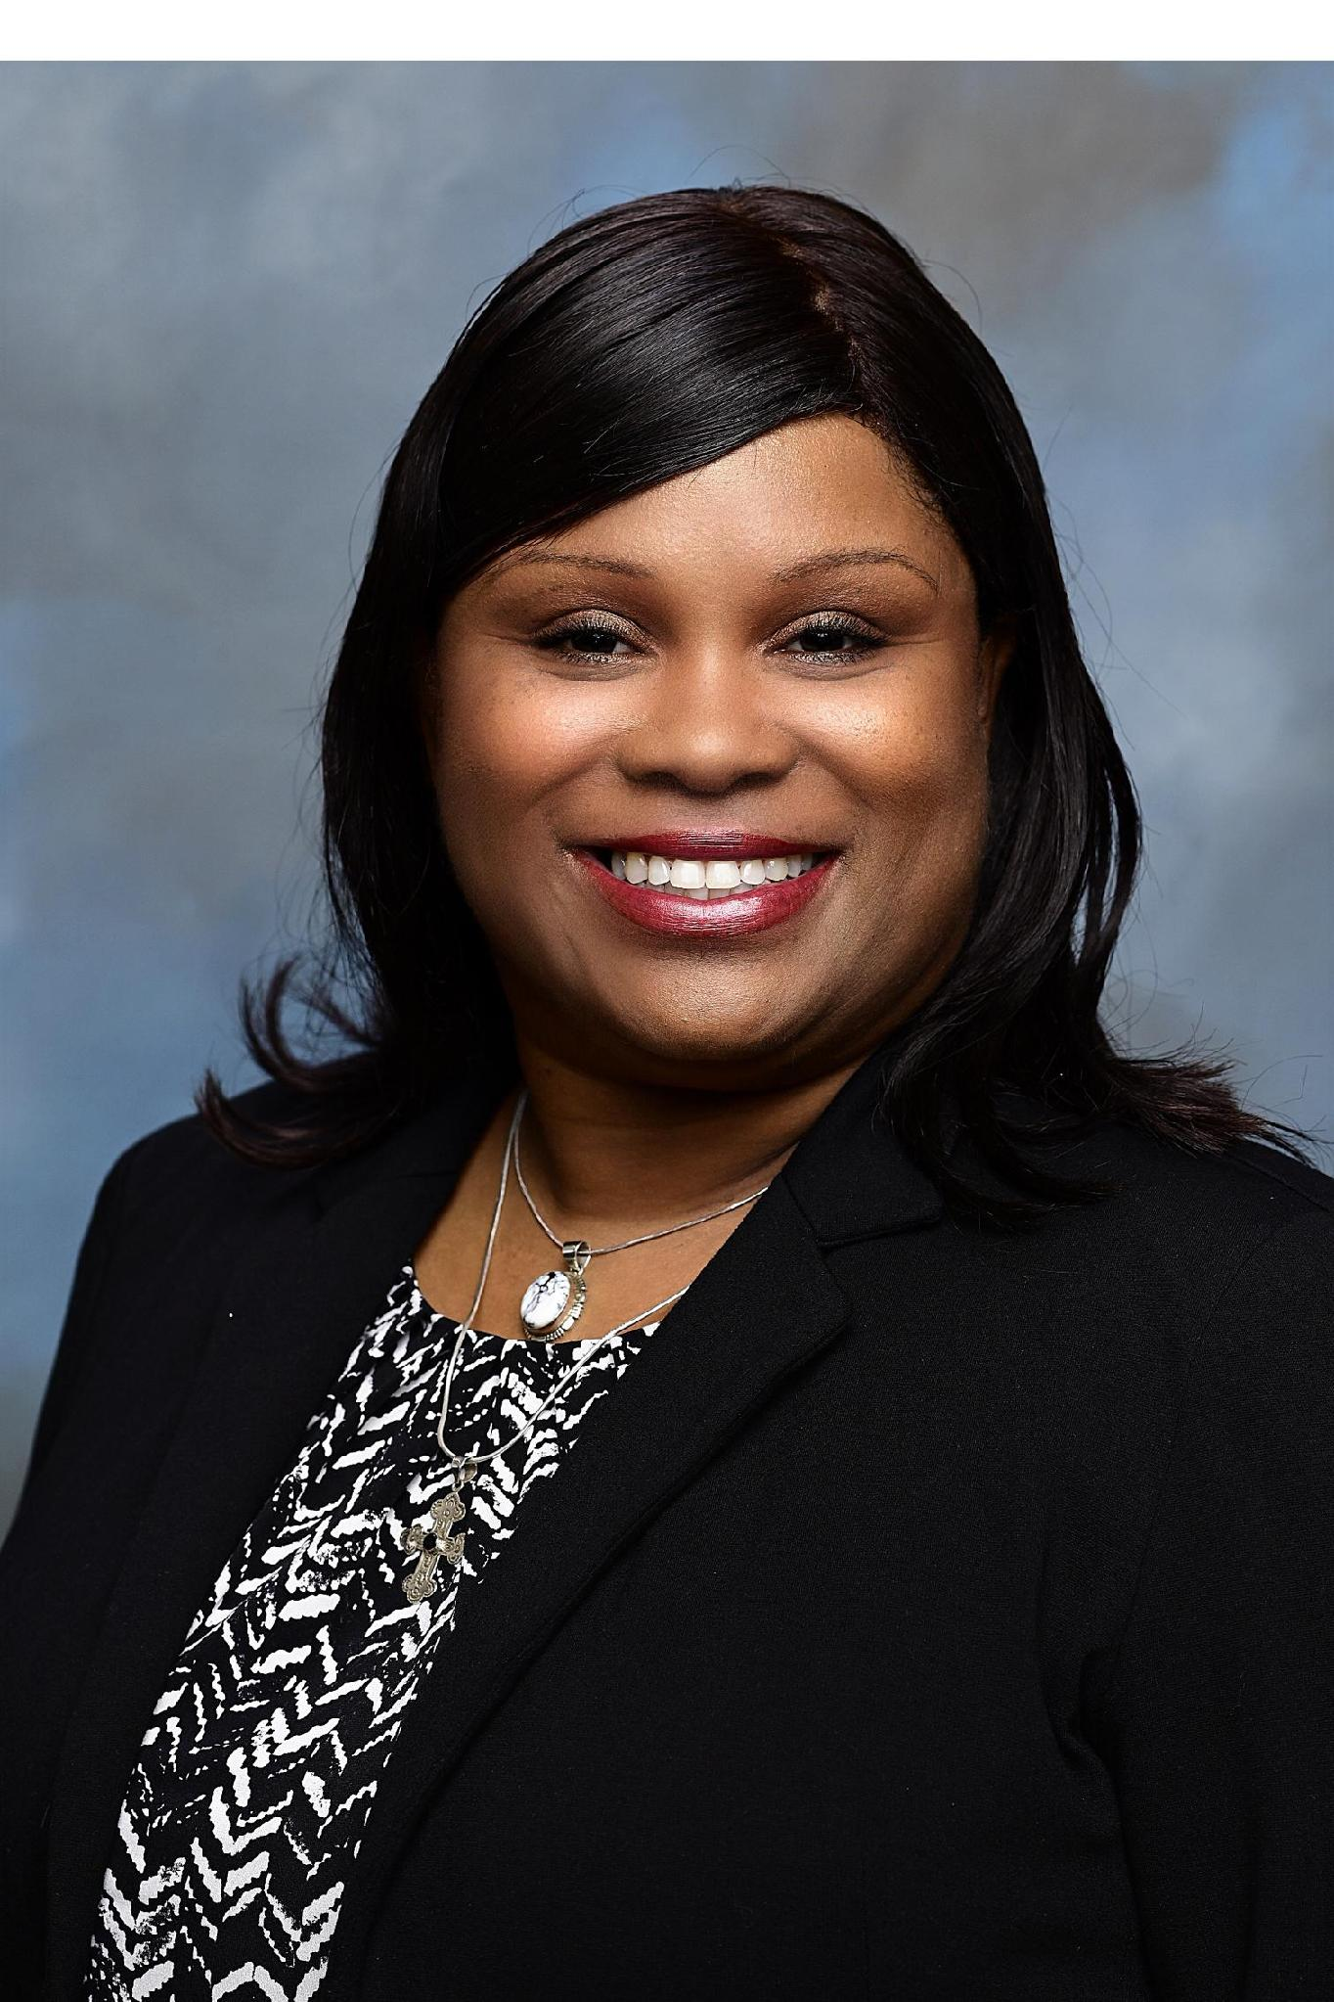


THANK YOU
Tracy Henshaw Cameron, Ed.D.
Lt. Governor, Div. 2 and Trustee-Elect, Region II
228-313-9858
tmeteach2019@gmail.com
Notes:
Thank you for being here today and for committing to grow even further in your leadership. By stepping into this role—and by taking time to strengthen your skills—you’re investing in the future of your club, your members and the community you serve.
Leading a Kiwanis club is both rewarding and challenging, and the impact you make extends far beyond meetings and agendas.
Your guidance shapes service, builds belonging and creates opportunities for your members to shine.
Your club is fortunate to have someone willing to lead with purpose and heart.
As you move forward, remember that you are not alone.
You have fellow officers, district leaders and an entire Kiwanis network ready to support you.
If you ever have questions, want help thinking through a situation or simply need a sounding board, please reach out anytime.
Thank you again for choosing to lead—and for choosing to make a difference.
Your year will matter.
Your leadership will matter.
And I can’t wait to see all the good your club will accomplish under your guidance.

