Slide 1

2026 CLUB LEADERSHIP EDUCATION
CLUB SECRETARY TRAINING
Louisiana – Mississippi – West Tennessee District
July 14, 2026
Notes:
Welcome, everyone, to Club Secretary 101.
Whether this is your first time serving as secretary or you’re returning with new perspective, this session is designed to help you begin your year with clarity and confidence.
Today’s training is meant to feel comfortable, welcoming and practical.
You don’t need to know everything right away — that’s exactly what this session is for.
By the end of today, you’ll have a solid understanding of what the club secretary does, where to focus your attention and which tools and systems will support you throughout the year.
Most importantly, I want you to feel confident that you are not doing this alone.
Kiwanis has a full network of leaders and resources ready to support you in this role.
Let’s go ahead and get started.

Slide 2


Housekeeping notes
  Participants will be muted during the presentation
  Feel free to use the chat feature for any questions you may have along the way.
Notes:
For virtual training, please mute participants and use the chat box for virtual education participation.)

Slide 3
Agenda
  Expectations
  Club Secretary Roles and Responsibilities
  Resources and support
  Q&A
Notes:
Here’s our plan for today.
We’ll begin with expectations to ensure we have a respectful training environment.
Then we’ll look at what the club secretary actually does — the real, everyday responsibilities that keep the club organized and running smoothly.
From there, we’ll move into a year-at-a-glance so you can see how your duties shift throughout the year and how to stay ahead of key deadlines.
Then we’ll review the key tools and resources that support you in your role, followed by time for questions.
My goal is that you leave today feeling supported, confident and ready to start strong.
And please keep in mind, there will be more in-depth training available in Club Secretary 201, where we’ll take an even closer look at how to carry out each responsibility with accuracy and confidence.

Slide 4
Group expectations
  Be present (Put cell phones on silent, etc.)
  Respect contributions of others.
  Actively listen and engage.
  Ask questions by placing them in the chat and seek to understand.
Notes:
To make this a meaningful session for everyone, here are just a few expectations.
First, be present. We know life is busy. Give yourself permission to be here fully — today is about your growth.
Second, respect the perspectives shared by others. Every club is unique, and we can all learn from different experiences.
Third, listen actively, not just waiting for your turn, but truly hearing others.
And lastly, ask questions whenever you need to. Type them into the chat and I will monitor it along the way. We are here to learn together.

Slide 5
Learning outcomes
  Understand the secretary’s core responsibilities with systems and routines.
  Recognize tasks that ensure smooth and reliable club operations. Including maintaining accurate files and permanent records.
  Document club and board meetings.
  Meet all reporting requirements.
  Communicate clearly.
  Identify key tools and resources available.
Notes:
Before we get started, I want to give you a clear picture of what you’ll walk away with by the end of today’s session.
Club secretary training is all about understanding what the role includes and the responsibilities you’ll be managing throughout the year.
First, you’ll have a clear understanding of what the club secretary actually does and why this role is essential to the success of the club.
Second, you’ll understand the secretary’s responsibilities in maintaining accurate information, smooth meetings and consistent club operations throughout the year.
And finally, you will know where to find the most important tools and resources that support you in this role.
You don’t need to memorize every detail of your responsibilities right now — you just need to know where to look and who to ask when you need guidance.

Slide 6

Notes:
Before we begin our next section, we want to share a brief message from the Kiwanis International President-Elect.
This welcome video is a reminder that your role as club secretary is part of something much larger than any one club.
As you watch, listen for the themes of leadership, service and connection—because those values are at the heart of everything we do in Kiwanis, and they’re reflected in the work you’ll carry out this year.
Let’s go ahead and play the video.
(Presenter note: play the video.)

Slide 7
KIWANIS CLUB SECRETARY
ROLE OF CLUB SECRETARY
Notes:
That was a wonderful message from our international president-elect.
Let’s begin exploring the role of club secretary.

Slide 8
The role of club secretary
What the club secretary does:
  Organizes club records and information.
  Supports smooth, accurate club operations.
  Communicates key updates and requirements.
  Keeps meetings and documentation on track.
  Ensures compliance and continuity.
Notes:
The club secretary’s responsibilities include keeping the club organized through accurate records, timely updates and clear documentation.
The secretary supports smooth operations by managing agendas, minutes, attendance and reporting — creating the structure that helps the club function effectively.
Secretaries also play a key communication role, sharing essential information with members, officers, the district and Kiwanis International so everyone stays aligned and informed.
They help keep meetings on track by preparing materials, recording decisions and ensuring follow-up tasks are documented and not forgotten.
Finally, secretaries ensure the club maintains compliance by submitting required reports, keeping permanent records and preserving continuity from year to year.

Slide 9
CLUB SECRETARY
YEAR AT A GLANCE
Notes:
Next, we’ll explore how these responsibilities come to life over the course of the year by walking through a year-at-a-glance view.

Slide 10
Start of the year
  Hold a transition meeting with the previous secretary.
  Align with officers and participate in yearly planning.
  Review key records and identify unfinished business.
  Confirm digital access and shared folder permissions.
  Review collected files and confirm club information in Kiwanis Engage.
  Establish systems.
  Prepare calendars and reports.
  Set up communication channels – Use the new “Mass Communication” feature in Kiwanis Engage to contact your members.
Notes:
Let's start at the beginning of the year, when the club secretary lays the foundation for strong administrative operations.
During this time, the secretary should align with officers on responsibilities and communication expectations. They also participate in the president’s planning conference so the entire leadership team starts the year on the same page.
Next, the secretary reviews the essential documents that guide club operations — bylaws, past records, officer entries and the current membership roster.
They also collect files from the outgoing secretary and confirm all club information in Kiwanis Engage to ensure accuracy moving forward.
This period is also when the secretary establishes the systems the club will rely on all year.
That includes setting up structures for agendas, minutes, documentation and record storage.
Additionally, the secretary prepares the annual club calendar, reporting expectations and new-member induction procedures and establishes the communication channels members will depend on.
All of this early-year work creates the clarity, organization and readiness needed for a smooth year ahead.

Slide 11
Getting Started in Kiwanis Engage
Log into Kiwanis Engage.
Access the Club Secretary Dashboard.
Review the layout and key navigation areas.
Confirm officer roles and permissions.
Ensure any members working with youth have updated club background checks.
Resources:
Kiwanis Engage video tutorials
KI Background checks FAQ
Notes:
Your work in Kiwanis Engage begins by visiting Kiwanis.org and clicking “Access Kiwanis Engage online reporting” button. Once signed in, you’ll select your club from the profile menu (in the upper left corner) and then review the different club officer features.
Start by exploring each section – Background checks, club bylaws, Club Details, Club Leadership Roles, Finances, Member Admin, Monthly & Annual Reports and Service Leadership Programs – to understand where everything is located.
Spend a few minutes opening each tab so you become familiar with how the pages are organized and how they respond when you make a selection.
Before entering or editing any data, verify that officer roles and permissions are correct.
Open the Club Leadership Roles tab and check that each officer listed is in the correct position with accurate term dates. If you find missing roles, duplicate entries or outdated information, update them right away. This ensures that your leadership team has the proper access to complete their duties.
Once you’ve reviewed officer information, also confirm that all individuals who are required to have a Kiwanis-approved background check have one on file through the Background Checks tab. This is especially important for advisors and anyone working directly with youth.
Updating this early prevents compliance issues and ensures your club meets Youth Protection Guidelines. Make it a habit to check these regularly to avoid surprises and keep your club’s records accurate. This Foundational orientation to Engage helps you feel confident navigating the system before you begin entering reports, updating membership information or tracking club activities.

Slide 12
Club Meetings
For each club meeting:
Help develop agenda.
Confirm program details.
Provide agenda to members before the meeting.
Take attendance.
Record minutes.
Note recognitions, announcements and guest information for the
official record.
Resources: Club meeting minutes
Notes:
As club secretary, your role is essential to preparing for and supporting effective club meetings. Before each meeting, you’ll collaborate with the club president and the program committee chair to build a clear agenda. The president will share the business items that need attention, while the program committee chair will provide details about speakers, guests, special activities, setup needs, and designated greeters. Once the agenda is finalized, you’ll send it to members ahead of time so they know what to expect.
During the meeting, your focus shifts to documentation. You’ll take attendance and record minutes, capturing motions, votes, decisions and any follow-up tasks assigned. You’ll also note recognitions, announcements and guest information so the official record is complete. You help support meeting flow by ensuring any needed documents or reports are available.
After the meeting, you’ll use this information to complete the Monthly Club Report in Kiwanis Engage, where attendance, activities and required updates are formally recorded. Together, these steps ensure your meetings are organized, accurate and fully documented

Slide 13
Monthly Board Meetings
For each board meeting:
Help develop agenda.
Send materials (agenda, minutes, reminder).
Prepare documents.
Take attendance; record minutes (motions, votes, actions).
Note announcements.
Gather information for monthly report in Kiwanis Engage.
Resources:
Board meeting minutes
Notes:
For the monthly board meeting, you will have several additional responsibilities as secretary.
You’ll begin by working with the club president to create a clear, organized agenda that reflects all business requiring board action. Once the agenda is finalized, you will email it — along with the previous month’s board minutes and a meeting reminder — to each board member so they are prepared for the discussion.
Ahead of the meeting, you will also sort and organize all club correspondence, bills, financial documents, committee reports and any materials that need to be presented or referenced. Preparing these items ensures the board has the information they need to make informed decisions.
During the meeting, you will take attendance and record complete, accurate minutes that capture motions, votes, approvals, committee reports, financial actions and follow-up assignments. You may also need to note recognitions, announcements or important updates shared during the meeting.
Finally, you will collect all information necessary for the Monthly Club Report in Kiwanis Engage. This includes board decisions, membership updates, service activities and any required reporting items that must be submitted to Kiwanis International. These steps ensure each board meeting is well-organized, well-documented and properly reported, supporting strong club governance throughout the year

Slide 14
Club Operation Files
All club correspondence
Convention information for district and Kiwanis International
Service Leadership Program documents and communications.
Notes:
As part of effective record keeping, it’s important to understand what documents must be maintained and how they should be organized. Begin by keeping all club correspondence — both paper and email — including district and Kiwanis International communications, convention materials and SLP program documents. These communications keep your club informed and connected within the broader Kiwanis community.
Next, establish a filing system that keeps your operational documents organized and accessible throughout the year. Create clear folders — digital, paper or both — for agendas, minutes, attendance, correspondence, financial records and permanent documents. Many clubs use cloud-based tools like Google Drive or SharePoint to centralize files and make sharing easier for officers and committees. A well-organized archive prevents confusion, supports smoother administration and protects the club’s historical records for future leaders.
This is also the time to determine how incoming mail and digital communications will be sorted and stored so that important information is never lost or overlooked. For email specifically, consider creating dedicated, role-based accounts — such as a club secretary email address — so the inbox can be passed from year to year. Some clubs create free Google accounts for club roles, which makes shared drives easier to manage and greatly simplifies leadership transitions

Slide 15
Club Finances
Update membership roster and contact details.
Confirm accurate dues calculations.
View, print and track open invoices.
Monitor outstanding payments.
Request invoice adjustments when needed.
Resources: Member dues resources
Notes:
Maintaining accurate club records includes supporting the treasurer with membership and billing tasks in Kiwanis Engage. As secretary, you’ll help keep the club roster and contact information accurate, which ensures dues are calculated correctly for every member.
In Engage, you can also access the club’s open invoices, allowing you to view, print and track payments throughout the year. This helps both you and the treasurer stay aware of who has paid and who still has outstanding balances. If corrections are needed, such as changes to member status or adjustments to billing amounts, you can also request invoice updates directly within the system.

Slide 16
Middle of the year
  Maintain minutes, attendance and records.
  Submit reports and updates.
  Support club communication and club correspondence.
  Document board actions.
  Partner on dues and billing.
  Track recognitions and milestones.
  Distribute official materials.
Notes:
Once these structures are in place, the secretary shifts from setting up the year to maintaining it.
This brings us to the middle of the year.
In the middle of the year, the secretary’s focus is on steady, accurate administrative management.
This includes maintaining minutes, attendance, roster updates, project records and all club correspondence so communication and documentation remain consistent.
Throughout this period, the secretary submits monthly reports to Kiwanis International, provides ongoing communication support for officers, committees and members, and ensures information flows smoothly across the entire club.
The secretary also attends and documents board meetings, capturing decisions and follow-up actions, and partners with the treasurer to keep dues and billing records current.
They continue updating the club calendar as events evolve and track recognitions and member milestones so accomplishments are acknowledged.
Additional responsibilities during this time include distributing convention materials and ensuring official communications reach the people who need them.
All of this keeps the club operating with stability, transparency and accuracy as the year progresses.

Slide 17
Club Bylaws
Maintain the club’s most current bylaws.
Review annually for required updates.
Coordinate revisions with officers and board.
Submit updated bylaws to Kiwanis International.
Store final approved version in club records.
Resources:
Kiwanis club bylaws
Frequently asked questions
Notes:
As the club secretary, one of your ongoing administrative duties is maintaining the most current version of your club’s bylaws.
Start by reviewing your bylaws at least once each year—ideally at the beginning of your term—to confirm they align with Kiwanis International’s Standard Form for Club Bylaws. If your club has older bylaws, or if district or international policy has changed, revisions may be needed. Work with the club president and the board to coordinate updates. This may include adjusting committee structures, meeting procedures, membership rules or officer responsibilities.
Once revisions are drafted, follow your club’s process for approval, which typically includes a board vote and a vote of the club membership.
After the updated bylaws are approved, your role is to submit the revised document to Kiwanis International using the upload link on Kiwanis Engage. Clubs should receive a confirmation link from member services after submitting. This step ensures your club is officially compliant and that Kiwanis International has the correct version on file. Finally, store the updated final bylaws in your permanent club records and your shared digital folders so officers and members have easy access.

Slide 18
Update Membership Changes
Add new members inductions.
Remove members who have left.
Update member details.
Notes:
Membership updates are another essential part of the club secretary’s responsibilities. You can maintain your club’s membership through the Member Admin tab.
This is where you document new members, member inductions, resignations and status changes such as leaves of absence. All membership changes should be added to the club roster first so that Engage reflects the correct information in the Monthly Report.

Slide 19
End of the year
  Complete year-end reports.
  Update permanent records.
  Prepare successor materials.
  Record elections and update officers.
  Plan installation and awards.
  Verify checklist tasks.
  Review board documentation.
Notes:
As the year winds down, the secretary’s role shifts again — this time toward transition and closure. This leads us into the final part of the year.
At the end of the year, the club secretary’s focus is on wrapping up club business and preparing for leadership continuity.
This includes completing year-end reports, updating permanent files and organizing materials so the incoming secretary has everything they need to start strong.
The secretary also records officer election results and updates officer information with Kiwanis International to ensure the new leadership is properly documented.
To support the club’s transition, the secretary helps plan the officer installation ceremony and coordinates member awards and recognitions.
During this time, the secretary also reviews the full year’s board actions and verifies that all documentation is complete, accurate and filed correctly.
The Leadership Guide and Secretary Checklist serve as key references to ensure every required task is finished before the term closes.
This thorough end-of-year closeout helps the club remain stable, organized and ready for the next leadership team to succeed.

Slide 20
Officer Installation Ceremony
Coordinate ceremony date and location.
Prepare officer list with titles and term dates.
Organize installation materials.
Confirm invited guests, speakers and dignitaries.
Record officer elections and update Kiwanis Engage after installation.
Resources:
Installation of club board members and officers
Notes:
As club secretary, you help ensure the officer installation ceremony is well-organized and runs smoothly.
Begin by coordinating with the president, board and lieutenant governor, who often leads or participates in the installation. Confirm the ceremony date early so the lieutenant governor can plan to attend, as their presence adds significance and connection to the district.
Prepare an accurate list of incoming officers, including their titles and term dates, and share it with the lieutenant governor or whoever will conduct the ceremony. You will also organize the materials needed—such as the installation script, certificates, programs, agendas or recognition items. If your club invites other dignitaries, such as district officers or community partners, you may help confirm their participation and ensure they have the information needed for the event.
During or after the ceremony, record that the installation took place and update the officer entries in Kiwanis Engage. This ensures the new officers have proper access to the tools and permissions they need and that the club remains in good standing.
By managing the logistics and collaborating with the lieutenant governor, you support a smooth leadership transition and help celebrate the officers who will guide the club in the year ahead

Slide 21
Annual Club Report
Gather year-end data.
Summarize all club activities.
Submit by the district deadline.
Resources:
Engage
Notes:
Filing the Annual Club Report is one of your final responsibilities as club secretary and serves as the official record of your club’s year.
The good news is: if you submit all 12 of your monthly reports online, your annual report will be ready for you to submit automatically!
If you are unable to submit your past month’s reports, a single year-end report can be provided.
You’ll begin by gathering all year-end data, including meeting minutes, Monthly Club Reports, service project summaries and fundraising totals.
The Annual Report also requires summarizing your club’s activities—such as service hours, community impact, fundraising totals and any major accomplishments.
Once all information is accurate and complete, submit the Annual Club Report by your district’s deadline — typically around December 1.
This ensures your club remains compliant, supports district reporting and preserves an accurate historical record for future club leaders.

Slide 22
Distinguished Criteria Award
Review annual Distinguished Club criteria.
Track service, membership and reporting requirements.
Maintain accurate data in Kiwanis Engage throughout the year.
Gather supporting documentation at year-end.
Submit the Distinguished application by the deadline.
Resources:
Distinguished Club Criteria
Notes:
Distinguished Club recognition is awarded each year to clubs that meet specific goals in service, membership, leadership and administrative excellence. As the club secretary, you play a key role in helping your club achieve this distinction. Start by reviewing the current year's Distinguished Club criteria, which are available on the Kiwanis website. These criteria usually include requirements such as completing service projects, maintaining or increasing membership, submitting all required reports on time and participating in leadership development.
Throughout the year, help your club stay on track by maintaining accurate records in Kiwanis Engage. Every service project, membership change and Monthly Club Report contributes to the data used to evaluate your club’s eligibility. When the year ends, gather any required documentation—such as service totals, leadership participation or project descriptions— and ensure all club information in Engage is complete and verified. Once everything is in place, you will work with the club president to submit the Distinguished Club application by the published deadline. This is typically done by the end of the administrative year.
Kiwanis International typically sends out an email notifying clubs of the deadline. Your reporting accuracy and consistency throughout the year make this process easier and help position your club for recognition

Slide 23
Required Forms
Monthly report form | Complete by the 10th of every month with the previous month’s information.
Membership report for annual dues billing | Update your roster throughout the year, adding and deleting members as needed. Clubs have until October 10 to delete any members for whom they should not be billed annual dues.
990, 990-N or 990-EZ form (U.S. clubs only) | File with the IRS by February 15. The 990 form allows your club to maintain its tax-exempt status. Get instructions and links at kiwanis.org/form990.
Annual report of club elections | Submit to the Kiwanis International Office electronically using the secretary dashboard by June 1.
Notes:
There are four forms that clubs are required to submit. These are time-sensitive. It will be up to you to make sure each is done in a timely manner.
The monthly report form, which we already discussed, is submitted on the 10th of each month detailing the previous month’s club activities. Again, this will be submitted through the secretary dashboard online.
The membership report is submitted for annual dues billing. It is important that you keep your club’s roster updated as members join and leave your club. Please do not wait until the end of the year to report these activities. Plan to make these updates at least quarterly. Note that, for your dues invoice for the year to be correct, you must have your roster updated prior to October 10.
For clubs based in the United States only, a Form 990 must be filed with the IRS by February 15. This is very important as it is how your club maintains its tax-exempt status. For instructions and links to the forms, visit kiwanis.org/form990.
When your club holds its elections for the next Kiwanis year, submit the results via the secretary dashboard. All clubs are required to submit their election results before June 1.

Slide 24
Optional Submissions
Proposed amendments and resolutions to the Kiwanis International Bylaws | Submit your proposal in writing to the Kiwanis International Office by October 31 for consideration in the House of Delegates.
Delegate certification forms | File a certification form by April 30 for delegates attending the Kiwanis International convention. Delegate certification forms for your district convention also have deadlines. Check with your district office or the district website to learn more.
Notes:
. If your club would like to propose an amendment or resolution to the Kiwanis International Bylaws to be considered in the House of Delegates at Kiwanis International Convention, those must be submitted in writing to the Kiwanis International Office by October 31.
If you have voting delegates that are attending the Kiwanis International Convention, you must submit delegate certification forms to Kiwanis International by April 30. These can be submitted via the secretary dashboard.
Delegates attending your district convention must also be certified. Please check with your district office or district website to learn more about the process and the deadlines.

Slide 25
Recordkeeping: Permanent Files
Board meeting minutes
Canceled checks (seven years)
Club newsletters
Club meeting minutes
Financial records and reports
Background checks of Kiwanis advisors (seven years)
Historic information/materials
Invoices
Lists of officers, directors and committees for each year
Recognitions such as: Legion of Honor, Ruby K, Life member, Significant donations
Official documents relate to club organization and incorporation
Official documents related to club foundation, if applicable
Other items of historical significance
Notes:
We specifically want to highlight the permanent files that you are responsible for keeping.
To keep records organized and accessible, you need to maintain both paper and digital copies of key documents when possible. This includes board and club meeting minutes, financial records and reports, invoices and club newsletters. Background checks for advisors should be kept for seven years, as outlined on kiwanis.org. You also need to retain canceled checks for seven years, along with historic information and materials.
Lists of officers, directors and committees for each year should be preserved permanently. In addition, keep documentation of member recognitions such as Legion of Honor, Ruby K, life member awards and significant donations. Official documents related to club organization and incorporation, as well as any documents for the club foundation if applicable, should also be stored securely.
As a reminder, using digital organization tools like shared Google Drive folders ensures that important documents remain accessible to both current leadership and future officers

Slide 26
Succession
Organize and update permanent records.
Create a digital folder with key documents.
Review the secretary annual checklist together.
Walk through Kiwanis Engage navigation and reporting.
Share transition notes, deadlines and recommendations.
Embrace improvement.
Resources:
Succession planning
Notes:
Preparing your successor is one of the most important responsibilities you have at the end of your term.
Start by organizing and updating the club’s permanent records, ensuring minutes, reports, rosters, bylaws and SLP documents are complete and correctly filed.
Then ensure they will have access to the digital folder — such as a Google Drive or shared cloud folder — that contains essential materials like templates, historical documents, bylaws, past minutes and anything the next secretary will need immediate access to.
Next, schedule a transition meeting with your successor.
During this meeting, walk through the Annual Secretary Checklist together so your successor knows what responsibilities begin right away and what to expect each month.
Take time to demonstrate how to navigate Kiwanis Engage, showing where to update officers, manage membership, submit monthly reports and check background check statuses.
Share any transition notes, recurring deadlines, helpful routines or recommendations you’ve learned during your year.
Finally, embrace improvement. Continuity is important, but so is growth. Let your successor know it’s okay — and encouraged — to identify more efficient ways of doing things. Positive change that strengthens systems, saves time or improves communication should be welcomed, not avoided. Progress happens when thoughtful improvements build on what already exists.
The goal is to ensure your successor begins their term confident, supported and fully prepared to ensure the club’s administrative continuity.

Slide 27
CLUB SECRETARY
KEY RESOURCES
Notes:
The good news is — you don’t have to do this alone. Kiwanis International provides excellent resources to help you succeed.
Let's dig into what is available to you.

Slide 28
Resources
  Support system
  Leadership guide
  Club secretary website
  Annual checklist
  Kiwanis Engage
  Youth protection guidelines
  Add additional provided materials here...
Notes:
Clubs rely on several key resources to support a smooth and successful administrative year under the leadership of the club secretary.
It’s important for secretaries to begin exploring these tools early, as they provide the structure and guidance needed to manage records, reporting and communication effectively.

Slide 29
Support system
  Former club officers
  Current club officers
  Board members
  Lieutenant governor
  District secretary
  District leaders
  Kiwanis network
Notes:
The club secretary never serves alone.
Former club secretaries are an invaluable source of insight, perspective and lived experience. Tap into them for help looking at previous years' records, so you can prepare for your year. Throughout the year, past secretaries are reliable resources to answer questions, compare approaches and help you learn what made previous terms successful — and what created challenges.
Your current club officers are your daily partners. They share information, support coordination and depend on your accuracy and organization to keep the club functioning smoothly. In turn, they offer clarity, context and collaboration that make your responsibilities manageable.
Your board members also strengthen your work by providing guidance, background knowledge and decision-making support. Their input helps you ensure the records you maintain reflect the club’s goals, actions and commitments.
Your lieutenant governor is a key resource as well — someone who can answer questions, clarify procedures and help you understand district expectations.
The district secretary and district trainers can provide additional support by offering reporting guidance, reminders and best practices, ensuring you stay on track throughout the year.
District leaders — including club coaches, certified instructors and membership specialists — offer tools, resources and strategies that reinforce strong club administration and smooth operations.
And finally, the broader Kiwanis network, from fellow secretaries to Kiwanis International staff, can offer mentorship, shared experience and a sense of community that reminds you that you’re part of something bigger than your club alone. .

Slide 30

Leadership guide
  Kiwanis 101 information
  Club secretary section
  Club president, treasurer and membership chair sections
  Resources section
Resources:
Leadership Guide
Notes:
The second resource we want to introduce is the Leadership Guide, a virtual-only document that contains the most current information for club officers.
If you have an older printed version, please discard it, as much of that content is now outdated.
You can access the updated guide at kiwanis.org/leadershipguide. The club secretary section begins on page 33.
Within the guide, you’ll find a deeper look at Kiwanis 101 and other general information about Kiwanis International, along with a full club secretary section that refreshes your knowledge of your role, responsibilities and the tools that will support you throughout your term.
The guide also includes overviews of the club president, treasurer and membership chair roles to help you understand the responsibilities of your fellow officers.
Throughout the document, you will see links to key resources such as Youth Protection Guidelines, awards and recognition programs, branding, insurance information and additional materials to help you lead effectively.
Please take time to familiarize yourself with the entire guide so you can confidently support your club throughout the year.

Slide 31
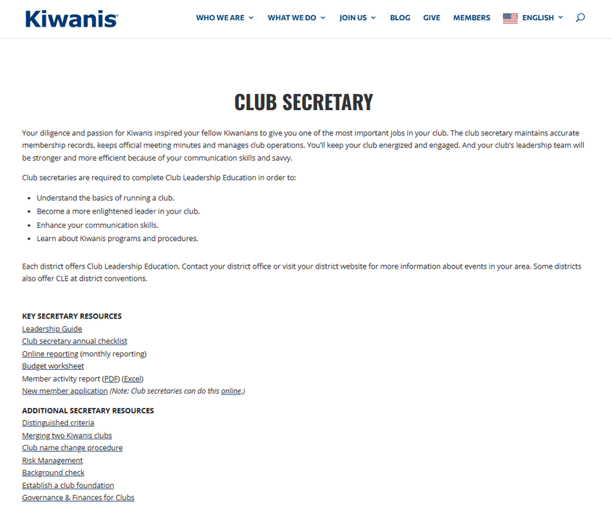
Club secretary webpage
  Leadership guide link
  Monthly checklist
  Distinguished criteria
  Club bylaws
  ACE Tools
  Background check information
  More
Resources:
Club secretary website
Notes:
The Club Secretary Webpage on kiwanis.org provides clear, easy-access tools and information designed specifically for club secretaries.
It brings together monthly checklists, reporting reminders, sample documents and key administrative resources that help secretaries stay accurate, organized and prepared throughout the year.
Although this material also appears in the Leadership Guide, nearly every link in the secretary section directs you right back to this website.
The site presents the same content in a more streamlined, user-friendly format with direct links that make navigation simpler during your term.
The website also includes additional resources — such as distinguished criteria and other important references — that support your role and help set your club up for success.

Slide 32
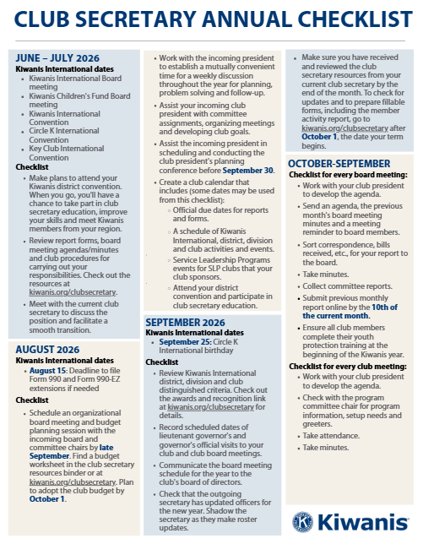
Annual checklist
  Roadmap
  Accountability partner
Resources:
Annual checklist
Notes:
One of the most important resources for a club secretary is the Annual Checklist.
It serves as a complete roadmap for the year, outlining every major administrative responsibility, reporting deadline and organizational task month by month. The checklist includes everything the secretary needs to stay on track — from membership updates to required submissions — and it begins in June, even before the term officially starts, to support early preparation and continuity.
The Annual Checklist keeps the secretary focused on the right tasks at the right time, prevents missed responsibilities and last-minute surprises, and provides the structure needed for smooth and predictable club operations.

Slide 33

Kiwanis Engage
  Training videos
  Recorded webinars
  Playground test site
Resources:
Kiwanis Engage
Notes:
Kiwanis Engage officially launched in July 2025, replacing older systems like Kiwanis Connect and Secretary Dashboard. This new platform was designed to make your club’s reporting, membership management and record keeping much easier and more accurate.
As club secretary, you’ll use Kiwanis Engage as the central system for many of your key responsibilities. It is where secretaries submit required monthly and annual reports, update officer information, manage membership changes, verify background checks and ensure the club’s administrative records stay accurate and current.
Engage also includes a training “Playground” environment and video tutorials that help secretaries understand the system’s features and requirements.
These tools exist so secretaries can clearly see what needs to be reported, where information is stored, and what actions are expected throughout the year.

Slide 34

Youth protection guidelines
  Ensures safe, compliant practices.
  Outlines mandatory requirements.
  Provides clear procedures.
Resources:
Youth Protection guidelines
Notes:
Finally, the Youth Protection Guidelines outline the required policies and background-check expectations for any volunteer who works directly with youth.
As a club officer, it is essential to review these guidelines regularly to ensure you and your club—including all members and SLP advisors—remain up to date and in full compliance.
Please visit the Youth Protection website to confirm your understanding of current requirements.

Slide 35
CLUB SECRETARY
QUESTIONS
Notes:
(Virtual training: Please place your questions in the chat box, and our team will do our best to respond to them.)

Slide 36
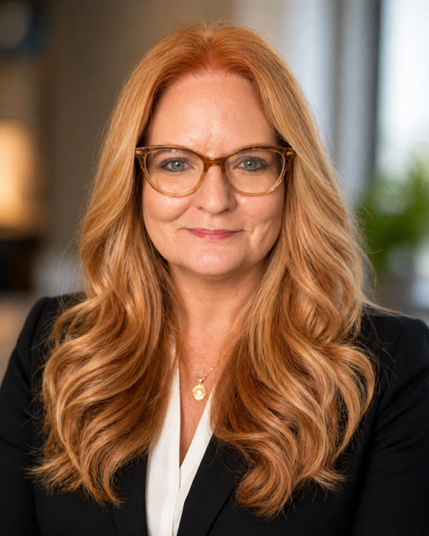
THANK YOU
Kimberly Jackson
Lieutenant Governor Division 1A
256-642-9490
kjackso1@gmail.com
Notes:
Thank you so much for being here and for stepping into this leadership role.
Your work as club secretary makes a real difference — for your club’s stability, your community and the young people your club supports.
Leadership in this role isn’t always easy, but it is incredibly important. Your club is fortunate to have someone willing to bring organization, consistency and care to its operations.
I’m excited to see the impact you’ll make this year.
We hope today served as a strong first step in understanding what it means to support your club well.
Here is my contact information.
Please reach out anytime — whether you have a question, need help navigating a challenge, or want to talk through an idea. I’m always happy to support you.
Thank you for choosing to lead.

